Slide 1

Orthodox Global Online Sunday School (OGOSS)

Slide 2
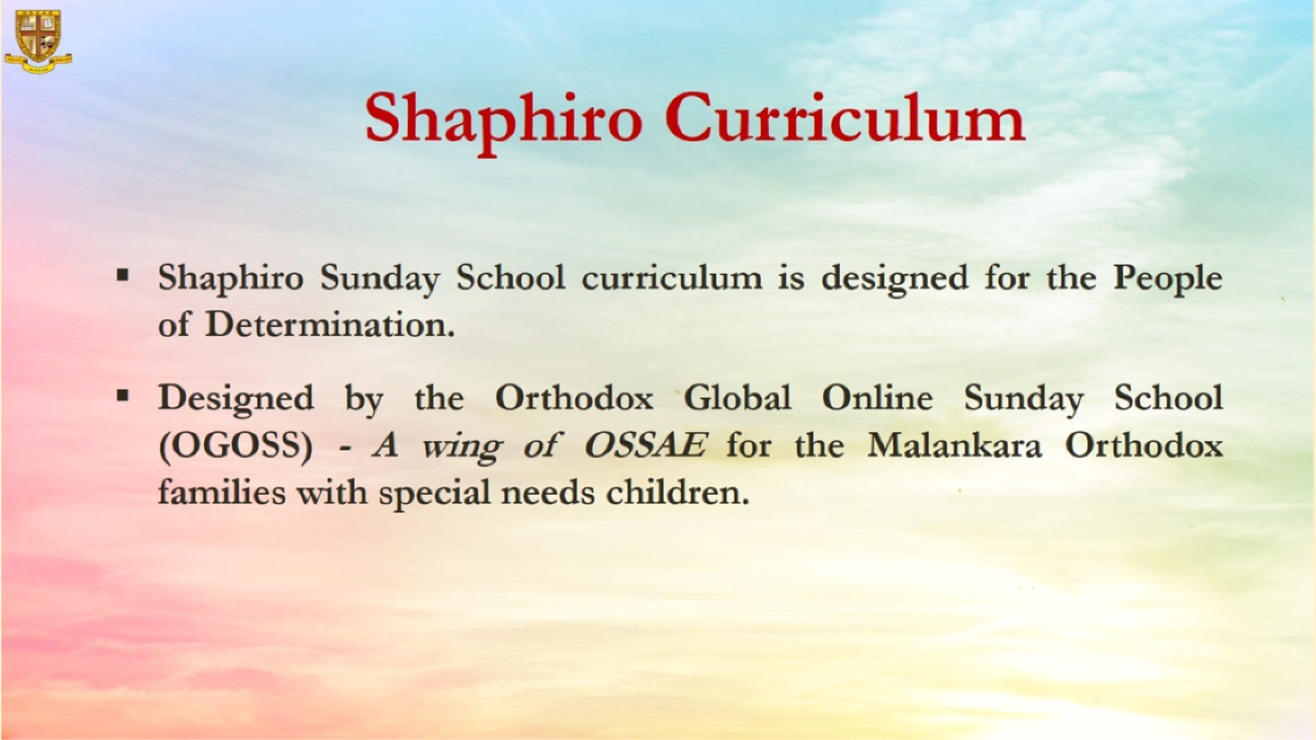

Slide 3


Slide 4
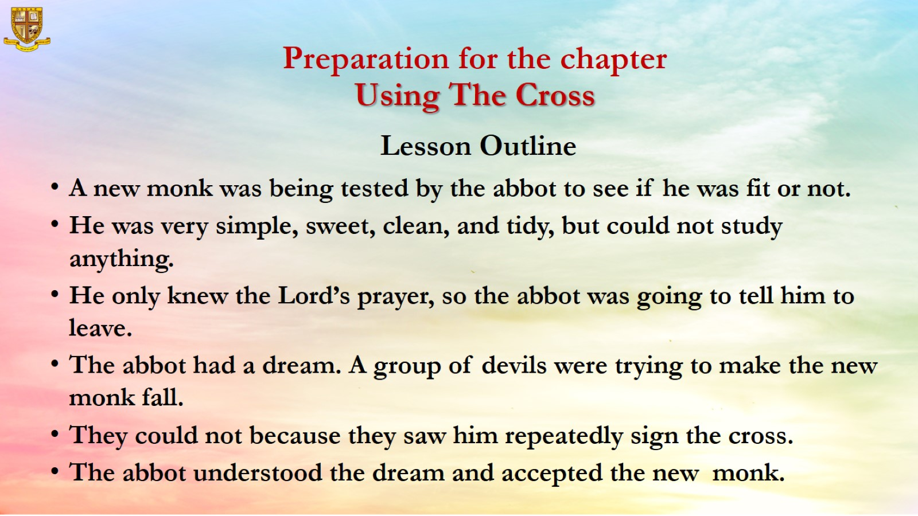
Preparation for the chapter
Using The Cross
Lesson Outline

Slide 5
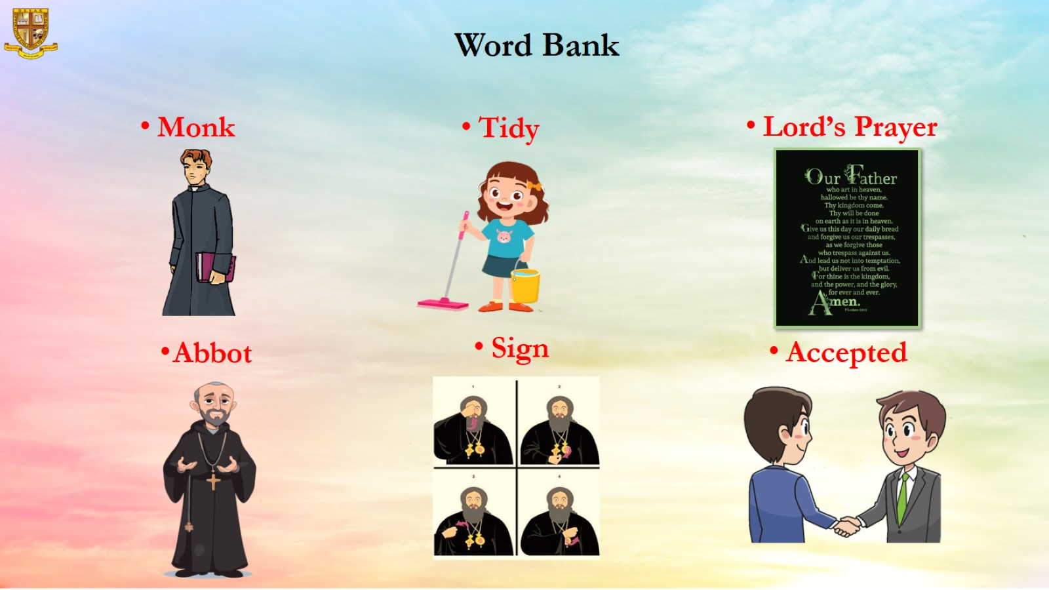
Word Bank

Slide 6

Objective: “To teach children to love the cross and to be proud of it.”

Slide 7

Memory Verse: “God forbid that I should glory except in the Cross of our Lord” Galatians 6:14

Slide 8
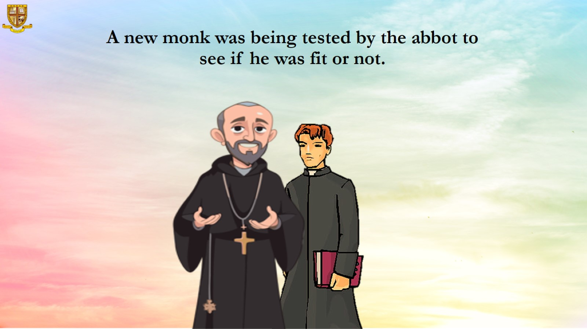
A new monk was being tested by the abbot to see if he was fit or not.

Slide 9
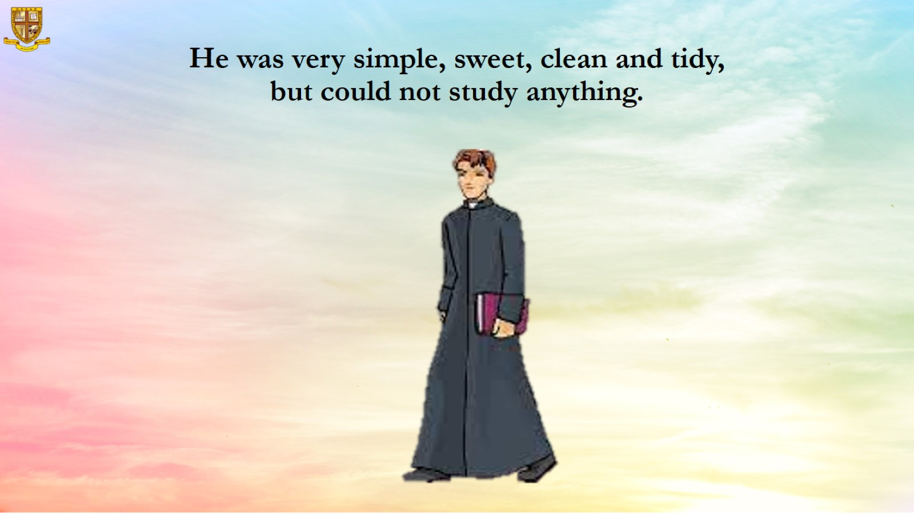
He was very simple, sweet, clean and tidy, but could not study anything.

Slide 10
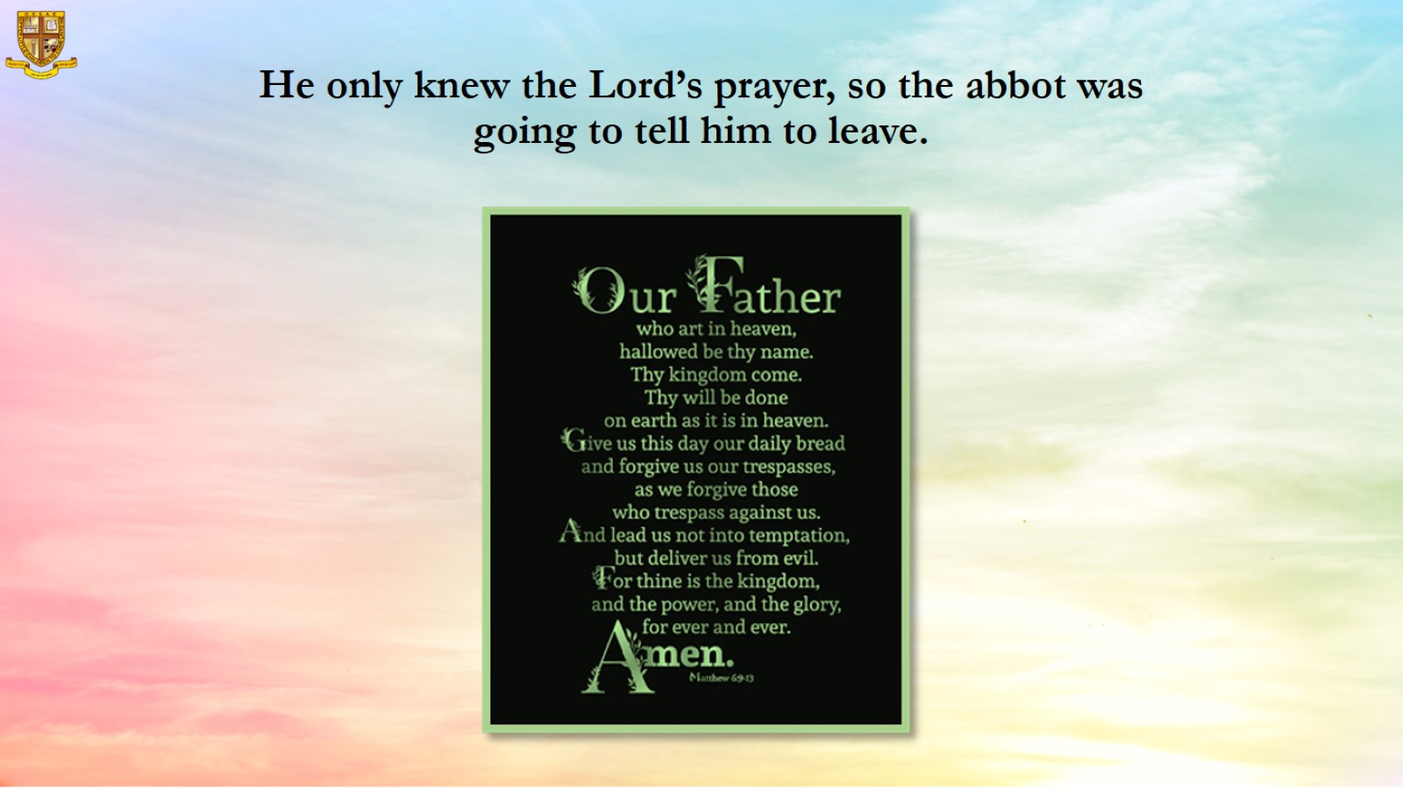
He only knew the Lord’s prayer, so the abbot was going to tell him to leave.

Slide 11
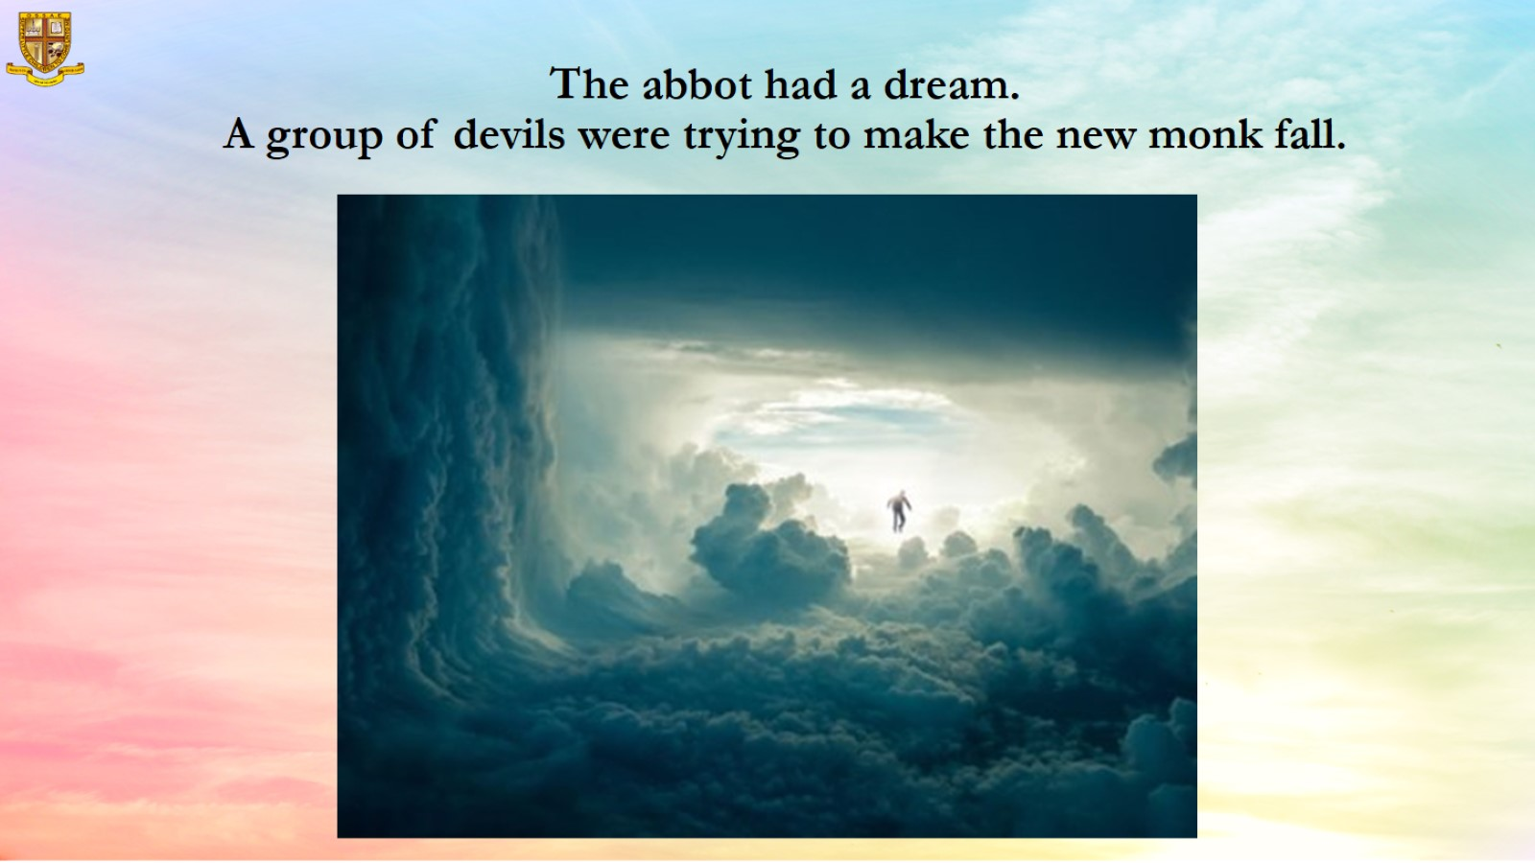
The abbot had a dream.
A group of devils were trying to make the new monk fall.

Slide 12
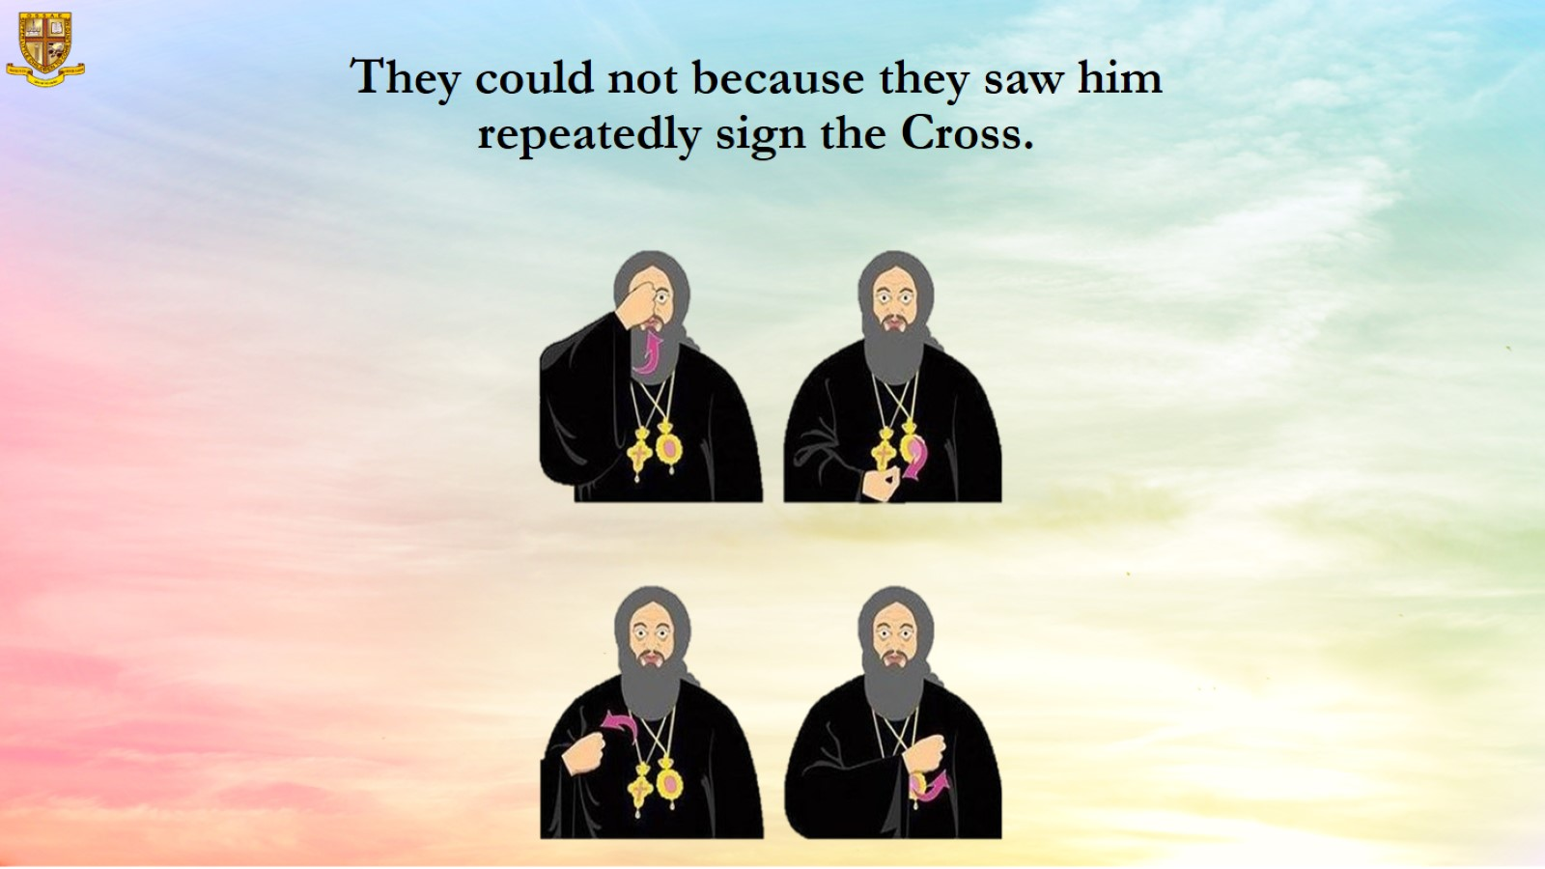
They could not because they saw him repeatedly sign the Cross.

Slide 13
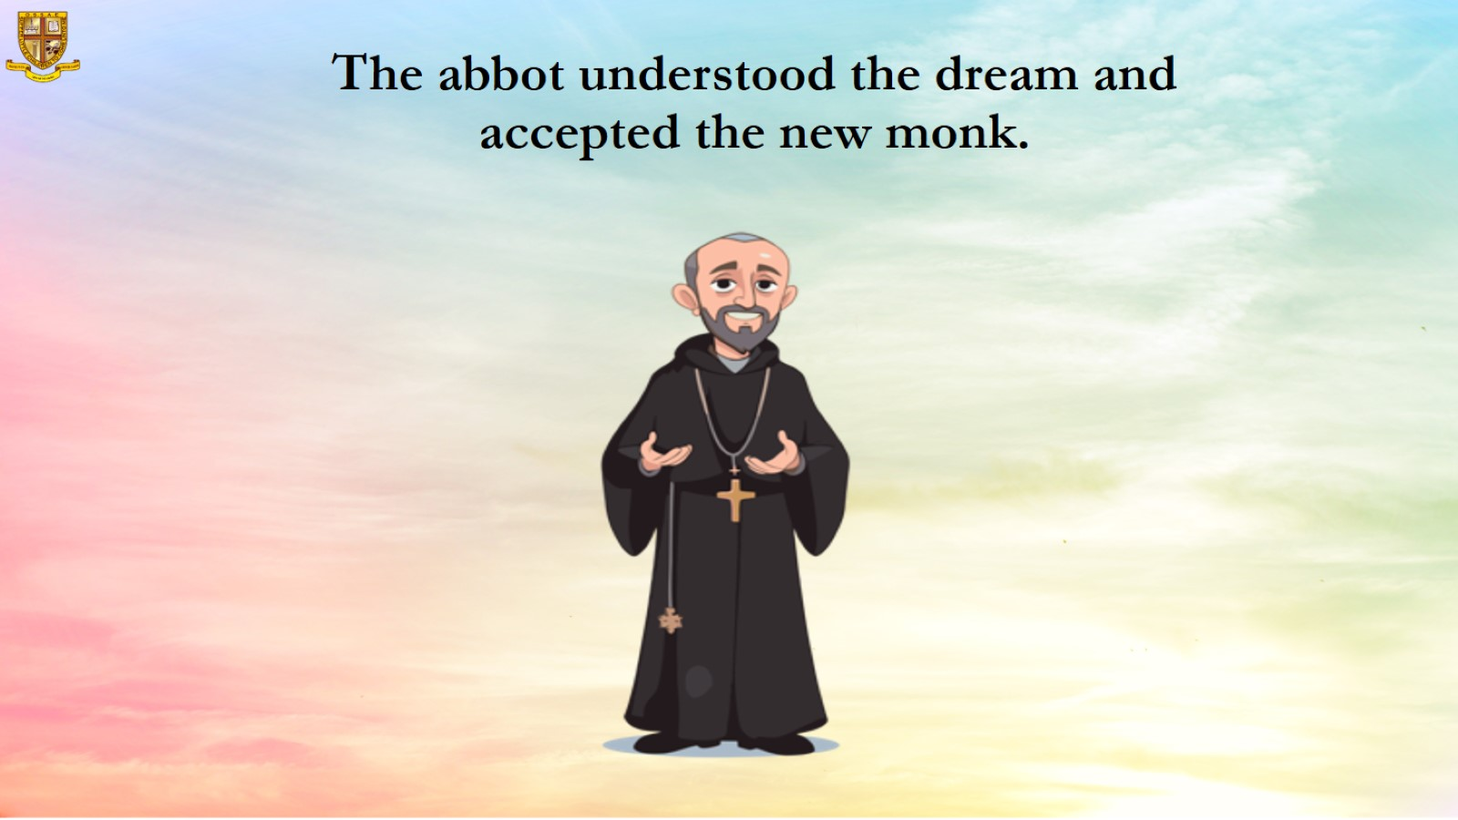
The abbot understood the dream and accepted the new monk.

Slide 14
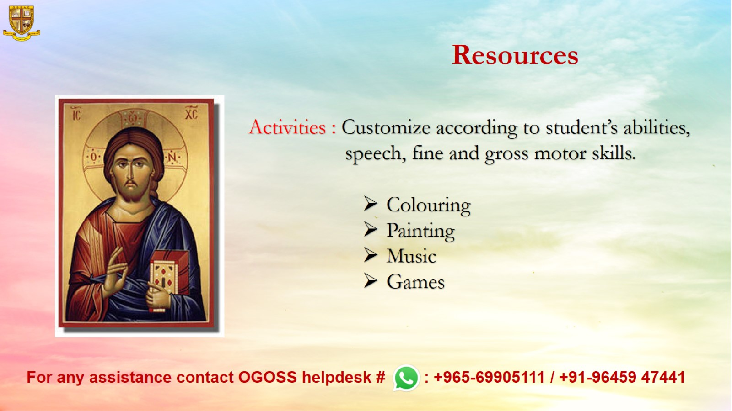
Resources

