Slide 1

Orthodox Global Online Sunday School (OGOSS)

Slide 2
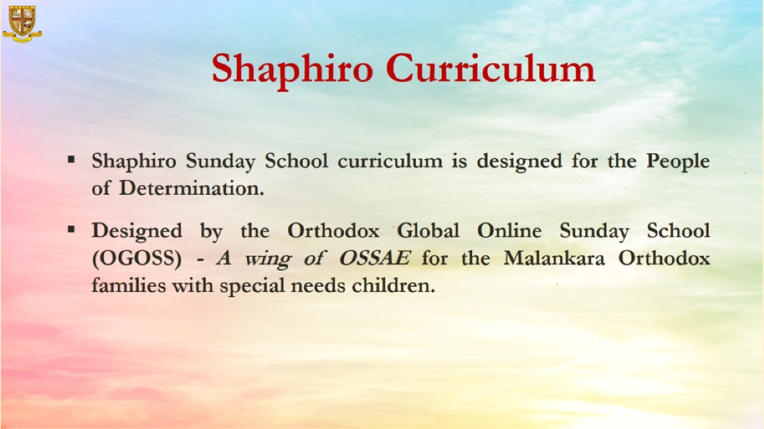

Slide 3


Slide 4
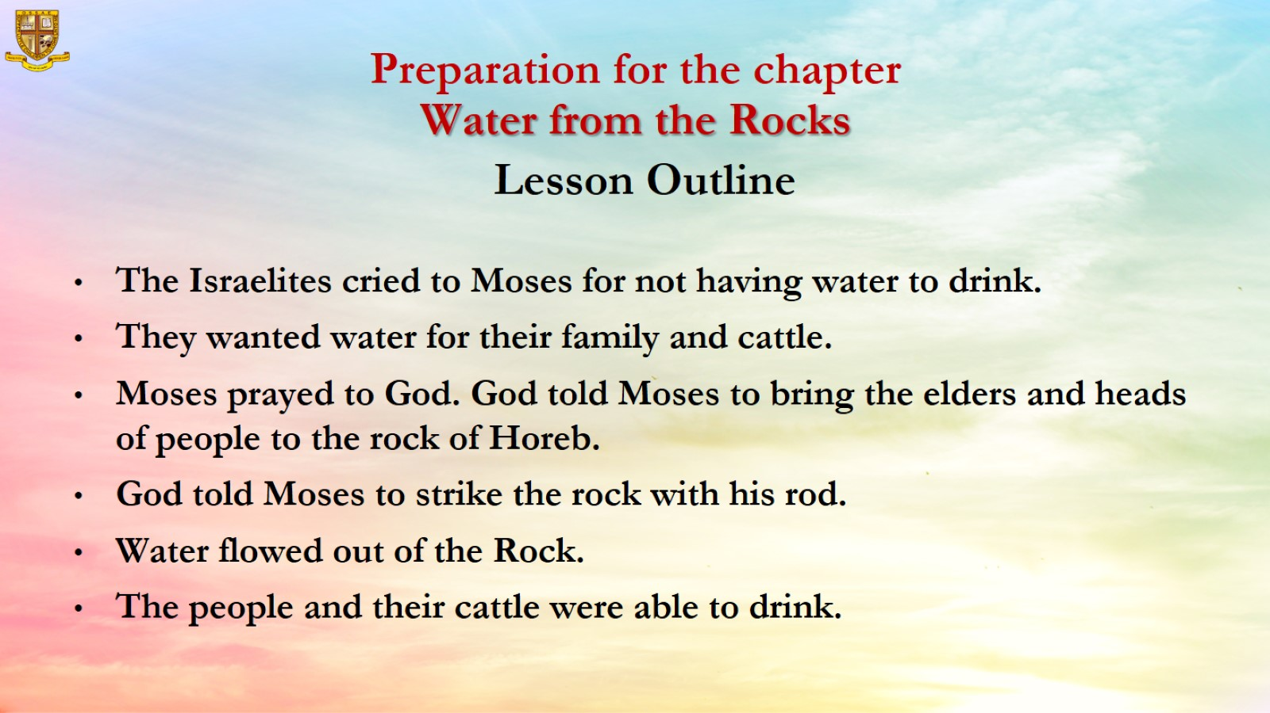

Slide 5
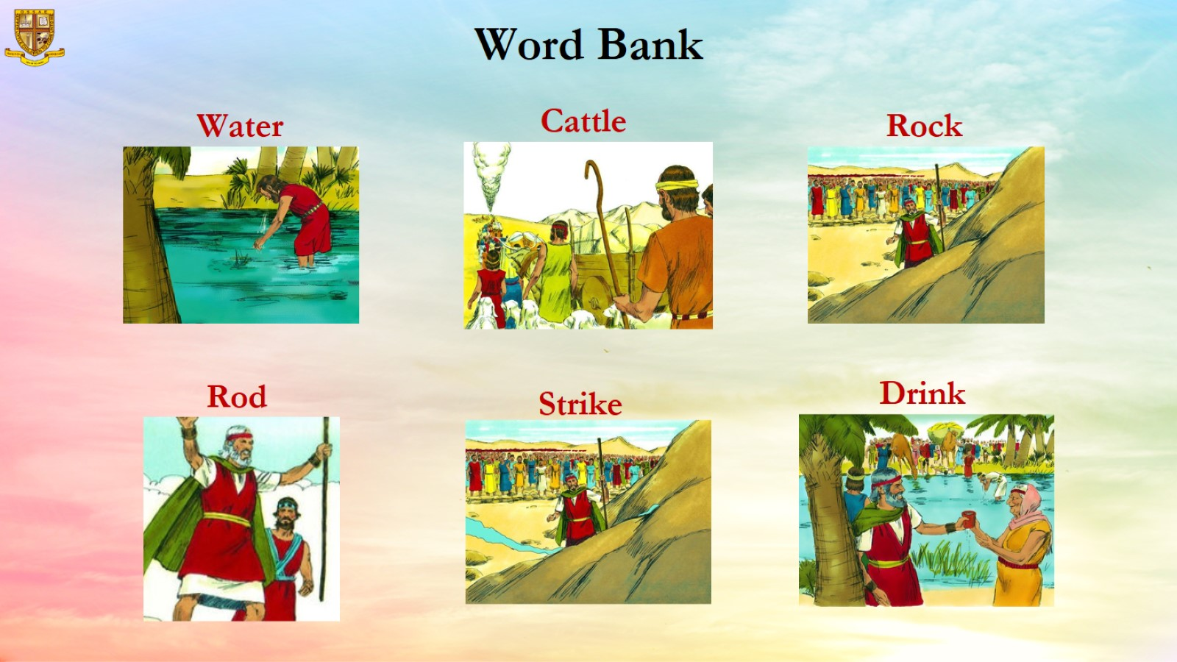

Slide 6
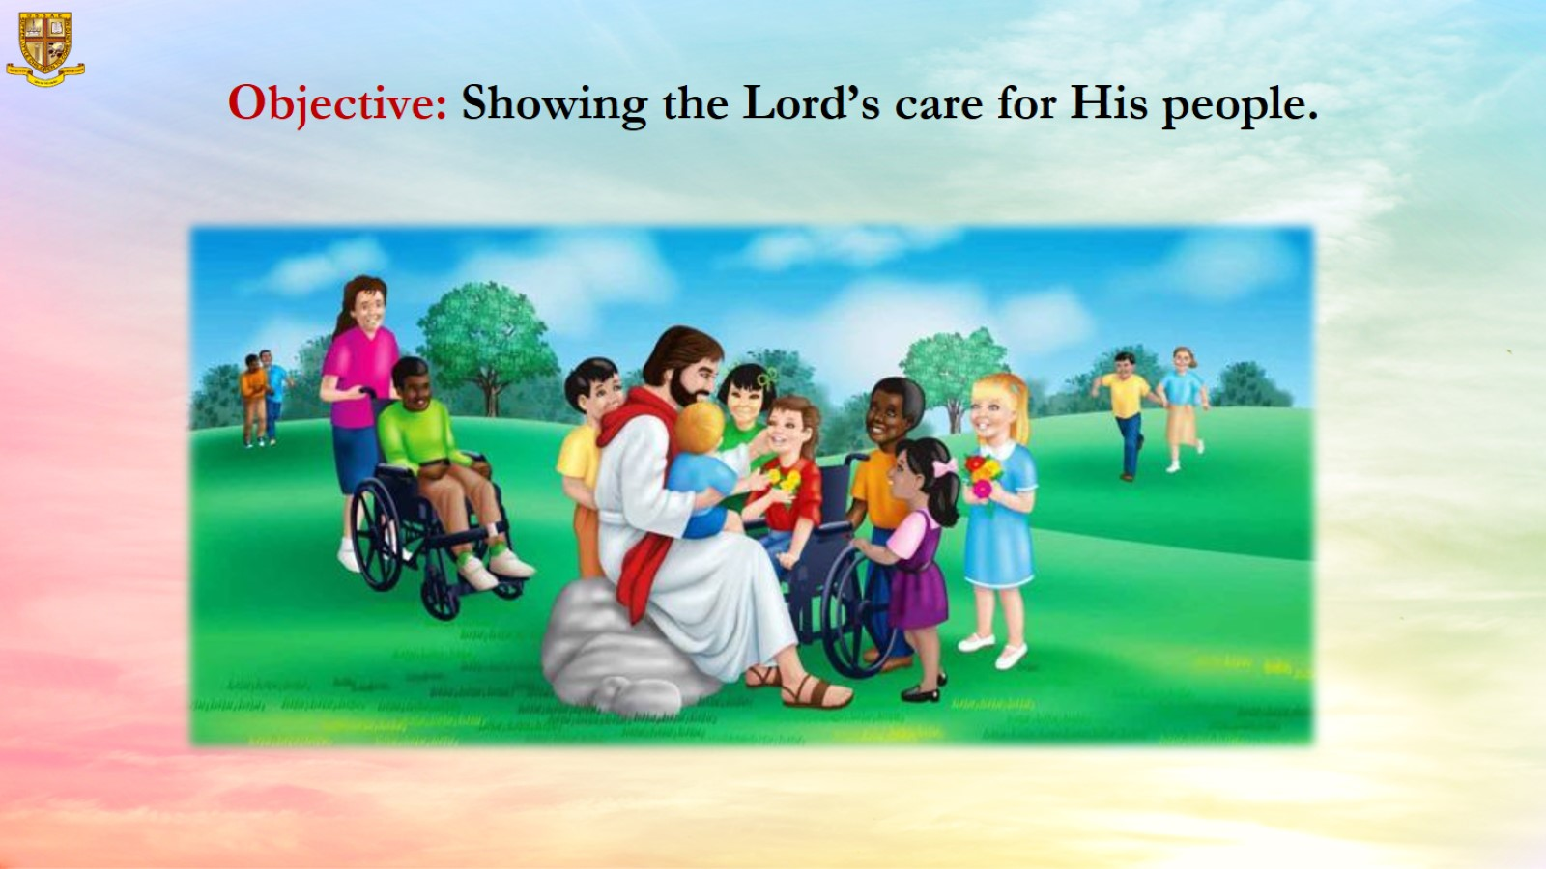
Objective: Showing the Lord’s care for His people.

Slide 7
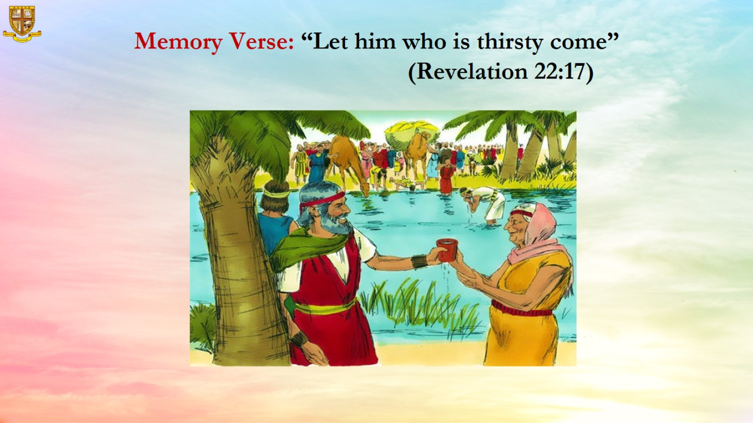
Memory Verse: “Let him who is thirsty come” (Revelation 22:17)

Slide 8
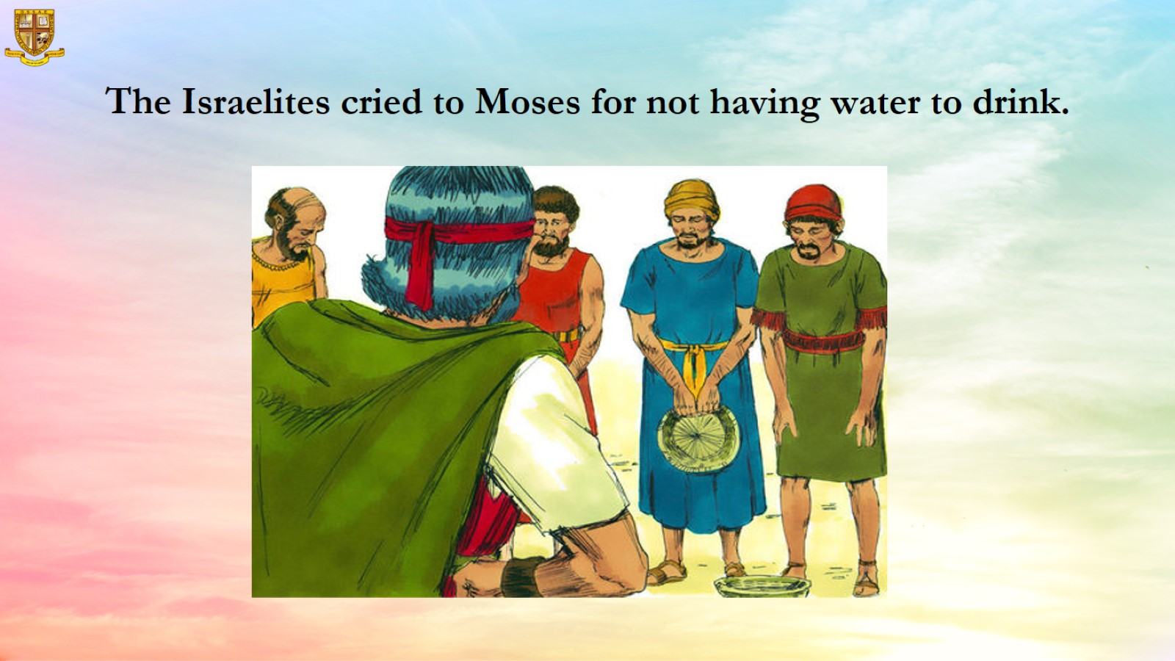
The Israelites cried to Moses for not having water to drink.

Slide 9
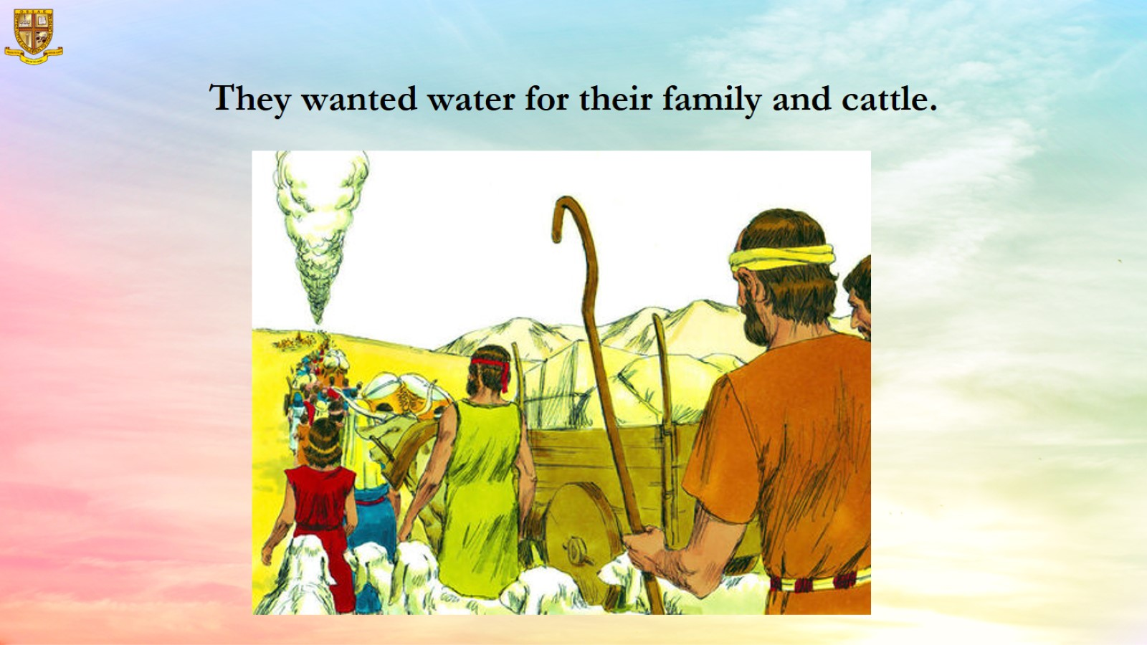
They wanted water for their family and cattle.

Slide 10
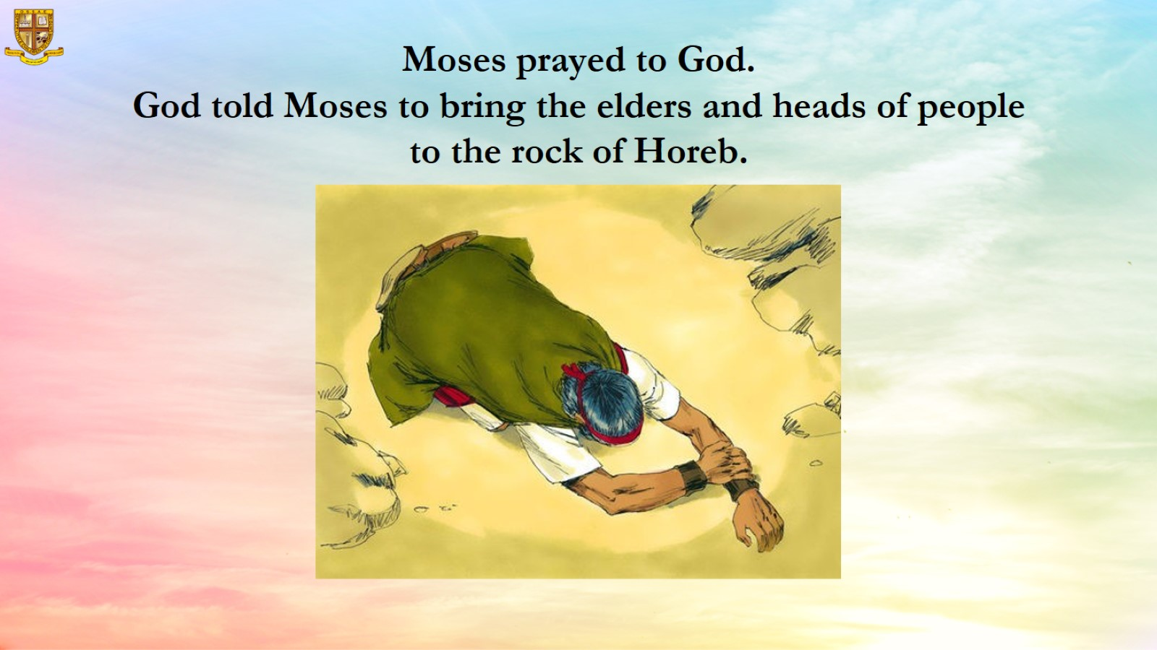
Moses prayed to God.
God told Moses to bring the elders and heads of people to the rock of Horeb.

Slide 11
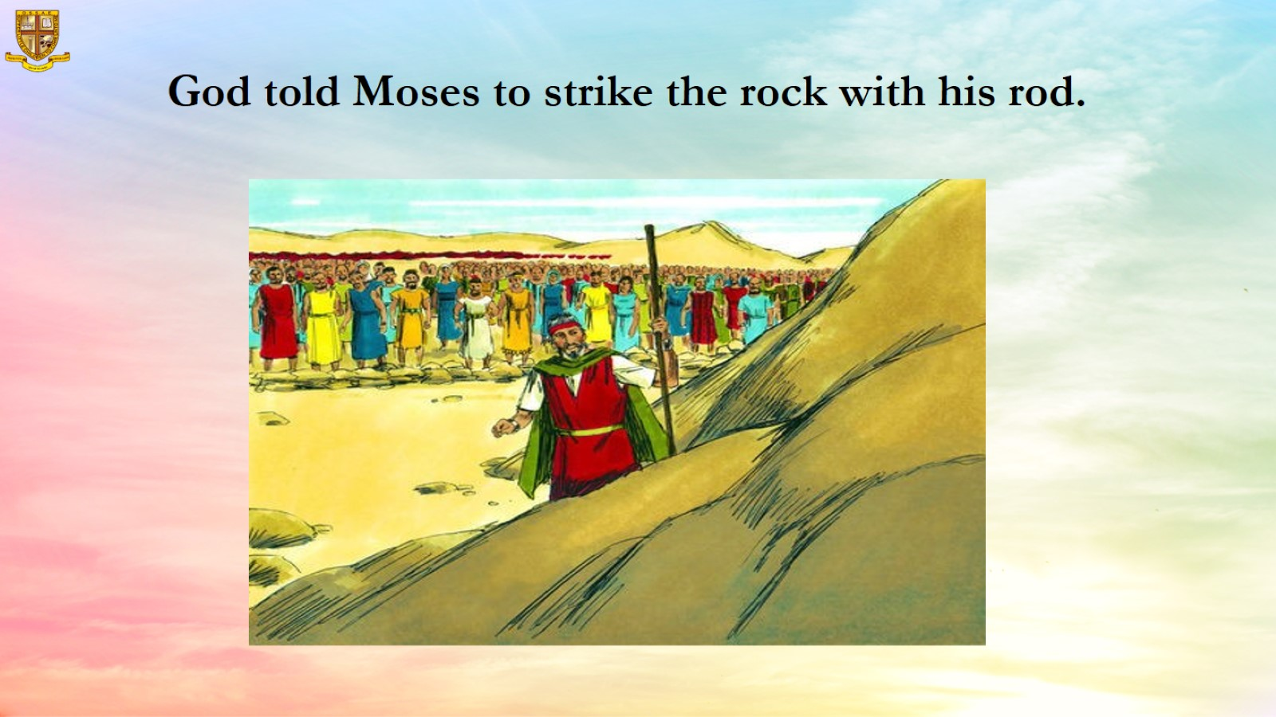
God told Moses to strike the rock with his rod.

Slide 12
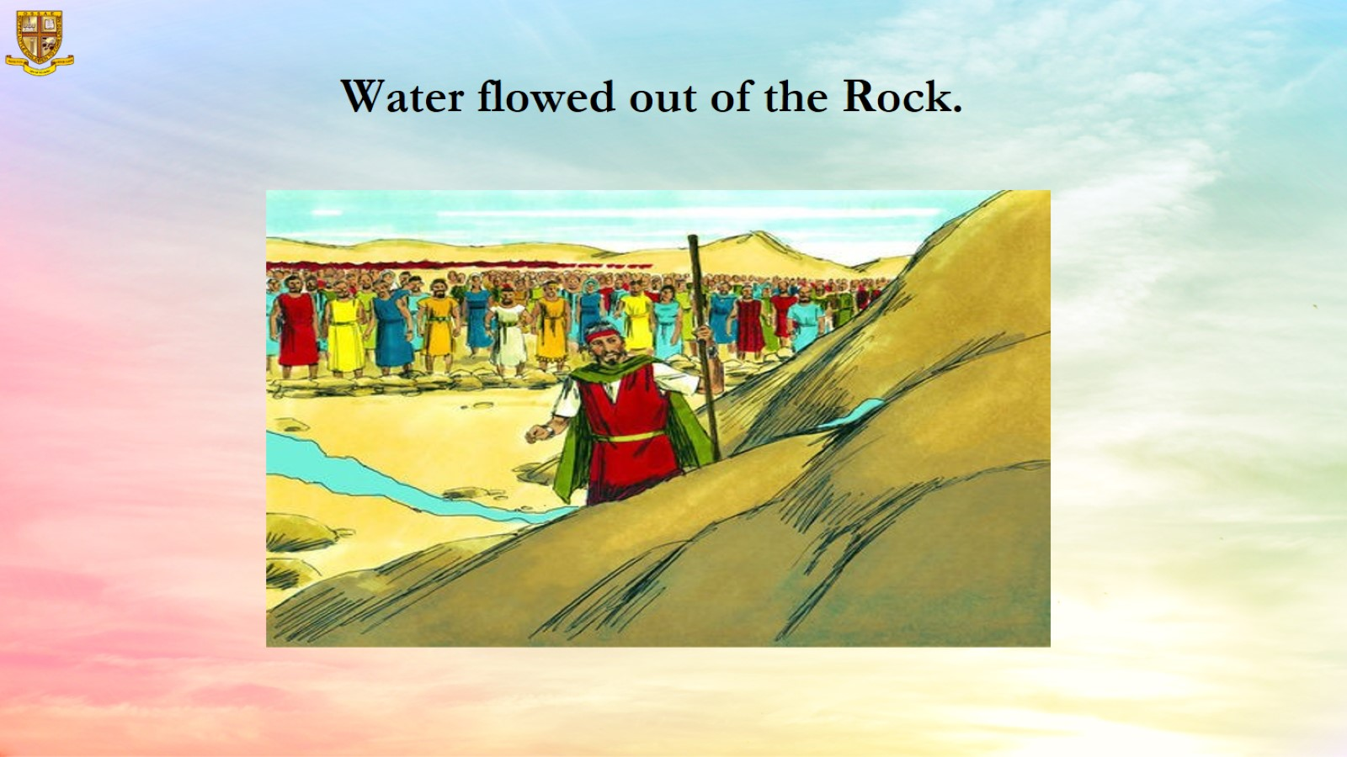
Water flowed out of the Rock.

Slide 13
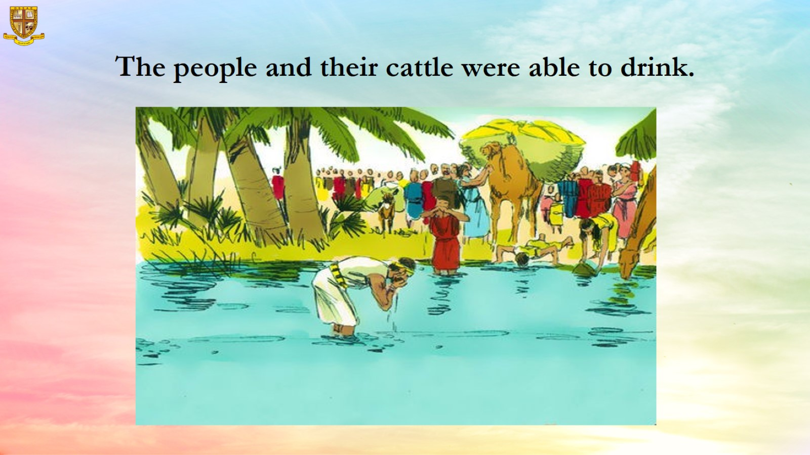
The people and their cattle were able to drink.

Slide 14
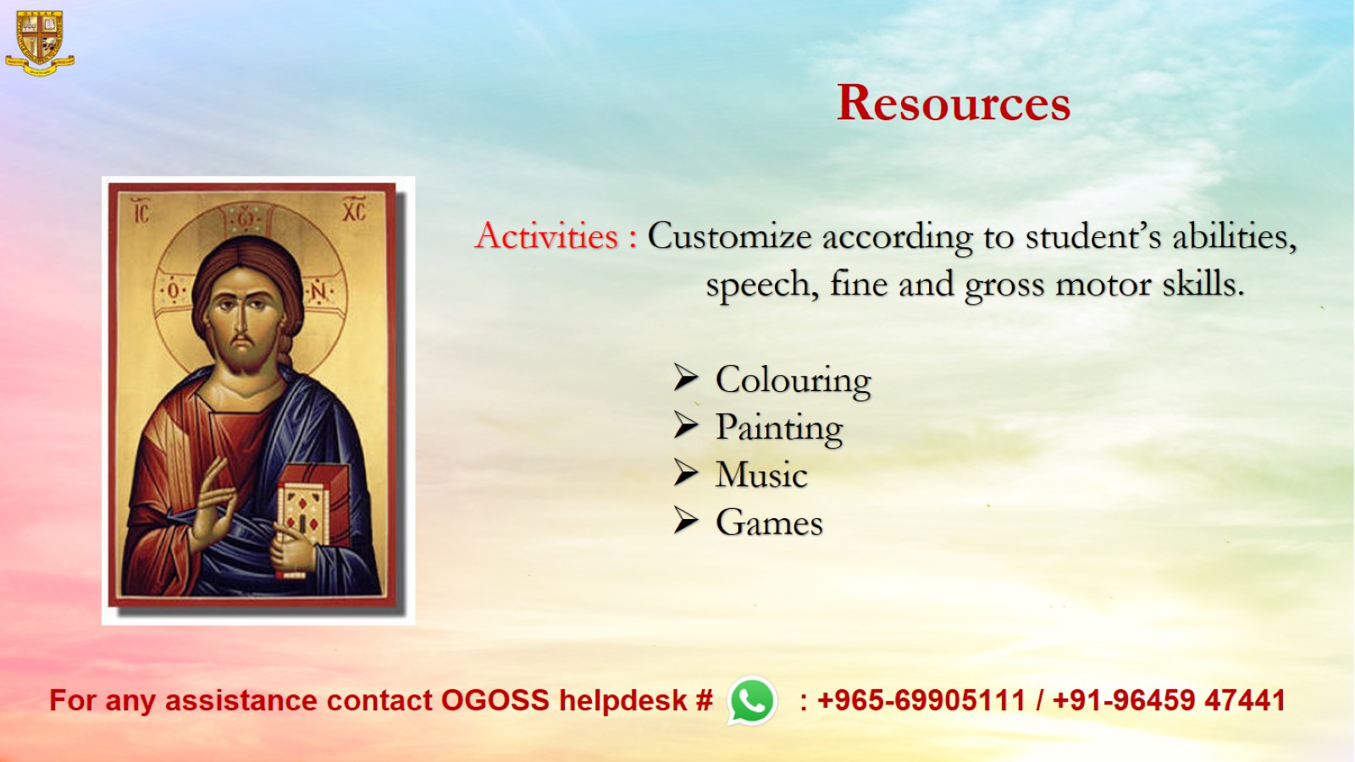
Resources

