Slide 1

Orthodox Global Online Sunday School (OGOSS)

Slide 2
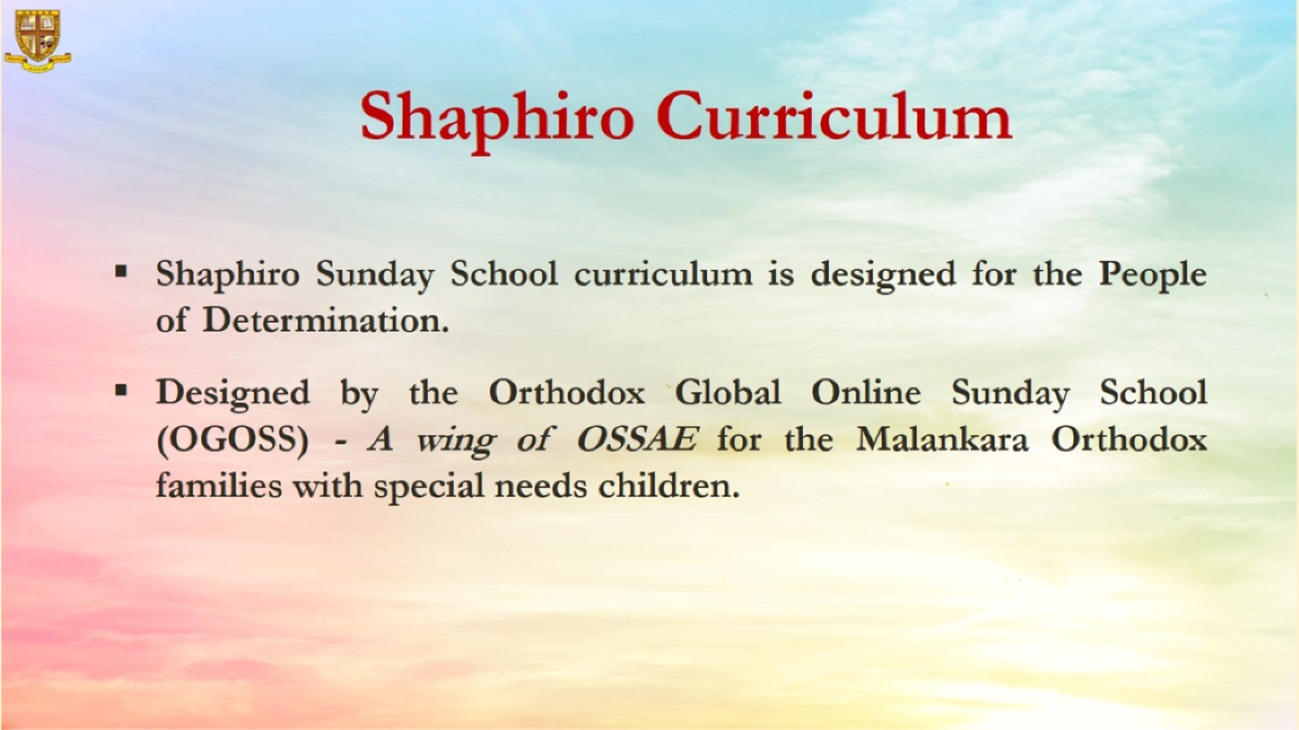

Slide 3


Slide 4
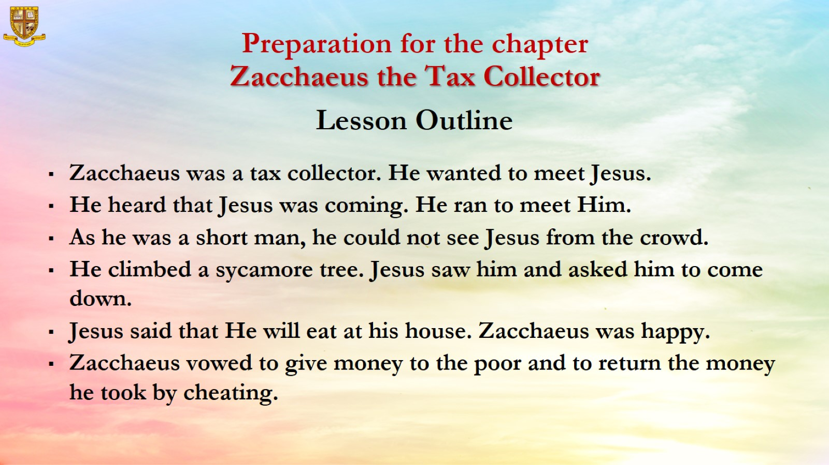

Slide 5
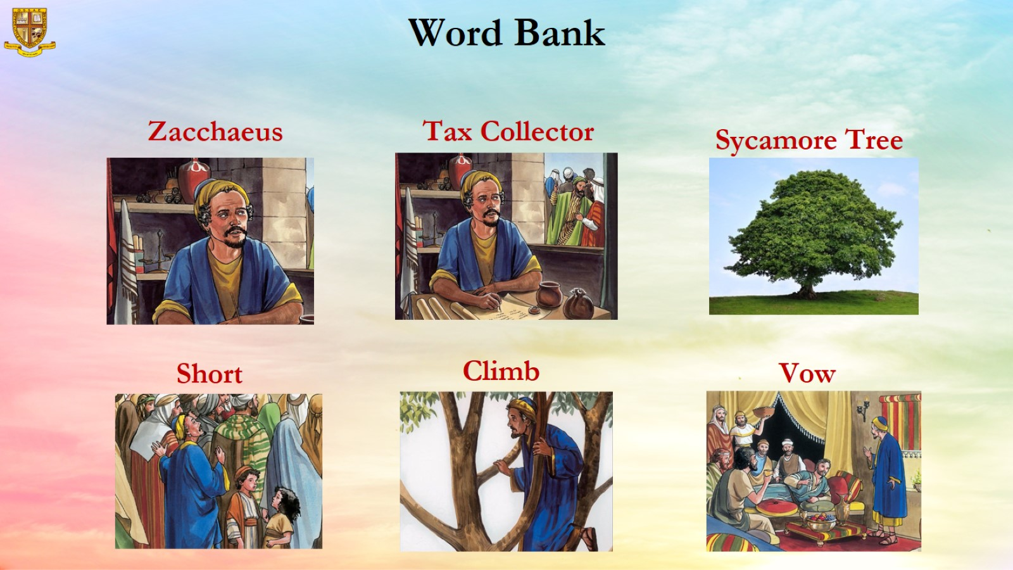

Slide 6
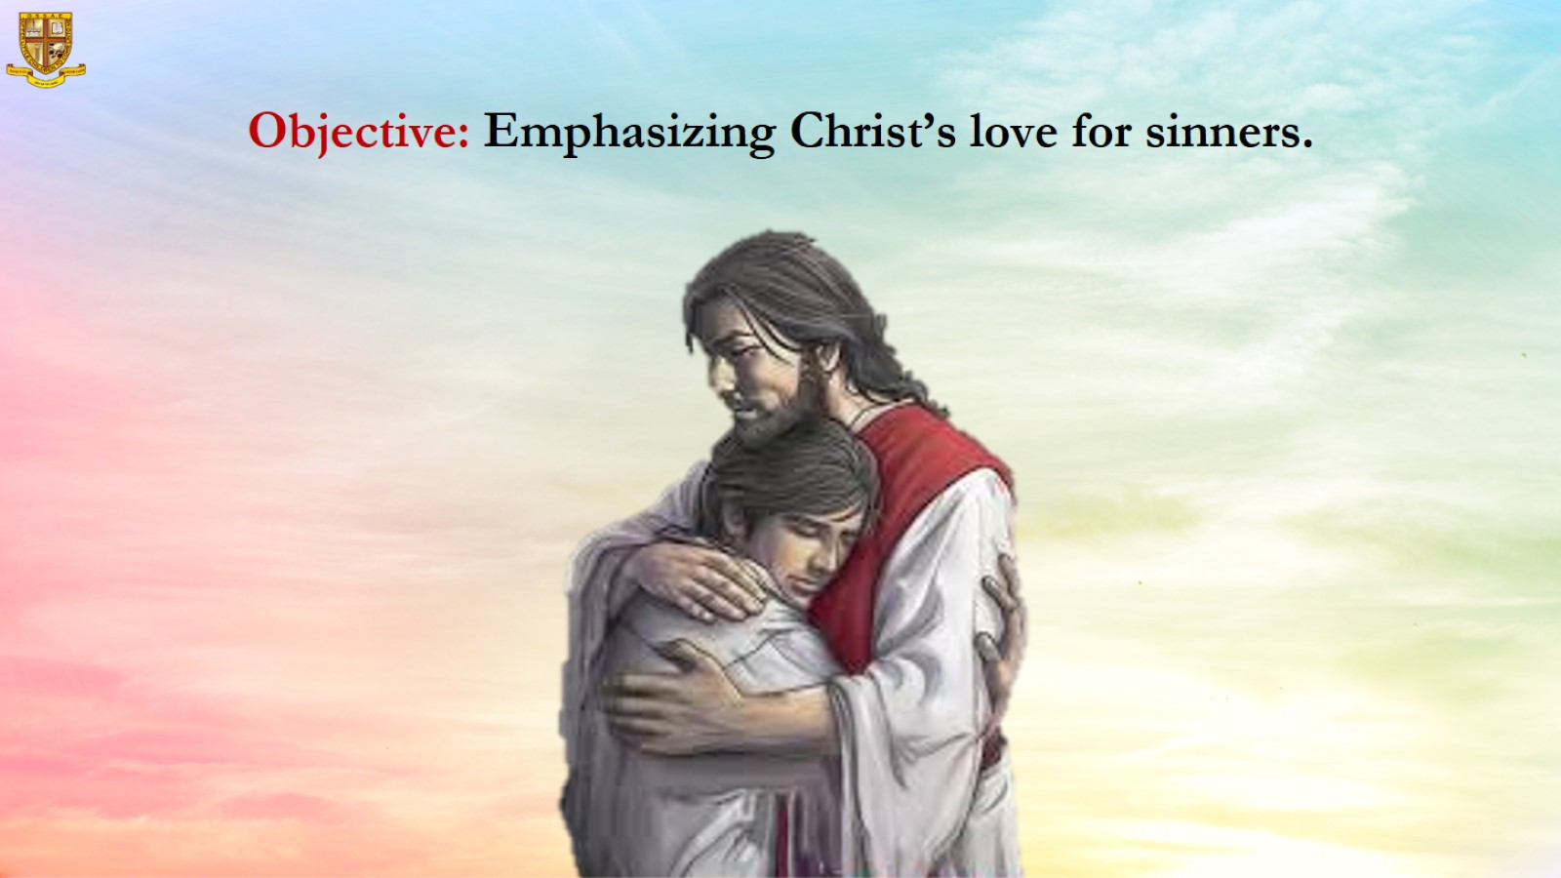
Objective: Emphasizing Christ’s love for sinners.

Slide 7
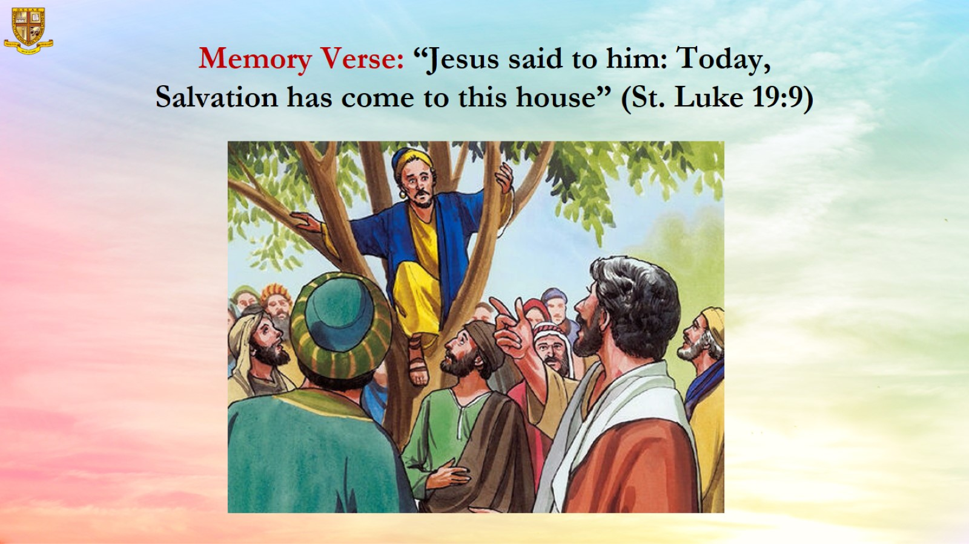
Memory Verse: “Jesus said to him: Today, Salvation has come to this house” (St. Luke 19:9)

Slide 8
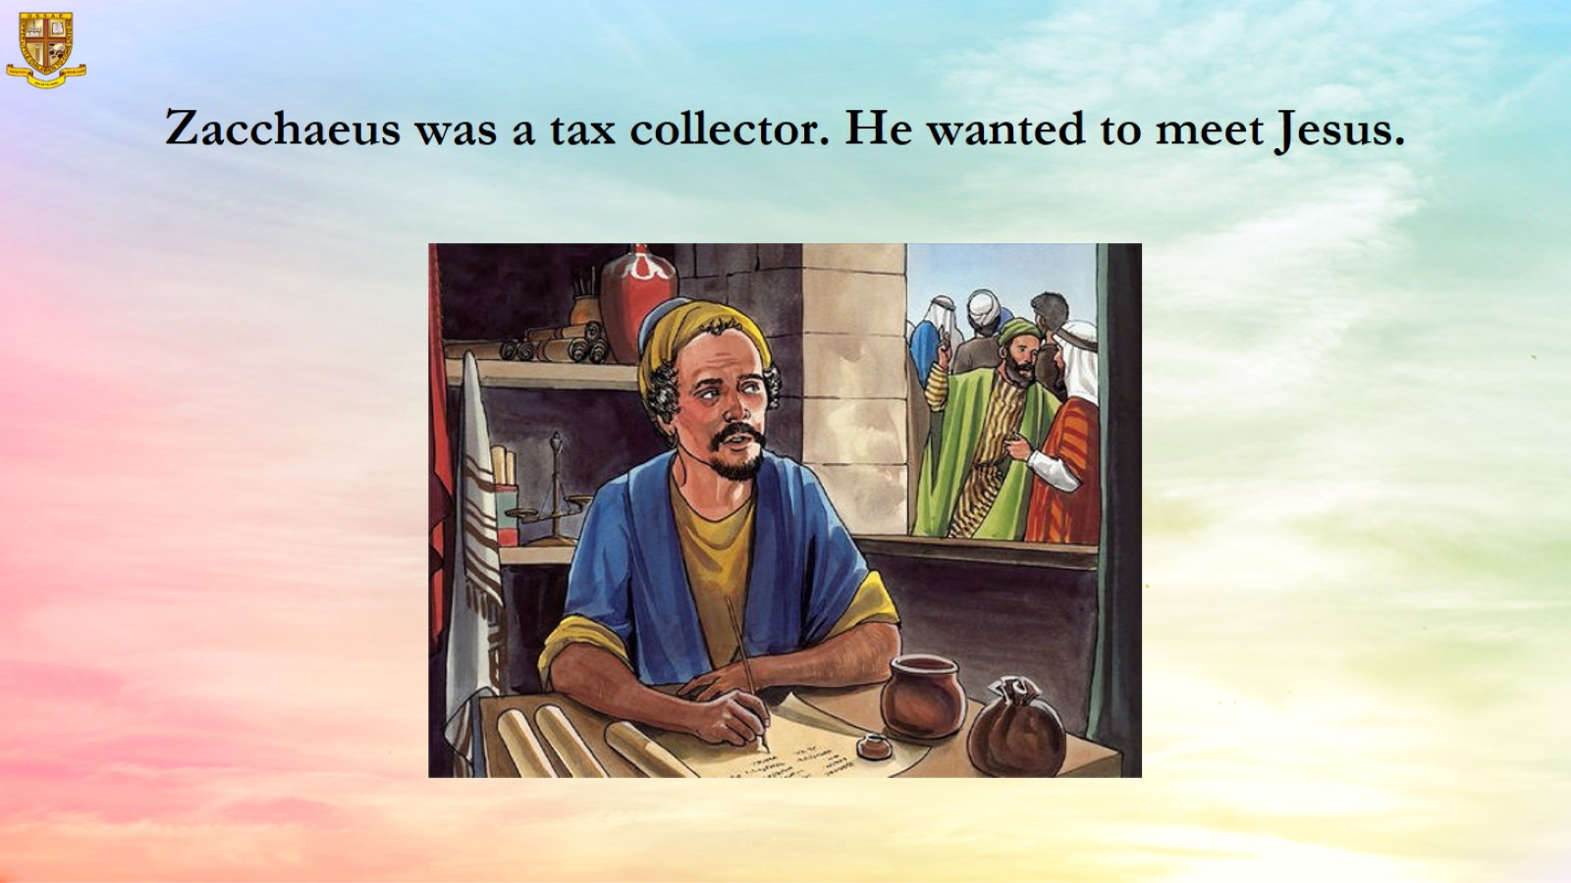
Zacchaeus was a tax collector. He wanted to meet Jesus.

Slide 9
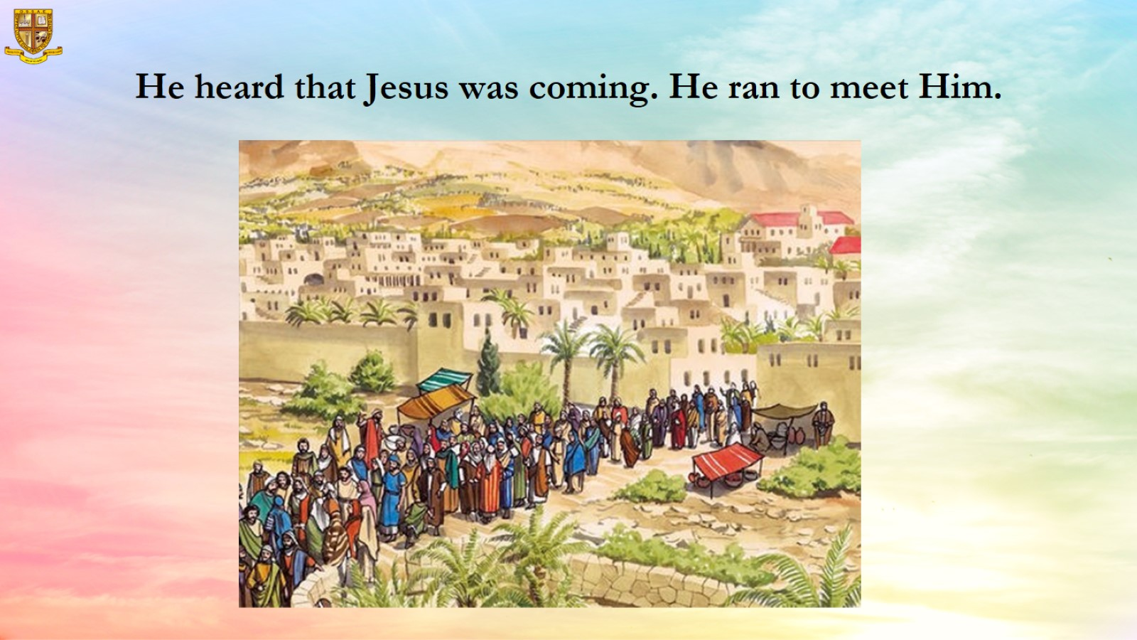
He heard that Jesus was coming. He ran to meet Him.

Slide 10
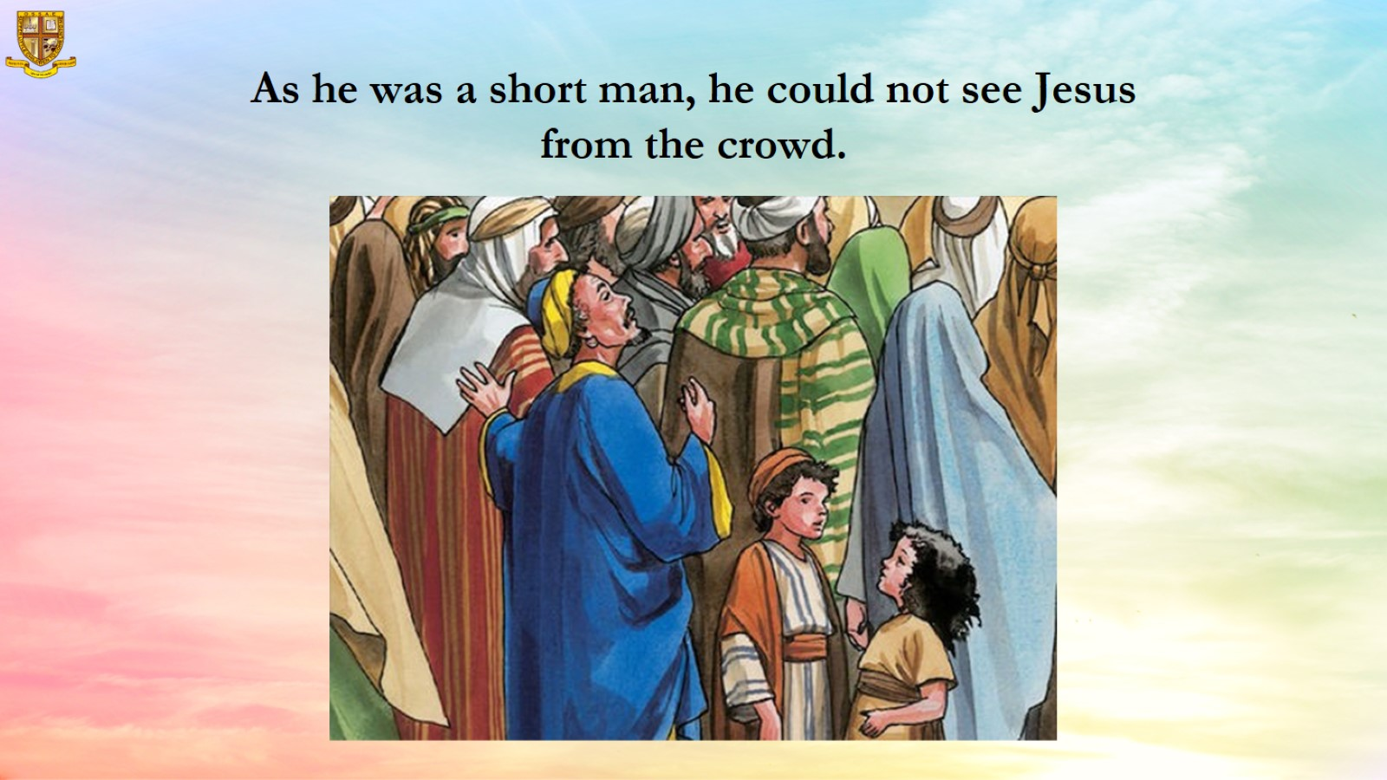

Slide 11
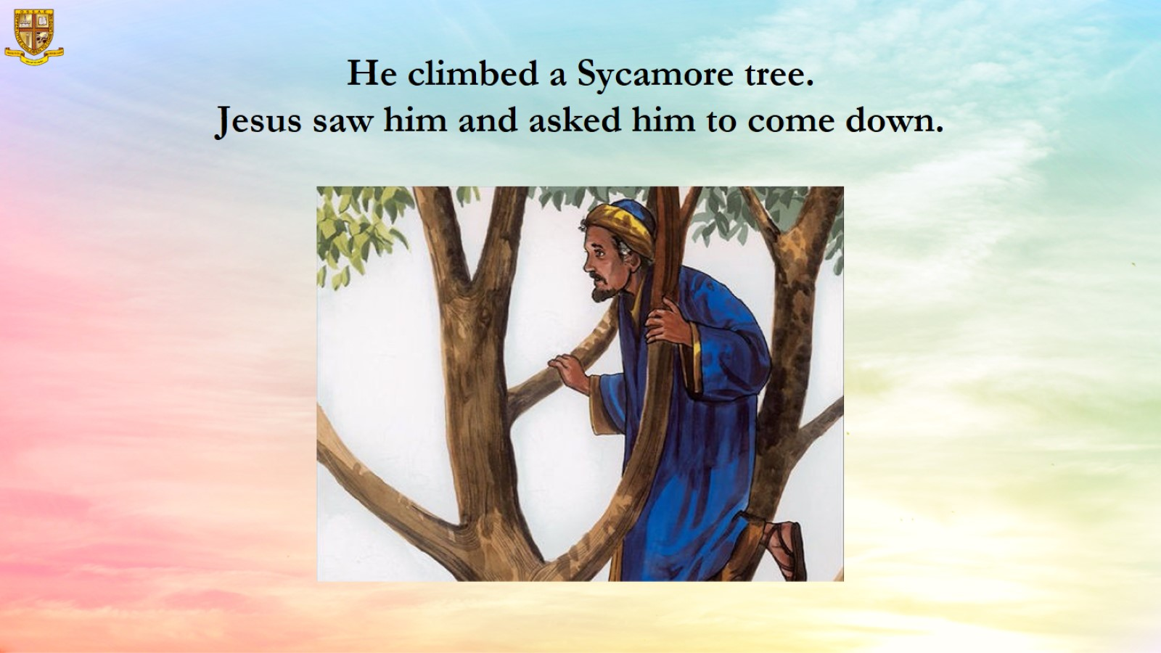
He climbed a Sycamore tree.
Jesus saw him and asked him to come down.

Slide 12
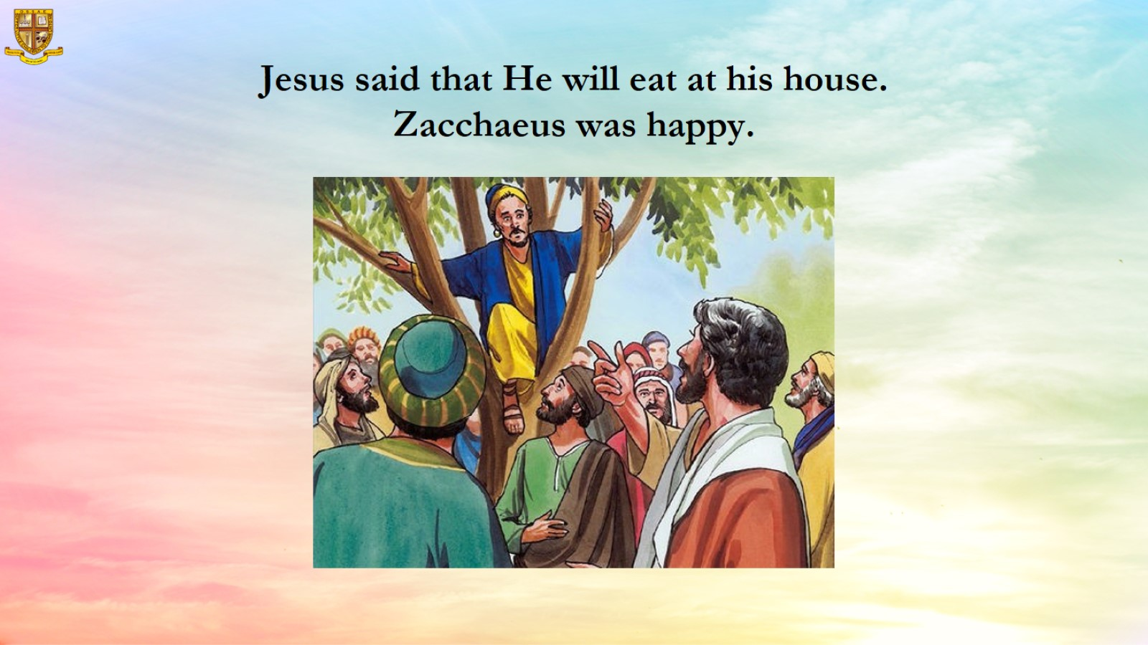
Jesus said that He will eat at his house. Zacchaeus was happy.

Slide 13
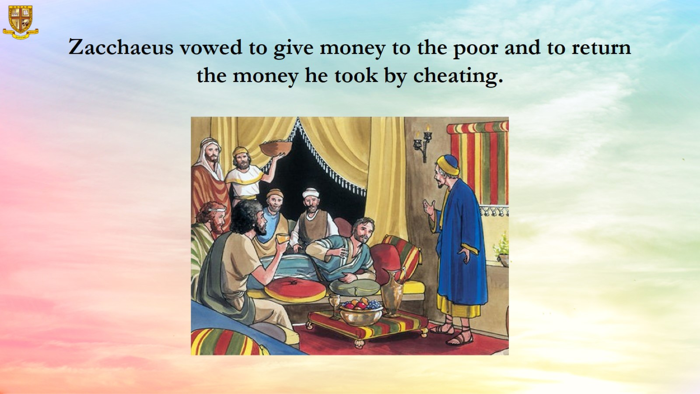
  Zacchaeus vowed to give money to the poor and to return the money he took by cheating.

Slide 14
