Slide 1
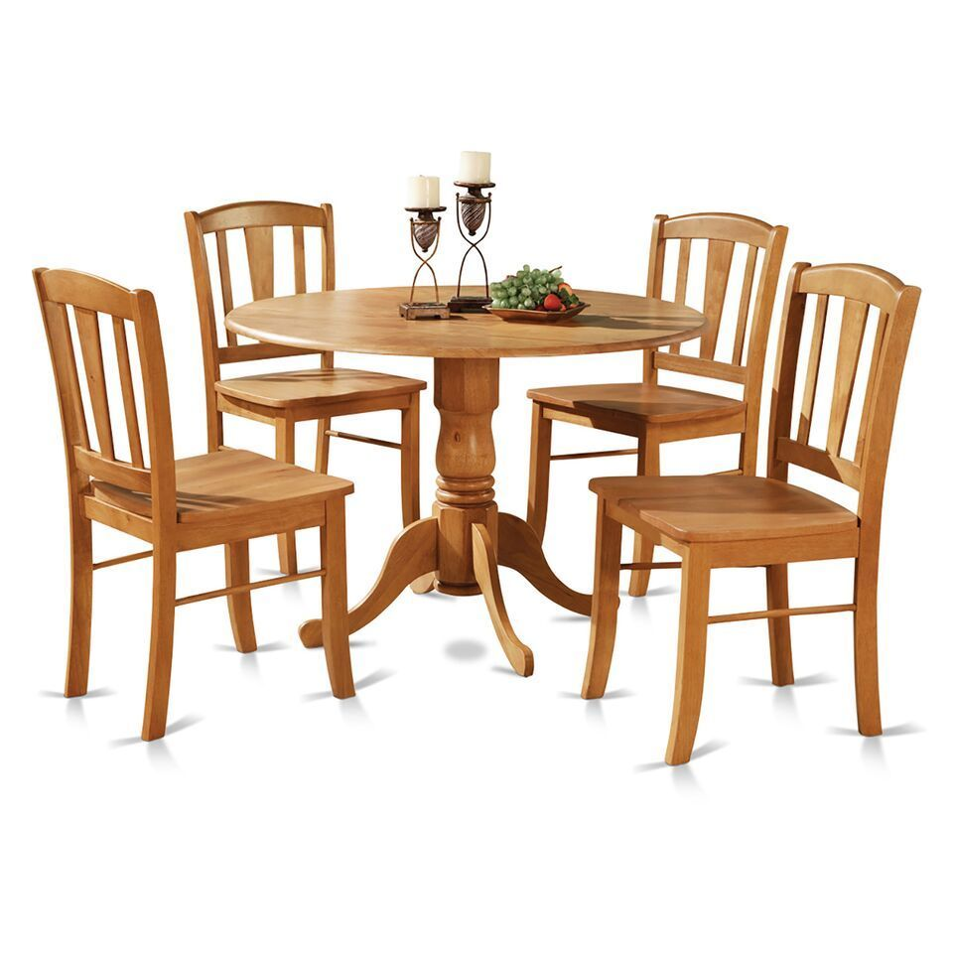
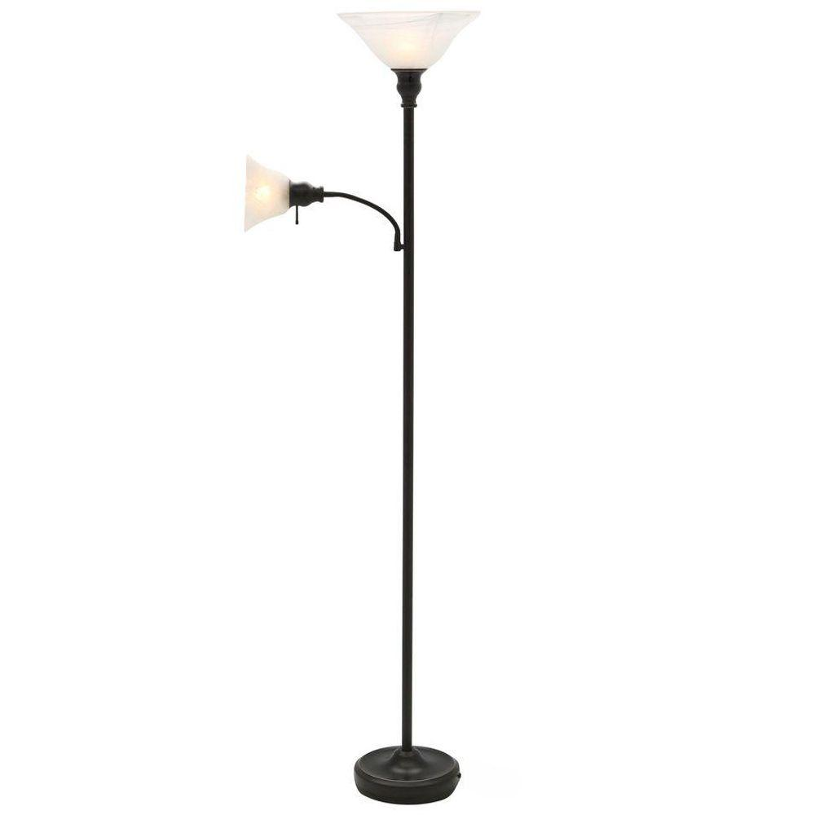
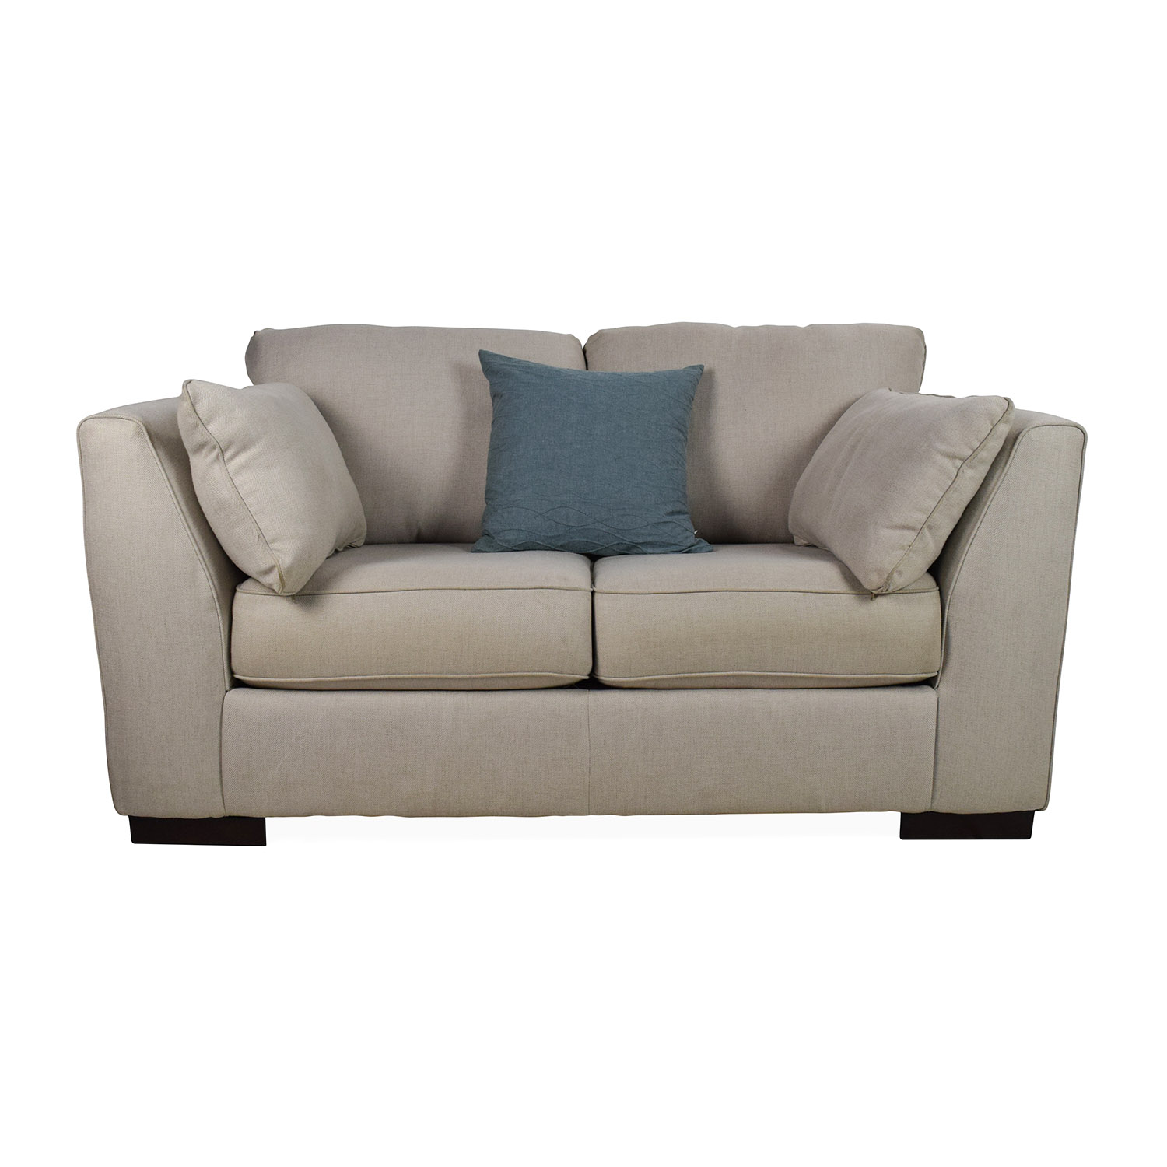
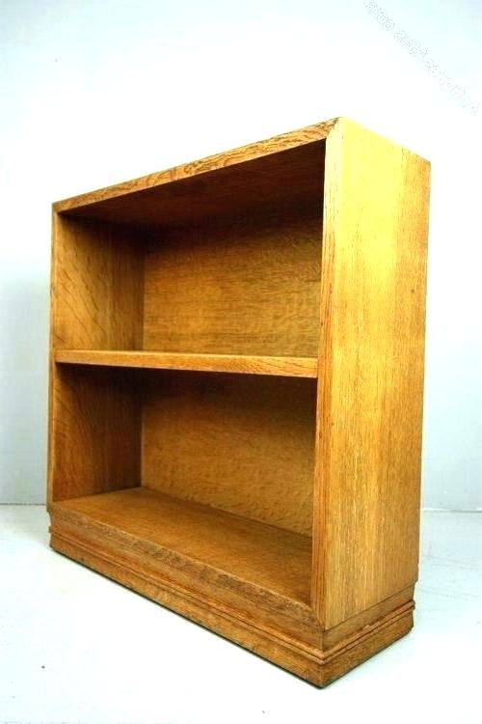
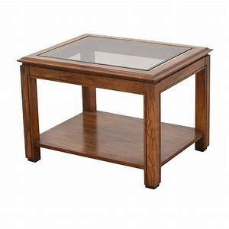
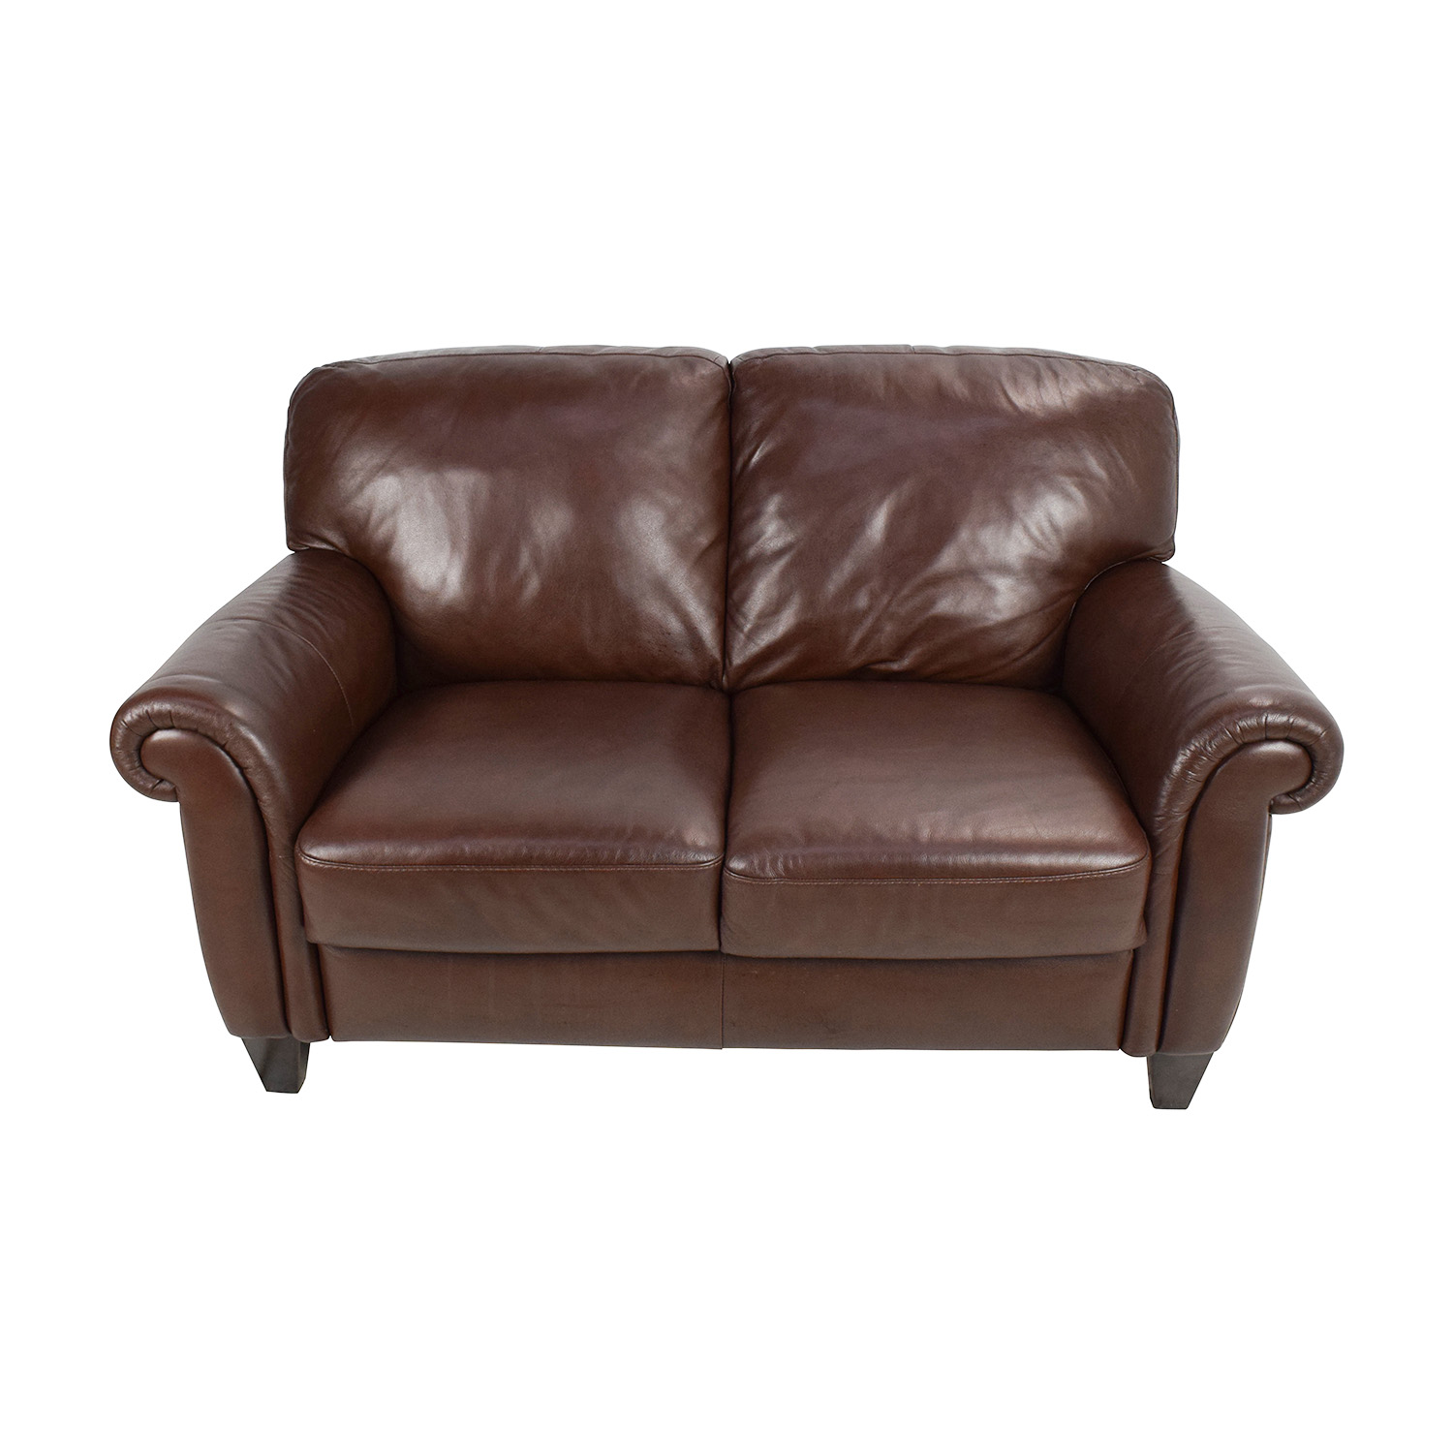
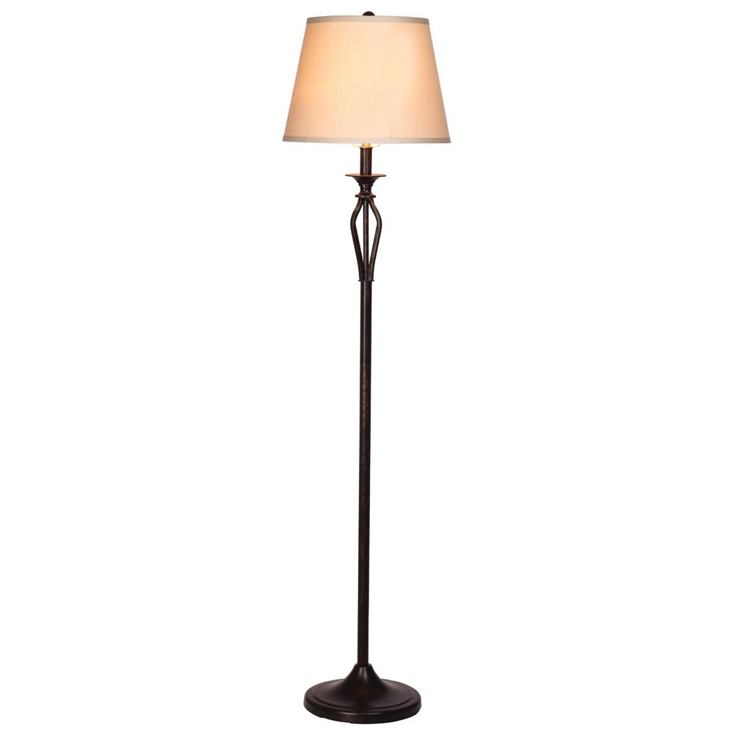
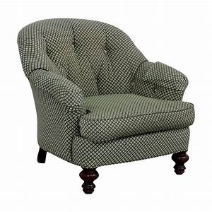
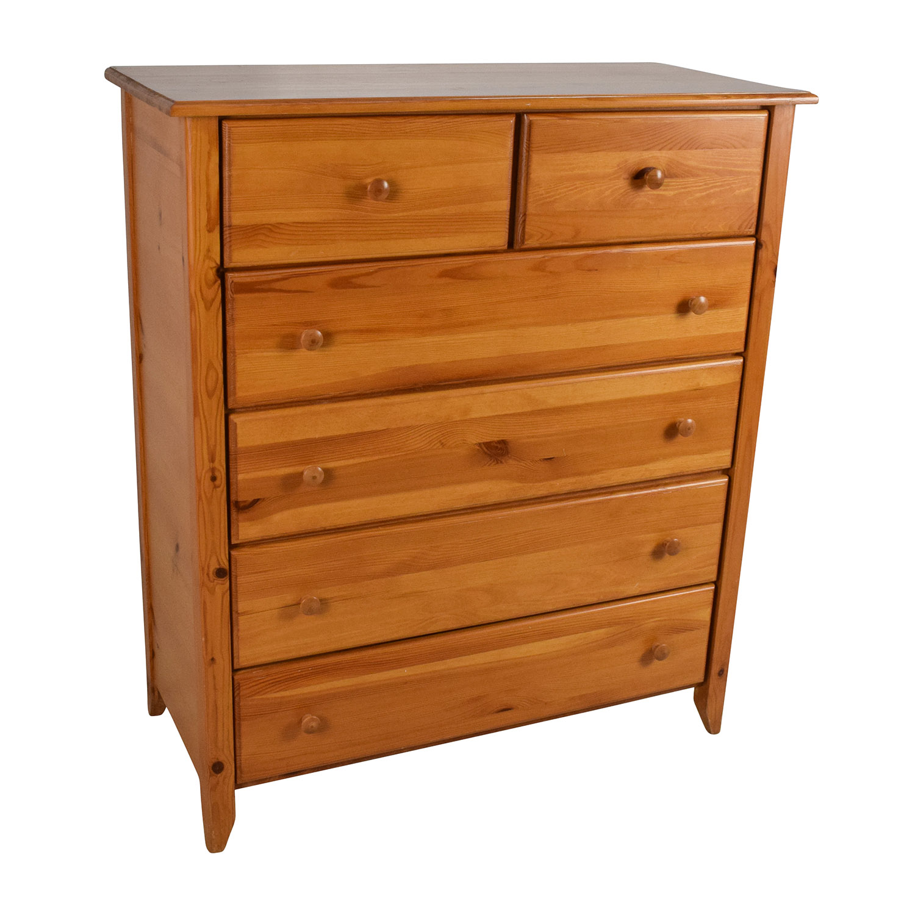
SAINTS PLACE WISH LIST
MOST NEEDED FURNITURE ITEMS:
Loveseats and sofas in good condition. No rips or tears or pet stains. No sleeper sofas or reclining sofas.
Small kitchen tables that seat 4-6 people.
Kitchen chairs
Living room arm chairs. No recliners please.
Dressers
Small book cases/side tables/coffee tables
Standing lamps and table lamps
Rugs in good condition
**We cannot accept: recliners, china cabinets, entertainment centers, sleeper sofas and oversized furniture (refugee apartments are small)

