Slide 1
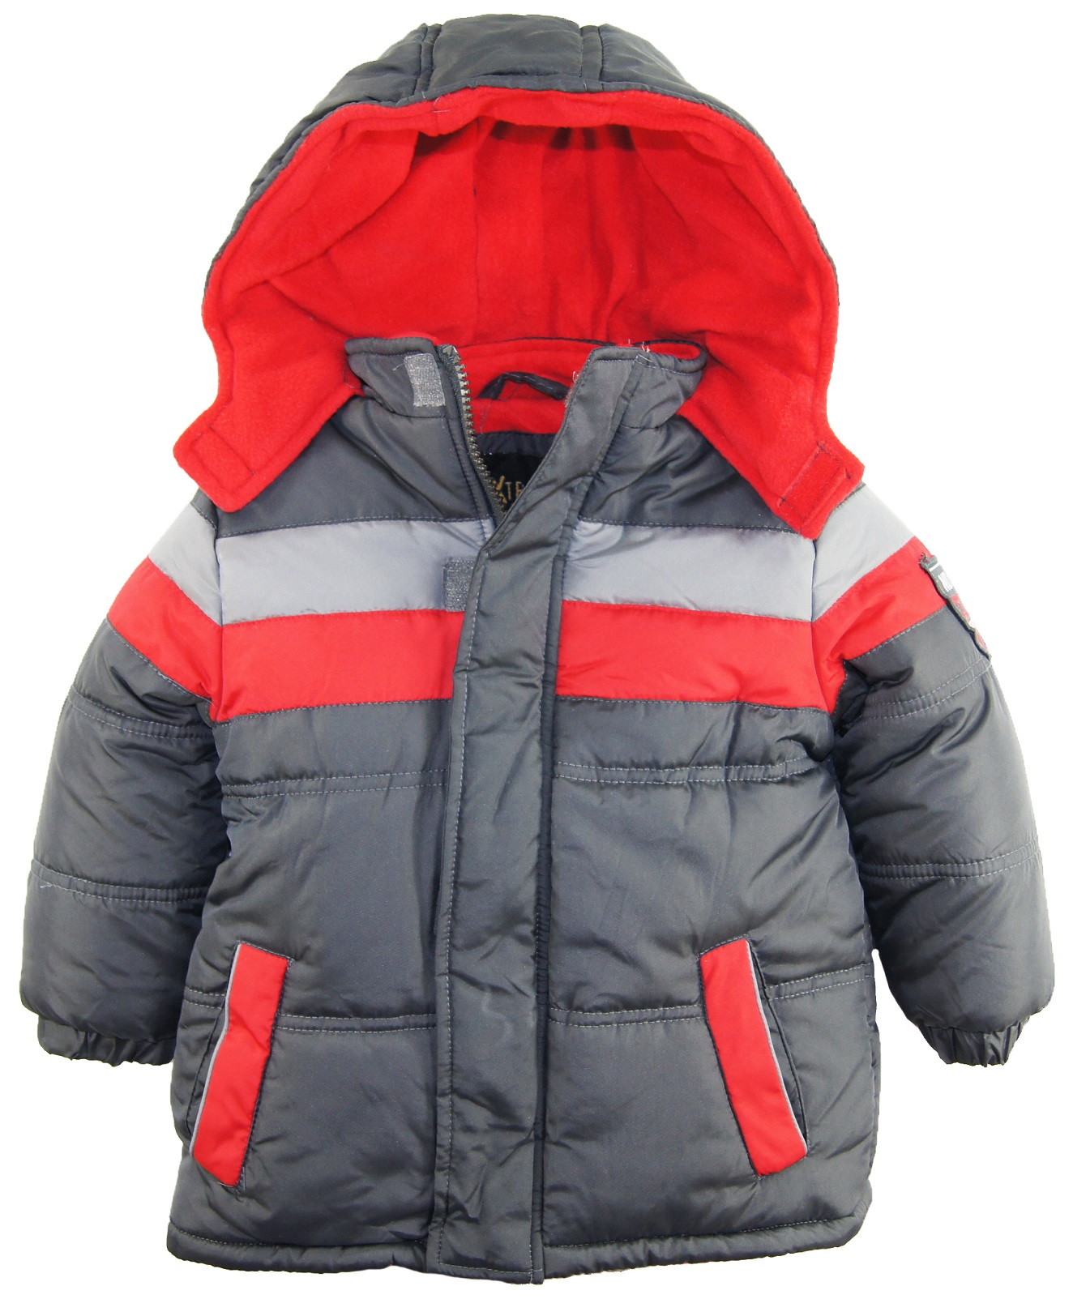
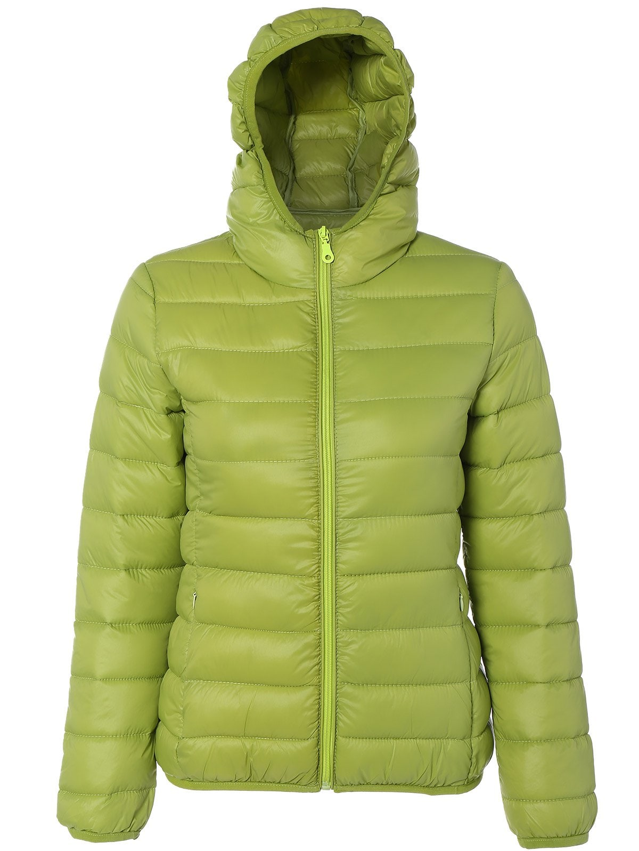
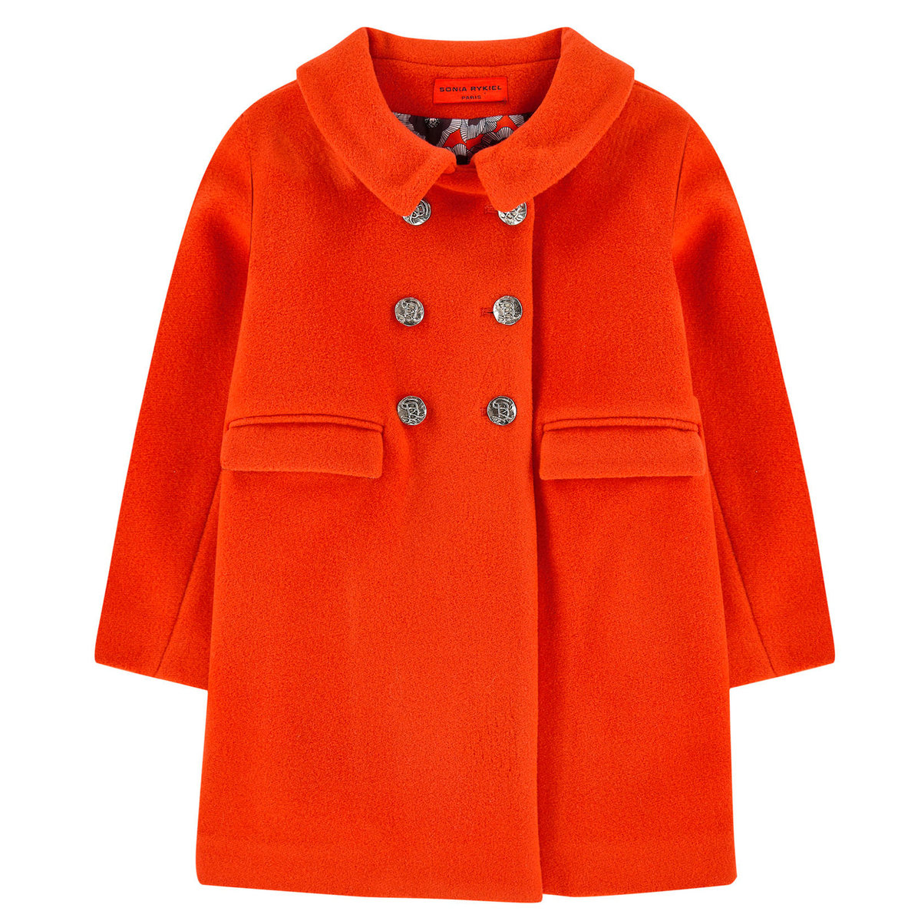
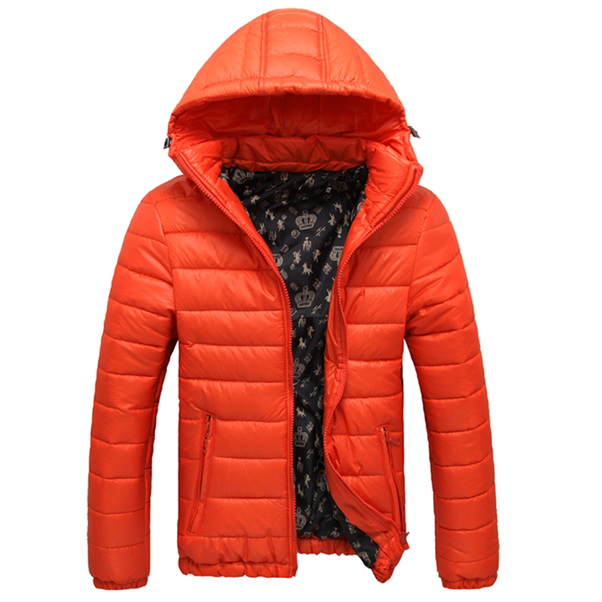
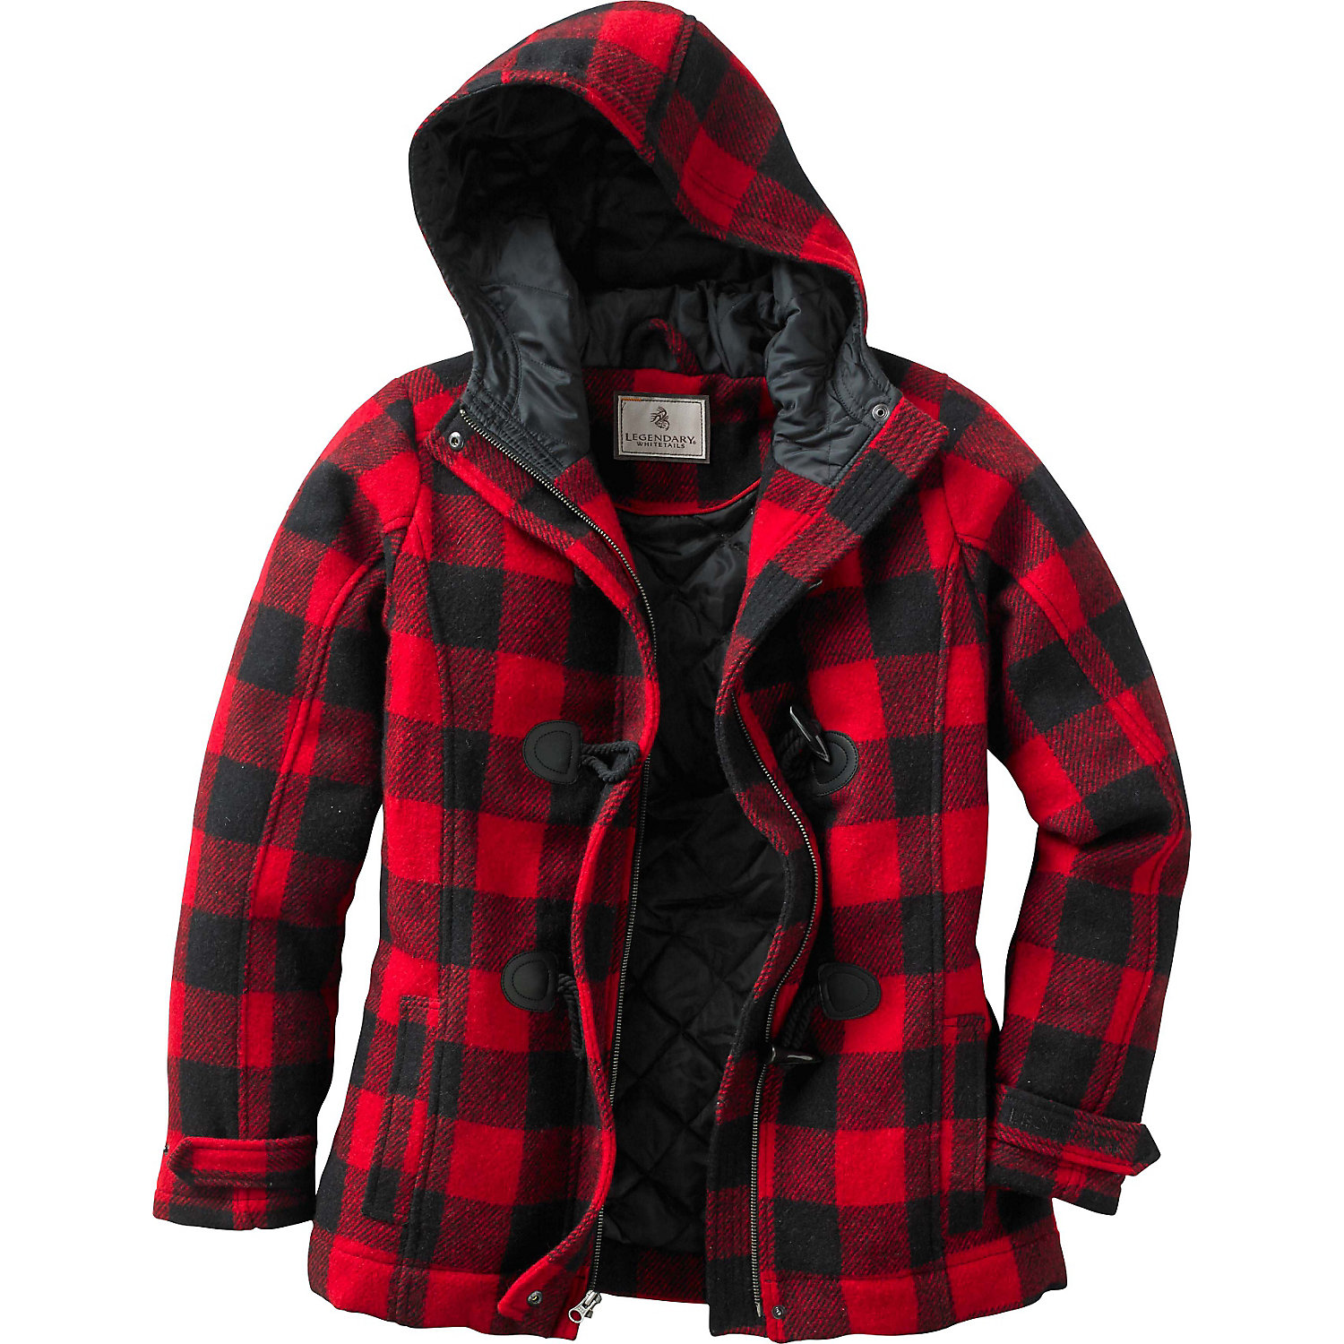
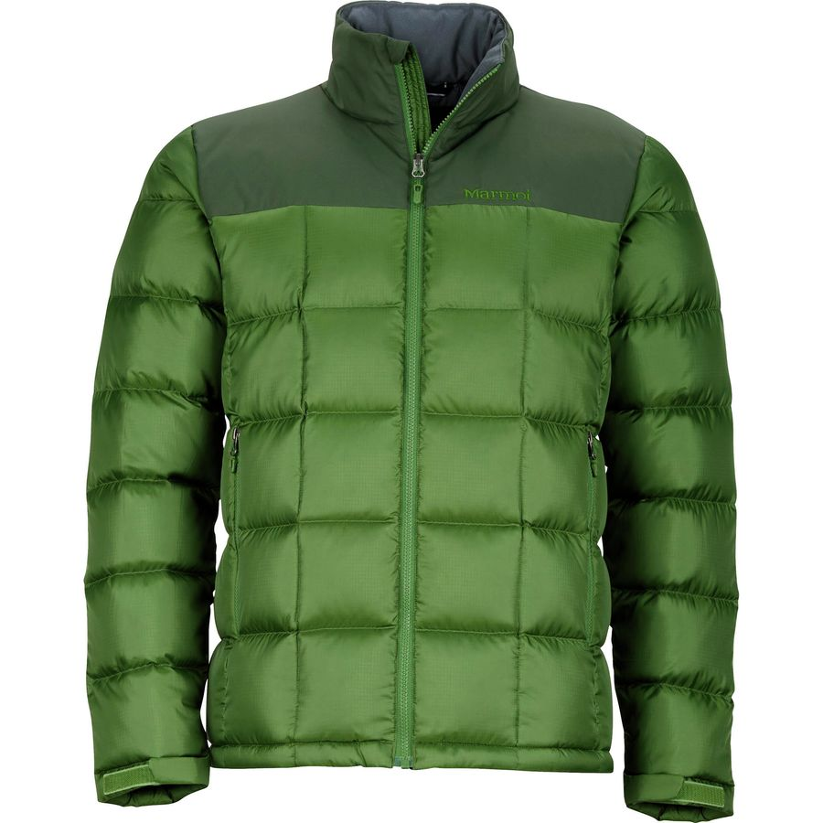

Baby it’s cold outside!
Baby it’s cold outside!
Saint’s place annual winter coat drive
Saint’s place annual winter coat drive
Help us to help out the less fortunate
Help us to help out the less fortunate
We are desperately in need of men’s women’s and children’s gently used coats, gloves and hats! Please make sure your items are in good shape, clean and the zippers work. Thank you!
We are desperately in need of men’s women’s and children’s gently used coats, gloves and hats! Please make sure your items are in good shape, clean and the zippers work. Thank you!

