Slide 1
Doctrine
A Brief Encounter with
Calvinism & Arminianism
Notes:
Today we are looking toward Doctrine: A Brief Encounter with Calvinism & Arminianism

Slide 2
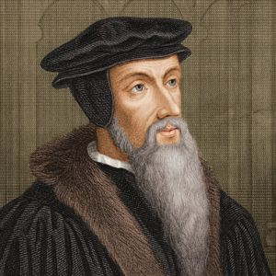
Who’s Who?
Jehan Cauvin
Notes:
Let’s first start with a brief description of some key players in this encounter were about to witness:
Click
Click Jehan Cauvin
John Calvin was an influential French theologian and pastor during the Protestant Reformation.
He was born July 10th, 1509 in Noyon, France
He became a principal figure in the development of the system of Christian theology later called Calvinism, he was a proponent in the movement in Geneva, Switzerland where he died on May 27th, 1564 ...

Slide 3
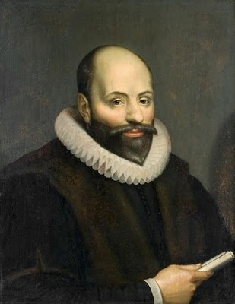
Who’s Who?
Jakob Hermanszoon
Notes:
The next key player in this encounter is:
Click this gentlemen
Click Jakob Hermanszoon was also known in the Latinized form as Jacobus or James Arminius, was a Dutch theologian during the Protestant Reformation that served as a professor in theology at the University of Leiden.
He was born on October 10th, 1560 in Oudewater, Netherlands and died October 19th, 1609 in Leiden, Netherlands.
He is most noted for his departure from the Reformed theology of the Belgic confession & the Heidelberg Catechism On Predestination resulting in what became the Calvinist-Arminian controversy addressed at the Synod of Dort (1618-1619).
So, what happened in the reformed church regarding Arminianism and Calvinism?

Slide 4
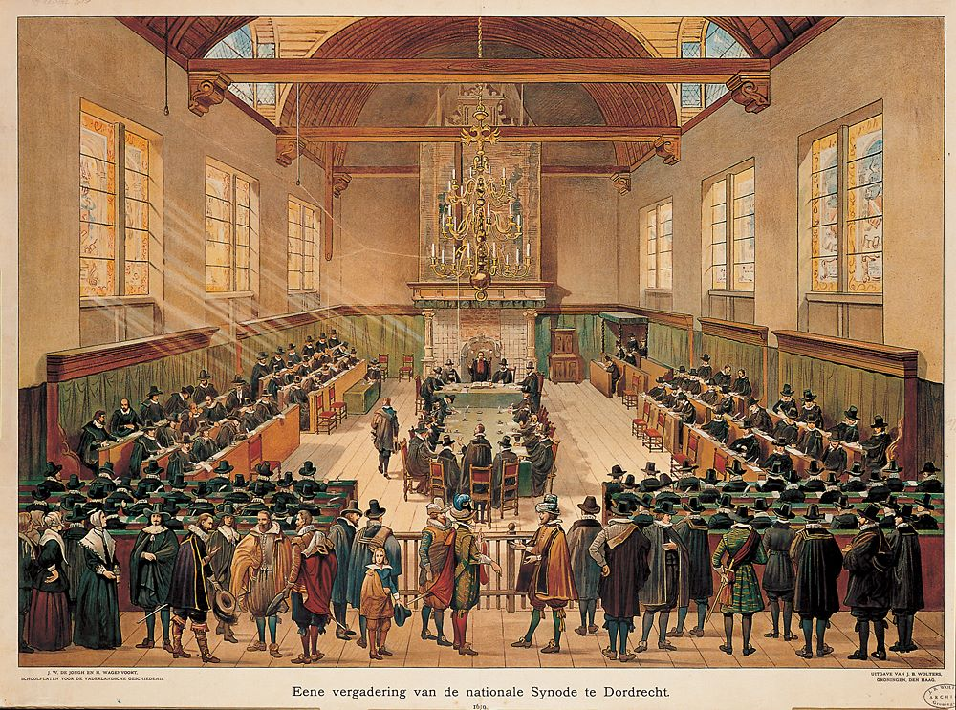
Notes:
During the Synod of Dort; Dort is a contemporary English term for the town in which this meeting was held. Dordrecht, Netherlands in 1618–1619, it was to settle a divisive controversy initiated by the rise of Arminianism. Voting representatives from eight foreign Reformed churches were also invited.
This is where 5 point Calvinism was defined, using the works of John Calvin.

Slide 5
Calvinism
Arminianism
T U L I P
otal Depravity
2 And you were dead in your trespasses and sins, ² in which you formerly walked according to the course of this world, according to the prince of the power of the air, of the spirit that is now working in the sons of disobedience. ³ Among them we too all formerly lived in the lusts of our flesh, indulging the desires of the flesh and of the mind, and were by nature children of wrath, even as the rest. Ephesians 2:1-3
Notes:
So what came out of this meeting…. Click
TULIP
First we look at T Click Total Depravity describes the desperate condition of fallen sinners. It means we are completely unwilling to submit to God and His perfect will. We are dead in our transgressions and sins.
Click Ephesians 2:1-3
2 And you were dead in your trespasses and sins, ² in which you formerly walked according to the course of this world, according to the prince of the power of the air, of the spirit that is now working in the sons of disobedience. ³ Among them we too all formerly lived in the lusts of our flesh, indulging the desires of the flesh and of the mind, and were by nature children of wrath, even as the rest.
There is a counter to TULIP -

Slide 6
Calvinism
Arminianism
T U L I P
otal Depravity
Prevenient Grace
⁴ But God, being rich in mercy, because of His great love with which He loved us, ⁵ even when we were dead in our transgressions, made us alive together with Christ (by grace you have been saved), ⁶ and raised us up with Him, and seated us with Him in the heavenly places in Christ Jesus, ⁷ so that in the ages to come He might show the surpassing riches of His grace in kindness toward us in Christ Jesus. Ephesians 2:4-10
Notes:
The Five Points of the Remonstrants. Was compiled just after Jacob Aminius’s death. Before TULIP was written out.
John Wesley also wrote regarding these differences in doctrine.
For T the Arminian view is… Click Yes, we agree with this original sin, but there is Prevenient Grace- which is grace given by God to open our eyes which have blinders on them. So, Grace before Salvation.
Click
⁴ But God, being rich in mercy, because of His great love with which He loved us, ⁵ even when we were dead in our transgressions, made us alive together with Christ (by grace you have been saved), ⁶ and raised us up with Him, and seated us with Him in the heavenly places in Christ Jesus, ⁷ so that in the ages to come He might show the surpassing riches of His grace in kindness toward us in Christ Jesus. Ephesians 2:4-10

Slide 7
Calvinism
Arminianism
T U L I P
otal Depravity
Prevenient Grace
⁸ For by grace you have been saved through faith; and that not of yourselves, it is the gift of God; ⁹ not as a result of works, so that no one may boast. ¹⁰ For we are His workmanship, created in Christ Jesus for good works, which God prepared beforehand so that we would walk in them.
Ephesians 2:4-10
Notes:
⁸ For by grace you have been saved through faith; and that not of yourselves, it is the gift of God; ⁹ not as a result of works, so that no one may boast. ¹⁰ For we are His workmanship, created in Christ Jesus for good works, which God prepared beforehand so that we would walk in them.
Ephesians 2:4-10
But is the Prevenient grace given to all people?

Slide 8
Calvinism
Arminianism
T U L I P
otal Depravity
Prevenient Grace
¹¹ For the grace of God has appeared, bringing salvation to all men, ¹² instructing us to deny ungodliness and worldly desires and to live sensibly, righteously and godly in the present age, ¹³ looking for the blessed hope and the appearing of the glory of our great God and Savior, Christ Jesus, ¹⁴ who gave Himself for us to redeem us from every lawless deed, and to purify for Himself a people for His own possession, zealous for good deeds.
Titus 2:11-14
Notes:
¹¹ For the grace of God has appeared, bringing salvation to all men, ¹² instructing us to deny ungodliness and worldly desires and to live sensibly, righteously and godly in the present age, ¹³ looking for the blessed hope and the appearing of the glory of our great God and Savior, Christ Jesus, ¹⁴ who gave Himself for us to redeem us from every lawless deed, and to purify for Himself a people for His own possession, zealous for good deeds.
Titus 2:11-14

Slide 9
Calvinism
Arminianism
T U L I P
otal Depravity
Prevenient Grace
⁸ But do not let this one fact escape your notice, beloved, that with the Lord one day is like a thousand years, and a thousand years like one day. ⁹ The Lord is not slow about His promise, as some count slowness, but is patient toward you, not wishing for any to perish but for all to come to repentance.
2 Peter 3:8-9
Notes:
⁸ But do not let this one fact escape your notice, beloved, that with the Lord one day is like a thousand years, and a thousand years like one day. ⁹ The Lord is not slow about His promise, as some count slowness, but is patient toward you, not wishing for any to perish but for all to come to repentance.
2 Peter 3:8-9

Slide 10
Calvinism
Arminianism
T U L I P
otal Depravity
Prevenient Grace
nconditional Election
Conditional
Notes:
Next is… Click Unconditional Election- another word is predestination… this is the thought that the sovereign grace of God is for a select group of people.
Now Arminians believe that it is… Click Conditional… John Wesley spoke of free grace instead of free will which is spoken of by contemporary Arminianism. He wrote and I am paraphrasing- that prevenient grace draws us to salvation, but we still have the ability to fall away or walk away from the free gift given. So, Election is conditional… We are justified by the Justifier but also by faith.

Slide 11
T U L I P
Calvinism
Arminianism
nconditional Election
Conditional
⁸ But what does it say? “The word is near you, in your mouth and in your heart”—that is, the word of faith which we are preaching, ⁹ that if you confess with your mouth Jesus as Lord, and believe in your heart that God raised Him from the dead, you will be saved; ¹⁰ for with the heart a person believes, [resulting in righteousness, and with the mouth he confesses, resulting in salvation.
Romans 10:8-10
Notes:
Click
⁸ But what does it say? “The word is near you, in your mouth and in your heart”—that is, the word of faith which we are preaching, ⁹ that if you confess with your mouth Jesus as Lord, and believe in your heart that God raised Him from the dead, you will be saved; ¹⁰ for with the heart a person believes, [resulting in righteousness, and with the mouth he confesses, resulting in salvation.
Romans 10:8-10
Key word here is “if” Ean (eh-an’); simply means if, in case – this shows that with Prevenient Grace which is given to all – we must respond to His grace.

Slide 12
T U L I P
Calvinism
Arminianism
nconditional Election
Conditional
5 Therefore, having been justified by faith, we have peace with God through our Lord Jesus Christ, ² through whom also we have obtained our introduction by faith into this grace in which we stand; and we exult in hope of the glory of God. Romans 5:1-2
Notes:
5 Therefore, having been justified by faith, we have peace with God through our Lord Jesus Christ, ² through whom also we have obtained our introduction by faith into this grace in which we stand; and we exult in hope of the glory of God. Romans 5:1-2
Introduction here is Prosagoge (pros-ag-ogue-ay’); meaning access, the act of bringing to – this is that prevenient grace spoken of earlier – but it continues Christ gave access through prevenient grace – an introduction -but it is by faith that we stand in this grace that He has freely offered. The gift of Free Grace is given – but we must accept it by Pistis (pis'-tis); a strong and welcome conviction or belief that Jesus is the Messiah, through whom we obtain eternal salvation in the kingdom of God.

Slide 13
T U L I P
Calvinism
Arminianism
nconditional Election
Conditional
imited Atonement
Unlimited
Notes:
L is for Click Limited Atonement… In other words, Christ died for only the elect, whom God had already chosen unconditionally to save.
Arminian’s believe that it is Click Unlimited- Christ’s died for all sinners alike.

Slide 14
T U L I P
Calvinism
Arminianism
imited Atonement
Unlimited
¹⁸ So then as through one transgression there resulted condemnation to all men, even so through one act of righteousness there resulted justification of life to all men.
Romans 5:18
Notes:
Click
¹⁸ So then as through one transgression there resulted condemnation to all men, even so through one act of righteousness there resulted justification of life to all men.
Romans 5:18
This verse was speaking of how sin entered the world and affected all mankind through Adam – and how true salvation came to the world through the sacrifice of Jesus Christ for all mankind.
And all is all - the word Pas (pas); means all individually, everyone and collectively it means some of all types.
God does not restrict His redemption - He offers it to all.
Men – is the word Anthropos (anth'-ro-pos); a human being, whether male or female – generically it is to include all human individuals.

Slide 15
T U L I P
Calvinism
Arminianism
imited Atonement
Unlimited
¹⁶ “For God so loved the world, that He gave His only begotten Son, that whoever believes in Him shall not perish, but have eternal life. ¹⁷ For God did not send the Son into the world to judge the world, but that the world might be saved through Him. ¹⁸ He who believes in Him is not judged; he who does not believe has been judged already, because he has not believed in the name of the only begotten Son of God. John 3:16-17
Notes:
¹⁶ “For God so loved the world, that He gave His only begotten Son, that whoever believes in Him shall not perish, but have eternal life. ¹⁷ For God did not send the Son into the world to judge the world, but that the world might be saved through Him. ¹⁸ He who believes in Him is not judged; he who does not believe has been judged already, because he has not believed in the name of the only begotten Son of God. John 3:16-17
World here is Kosmos (kos'-mos); the inhabitants of the earth, men, the human family
Whoever is that word Pas again meaning all, everyone.
Whoever believes – an act of faith toward the Free Grace given – believes - Pisteuo (pist-yoo'-o); to think to be true – those who place confidence in Him shall not perish…
Now if we continued reading, we would see…
¹⁹ This is the judgment, that the Light has come into the world, and men loved the darkness rather than the Light, for their deeds were evil. ²⁰ For everyone who does evil hates the Light, and does not come to the Light for fear that his deeds will be exposed. ²¹ But he who practices the truth comes to the Light, so that his deeds may be manifested as having been wrought in God.”
But he who practices the truth --- we see that response again to Free Grace – we spoke of truth this morning.
Aletheia (al-ay'-thi-a); which means what is true in things appertaining to God and the duties of man, it is moral and religious truth. This shows that we are to Poieo (poy-eh'-o); practice – acquire – make ready --- we need to respond to Holy Spirit’s guidance. And draw even closer to the light. Sanctified, made holy, set apart that our deeds may be manifested as having been wrought in God.

Slide 16
T U L I P
Calvinism
Arminianism
imited Atonement
Unlimited
rresistable Grace
Able to Resist
Notes:
I is Click Irresistible Grace- which is closely related to the previous two… if God elects you unconditionally, being saved by His sovereign will and Christ’s blood is sufficient for the salvation of those who are elected, then there is no way you can deny this grace given. We could not fail to respond positively to God’s grace. Now this irresistible grace is said not to violate our own wills but changes them so that we respond appropriately.
Like stated with conditional under Arminianism… Arminians believe that we have the ability to walk away or Click… resist

Slide 17
T U L I P
Calvinism
Arminianism
rresistable Grace
Able to Resist
² Behold I, Paul, say to you that if you receive circumcision, Christ will be of no benefit to you. ³ And I testify again to every man who receives circumcision, that he is under obligation to keep the whole Law. ⁴ You have been severed from Christ, you who are seeking to be justified by law; you have fallen from grace. ⁵ For we through the Spirit, by faith, are waiting for the hope of righteousness. Galatians 5:2-5
Notes:
Looking back to Romans 10 - ⁹ that if you confess with your mouth Jesus as Lord, and believe in your heart that God raised Him from the dead, you will be saved;
Click
² Behold I, Paul, say to you that if you receive circumcision, Christ will be of no benefit to you. ³ And I testify again to every man who receives circumcision, that he is under obligation to keep the whole Law. ⁴ You have been severed from Christ, you who are seeking to be justified by law; you have fallen from grace. ⁵ For we through the Spirit, by faith, are waiting for the hope of righteousness. Galatians 5:2-5
Fallen from Grace – here uses the word Ekpipto (ek-pip'-to); which means to fall down from a thing – to fall from the divine promise of salvation. Grace was given – but not accepted.
This set of verses continues…
⁶ For in Christ Jesus neither circumcision nor uncircumcision means anything, but faith working through love.
⁷ You were running well; who hindered you from obeying the truth? ⁸ This persuasion did not come from Him who calls you. ⁹ A little leaven leavens the whole lump of dough.
When it said - Him who calls you - this is Christ through Prevenient Grace.

Slide 18
T U L I P
Calvinism
Arminianism
rresistable Grace
Able to Resist
erseverance of the Saints
Conditional
Notes:
Last is Click Perseverance of the Saints… If all these other points are true, then there would be no doubt that a person would persevere.
Arminians believe this is Click… Conditional and that we can make a shipwreck of our faith. If you stay in Christ, you will persevere.

Slide 19
T U L I P
Calvinism
Arminianism
erseverance of the Saints
Conditional
⁴ For in the case of those who have once been enlightened and have tasted of the heavenly gift and have been made partakers of the Holy Spirit, ⁵ and have tasted the good word of God and the powers of the age to come, ⁶ and then have fallen away, it is impossible to renew them again to repentance, since they again crucify to themselves the Son of God and put Him to open shame.
Hebrews 6:4-12
Notes:
Click
⁴ For in the case of those who have once been enlightened and have tasted of the heavenly gift and have been made partakers of the Holy Spirit, ⁵ and have tasted the good word of God and the powers of the age to come, ⁶ and then have fallen away, it is impossible to renew them again to repentance, since they again crucify to themselves the Son of God and put Him to open shame.

Slide 20
T U L I P
Calvinism
Arminianism
erseverance of the Saints
Conditional
⁷ For ground that drinks the rain which often falls on it and brings forth vegetation useful to those for whose sake it is also tilled, receives a blessing from God; ⁸ but if it yields thorns and thistles, it is worthless and close to being cursed, and it ends up being burned. ⁹ But, beloved, we are convinced of better things concerning you, and things that accompany salvation, though we are speaking in this way. Hebrews 6:4-12
Notes:
⁷ For ground that drinks the rain which often falls on it and brings forth vegetation useful to those for whose sake it is also tilled, receives a blessing from God; ⁸ but if it yields thorns and thistles, it is worthless and close to being cursed, and it ends up being burned. ⁹ But, beloved, we are convinced of better things concerning you, and things that accompany salvation, though we are speaking in this way. Hebrews 6:4-12

Slide 21
T U L I P
Calvinism
Arminianism
erseverance of the Saints
Conditional
¹⁰ For God is not unjust so as to forget your work and the love which you have shown toward His name, in having ministered and in still ministering to the saints. ¹¹ And we desire that each one of you show the same diligence so as to realize the full assurance of hope until the end, ¹² so that you will not be sluggish, but imitators of those who through faith and patience inherit the promises. Hebrews 6:4-12
Notes:
¹⁰ For God is not unjust so as to forget your work and the love which you have shown toward His name, in having ministered and in still ministering to the saints. ¹¹ And we desire that each one of you show the same diligence so as to realize the full assurance of hope until the end, ¹² so that you will not be sluggish, but imitators of those who through faith and patience inherit the promises. Hebrews 6:4-12
In these verses we read – we see that there can be a falling away even after being enlightened and have tasted of the heavenly gift and have been made partakers of the Holy Spirit, ⁵ and have tasted the good word of God and the powers of the age to come,
In these verses on this screen, things that can accompany salvation - we see the possibility to persevere --- show diligence so as to realize the full assurance of hope.

Slide 22
T U L I P
Calvinism
Arminianism
erseverance of the Saints
Conditional
²⁶ For if we go on sinning willfully after receiving the knowledge of the truth, there no longer remains a sacrifice for sins, ²⁷ but a terrifying expectation of judgment and the fury of a fire which will consume the adversaries. ²⁸ Anyone who has set aside the Law of Moses dies without mercy on the testimony of two or three witnesses.
Hebrews 10:26-36
Notes:
²⁶ For if we go on sinning willfully after receiving the knowledge of the truth, there no longer remains a sacrifice for sins, ²⁷ but a terrifying expectation of judgment and the fury of a fire which will consume the adversaries. ²⁸ Anyone who has set aside the Law of Moses dies without mercy on the testimony of two or three witnesses. Hebrews 10:26-36

Slide 23
T U L I P
Calvinism
Arminianism
erseverance of the Saints
Conditional
²⁹ How much severer punishment do you think he will deserve who has trampled under foot the Son of God, and has regarded as unclean the blood of the covenant by which he was sanctified, and has insulted the Spirit of grace? ³⁰ For we know Him who said, “Vengeance is Mine, I will repay.” And again, “The Lord will judge His people.” ³¹ It is a terrifying thing to fall into the hands of the living God. Hebrews 10:26-36
Notes:
²⁹ How much severer punishment do you think he will deserve who has trampled under foot the Son of God, and has regarded as unclean the blood of the covenant by which he was sanctified, and has insulted the Spirit of grace? ³⁰ For we know Him who said, “Vengeance is Mine, I will repay.” And again, “The Lord will judge His people.” ³¹ It is a terrifying thing to fall into the hands of the living God.
Hebrews 10:26-36

Slide 24
T U L I P
Calvinism
Arminianism
erseverance of the Saints
Conditional
³² But remember the former days, when, after being enlightened, you endured a great conflict of sufferings, ³³ partly by being made a public spectacle through reproaches and tribulations, and partly by becoming sharers with those who were so treated. ³⁴ For you showed sympathy to the prisoners and accepted joyfully the seizure of your property, knowing that you have for yourselves a better possession and a lasting one.
Hebrews 10:26-36
Notes:
³² But remember the former days, when, after being enlightened, you endured a great conflict of sufferings, ³³ partly by being made a public spectacle through reproaches and tribulations, and partly by becoming sharers with those who were so treated. ³⁴ For you showed sympathy to the prisoners and accepted joyfully the seizure of your property, knowing that you have for yourselves a better possession and a lasting one.
Hebrews 10:26-36

Slide 25
T U L I P
Calvinism
Arminianism
erseverance of the Saints
Conditional
³⁵ Therefore, do not throw away your confidence, which has a great reward. ³⁶ For you have need of endurance, so that when you have done the will of God, you may receive what was promised.
Hebrews 10:26-36
Notes:
³⁵ Therefore, do not throw away your confidence, which has a great reward. ³⁶ For you have need of endurance, so that when you have done the will of God, you may receive what was promised.
Hebrews 10:26-36
These scriptures show that we can sin willfully after receiving the knowledge of truth. This shows a blatant disregard for the blood of the covenant by which someone was sanctified.
However, this scripture continues speaking of former days – how the people showed sympathy to prisoners – and lost their property for doing so --- knowing at the time that they have a better possession that is a lasting one. This ends with that conditional aspect toward Perseverance – Therefore, do not throw away your confidence – that free and fearless confidence that has great reward.

Slide 26
Calvinism
Arminianism
T U L I P
otal Depravity
Prevenient Grace
nconditional Election
Conditional
imited Atonement
Unlimited
rresistable Grace
Able to Resist
erseverance of the Saints
Conditional
Notes:
Now the last Letter P is what most Baptists adhere to. Many have not held to all five points of Calvinism and are kind of Calvinist Arminian Hybrids…
We could spend days going over scripture and how to interpret the Bible as a whole… but I believed God wanted us all to know these thoughts, with some corresponding scripture - so we could begin to understand what the differences are among the Body of Christ.

Slide 27
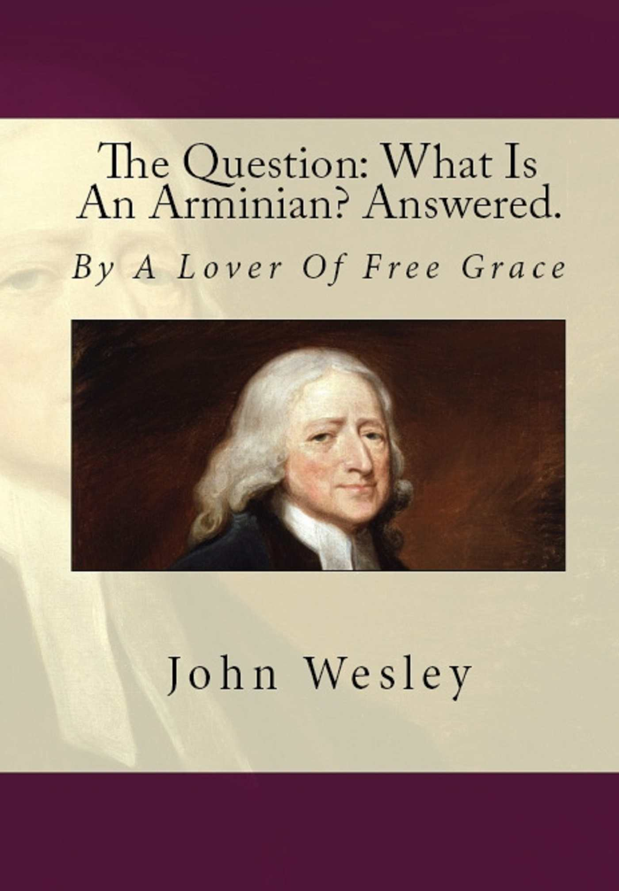
Notes:
This was printed for George Whitfield and then was sold among the Methodist Preaching Houses.
At the end of the writing John Wesley concluded…
Away then with all ambiguity: Away with all expression which only puzzle the cause. Let honest men speak out, and not play with hard words, which they do not understand: And how could any man know what Arminius held, who has never read one page of his writings? Let no man bawl against Arminians, til he knows what the term means. And then he will know that Arminians and Calvinists are just upon a level. And Arminians have as much to be angry at Calvinists, as Calvinist have to be angry at Arminians. John Calvin was a pious, learned, sensible man: And so was James Harmens. Many Calvinists are pious, learned, sensible men: And so are many Arminians. Only the former hold Absolute Predestination. The latter Conditional.
One more word it is not the duty of every Arminian Preacher, first, never in public or in private, to use the word Calvinist as a term of reproach. Seeing it is neither better nor worse than calling names. A practice no more consistent with good sense, or good manners, than it is with Christianity.
Secondly, to do all in him lies, to prevent his hearers from doing it, by showing him the sin and folly of it?
And it is not equally the duty of every Calvinist Preacher, first, never in public or in private, to use the word Arminian as a term of reproach. Secondly, to do all in him lies, to prevent his hearers from doing it, by shering them the sin and folly thereof? And more earnestly and diligently, if they have been accustom to do it? Perhaps encourage therin by his own example?
In other words, we are all part of the Body of Christ, and we need to treat others in the body as our brothers and sisters.
There can be discussion and debate in love. And sometimes there is a point where we can agree to disagree.
One thing we must understand is all denominations / non-denominations that believe that Jesus is Lord and that He died on the cross for our sins- to reconcile us to God and who was raised from the dead on the third day… those who believe that the Father is God, Jesus is God and the Holy Spirit is God all have the same cornerstone at the foundation of our faith.

