Slide 1
Prayer
Notes:
So Let’s Pray.

Slide 2
Prayer
As I arise today, may the strength of God
pilot me, the power of God uphold me,
the wisdom of God guide me.
May the eye of God look before me,
the ear of God hear me,
the word of God speak for me.
May the hand of God protect me,
the way of God lie before me,
the shield of God defend me,
the host of God save me.
Christ with me, Christ before, Christ behind me, Christ in me, Christ beneath me, Christ above me, Christ on my right, Christ on my left, Christ when I lie down, Christ when I sit, Christ when I stand, Christ in the heart of everyone who thinks of me, Christ in the mouth of everyone who speaks of me, Christ in every eye that sees me,
Christ in every ear that hears me.
Amen
Notes:
Instead of a prayer verse- today we are going to look at a prayer that was written a little while back.
As I arise today, may the strength of God
pilot me, the power of God uphold me,
the wisdom of God guide me.
May the eye of God look before me, the ear of God hear me, the word of God speak for me.
May the hand of God protect me, the way of God lie before me, the shield of God defend me, the host of God save me.
CLICK
Christ with me, Christ before, Christ behind me, Christ in me, Christ beneath me, Christ above me, Christ on my right, Christ on my left, Christ when I lie down, Christ when I sit, Christ when I stand, Christ in the heart of everyone who thinks of me, Christ in the mouth of everyone who speaks of me, Christ in every eye that sees me, Christ in every ear that hears me.
Amen
This was a prayer written by St. Patrick in 433AD and is one that gives great points to consider- we all need God to uphold us, to guide us, His eye to look before us, we ask God to hear our prayer, we need His word to speak for us- whether it is scripture opened up to us or His word given to others through us, we all need His hand to guard us, and ask that His way lie before us, God protects us.
I enjoyed reading this prayer written hundreds of years ago. It still can ring true even in our day.

Slide 3

Connections
Notes:
Today for Connections - I would like you to draw a shamrock. – and hold onto this as we will complete connections with the next slide.

Slide 4
FAITH
HOPE
LOVE
Notes:
It has been said that St. Patrick used a shamrock to show the pagans in Ireland an example of the Trinity… There is no evidence of this in any of St. Patrick’s writings or writings during the time he lived.
First lets look at a Legend that is intertwined with the Shamrock Legend; It is said that back in the fifth century St. Patrick drove the snakes from Ireland. Standing atop a hill he used his staff to herd the snakes into the sea, banishing them for eternity. Now it is true that there are no snakes in Ireland, however there are none in the fossil record which indicates that there may have never been snakes on the Emerald Isle. There are scholars who say that this Legend was a reference to Patrick ridding the Isle of Pagan believers.
Getting back to the Shamrock; Legend states that Patrick used the shamrock as a symbol to explain the Trinity to Unbelievers, Patrick would hold up a shamrock and challenge his hearers, "Is it one leaf or three?" "It is both one leaf and three," was their reply. "And so it is with God," he would conclude.
http://whatsaiththescripture.com/Fellowship/Edit_Trinity.and.Shamrock.html
The first reference written down is from the early 1800’s: It appeared in the first book ever published about Irish plants, written by Caleb Threlkeld, a British minister and doctor. In his Synopsis Stirpium Hibernicarum, Threkeld writes of white clover:
"This plant is worn by the people in their hats on the 17th day of March yearly, which is called St Patrick’s day. It being the current tradition that by this 3-leafed grass [Patrick] emblematically set forth the mystery to them of the Holy Trinity.”
He added, judgmentally: “However that be, when they wet their Seamar-oge [shamrock], they often commit Excess in Liquor … generally leading to debauchery.”
http://www.smithsonianmag.com/arts-culture/no-one-really-knows-what-shamrock-180954578/
For Connections I would ask that you write something from another belief about the Shamrock and what it represents in the lobes of the clover you drew- this belief is that one lobe of the clover represents… CLICK “FAITH”, the next is CLICK “HOPE”, and the last is CLICK “LOVE”. Now even though the tradition says that a forth represents luck. We are just going to stick to the original Shamrock of Faith Hope & Love.
Put this Shamrock in your Bible as a reminder to pray for the Body of Christ- you can think of certain people in this room or elsewhere, or of the Church as a whole- Pray that our FAITH is increased through God’s strength, through His might to uphold us, that HOPE may be revealed as the wisdom of God guides us, and as God looks before us, hears us and His word speak for us -that it is all wrapped in LOVE through our Lord Jesus Christ.
Does anyone know what verse faith, hope and love all come together in….

Slide 5

Notes:
Does anyone know what verse faith, hope and love all come together in….

Slide 6
¹³ But now faith, hope, love, abide these three; but the greatest of these is love.
1 Corinthians 13:13
Notes:
CLICK
¹³ But now faith, hope, love, abide these three; but the greatest of these is love.
1 Corinthians 13:13

Slide 7



A Shamrock Sunday
Happy
St. Patrick’s
Day
Notes:
Today for Seeking Truth – we are going to look for a Sunday Shamrock that Faith, Hope and Love shown in the History and Tradition of St. Patrick’s Day.
First of all who is St. Patrick?

Slide 8
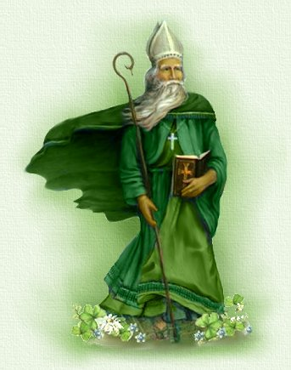
St. Patrick
Notes:
St Patrick’s birth name was Maewyn. St. Patrick is said to have been born and raised in Kilpatrick, near Dumbarton, Scotland in Roman-Britain during the 5th-century. He wrote down some insights of his journey in life:
In a writing titled “St. Patrick's Confession”
Patrick wrote:
"I, Patrick, a sinner, a most simple countryman, the least of all the faithful and most contemptible to many, had for father the deacon Calpurnius, son of the late Potitus, a presbyter, of the settlement of Bannaven Taburniae; he had a small villa nearby where I was taken captive. I was at that time about sixteen years of age. I did not, indeed, know the true God; and I was taken into captivity in Ireland with many thousands of people, according to our deserts, for quite drawn away from God, we did not keep his precepts, nor were we obedient to our presbyters who used to remind us of our salvation. And the Lord brought down on us the fury of his being and scattered us among many nations, even to the ends of the earth, where I, in my smallness, am now to be found among foreigners.“
Tradition says that after he was captured by Irish pirates during a raiding party- he was taken to Ireland as a slave to herd and tend sheep. Ireland was a land of Druids and pagans. Patrick wrote in his memoir named “Confession’” about his turning toward God, he wrote:
“The love of God and his fear grew in me more and more, as did the faith, and my soul was rosed, so that, in a single day, I have said as many as a hundred prayers and in the night, nearly the same. I prayed in the woods and on the mountain, even before dawn. I felt no hurt from the snow or ice or rain.”
It is believed that his captivity lasted until he was twenty, when he escaped after having a dream from God in which he was told to leave Ireland by going to the coast. There he found some sailors who took him back to Britain and was reunited with his family.
A few years after returning home, he wrote of a vision he had and described it in his memoir:
“I saw a man coming, as it were from Ireland. His name was Victorious, and he carried many letters, and he gave me one of them. I read the heading: ‘The Voice of the Irish.’ As I began the letter, I imagined in that moment that I heard the voice of those very people who were near the wood of Foclut, which is beside the western sea- and they cried out, as with one voice: ‘We appeal to you, holy servant boy, to come and walk among us.”
This vision is what prompted his studies for priesthood. He was ordained by St. Germanus, the Bishop of Auxerre, who he studied under for years, he was later ordained a bishop and sent to take the Gospel to Ireland.
Patrick arrived in Slane, Ireland on March 25, 433. One notable legend of his arrival is when he met the chieftain of one of the druid tribes, this chieftain was said to of tried to kill Patrick, but was unable to do so due to an intervention by God. This chieftain ended up converting to Christianity. Patrick then began a tireless journey of 40 years- spreading the Gospel throughout the land of Ireland, converting thousands, his journey was marked by churches being built across the country.
After years of living in poverty, traveling and enduring much suffering, he died at Saul, where he built the first Irish church.
His death March 17, 461AD marks the day we celebrate St. Patrick’s Day.
We can learn from tradition and history – we can imagine the fervor the zeal of those who sought out God with all their heart in the past – even like in Patrick’s case to go back to a land where he had escaped from slavery to spread the Gospel that saves… God has better things if we seek Him out.
http://whatsaiththescripture.com/Fellowship/Edit_Trinity.and.Shamrock.html
http://www.gpb.org/education/origins-of-st-patricks-day
http://www.catholic.org/saints/saintpatrick/
http://sttars.org/blog/st-patrick-the-shamrock-saint/ Patrick pic

Slide 9
⁹ But, beloved, we are convinced of better things concerning you, and things that accompany salvation, though we are speaking in this way. ¹⁰ For God is not unjust so as to forget your work and the love which you have shown toward His name, in having ministered and in still ministering to the saints. ¹¹ And we desire that each one of you show the same diligence so as to realize the full assurance of hope until the end, ¹² so that you will not be sluggish, but imitators of those who through faith and patience inherit the promises.
Hebrews 6:9-12
Notes:
Just after the writer of Hebrews spoke to importance of growing in maturity – and warned of the Peril of Falling away – Falling away - even after tasting the heavenly gift and being a partaker of Holy Spirit- the writer reminded those then and us now… of Better Things…
⁹ But, beloved, we are convinced of better things concerning you, and things that accompany salvation, though we are speaking in this way. ¹⁰ For God is not unjust so as to forget your work and the love which you have shown toward His name, in having ministered and in still ministering to the saints. ¹¹ And we desire that each one of you show the same diligence so as to realize the full assurance of hope until the end, ¹² so that you will not be sluggish, but imitators of those who through faith and patience inherit the promises.
Hebrews 6:9-12
We can learn from tradition and history – we can imagine the fervor the zeal of those who sought out God with all their heart in the past – even like in Patrick’s case to go back to a land where he had escaped from slavery to spread the Gospel that saves… God has better things if we seek Him out. If we are imitators of those who through faith and patience inherit the promises.

Slide 10
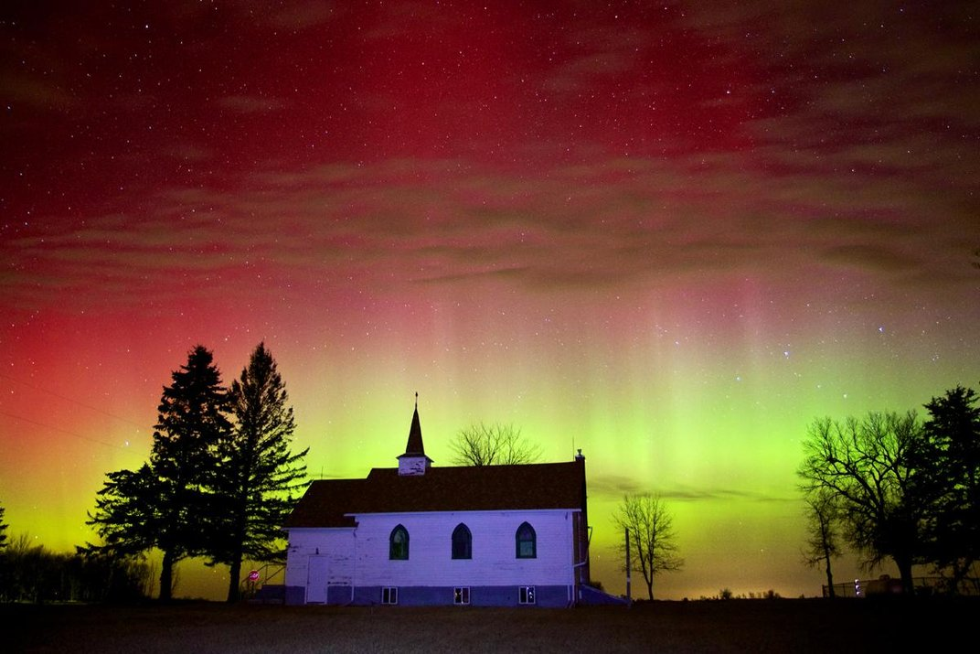
Notes:
The last time St. Patricks Day landed on a day when we were having discipleship was in 2018 Saturday Soul Retention - we talked about the history and aspects of the 3-leaf clover and St Patrick’s history and tradition --- Three years earlier I found this picture that was dated March 17th 2015 the sky was filled early in the morning with brilliant colors of red, purple and green. Data from NOAA’s (National Oceanic and Atmospheric Administration) Space Weather Prediction Center spoke of a severe solar storm that began weakly on March 17th but intensified causing northern lights that could be seen much farther south than normal – even reaching into Michigan.
This picture was taken in South Dakota by Christian Begeman.
God can always be seen in the beauty of His creation.
He even will mess with our traditions by sending us beautiful colors to look upon in the heavens.
In 2015 – He decided to show us some green – which changed in the heavens as you gaze higher to a beautiful purple showing His majesty.
http://www.smithsonianmag.com/science-nature/severe-solar-storm-paints-sky-green-st-patricks-day-180954608/

