Slide 1
History / Science
Jesus in Archaeological Sources & Non-Christian Historical Sources
Notes:
Today Knowing Truth we are going to see where Jesus is shown in archaeological sources- & non-Christian Historical Sources. We will begin with Archaeology which is the study of artifacts, bones, monuments and other objects to understand history and the culture of the day.

Slide 2
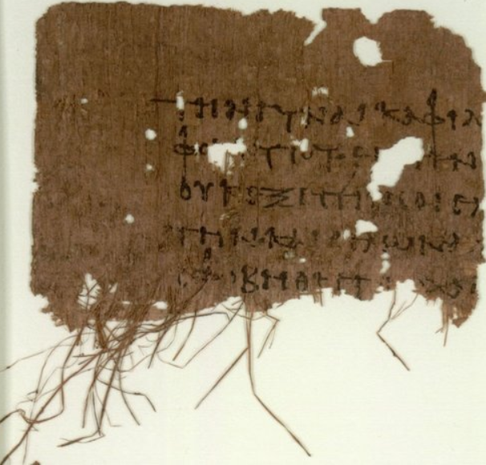
Earliest
Gospel Manuscripts About Jesus
P103 (Oxy 4403) AD 100-200
Matthew 13:55-56 & 14:3-5
Notes:
Papyrus 103 (in the Gregory-Aland numbering), designated by P¹⁰³, is a copy of part of the New Testament in Greek. It is a papyrus manuscript of the Gospel of Matthew.
Description
The surviving texts of Matthew are verses 13:55-56 and 14:3-5: they are in a fragmentary condition. The manuscript has paleographically been assigned a date from the early to middle 2nd century (100-150 C.E.) Probably together with Papyrus 77 it belonged to the same codex.
Name P. Oxy. 4403
Sign P¹⁰³
Text Gospel of Matthew 13:55-56; 14:3-5
Date 2nd / 3rd century
Script Greek
Found Oxyrhynchus, Egypt
Now at Sackler Library
Cite J. D. Thomas, OP LXIV (1997), pp. 5-7
Size [16] x [11] cm
Type Alexandrian text-type
Category I
P77 (P. Oxy. 2683 + 4405)/P103 (P. Oxy. 4403) - Christian Publishing House Blog

Slide 3
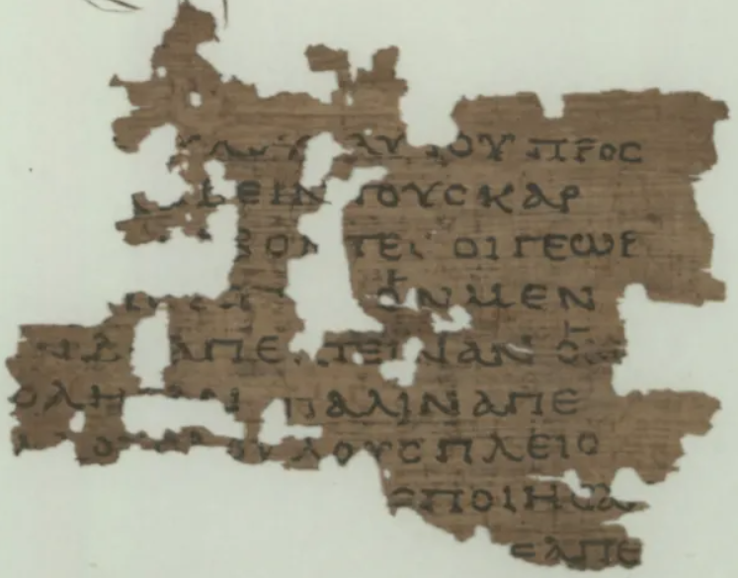
Earliest
Gospel Manuscripts About Jesus
P104 (Oxy 4404) AD 100-200
Matthew 21-34-37
Notes:
Papyrus 104 (in the Gregory-Aland numbering), designated by the symbol P¹⁰⁴, is a fragment that is part of a leaf from a papyrus codex, it measures 2.5 by 3.75 inches (6.35 by 9.5 cm) at its widest. It is conserved in the Papyrology Rooms at Sackler Library, Oxford, UK. The front (recto) contains lines from the Gospel of Matthew 21:34-37, in Greek, the back (verso) contains tentative traces of lines from verses 43 and 45.[1]
PAPYRUS 104 P104 (P. Oxy. 4404) A Very Early Greek Fragment Copy of the Gospel of Matthew - Christian Publishing House Blog

Slide 4
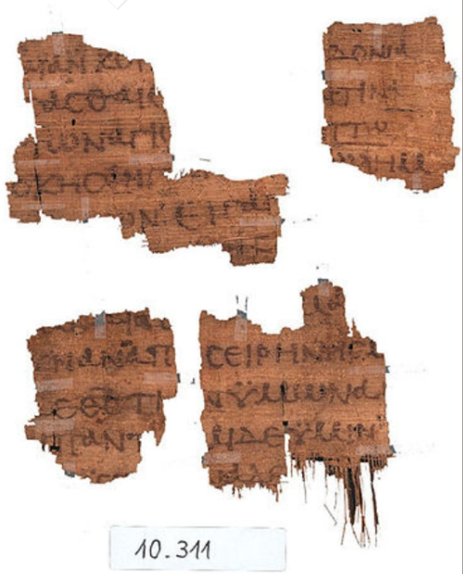
Earliest
Gospel Manuscripts About Jesus
P137 (Oxy 5345) AD 100-200
Mark 1:7-9, 16-18
Notes:
PAPYRUS 137 (Gregory-Aland numbering) is designated 𝔓¹³⁷. It is a fragment of the Gospel of Mark in Greek. It is from a codex, which is written on both sides: the recto (right/front) side containing Mark 1:7-9 and the verso (back) side containing Mark 1:16-18. P¹³⁷ has been dated paleographically to about 175-225 C.E.
PAPYRUS 137 (P137): The Recently Published Earliest Manuscript Fragment of Mark - Christian Publishing House Blog

Slide 5
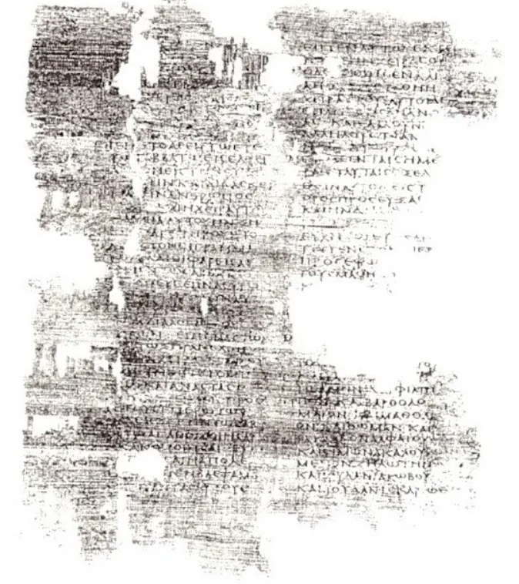
Earliest
Gospel Manuscripts About Jesus
P4 (Suppl. Gr 1120) AD 150-200
Luke 1:58-59; 1:62-2:1, 6-7; 3:8-4:2, 29-32, 34-35; 5:3-8; 5:30-6:16
Notes:
PAPYRUS 4
P⁴
Contents: Luke 1:58–59; 1:62–2:1, 6–7; 3:8–4:2, 29–32, 34–35; 5:3–8; 5:30–6:16
Date: 150–175 C.E.
Discovered: Coptos, Egypt in 1889
Housing Location: Paris, Bibliothèque Nationale, Suppl. Gr. 1120
Physical Features: P⁴ is one the earliest manuscripts of the Gospel of Luke and contains extensive sections of the first six chapters: 1:58-59; 1:62-2:1; 2:6-7; 3:8-4:2; 4:29-32, 34-35; 5:3-8; 5:30-6:16
Papyrus 4/64/67 (P4/P64/P67) Alexandrian Text Type (150-175 C.E.) - Christian Publishing House Blog

Slide 6
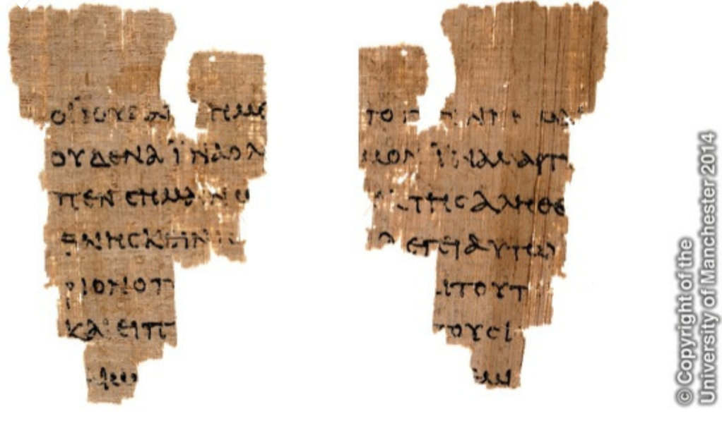
Earliest
Gospel Manuscripts About Jesus
P52 (Rylands Greek 457) AD 90-175
John 18:31-33, 37, 38
Info for Slides of Manuscripts Derived from: Excavating the Evidence for Jesus: The Archaeology and History of Christ and the Gospels Titus Kennedy & https://christianpublishinghouse.co/
Notes:
Imagine stumbling upon a hidden treasure in the most unlikely of places, a garbage heap. This treasure, however, is not a literal gem but rather something of incredible value. A century ago, a discovery was made in a rubbish pile that holds immense significance even today. What was this treasure, and why does it matter?
At the beginning of the 20th century, two scholars from the University of Oxford, Bernard P. Grenfell and Arthur S. Hunt, journeyed to Egypt. In the midst of garbage heaps near the Nile Valley, they discovered numerous papyrus fragments. Later, in 1920, while cataloging the collection, Grenfell obtained additional fragments on behalf of The John Rylands Library in Manchester, England. Unfortunately, both men passed away before completing the catalog.
Another Oxford scholar, Colin H. Roberts, took over the task. During his sorting process, he came across a small papyrus fragment measuring 3.5 by 2.4 inches (9 x 6 cm). To his surprise, the Greek text contained familiar words. One side of the fragment featured words from John 18:31-33, and the other side held parts of verses 37 and 38. Roberts had found an invaluable artifact.
Roberts believed the fragment to be quite old, but he needed to determine its age. He turned to the study of ancient writing, known as paleography, to compare the fragment’s handwriting with other dated ancient manuscripts. This method allowed him to establish an approximate age, but he sought further confirmation. He sent photographs of the fragment to three papyrologists for their expertise.
Upon examining the script and stroke styles, all three scholars agreed that the fragment was likely written in the first half of the second century AD., only a few decades after the Apostle John’s death. Although paleography isn’t a foolproof dating method, this small piece of papyrus remains the oldest known manuscript fragment of the Christian Greek Scriptures.
PAPYRUS 52 (P52) The Significance of a Priceless Discovery - Christian Publishing House Blog

Slide 7
Non-Christian Historical Evidence
SUETONIUS (ca. AD 69–130)
“Since the Jews constantly made disturbances at the instigation of Chrestus, he expelled them from Rome”
(Suetonius, Divus Claudius 25, ca. AD 121).
Acts 18:2
Excavating the Evidence for Jesus: The Archaeology and History of Christ and the Gospels Titus Kennedy & https://www.biblicalcyclopedia.com/
Notes:
SUETONIUS (ca. AD 69–130)
“Since the Jews constantly made disturbances at the instigation of Chrestus, he expelled them from Rome”
(Suetonius, Divus Claudius 25, ca. AD 121).
Acts 18:2
Chrestus, a person named by Suetonius (Claud. 25) as having incited a sedition among the Jews at Rome, which led to their expulsion from the city
Tertullian a 2nd century Christian Author – said:
Suetonius does not refer to some actual dissension between Jews and Christians, but confounds the name Christ, which was most unusual as a proper name, with the much more frequent appellation of Chrestus (see Tertullian, Apol. 3; Lactantius, Instit. 4:7, 5; Milman, Hist. of Christianity, 1:430).

Slide 8
Non-Christian Historical Evidence
LUCIAN OF SAMOSATA (ca. AD 125–180)
“He learned the wondrous lore of the Christians, by associating with their priests and scribes in Palestina…they still worship, the man who was crucified in Palestina because he introduced this new cult into the world…denying the Greek gods and by worshipping that crucified sophist himself and living under his laws” (Lucian, Passing of Peregrinus 11-13, ca. AD 166).
Excavating the Evidence for Jesus: The Archaeology and History of Christ and the Gospels Titus Kennedy & Lucian - The Passing of Peregrinus (earlychurchtexts.com)
Notes:
Lucian a Satirist - in a writing meant to be hurtful to someone named Peregrinus and toward radically out of step cynics at the time..
However, in this written satire – historical proof of Jesus was shown through this unbeliever.
LUCIAN OF SAMOSATA (ca. AD 125–180) “He learned the wondrous lore of the Christians, by associating with their priests and scribes in Palestina…they still worship, the man who was crucified in Palestina because he introduced this new cult into the world…denying the Greek gods and by worshipping that crucified sophist himself and living under his laws” (Lucian, Passing of Peregrinus 11-13, ca. AD 166).
Lucian's work can be faulted for its bias if it is read as a straightforward historical account of Peregrinus's life and death. However, it is a work of satire, with several possible purposes. His presentation of facts is sometimes motivated by his intention to attack beliefs that he viewed as disingenuous, naïve, or superstitious. Several scholars have attempted to divine Lucian's purpose in order to better judge the veracity of his account. According to Mark Edwards, satire "seeks, not truth, but the characteristic and the probable". Along these lines, Lucian shows that Peregrinus, rather than being the consummate Cynic, was actually a fake, and that early Christianity was home to the most radically out-of-step Cynics at that time. Edwards argues that Lucian's character Philosophy in The Fugitives makes a distinction between the admirable deaths of the Brahmins and the less honorable lives of the pretenders, led by Peregrinus, who only care for the appearance of these virtues in order to avoid work and accumulate wealth.
Passing of Peregrinus - Wikiwand
11. “It was then that he learned the wondrous lore of the Christians, by associating with their priests and scribes in Palestine. And—how else could it be?—in a trice he made them all look like children, for he was prophet, cult-leader, head of the synagogue, and everything, all by himself. He interpreted and explained some of their books and even composed many, and they revered him as a god, made use of him as a lawgiver, and set him down as a protector, next after that other, to be sure, whom they still worship, the man who was crucified in Palestine because he introduced this new cult into the world.
12. “Then at length Proteus was apprehended for this and thrown into prison, which itself gave him no little reputation as an asset for his future career and the charlatanism and notoriety-seeking that he was enamoured of. Well, when he had been imprisoned, the Christians, regarding the incident as a calamity, left nothing undone in the effort to rescue him. Then, as this was impossible, every other form of attention was shown him, not in any casual way but with assiduity, and from the very break of day aged widows and orphan children could be seen waiting near the prison, while their officials even slept inside with him after bribing the guards. Then elaborate meals were brought in, and sacred books of theirs were read aloud, and excellent Peregrinus—for he still went by that name—was called by them ‘the new Socrates.’
13. “Indeed, people came even from the cities in Asia, sent by the Christians at their common expense, to succour and defend and encourage the hero. They show incredible speed whenever any such public action is taken; for in no time they lavish their all. So it was then in the case of Peregrinus; much money came to him from them by reason of his imprisonment, and he procured not a little revenue from it. The poor wretches have convinced themselves, first and foremost, that they are going to be immortal and live for all time, in consequence of which they despise death and even willingly give themselves into custody; most of them. Furthermore, their first lawgiver persuaded them that they are all brothers of one another after they have transgressed once for all by denying the Greek gods and by worshipping that crucified sophist himself and living under his laws. Therefore they despise all things indiscriminately and consider them common property, receiving such doctrines traditionally without any definite evidence. So if any charlatan and trickster, able to profit by occasions, comes among them, he quickly acquires sudden wealth by imposing upon simple folk.
14. “However, Peregrinus was freed by the then governor of Syria, a man who was fond of philosophy. Aware of his recklessness and that he would gladly die in order that he might leave behind him a reputation for it, he freed him, not considering him worthy even of the usual chastisement.

Slide 9
Non-Christian Historical Evidence
THALLUS (ca. AD 50)
“[O]n the whole world there pressed a fearful darkness, and the rocks were rent by an earthquake, and many places in Judea and other districts were thrown down. Thallus calls this darkness an eclipse of the sun in the third book of histories, without reason it seems to me. For the Hebrews celebrate the Passover on the 14th day according to the moon, and the passion of our Saviour falls on the day before the Passover; but an eclipse of the sun takes place only when the moon comes under the sun” (Thallus, recorded in Julius Sextus Africanus ca. AD 220).
Excavating the Evidence for Jesus: The Archaeology and History of Christ and the Gospels Titus Kennedy & Sextus Julius Africanus | Early Church, Roman Empire, Chronography | Britannica
Notes:
THALLUS (ca. AD 50) “[O]n the whole world there pressed a fearful darkness, and the rocks were rent by an earthquake, and many places in Judea and other districts were thrown down. Thallus calls this darkness an eclipse of the sun in the third book of histories, without reason it seems to me. For the Hebrews celebrate the Passover on the 14th day according to the moon, and the passion of our Saviour falls on the day before the Passover; but an eclipse of the sun takes place only when the moon comes under the sun” (Thallus, recorded in Julius Sextus Africanus ca. AD 220).
Sextus Julius Africanus (born c. AD 180, Jerusalem—died c. 250) first Christian historian known to produce a universal chronology.

Slide 10
More!!!
The Babylonian Talmud (70AD- 200AD)
Gaius Suetonius Tranquillus (117AD-138AD)
Gaius Pinius Secundus (112AD)
Mara Bar-Serapion (late 1st to early 3rd century)
Toledoth Jesu (5th century)
Alexamenos Graffito (picture) (discovered 1857)
Notes:
Here are even more accounts of Jesus in history… Not only is Jesus shown in the historical document that we call the Bible, He is also shown in non-Christian sources. Our Faith is what we should lean on for the hope we have. This Faith is the cake… and all these sources are the icing. Faith is divine, but icing is yummy too.

Slide 11
The Megiddo Mosaic Inscription
Notes:
The last artifact we will look at tonight is one of my favorites… what do you think this is???
CLICK---The Megiddo Mosaic Inscription was unearthed by prisoners accidentally in 2005. This was found at a maximum security prison located in Megiddo, Israel. It is an ancient piece of a church floor that was 16 X 32 feet. So this maximum security prison was built on a church and this church dates to the third century AD- many believe it to be the oldest church yet discovered in the Holy Land.
The flooring is laid out with small mosaic tiles- the inscription is in Greek and describes a table offered to Christ by a female worshipper named “Akeptous” this was offered “as a memorial” it states.
One other thing that makes this discovery significant is the reference “to the God Jesus Christ” – Traditionally in this time they would underline this type of phrase but in this case it is over lined which shows an emphasis. This find by some prisoners digging around - shows us that there was an acceptance of Christianity within the borders of Israel.

