Slide 1
Prayer
Notes:
So Let’s Pray.

Slide 2
Philippians 1:3-6 NKJV
3 I thank my God upon every remembrance of you, 4 always in every prayer of mine making request for you all with joy, 5 for your fellowship in the gospel from the first day until now, 6 being confident of this very thing, that He who has begun a good work in you will complete it until the day of Jesus Christ;
Notes:
“Everyone turn to Philippians 1:3-6 NKJV
3 I thank my God upon every remembrance of you, 4 always in every prayer of mine making request for you all with joy, 5 for your fellowship in the gospel from the first day until now, 6 being confident of this very thing, that He who has begun a good work in you will complete it until the day of Jesus Christ;
Paul said in every prayer making a request for your fellowship in the gospel. Think about this as we go forward this day.

Slide 3

SHOWING TRUTH
Spiritual Disciplines
The Discipline of
Matthew 6:19-21
Koinonia (koy-nohn-ee'-ah); (Strong’s)
Word Origin: Greek, Noun Feminine
from (2844)
fellowship, association, community, communion, joint participation, intercourse
  the share which one has in anything, participation
  intercourse, fellowship, intimacy
    the right hand as a sign and pledge of fellowship (in fulfilling the apostolic office)
a gift jointly contributed, a collection, a contribution, as exhibiting an embodiment and proof of fellowship
Notes:
For Showing Truth we are going to look at the Discipline of Fellowship.
We have talked about other disciplines in the past- this one I believe is ranked #2.
What is fellowship though?
In the prayer verses…
Philippians 1:3-6 NKJV
3 I thank my God upon every remembrance of you, 4 always in every prayer of mine making request for you all with joy, 5 for your fellowship in the gospel from the first day until now, 6 being confident of this very thing, that He who has begun a good work in you will complete it until the day of Jesus Christ;
the fellowship in the Gospel was speaking of…

Slide 4

The Discipline of
Koinonia (koy-nohn-ee'-ah); (Strong’s)
Word Origin: Greek, Noun Feminine
from (2844)
fellowship, association, community, communion, joint participation, intercourse
  the share which one has in anything, participation
  intercourse, fellowship, intimacy
    the right hand as a sign and pledge of fellowship (in fulfilling the apostolic office)
a gift jointly contributed, a collection, a contribution, as exhibiting an embodiment and proof of fellowship
The Discipline of
Notes:
Koinonia (koy-nohn-ee'-ah); (Strong’s)
Word Origin: Greek, Noun Feminine
from (2844)
fellowship, association, community, communion, joint participation, intercourse
the share which one has in anything, participation
intercourse, fellowship, intimacy
the right hand as a sign and pledge of fellowship (in fulfilling the apostolic office)
a gift jointly contributed, a collection, a contribution, as exhibiting an embodiment and proof of fellowship
Intercourse 1829 Webster Dictionary
IN'TERCOURSE, noun [Latin intercursus, intercurro; inter and curro, to run.] Literally, a running or passing between. Hence,
1. Communication; commerce; connection by reciprocal dealings between persons or nations, either in common affairs and civilities, in trade, or correspondence by letters. We have an intercourse with neighbors and friends in mutual visits and in social concerns; nations and individuals have intercourse with foreign nations or individuals by an interchange of commodities, by purchase and sale, by treaties, contracts, etc.
2. Silent communication or exchange.
This sweet intercourse of looks and smiles.
Could the Gospel be a silent communication or exchange?

Slide 5
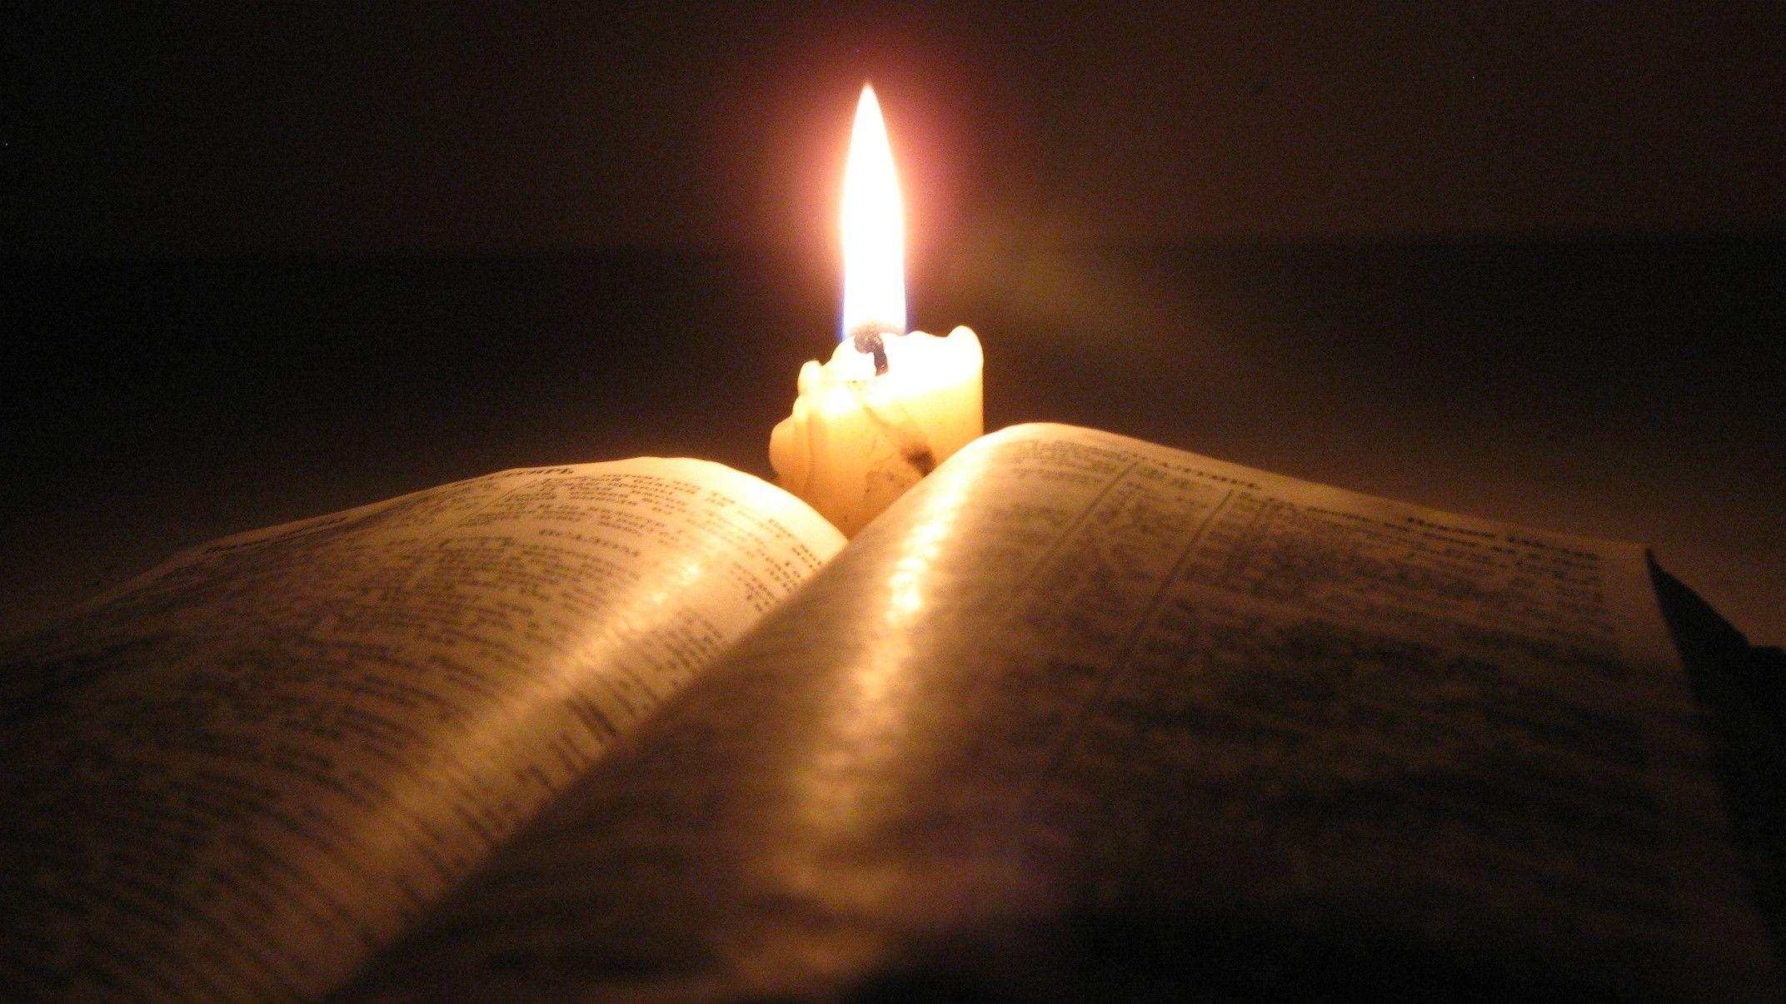
Acts 2:41,42 (MKJV)
41 Then those who gladly received his word were baptized; and that day about three thousand souls were added to them. 42 And they continued steadfastly in the apostles' doctrine and fellowship, in the breaking of bread, and in prayers.
Notes:
What does the Bible say about Fellowship?
Acts 2:41,42 (MKJV)
41 Then those who gladly received his word were baptized; and that day about three thousand souls were added to them. 42 And they continued steadfastly in the apostles' doctrine and fellowship, in the breaking of bread, and in prayers.
Can fellowship be a discipline…?

Slide 6

Discipline
1829 Webster Dictionary
DISCIPLINE, noun [Latin, to learn.]
This transitive verb is:
1. To instruct or educate; to inform the mind; to prepare by instructing in correct principles and habits; as, to discipline youth for a profession, or for future usefulness.
5. To advance and prepare by instruction.
Notes:
Let’s visit this word Discipline again first: most hear this and think punishment right away.
(But we are looking at this as a transitive verb- which means it is characterized by transition)
1. To instruct or educate; to inform the mind; to prepare by instructing in correct principles and habits; as, to discipline youth for a profession, or for future usefulness.
5. To advance and prepare by instruction.

Slide 7
1 John 1:1-10
Notes:
Let’s go back to the Bible:
Everyone turn to 1 John Chapter 1
John was the remaining apostle that was an eyewitness to Jesus’ ministry. He saw the miracles, His death, His resurrection and all the other disciples had already been martyred in Christ’s name. Before John wrote this general epistle – this letter was not to a specific church but to the church in general – the rise of Gnosticism was in this time – people who had a special knowledge… this special knowledge denied the incarnation of Jesus – they were teaching that Jesus just came in spirit and not in body – this was just the beginning of the false beliefs that would come out of Gnosticism. Chapter 1 begins by focusing on fellowship.
1 John 1 (MKJV)

Slide 8
1 John 1: (MKJV)
1 That which was from the beginning, which we have heard, which we have seen with our eyes, which we have looked upon, and our hands have handled, concerning the Word of life-
Notes:
1 John 1 (MKJV)
1 That which was from the beginning, which we have heard, which we have seen with our eyes, which we have looked upon, and our hands have handled, concerning the Word of life-

Slide 9
1 John 1: (MKJV)
2 the life was manifested, and we have seen, and bear witness, and declare to you that eternal life which was with the Father and was manifested to us-
Notes:
2 the life was manifested, and we have seen, and bear witness, and declare to you that eternal life which was with the Father and was manifested to us-

Slide 10
1 John 1: (MKJV)
3 that which we have seen and heard we declare to you, that you also may have fellowship with us; and truly our fellowship is with the Father and with His Son Jesus Christ.
De (deh);
Word Origin: Greek, Conjunction
a primary particle (adversative or continuative)
but, moreover, and, etc.
Notes:
3 that which we have seen and heard we declare to you, that you also may have fellowship with us; and truly our fellowship is with the Father and with His Son Jesus Christ.
There is more to this koinonia which is in blue –
In the verse there was a second fellowship: “and truly our fellowship is with the Father and with His Son Jesus Christ.”
John was saying when you partake in the way with us the blue fellowship-
Then this red word is used just before koinonia- CLICK
Meaning moreover-
Moreover the fellowship is with the Father and the Son… we are not sharing just things among ourselves, we are sharing the Almighty when we have true fellowship.

Slide 11
4 And these things we write to you that your joy may be full.
5 This is the message which we have heard from Him and declare to you, that God is light and in Him is no darkness at all.
Notes:
Let’s continue in the word-
4 And these things we write to you that your joy may be full.
5 This is the message which we have heard from Him and declare to you, that God is light and in Him is no darkness at all.

Slide 12
6 If we say that we have fellowship with Him, and walk in darkness, we lie and do not practice the truth.
7 But if we walk in the light as He is in the light, we have fellowship with one another, and the blood of Jesus Christ His Son cleanses us from all sin.
Notes:
6 If we say that we have fellowship with Him, and walk in darkness, we lie and do not practice the truth.
7 But if we walk in the light as He is in the light, we have fellowship with one another, and the blood of Jesus Christ His Son cleanses us from all sin.

Slide 13
8 If we say that we have no sin, we deceive ourselves, and the truth is not in us.
9 If we confess our sins, He is faithful and just to forgive us our sins and to cleanse us from all unrighteousness.
Notes:
8 If we say that we have no sin, we deceive ourselves, and the truth is not in us.
9 If we confess our sins, He is faithful and just to forgive us our sins and to cleanse us from all unrighteousness.

Slide 14
10 If we say that we have not sinned, we make Him a liar, and His word is not in us.
Notes:
10 If we say that we have not sinned, we make Him a liar, and His word is not in us.
John continues from fellowship to what fellowship is not.

Slide 15
2 Corinthians 6:14-15
Notes:
Everyone turn to 2 Corinthians 6:14-15
Paul in writing to the church in Corinth gave instruction with koinonia.

Slide 16
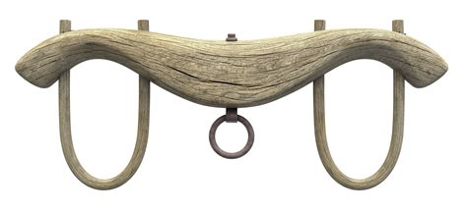
2 Corinthians 6:14-15 (MKJV)
14 Do not be unequally yoked together with unbelievers. For what fellowship has righteousness with lawlessness? And what communion has light with darkness?
15 And what accord has Christ with Belial? Or what part has a believer with an unbeliever?
ASSO'CIATING, participle present tense Uniting in company or in interest; joining.
Notes:
2 Corinthians 6:14-15 (MKJV)
14 Do not be unequally yoked together with unbelievers. For what fellowship has righteousness with lawlessness? And what communion has light with darkness?
15 And what accord has Christ with Belial? Or what part has a believer with an unbeliever?
What was Paul saying here?
Paul was referencing an illustration from the Old Testament; to not yoke together different livestock together for work…. CLICK A yoke was a wavy hunk of wood that you would put over the necks of the animals and would tie to them and to the load you were pulling or to a plow. So you wouldn’t put a yoke on a donkey and an ox, or a lamb and a horse…
But is Paul saying we should totally disconnect from the world… no… it says not to fellowship… which is communion, joint participation, uniting… If you are participating with a group that goes to the bar 3 times a month to party, or a group that disregards God in what they do, it can be destructive and cause a disconnect with God.
If you think back to the meaning of koinonia:
Fellowship or Joint participation is associating with others who believe in Christ, when we think of associate we think work and it can mean that, but there are some key words to think of: CLICK- ASSO'CIATING, participle present tense Uniting in company or in interest; joining.

Slide 17
SHOWING TRUTH
Security
Grow Spiritually
Counsel
Relationship Builder
Matthew 6:19-21
Grow Closer To God
Koinonia (koy-nohn-ee'-ah); (Strong’s)
Word Origin: Greek, Noun Feminine
from (2844)
fellowship, association, community, communion, joint participation, intercourse
  the share which one has in anything, participation
  intercourse, fellowship, intimacy
    the right hand as a sign and pledge of fellowship (in fulfilling the apostolic office)
a gift jointly contributed, a collection, a contribution, as exhibiting an embodiment and proof of fellowship
Notes:
The song We Believe shows us how we come together in one accord- we sang in harmony – people from different backgrounds in life – all calling out a song of faith.
When Soul Retention was forming through prayer – God put it on my heart to revive some old school thoughts – one was Methodist Class Meetings & Band Societies… Class Meetings are fellowship like we have here every week for Soul Retention. With Band Societies I took some aspects for - people to meet for prayer, encouragement, accountability, & friendship. These would act like a gardener through the Holy Spirit – to removed hindrances that prevent growth.
We see this thought growing in the Women of Faith gatherings… We recently set up time for some men to gather.
These types of small groups are a place where we can meet with all men or all women to grow together deeply. Holy Spirit strengthens and equips us through this type of fellowship and when we come together as a whole once a week for Soul Retention – koinonia is increased.
Would you all please pray about the church – pray for us to band together even more – to build trust, to share in encouragement, accountability, to create a soul retention through the power and guidance of our Lord and Savior as we journey together.
What are some reasons to have fellowship?
To CLICK grow closer to God, CLICK grow spiritually, CLICK security, CLICK counsel, to build relationships.

Slide 18
SHOWING TRUTH
True Friendship
Means of Holiness
by the Holy
Spirit
Love/Joy
Relationship Builder
Matthew 6:19-21
Sheds Light-Standards/Values
Koinonia (koy-nohn-ee'-ah); (Strong’s)
Word Origin: Greek, Noun Feminine
from (2844)
fellowship, association, community, communion, joint participation, intercourse
  the share which one has in anything, participation
  intercourse, fellowship, intimacy
    the right hand as a sign and pledge of fellowship (in fulfilling the apostolic office)
a gift jointly contributed, a collection, a contribution, as exhibiting an embodiment and proof of fellowship
Notes:
What does fellowship do?
CLICK Sheds light on our own standards/values, CLICK it is a means through the Holy Spirit in sanctifying us, CLICK builds our relationship with God and others, CLICK causes true friendship, CLICK shows love, brings joy… etc…

Slide 19
Practical
Applications
Of Fellowship
In Our Lives:
Have Fun Together In Christ
Prayer
Be A True Friend
Take A Time- For Koinonia
Step Out Of Your Comfort Zone
Notes:
A Practical Application Of Fellowship In Our Lives:
CLICK- First We Need To Begin To Pray About It; Ask the Holy Spirit to guide us to the fellowship that is His will.
CLICK- Take A Time That You Associate With The World & Give That Slot Of Time To Koinonia; we all have activities with the world, and scripture says to be in the world but not of it… we can give a little of this time to fellowship among the body of Christ.
CLICK- Have Fun Together In Christ; Can koinonia be fun… YES, brothers and sisters in Christ should gather to have fun… Family Fun Night on the last Wednesday of the month is a real joy. Meeting in other instances like playing a game of pool with someone or going out for an ice cream together well maybe a hot cocoa instead that is a real treat. The main thing is not to forget that when we associate together, we are in Christ. Do not leave God out of the fun you are having.
CLICK- Step Out Of Your Comfort Zone; attend a fellowship gathering, that we normally do not go to, or would even feel uncomfortable going to. Maybe God is leading us to begin a small group with people in Soul Retention including people who do not attend. Maybe there already is a group that can include others.
CLICK- After Friendships Are Established Be A True Friend; This thought is to go beyond the superficial hellos and gatherings, as a small group connects we need to get to a point where we can ask a brother or sister – how have they been doing in their walk with God, it is the ability to have any questions about scripture and talk about what God requires of us, it is when we wonder about something – whether it is a sin or not and have a place to talk to someone in confidence about it. It is not a place to fix someone – but a place where we can go for prayer – for someone to laugh along side us, or cry along side us. A place where someone will just listen – and pray, looking toward God.

