Slide 1

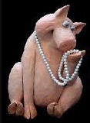
GOSPELS: Pups, Pigs & Pearls

Slide 2



GOSPELS: Pups, Pigs & Pearls
Proverbs 23:9
Do not speak in the hearing of a fool,
For he will despise the wisdom of your words.
Matthew 7:6
6 “Do not give what is holy to dogs, and do not throw your pearls before swine, or they will trample them under their feet, and turn and tear you to pieces.
Notes:
Right after Jesus spoke about pulling the beam out of your eye before looking to remove the speck in your brothers' eye… He said this comment about dogs and swine – let’s look at this first part of the scripture… “Do not give what is holy to dogs,…”
If we just look at the words in Greek – it reveals some meaning…
CLICK
Holy is Hagios (hag'-ee-os); meaning most holy thing.
CLICK
Dogs is Kuon (koo'-ohn); meaning a dog, but metaphorically meaning a man of impure mind, an impudent man – which is a shameless man that is bold while despising others.
Now this dog here is too cute to represent Kuon (koo'-ohn)… this is better pictured as….

Slide 3
GOSPELS: Pups, Pigs & Pearls
Proverbs 23:9
Do not speak in the hearing of a fool,
For he will despise the wisdom of your words.
Matthew 7:6
6 “Do not give what is holy to dogs, and do not throw your pearls before swine, or they will trample them under their feet, and turn and tear you to pieces.
Notes:
I have read that it is believed this principle of Jesus was proven by His physical ministry here on earth – He did not perform miracles for unbelievers. Which is shown a little later in Matthew and other Gospels – think about it - when He visited Nazareth, He did not do many mighty works there because of their unbelief.
What is holy is not just miracles given – it is the Gospel spoken.

Slide 4
GOSPELS: Pups, Pigs & Pearls
Proverbs 23:9
Do not speak in the hearing of a fool,
For he will despise the wisdom of your words.
Matthew 7:6
6 “Do not give what is holy to dogs, and do not throw your pearls before swine, or they will trample them under their feet, and turn and tear you to pieces.
Notes:
Proverbs 23:9
Do not speak in the hearing of a fool,
For he will despise the wisdom of your words.

Slide 5



GOSPELS: Pups, Pigs & Pearls
Proverbs 23:9
Do not speak in the hearing of a fool,
For he will despise the wisdom of your words.
Matthew 7:6
6 “Do not give what is holy to dogs, and do not throw your pearls before swine, or they will trample them under their feet, and turn and tear you to pieces.
Notes:
The second part of this scripture is:
and do not throw your pearls before swine, or they will trample them under their feet, and turn and tear you to pieces.
CLICK
Looking at throw – we see the word Ballo (bal'-lo); meaning to throw or let go of a thing without caring where it falls.
CLICK
Pearls or Margarites (mar-gar-ee'-tace); is a literal pearl but is also a proverb, a word of great value.
Swine were known as unclean animals – and have shown to not appreciate what is valuable.
It says: or they will trample them… CLICK
Katapateo (kat-ap-at-eh'-o); means to trample but also metaphorically means to treat with rudeness and insult, to treat with insulting neglect.
This could go beyond verbal abuse and become a physical retaliation – KJV says rend you… which means to rip apart.
There is another story about a different kind of dog than what we witnessed earlier.

Slide 6
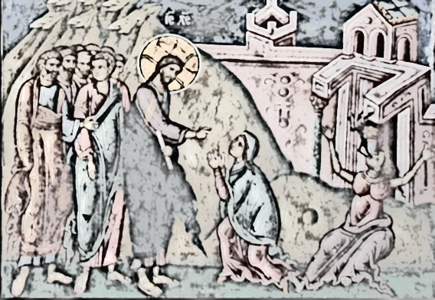
Notes:
So what does this painting have to do with dogs…

Slide 7
Matthew 15:21-28
21 Jesus went away from there, and withdrew into the district of Tyre and Sidon. 22 And a Canaanite woman from that region came out and began to cry out, saying, “Have mercy on me, Lord, Son of David; my daughter is cruelly demon-possessed.” 23 But He did not answer her a word. And His disciples came and implored Him, saying, “Send her away, because she keeps shouting at us.”
Notes:
So what does this painting have to do with dogs…
CLICK
This was a story about a Syrophoenician woman who came to the Savior.
Matthew 15:21-28
21 Jesus went away from there, and withdrew into the district of Tyre and Sidon. 22 And a Canaanite woman from that region came out and began to cry out, saying, “Have mercy on me, Lord, Son of David; my daughter is cruelly demon-possessed.” 23 But He did not answer her a word. And His disciples came and implored Him, saying, “Send her away, because she keeps shouting at us.”

Slide 8
Matthew 15:21-28
24 But He answered and said, “I was sent only to the lost sheep of the house of Israel.” 25 But she came and began to bow down before Him, saying, “Lord, help me!” 26 And He answered and said, “It is not [good to take the children’s bread and throw it to the dogs.” 27 But she said, “Yes, Lord; but even the dogs feed on the crumbs which fall from their masters’ table.” 28 Then Jesus said to her, “O woman, your faith is great; it shall be done for you as you wish.” And her daughter was healed at once.
Notes:
Matthew 15:21-28
24 But He answered and said, “I was sent only to the lost sheep of the house of Israel.” 25 But she came and began to bow down before Him, saying, “Lord, help me!” 26 And He answered and said, “It is not [good to take the children’s bread and throw it to the dogs.” 27 But she said, “Yes, Lord; but even the dogs feed on the crumbs which fall from their masters’ table.” 28 Then Jesus said to her, “O woman, your faith is great; it shall be done for you as you wish.” And her daughter was healed at once.

Slide 9
Mark 7:24-30
24 Jesus got up and went away from there to the region of Tyre. And when He had entered a house, He wanted no one to know of it; yet He could not escape notice. 25 But after hearing of Him, a woman whose little daughter had an unclean spirit immediately came and fell at His feet. 26 Now the woman was a Gentile, of the Syrophoenician race. And she kept asking Him to cast the demon out of her daughter.
Notes:
This story was also told from a different perspective in the book of Mark.
Mark 7:24-30
24 Jesus got up and went away from there to the region of Tyre. And when He had entered a house, He wanted no one to know of it; yet He could not escape notice. 25 But after hearing of Him, a woman whose little daughter had an unclean spirit immediately came and fell at His feet. 26 Now the woman was a Gentile, of the Syrophoenician race. And she kept asking Him to cast the demon out of her daughter.

Slide 10
Mark 7:24-30
27 And He was saying to her, “Let the children be satisfied first, for it is not good to take the children’s bread and throw it to the dogs.” 28 But she answered and said to Him, “Yes, Lord, but even the dogs under the table feed on the children’s crumbs.” 29 And He said to her, “Because of this answer go; the demon has gone out of your daughter.” 30 And going back to her home, she found the child lying on the bed, the demon having left.
Notes:
Mark 7:24-30
27 And He was saying to her, “Let the children be satisfied first, for it is not good to take the children’s bread and throw it to the dogs.” 28 But she answered and *said to Him, “Yes, Lord, but even the dogs under the table feed on the children’s crumbs.” 29 And He said to her, “Because of this answer go; the demon has gone out of your daughter.” 30 And going back to her home, she found the child lying on the bed, the demon having left.

Slide 11
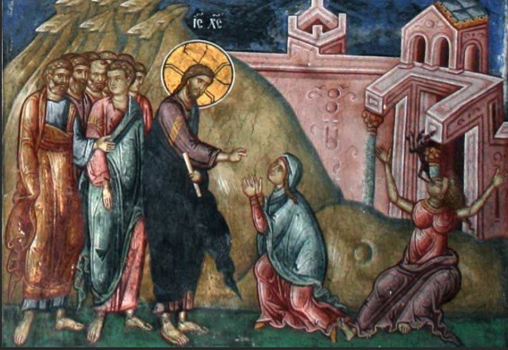
Notes:
Jesus was not seeking to have a public ministry in Tyre – It is thought to have possibly been a place for Him to get some rest from the havoc of the Sadducees and to disciple the 12 before His crucifixion… but word spreads fast when God on earth walks into town.
Even though Jesus was sent for the lost sheep of Israel – His earthly ministry touched those who were not of the sheepfold yet. People who were outsiders came and worshipped the one true God… even though others were trying to turn them away.
The dog mentioned in this Gospel story – is not one of the Kuon (koo'-ohn) from the last Gospel message but a… Kunarion (koo-nar'-ee-on); which means a little dog, this would be a domesticated dog…

Slide 12
Notes:
CLICK
We have seen with the first Gospel that there are dogs and pigs that will reject the saving message of the gospel. That in some cases the Pearl of Great Price… is not accepted and even rejected harshly – or even thought of as insignificant….
I heard one pastor in the past say that – these dogs and swine need a different type of evangelism – he called it pre-evangelism… which is prayer and true love shown to them by action.
There are times where we must wait on the prevenient grace of God – to go from these…

Slide 13
Notes:
To this…
People must recognize a need - before receiving a solution.

