Slide 1

Notes:
For Seeking Truth, we are going to begin with scripture to find what God’s message is for us…
Some of these may be familiar – lets work together to see the setting and figure out God’s message.

Slide 2
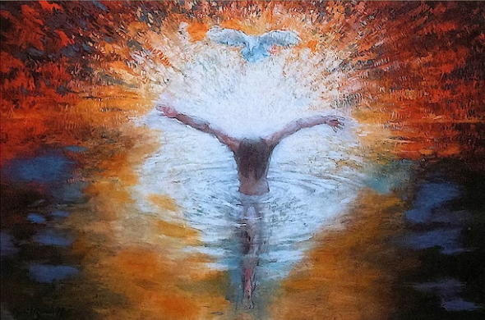
Matthew 3:17
And suddenly a voice came from heaven, saying, "This is My beloved Son, in whom I am well pleased.“
Notes:
Matthew
3:17 And suddenly a voice came from heaven, saying, "This is My beloved Son, in whom I am well pleased.“
What was happening at this time?
CLICK Jesus Baptism

Slide 3
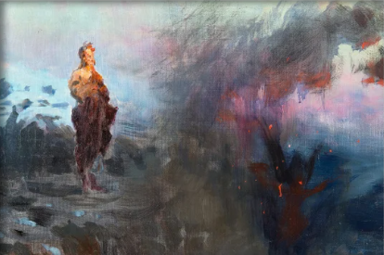
Matthew 4:3-4
3 Now when the tempter came to Him, he said, "If You are the Son of God, command that these stones become bread."
4 But He answered and said, "It is written, 'Man shall not live by bread alone, but by every word that proceeds from the mouth of God.' "
Notes:
Matthew 4:3-4
3 Now when the tempter came to Him, he said, "If You are the Son of God, command that these stones become bread."
4 But He answered and said, "It is written, 'Man shall not live by bread alone, but by every word that proceeds from the mouth of God.' "
Can anyone recall what was going on here?
CLICK Jesus was being tempted by Satan.

Slide 4
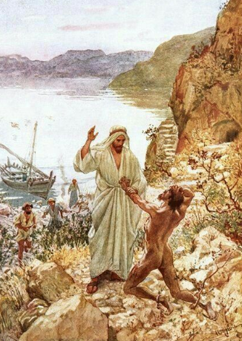
Matthew 8:29
And suddenly they cried out, saying, "What have we to do with You, Jesus, You Son of God? Have You come here to torment us before the time?"
Notes:
Matthew
8:29 And suddenly they cried out, saying, "What have we to do with You, Jesus, You Son of God? Have You come here to torment us before the time?"
What was happening here?
CLICK Jesus called out the demons from men and they called His name and asked that they be allowed to enter swine instead of being cast into the abyss.

Slide 5
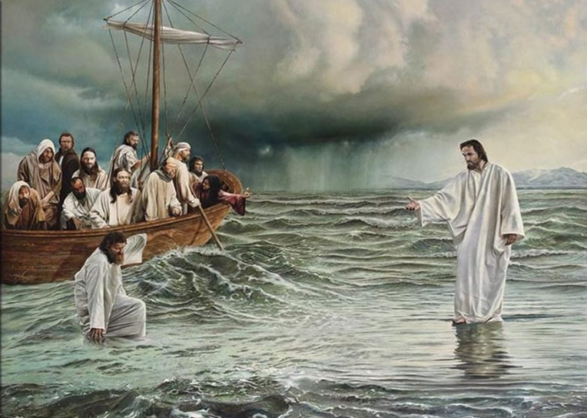
Matthew 14:33
Then those who were in the boat came and worshiped Him, saying, "Truly You are the Son of God."
Notes:
Matthew
14:33 Then those who were in the boat came and worshiped Him, saying, "Truly You are the Son of God."
What happened just before they worshipped Christ?
CLICK Peter walked on water toward Jesus then began to sink.

Slide 6
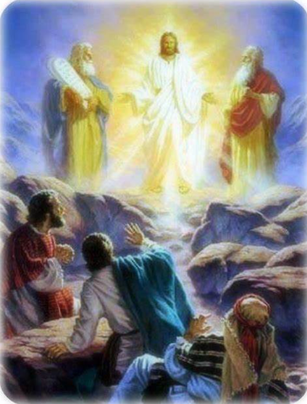
Matthew 17:5
While he was still speaking, behold, a bright cloud overshadowed them; and suddenly a voice came out of the cloud, saying, "This is My beloved Son, in whom I am well pleased. Hear Him!"
Notes:
Matthew
17:5 While he was still speaking, behold, a bright cloud overshadowed them; and suddenly a voice came out of the cloud, saying, "This is My beloved Son, in whom I am well pleased. Hear Him!"
When did this occur? CLICK The transfiguration.

Slide 7
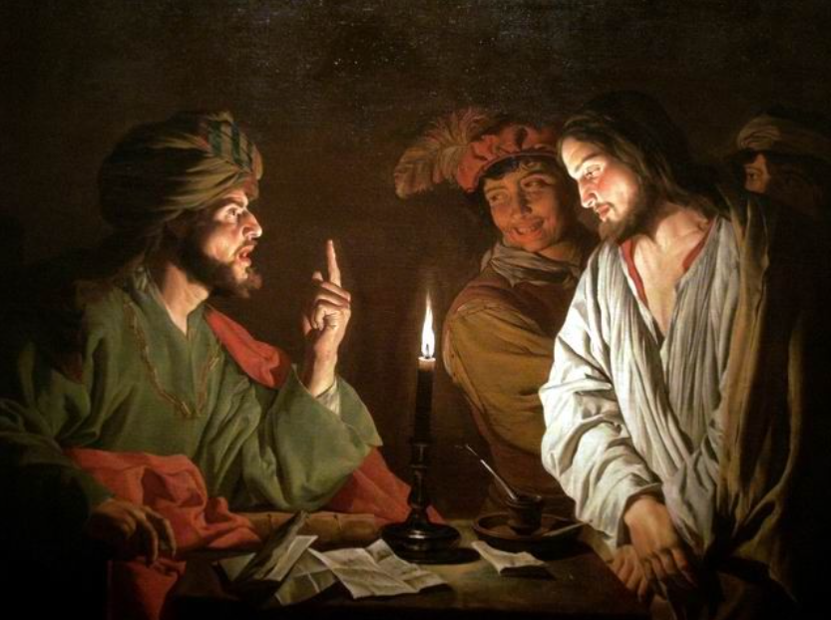
Matthew 26:63
But Jesus kept silent. And the high priest answered and said to Him, "I put You under oath by the living God: Tell us if You are the Christ, the Son of God!"
Notes:
Matthew
26:63 But Jesus kept silent. And the high priest answered and said to Him, "I put You under oath by the living God: Tell us if You are the Christ, the Son of God!"
Anyone know who this high priest is?
CLICK Jesus was being grilled by the Caiaphas… but listen how He answered him.
64 Jesus said to him, "It is as you said. Nevertheless, I say to you, hereafter you will see the Son of Man sitting at the right hand of the Power, and coming on the clouds of heaven."

Slide 8
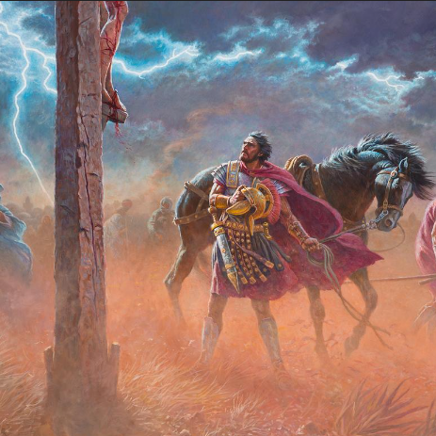
Matthew 27:54
So when the centurion and those with him, who were guarding Jesus, saw the earthquake and the things that had happened, they feared greatly, saying, "Truly this was the Son of God!"
Notes:
Matthew
27:54 So when the centurion and those with him, who were guarding Jesus, saw the earthquake and the things that had happened, they feared greatly, saying, "Truly this was the Son of God!"
CLICK Jesus crucifixion and the aftermath even opened eyes of those who were guarding Him.

Slide 9
Mark
1:11 Then a voice came from heaven, "You are My beloved Son, in whom I am well pleased."
3:11 And the unclean spirits, whenever they saw Him, fell down before Him and cried out, saying, "You are the Son of God.“
5:7 And he cried out with a loud voice and said, "What have I to do with You, Jesus, Son of the Most High God? I implore You by God that You do not torment me."
9:7 And a cloud came and overshadowed them; and a voice came out of the cloud, saying, "This is My beloved Son. Hear Him!"
14:61-62 But He kept silent and answered nothing. Again the high priest asked Him, saying to Him, "Are You the Christ, the Son of the Blessed?"
Jesus said, "I am. And you will see the Son of Man sitting at the right hand of the Power, and coming with the clouds of heaven."
Notes:
The Gospels fill in the paintings of these moments – revealing different perspectives…
Let’s look at the Gospel according to Mark:
Mark
1:11 Then a voice came from heaven, "You are My beloved Son, in whom I am well pleased."
Christ’s Baptism.
3:11 And the unclean spirits, whenever they saw Him, fell down before Him and cried out, saying, "You are the Son of God.“
The unclean spirits and demons knew who Jesus was.
5:7 And he cried out with a loud voice and said, "What have I to do with You, Jesus, Son of the Most High God? I implore You by God that You do not torment me."
Legion – who was many demons – previously in Matthew the ones who went into the swine.
9:7 And a cloud came and overshadowed them; and a voice came out of the cloud, saying, "This is My beloved Son. Hear Him!"
Transfiguration recounted.
14:61-62 But He kept silent and answered nothing. Again the high priest asked Him, saying to Him, "Are You the Christ, the Son of the Blessed?"
Jesus said, "I am. And you will see the Son of Man sitting at the right hand of the Power, and coming with the clouds of heaven.“
Jesus before the high priest.

Slide 10
Luke
1:32 "He will be great, and will be called the Son of the Highest; and the Lord God will give Him the throne of His father David.
35 And the angel answered and said to her, "The Holy Spirit will come upon you, and the power of the Highest will overshadow you; therefore, also, that Holy One who is to be born will be called the Son of God.
3:22 And the Holy Spirit descended in bodily form like a dove upon Him, and a voice came from heaven which said, "You are My beloved Son; in You I am well pleased."
4:41 And demons also came out of many, crying out and saying, "You are the Christ, the Son of God!" And He, rebuking them, did not allow them to speak, for they knew that He was the Christ.
9:35 And a voice came out of the cloud, saying, "This is My beloved Son. Hear Him!"
22:70 Then they all said, "Are You then the Son of God?" So He said to them, "You rightly say that I am."
Notes:
Luke
1:32 "He will be great, and will be called the Son of the Highest; and the Lord God will give Him the throne of His father David.
When was this? An angel of the Lord spoke to Mary about her pregnancy to come. The angel explained more in verse 35.
35 And the angel answered and said to her, "The Holy Spirit will come upon you, and the power of the Highest will overshadow you; therefore, also, that Holy One who is to be born will be called the Son of God.
3:22 And the Holy Spirit descended in bodily form like a dove upon Him, and a voice came from heaven which said, "You are My beloved Son; in You I am well pleased."
The baptism of Christ recounted.
9:7 And a cloud came and overshadowed them; and a voice came out of the cloud, saying, "This is My beloved Son. Hear Him!"
Transfiguration recounted.
22:70 Then they all said, "Are You then the Son of God?" So He said to them, "You rightly say that I am."
Chief priests and elders.

Slide 11
John
1:34 "And I have seen and testified that this is the Son of God."
49 Nathanael answered and said to Him, "Rabbi, You are the Son of God! You are the King of Israel!"
3:16 "For God so loved the world that He gave His only begotten Son, that whoever believes in Him should not perish but have everlasting life.
18 "He who believes in Him is not condemned; but he who does not believe is condemned already, because he has not believed in the name of the only begotten Son of God.
5:25 "Most assuredly, I say to you, the hour is coming, and now is, when the dead will hear the voice of the Son of God; and those who hear will live.
9:35 Jesus heard that they had cast him out; and when He had found him, He said to him, "Do you believe in the Son of God?"
Notes:
John
1:34 "And I have seen and testified that this is the Son of God."
This was John the Baptist proclaiming Christ as the Son of God.
49 Nathanael answered and said to Him, "Rabbi, You are the Son of God! You are the King of Israel!"
Who was this Nathanael guy? Jesus saw His heart that he had no deceit… before Philip called Nathanael Jesus saw him under the fig tree… I think there is more to that story – maybe Nathanael was speaking to God at that time… and the Christ heard him.
3:16 "For God so loved the world that He gave His only begotten Son, that whoever believes in Him should not perish but have everlasting life.
Christ was speaking to Nicodemus about being born again and continues in verse 18.
18 "He who believes in Him is not condemned; but he who does not believe is condemned already, because he has not believed in the name of the only begotten Son of God.
5:25 "Most assuredly, I say to you, the hour is coming, and now is, when the dead will hear the voice of the Son of God; and those who hear will live.
This was in many verses when Jesus spoke to the Jews who wanted to persecute Him for healing on the Sabbath.
9:35 Jesus heard that they had cast him out; and when He had found him, He said to him, "Do you believe in the Son of God?"
Now this was the blind man that Jesus healed – he was brought before the Pharisees and said Jesus healed him… after a while they cast him out.
Look at this response to Jesus by the once blind man.
36 He answered and said, "Who is He, Lord, that I may believe in Him?"
37 And Jesus said to him, "You have both seen Him and it is He who is talking with you."
38 Then he said, "Lord, I believe!" And he worshiped Him.
He not only could see physically – he saw who God is spiritually.

Slide 12
John
10:36 "do you say of Him whom the Father sanctified and sent into the world, 'You are blaspheming,' because I said, 'I am the Son of God’?
19:7 The Jews answered him, "We have a law, and according to our law He ought to die, because He made Himself the Son of God."
20:30-31 And truly Jesus did many other signs in the presence of His disciples, which are not written in this book; but these are written that you may believe that Jesus is the Christ, the Son of God, and that believing you may have life in His name.
Notes:
John
10:36 "do you say of Him whom the Father sanctified and sent into the world, 'You are blaspheming,' because I said, 'I am the Son of God’?
This was on Solomon’s porch where Jesus spoke to those who were about to stone Him.
19:7 The Jews answered him, "We have a law, and according to our law He ought to die, because He made Himself the Son of God."
Jesus was brought before Pilate who found no fault in Him and was somewhat forced to do the will of those bring charges against Christ.
20:30-31 And truly Jesus did many other signs in the presence of His disciples, which are not written in this book; but these are written that you may believe that Jesus is the Christ, the Son of God, and that believing you may have life in His name.
Who here has watch Jeopardy?
If you had to sum up all of these into a question what would that question be?

Slide 13


SON of GOD
Notes:
Who here has watched Jeopardy?
Think about if you had to sum up all of these scriptures that we read through - into a question- what would that question be?

Slide 14
SON of GOD
Notes:
Jeopardy would have a category called “Son of God”
Son of God for 2000
Then Alex would give a clue: “He clamed to be the Son of God – which meant He Himself is God”
We would hit the buzzer and shout out:

Slide 15
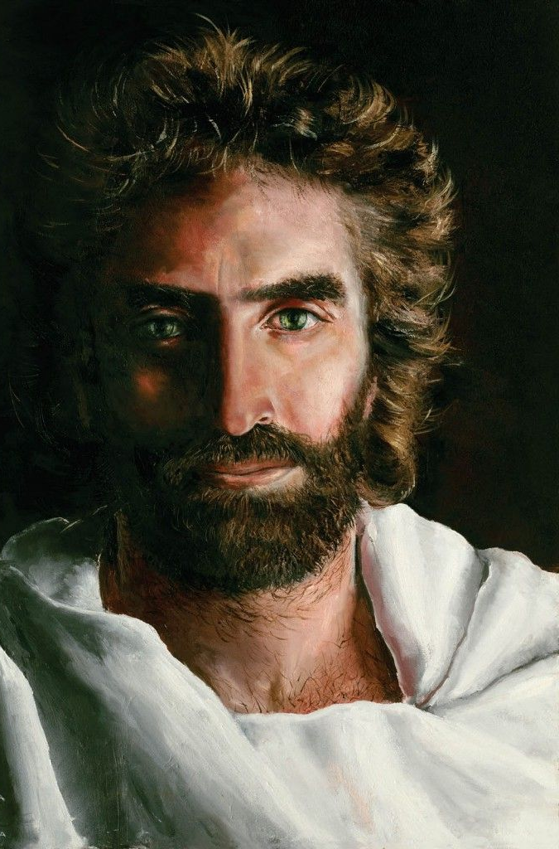
Who is Jesus Christ?
Painting By:
Akiane Kramarik
Notes:
CLICK Who is Jesus Christ?

Slide 16
There is Something about that Name
Notes:
Who is Jesus Christ?

Slide 17
John
5:18 Therefore the Jews sought all the more to kill Him, because He not only broke the Sabbath, but also said that God was His Father, making Himself equal with God.
14:6 Jesus said to him, "I am the way, the truth, and the life. No one comes to the Father except through Me.
10:9-10 "I am the door. If anyone enters by Me, he will be saved, and will go in and out and find pasture.
"The thief does not come except to steal, and to kill, and to destroy. I have come that they may have life, and that they may have it more abundantly.
6:35 And Jesus said to them, "I am the bread of life. He who comes to Me shall never hunger, and he who believes in Me shall never thirst.
Notes:
We know the question now. Let’s read on…
John
5:18 Therefore the Jews sought all the more to kill Him, because He not only broke the Sabbath, but also said that God was His Father, making Himself equal with God.
Saying that He was the Son of God made Him equal to God John 5:18… But when we look at Jesus and what He said about Himself did he make it known that He was God?
Let’s just look in the Gospel of John and see if it points to Him being God.
14:6 Jesus said to him, "I am the way, the truth, and the life. No one comes to the Father except through Me.
We see in this verse- Jesus was making it clear that there is only one way to God- not many ways.
These next verses show that Salvation is through Jesus Christ.
10:9-10 "I am the door. If anyone enters by Me, he will be saved, and will go in and out and find pasture.
"The thief does not come except to steal, and to kill, and to destroy. I have come that they may have life, and that they may have it more abundantly.
6:35 And Jesus said to them, "I am the bread of life. He who comes to Me shall never hunger, and he who believes in Me shall never thirst.

Slide 18
John
11:25-26 Jesus said to her, "I am the resurrection and the life. He who believes in Me, though he may die, he shall live.
"And whoever lives and believes in Me shall never die. Do you believe this?"
4:25-26 The woman said to Him, "I know that Messiah is coming" (who is called Christ). "When He comes, He will tell us all things."
Jesus said to her, "I who speak to you am He."
8:58 Jesus said to them, "Most assuredly, I say to you, before Abraham was, I AM."
17:5 "And now, O Father, glorify Me together with Yourself, with the glory which I had with You before the world was.
Notes:
John
11:25-26 Jesus said to her, "I am the resurrection and the life. He who believes in Me, though he may die, he shall live.
"And whoever lives and believes in Me shall never die. Do you believe this?"
4:25-26 The woman said to Him, "I know that Messiah is coming" (who is called Christ). "When He comes, He will tell us all things."
Jesus said to her, "I who speak to you am He."
These next verses we see He is eternal.
8:58 Jesus said to them, "Most assuredly, I say to you, before Abraham was, I AM."
Jesus not only spoke of Himself as eternal here – He called Himself the “I AM” which God the Father called himself when speaking to Moses- this comment ruffled some feathers among the Jews.
17:5 "And now, O Father, glorify Me together with Yourself, with the glory which I had with You before the world was.
This verse speaks for itself about Christ as God.

Slide 19

John
14:9-11 Jesus said to him, "Have I been with you so long, and yet you have not known Me, Philip? He who has seen Me has seen the Father; so how can you say, 'Show us the Father'?
"Do you not believe that I am in the Father, and the Father in Me? The words that I speak to you I do not speak on My own authority; but the Father who dwells in Me does the works.
"Believe Me that I am in the Father and the Father in Me, or else believe Me for the sake of the works themselves.
10:30 "I and My Father are one."
Ego (eg-o') Kai (kahee) Pater (pat-ayr') Esmen (es-men') Heis (hice)
Notes:
John
14:9-11 Jesus said to him, "Have I been with you so long, and yet you have not known Me, Philip? He who has seen Me has seen the Father; so how can you say, 'Show us the Father'?
"Do you not believe that I am in the Father, and the Father in Me? The words that I speak to you I do not speak on My own authority; but the Father who dwells in Me does the works.
"Believe Me that I am in the Father and the Father in Me, or else believe Me for the sake of the works themselves.
Lets look at what He is saying in a shorter form:
10:30 "I and My Father are one."
But does this truly mean this in the original language?
CLICK
If we read this from the right to the left it says this:
CLICK
Ego (eg-o') Kai (kahee) Pater (pat-ayr') Esmen (es-men') Heis (hice)
Ego meaning- I,me,my
Kai meaning- and, also, even, indeed, but
Pater meaning God is called the Father
of the stars, the heavenly luminaries, because he is their creator, upholder, ruler
of all rational and intelligent beings, whether angels or men, because he is their creator, preserver, guardian and protector
of spiritual beings and of all men
of Christians, as those who through Christ have been exalted to a specially close and intimate relationship with God, and who no longer dread him as a stern judge of sinners, but revere him as their reconciled and loving Father
the Father of Jesus Christ, as one whom God has united to himself in the closest bond of love and intimacy, made acquainted with his purposes, appointed to explain and carry out among men the plan of salvation, and made to share also in his own divine nature
by Jesus Christ himself
by the apostles
Esmen meaning- first person plural of “to be”
Heis meaning one
We see that the Son of God is not just God’s Son but He is God Himself.

Slide 20
Matthew 28:18-20
18 And Jesus came and spoke to them, saying, "All authority has been given to Me in heaven and on earth.
19 "Go therefore and make disciples of all the nations, baptizing them in the name of the Father and of the Son and of the Holy Spirit,
20 "teaching them to observe all things that I have commanded you; and lo, I am with you always, even to the end of the age." Amen.
Notes:
After Jesus rose from the grave and was glorified- He said this to His disciples.
Matthew 28:18-20
18 And Jesus came and spoke to them, saying, "All authority has been given to Me in heaven and on earth.
19 "Go therefore and make disciples of all the nations, baptizing them in the name of the Father and of the Son and of the Holy Spirit,
20 "teaching them to observe all things that I have commanded you; and lo, I am with you always, even to the end of the age." Amen.

