Slide 1
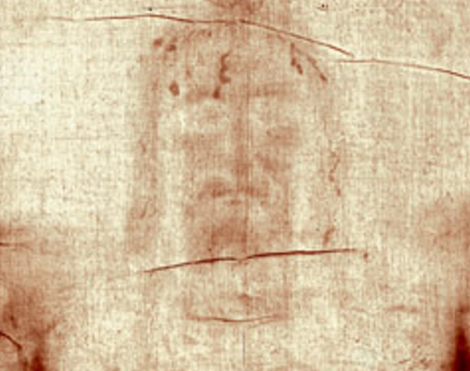
Sharing the Shroud
https://answersingenesis.org/archaeology/testing-the-shroud-of-turin/
Spiritual Encounter With the Shroud by Caspar McCloud
https://answersingenesis.org/archaeology/shroud-of-turin-gets-own-app/
http://www.jesusisreal.org/shroudofturin/
http://www.catholicjournal.us/2010/10/26/the-shroud-and-sudarium/
The Shroud of Turin: Baima Ballone, P., Turin Shroud Encyclopedia
Excavating the Evidence for Jesus by Titus Kennedy
oF Turin
Notes:
Today for Showing Truth we are going to examine something that we could share with someone.

Slide 2
Sharing the Shroud
oF Turin
https://answersingenesis.org/archaeology/testing-the-shroud-of-turin/
Spiritual Encounter With the Shroud by Caspar McCloud
https://answersingenesis.org/archaeology/shroud-of-turin-gets-own-app/
http://www.jesusisreal.org/shroudofturin/
http://www.catholicjournal.us/2010/10/26/the-shroud-and-sudarium/
The Shroud of Turin: Baima Ballone, P., Turin Shroud Encyclopedia
Excavating the Evidence for Jesus by Titus Kennedy
Notes:
Sharing the Shroud of Turin – This artifact has come into view more recently with new articles – a Newsmax Magazine just recently had this as a cover story - there is a lot of info out there about this shroud and we are going to dive into many facts and beliefs. So that if a time may arise, we can share some thoughts with someone and maybe – just maybe turn a little dirt in the soil of the soul.

Slide 3
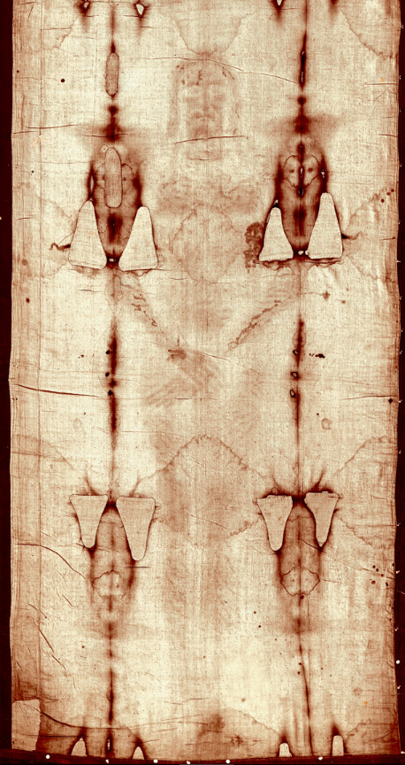
The Shroud of Turin
Notes:
The Shroud of Turin is believed to of been the burial linen that covered Jesus Christ in the tomb.
It is a 14.3ft long by 3.7ft wide piece of linen- we are only showing half of it now – its length is said to of covered the front and back side of Jesus Christ.
This shroud was made known for the first time in France -1347. It was first photographed in 1898.
It is now stored in Turin, Italy hence the name. And is kept in a vault in the Cathedral of St. John the Baptist. It was last displayed for viewing in 2015.
The image on the linen is 3 dimensional. It is marked by what seems to be a spear wound, puncture wounds on the head, in the wrist & ankle, plucked out beard, swollen cheek bones, damaged knees.

Slide 4
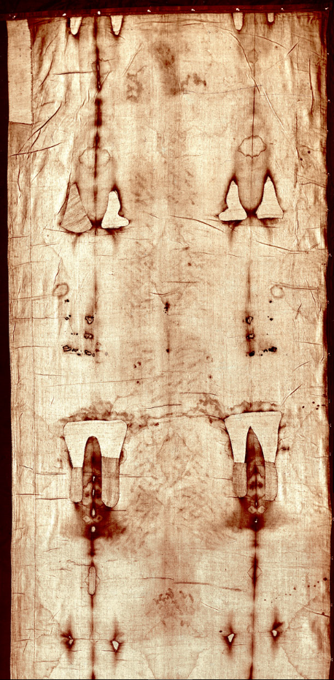
The Shroud of Turin
Notes:
The back side of the shroud shows markings from the lashings- total markings are approximately 120 on the shroud- which could relate to the 40 lashes given by the Romans.

Slide 5
John 20:6-7
6 Then Simon Peter came, following him, and went into the tomb; and he saw the linen cloths lying there,
7 and the handkerchief that had been around His head, not lying with the linen cloths, but folded together in a place by itself.
The Shroud of Turin
Matthew 27:59-60
59 When Joseph had taken the body, he wrapped it in a clean linen cloth,
60 and laid it in his new tomb which he had hewn out of the rock; and he rolled a large stone against the door of the tomb, and departed.
Notes:
It is believed that the image was formed by a radioactive happenstance- the power of His resurrection. Normally an image is not formed in burial cloths… many point to the miracle of Christ’s resurrection as the reason for the image.
Those who believe that this is truly the burial covering of Jesus – refute the idea of forgery- because of the different ages that have been given to this artifact. They have said that even in our technology now- it would be difficult to make such a forgery.
Theologically some say that scripture does not line up with the thought of the shroud itself being one whole piece… they point to- John 20:6-7 CLICK
6 Then Simon Peter came, following him, and went into the tomb; and he saw the linen cloths lying there,
7 and the handkerchief that had been around His head, not lying with the linen cloths, but folded together in a place by itself.
They look at the word for linen:
Othonion (oth-on'-ee-on);
Word Origin: Greek, Noun Neuter
from a presumed derivative of (3607)
a piece of linen, small linen cloth
strips of linen cloth for swathing the dead
There are others who point to Matthew 27:59-60
CLICK
59 When Joseph had taken the body, he wrapped it in a clean linen cloth,
60 and laid it in his new tomb which he had hewn out of the rock; and he rolled a large stone against the door of the tomb, and departed.
The word for linen cloth here is:
Sindon (sin-done');
Word Origin: Greek, Noun Feminine
of uncertain (perhaps foreign) origin
linen cloth, esp. that which was fine and costly, in which the bodies of the dead were wrapped
thing made of fine cloth
of a light and loose garment worn at night over a naked body
This word references one piece of cloth, and those who belief the Shroud is what Christ was buried with- suggest that the John 20:6-7 reference refers to the strips used to tie the linen to the body at the neck, waist, knees & neck. That the meaning of linen cloths was just speaking of the pieces of linen there, including the on cloth that covered Christ’s body as a whole.
So, both sides do have an argument- I am just showing you both possibilities.

Slide 6
The Shroud of Turin
Notes:
Let’s go to the dating of the shroud through scientific methods:
In 1988 radiocarbon dating was completed on a small portion of the shroud – it was thought to be dated between 1260-1390 AD. Which many used to reject the authenticity of the shroud. But subsequently several scientists argued that contamination could have flawed the test results, such as testing a section repaired during the Middle Ages or the fire in 1532 that damaged the shroud and might have contaminated the results. Other evidence might indicate a 1st-century origin, such as this weave type being known from cloth discovered at Masada, dating to Roman-period Judea. Pollen samples from the shroud also suggest a point of origin in the Middle East and the Mediterranean, including garland chrysanthemum that is found in the area of Judea. Analysis of dirt particles found travertine aragonite limestone that matched chemical signatures from Jerusalem tombs.
Another scientist Giulio Fanti, a professor of mechanical and thermal measurement at the University of Padua wrote of his findings:
In his book Il Mistero della Sindone (The Mystery of the Shroud) that over the past fifteen years he has had material from the fibers extracted in 1988 re-dated by three different laboratories and analyzed the fibers using nondestructive vibrational spectroscopy and several other tests. Fanti reports the original radiocarbon dates evidently were performed on contaminants or on fibers used to repair damage from a medieval fire. The revised dates report the Shroud’s fabrics date between 300 B.C. and 400 A.D. Fanti also says his tests confirm the presence of pollen and dust consistent with a Middle Eastern origin.

Slide 7

The Shroud of Turin
Notes:
During some preliminary scientific investigation in 1973, Swiss forensic scientist Dr Max Frei applied adhesive tapes to the shroud to lift from it any loose microscopic particles. Examining these samples under the microscope, he was able to identify pollen grains from many plant species. The pollen grains of each species have a unique shape and surface texture. They are to plants what fingerprints are to us. The publication of Frei's analysis was of profound importance, because the geographical distribution of these plants he identified matches the journey of the shroud as described above. Of the 58 species Frei identified, 13 are found only in southern Israel. These include at least 6 species found only in the vicinity of Jerusalem. He identified a further 20 species found in the region around Edessa, as well as other species found in France and Italy.
The species represented by the greatest number of pollen grains in Frei's research was Goundelia tournefortii, commonly known as thorny thistle tumbleweed. Grant Jeffrey comments that "Scholars believe that this plant contained the type of thistle that was used by the Roman soldiers to make a crown of thorns that produced the scalp wounds on Jesus' head that are visible on the burial cloth."
Frei's findings have been confirmed by a review of the pollen evidence in 1999 by Professor Uri Baruch, a pollen expert with the Isreali Antiquities Authority.

Slide 8
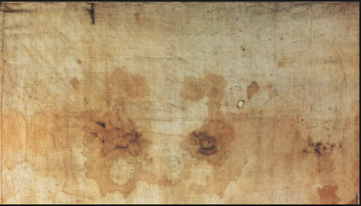
The Sudarium of Oviedo
Notes:
The Sudarium of Oviedo is a cloth that is 34” by 21”
This cloth has been in Spain since the early 7th century… In 570AD Antoninus of Piacenza wrote that the Sudarium was cared for in the vicinity of Jerusalem, in a cave near the monastery of St. Mark.
This cloth was said to be used to wipe or wrap around Jesus' face while he was taken down from the cross. Unlike the Shroud of Turin there is no image. However, it has blood stains and bodily fluids.
It is believed by some that the blood type found on both the Sudarium and the Shroud are type AB and the blood markings line up with those on the Shroud of Turin, also the pollen grains found were identical to the Shroud and originated in Jerusalem.
The blood on the Sudarium has been identified as human, and as type AB. There is very little blood actually remaining on the shroud. It is degraded, and most of it has been replaced by bacteria and fungi. Some reports show that it is believed to be human blood but state that there is not enough data to be certain.
Dr Baima Ballone a former surgeon, coroner and Professor of Forensic Medicine at the University of Turin - has analysed samples taken from the cloth with adhesive tape and reported that the blood on the shroud is also type AB. Baima Bollone and his colleagues used fluorescent human antibodies to demonstrate that it was human blood on the threads from the soles of the two feet (B12c and B12d)[19].
Interestingly, type AB is quite rare in Europe and most of the world, about 3.2% of population. However, it is quite common (18%) among Jews from Northern Palestine.
The reason we studied these artifacts is to have a little understanding of what is out there. Many people rest their faith on these items, while many other use these artifacts as proof of Christ not existing.
Where does our faith lie?
“For those who believe, no explanation is necessary; for those who do not, no explanation is possible.”

