Slide 1
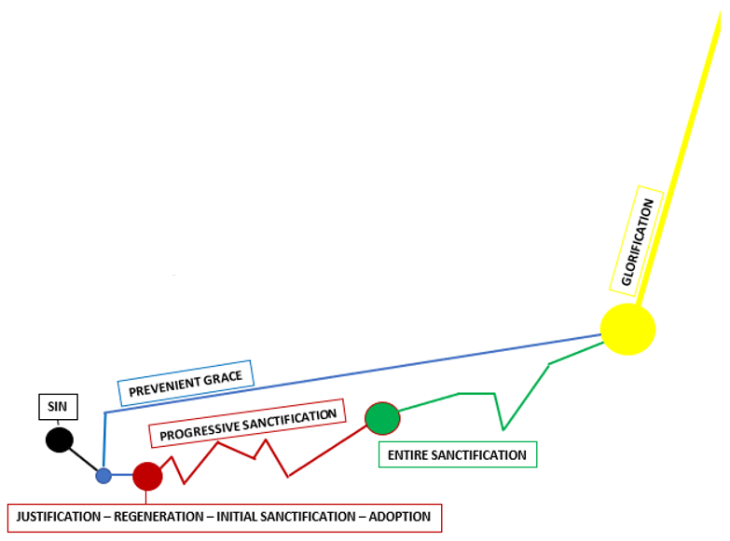
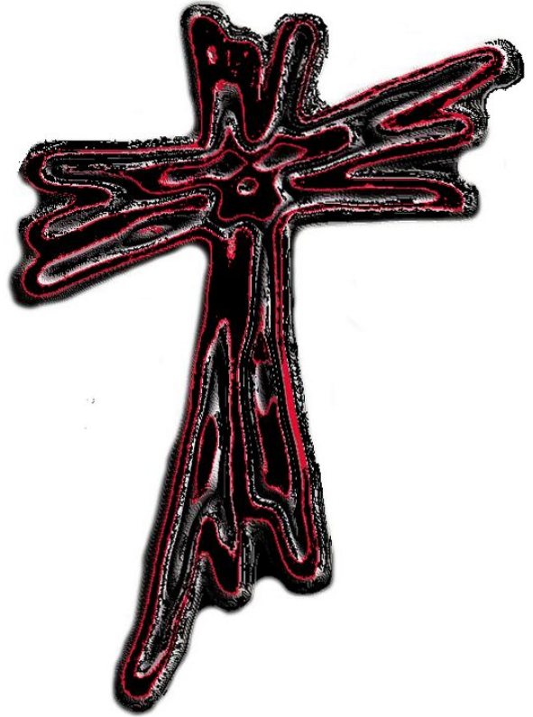
SHOWING RUTH
The Journey from
SIN to GLORIFICATION
Notes:
The Journey from Sin to Glorification
CLICK
Today for Showing Truth – we are going to investigate the journey we all face.

Slide 2

Romans 6:6 ESV
⁶ We know that our old self was crucified with him in order that the body of sin might be brought to nothing, so that we would no longer be enslaved to sin.
Notes:
We begin with SIN- Bent toward this disease - that is more than a pandemic – it infects everyone.
CLICK
Romans 6:6
⁶ We know that our old self was crucified with him in order that the body of sin might be brought to nothing, so that we would no longer be enslaved to sin.
John Wesley: “Our old man - Coeval with our being, and as old as the fall; our evil nature; a strong and beautiful expression for that entire depravity and corruption which by nature spreads itself over the whole man, leaving no part uninfected…

Slide 3
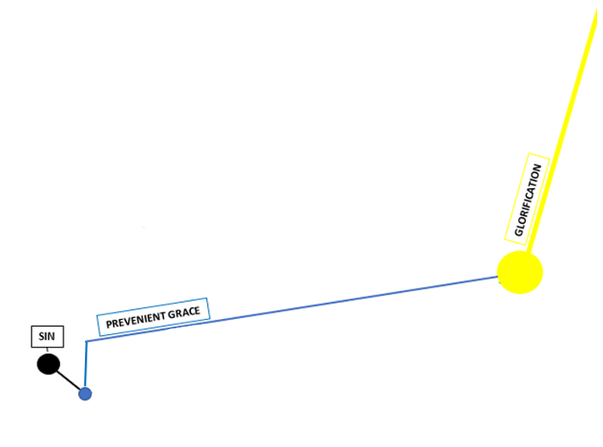
Matthew 18:2-4 ESV
² And calling to him a child, he put him in the midst of them ³ and said, “Truly, I say to you, unless you turn and become like children, you will never enter the kingdom of heaven. ⁴ Whoever humbles himself like this child is the greatest in the kingdom of heaven.
Notes:
PREVENIENT GRACE- Is grace given to people before the Heart of Accountability – those with the heart of a child are covered by this grace even to the point of glorification.
CLICK
Matthew 18:2-4
² And calling to him a child, he put him in the midst of them ³ and said, “Truly, I say to you, unless you turn and become like children, you will never enter the kingdom of heaven. ⁴ Whoever humbles himself like this child is the greatest in the kingdom of heaven.

Slide 4
Matthew 19:14
¹⁴ but Jesus said, “Let the little children come to me and do not hinder them, for to such belongs the kingdom of heaven.”
Notes:
Matthew 19:14
¹⁴ but Jesus said, “Let the little children come to me and do not hinder them, for to such belongs the kingdom of heaven.”
Prevenient Grace is at work even before responsiveness. Infant baptism is an expression of this Prevenient Grace.
2 Timothy 3:15.
¹⁴ But as for you, continue in what you have learned and have firmly believed, knowing from whom you learned it ¹⁵ and how from childhood you have been acquainted with the sacred writings, which are able to make you wise for salvation through faith in Christ Jesus.

Slide 5
John 6:44
⁴⁴ No one can come to me unless the Father who sent me draws him. And I will raise him up on the last day.
Notes:
This is also the grace that opens our hearts to be able to have a clear decision to accept or reject the Lord.
John 6:44
⁴⁴ No one can come to me unless the Father who sent me draws him. And I will raise him up on the last day.

Slide 6
Romans 2:4
⁴ Or do you presume on the riches of his kindness and forbearance and patience, not knowing that God's kindness is meant to lead you to repentance?
Notes:
Romans 2:4
⁴ Or do you presume on the riches of his kindness and forbearance and patience, not knowing that God's kindness is meant to lead you to repentance?

Slide 7
Titus 2:11
¹¹ For the grace of God has appeared, bringing salvation for all people,
Notes:
Titus 2:11
¹¹ For the grace of God has appeared, bringing salvation for all people, --- this scripture continues and even shows grace that trains us as we continue to walk with God… will talk a little more about that later… the scripture goes on to say:
¹² training us to renounce ungodliness and worldly passions, and to live self-controlled, upright, and godly lives in the present age, ¹³ waiting for our blessed hope, the appearing of the glory of our great God and Savior Jesus Christ, ¹⁴ who gave himself for us to redeem us from all lawlessness and to purify for himself a people for his own possession who are zealous for good works.

Slide 8
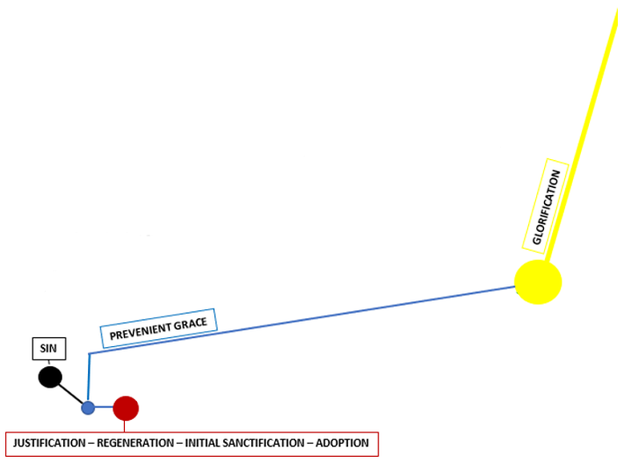
Acts 13:38-39
³⁸ Let it be known to you therefore, brothers, that through this man forgiveness of sins is proclaimed to you, ³⁹ and by him everyone who believes is freed from everything from which you could not be freed by the law of Moses.
Notes:
JUSTIFICATION- Christ is the cure to the disease of sin. In the court of the soul – Justification is the remission from sin, absolution from guilt and punishment. We are pardoned by His act of free grace. Rendered righteous on account of the atonement of Jesus Christ. One who truly believes is justified by the Justifier.
CLICK
Acts 13:38-39
³⁸ Let it be known to you therefore, brothers, that through this man forgiveness of sins is proclaimed to you, ³⁹ and by him everyone who believes is freed from everything from which you could not be freed by the law of Moses.

Slide 9
Romans 5:1-2
5 Therefore, since we have been justified by faith, we have peace with God through our Lord Jesus Christ. ² Through him we have also obtained access by faith into this grace in which we stand, and we rejoice in hope of the glory of God.
Notes:
There is peace that comes with being justified. We can rejoice in hope of the glory of God.
Romans 5:1-2
5 Therefore, since we have been justified by faith, we have peace with God through our Lord Jesus Christ. ² Through him we have also obtained access by faith into this grace in which we stand, and we rejoice in hope of the glory of God.

Slide 10
Ephesians 2:8-9
⁸ For by grace you have been saved through faith. And this is not your own doing; it is the gift of God, ⁹ not a result of works, so that no one may boast.
Notes:
REGENERATION- Being born again is a gift – The New Birth of Grace and Salvation is a gift that is unwrapped through faith.
Ephesians 2:8-9
⁸ For by grace you have been saved through faith. And this is not your own doing; it is the gift of God, ⁹ not a result of works, so that no one may boast.

Slide 11
Titus 3:5
⁴ But when the goodness and loving kindness of God our Savior appeared,
⁵ he saved us, not because of works done by us in righteousness, but according to his own mercy, by the washing of regeneration and renewal of the Holy Spirit,
Notes:
He saved us by the washing of regeneration of the Holy Spirit.
Titus 3:5
⁴ But when the goodness and loving kindness of God our Savior appeared,
⁵ he saved us, not because of works done by us in righteousness, but according to his own mercy, by the washing of regeneration and renewal of the Holy Spirit,
This scripture continues on and says:
⁶ whom he poured out on us richly through Jesus Christ our Savior, ⁷ so that being justified by his grace we might become heirs according to the hope of eternal life.
This washing, this regeneration is the entrance for the Rehabilitator.

Slide 12
Ephesians 1:13
¹³ In him you also, when you heard the word of truth, the gospel of your salvation, and believed in him, were sealed with the promised Holy Spirit,
¹⁴ who is the guarantee of our inheritance until we acquire possession of it, to the praise of his glory.
Notes:
INITIAL SANCTIFICATION- The Rehabilitator begins dismantling the walls we have up that are preventing our complete submission to God. The natural bent toward sinning begins to bend toward God’s will and righteousness. We are sealed in Him.
Ephesians 1:13
¹³ In him you also, when you heard the word of truth, the gospel of your salvation, and believed in him, were sealed with the promised Holy Spirit,
¹⁴ who is the guarantee of our inheritance until we acquire possession of it, to the praise of his glory.

Slide 13
Philippians 1:6
⁶ And I am sure of this, that he who began a good work in you will bring it to completion at the day of Jesus Christ.
2 Peter 1:3-11
Romans 8:1-39
Notes:
Philippians 1:6
⁶ And I am sure of this, that he who began a good work in you will bring it to completion at the day of Jesus Christ.
CLICK
2 Peter 1:3-11
³ His divine power has granted to us all things that pertain to life and godliness, through the knowledge of him who called us to his own glory and excellence, ⁴ by which he has granted to us his precious and very great promises, so that through them you may become partakers of the divine nature, having escaped from the corruption that is in the world because of sinful desire. ⁵ For this very reason, make every effort to supplement your faith with virtue, and virtue with knowledge, ⁶ and knowledge with self-control, and self-control with steadfastness, and steadfastness with godliness, ⁷ and godliness with brotherly affection, and brotherly affection with love. ⁸ For if these qualities are yours and are increasing, they keep you from being ineffective or unfruitful in the knowledge of our Lord Jesus Christ. ⁹ For whoever lacks these qualities is so nearsighted that he is blind, having forgotten that he was cleansed from his former sins. ¹⁰ Therefore, brothers, be all the more diligent to confirm your calling and election, for if you practice these qualities you will never fall. ¹¹ For in this way there will be richly provided for you an entrance into the eternal kingdom of our Lord and Savior Jesus Christ.
CLICK
Romans 8:1-39 take some time later and read this it speaks of Life in the Spirit, how we are Heirs with Christ, Future Glory & God’s Everlasting Love.
Life in the Spirit
8 There is therefore now no condemnation for those who are in Christ Jesus.^{[a]} ² For the law of the Spirit of life has set you^{[b]} free in Christ Jesus from the law of sin and death. ³ For God has done what the law, weakened by the flesh, could not do. By sending his own Son in the likeness of sinful flesh and for sin,^{[c]} he condemned sin in the flesh, ⁴ in order that the righteous requirement of the law might be fulfilled in us, who walk not according to the flesh but according to the Spirit. ⁵ For those who live according to the flesh set their minds on the things of the flesh, but those who live according to the Spirit set their minds on the things of the Spirit. ⁶ For to set the mind on the flesh is death, but to set the mind on the Spirit is life and peace. ⁷ For the mind that is set on the flesh is hostile to God, for it does not submit to God's law; indeed, it cannot. ⁸ Those who are in the flesh cannot please God.
⁹ You, however, are not in the flesh but in the Spirit, if in fact the Spirit of God dwells in you. Anyone who does not have the Spirit of Christ does not belong to him. ¹⁰ But if Christ is in you, although the body is dead because of sin, the Spirit is life because of righteousness. ¹¹ If the Spirit of him who raised Jesus from the dead dwells in you, he who raised Christ Jesus^{[d]} from the dead will also give life to your mortal bodies through his Spirit who dwells in you.
Heirs with Christ
¹² So then, brothers,^{[e]} we are debtors, not to the flesh, to live according to the flesh. ¹³ For if you live according to the flesh you will die, but if by the Spirit you put to death the deeds of the body, you will live. ¹⁴ For all who are led by the Spirit of God are sons^{[f]} of God. ¹⁵ For you did not receive the spirit of slavery to fall back into fear, but you have received the Spirit of adoption as sons, by whom we cry, “Abba! Father!” ¹⁶ The Spirit himself bears witness with our spirit that we are children of God, ¹⁷ and if children, then heirs—heirs of God and fellow heirs with Christ, provided we suffer with him in order that we may also be glorified with him.
Future Glory
¹⁸ For I consider that the sufferings of this present time are not worth comparing with the glory that is to be revealed to us. ¹⁹ For the creation waits with eager longing for the revealing of the sons of God. ²⁰ For the creation was subjected to futility, not willingly, but because of him who subjected it, in hope ²¹ that the creation itself will be set free from its bondage to corruption and obtain the freedom of the glory of the children of God. ²² For we know that the whole creation has been groaning together in the pains of childbirth until now. ²³ And not only the creation, but we ourselves, who have the firstfruits of the Spirit, groan inwardly as we wait eagerly for adoption as sons, the redemption of our bodies. ²⁴ For in this hope we were saved. Now hope that is seen is not hope. For who hopes for what he sees? ²⁵ But if we hope for what we do not see, we wait for it with patience.
²⁶ Likewise the Spirit helps us in our weakness. For we do not know what to pray for as we ought, but the Spirit himself intercedes for us with groanings too deep for words. ²⁷ And he who searches hearts knows what is the mind of the Spirit, because^{[g]} the Spirit intercedes for the saints according to the will of God. ²⁸ And we know that for those who love God all things work together for good,^{[h]} for those who are called according to his purpose. ²⁹ For those whom he foreknew he also predestined to be conformed to the image of his Son, in order that he might be the firstborn among many brothers. ³⁰ And those whom he predestined he also called, and those whom he called he also justified, and those whom he justified he also glorified.
God's Everlasting Love
³¹ What then shall we say to these things? If God is for us, who can be^{[i]} against us? ³² He who did not spare his own Son but gave him up for us all, how will he not also with him graciously give us all things? ³³ Who shall bring any charge against God's elect? It is God who justifies. ³⁴ Who is to condemn? Christ Jesus is the one who died—more than that, who was raised—who is at the right hand of God, who indeed is interceding for us.^{[j]} ³⁵ Who shall separate us from the love of Christ? Shall tribulation, or distress, or persecution, or famine, or nakedness, or danger, or sword? ³⁶ As it is written,
“For your sake we are being killed all the day long;
we are regarded as sheep to be slaughtered.”
³⁷ No, in all these things we are more than conquerors through him who loved us. ³⁸ For I am sure that neither death nor life, nor angels nor rulers, nor things present nor things to come, nor powers, ³⁹ nor height nor depth, nor anything else in all creation, will be able to separate us from the love of God in Christ Jesus our Lord.

Slide 14
Titus 3:7
⁷ so that being justified by his grace we might become heirs according to the hope of eternal life.
Notes:
ADOPTION- When we are adopted into the family of God – we are heirs, just as if we were His children.
Titus 3:7
⁷ so that being justified by his grace we might become heirs according to the hope of eternal life.

Slide 15
John 1:12-13
¹² But to all who did receive him, who believed in his name, he gave the right to become children of God, ¹³ who were born, not of blood nor of the will of the flesh nor of the will of man, but of God.
Notes:
John 1:12-13
¹² But to all who did receive him, who believed in his name, he gave the right to become children of God, ¹³ who were born, not of blood nor of the will of the flesh nor of the will of man, but of God.

Slide 16
Ephesians 2:19
¹⁹ So then you are no longer strangers and aliens, but you are fellow citizens with the saints and members of the household of God, ²⁰ built on the foundation of the apostles and prophets, Christ Jesus himself being the cornerstone, ²¹ in whom the whole structure, being joined together, grows into a holy temple in the Lord.
Notes:
Ephesians 2:19
¹⁹ So then you are no longer strangers and aliens, but you are fellow citizens with the saints and members of the household of God, ²⁰ built on the foundation of the apostles and prophets, Christ Jesus himself being the cornerstone, ²¹ in whom the whole structure, being joined together, grows into a holy temple in the Lord.

Slide 17
1 John 3:1
3 See what kind of love the Father has given to us, that we should be called children of God; and so we are. The reason why the world does not know us is that it did not know him.
Notes:
With His wonderful manner of love bestowed on us – we are called children of God!
1 John 3:1
3 See what kind of love the Father has given to us, that we should be called children of God; and so we are. The reason why the world does not know us is that it did not know him.

Slide 18
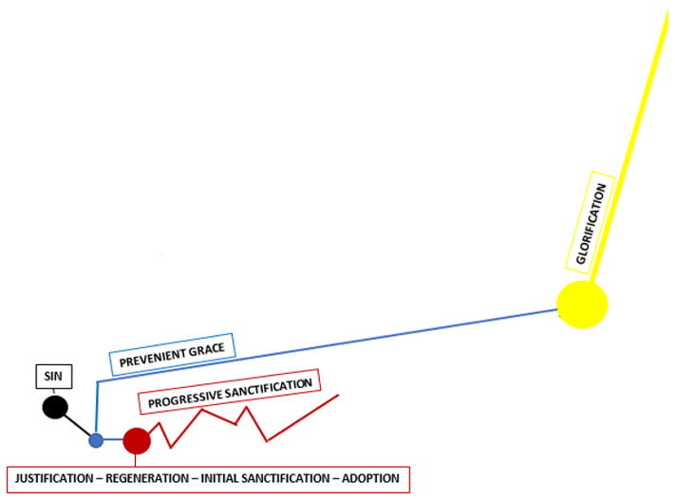
Romans 6:6 ESV
⁶ We know that our old self was crucified with him in order that the body of sin might be brought to nothing, so that we would no longer be enslaved to sin.
Notes:
PROGRESSIVE SANCTIFICATION- John Wesley continued about Romans 6:6 speaking to the infection within the whole man… “This in a believer is crucified with Christ, mortified, gradually killed, by virtue of our union with Him. That the body of sin - All evil tempers, words, and actions, which are the members of the old man, might be destroyed.”
With Progressive Sanctification the Holy Spirit continues to dismantle the wall of self and continues to bend our heart toward righteousness as we submit to His guidance.
A growth from grace to grace. This time of preparation is one with ups and downs at times and leads to a more perfect heart frame of obedience.

Slide 19
John 17:17
¹⁷ Sanctify them in the truth; your word is truth.
Notes:
John 17:17
¹⁷ Sanctify them in the truth; your word is truth.

Slide 20
Hebrews 9:14
¹⁴ how much more will the blood of Christ, who through the eternal Spirit offered himself without blemish to God, purify our conscience from dead works to serve the living God.
Notes:
Hebrews 9:14
¹³ For if the blood of goats and bulls, and the sprinkling of defiled persons with the ashes of a heifer, sanctify for the purification of the flesh,
¹⁴ how much more will the blood of Christ, who through the eternal Spirit offered himself without blemish to God, purify our conscience from dead works to serve the living God.

Slide 21
Hebrews 12:10-11
¹⁰ For they disciplined us for a short time as it seemed best to them, but he disciplines us for our good, that we may share his holiness. ¹¹ For the moment all discipline seems painful rather than pleasant, but later it yields the peaceful fruit of righteousness to those who have been trained by it.
Colossians 3:1-10
Notes:
Hebrews 12:10-11
¹⁰ For they disciplined us for a short time as it seemed best to them, but he disciplines us for our good, that we may share his holiness. ¹¹ For the moment all discipline seems painful rather than pleasant, but later it yields the peaceful fruit of righteousness to those who have been trained by it.
CLICK
Colossians 3:1-10
3 If then you have been raised with Christ, seek the things that are above, where Christ is, seated at the right hand of God. ² Set your minds on things that are above, not on things that are on earth. ³ For you have died, and your life is hidden with Christ in God. ⁴ When Christ who is your life appears, then you also will appear with him in glory.
⁵ Put to death therefore what is earthly in you: sexual immorality, impurity, passion, evil desire, and covetousness, which is idolatry. ⁶ On account of these the wrath of God is coming. ⁷ In these you too once walked, when you were living in them. ⁸ But now you must put them all away: anger, wrath, malice, slander, and obscene talk from your mouth. ⁹ Do not lie to one another, seeing that you have put off the old self with its practices ¹⁰ and have put on the new self, which is being renewed in knowledge after the image of its creator.

Slide 22
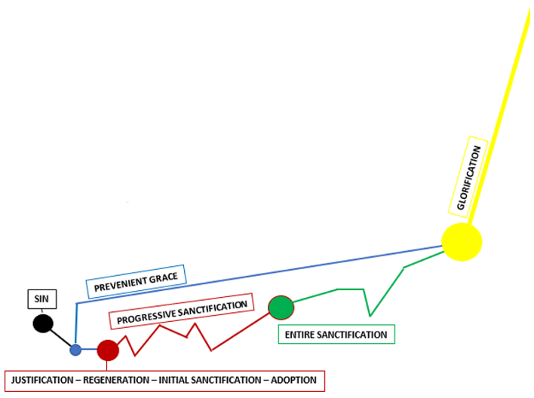
1 Thessalonians 5:23
²³ Now may the God of peace himself sanctify you completely, and may your whole spirit and soul and body be kept blameless at the coming of our Lord Jesus Christ. ²⁴ He who calls you is faithful; he will surely do it.
Notes:
ENTIRE SANCTIFICATION- The wall has been dismantled by the Rehabilitator. This crisis of belief is marked with total submission. We are bent toward righteousness. This is the point we begin the journey of giving ourselves entirely to God. The freedom to love God with all our heart, mind, soul and strength and love our neighbors as ourselves.
CLICK
1 Thessalonians 5:23
²³ Now may the God of peace himself sanctify you completely, and may your whole spirit and soul and body be kept blameless at the coming of our Lord Jesus Christ. ²⁴ He who calls you is faithful; he will surely do it.

Slide 23
Hebrews 10:14
¹⁴ For by a single offering he has perfected for all time those who are being sanctified.
Notes:
Hebrews 10:14
¹⁴ For by a single offering he has perfected for all time those who are being sanctified.

Slide 24
1 Thessalonians 4:3-5.
³ For this is the will of God, your sanctification: that you abstain from sexual immorality; ⁴ that each one of you know how to control his own body in holiness and honor, ⁵ not in the passion of lust like the Gentiles who do not know God;
Notes:
1 Thessalonians 4:3-5.
³ For this is the will of God, your sanctification: that you abstain from sexual immorality; ⁴ that each one of you know how to control his own body in holiness and honor, ⁵ not in the passion of lust like the Gentiles who do not know God;
This scripture continues on to say:
⁶ that no one transgress and wrong his brother in this matter, because the Lord is an avenger in all these things, as we told you beforehand and solemnly warned you. ⁷ For God has not called us for impurity, but in holiness. ⁸ Therefore whoever disregards this, disregards not man but God, who gives his Holy Spirit to you.
Melissa and I are both on the journey of Entire Sanctification, there is no hindrance to love God with all our hearts, this is an ever-growing Love Relationship with the Almighty.
When we examine the possibility of sin after the crisis of belief. We see that it is possible to fall. There is no point in our journey here on earth where we won’t be susceptible to temptation, God gives us free will. With this gift to love freely we can leave freely, fall freely, even hate freely. I love to quote Phil Bence regarding this journey on the pathway of time from Grace to Glorification. He said with holiness: “It is not that we are not able to sin, but that we are able to not sin.”
Just like with the timeline graph drawn, there are ups and downs during Progressive Sanctification and these can occur during Entire Sanctification.

Slide 25
Hebrews 6
Notes:
Hebrews 6
6 Therefore let us leave the elementary doctrine of Christ and go on to maturity, not laying again a foundation of repentance from dead works and of faith toward God, ² and of instruction about washings, the laying on of hands, the resurrection of the dead, and eternal judgment. ³ And this we will do if God permits. ⁴ For it is impossible, in the case of those who have once been enlightened, who have tasted the heavenly gift, and have shared in the Holy Spirit, ⁵ and have tasted the goodness of the word of God and the powers of the age to come, ⁶ and then have fallen away, to restore them again to repentance, since they are crucifying once again the Son of God to their own harm and holding him up to contempt. ⁷ For land that has drunk the rain that often falls on it, and produces a crop useful to those for whose sake it is cultivated, receives a blessing from God. ⁸ But if it bears thorns and thistles, it is worthless and near to being cursed, and its end is to be burned.
⁹ Though we speak in this way, yet in your case, beloved, we feel sure of better things—things that belong to salvation. ¹⁰ For God is not unjust so as to overlook your work and the love that you have shown for his name in serving the saints, as you still do. ¹¹ And we desire each one of you to show the same earnestness to have the full assurance of hope until the end, ¹² so that you may not be sluggish, but imitators of those who through faith and patience inherit the promises.
The Certainty of God's Promise
¹³ For when God made a promise to Abraham, since he had no one greater by whom to swear, he swore by himself, ¹⁴ saying, “Surely I will bless you and multiply you.” ¹⁵ And thus Abraham, having patiently waited, obtained the promise. ¹⁶ For people swear by something greater than themselves, and in all their disputes an oath is final for confirmation. ¹⁷ So when God desired to show more convincingly to the heirs of the promise the unchangeable character of his purpose, he guaranteed it with an oath, ¹⁸ so that by two unchangeable things, in which it is impossible for God to lie, we who have fled for refuge might have strong encouragement to hold fast to the hope set before us. ¹⁹ We have this as a sure and steadfast anchor of the soul, a hope that enters into the inner place behind the curtain, ²⁰ where Jesus has gone as a forerunner on our behalf, having become a high priest forever after the order of Melchizedek.

Slide 26
Hebrews 10:38
³⁸ but my righteous one shall live by faith,
and if he shrinks back,
my soul has no pleasure in him.”
Notes:
Hebrews 10:38
³⁸ but my righteous one shall live by faith,
and if he shrinks back,
my soul has no pleasure in him.”
David a man after God’s own heart fell with covetousness, adultery & murder. We can draw back even if we have tasted the fullness of His gift. Praise God that if this does occur – God does not just write us off as damaged goods.

Slide 27
Matthew 18:12-14.
¹² What do you think? If a man has a hundred sheep, and one of them has gone astray, does he not leave the ninety-nine on the mountains and go in search of the one that went astray? ¹³ And if he finds it, truly, I say to you, he rejoices over it more than over the ninety-nine that never went astray. ¹⁴ So it is not the will of my Father who is in heaven that one of these little ones should perish.
Notes:
He seeks us out like a lamb who has wondered off, He leaves the 99 to seek out the lost and brings us back into the fold of His loving care.
Matthew 18:12-14.
¹² What do you think? If a man has a hundred sheep, and one of them has gone astray, does he not leave the ninety-nine on the mountains and go in search of the one that went astray? ¹³ And if he finds it, truly, I say to you, he rejoices over it more than over the ninety-nine that never went astray. ¹⁴ So it is not the will of my Father who is in heaven that one of these little ones should perish.
At the same time, we must allow Him to take us into His arms by repenting and turning towards Him.

Slide 28
Romans 8:30
³⁰ And those whom he predestined he also called, and those whom he called he also justified, and those whom he justified he also glorified.
Notes:
GLORIFICATION- This is not the end but the beginning. A beginning of true freedom, one not plagued with the effects of sin. We cannot imagine the grandeur of being in the presence of God.
Romans 8:30
³⁰ And those whom he predestined he also called, and those whom he called he also justified, and those whom he justified he also glorified.

Slide 29
1 Peter 5:4
⁴ And when the chief Shepherd appears, you will receive the unfading crown of glory.
Notes:
1 Peter 5:4
⁴ And when the chief Shepherd appears, you will receive the unfading crown of glory.

Slide 30
Matthew 13:43
⁴³ Then the righteous will shine like the sun in the kingdom of their Father. He who has ears, let him hear.
Notes:
Matthew 13:43
⁴³ Then the righteous will shine like the sun in the kingdom of their Father. He who has ears, let him hear.
Years back with the teen group we taught Sanctification with a three-legged race. This race was to show our walk with God in a physical sense and we spoke about it after in a class setting. I was light on the Christianese and heavy on the simple aspect of our journey with God. I told them that when we accept God into our hearts, we begin a three-legged race. We are tied to the Holy Spirit, we may be carrying baggage and we may not be able to see or hear.
Some of the group was assigned to be the Holy Spirit tied to a child of God. I had goggles that were painted over, ear plugs, and backpacks filled with rocks that each child of God would have to bear.
There were stations along the path of the race and at each station the Holy Spirit would remove a burden or an obstruction. As they went through the race the walk became easier and their stride with the Holy Spirit was more in step.
During class, I spoke of how we can pick up our stride and we can even get to a fast pace, in some cases we may fall – in these times the grace of our God can lift us up and help us to begin our stride again.

