Slide 1

The Tree of Life
Jesus
Notes:
Today for Knowing Truth, we are going to look at the Tree of Life.
I do not mean the Tree mentioned in Genesis that was in the midst of the garden or in Revelation which is in the Paradise of God. (Rev 2:7) It is not related to how proverbs calls wisdom or the fruit of righteousness the Tree of Life (Proverbs 3:18 & Proverbs 11:30)
CLICK
This Tree of Life that we will be looking at is the Genealogy of Jesus.

Slide 2
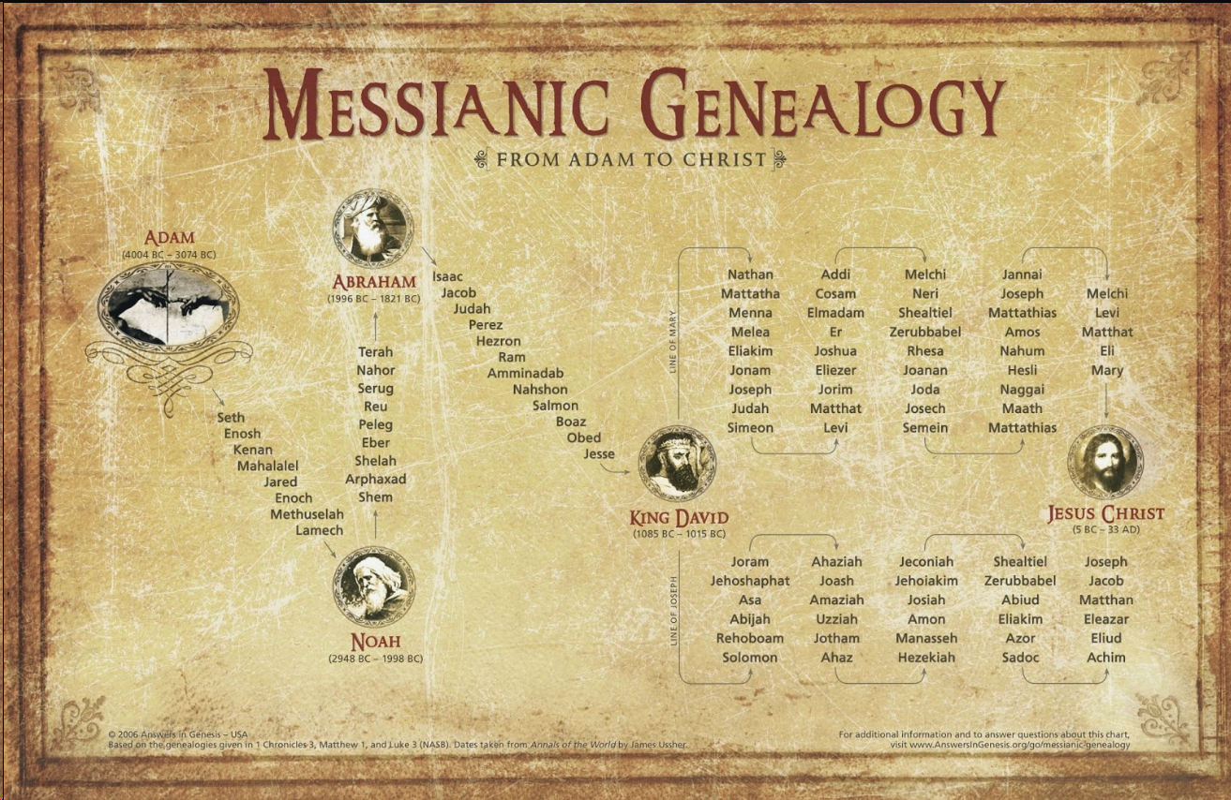
Notes:
This graph is from Answers in Genesis - what I like is that it uses genealogies from 1 Chronicles 3, Matthew1 and Luke 3 – the dates are taken from Annals of the World by James Ussher.

Slide 3
Notes:
We are going to look deeper with some people as we journey through genealogy. We know Adam and Eve was the beginning. The genealogy continues with the 3rd son however (Seth) – anyone know why that was – why not the first two sons?

Slide 4
²⁵ Adam had relations with his wife again; and she gave birth to a son, and named him Seth, for, she said, “God has appointed me another offspring in place of Abel, for Cain killed him.” ²⁶ To Seth, to him also a son was born; and he called his name Enosh. Then men began to call upon the name of the Lord.
Genesis 4:25-26
Notes:
²⁵ Adam had relations with his wife again; and she gave birth to a son, and named him Seth, for, she said, “God has appointed me another offspring in place of Abel, for Cain killed him.” ²⁶ To Seth, to him also a son was born; and he called his name Enosh. Then men began to call upon the name of the Lord.
Genesis 5:25-26

Slide 5
Notes:
Let’s jump ahead to Enoch – what is so special about Enoch?

Slide 6
²¹ Enoch lived sixty-five years, and became the father of Methuselah. ²² Then Enoch walked with God three hundred years after he became the father of Methuselah, and he had other sons and daughters. ²³ So all the days of Enoch were three hundred and sixty-five years. ²⁴ Enoch walked with God; and he was not, for God took him.
Genesis 5:21-24
Notes:
²¹ Enoch lived sixty-five years, and became the father of Methuselah. ²² Then Enoch walked with God three hundred years after he became the father of Methuselah, and he had other sons and daughters. ²³ So all the days of Enoch were three hundred and sixty-five years. ²⁴ Enoch walked with God; and he was not, for God took him.
Genesis 5:21-24
Throughout the Genealogy in Genesis it always says when someone bore a child and when they died – with Enoch – it does not say he died but that God took him.

Slide 7
²⁵ Methuselah lived one hundred and eighty-seven years, and became the father of Lamech. ²⁶ Then Methuselah lived seven hundred and eighty-two years after he became the father of Lamech, and he had other sons and daughters. ²⁷ So all the days of Methuselah were nine hundred and sixty-nine years, and he died.
Genesis 5:21-24
Notes:
If we continue Methuselah was the oldest man recorded in history.
²⁵ Methuselah lived one hundred and eighty-seven years, and became the father of Lamech. ²⁶ Then Methuselah lived seven hundred and eighty-two years after he became the father of Lamech, and he had other sons and daughters. ²⁷ So all the days of Methuselah were nine hundred and sixty-nine years, and he died.
Genesis 5:21-24

Slide 8
Notes:
Noah was a man who also walked with God like Enoch – but the earth was filled with violence. God did not take Noah like Enoch – He used Noah to reboot humanity. In Genesis 8 God said to Himself “I will never again curse the ground on account of man, for the intent of man’s heart is evil from his youth; I will never again destroy every living thing, as I have done. “While the earth remains, Seedtime and harvest, and cold and heat, and summer and winter, and day and night, shall not cease.” (Gen 8:21b-22)---
In Genesis 9 God made a covenant with Noah sealed with a bow - ¹¹ I establish My covenant with you; and all flesh shall never again be cut off by the water of the flood, neither shall there again be a flood to destroy the earth.” ¹² God said, “This is the sign of the covenant which I am making between Me and you and every living creature that is with you, for ^{[h]}all successive generations; ¹³ I set My bow in the cloud, and it shall be for a sign of a covenant between Me and the earth. ¹⁴ It shall come about, when I bring a cloud over the earth, that the bow will be seen in the cloud, ¹⁵ and I will remember My covenant, which is between Me and you and every living creature of all flesh; and never again shall the water become a flood to destroy all flesh. ¹⁶ When the bow is in the cloud, then I will look upon it, to remember the everlasting covenant between God and every living creature of all flesh that is on the earth.” ¹⁷ And God said to Noah, “This is the sign of the covenant which I have established between Me and all flesh that is on the earth.”
With his son Shem the messianic genealogy continued… One person stuck out to me before we get to Abram – there was some interesting verses surrounding him – Peleg

Slide 9

²⁵ Two sons were born to Eber; the name of the one was Peleg, for in his days the earth was divided; and his brother’s name was Joktan.
Genesis 10:25
Notes:
²⁵ Two sons were born to Eber; the name of the one was Peleg, for in his days the earth was divided; and his brother’s name was Joktan.
Genesis 10:25
Palag’s (paw-lag’) name does mean to split, to be divided… but if we continue and look ahead in the verse it says the earth: 'erets (eh'-rets); which means land, the whole earth (as opposed to a part), surface of the earth, sometimes in phrases it can mean people of the land…. 'erets (eh'-rets) Palag (paw-lag’) the earth was divided… this could have been a division among people, however, I remember back in my school days a theory that the earth was all one super continent until it was divided… Pangaea (pan gee ah)… hmm what if the flood cause the land masses to move… just a thought ☺

Slide 10
Notes:
We move onto Abram (exalted father) – who became Abraham (father of a multitude) (Gen 17:5)– his wife Sarai (princess) – who became Sarah (noblewoman) (Gen 17:15)
Abraham being 99 and Sarah being 90 years old would have a child – (Gen 18:12) when Sarah heard of this what do you think she did--- she laughed Tsachaq (tsaw-khak’)
Isaac was born though and his name Yitschaq (yits-khawk’); means “he laughs”
Jacob continued this lineage through Leah with the last son she bore – she said (Gen 29:35) “this time I will praise the Lord.” Therefore, she named him Judah…

Slide 11
Notes:
Let’s get into the sticky part of this genealogy… Salmon – is not a color here but has some significance to the line of Jesus… we will get to Salmon in a moment…
We see Boaz after Salmon – anyone recognize this name Boaz?…

Slide 12
⁵ Salmon was the father of Boaz by Rahab, Boaz was the father of Obed by Ruth, and Obed the father of Jesse. ⁶ Jesse was the father of David the king.
Matthew 1:5-6
Notes:
⁵ Salmon was the father of Boaz by Rahab, Boaz was the father of Obed by Ruth, and Obed the father of Jesse. ⁶ Jesse was the father of David the king.
Matthew 1:5-6
Ellicott’s wrote about how the - The Old Testament records are silent as to the marriage of Salmon with the harlot of Jericho. When they were compiled it was probably thought of as a blot rather than a glory; but the fact may have been preserved in the traditions of the house of David. It has been conjectured that Salmon may have been one of the two unnamed spies whose lives were saved by Rahab, when he was doing the work which Caleb had done before him. The mention of Rahab in James 2:25, Hebrews 11:31, shows that her fame had risen at the time when St. Matthew wrote. The Talmud legends, curiously enough, reckon eight prophets among her descendants, including Jeremiah and Baruch, but not any of the line of David. Assuming the connection between St. Matthew and St. James, which has been shown in the Introduction to this Gospel to be probable, the mention of Rahab by both takes its place as an interesting coincidence.
Now if this is true that Rahab was in Christ’s lineage – then Christ was also Gentile… really if you truly contemplate lineage --- we are all descendants from Noah.

Slide 13
Notes:
Ok we got through that mess now let’s get through the next…

Slide 14
Notes:
We all know King David… but there are two lines that come from him --- one mentioned in Luke and one mentioned in Matthew… In Luke 3:23 the genealogy of Jesus begins with “²³ When He began His ministry, Jesus Himself was about thirty years of age, being, ^{[h]}as was supposed, the son of Joseph, the son of Eli…”

Slide 15
Notes:
In Matthew 1:16 it says: ¹⁶ Jacob was the father of Joseph the husband of Mary, by whom Jesus was born, who is called the Messiah.

Slide 16
Notes:
We can see that these two lists are very much different --- 41 names mentioned --- with Luke 3:23 saying: “²³ When He began His ministry, Jesus Himself was about thirty years of age, being, ^{[h]}as was supposed, the son of Joseph, the son of Eli…”
And the lower list having only having 29 --- with Matthew 1:16 saying: ¹⁶ Jacob was the father of Joseph the husband of Mary, by whom Jesus was born, who is called the Messiah.
Most interpreters have supposed that Matthew gives the genealogy of Joseph and Luke that of Mary. They were both descendent of David, but in different lines. Since Jesus was not the son of Joseph, it was important to show that Mary was a descendent of David also.
There are other explanations for the two lines… Matthew 1:5 Commentaries: Salmon was the father of Boaz by Rahab, Boaz was the father of Obed by Ruth, and Obed the father of Jesse. (biblehub.com)
One thing I noticed without the commentary of others was – if this is the line of Mary and the line of Joseph and knowing the thought of how culture was in regard to betrothal in this time… Mary was most likely 12 to 14 years old when she was betrothed – and Joseph could have been from his teens all the way into his 40’s – even an older widower… this older Joseph and younger Mary kind of lines up with the amount of descendants going back to David…

Slide 17
Notes:
I like What Matthew Henry said regarding the Genealogy of Jesus:
It was promised to Abraham that Christ should descend from him, Ge 12:3; 22:18; and to David that he should descend from him, 2Sa 7:12; Ps 89:3, &c.; 132:11; and, therefore, unless Jesus is a son of David, and a son of Abraham, he is not the Messiah. Now this is here proved from well-known records. When the Son of God was pleased to take our nature, he came near to us, in our fallen, wretched condition; but he was perfectly free from sin: and while we read the names in his genealogy, we should not forget how low the Lord of glory stooped to save the human race.
I love to look into graphs and graph out scripture in a picture that I can comprehend – but this is just a picture of a family tree --- in a sense it is like going to Ancestry.com or going through the several other avenues to find out our heritage --- we will probably never know all the ins and outs until we are in Paradise with our Savior and at that time it probably will not matter.
The one thing that is interesting is to see some of the backgrounds of those who would lead the way to a baby born to die for our salvation… Immanuel.

