Slide 1
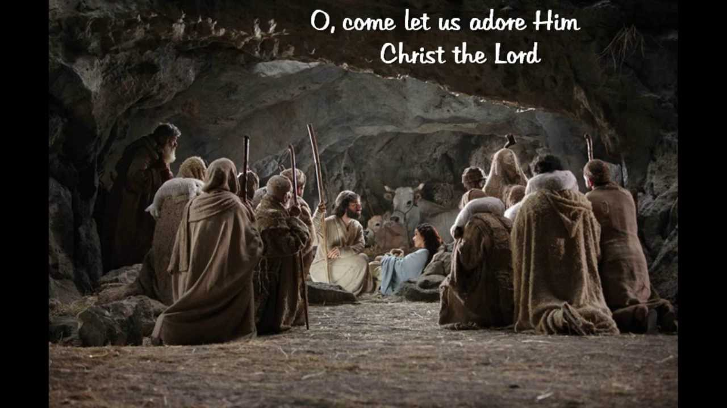
What, When, Who? – CHRIST!
Notes:
Today for Showing Truth we are going to examine What, When, Who? – CHRIST!
I have added some new findings regarding some dates.
When is Jesus Birthday?
The first time the 25th was the celebration of Christ birth was in the 4th Century – the Western Church - Pope Julius about 350 AD set the 25th of December as the day to celebrate our Christ’s birth.
The Eastern Church celebrated His birth on January 6th –
Different calendars, different times proposed - the Western Church went by the Gregorian calendar – while the Eastern Church used the older Julian calendar.
Most people have not heard of Hippolytus – a Christian author who wrote in the early third century. While there has been debate over manuscript tradition and what Hippolytus thought about the birth date of Christ – an artifact was brought into view by the Biblical Archaeological Society… in 2022; T.C. Schmidt wrote about the statue of Hippolytus – dating to 222AD – located in the Vatican Library – this statue depicts a figure seated on a chair and has an extensive number of inscriptions on it. One inscription from Hippolytus states that the “Genesis of Christ” occurred during the Passover of April 2, 2BC. Many scholars have interpreted this to mean the “birth” of Jesus. T.C. Schmidt believes after extensive research that this most likely refers to the “conception” of Jesus and points to Matthew 1:18. If Christ was conceived April 2 --- nine months later would put His birth near December 25th.
(“What we need is another good clue. Happily, this can be found in a different work of Hippolytus, one called the Chronicon. In this, Hippolytus makes all sorts of chronological calculations involving the dates of biblical events and personages. Careful examination of these calculations makes clear that Hippolytus believed Jesus was born precisely nine months after March 25, the vernal equinox of the Roman calendar. And naturally, nine months from March 25 is exactly December 25, the Roman winter solstice.²”)
Was it December 25th, January 6th, April 2nd?? Is there any other evidence to point us to Christ’s Birthday…
Thoughts and writings are from:
The Wonders of Bible Chronology, Page 84,85, Philip Mauro, first published 1922, Reprinted by Reiner Publications, Swengel, Pennsyvania
Halley’s Bible Handbook, Deluxe Edition Completely Revised and Expanded Edition, Page 495, Published by Zondervan
Calculating Christmas - The BAS Library (biblicalarchaeology.org)

Slide 2

AD
| | ? | | |
BC
Notes:
Well to find out the actual year we need to go to the beginning of how we recognize what year it is.
CLICK
BC means Before Christ- we are not using the new format of time BCE which removes Christ and replaces Him with Common – Christ is far from common and in our time He is a pivot point in our relationship with God.
CLICK
while AD means? Anno Domini (pronounced dom-i-nee per Cambridge) – which is Latin meaning the Years from the start of the Christian era. When we see them use CE or Common Era for this time – instead think of the meaning of Anno Domini --- Christian Era
Our years as we know them began in 532AD – a monk named Dionysius Exiguus set the system in place – at that time the dates began from the era of Emperor Diocletian. The monk did not want the system of dates to reflect the Diocletian- this Emperor oppressed and persecuted the people during his rule. The monk wanted to date all events from the Incarnation of Jesus Christ. He wrote to Bishop Petronius about this new system of dating and said: “to the end that the commencement of our hope might be better known to us and that the cause of man’s restoration, namely, our Redeemer’s passion, might appear with clearer evidence.”
So Jesus was born in 1AD then right? Wrong.
While this faithful monk had the right idea- he had the wrong date.
Historically we do not have any data about how he came up with this year as the birth of Christ- but we can figure the birth year of Christ by looking to history in scripture and with secular history. For certain Jesus was born before the death of Herod.

Slide 3
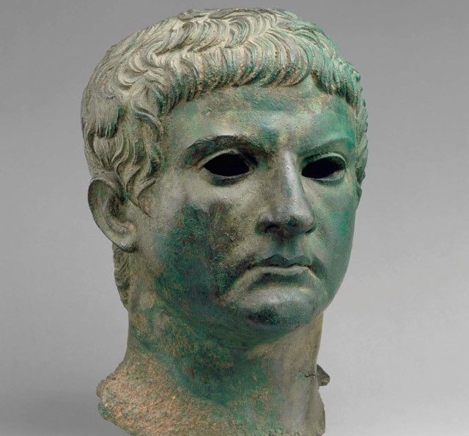
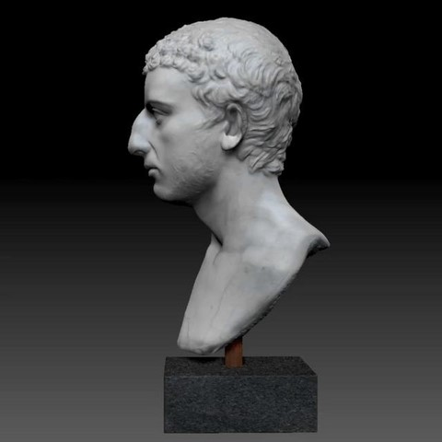

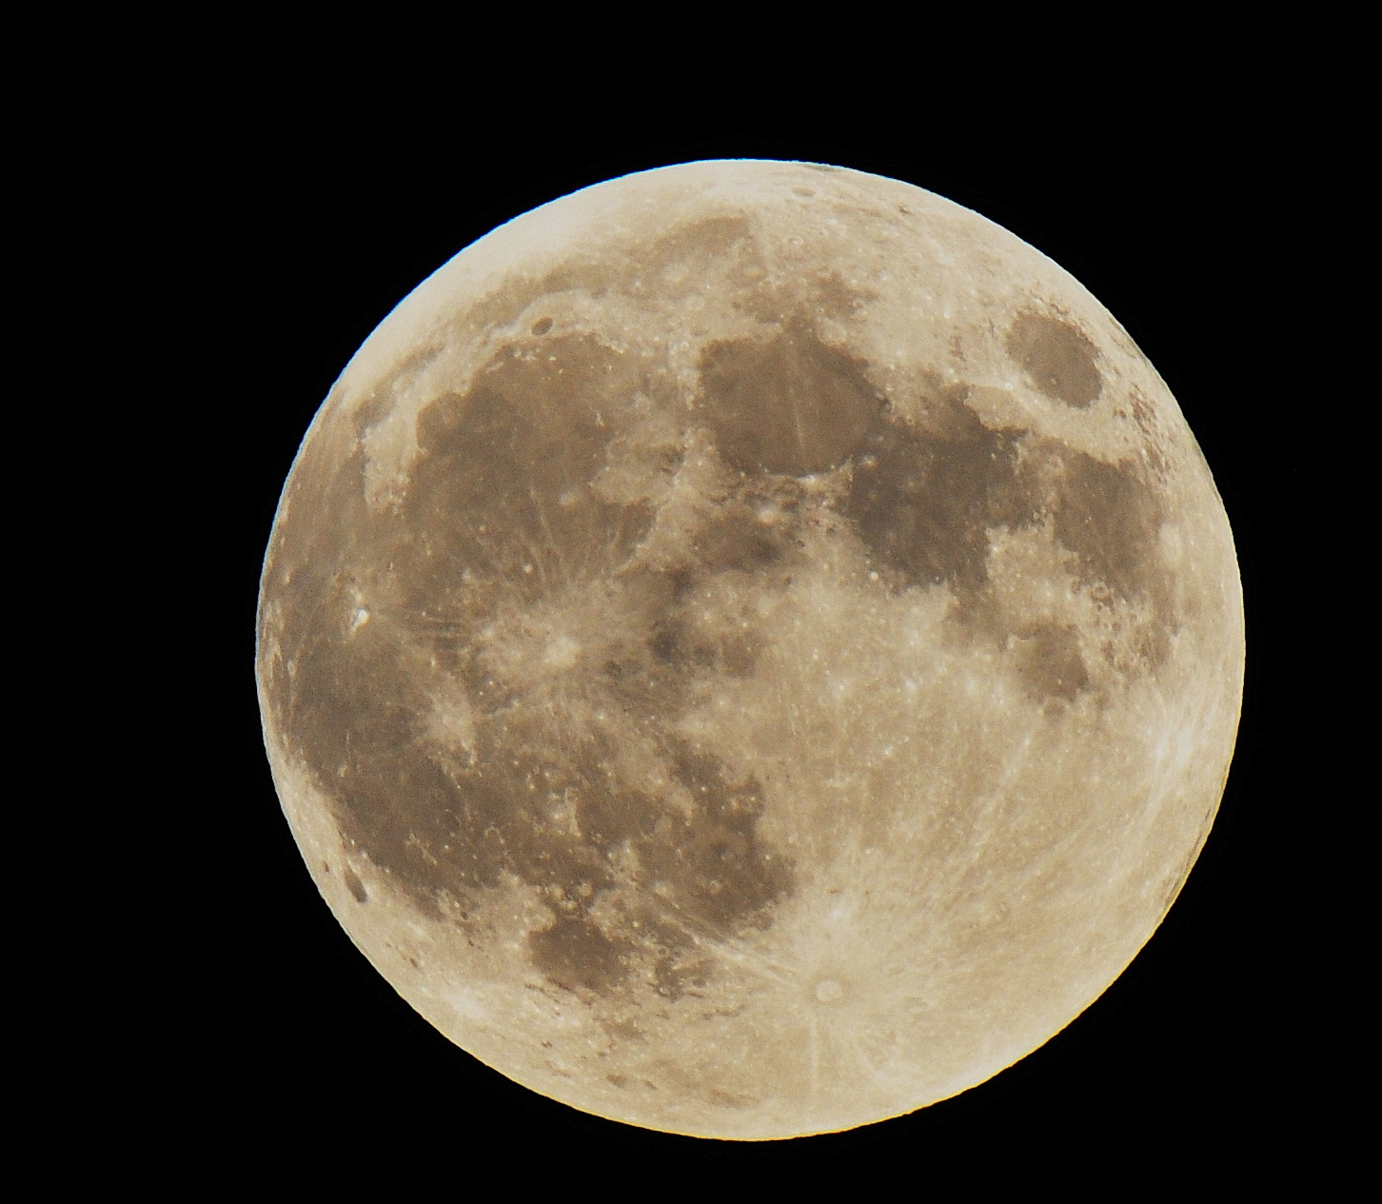
4BC
37BC
Notes:
CLICK
In the writings of Josephus (Josephus, Antiq., I 17 c. 8 s. 1. (191) 8:459)
CLICK
We find that Herod ruled the kingdom for thirty-four years after killing Antigonus and thirty-seven years from the time he was declared to be king by the Romans. CLICK
He started his reign after the death of Antigonus in 37BC – in 31 BC it was the 7th year of his reign and the battle of Actium was recorded (Josephus, War., l. 1. c. 19. s. 2. (370) 2:173,175) – So if we look at these dates the last year of Herod’s 34 year reign would be CLICK 4BC.
There was one other dating method to narrow it down- CLICK Josephus wrote of only one eclipse of the moon in all of his writings – This was on March 13, 4 BC during the year that Herod died.
So Jesus was born before Herod’s death. Actually, there was another writing in the Encyclopedic Celebration of Roman culture written in the early 5th century AD called Macrobius, Saturnalia (Macrobius, Saturnalia, 1. 2. C. 4.) which said: that Augustus heard of the edict of Herod, by which all children who were two years old or under were to be killed. When Augustus heard that one of Herod’s own sons were also killed because of this edict- CLICK Augustus said: “It was better to be Herod’s sow, than his son.”

Slide 4
Matthew 2:14-23 MKJV
14 When he arose, he took the young Child and His mother by night and departed for Egypt,
15 and was there until the death of Herod, that it might be fulfilled which was spoken by the Lord through the prophet, saying, "Out of Egypt I called My Son."
16 Then Herod, when he saw that he was deceived by the wise men, was exceedingly angry; and he sent forth and put to death all the male children who were in Bethlehem and in all its districts, from two years old and under, according to the time which he had determined from the wise men.
17 Then was fulfilled what was spoken by Jeremiah the prophet, saying:
Notes:
Matthew 2:14-23 MKJV
14 When he arose, he took the young Child and His mother by night and departed for Egypt,
15 and was there until the death of Herod, that it might be fulfilled which was spoken by the Lord through the prophet, saying, "Out of Egypt I called My Son."
16 Then Herod, when he saw that he was deceived by the wise men, was exceedingly angry; and he sent forth and put to death all the male children who were in Bethlehem and in all its districts, from two years old and under, according to the time which he had determined from the wise men.
17 Then was fulfilled what was spoken by Jeremiah the prophet, saying:

Slide 5
Matthew 2:14-23 MKJV
18 "A voice was heard in Ramah, Lamentation, weeping, and great mourning, Rachel weeping for her children, Refusing to be comforted, Because they are no more."
19 But when Herod was dead, behold, an angel of the Lord appeared in a dream to Joseph in Egypt,
20 saying, "Arise, take the young Child and His mother, and go to the land of Israel, for those who sought the young Child's life are dead."
21 Then he arose, took the young Child and His mother, and came into the land of Israel.
Notes:
18 "A voice was heard in Ramah, Lamentation, weeping, and great mourning, Rachel weeping for her children, Refusing to be comforted, Because they are no more."
19 But when Herod was dead, behold, an angel of the Lord appeared in a dream to Joseph in Egypt,
20 saying, "Arise, take the young Child and His mother, and go to the land of Israel, for those who sought the young Child's life are dead."
21 Then he arose, took the young Child and His mother, and came into the land of Israel.
.

Slide 6
Matthew 2:14-23 MKJV
22 But when he heard that Archelaus was reigning over Judea instead of his father Herod, he was afraid to go there. And being warned by God in a dream, he turned aside into the region of Galilee.
23 And he came and dwelt in a city called Nazareth, that it might be fulfilled which was spoken by the prophets, "He shall be called a Nazarene."
Notes:
22 But when he heard that Archelaus was reigning over Judea instead of his father Herod, he was afraid to go there. And being warned by God in a dream, he turned aside into the region of Galilee.
23 And he came and dwelt in a city called Nazareth, that it might be fulfilled which was spoken by the prophets, "He shall be called a Nazarene."

Slide 7
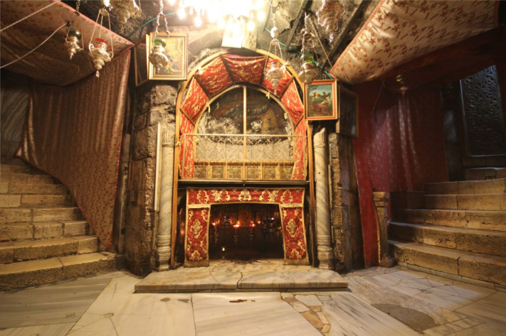
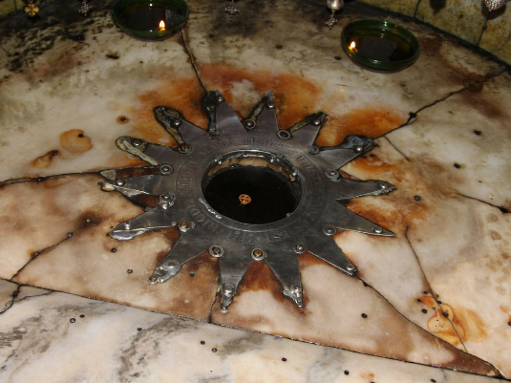
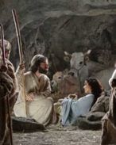
Notes:
Let’s start back into our discussion with where – which I didn’t mention in the title. According to Dr. Titus Kennedy…
CLICK
The traditional birth location of Jesus in a cave is underneath the Church of the Nativity.
We know that Matthew and Luke record the birth of Jesus in Bethlehem, while unnamed people in the Gospel of John referred to this idea (Matthew 2:1-6; Luke2:4-7; John 7:41-42). Because Joseph was from the line of David and his family home was in Bethlehem, he was required to go there for registration of the census. The prophecy found in the Book of Micah shows the link to King David and the birth of Jesus there. We can reference 1 Samuel 17:12 & Micah 5:2.
After the time of Jesus – Christians seemed to have visited the place regularly.
According to early church writers of the 2nd and 3rd century, Jesus was born in a cave in Bethlehem – this was apparently known in antiquity. Origen (lived 185-253AD) reported that pagans spread the word about Jesus being born in a specific cave of Bethlehem (Justyn Martyr, Dialogue with Trypho 78; Origen, Contra Celsus 1.51).
Based on the presence of the manger, the cave was perhaps an animal shelter connected to a house.
During the time of Hadrian as emperor 117 to 138AD… he was rebuilding Jerusalem as a Roman colony named Aelia Capitolina and in the process was covering major sites associated with Jesus, he placed a shrine to Adonis over the location of the birth of Jesus around 135AD (Jerome, Letter 58 to Paulinus). Therefore, even the pagan Roman authorities recognized the significance and importance of Bethlehem as the place where Jesus Christ was born and tried to cover it with the false god of fertility.
CLICK
Finally, Emperor Constantine ordered the Church of the Nativity constructed to commemorate the site in 327AD.

Slide 8

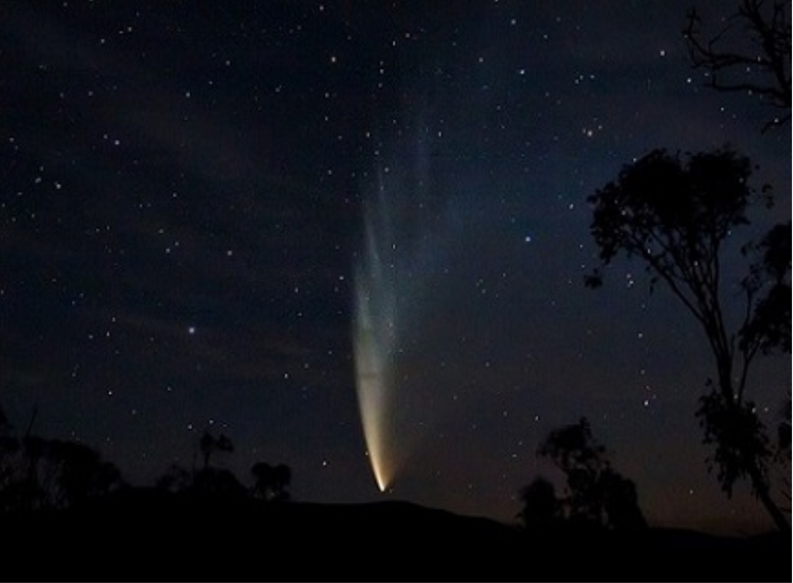
Notes:
Many believe that Christ was born in the months of autumn and winter. But there is another thought about Him being born in spring time and which narrows the year down even more: http://adsbit.harvard.edu/cgi-bin/nph-iarticle_query?bibcode=1991QJRAS..32..389H&db_key=AST&page_ind=0&data_type=GIF&type=SCREEN_VIEW&classic=YES
These writings are at adsbit.Harvard.edu
These are copyrighted by Royal Astronomical Society and are provided by NASA Astrophysics Data System: In 1991 Colin J. Humphreys from the Department of Materials Science and Metallurgy at the University of Cambridge, CB2 3QZ
Wrote a summary of his findings:
Astronomical and historical evidence suggests that the Star of Bethlehem was a comet which was visible in the 5BC, and described in ancient Chinese records. A comet uniquely fits the description in Matthew of a star which newly appeared, travelled slowly through the sky against the star background and ‘stood over’ Bethlehem.
It is proposed that a remarkable sequence of three astronomical events stimulated the journey of the Magi (pronounced may-jie per Cambridge):
the triple conjunction of Saturn and Jupiter in 7BC;
The massing of the three planets Saturn, Jupiter and Mars in 6BC;
And finally the appearance in 5BC of the ‘star of Bethlehem’, a comet initially in Capricornus.
It is shown that each of these events would have been rich in significance to the Magi, and the combination would have provided a very clear sign that a mighty new king was about to be born in Israel.
The evidence points to Jesus being born in the period 5BC March 9- May 4, probably around Passover time: 5BC April 13-27.
Birth in spring is consistent with the account in Luke that there were shepherds living out in the fields nearby keeping watch over their flock by night.
Birth in 5BC is also consistent with some historians due to the census of Caesar Augustus.
The date of the Nativity presented here enables a new chronology of the life of Christ to be constructed which is consistent with the available evidence.
Dr. Titus Kennedy in his book Excavating the Evidence for Jesus: The Archaeology and History of Christ and the Gospels spoke to the year of Jesus Birth… and wrote:
“An analysis of the available information suggests that Quirinius was not the governor of Syria Province at the time of the birth of Jesus of Nazareth, but that as the military commander he would have administered the census ordered by Emperor Augustus, possibly in conjunction with Saturninus. In this scenario, after the census of Augustus was initially ordered in 8BC and Joseph and Mary eventually received word in Galilee, they traveled to Bethlehem, settled into their makeshift accommodations, and eventually Jesus was born, placing the birth around 8BC or perhaps more likely in 7BC.

Slide 9

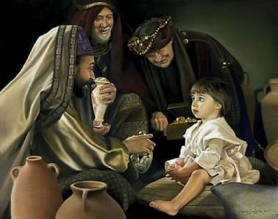
Notes:
Matthew 2:9-12 MKJV
9 When they heard the king, they departed; and behold, the star which they had seen in the East went before them, till it came and stood over where the young Child was.
10 When they saw the star, they rejoiced with exceedingly great joy.
11 And when they had come into the house, they saw the young Child with Mary His mother, and fell down and worshiped Him. And when they had opened their treasures, they presented gifts to Him: gold, frankincense, and myrrh.
12 Then, being divinely warned in a dream that they should not return to Herod, they departed for their own country another way.
The picture here of the wise men is somewhat in line with various accounts and the time frame of how old Christ was when they visited. This could have been when little Jesus was only about 40 days up to 2 years old – some think probably toward the younger side. (Matthew 2:16; Luke 2:22, 39) – It would of took some time to travel once the Magi saw the star or as we have found a comet… There was time before Herod realized these wise advisors, were not coming back to him. That is why Herod had the edict to kill children with the age span of 2 years and under. It is believed the magi came from Babylon or a country near that area. They were most likely familiar with Jewish scripture and knew of the coming Messiah – this land was associated with Daniel and they may have known of Daniels prophecies.
We see three wise men here in the picture – but there were most likely more – it would have probably been a group of 20 or more for the 1000-mile trek through a land filled with bandits.
We see the gifts given to our King – gold representing royalty, and which provided for their trip into Egypt and even their stay there – which would have been costly. The frankincense was symbolic of prayers rising to the heavens. But practically could be used in a variety of medicinal ways… today it is used to reduce feelings of anxiety, stimulate the immune system, it contains anti-inflammatory properties, which also can reduce diarrhea, asthma, wheezing, it helps with oral health, it even eliminates surface and airborne bacteria.
The gift of Myrrh was often used as a burial oil and embalming – this could have been a foretelling of His death to come – but practically it also had medicinal value – it was used for cleaning wounds and to prevent infections from taking hold --- and you know with little boys – there are going to be some boo boos, it has a calming scent to it… current studies have shown that it contains antioxidants – so high that it may support healthy liver function even more so than oranges and other citrus fruits. With its anti-inflammatory compounds it even helps with hay fever and the swelling and itching that comes with it, it is even used to treat symptoms like sneezing, headaches and rashes.
The gifts to our King were practical and a foreshadow of things to come.
So, if we look at scripture, historical writings about the star or comet of Bethlehem – we could gather that Christ was born possibly in spring 5BC to 7BC.
However, with other extrabiblical finds we could think that His birth was December 25th, January 6th, April 2nd even near 2BC – whatever date you may gravitate to we all can see that – in any case -
He was our King when He came as a child incarnate, and He is our King now even as we wait for His Advent to come.
Happy Birthday Jesus!!

