Slide 1
HISTORY
X-mas Traditions
Notes:
Today we are going to look at Xmas traditions. In Christmas past I have asked what are some traditions you have had – this season I want us to think of how traditions may have changed in our lives.

Slide 2
Hazelwood
Family
Tradition
Notes:
As a family we have celebrated a tradition that began when our boys were young.
CLICK
That’s right The Christmas pickle.

Slide 3
Hazelwood
Family
Tradition
Notes:
This year the tradition is going to change – not sure how just yet but with having Joshua move out – the competition has lessoned in finding the pickle hidden in the tree.
This tradition started from a writing on a pickle ornament package – and brought some additional fun to Christmas morning before opening presents.
Now if you read the package when you buy this pickle ornament, it states that it was a German tradition an Old World Custom… parents hide the pickle in the Christmas tree, when the children see the tree for the first time they look for it, the first to find it receives an extra little gift from St. Nicholas.
Problem with this tradition is that I could not find it in German history, either it was done in a small village, or some German-American made it up to sell pickles as ornaments.
For our family in the past - the first to find it gets to open the first Christmas Day gift.
Christmas season is just chuck full of Tradition and we are going to go over some to better understand the whats and the whys.

Slide 4
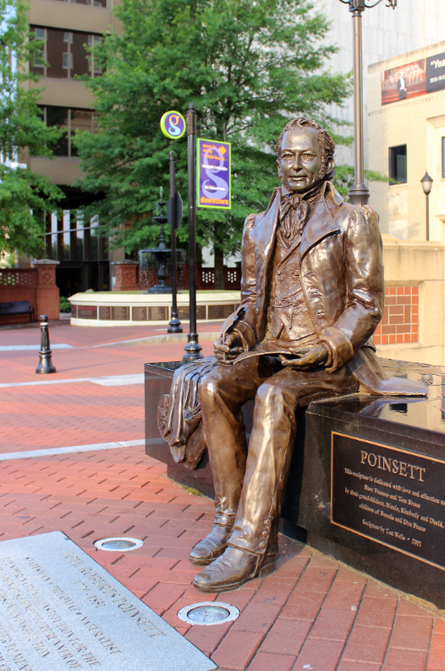
Flower of the Holy Night
Notes:
Does anyone know about the tradition of the poinsettia?
In 1829 the first US Ambassador to Mexico brought back the Click- “Flower of the Holy Night”
So where did it get the name poinsettia?
CLICK
The ambassador's name was Dr. Joel Roberts Poinsett. An American Physician, diplomat and botanist.
With most traditions, there is a story behind it. In regard to the poinsettia: The flower of the Holy Night was said to have sprang up as a poor boy knelt down to worship Jesus.
Dr. Poinsett began planting them in South Carolina and they grew in popularity across the nation. A plant that always seems to be around in the Christmas season.
Maybe because this flower naturally sets bud and produces flowers as the Autumn nights lengthen. It will naturally bloom in November or December.

Slide 5
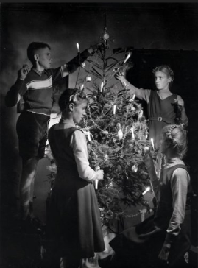
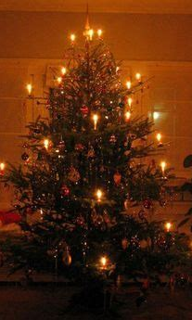
The
Christmas
Tree
Notes:
Does anyone know about the tradition of the Christmas Tree? There are a few as it relates to Christianity.
The first reference in Church writings to a tree was Tertullian in the 200AD’s: “You are the light of the world, a tree ever green, if you have renounced the heathen temple.”
In the 400 AD’s, St, Boniface (Wynfred), was sent by Pope Gregory II as a missionary to heathen Germans at Geismar, where he confronted Chieftain Gundhar, who was about to offer the little Prince Asulf as a “bloody sacrifice” to Thor, their pagan god believed to live in a huge oak tree. St. Boniface boldly took an ax and after a few swings at the mighty “blood” oak, an enormous wind blew the tree over. The heathen were in awe. Then pointing to an evergreen nearby, St. Boniface stated: “This is the word… Not a drop of blood shall fall tonight, for this is the birth-night of Saint Christ, Son of the All-Father and Savior of the world. This little tree, a young child of the forest, shall be a home tree tonight. It is the wood of peace, for your houses are built of fir. It is the sign of endless life, for its branches are ever green. See how it points toward the Heaven! Let this be called the tree of the Christ Child; gather about it, not in the wild woods but in your homes; there it will shelter no deeds of blood, but loving gifts of kindness.”
In 1520, Martin Luther was walking on Christmas Eve under the cold December sky and noticed countless stars illuminating the night. He returned home, and to the delight of his children, set up an evergreen tree placing a great number of small candles on its branches. He told his children of the Christ Child, the Light of the World, whose birth had so gloriously brightened the sky on that first Christmas Eve. He set up a creche’ scene under the tree so that the lights would appear as the stars above Bethlehem.

Slide 6
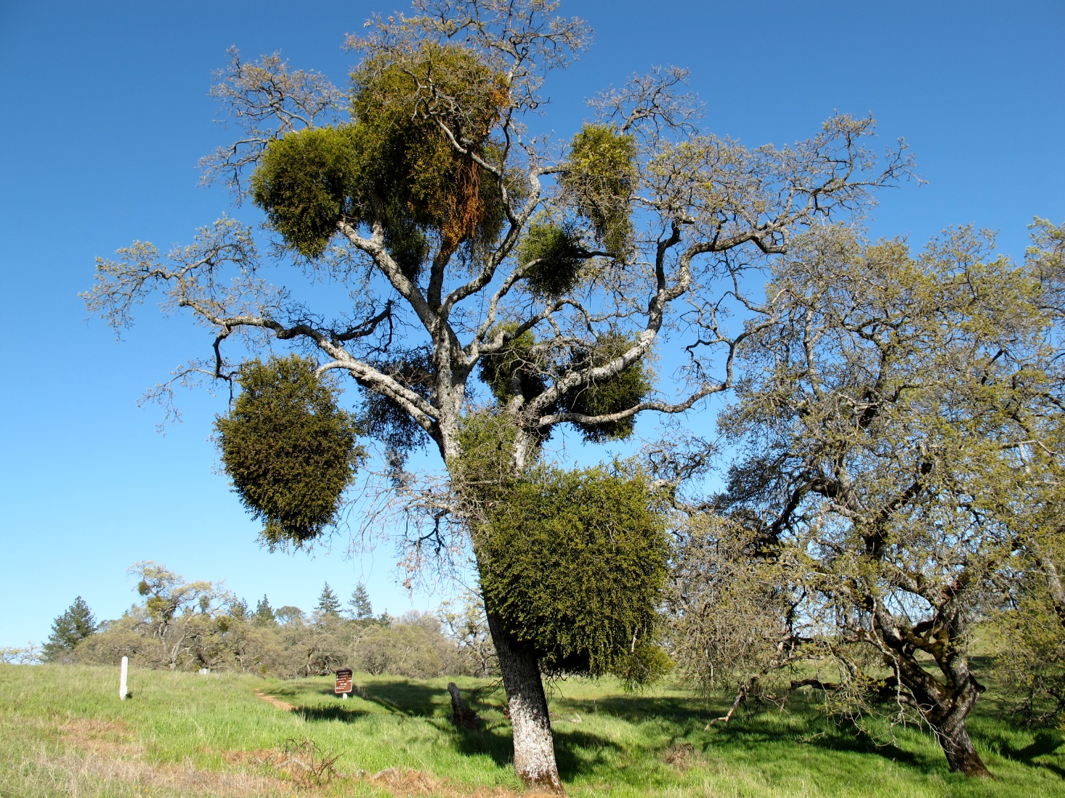

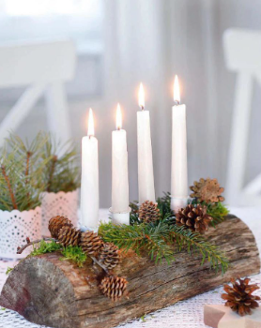
Pagan Traditions
Notes:
Click- What do you think this is?
It is an parasitic plant that comes from evergreens and is known to infest a number of Californian trees… including ash, alser, birch, box elder, cottonwood, locust, silver maple, walnut and zelkova.
It is the Broadleaf mistletoe… tradition states that it was hung by druids to ward off evil spirits. The custom of kissing under it, originated with the Celts and Teutons of Northern Europe.
Celtic druids believed that mistletoe contained the spirit of the tree in which it grew; this was the only part of the tree that stayed green all winter. Norse legends tell the tale of Balder, son of the goddess Frigga.
As the legend goes, Balder was killed by an evil spirit with an arrow made of mistletoe. Saddened by her son's death, Frigga wept tears of white berries, which brought Balder back to life. Frigga was so overjoyed that she blessed the plant and promised a kiss to all who passed beneath it.
CLICK

Slide 7
Pagan Traditions
Notes:
What do you think this is? Yule Log.
Druids had a great ceremony at their winter feast. The Yule Log was blessed. This blessing promised it would bring good luck if it were kept burning during the entire winter solstice. They would keep an unburnt portion of the log to begin the fire the following year. The ashes were thought to bring fertility to the soil.

Slide 8



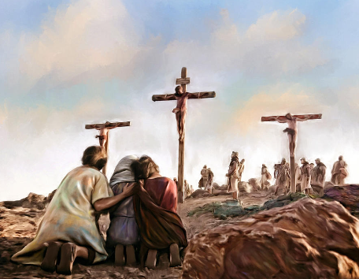

X-mas
X
Notes:
X Mas
The Greek symbol “X” is an abbreviation that means Christos, this is the origin of X mas as Christmas. In 1390, the mark + or X written before the alphabet was called the Cros-Kryst, which means the Cross of Christ. CLICK
By the time 1475 rolled around it evolved into “Criss-Cross” this was from the Middle English pronunciation of “Christ’s-Cross”.
Has anyone ever heard of learning the “Criss-Cross Row”? CLICK This was an expression used for learning the alphabet. In addition the mark “X” stood for the invocation said before reciting the alphabet. Which was: “May Christ’s Cross give me success”.
CLICK
The “Criss-Cross” or “Christ’s-Cross” “X” was also used for a written oath before God, used when signing a document. When a person could not write, they could use an “X” for their signature and often accompanied it with a kiss. CLICK We even see an X in front of a signature line and hear X marks the spot and seal with a kiss.

Slide 9
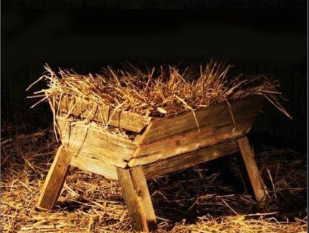
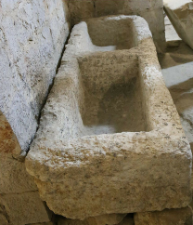
Notes:
Ok first what is this?
Ticket Bonus question --- what is wrong with this representation of the manger?

Slide 10
Notes:
Jesus was then born and placed in a manger in Bethlehem (Luke 2:6-7).
This specific manger is an ancient stone manger found in Nazareth.
The manger would have been stone, which was the typical type of manger used in the area of Bethlehem in ancient times.
Stone is abundant and found almost everywhere, while wood that can be used in construction is relatively scarce.
Kennedy, Titus M. Excavating the Evidence for Jesus: The Archaeology and History of Christ and the Gospels (p. 31). Harvest House Publishers. Kindle Edition.

Slide 11

St. Nicholas
Notes:
Let’s continue with a tradition that has morphed through the ages: Who do think this is?
Click
Old St. Nick.
There have been many legends laced with some truth about this man. But one that really stuck was the tradition of secret gift giving. This was celebrated on the anniversary of his death December 6, 343 AD.
Nicholas is most notably remembered for having helped the family of a nobleman of Patara who had gone bankrupt. Ruthless creditors not only took the nobleman’s property, but threatened to take his three beautiful daughters as well. The father’s only hope was to marry off his daughters before the creditors could take them, thereby saving them from a life of white slavery and prostitution. Unfortunately, he did not have the money for the girls’ dowries, which were necessary to for them to marry.
Nicholas heard of this dilemma and late one night threw a bag of gold in the family’s window to save the eldest daughter from the fate of an outcast. The news spread across town and she was soon lawfully married. Shortly thereafter, Nicholas did the same, rescuing the second daughter. The father is said to have exclaimed:
“O merciful God, Author of our salvation, Who hast redeemed me by Thine Own Blood and now redeemest by gold my home and my daughters from the nets of the enemy, do Thou Thyself show me the minister of Thy mercy and Thy philanthropic goodness. Show me this earthly angel who preserves us from sinful perdition, so that I might know who hath snatched us from poverty which oppresses us and delivers us from evil thoughts and intentions. O Lord, by Thy mercy secretly done for me by the generous hand of Thy servant unknown to me, I can give my second daughter lawfully in marriage and with this escape the snares of the devil, who desired by a tainted gain, or even without it, to increase my great ruin.”
Finally, when Nicholas threw the bag of gold in to save the third daughter, which supposedly landed in one of her stockings set out by the fireplace to dry, the father ran outside and caught him, saying:
“If the Lord great in mercy had not raised me up through thy generosity, then I, an unfortunate father, already long ago would he lost together with my daughters in the fire of Sodom. Now we are saved through thee and delivered from a horrible fall into sin.”
Nicholas, who wanted the glory to go to God alone, made the father swear with an oath not to reveal where the gifts came from while Nicholas was living.
This was the basis for the later tradition of secret gift-giving on the anniversary of Nicholas’ death. The story of these three bags of gold led bankers, money lenders and pawnbrokers to adopt three gold balls as their symbol, as they lent money to those in need.

Slide 12

Kris Kringle
Notes:
Who do you think this is?
Click-
I remember this one when I was a kid- Kris Kringle. But Kris Kringle didn’t begin with this stop motion animation made in 1970 starring Fred Astaire & Mickey Rooney.

Slide 13
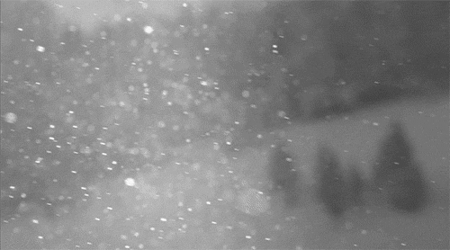
Kris Kringle
“Kris Kindl” (Christkindl)
Notes:
The name Kris Kringle was started by Martin Luther in 1517. Luther ended all prayer to the saints including St. Nicholas. However, he understood the importance of tradition in peoples lives and refocused the attention of the people to an old German name Click- “Kris Kindl” (Christkindl) meaning Christ Child.
Luther taught Christ was the giver of all gifts and our gift-giving should be in remembrance of the great gifts Christ gave us.

Slide 14
Father Christmas
Notes:
This is a Roman silver coin dated to be 104BC- Who do you think is represented on it?
In 1534 King Henry VIII broke free from the English church in Rome due to wanting a divorce from his wife who was unable to produce a male child, divorce was not allowed by the church. He ended all honoring of saints including St. Nicholas, unlike Martin Luther, he didn’t focus on the Christ Child. He also knew that tradition was important and introduced
Click-
Father Christmas, which was a reintroduction of Saturn the Roman god of plenty.
Since England no longer celebrated St. Nicholas’s Feast Day on December 6th, they moved the celebration of Father Christmas to December 25th to coincide with Christmas Day.

Slide 15

Who is St. Nicholas?
Notes:
Traditions varied across different countries in Italy he was named Bobbo Natale
Click-
In France Piere Noel Click-
In Germany Weinachtsmann Click- but he was also accompanied by Krampus Click- for the children who were naughty- Krampus was a chain rattling little devil who would deal with those naughty children.

Slide 16
Who is St. Nicholas?
Notes:
Joulupukki was in Finland.
In Sweden he was called Tomten Click-
Denmark had a superstitious tradition that came from their pagan roots- Nisse Click- was a small gnome like creature that was also referred to as an elf or sprite. This creature was thought to live in your house or barn. It was given to mischief, so it was customary to leave out a plate of porridge on Christmas Eve to appease it. Kind of like leaving a treat so you would not get a trick during Halloween.
In the Netherlands Click- Sinterklaas was known to come by boat to Holland from Spain – he would ride a white horse across the rooftops with his Moorish costumed helper Zwarte Piet – checking on the children. The good kids received gifts, while the naughty kids were brought back to Spain in gunny sacks.

Slide 17
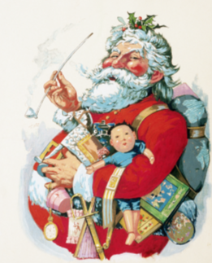
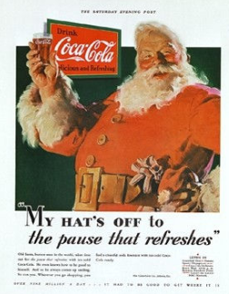
So how did we get to the Santa Claus today?
St. Nicholas – Sant Niklass – Sinter Klaas – Santa Claus
Notes:
So how did we get to the Santa Claus today?
Click- The name St. Nicholas transformed from the Dutch to Sant Niklass to Sinter Klaas to Santa Claus.
In 1860 a civil war illustrator who sketched everything in black and white including Santa was asked by the McLoughlin Brothers publishing to do a final series of cartoons in color. This was the first time Santa Claus had a red suit with white fur trim. Click-
Now we come to our last rendition of Santa Claus- In 1930 Coca Cola hired Haddon Sunblom to illustrate Santa Claus for an advertisement campaign. Haddon portrayed him as a blue eyed, ruby red lips, with a ruddy complexion. Click- this Santa swept across America and as the invention of the television and mass media, marketing, magazines stationary, cards, even store displays grew. The Coca Cola Santa became the image of what people would see Santa as.

