Slide 1


1st Timothy 4:8
“…physical training is of some value…”
Disability and the church conference, April 21st, 2026
Tony D’Orazio, Emily Kullman Phd

Slide 2
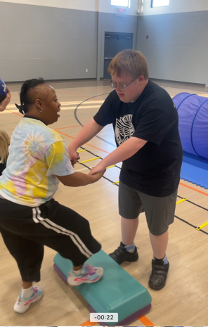
Disability, Obesity, and health
Obesity impacts 40.5% of the disabled population
  Compared to 30.3% of the non-disabled population
Associated with a myriad of diseases
  Cardiovascular disease
  Metabolic disease
  Neurological/mental disease
  Cancer

Slide 3
Obesity, metabolic health, and brain health
Obesity significantly increases the risk of stroke, anxiety, and depression
Metabolic disease (insulin resistance, diabetes), regardless of obesity status, significantly increases the risk of dementia, particularly in younger people, as well as Alzheimer’s Disease
  Alzheimer’s sometimes referred to as “type III diabetes”
  Associated with insulin resistance in the brain

Slide 4
Benefits of Exercise
Physical Benefits
Mental and Emotional Benefits
Improved cardiovascular health
Improved metabolic health
Improved muscular health
Reduced likelihood of many diseases
  Heart disease
  Diabetes
  Cancer
  Hypertension
Reduced anxiety
Reduced depression
Improved mood
Reduced likelihood of neurodegenerative diseases
  Alzheimer’s Disease
  Dementia
  Parkinson’s Disease
  Stroke

Slide 5
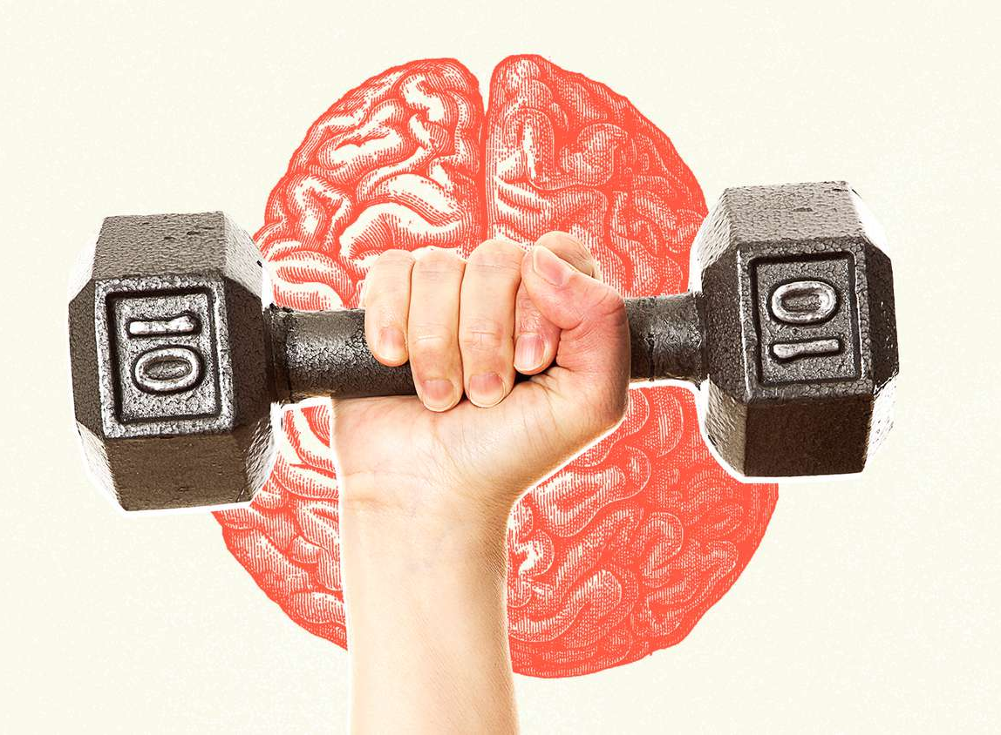
Physical Activity and Brain Health
Mechanisms of improved brain health
  Reduced obesity
  Improved brain blood flow
  Reduced inflammation
  Improved insulin signaling
  Increased brain-derived neurotrophic factor (BDNF) signaling
    Associated with improved learning, cognition, and nervous system health

Slide 6
Down syndrome, physical activity, and Alzheimer’s disease
Preliminary Data
Compared adults with Down Syndrome who regularly exercise to sedentary adults with Down Syndrome
Exercise group had
  Lower fasting glucose
    Indicates better metabolic health

Slide 7
Down syndrome, physical activity, and Alzheimer’s disease
Preliminary Data
Compared adults with Down Syndrome who regularly exercise to sedentary adults with Down Syndrome
Exercise group had
  Lower fasting glucose
  Lower HbA1c (>5.6 = pre-diabetes)
    Further confirms better metabolic health

Slide 8
Down syndrome, physical activity, and Alzheimer’s disease
Preliminary Data
Compared adults with Down Syndrome who regularly exercise to sedentary adults with Down Syndrome
Exercise group had
  Lower fasting glucose
  Lower HbA1c (>5.6 = pre-diabetes)
  Higher BDNF (Brain-derived neurotrophic factor)
*Higher BDNF is associated with improved cognitive abilities and lower levels of neurodegenerative disease, including Alzheimer’s Disease

Slide 9

How much exercise do you need?
(Probably not as much as you think!)
ACSM Guidelines
  Moderate-intensity aerobic physical activity (PA) for 30 minutes, 5 days per week, OR vigorous-intensity aerobic PA for 20 minutes 3 days per week
    Can be a combination of moderate and vigorous activity
    Can accumulate a total of 30 minutes by performing multiple bouts of at least 10 minutes
  Muscular strength and endurance activities targeting all major muscle groups at least 2 non-consecutive days per week

Slide 10
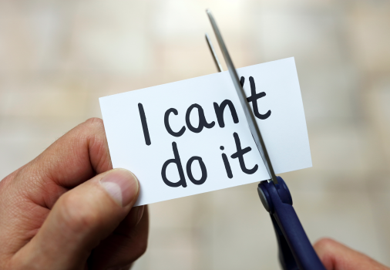
Barriers to physical activity in those with disabilities
Degree of disability
Access to adequate facilities
Caregiver perceptions
Lack of expectations

Slide 11
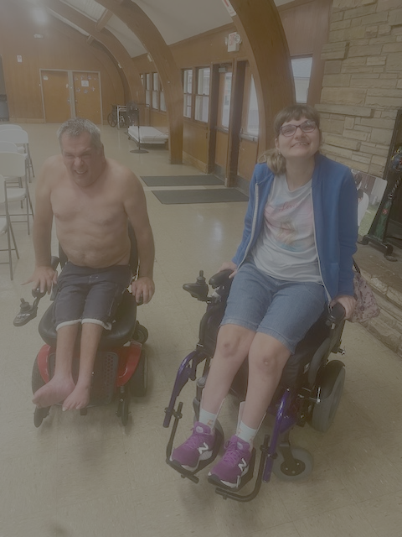
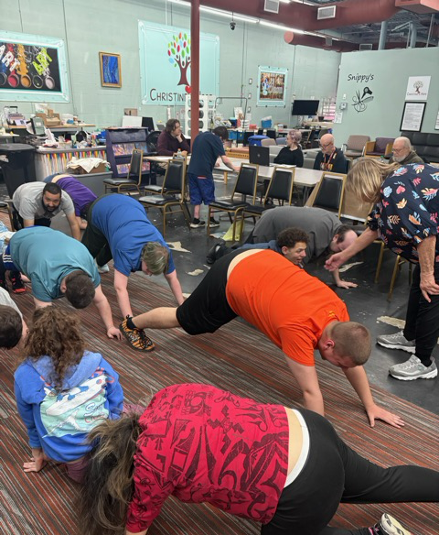
Role of the church
Disability ministry
Facility/equipment
Personnel
  Special Strong
  Autism Fitness
  Adaptive Fitness
Consultation

Slide 12
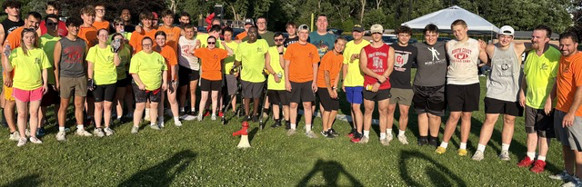
References
American College of Sports Medicine, “ACSM’s Guidelines for Exercise Testing and Prescription”, 12th ed. 2026.
Centers for Disease Control (CDC), “Disability Impacts All of Us”, https://www.cdc.gov/disability-and-health/articles-documents/disability-impacts-all-of-us-infographic.html
Mahindru A, Patil P, Varun A. “Role of Physical Activity on Mental Health and Well-Being: A Review”. Cureus, 7;15(1):e33475, 2023.
Mahalakshmi B, Maurya N, Lee S, Kumar B. “Possible Neuroprotective Mechanisms of Physical Exercise in Neurodegeneration”. Int J Mol Sci, 16;21(16):5895, 2020.
Wang M, et al. “Obesity, Metabolic Health, and Brain Health: Insights from a Prospective Cohort Study”, J Affect Disord, 1;392:120184, 2026.

Slide 13
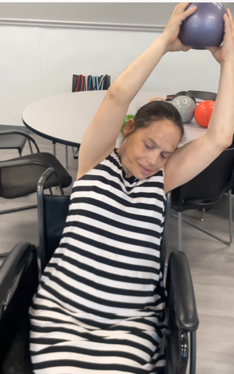
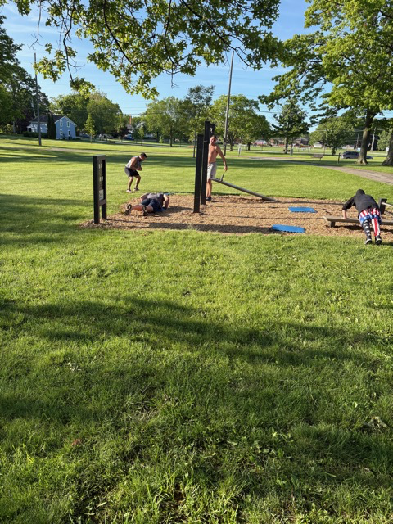
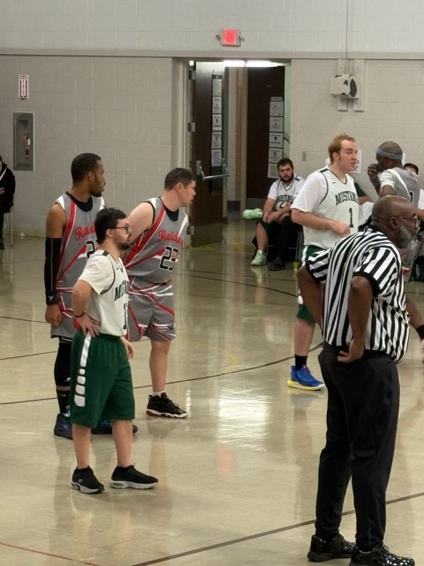

Questions?

Slide 14
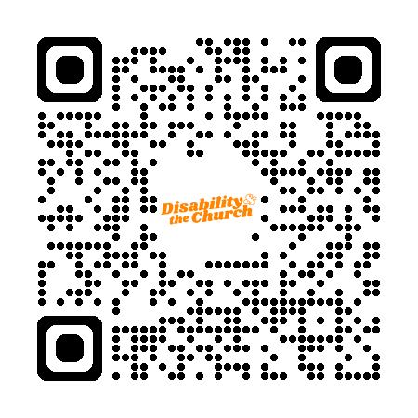

Thank you!
SCAN BELOW FOR JACOB'S LADDER'S NEXT VIRTUAL BIBLE STUDY (FACEBOOK EVENT PAGE)
SCAN BELOW FOR RESOURCES FROM THIS PRESENTATION

