Slide 1



Plantos Verde: Transform Your Harvest with Nature’s Finest Solution
Revitalize Your Crops | Boost Your Yield | Cultivate Sustainability

Slide 2
What is Plantos Verde®?
A cutting-edge agricultural solution designed to unlock the full potential of your crops and soil
Engineered to restore plant vitality, enhance resilience, and promote sustainable farming
Focused on boosting photosynthesis, water regulation, immunity, and root biomass
Delivers healthier plants, higher yields, and a greener future
Key Benefits of Plantos Verde®
Unmatched Yield Increases
Experience a proven 20% to 30% boost in crop yield, maximizing your harvest and profitability
Elevated Saccharose Content
Increase Saccharose levels by 2% to 3%, thus enhancing the quality and market value of your products
Superior Resilience
Strengthen plants against environmental stressors, ensuring consistent performance in challenging conditions
Earlier Harvests, thus better use of investments and soil
Accelerate crop maturity, allowing you to bring your produce to market faster
Sustainability at Heart
Promote eco-friendly farming practices by improving plant and soil health, reducing the need for chemical inputs
Robust Plant and Soil Health
Foster stronger root systems and enhanced soil vitality for long-term agricultural success

Slide 3
Why Choose Plantos Verde®
Plantos Verde® is more than just a product-it's a promise of excellence
By optimizing photosynthesis and water regulation, it ensures your crops thrive under any conditions
The result: healthier plants with increased immunity and root biomass
Leads to higher yields and better-quality produce
Suitable for growing fruits, vegetables, or grains
Your partner in achieving exceptional results while prioritizing sustainability
Join Plantos Verde® Revolution
Plantos Verde® is trusted by farmers who demand the best for their crops and the environment
By choosing Plantos Verde®, you are not just investing in a product, you are investing in the future of your farm and the health of your people working there
By applying Plantos Verde® you reduce the CO2 footprint of your farm and production
And you participate in a reduction of CO2 contents of the atmosphere by increasing the portion of biomass remaining in the soil after each crop
Increase your yields, improve crop quality, and contribute to a sustainable world
Enjoy the peace of mind that comes with our money-back guarantee

Slide 4
Our Money-Back Guarantee
We stand behind Plantos Verde® with unwavering confidence.
If Plantos Verde® does not deliver the following results, we offer a full money-back guarantee (terms and conditions apply, with AGRIMEDIC present during all applications):
Minimum 5-10% Yield Increase
Watch your production soar
Increased Brix Reading
Achieve sweeter, higher-quality crops
Enhanced Biomass
Stronger, more vigorous plants
Improved Root Development, thus more biomass remaining in the soil
Improve retention of humidity by increase of root-biomass
Build a foundation for healthier crops
Elevated Protein Levels
Boost nutritional value for superior produce
Produce more uniform fruits
Improve the storage capacity of fruits

Slide 5
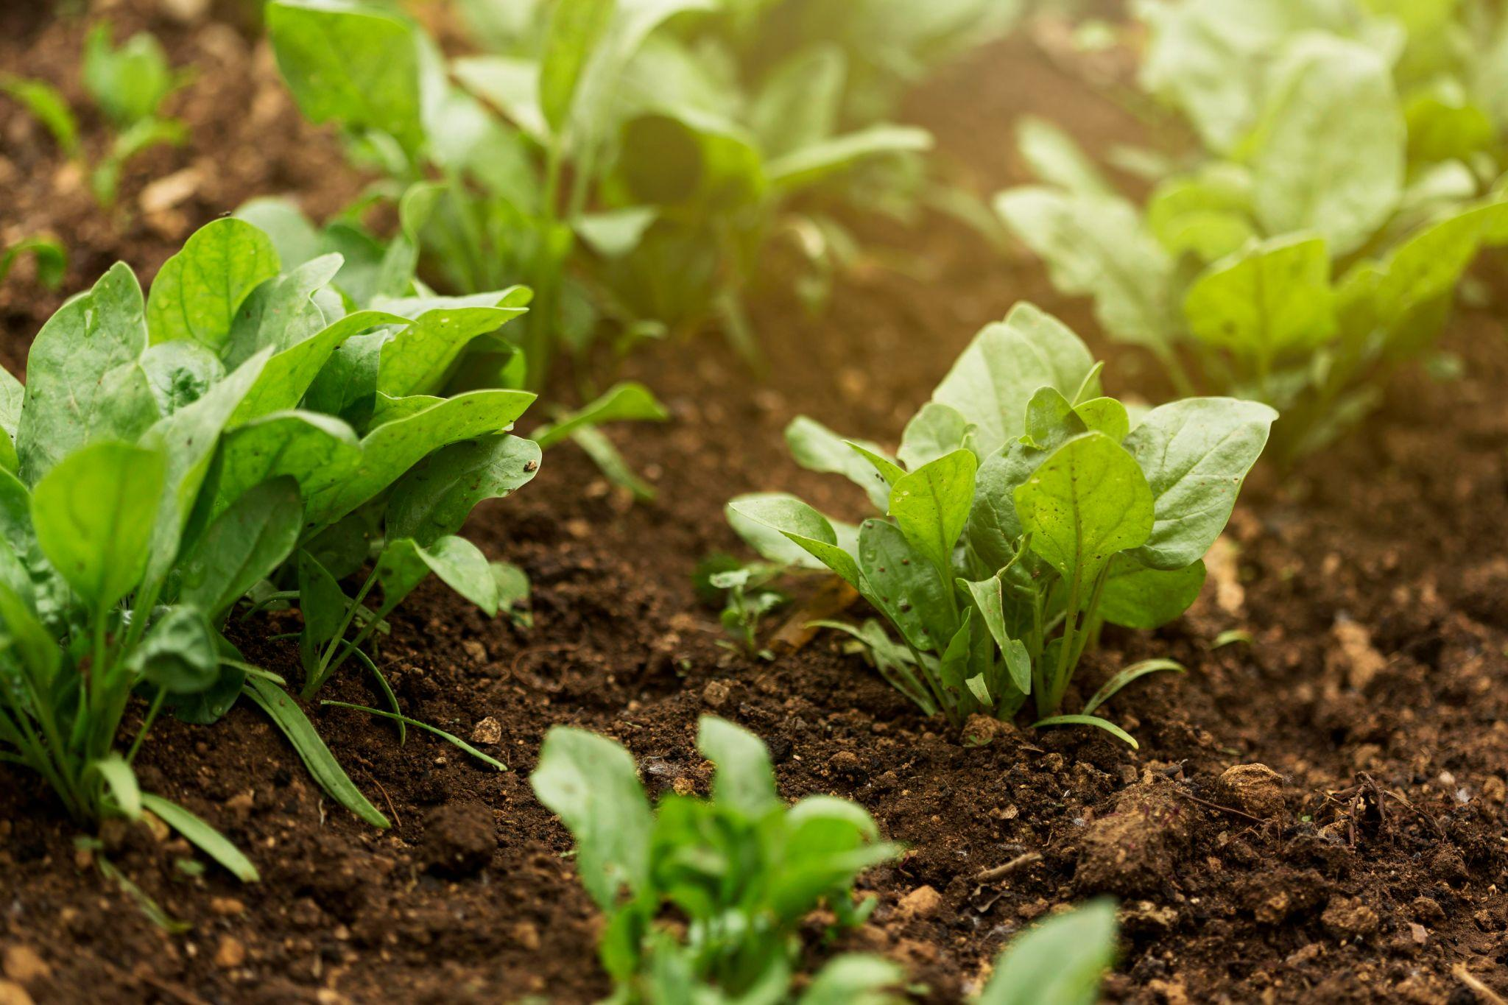
Contact Us Today
Ready to transform your harvest?
Visit https://agrimedic-global.com/or contact our Atisang Molapo at am@agrimedic-global.com
Learn how Plantos Verde can elevate your farming operation
Let’s grow stronger, healthier, and more sustainable crops together!

