Slide 1
Quality Management 101
Adapted for CHPC Quality and Performance Measure Team
Presented by
Dionne N. Kotey, MPH
City of New Haven Ryan White Part A Office
January 16, 2020

Slide 2
Key Definitions to Remember
Quality
Performance Measure
Quality Assurance (QA)
Quality Improvement (QI)
Continuous Quality Improvement (CQI)
Quality Management (QM)
Indicator
Outcome

Slide 3
Quality
The degree to which a health or social service meets or exceeds established professional standards and user expectations.
Notes:
This is about improving the quality of lives for our clients. How well are we doing with engaging and retaining clients in care, so they can achieve viral suppression.

Slide 4
Performance Measurement
The process of collecting, analyzing, and reporting data regarding patient care, health outcomes on an individual or population level, and patient satisfaction.

Slide 5
Quality Improvement (QI)
Refers to the development and implementation of activities aimed at improving performance.
Notes:
There various QI methods e.g. Model for improvement, Lean six sigma. It is important to document QI initiatives so as to keep track of changes or improvements.

Slide 6
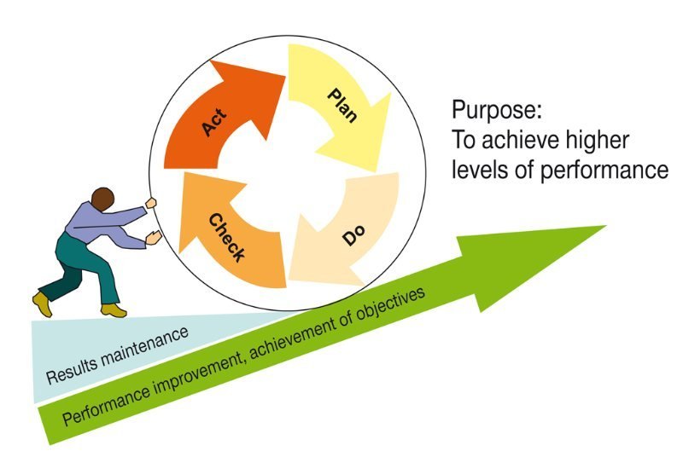
Continuous Quality Improvement (CQI)
The ongoing monitoring, evaluation and improvement processes.

Slide 7
Quality Assurance
Refers to a broad spectrum of activities aimed at ensuring compliance with minimum quality standards. Examples include site visits and chart audits.
Notes:
Retrospective process of measuring compliance eg professional guidelines, HHS guidelines and service standards put forth by the planning council. The most common forms of QA include site visits and chart reviews.

Slide 9
Indicator
Measure used to determine, over time, an organization’s performance of a particular element of care. The indicator may measure function, process or outcome.

Slide 10
Outcome
Benefits or other results (positive or negative) for clients that may occur during or after their participation in a program. Outcomes may be client-level or system-level.

Slide 11
Key Characteristics of Quality Management (QM) Programs
Systematic process that includes leadership accountability and dedicated resources.
Use of data and measurable outcomes to determine progress toward relevant, evidence-based benchmarks.
Continuous process that is adaptive to change and that fits within the framework of other programmatic QA and QI activities.
Data collected is used to provide feedback into the process and to assure that goals are accomplished and that they are concurrent with improved outcomes.

Slide 12
‘QI is not QA’
 | Quality Assurance | Quality Improvement
Motivation | Measuring compliance with standards | Continuously improving processes to meet standards
Means | Inspection | Prevention
Focus | Individuals, “bad apples” | Processes and Systems
Responsibility | Few | All

Slide 13
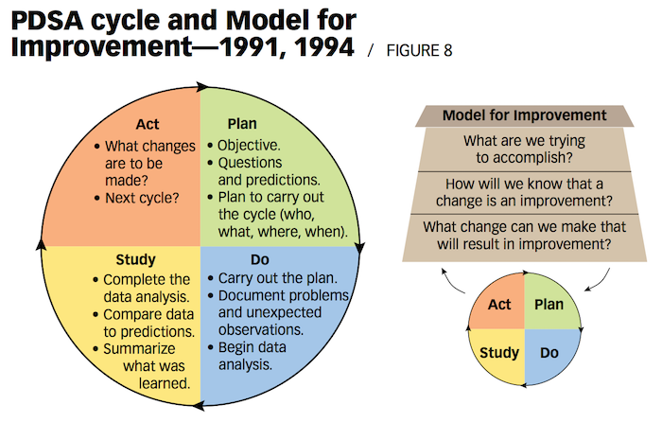
Model for Improvement & PDSA Cycle
How can we drive change and improvements in HIV programs?

Slide 14
Example PDSA Project StayWell Health Center – Waterbury, CT Lead: Kathyleen Pitner

Slide 15
01
PLAN
PDSA
02
Objective
To identify barriers and capture missing data
Prediction
Syphilis screening rates will continue to increase, reducing barriers to data entry and collection practices by the end of the grant year
REPORT
03
2019
04
P1_Improve Response Rates
Medical Case Managers (MCMs) will request missing laboratory results 30 days prior to a client’s visit
05
SYPHILIS
P2_Improve Data Collection
MCMs will collect missing laboratory result via stakeholder collaboration
P3_Improve Data Input
Files will be audited monthly against database systems (CAREWare and Intergy) to both identify discrepancies and ensure accurate and timely input of data into CAREWare

Slide 16
01
DO
PDSA
02
P1_MCMs were consistent with requesting missing laboratory results within the established time frame.
P2_MCMs collaborated with external infectious disease (ID) providers to achieve patient adherence or medical compliance: Missing labs were ordered, and clients were notified of their need to be screened prior to scheduled appointments.
P3_MCMs files (hard copies) of noncompliant clients were audited against CAREWare and Intergy (EMR) to determine the quality of performance and to update CAREWare with the latest findings.
REPORT
03
2019
04
05
SYPHILIS

Slide 17
01
STUDY
PDSA
Quarter-End Results for Years 2018 and 2019
Numerator: Clients Meeting the Performance Measure
02
57.2%
31-October 2018 (Baseline)
(141/247)
REPORT
03
2019
57.2%
30-November 2018
(141/247)
04
72.7%
28-February 2019
(181/249)
05
SYPHILIS
31-May 2019
(204/254)
80.0%
79.9%
31-August 2019
(179/224)

Slide 18
Not Meeting Performance Measure (n = 53)
Meeting Performance Measure (n = 179)
SYPHILIS: STUDY_DEMOGRAPHICS (79.9%)
By Deserray James-Green

Slide 19
01
ACT
PDSA
02
Restart the cycle at the planning phase
Rationale
The intervention achieved results, but there is an opportunity for better outcomes. To that end, the current process will be modified in the next planning phase to include new collaborative activities.
REPORT
03
2019
04
05
SYPHILIS

Slide 20
Resources for Quality Improvement
https://targethiv.org/cqii
HIV Measures
Change Ideas
Best Practices
Tools/Resources
Literature
FAQs

Slide 21
Participating on a Quality Management (QM) Team
Clifford Batson

Slide 22
Ryan White Hartford’s QM Team
Focuses on improving specific performance measures
Reviews data on measures
Identified measures to improve
Organizations like CHS present quality improvement projects for identified measures
Hartford has consistently met our goals – we are making a difference for people living with HIV

Slide 23
My Experiences and Role on the Team
Received training and support from Peta-Gaye – learned about data and quality improvement
Listen to presentations, take notes, and review at home to better understand the data
Ask other QM members questions about the data to continue learning
Recruit consumers to participate on the Planning Council and QM Team – share my experiences and why it’s important. It takes time to learn all the aspects of QM, but consumers need to understand the data. This makes a difference in the quality of our care.

