Slide 1
Partner Services STD Control Program
Linda Ferraro, STD Program Director
CT HIV Planning Consortium
QPM Team Meeting
February 19, 2020
Connecticut Department of Public Health
Keeping Connecticut Healthy

Slide 2
What is Partner Services?
Partner Services is a free and confidential health department program that assists in linking STD and/or HIV infected persons and their partners to testing, treatment, medical care, prevention interventions and/or other appropriate support services in order to improve their health outcomes and reduce the risk of transmission to others.
Those patients are actively sought by field staff to assure that they and their partners receive adequate treatment and follow up services.
Medical providers should emphasize partner notification services with all infected patients.
Partners are confidentially located for screening and treatment by trained field staff (Disease Intervention Specialists-DIS) without divulging the identity of the infected patient.

Slide 3
Partner Services - Statutes & Laws
Sec. 19a-215 (5)(d). Commissioners' lists of reportable diseases, emergency illnesses and health conditions and reportable laboratory findings.
When a local director of health, the local director’s authorized agent or the Department of Public Health receives a report of a disease or laboratory finding on the commissioner’s lists of reportable diseases, emergency illness and health conditions and laboratory findings, the local director of health, the local director's authorized agent or the Department of Public Health may contact first the reporting health care provider and then the person with the reportable finding to obtain such information as may be necessary to lead to the effective control of further spread of such disease. In the case of reportable communicable diseases and laboratory findings, this information may include obtaining the identification of persons who may be the sources or subsequent contacts of such infection.

Slide 4
Partner Services - Statutes & Laws
Sec.19a-584. Informing and warning of known partners of possible exposure to the HIV virus.
(a) A public health officer may inform or warn partners of an individual that they may have been exposed to HIV under the following conditions: (1) the public health officer reasonable believes there is a significant risk of transmission to the partner; (2) the public health officer has counseled the protected individual regarding the need to notify the partner and the public health officer reasonable believes the protected individual will not inform the partner; (3) the public health officer has informed the protected individual of such officer’s intent to make sure disclosure. The public health officer may also warn or inform a partner at the request of a protected individual.

Slide 5
Partner Services - Statutes & Laws
Sec.19a-584 (con’t)
When making such disclosure to the partner the public health officer shall provide or make referrals for the provision of the appropriate medical advice an counseling for coping with the emotional consequences of learning the information and for changing behavior to prevent transmission or contraction of the HIV infection. The public health officer shall not disclose the identify of the protected individual or the identity of any other partner. The public health officer, making a notification, shall make sure disclosure in person, except where circumstances reasonably prevent doing so. The public health officer shall make a good faith effort to notify the partner of the risk of HIV infection. The public health officer shall have no obligation to warn or inform, identify or locate any partner.

Slide 6
Partner Services - Statutes & Laws
Sec. 19a-584 (con’t)
(b) A physician may warn or inform a known partner of a protected individual if both the partner and the protected individual are under the physician’s care or the physician may disclose confidential HIV-related information to a public health officer for the purpose of informing or warning partners of the protected individual that may have been exposed to HIV, under the following conditions: [same as (a) () – (3)].
(c) For the purposes of this section, “public health officer” means an employee of the Department of Public Health designated by the commissioner or if authorized by the commissioner, a local health director or designee.

Slide 7
DIS Partner Services Process
After receiving lab report or referral
Contact individual – “Index patient” through field visits, letters, phone calls
Interview
Confirm treatment and linkage to care
Verify demographics and identify risk profile
Provide education and prevention messaging
Solicit partner information – name/s, contact information, locating information
Reassure confidentiality
Identify barriers to resources and care
Work to locate and contact partners or assist index patient in notifying partner/s

Slide 8
Reporting Requirements
CDC PS 18-1802 Partner Services data collection requirements variables (handout)
Part 1: Index Patient Demographics

Slide 9
Reporting Requirements
Part 2
Partner Demographics
Part 3
Partner Test & Referral to Care

Slide 10
REFERRAL FOR HIV CLIENTS
KEY TO REDUCING HIV & STD TRANSMISSION AND SUCCESSFUL PARTNER SERVICES
Complete Client Referral Form for Partner Services
Send all labs
Need information from chart on:
CT
GC
Hepatitis C
TB
Viral load and CD4 count
Dates associated with all tests and results

Slide 11
REFERRAL FOR HIV CLIENTS
Partner Referral Form for Partner Services
Complete if you have information on a partner that the client has disclosed to you
Complete one form for each partner
HIV Referral – Checklist
Inform the client that the State Health Department will be contacting them to provide partner services and information on supportive resources
Complete all information listed on form(s)
Call and speak with a DIS Regional Supervisor
Fax referral forms and labs
Use a coversheet for your agency

Slide 12
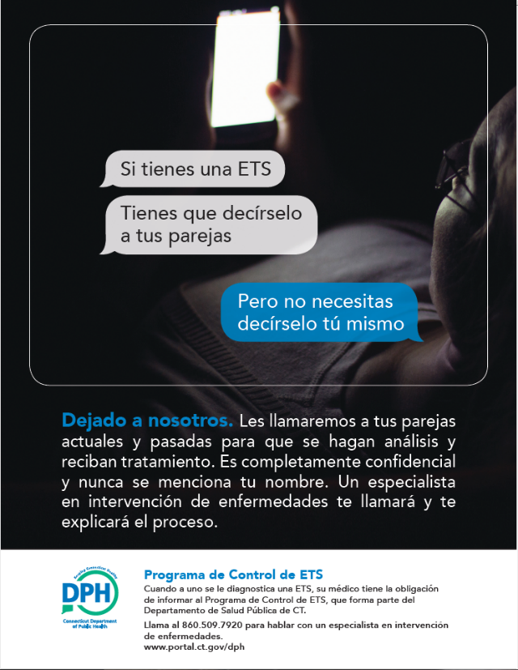
Partner Services Media
Video – “Leave it to Us”

Slide 13
Region Supervisors
Region 1
Ava Nepaul, DIS Supervisor
(860) 509-8239
Region 2
Wanda Richardson, DIS Supervisor
(203) 946-7233

Slide 14
QUESTIONS
Contact Information:
Linda Ferraro (860) 509-8203
linda.ferraro@ct.gov

