Slide 1
Healthier Housing Systems = Healthier Youth Living with HIV”
Quality Improvement Summit
October 18th2023

Slide 2
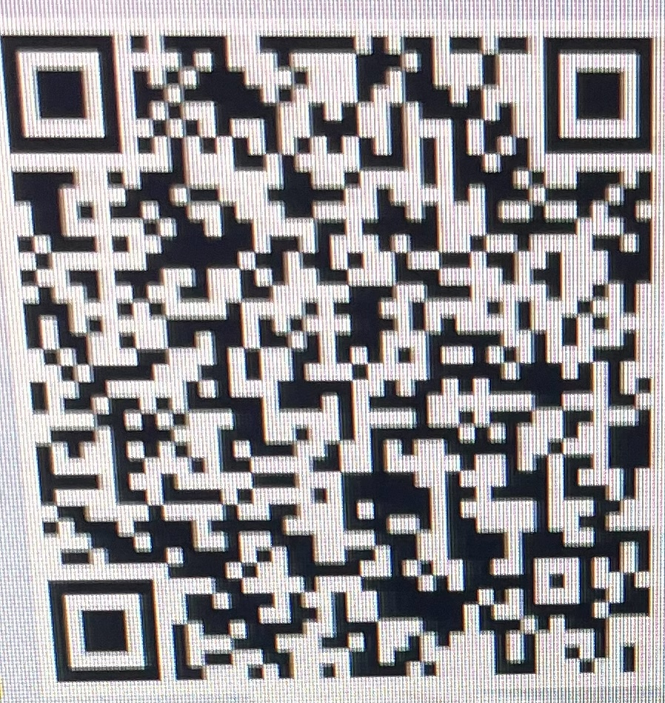
“Healthier Housing Systems = Healthier Youth Living with HIV”
Danielle Warren-Dias, MS Community Health Program Director
Nilda Fernandez-Betancourt, LMSW Community Health Program Clinical Supervisor
Consuelo Munoz, MSc. Community Health Worker/Housing Navigator
UConn Health/CT Children’s Pediatric, Youth and Family HIV Program
Notes:
Danielle

Slide 3
Quality Improvement Objectives for Housing Program
Innovation in leveraging funding
Community partnerships
Nuances of housing for youth and young adults experiencing homelessness
Housing as health care and prevention
Ways to leverage pertinent services
Notes:
Nilda

Slide 4
Program Principles
Community oriented-Pulse on the needs of the community in real time
Client-centered
Culturally Responsive & Inclusive
Strength-based Approach – From Emergency Housing to Home Ownership
Notes:
Consuelo

Slide 5
Care and Treatment Services
Outpatient/Ambulatory Medical Services
Medical Case Management
Nutritional
Peer to Peer Psychosocial Groups
Food Vouchers
Medical Transportation
Notes:
Nilda

Slide 6
Prevention Services
Hartford Youth Health Identification and Linkage (HYHIL) Consortia
Routine HIV Testing
PrEP Navigation
Notes:
Nilda

Slide 7
Youth Housing Stabilization Program-Background
Awarded for the 2019-2020 RWHAP, Part D Supplemental funding for our Youth Housing Stabilization Program. Viral load for youth experiencing homelessness was 43%.
Granted – 3 components:
Establish an emergency shelter appropriate for youth, particularly for LGBTQ+ youth
Assigned a Specific Housing Specialist/Navigator
Mandated by HRSA – establish or participate in a youth housing network.
In 2020, COVID19 Pandemic– homelessness reached a peak among youth and women
Notes:
Danielle
We felt there were disjointed recourses for youth living with HIV (adult focused programs)

Slide 8
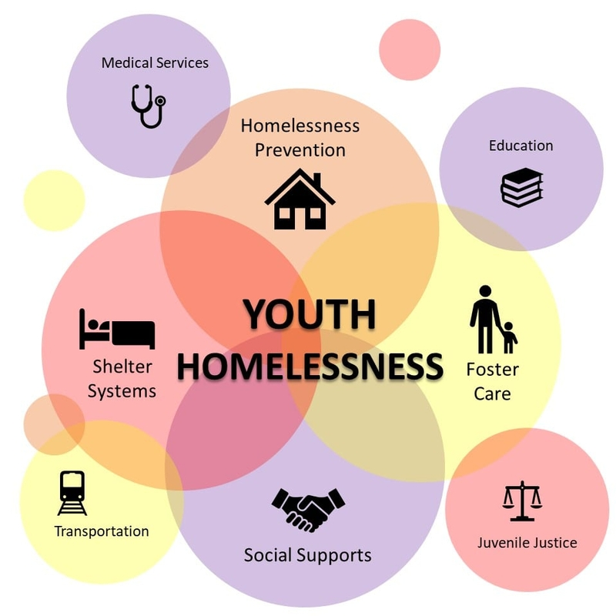
Best Practices
Environmental Landscape (i.e., COVID19 - need to be flexible/nimble to address the immediate needs of individuals-real time).
Leveraging/Blending Funding Sources
Ryan White HIV/AIDS Program (RWHAP) Parts A, B, D and 340B
Notes:
Danielle

Slide 9
Interactive activity
What other funding resources would you add?
Notes:
Nilda

Slide 10
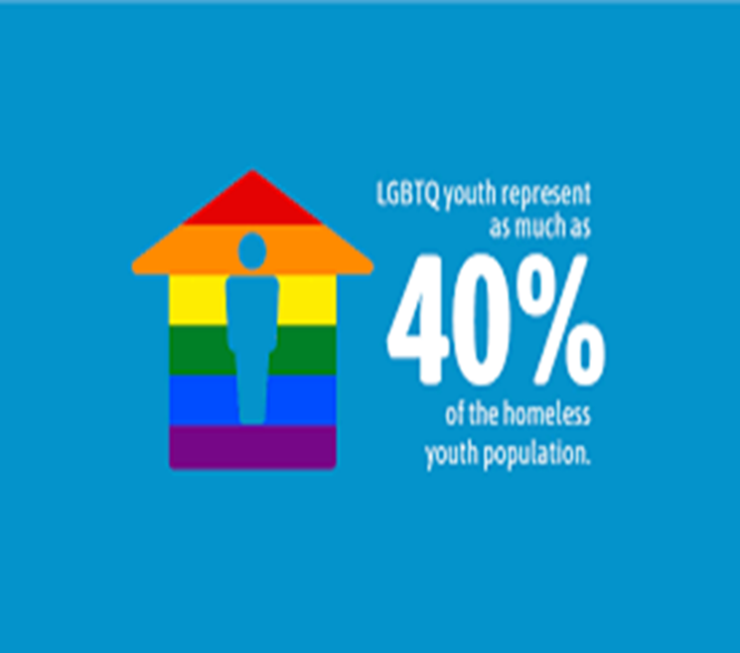
Emergency Shelter/Shelter Placement
Think outside of box to leverage resources
CT Dept. of Housing (DOH)
LGBTQ+ Youth - Partnered with San Juan Center, Inc. rooming house and provide career/employment services.
Ryan White HIV/AIDS Program (RWHAP)
Referrals to RW Client Assistance/Housing Services
Emergency Shelter/Hotel stays start at 21days with options for extensions 2 week per extensions.
Notes:
Consuelo
All youth are referred to HOPWA via Housing Support specialist
Youth Solutions meetings.
to circumvent a broken housing system. (Intake appointment to verify homelessness –1-2 weeks later.).
Citation:
2 Romero AP, Goldberg SK, Vasquez LA. LGBT people and housing affordability, discrimination, and homelessness. Los Angeles: The Williams Institute UCLA School of Law; 2020. Available at https://williamsinstitute.law.ucla.edu/wp-content/uploads/LGBT-Housing-Apr-2020.pdf 3 Choi SK, Wilson BDM, Shelton J, Gates G. Serving our youth 2015: The needs and experiences of
Special Opportunities for Adolescent Residents (SOAR)

Slide 11
Housing Navigation
Dedicated staff to help clients navigate through the housing continuum/Housing Navigator
Housing Opportunities for People Living with HIV/AIDS (HOPWA)
Referrals
Follow Up
Advocacy
Notes:
Consuelo

Slide 12
Housing Navigation Process
1. ACCESS
Hotel
Rooming House
Adolescent mothers with Children
Youths (LGBTQ+)
1. Call 211
Access to:
(CAN) Coordinated Access Network
(# HMIS) Homeless Management Information System
(VI-SPDAT) Vulnerability Index- Services Prioritization Decision Assistance
3. Journey Home
Attending the Family, Individual solution meeting
Requested Conference
Homeless Verification
Disabling Condition
2. Assessment
2. HOPWA
3. Stabilization
Solution Meeting: matches clients to different housing programs according to client’s needs.
(i.e., rapid rehousing, transitional housing, permanent housing)
Notes:
Consuelo

Slide 13
Coordinated Access Network (CAN) and Coalition to End Homelessness
Strengths
Weaknesses
Mutual Respect & Compassion
Provider Trainings
Advocacy
Champion Landlords
Homeownership possibilities (new)
Coordination and leadership by Journey Home
Prioritization
US Dept of Housing and Urban Development Housing (HUD) Definitions
Process is slow
Lack of housing/funding resources
Prior Eviction/s is a Deterrent – not enough landlords
Notes:
Danielle
;Ask participants to use the chat to respond.
Housing Urban Development (HUD)
Definition of Housing
Homelessness
Unsheltered
Under a Bridge
Couch Surfing
At Risk

Slide 14
INTERACTIVE ACTIVITY:
Based on your experience what are some of the weaknesses you’ve identified in the housing system where you live/work?
Notes:
Danielle

Slide 15
Quality of life, Health and Wellbeing Outcomes
Youth Housing Stabilization program increased Immediate access to:
Emergency shelter
90% of participants have been linked to Stable Housing
Linkage to Care
Viral Load Suppression - Baseline 43% Currently: 90%
Syphilis Care/Treatment
Mpox Vaccines (quality improvement program)
Addresses Food Insecurity (food vouchers and other resources)
95% are currently employed 5% on disability
Medical Case Management
Notes:
Danielle
Viral Load Suppression (90%): “By employing the strategies and tactics discussed, our Youth Housing Stabilization Program improved in viral load suppression for youth with HIV from 43% in 2019 to 90% in 2023. according to SOURCE”).

Slide 16
“I’ve been so grateful for the housing program & especially my case manager. While entering the program I was not medicated, addicted & feeling lost and helpless. With the help of my case worker I was able to quickly locate housing quickly get connected with services and become more successful in meeting my everyday needs. Without the help of my case manager and the housing program I could not imagine where I would be at. My case manager is very knowledgeable in navigating HIV needs for young people and advocating one hundred percent for the young people she serves.”
-Participant-

Slide 17
Resources
CT Children’s Our Team”
Journey Home https://journeyhomect.org/
San Juan Center https://www.sanjuancenter.org/copy-of-inico-espanol
CT Coalition to End Homelessness https://www.cceh.org/
Coordinated Access Network
United Way - 211 https://www.211ct.org/
CT Department of Urban Housing and Development https://www.hud.gov/connecticut

Slide 18
Thank you!!! Questions & Answers Dwarren@uchc.edu Cmunoz@uchc.edu Fernandez@UCHC.edu

Slide 19
Questions & Answers
This Photo by Unknown Author is licensed under CC BY-SA
Notes:
Wendy will lead Q and A

