Slide 1


Slide 2
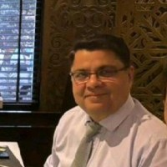
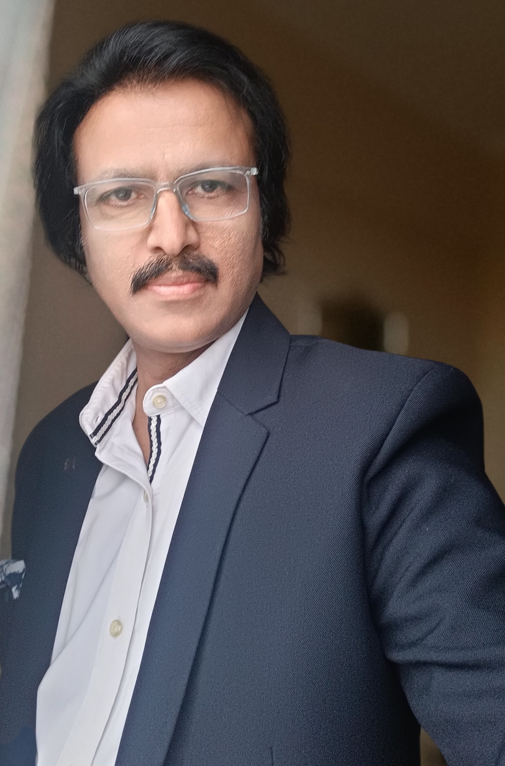

Brief Introduction
Introduction
Who We Are

Slide 3

Manoj Yermalkar – Managing Partner
BE (Mechanical) | CIPP | CIPM | CISCP | CISCM | 31+ Years of Industry Experience A seasoned Supply Chain Leader and Trainer with over three decades of deep industry experience in managing and setting up complex, end-to-end supply chains.
Manoj has successfully led supply chain transformations across industries, combining strategic vision with hands-on execution. For the past 10 years, he has been an educator and mentor, teaching professionals through real-world case studies with
IPSCMI USA and ASCM, bridging classroom concepts with on-ground reality. Key Highlights:
• Expert in Supply Chain Design, Planning, and Execution
• Certified Professional: CIPP, CIPM, CISCP, CISCM (IPSCMI – USA)
• Faculty and Mentor with ASCM and IPSCMI-USA
• Known for practical, experience-driven teaching methodology Core Strengths:
Supply Chain Strategy | Procurement | Inventory Planning |
Operations, Professional Training|
My goal has always been to make supply chain learning
practical — where learners don’t just understand processes but experience them.

Slide 4
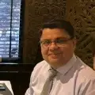
Vanish Ahluwalia – Managing Partner
Global Supply Chain | Logistics & Shipping Expert | 25+ Years of Experience A global logistics and shipping expert with over 25 years of experience across India and international markets.
Vanish has worked with world-leading and Indian organizations, driving innovation and operational excellence across the logistics value chain. Career Footprint: • TATA Group | ADANI Group | CONCOR | ALLCARGO Logistics | JINDAL Group • P&O Nedlloyd (now Maersk Line) | NYK Line | ECU Worldwide | Triton International Academic & Industry Engagements: • IIT Madras – Faculty, MBA (DoMS) • IIFT – Conducted AACSB-accredited “Global Supply Chain & Logistics” course • Blue Ocean Corp. – CISCP-CISCM programs with IPSCMI • LSC, CILT, Export Promotion Council, DSEU – Trainer, Consultant & Faculty Expertise Areas: Global Shipping | Freight Operations | Multimodal Logistics | Port & ICD Operations | E-Commerce Supply Chains “I believe the future of supply chains lies in collaboration — connecting people, processes, and technology seamlessly across borders.”

Slide 5









Three decades
Three Decades
Project, Capital Goods and Engineering Industry experience
In industries like Adani, Tata, CCI,All Cargo
Our Strengths
Area of expertise
Academics & Certifications
Supply Chains & Logistics Management
S & OP,Digitalisation
BE,PGDIB,CIPP,CISCM,CIPM,GDMM
Academics & Certifications
Supply Chain Projects
Master of Laws, LLM in Maritime with Ist Div.
* Bachelor’s in Sciences, BSc. Delhi University * Diploma in Computer Sciences, Apple Ind.
* P. G. in Materials Management, Annamalai
* Shipping Orientation for Export Exe, IIFT
Establishment of supply chains across South Asia
Cost Management, Quality Management,Logistics Management,Delivery Management, Working Capital Management
Trainings & Courses
Trainings and Courses
IPSCMI USA, ISM USA and Digital supply chain contents for Simplilearn
CIPP,CIPM,CILT,CISCP & CISCM,DSEU & FIEO

Slide 6
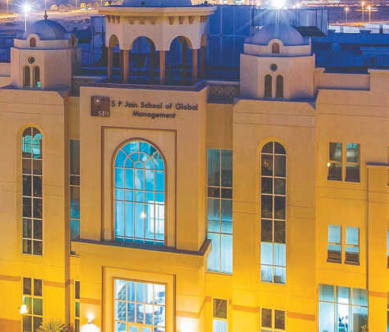
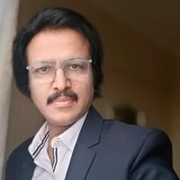
Digital Supply Chain Management Certification
Program Advisors
Manoj Yermalkar
Head-Procurement- ACGE
Manoj Yermalkar, Head of Procurement at ACG, brings 30+ years’ experience in procurement, logistics, and sourcing.
He’s held leadership roles at Triveni Turbines and Otis Elevators.
With engineering and PG degrees, he advises Simplilearn’s supply chain curriculum.

Slide 7
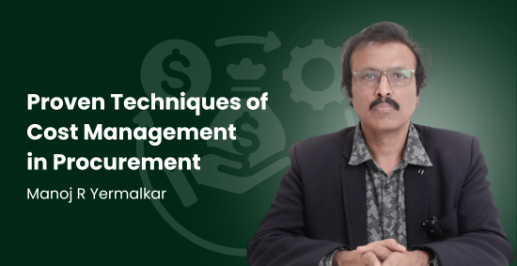
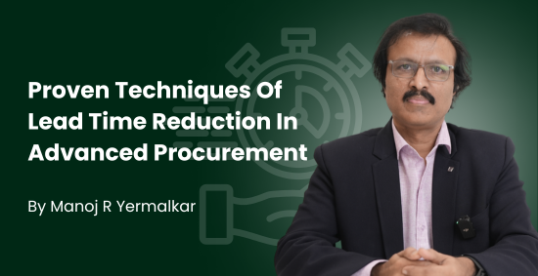
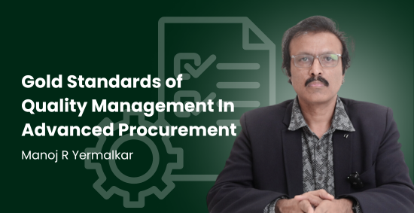
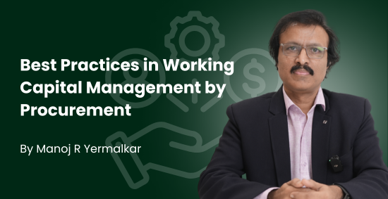
SCMDOJO Courses

Slide 8
MV Global Courses On Various Platforms
Effective Negotiations
Strategic Procurement
Procurement Management
Strategic Cost Management
Digital Dominance- Transforming Supply Chains With Technology
Third Party Risk Management
Strategic Cost Management
Strategic Sourcing & Category Management
Sustainable Procurement
Supply Chain Innovations

Slide 9
To Summarize
Expert Course Creators & content creators In Supply Chain
Differentiation than others: Real world examples, case studies and solutions
Hands on extensive experience in end to end supply chain
Operating and Leadership Experience of more than two decades each
A collective experience of 60 Years

Slide 10
Our Offerings
Courses
Curriculum
Teaching
Interviews
Syllabus
Course creations on Supply Chain, Procurement and Maritime Logistics
Curriculum Setting
Teach the courses with ready or customized contents
Conduct Interviews and select the right candidates
Syllabus Creation and Printing

Slide 11

THANK YOU

