Slide 1
Projecting to lifetime sexual recidivism ….

Slide 2
Background

Slide 3
What does “projecting to lifetime” mean?
If you had followed all the members of the samples to their death, what sexual recidivism rate would you observe?
We take the 20-year-rate as an acceptable estimate of the lifetime rate because the rate of reoffending per year declines steadily such that the amount of additional offending expected in the 21st and subsequent years is vanishingly small.

Slide 4
Why would you want to “project to lifetime”?
20-year recidivism rates better embody the total risk represented by the individual
Sometimes the forensic question that psychologists are being asked to provide information about requires estimates of lifetime risk
  This is widely understood to be the case in SVP cases
  If you don’t estimate lifetime risk, you are not answering the question posed by the law

Slide 5
Past Attempts
Doren (2009) Empirically based recidivism assessment estimate extrapolations across time and outcome measure. In Anita Schlank (2009) The Sexual Predator. Civic Research Institute
Identified six studies which provided both shorter term recidivism rates and rates based on follow ups that went beyond 20 years
He reported that the long-term sexual recidivism rate was typically about twice the five-year rate.
He therefore recommended doubling obtained five-year rates to get an estimate of the lifetime rate

Slide 6
Problem with Doren’s Method
S99R Score | 5 Yr Sex | 15 Yr Sex | Ratio
-3 to -1 | 2.2 | 4.7 | 2.1
0 to 4 | 6.7 | 12.6 | 1.9
5+ | 22.0 | 31.8 | 1.4
It assumes that the ratio between the 5-year-rate and longer-term rates is the same at all risk levels
It turns out that this assumption is wrong
From Hanson et al. (2014)
The relationship is orderly, but fixed ratios are the wrong metric

Slide 7
Time Free Project
Hanson and colleagues explored the effect of time free in the community after release from the index sex offense
There were a series of related studies that culminated in developing the Time Free Calculator
We used samples collected to create recidivism norms for Static-99R

Slide 8
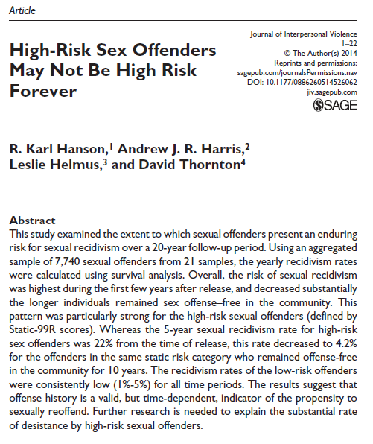

Slide 9
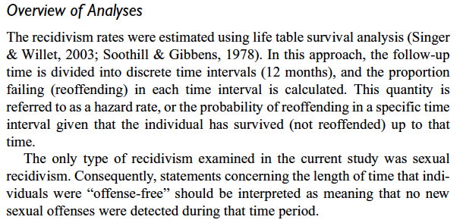

Slide 10
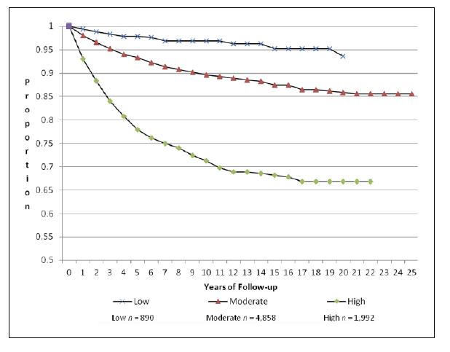

Slide 11
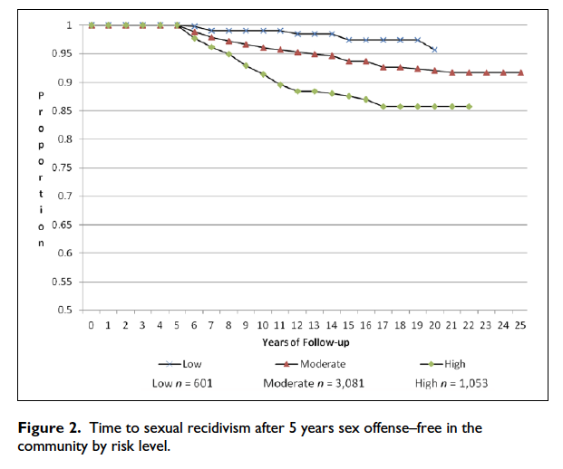

Slide 12
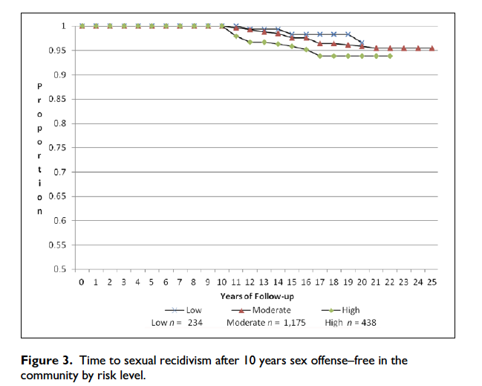

Slide 13
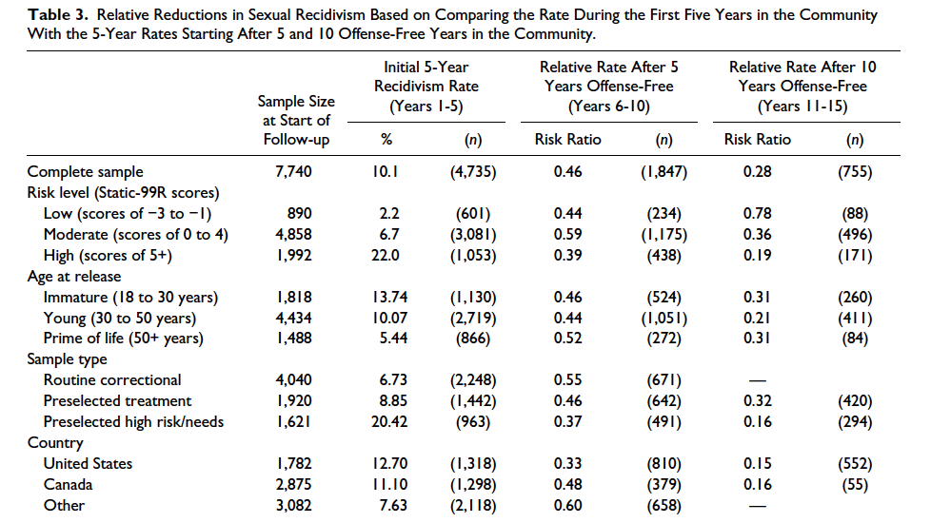

Slide 14
Key Points
For each five years in the community without sexual offending the rate of sex recidivism in the next five years approximately halved
This effect is similar for 5 yrs → 10 yrs and 10 yrs → 15 yrs
Similar results are found for
  Those with adult victims vs child victims
  Those released at different ages
  Different countries
Effect seemed to be bigger for higher risk individuals

Slide 15
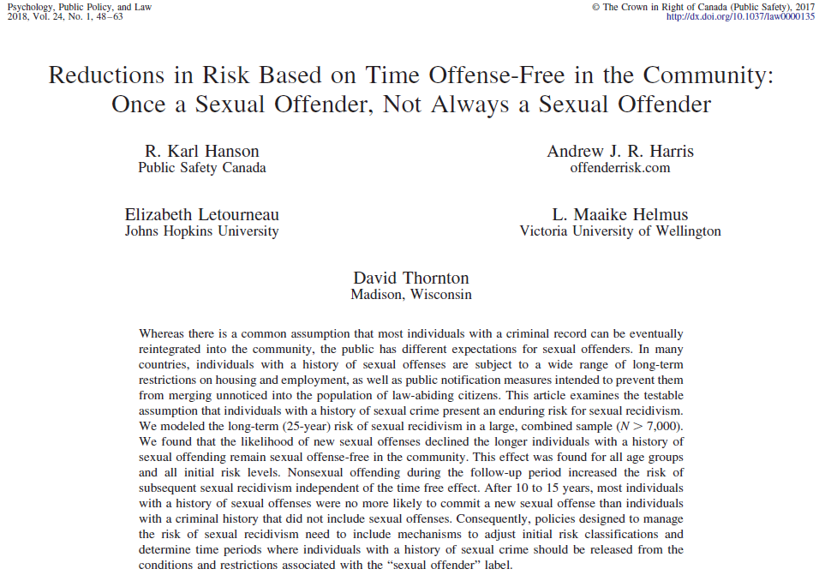

Slide 16
Method
Follow up divided into six-month periods with the outcome being sex reoffense or not in each six-month period
  Person-Period data set
Discrete time survival analysis
A logistic model fit the data with the odds of sex recidivism declining by a consistent amount when expressed on the log scale
No interaction between the size of the time-free effect when expressed as a decline in the log odds of recidivism and either Static-99R score or sample type

Slide 17
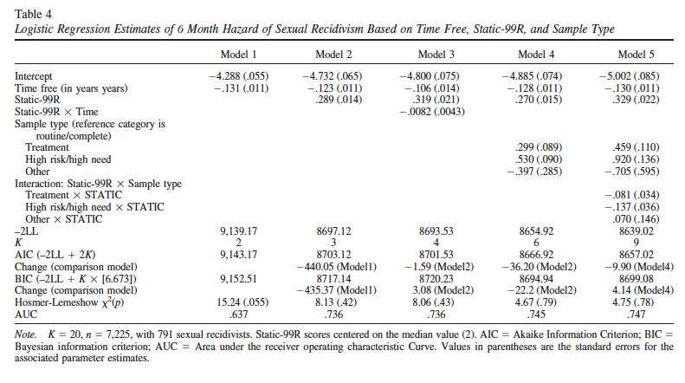

Slide 18
Model 5 is preferred
You can understand this model as having two components
  A time-free parameter
  A set of parameters specifying initial risk
The graph in the next slide may be easier to understand
  Note that each curve is generated from the same equation, just with different starting levels of risk

Slide 19
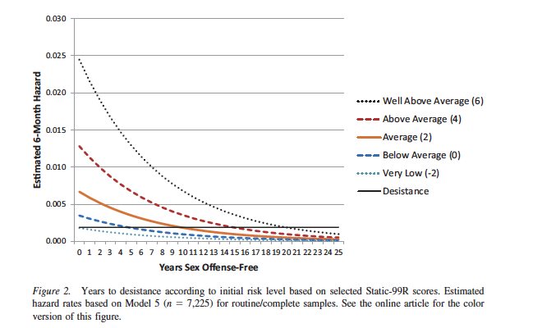

Slide 20
We also looked to see if there was an effect of non-sexual offenses occurring during the follow up
We could only examine this in 13 data sets
We found that the occurrence of a nonsexual conviction added a constant amount to the risk
It did not interact with the time free effect
  Meaning the time-free effect still occurred
  The effect of a nonsexual offense was to cancel out 3.3 years of time-free effect
A useful way to think of the effect of nonsexual conviction is that it tells us that the person’s risk was higher than we initially supposed

Slide 21
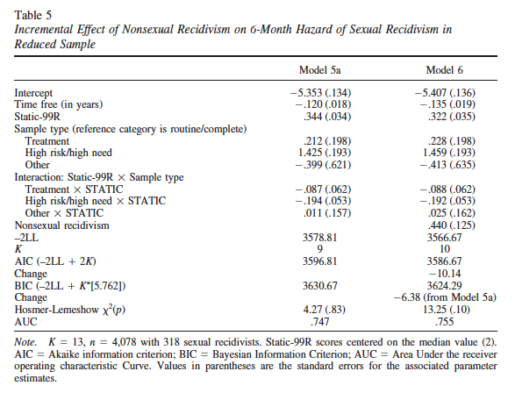

Slide 22
From Time Free to Projection
We realized that if the time-free effect could be expressed in a way that was constant over the follow up period then it would be possible to project any known rate to a different rate
If you know the Year 1 rate, then you can apply the time-free effect to get the Year 2 rate, and then apply the time-free effect to get the Year 3 rate from the Year 2 rate etc. out to as many years as you like
How this is done is described in the next paper

Slide 23
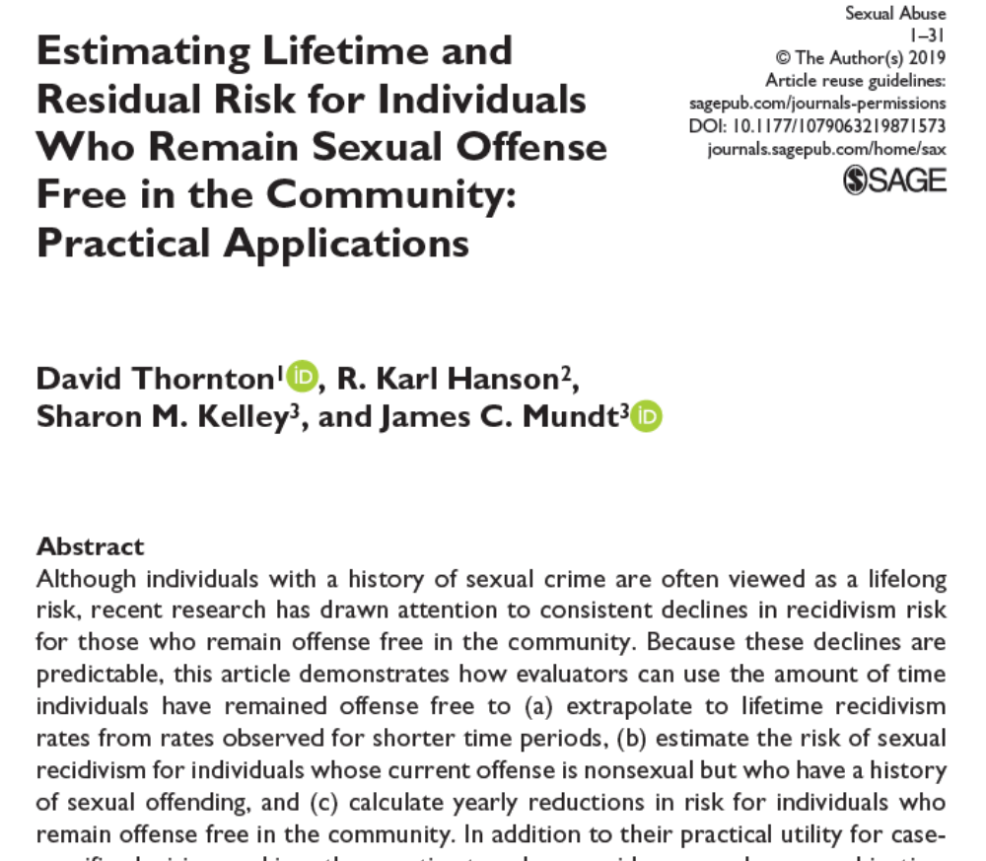


Slide 24
Model
Start from a rate for a given follow up period (say 7% at 5 years)
Find the year 1 rate that produces that (say) 5-year rate
  This is done through iteration
  Guess a year one rate, does it over or underestimate the 5-year rate, adjust the guess to reduce the discrepancy. Repeat until you have the correct year 1 rate
Apply the time-free effect starting from that year 1 rate so you get the rates for each successive year
Combine these rates so you get the cumulative rate that applies after each year of follow up

Slide 25
We get the estimate of the Time-Free Effect
From the paper you have already seen (Hanson et al., 2018)
So, the empirical basis of the Time-Free Calculator is the work in Hanson et al., 2018)
Data from 20 different samples (follow-up time of 6 months to 31.5 years (M = 8.2, SD = 5.3)
Turned into a person-period data set with 105,347 observations, containing 791 recidivism events
Modeled using Discrete Time Survival Analysis
What this gives us is the size of the time-free effect expressed in a metric that makes it constant over risk levels and over the duration of follow up

Slide 26
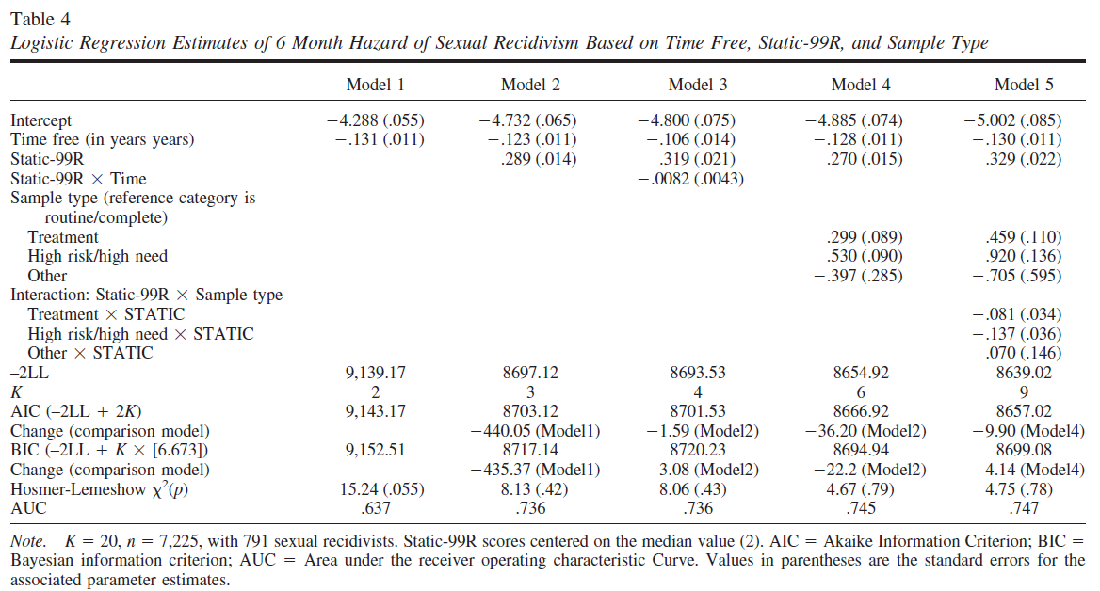
Equations for Declining Risk over Time

Slide 27
Size of Time Free Effect from Model 5
Log Odds of sex recidivism in a six-month period declines by
-0.130
for each year the follow up extends (CI=.011)
The next slides shows graphically how a constant time-free effect steadily reduces the twelve-month hazard rate

Slide 28
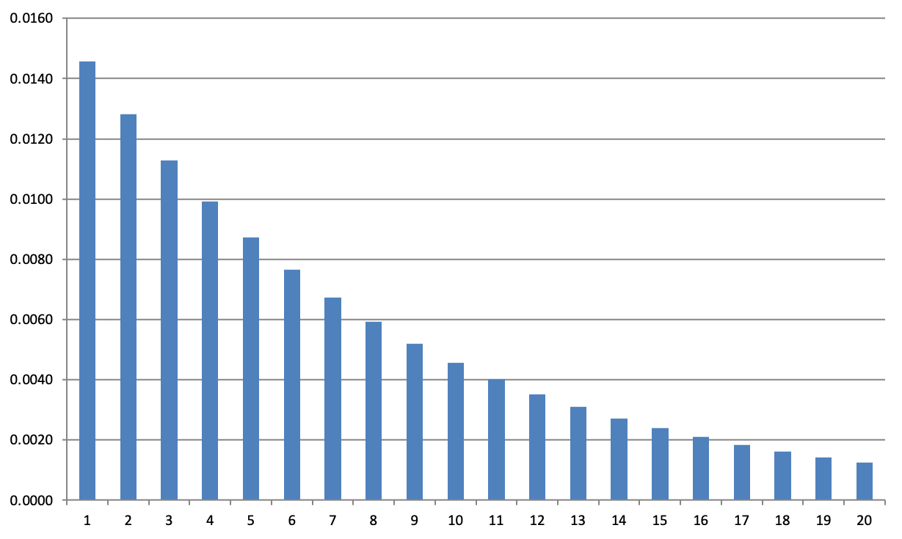
Annual Hazards (Score of 2)
Years in the community

Slide 29
Can we express this more simply?
We may have to explain how the 20-year rates are obtained in a way accessible to a court

Slide 30
Sexual recidivism rates increase as the follow up increases
The way this happens is quite orderly and has been modeled mathematically

Slide 31
You can think of it like this
The increase in sexual recidivism rates over years of follow-up can be expressed as a graph
Each starting level of risk has its own graph of how the cumulative reconviction rate increases over time
These graphs don’t cross
This means if we know which graph a (say) 5-year recidivism rate sits on you can run forward along the graph to find the associated 20-year rate

Slide 32
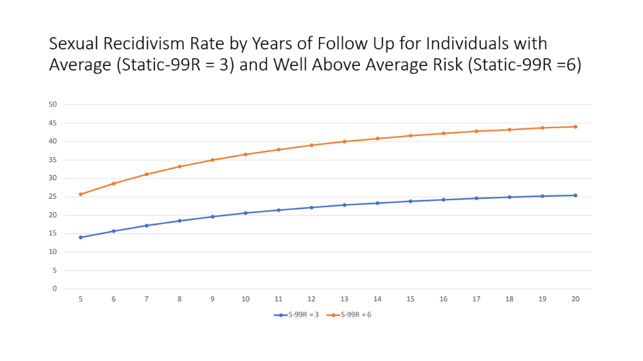

Slide 33
You don’t have to solve these equations yourself to get projected rates
The Calculator is programmed to solve them for you
You just have to give it some starting information
A short-term rate with the duration this applies to
The date of release from the index (which is the start point)
Was the person removed from the community after that (and if so for how long)?
Was the person convicted for a non-sexual offense after the date of release from the index (and if so, when)?

Slide 34
How to Use the Time Free Calculator

Slide 35
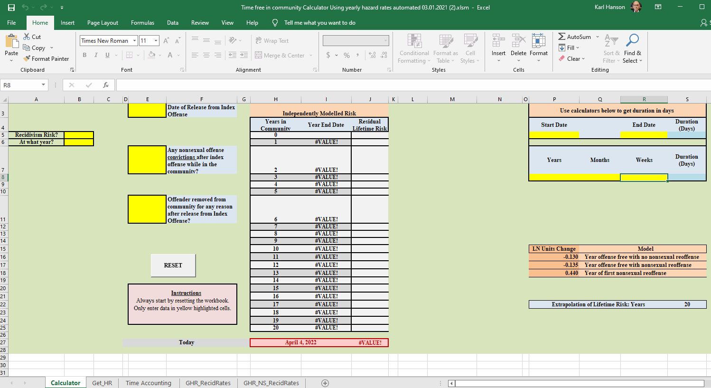
Excel Time Free Calculator

Slide 36
Going to Recap the model briefly then demonstrate it

Slide 37
Statistical Model
Consistent, predictable decline in annual risk over time leads to cumulative risk that increases by predictable but declining amounts
Independent and incremental effect of nonsexual recidivism
The reduction is constant across all initial risk levels (in logit metric)
The hazard of reoffending after 20 years sexual offense free is negligible.
For the purpose of our analyses, it was set to zero.

Slide 38
Key Insight
The time-free effect is constant when the outcome is expressed in logits but not when it is expressed as proportions

Slide 39
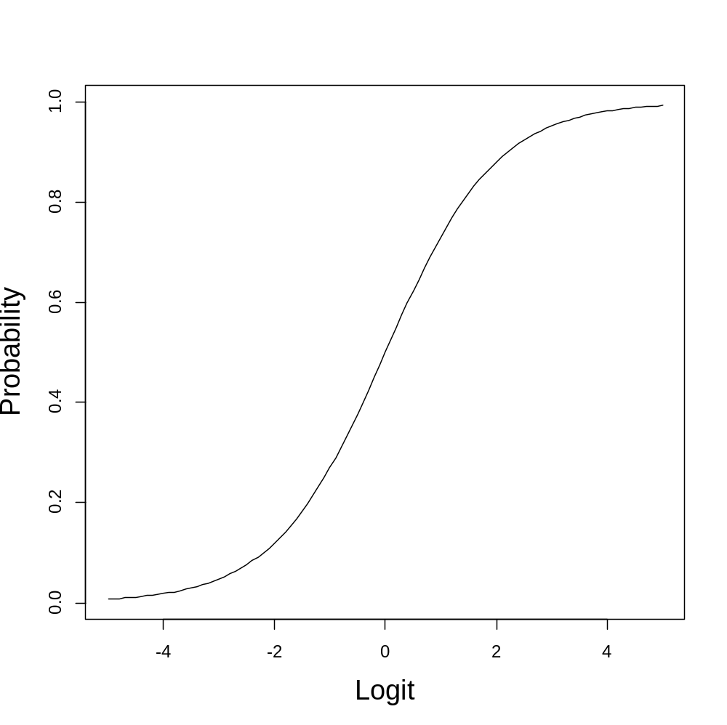
Proportions Compared to Logits

Slide 40
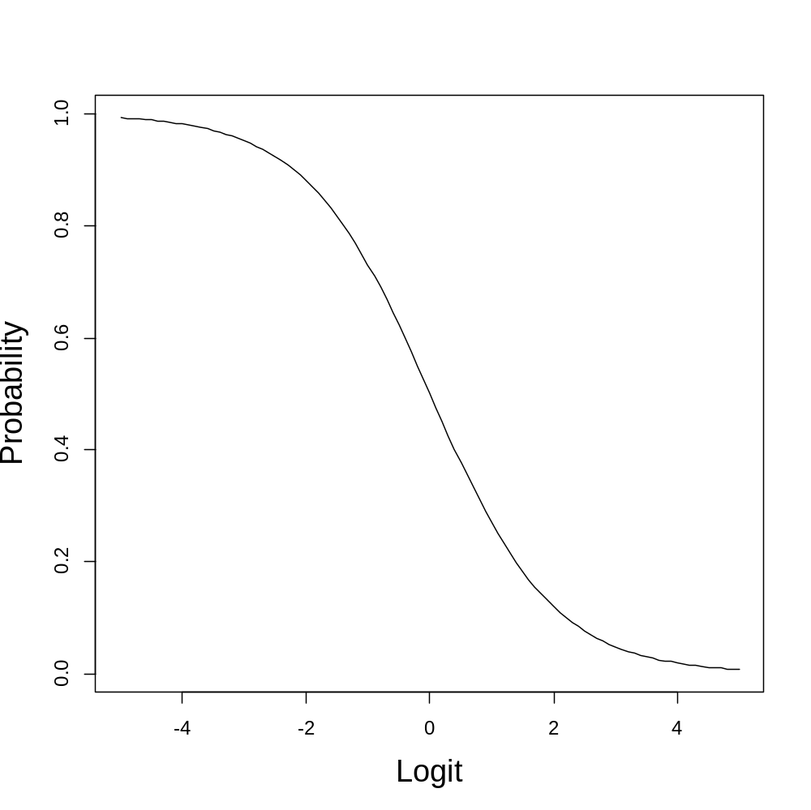
Negative Logistic Curve

Slide 41
Region of Interest

Slide 42
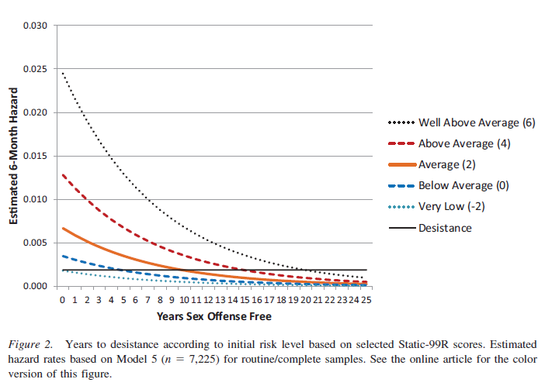

Slide 43
Equations for Declining Risk over Time

Slide 44
Model 5
Logit annual hazard = -5.002 - .130 (years offence free) + .329 (Static-99R) + .459 (if treatment sample) + .920 (if High Risk/High Need sample) - .705 (if other sample) -.081 (treatment x Static-99R) -.137 (HRHN x Static-99R) + .070 (other sample x Static-99R)

Slide 45

Model 5 - Simplified
Annual hazard = Initial hazard - .130 (years offence free)
All the other terms in Model 5 estimate initial hazard.
Initial hazard can be estimated using any method.
There are no interactions between initial risk and time (in logit metric).

Slide 46
Annual Hazards (Score of 2)
Years in the community

Slide 47
Why might individuals desist?
Aging
  Physical decline
  Lower sexual responsiveness
  Increased psychological maturity
Increasing rewards from prosocial life
  Success in work & Rewarding leisure activities
  Decent friends & Caring intimate partner
Self-regulating DRF
  Learn prosocial ways of living and coping
Expressing DRF in nonsexual ways

Slide 48
What to do when the index offence is not a sexual offence?

Slide 49
What to do when the index offence is not a sexual offence?
Non-sexual recidivism increases sexual recidivism risk by 55%
This is independent and incremental to time free effect
Need to consider time free AND new non-sexual offences
A new non-sexual offence is equivalent to
subtracting 3.3 years from time free, or
Adding 1.5 Static-99R points

Slide 50
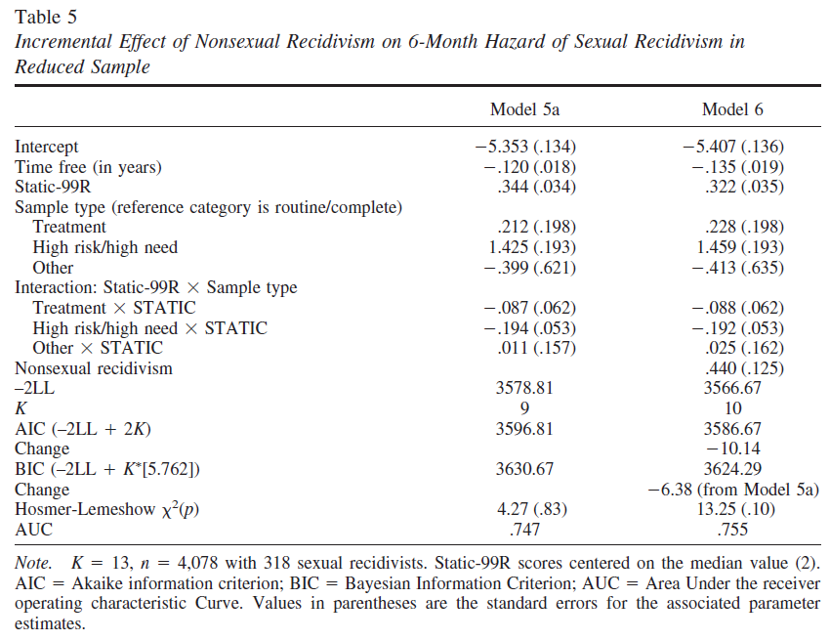
Model for Nonsexual Recidivism

Slide 51
Model 6 - Simplified
Annual hazard = Initial hazard - .135 (years offence free)
+ .440 (if any nonsexual recidivism)
Initial hazard can be estimated using any method.
There are no interactions between initial risk, nonsexual recidivism, and time (in logit metric).

Slide 52
Projection to Lifetime
When the decline in risk is consistent, then we can estimate what the annual hazards would have been if we had longer follow-up periods
Endpoint: After 20 years, the residual risk is negligible (no different from the base rate in the general male population) – hence set at zero.

Slide 53
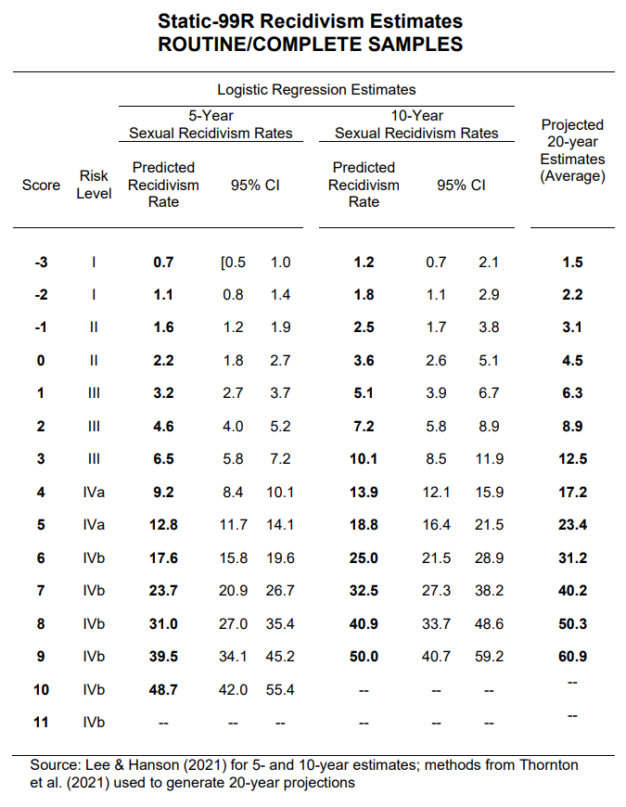
2021 STATIC Evaluators’ Workbook
20-year projections start with 5-year and 10-year rates, then average

Slide 54
These projections are…
Based on well-established statistical techniques (discrete time survival analysis).
Estimated from a large sample (over 7,000 cases) with nearly 400 followed out 20 years.
Provide 20-year recidivism estimates that are expected to be accurate within +/- 5% for higher risk individuals.

Slide 55
2021 STATIC WORKBOOK
20-Year Projections for Static-99R and Static-2002R for Routine and HRHN samples
If you want to use other actuarial sexual recidivism risk tools
  Static (RM-2000S, VASOR-2, MnSOST-4)
  Static/Dynamic (Static/STABLE-2007, VRS-SO)
Then you need to use the Time-Free Calculator to get projected 20-year risk estimates

Slide 56
The Time-Free Calculator
You can download it from www.saarna.org
Make sure you download the manual for it too
It takes as input
  Initial risk at some specified follow up
  Date of release from index offense
  Any non-sexual offense (and date)
  Any removals from the community since release from index (and how long)
Notes:
David Starts Here

Slide 57
Before Using it for the first time
You need an up-to-date version of Excel
If asked, allow it to run Macros
Excel has to be configured to support iterative calculations
  In Windows version:
    File->Options->Formulas
    Check “Enable iterative calculations”
    Set “Maximum iterations” to 10,000
    Set “Maximum Change” to 0.0001
  In Apple version (laptops and desktops)
    Excel->Preferences->Calculation
    Check “Use iterative calculations”
    Set “Maximum iterations” to 10,000
    Set “Maximum Change” to 0.0001
  Make sure you save these settings
You will have to do this every time Excel is updated

Slide 58
Before using it this time
Click “Reset” twice
Wait until fields clear
Note that even if the fields visible to you are empty there may be values in the fields not visible to you that have values from a previous use that need to be cleared

Slide 59
Variation in Estimate due to Iteration
The initial risk is approximated from the recidivism rate you enter into the calculator using an iterative process
Iteration is continued until it gets an initial risk that sufficiently well reproduces the initial risk you entered
If you repeatedly run the calculator with the same inputs the estimate of initial risk will be slightly different each time and this can lead to the final 20-year projection being slightly different
This effect is small (no larger than a quarter of a percentage point – e.g., 25.6 vs. 25.7)
If you care about such small differences, run the calculator three or four times and take the most common result or, if no result is more common, average them

Slide 60

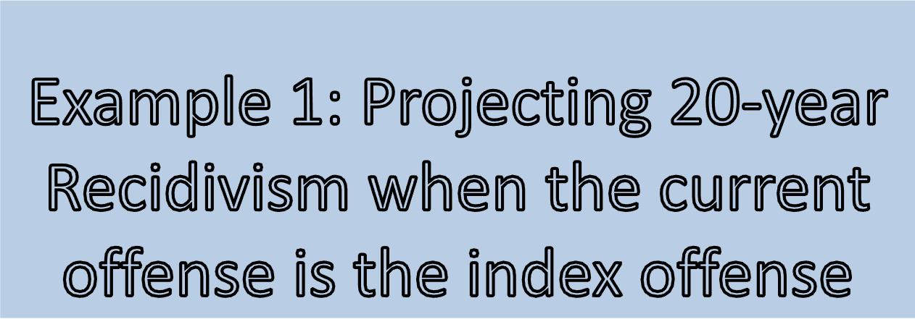

Slide 61
Example
John Smith is serving a prison sentence for a sex offense
You are asked to assess his risk for sexual recidivism if he were to be released today
He is aged 37, his Static-99R is a 4, his STABLE-2007 is a 12, based on this you estimate his 5-year sexual recidivism risk as 13.6% (Risk Level IVa)
How do you get to his 20-year risk using the Calculator?
Example was run on September 16th, 2021

Slide 62
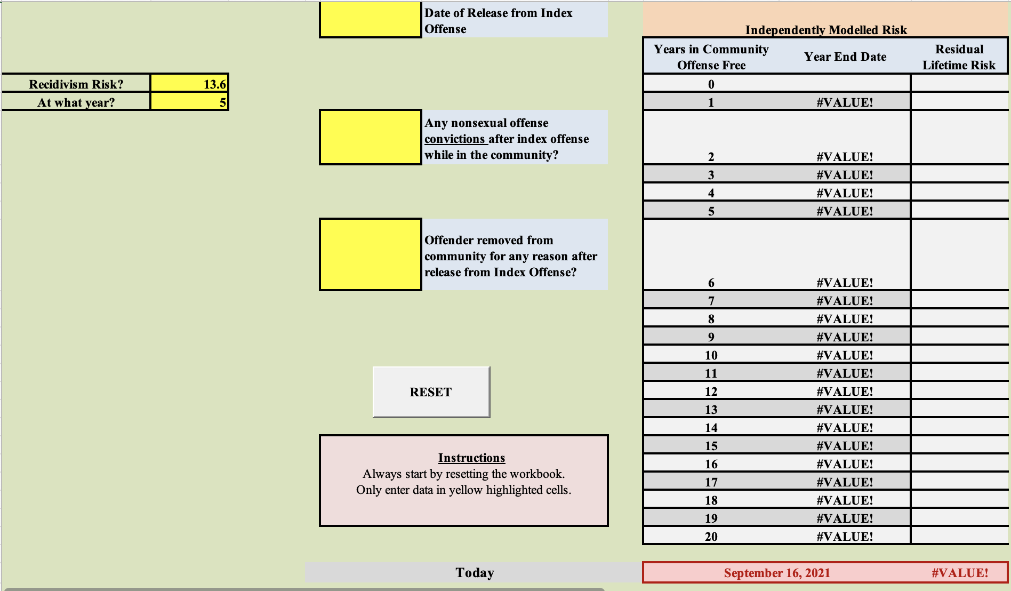

Slide 63
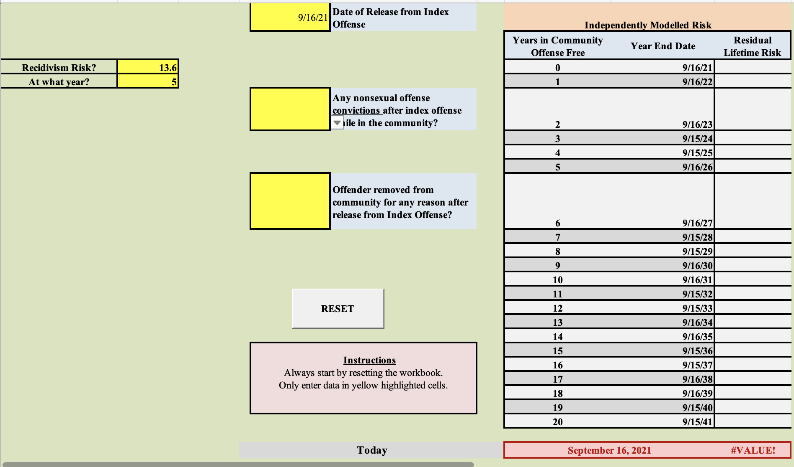

Slide 64
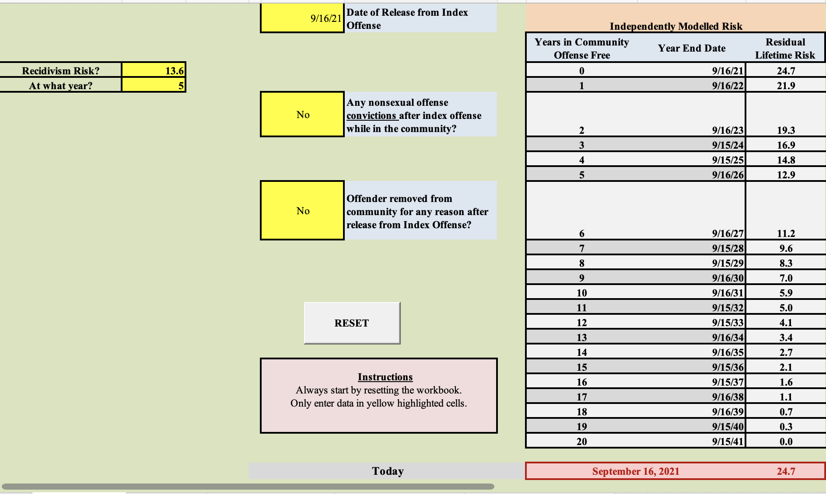

Slide 65
13.6% at 5 years → 24.7% at 20 years

Slide 66
Now your turn
5-year sexual recidivism rate of 28%
  What is the 20-year sexual recidivism rate?
10-year sexual recidivism rate of 32%
  What is the 20-year sexual recidivism rate?
Use today’s date (2022-04-11) as release date
Please post your answers in the Chat
If you have a problem using the calculator, please use the Chat to explain it and I will try to help you

Slide 67
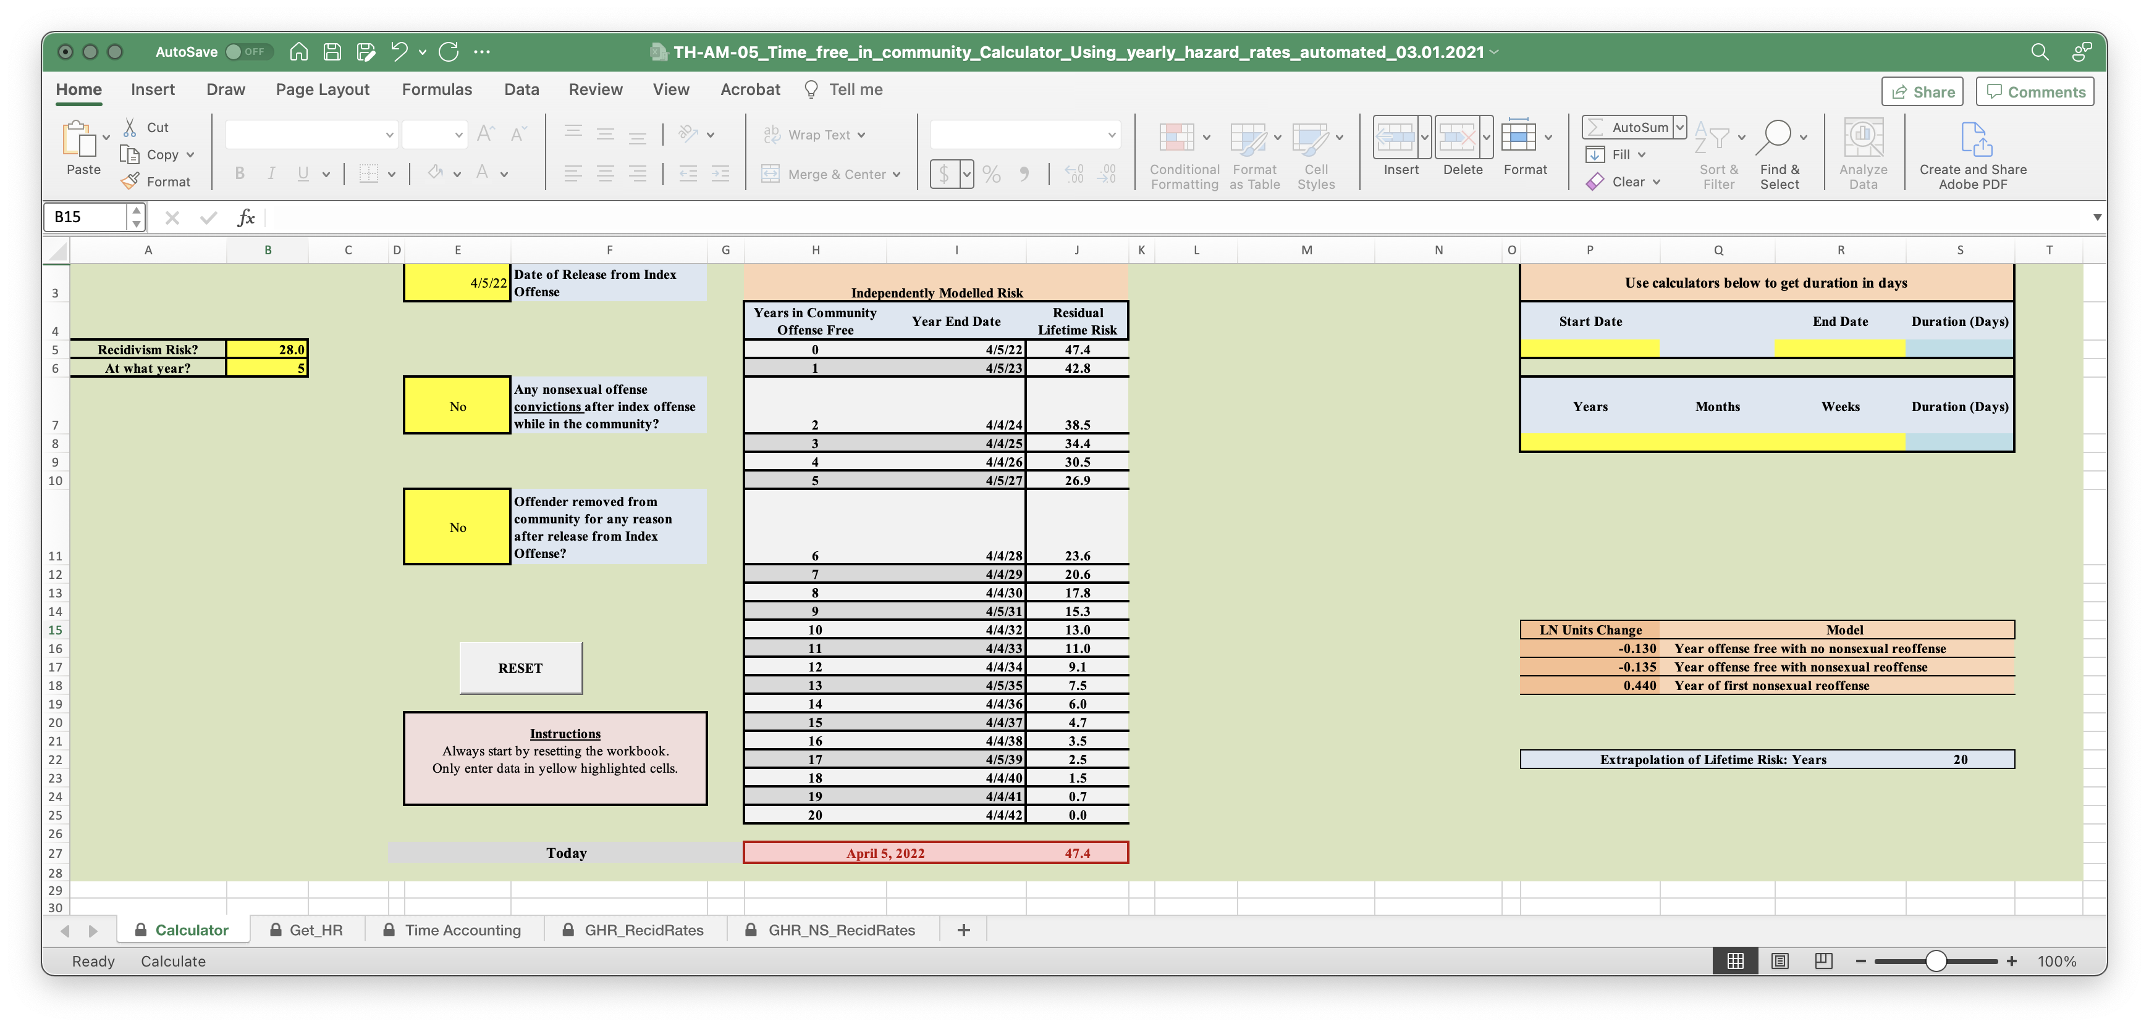
Answer for A

Slide 68
Answer for A
5-year sexual recidivism rate of 28%
  20-year sexual recidivism rate = 47.4%

Slide 69
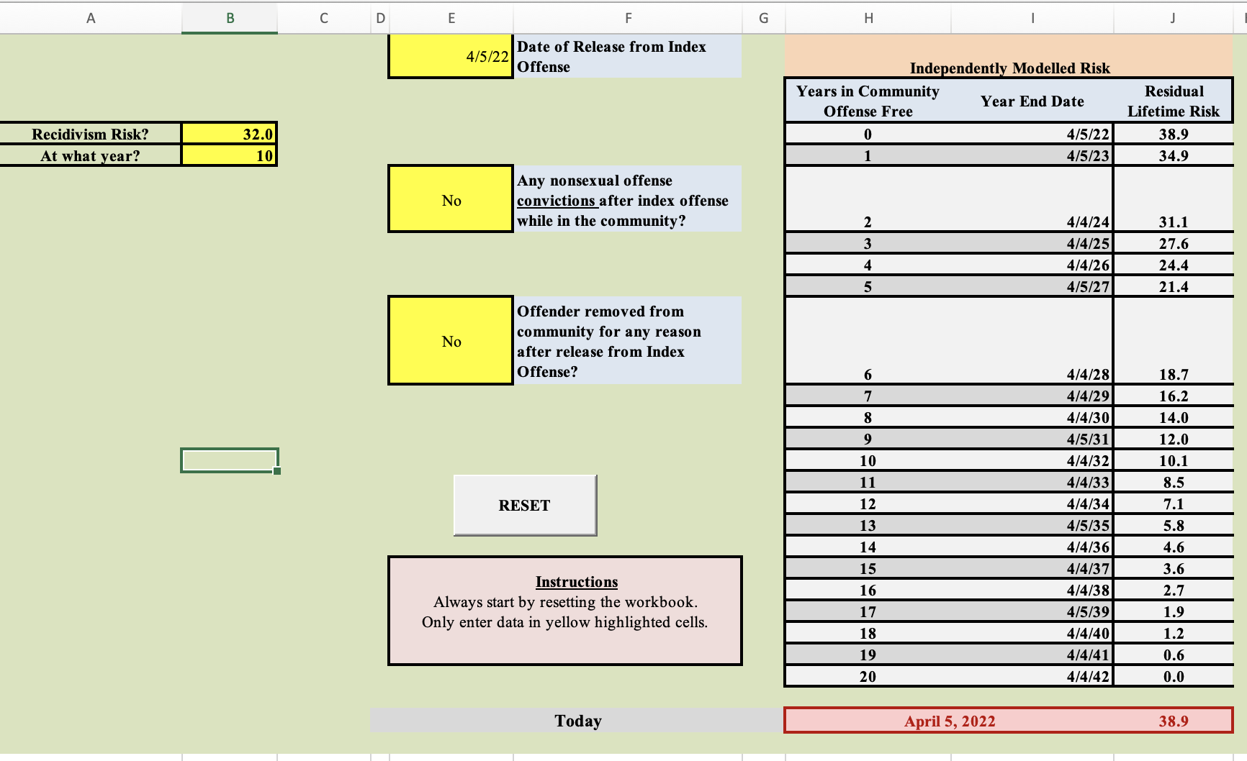
Answer for B

Slide 70
Answer for B
10-year sexual recidivism rate of 32%
  20-year sexual recidivism rate = 38.9%

Slide 71
What about Life Expectancy?
Projection to 20 years assumes the person is going to live that long!
Good practice is to check life expectancy in standard tables and note any factors that might modify this
I use social security life expectancy tables
https://www.ssa.gov/oact/STATS/table4c6.html
I usually have a health issues section in my reports and include the life expectancy there
Suppose you estimate a life expectancy of 12 years, what should you do?

Slide 72
Life Expectancy of 12 years
Go to the GHR_NS_RecidRates tab
On the leftmost column (headed Year)
Go down to 12
Read across the row until you get to the column headed recidivism rate
Read that he number from that cell, this is the cumulative recidivism rate after 12 years

Slide 73
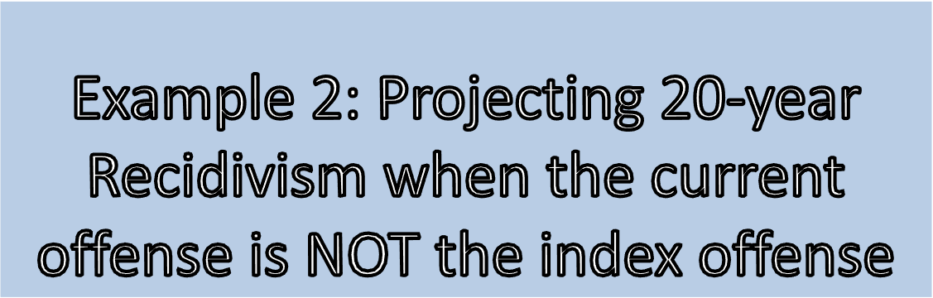

Slide 74
This means his current offense is non-sexual but earlier in his history he was recorded as having committed a sex offense

Slide 75
Mr. Green:
  Was incarcerated for sexual offending
  Released from his last sexual offence on May 3, 2020
  At release, he had a Static-99R score of 3
    New Routine/Complete norms (Lee & Hanson, 2021): 10.1% for 10 years
  He was arrested for burglary on June 21, 2021 and placed in custody
  He pled guilty to burglary on June 30, 2021 and was sentenced to Jail
  He is about to be released from Jail on April 30th, 2022
  We are evaluating him to determine what is risk will be on release
  Example was run on April 5th, 2022. You should used today’s date to run the example yourself
Notes:
Revision needed due to future release date

Slide 76
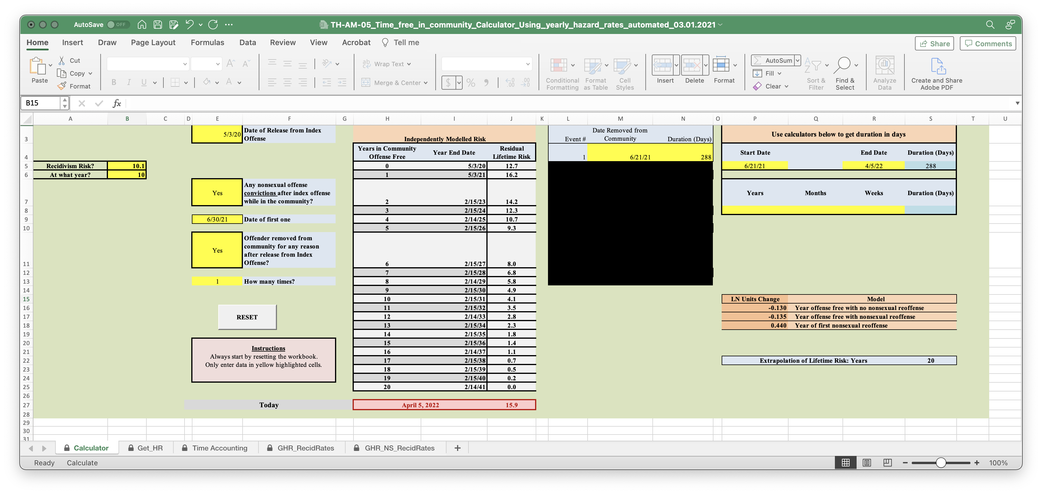
15.9%

Slide 77
Your turn (2a)
Mr. Red:
  Was incarcerated for sexual offending; released on October 3, 2015
  At his release, he had a Static-99R score of 3
    New Routine/Complete norms (Lee & Hanson, 2021): 10.1% for 10 years
  He was arrested for burglary x 3 on March 15, 2020 and placed in custody
  He pled guilty to burglary on July 30, 2020 and was sentenced to prison
  He is about to be released from prison on April 30th, 2022
  We are evaluating him to determine what is risk will be on release.
  You should use today’s date when running this example
Notes:
Revision needed

Slide 78
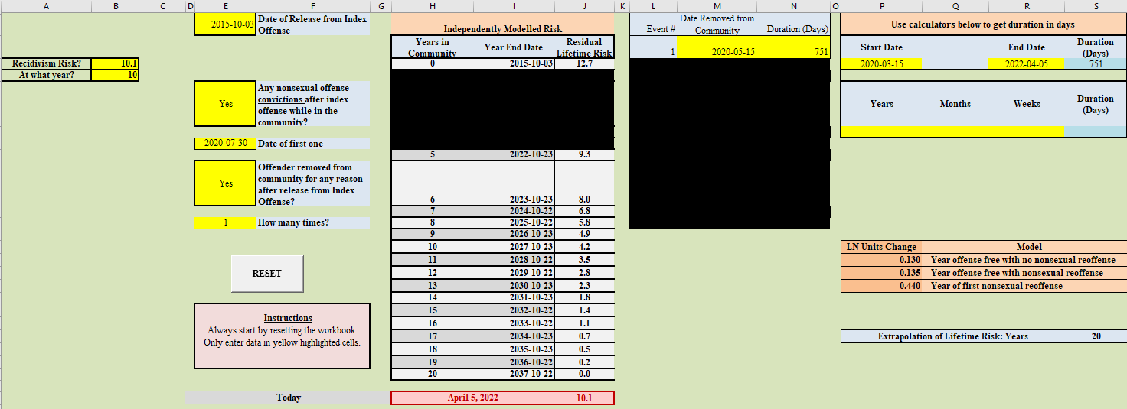
Answer for 2A

Slide 79
Answer for 2a
Risk at release = 10.1%
Note that this individual gets the benefit of time-free risk reduction between October 2015 and March 2020 but also gets some risk added because of the burglary

Slide 80
Your turn (2b)
Released from index sex offense on October 10th 2013, at which time he was scored 7 on Static-99R and HRHN Norms were judged appropriate → 30.7% at 5 years, 51.1% at 20 years
Arrested for Disorderly Conduct on May 20th 2020, but not detained
Pled Guilty on June 10th, 2020, fined and place on 3 years supervision.
You are assessing him today (April 2022)

Slide 81
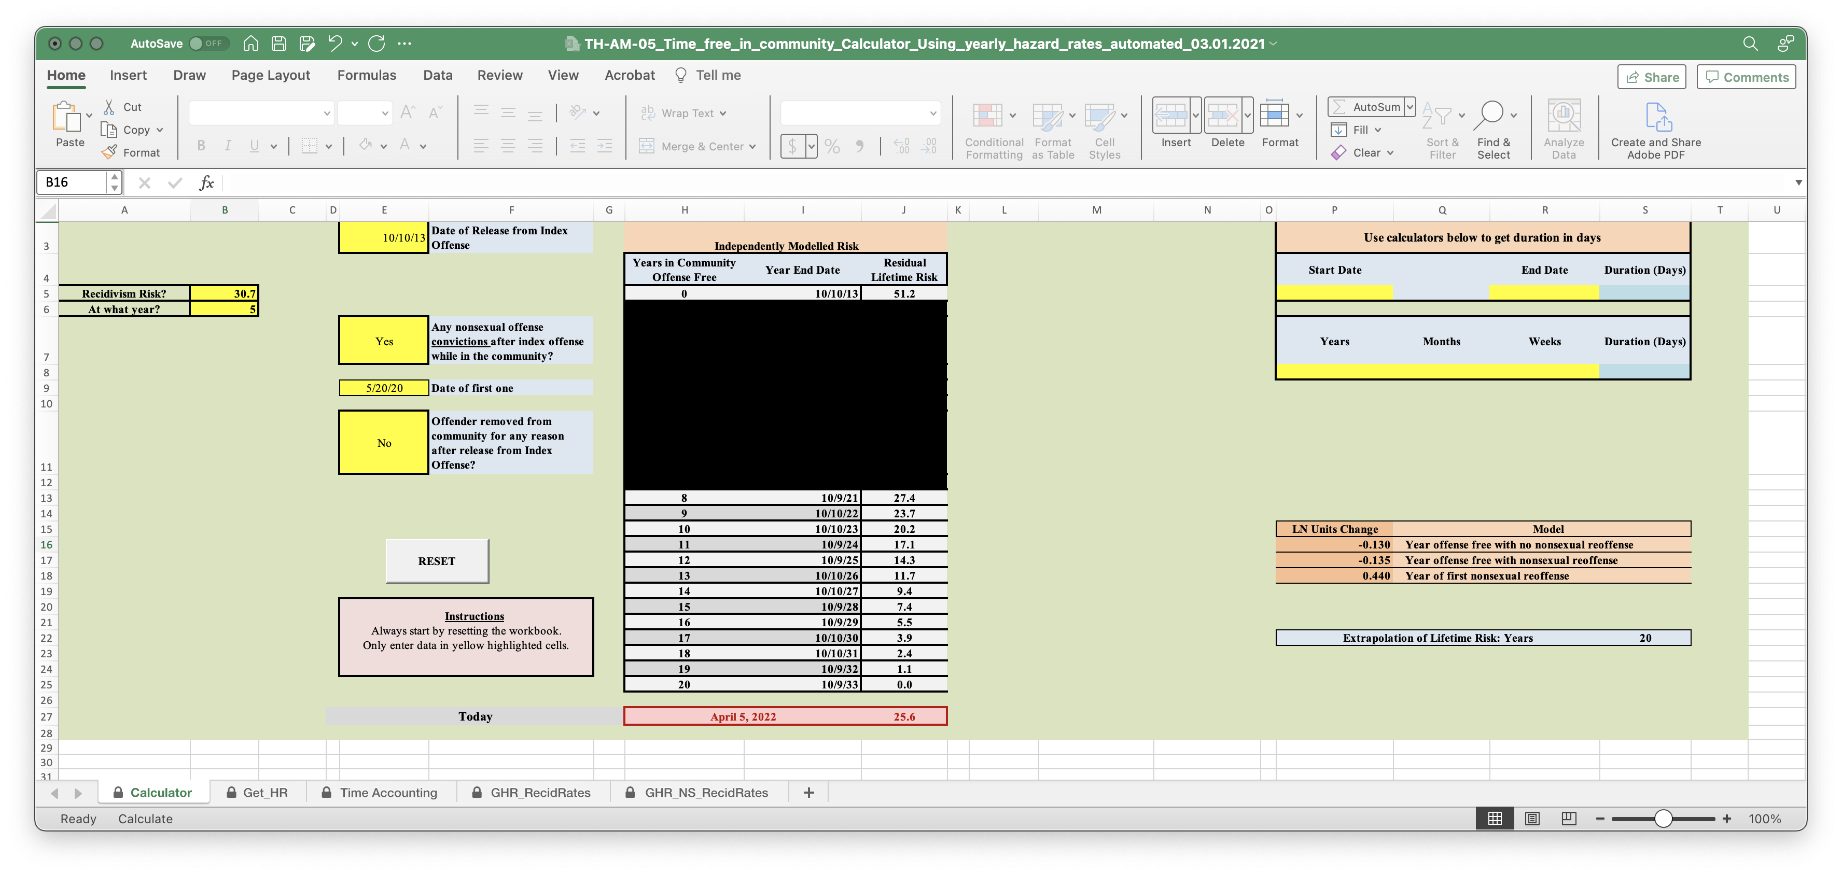
Answer for 2B

Slide 82
Answer for 2b
Risk now is 25.6%
This individual gets the benefit of time free effects up until June 2020
His risk then goes up because of the nonsexual conviction
But he gets further benefit from time-free effects up until the present

Slide 83
Small Points
You can extrapolate from any rate/years combination, regardless of where you got it from
With Static-99R you now have 5 and 10 year rates for both Routine and HRHN samples
The tables in the workbook are based on averaging extrapolations from these two starting points
They have different strengths and weaknesses
  5-year rates in Static-99R norms are estimated more accurately but you then have to extrapolate over 15 years
  10-year rates are estimated less accurately (especially for HRHN) but you only need to extrapolate over 10 years

Slide 84
Margin of Error
The underlying formula used for these extrapolations is estimated based on a huge person/period data set, so confidence intervals are narrow
Different ways of calculating potential error all indicated that error was small, 20-year estimates being within plus or minus 1 or 2 points at most risk levels, rising to +/- 5 points at higher risk levels
Be aware that if the release conditions for the person you are assessing are fundamentally different then different recidivism rates might apply

Slide 85
STABILITY OF THE MODEL

Slide 86
How stable is the model?
The model used to make the projections was derived from the Static-99R normative samples and so apply to them
Time Free effect was similar in different subsamples (e.g. different countries)
How can we check its stability in other samples?
Compare Projections to Observed Rates
By risk class within a sample (Strongest)
Overall base rate within a sample (OK but limited)
Overall base rate between samples (Weakest)

Slide 87
Compare Projections to Observed Rates
By risk class within a sample (Strongest)

Slide 88
Testing Projections in a New HRHN Sample
Hanson, R. K., Lee, S. C., & Thornton, D. (2022). Long Term Recidivism Rates Among Individuals at High Risk to Sexually Reoffend. Sexual Abuse, 36(1), 3-32. https://doi.org/10.1177/10790632221139166 (Original work published 2024)
Long term follow-up of 377 individuals from the 1990s (Hanson & Harris, 2000)
Median follow-up time of 20.5 years
Overall 31.6% sexual recidivism rate (119/377)
HRHN subsample (n = 190) identified by Thornton’s SRA

Slide 89
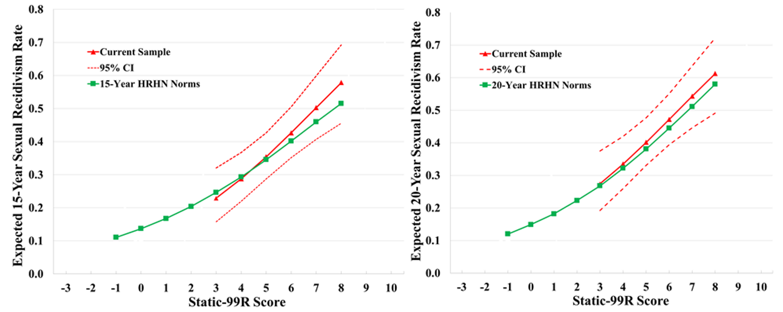
Calibration Plots for Static-99R HRHN
15-Year and 20-Year Projections

Slide 90
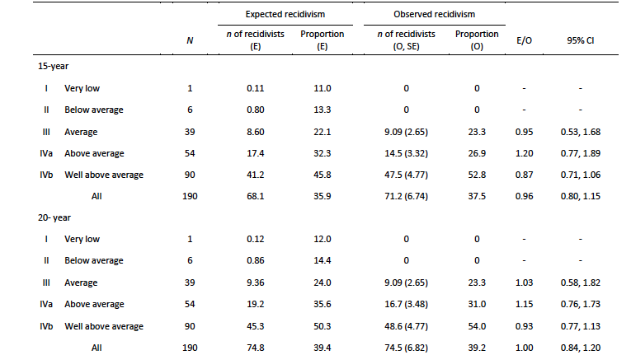
Good Calibration of 15-year and 20-year estimates
(E/O indices close to 1)

Slide 91
Compare Projections to Observed Rates
Overall base rate within a sample (OK but limited)
I found two studies that had 5-year and 20-year sex recidivism rates for the whole sample
Hanson, R. K., Marquez Alcala, G., & Prescott, J. J. (2025). How public registries obscure sexual recidivism risk: Evidence from state administrative data. Psychology, Public Policy, and Law. Advance online publication. https://dx.doi.org/10.1037/law0000482
Lussier, P., Masson, G., Deslauriers-Varin, N., Proulx, J., & St-Pierre, E. (2026). Lifetime Sexual Recidivism of Adult Justice-Involved Individuals: A 30-Year Prospective Longitudinal Study. Journal of Interpersonal Violence, 0(0). https://doi.org/10.1177/08862605251400743

Slide 92
Within Sample Comparison of 5 and 20 Year Base Rates
Sample | Hanson et al. 2025 | Lussiere et al. 2026
5-Year Sex Recid | 5% | 9%
Projected 20-Year Sex Recid | 10% | 17%
Observed 20-Year Sex Recid | 10% | 19%

Slide 93
Compare Projections to Observed Rates
Overall base rate between samples (Weakest)
This is the weakest paradigm because individual studies may differ in length of follow up, in how the sample was selected, and in how sex recidivism was measured
Lussier, P., McCuish, E., St-Pierre, E., & Baguet, A.-L. (2025). Examining Benchmarks of Sexual Recidivism Rates for Short, Moderate, and Long-Term Follow-Up Periods: A Meta-Analysis of Canadian and American Studies. Trauma, Violence, & Abuse, 0(0). https://doi.org/10.1177/15248380251338791

Slide 94
Lussiere et al (2025) grouped studies in terms of length of follow up and compare the base rates for different groups of studies
They note that (as one would expect) there is significant heterogeneity of results
The most that can be concluded from their data is that mean sexual recidivism rates ranged from 6% at the shortest follow up (less than 36 months) to 17% at the longest follow up (144 months or longer).
This is not inconsistent with Calculator, but this approach is too inexact to yield results that can speak the accuracy of the Time-Free Calculator.

Slide 95
Summary
The Time Free Calculator is based on applying a well-established statistical method to a large person-period sexual recidivism data set drawn from 20 underlying samples.
It applies specifically to the recidivism norms for Static-99R and Static-2002R because the same samples used to create the Calculator were also used to create these norms.
A more limited amount of research has been carried out into how well the Calculator generalizes to samples not included in its development
To date, these studies give results that support the accuracy of the 20-year sexual recidivism rates projected by the Calculator.

Slide 96
Scenario 1
Using STABLE if current offense is not the index sex offense

Slide 97
You may be asked to evaluate
Current offense is non-sexual
Prior Sex offense
Meaningful amount of time in the community that needs to be allowed for
Have to get an estimate of risk at the time of release from the index sex offense
  Easy to get Static-99R score as applied at that time
  Would like to account for dynamic risk but don’t have the information to score STABLE as it applied then
What to do?

Slide 98
One Option
To calculate the initial risk just based on Static-99R
This is one of the option Karl and I proposed some years ago.
It isn’t perfect but all options for this scenario have flaws
It is perfectly defensible

Slide 99
Scenario 2
Release date far in the future

Slide 100
You may be asked to evaluate
An individual is coming to the end of his sentence, but he has to serve a long Federal sentence before he returns to the community
You can work out what his Static-99R score would be at points he might be released from the Federal sentence
But what about STABLE? How can you know what his STABLE score will be that far in the future?
Suggestion
  Work out Static/STABLE implied risk if returned to the community at the end of the current sentence
  Work out implied Static-99R score for various Federal release points
  Discuss plausible scenarios for changes in STABLE score and how they might affect future risk

Slide 101

Questions?

