Slide 1
Instructions
How to Open a ‘Zipped File’
if you do not have ‘WinZip’ installed
(or alternative file compression software)

Slide 2
Note:
These instructions are written around downloading and opening a ‘Zipped’ file that is an attachment to an email.
However the instructions on Slide 10 can also be used to open any ‘zipped file that you already have.

Slide 3
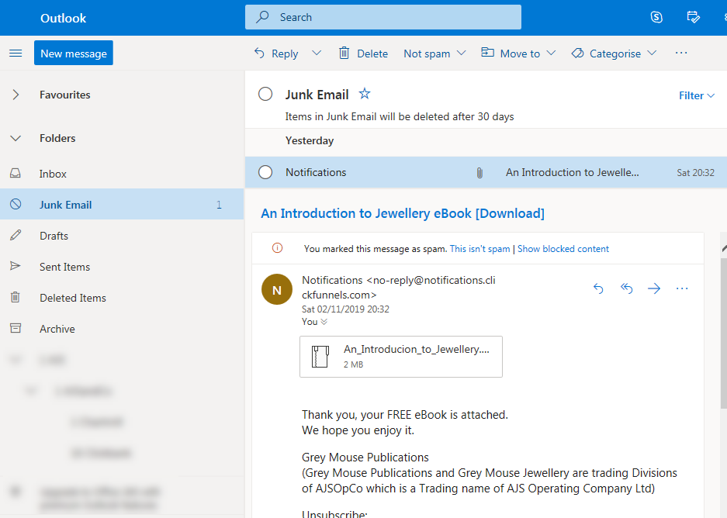
If the email is in your SPAM or JUNK folder. mark it as NOT SPAM to move it into your ‘inbox’

Slide 4
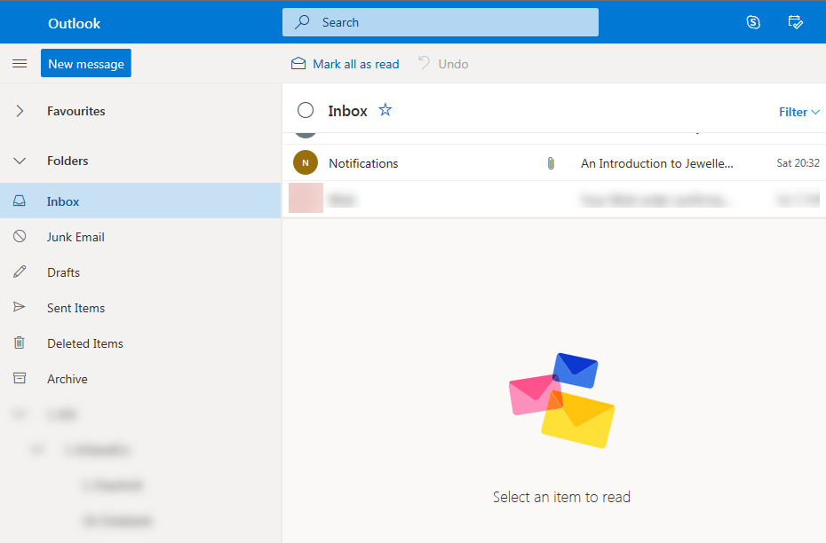
Open ‘Notifications’ email

Slide 5
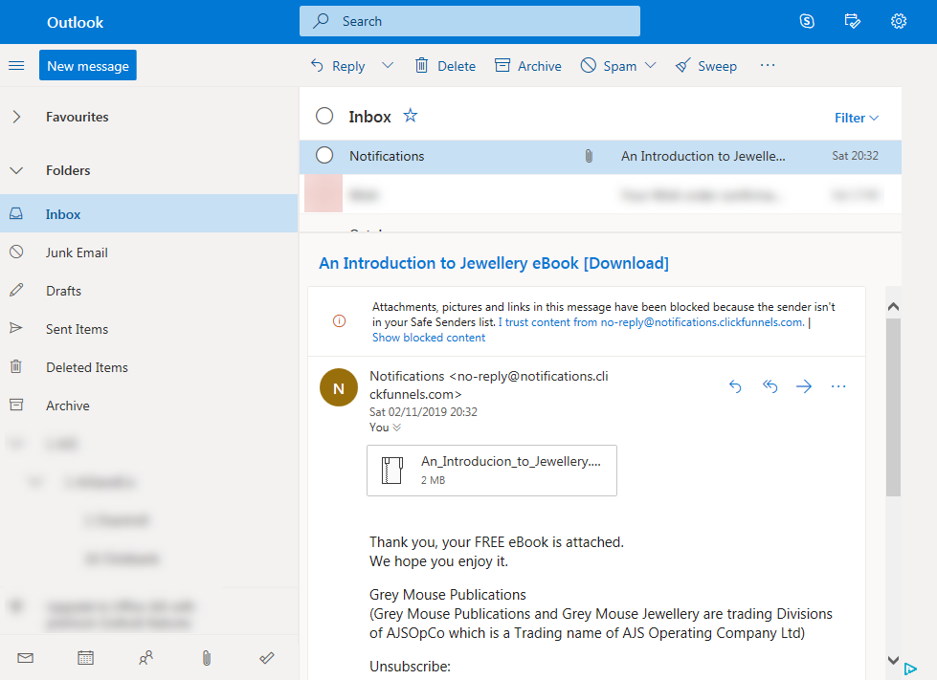
Click on attached ‘Zipped’ File

Slide 6
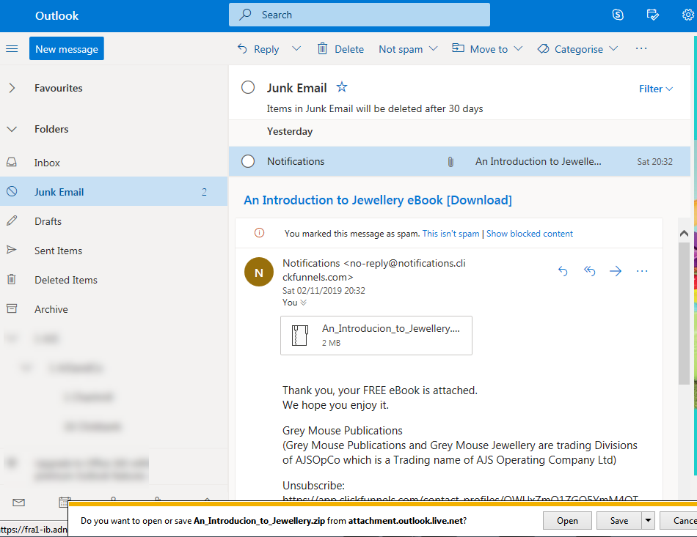
Click on Save

Slide 7
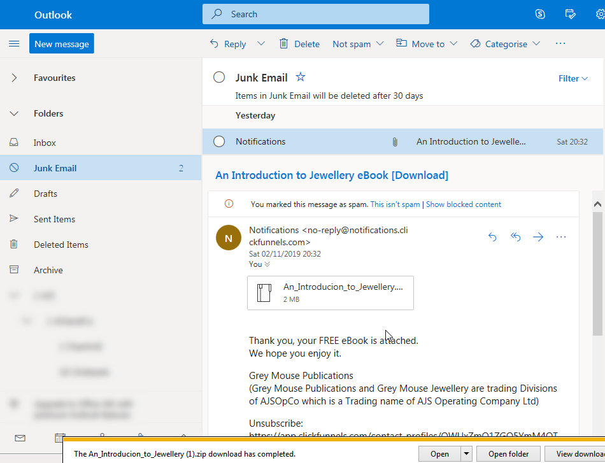
Click on Open Folder

Slide 8
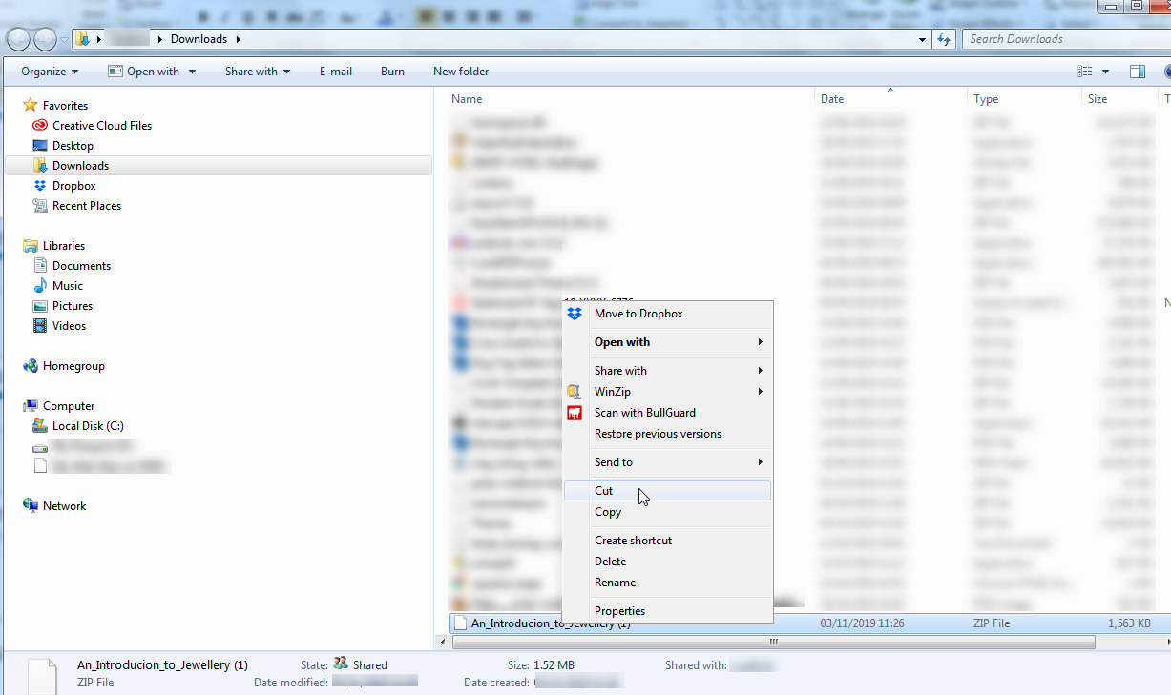
Right Click on File & ‘Cut’

Slide 9
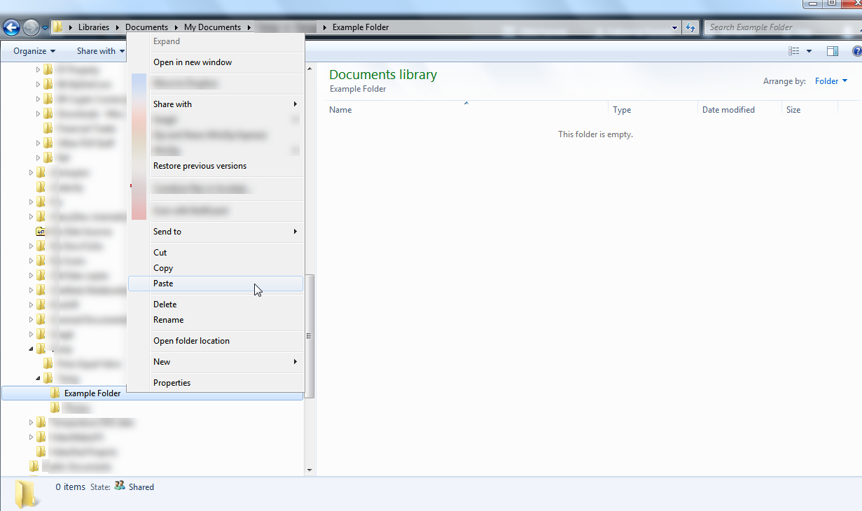
Right Click on your Folder & ‘Paste’

Slide 10
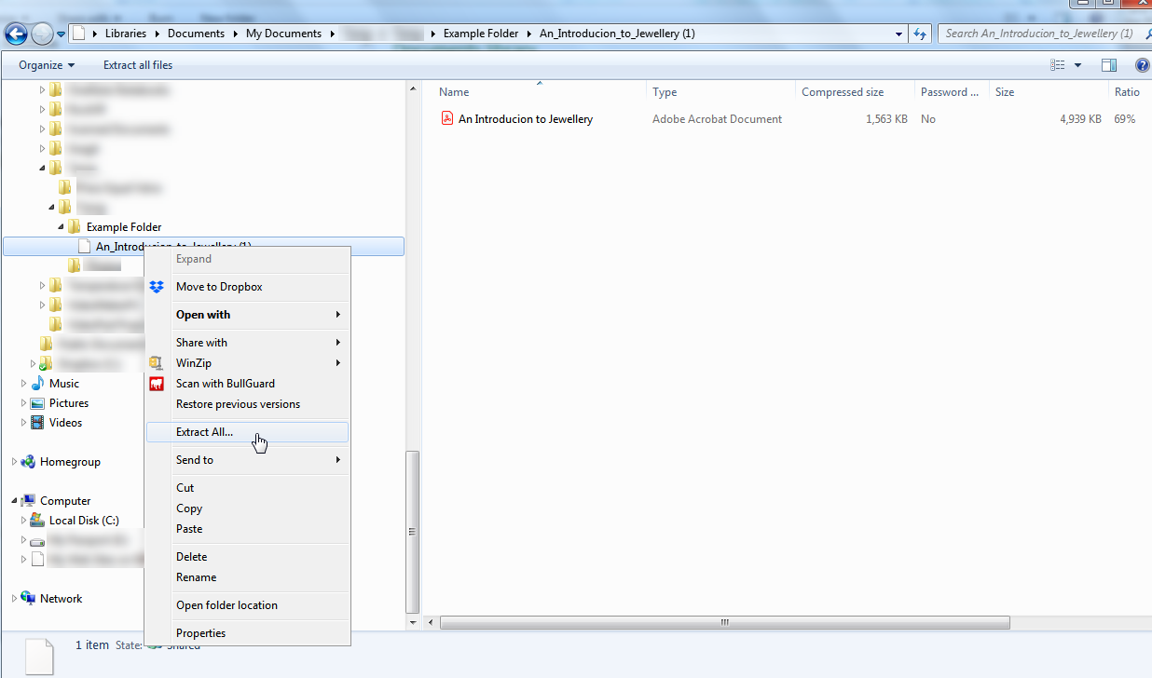
After ‘Extracting All’ you will see ‘unzipped’ file here
Right Click on the ‘Zipped’ file in your Folder & ‘Extract All’
Note: In some Browsers the file might ‘Extract’ automatically when you click on it.

Slide 11
Please note:
The layout of different Browsers is slightly different and they get updated from time to time, so the layout and terminology may vary, BUT the principle of the process remains the same.
We hope you found these instructions helpful.

