Slide 1
The Secret Treasure
Investor Pitch Deck – Feature Film
By Richard Dyrkacz, MD, PhD, PMP

Slide 2
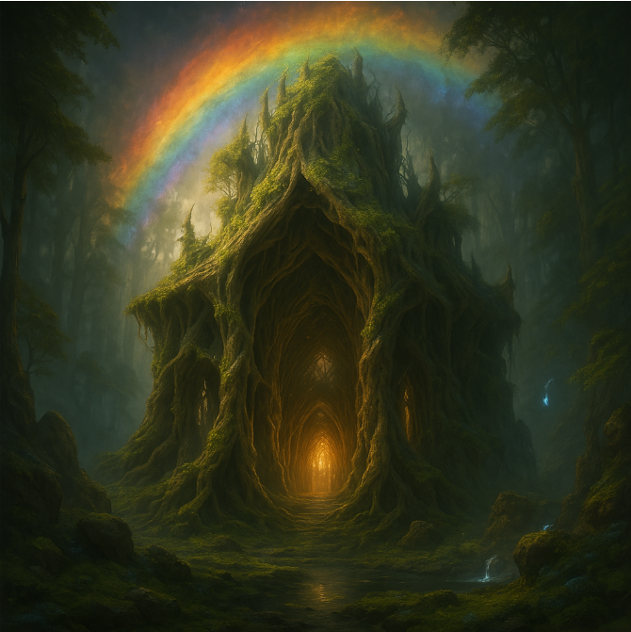
Presentation outline
Story: Logline, Genre + Tone, Synopsis, Characters
Film: Visual World, Music, Emotional Core
Business Aspect: Target Market, IP, Finances
Production Plan
Closing Vision Statement
2
Story
Film
Biz
Plan
Closing

Slide 3
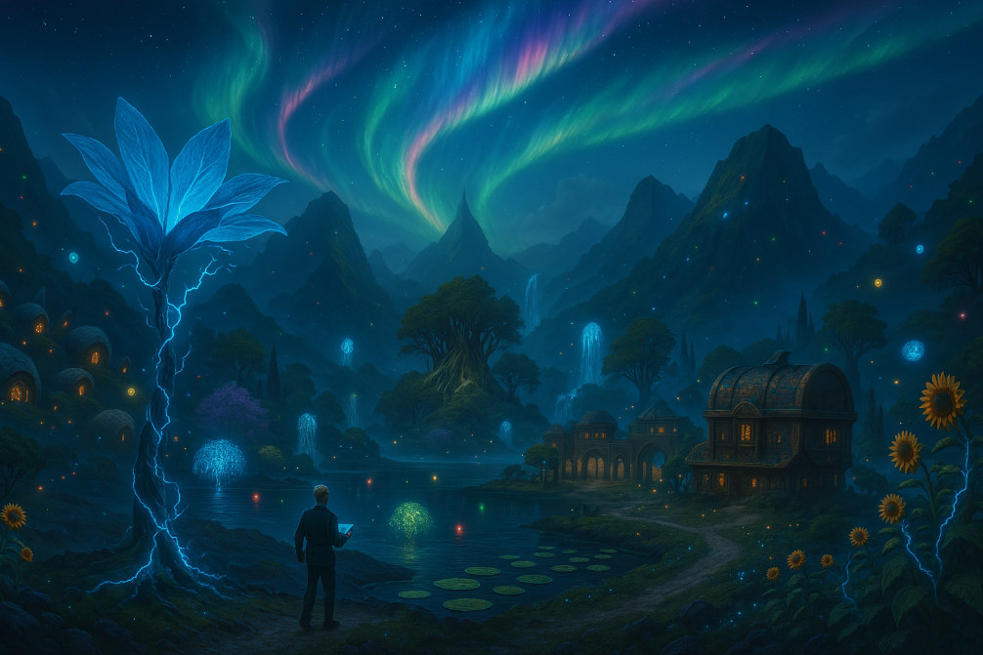
Logline
A debt-ridden teenage janitor discovers a legendary village beneath the earth, where magic and machines collide. To claim its treasure and rescue the girl he loves, he must survive a deadly sky race, outwit a pirate army, and decide once and for all what’s worth more:
gold or love.
3
Story
Film
Biz
Plan
Closing

Slide 4

Genre + Tone
Genre: Fantasy | Sci-Fi | Adventure
Similar Stories: Harry Potter, Avatar, Final Fantasy
Audience: Ages 10–35, fantasy lovers, anime fans, families
4
Story
Film
Biz
Plan
Closing

Slide 5
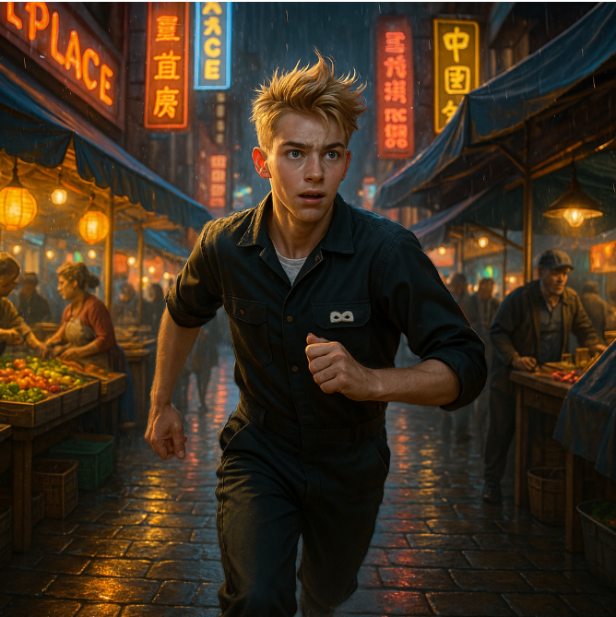
synopsis
Ethan Goodman, a janitor burdened by debt, uncovers a portal to Windleheim — a magical, living world now being corrupted by pollution from his own. General Global, a colossal corporate entity, is destroying it. Ethan must make a moral choice to protect the realm before it is destroyed.
5
Story
Film
Biz
Plan
Closing

Slide 6
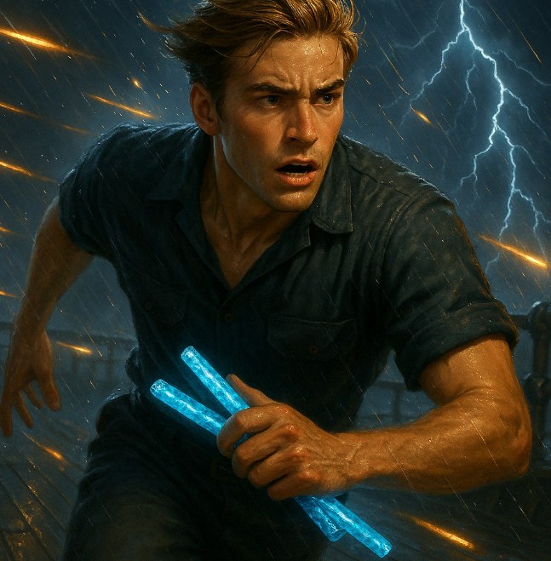
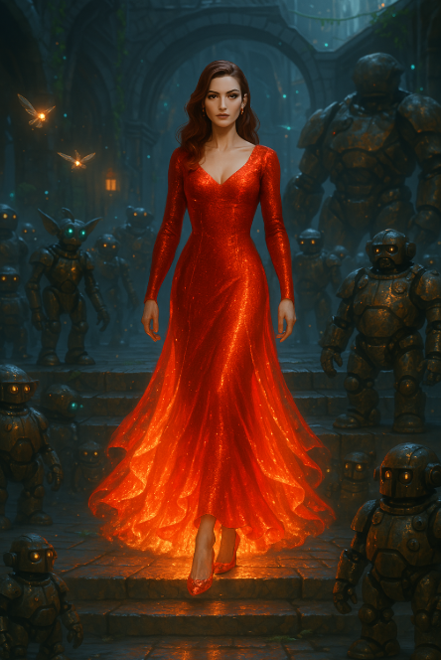
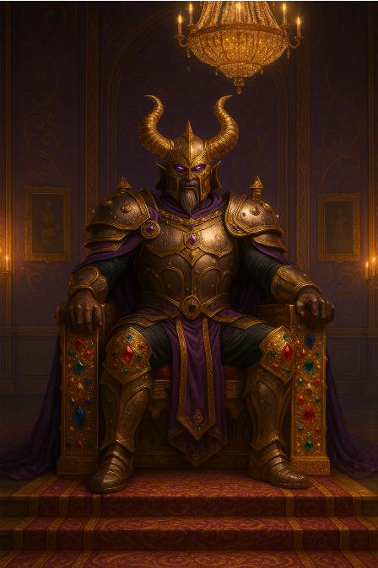
Main Characters
Ethan: A teenage janitor with nothing but a mop, a dream, and the accidental destiny of saving two worlds — no pressure.
Rose: A singing sensation with the voice of an angel, the aim of a sniper, and the emotional depth of a thousand indie ballads.
Azaroth: A warlord and weathered dad trying to reconnect with his daughter and not incinerate everyone in the process.
7
Story
Film
Biz
Plan
Closing

Slide 7
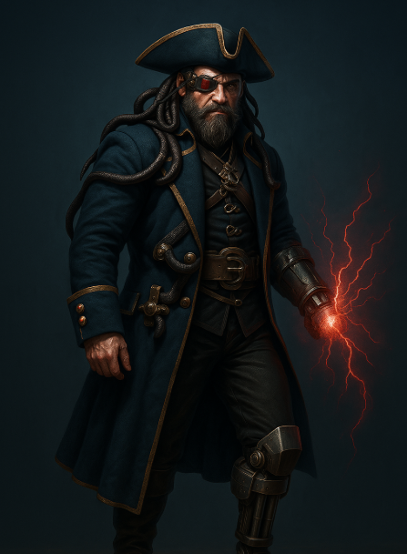
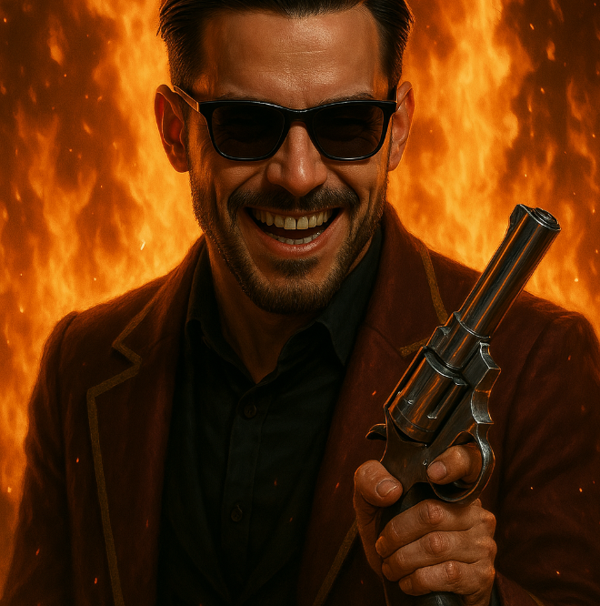
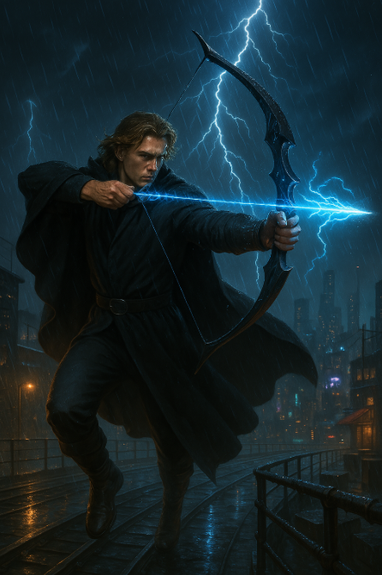
Main Characters
Banedagger: As a battle-scarred lunatic forged in the fires of a dystopian boxing ring, he is a dangerous sky pirate with a crackling red hook for a hand, a minigun for a leg, and serpents that slither from his hat — a walking weapon of chaos.
Vance: A jaded rebel with explosive fists, a mysterious past, and the emotional availability of a locked bunker.
Bosh: A spirited freedom-fighter who masks pain with charm — the glue that holds the group together, even as his own grip begins to slip.
8
Story
Film
Biz
Plan
Closing

Slide 8
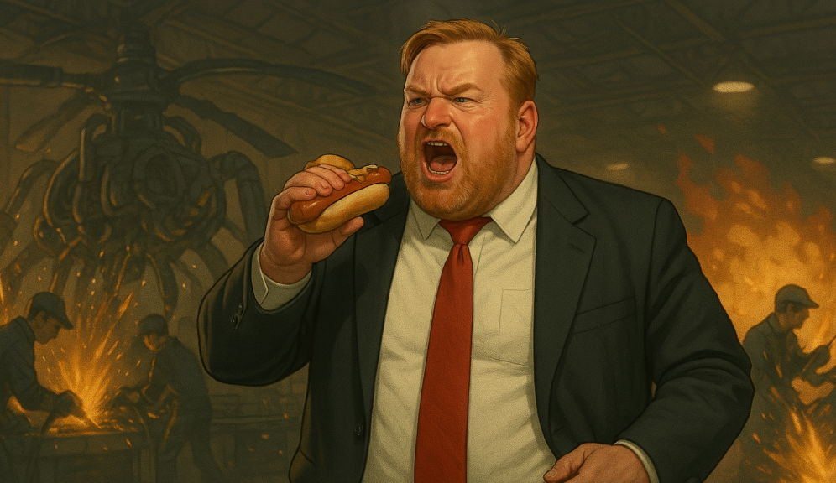
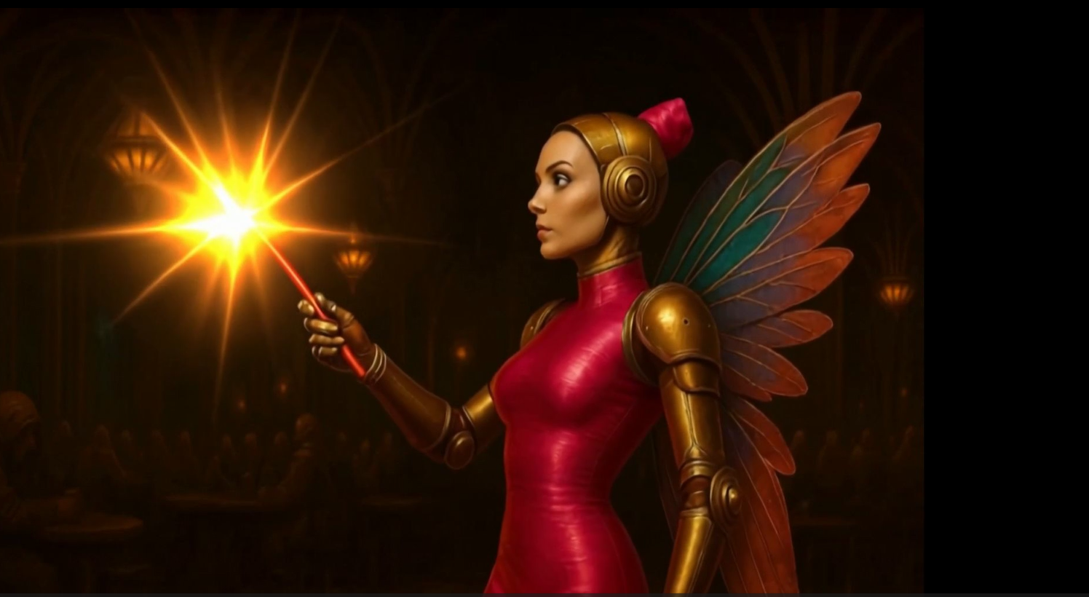
Main Characters
Pallister: A global media titan and puppet master of a poisoned world — obsessed with control and locked in a collision course with the nephew he once called family.
Bronzella: The robotic fairy queen with no time for fools, feelings, or your fragile human ego — she’ll save your life and roast you in the same breath.
9
Story
Film
Biz
Plan
Closing

Slide 9
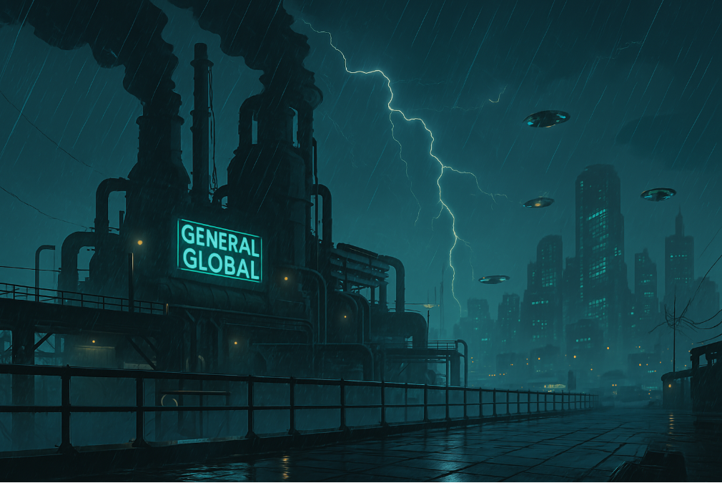
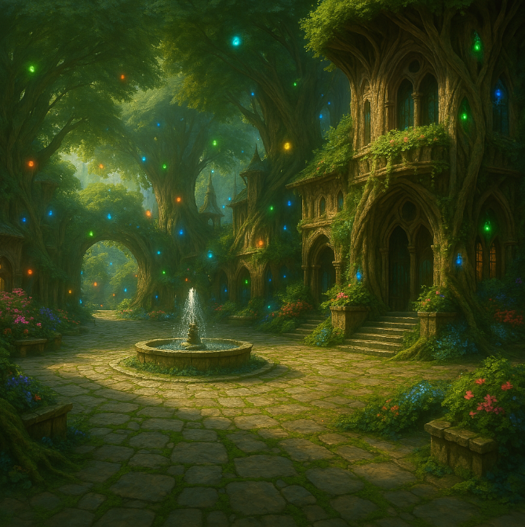
Visual World
New Manhattan: A cybertech metropolitan dystopia
Windleheim: A bioluminescent forest powered by magic
10
Story
Film
Biz
Plan
Closing

Slide 10
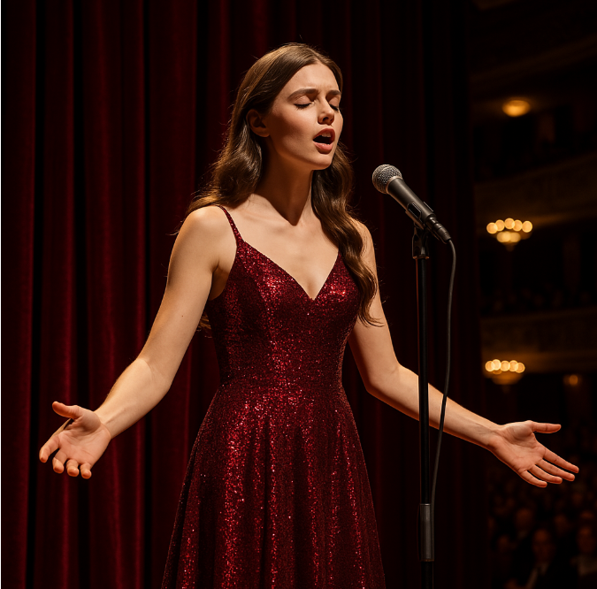
Music & Emotional Core
Two original songs sung by Rose:
  'Bring Me Back to You' (about her estranged father)
  'All I Ever Needed' (end credits ballad for Ethan)
Emotional themes: Redemption, love, environmental collapse, hope
End on a rainbow-lit kiss as Rose’s voice fades into the credits
11
Story
Film
Biz
Plan
Closing

Slide 11
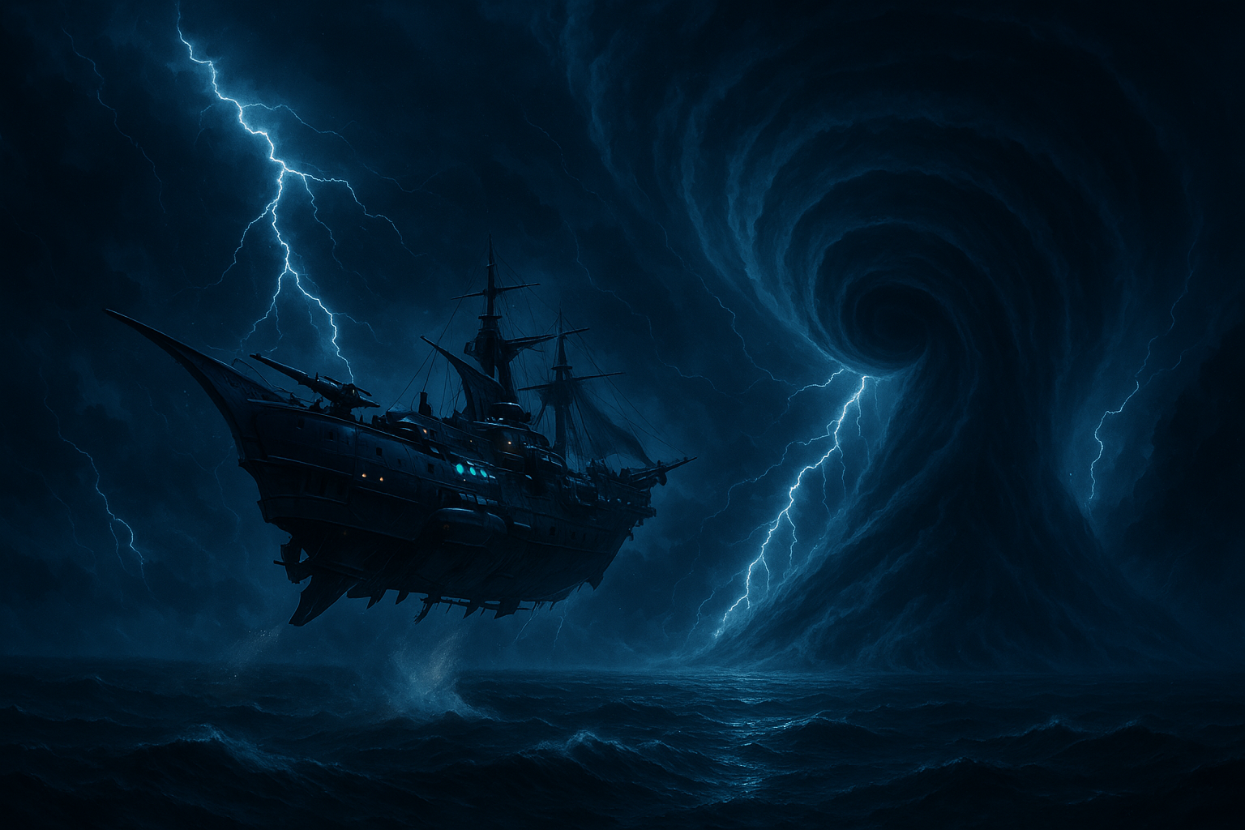
Target Market
Core demographic: Ages 10–35
Secondary: Families, anime & fantasy fans, emotional drama lovers
Four-quadrant appeal: Action, emotion, spectacle, mystery, and story
12
Story
Film
Biz
Plan
Closing

Slide 12
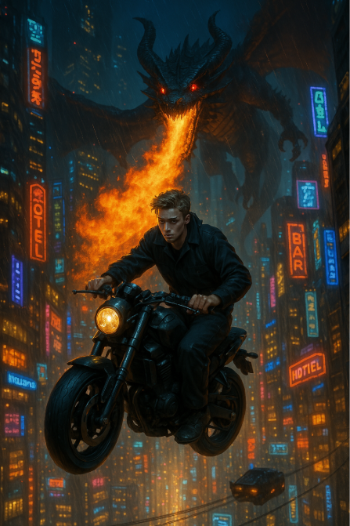
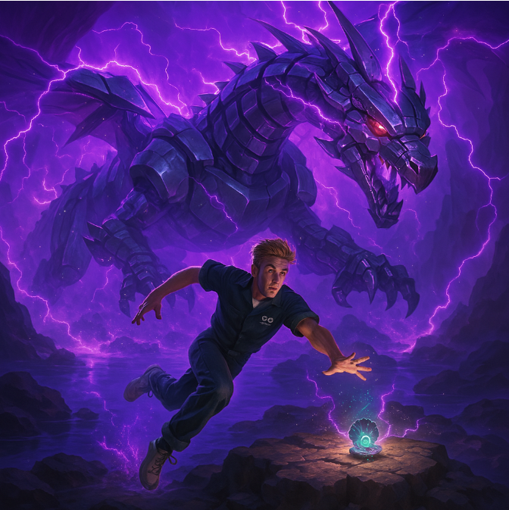
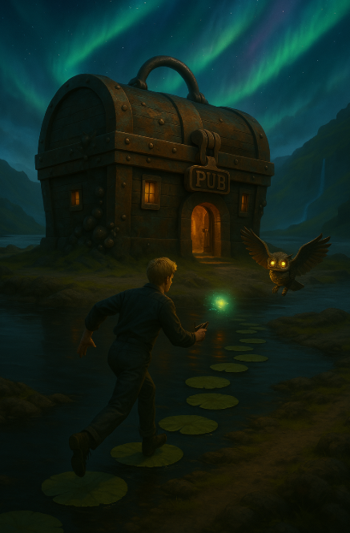
CONCEPT ART
A 230-page concept art book for this film has been created
Illustrative overview of what the movie looks like scene by scene
13
Story
Film
Biz
Plan
Closing

Slide 13
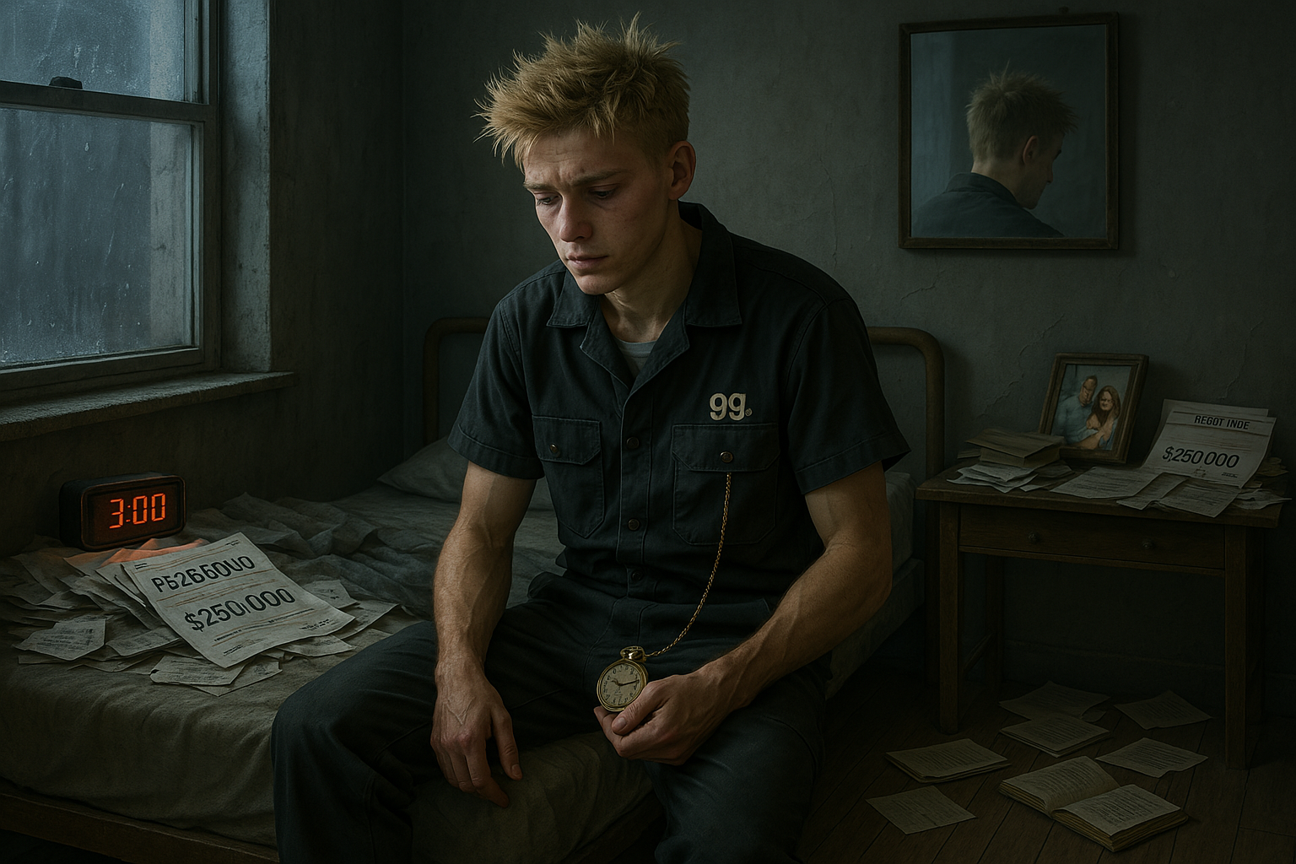
Business & IP Protection
Script copyrighted: WGA & Government of Canada
Concept art, characters, and storyline IP fully protected
Franchise potential: novels, merchandise, app, sequels
Website, concept art, and trailers established
14
Story
Film
Biz
Plan
Closing

Slide 14
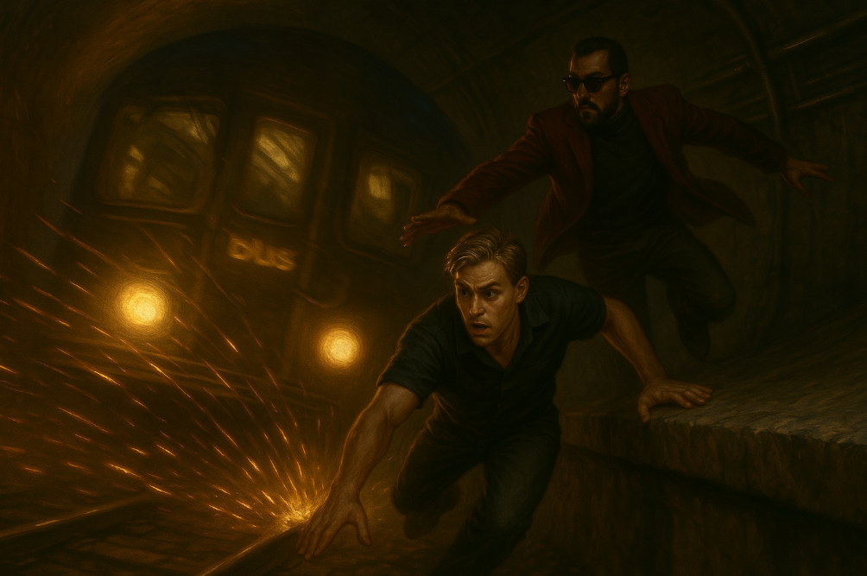
Budget and Financial Model
Scenario 1 – $30M Tier
Indie-style production with controlled scope
Heavy use of AI tools, practical effects, streamlined cast
Estimated Gross Break-Even: $45M–50M
ROI Goal: 1.5x–3x via streaming, theatrical, merch
15
Story
Film
Biz
Plan
Closing

Slide 15
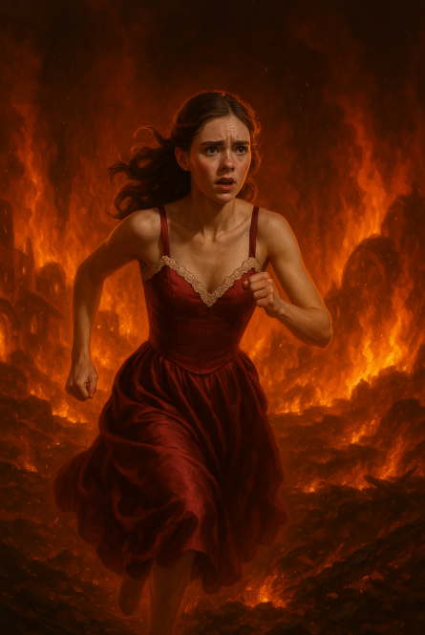
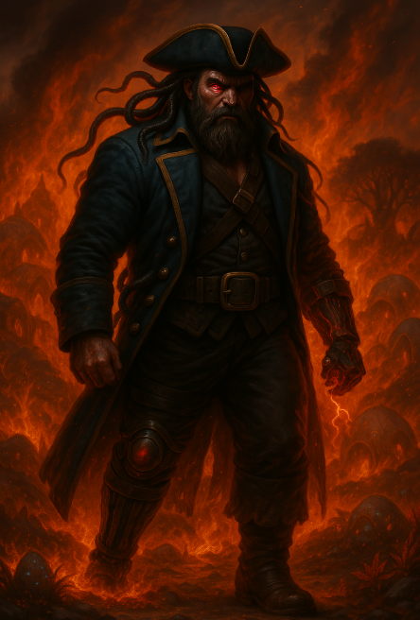
Budget and Financial Model
Scenario 2 – $100M Tier
High-concept blockbuster with global reach
Expanded cast, premium VFX, international shoots
Estimated Gross Break-Even: $140M
ROI Goal: 3x–5x, positioned as tentpole IP with franchise legs
16
Story
Film
Biz
Plan
Closing

Slide 16
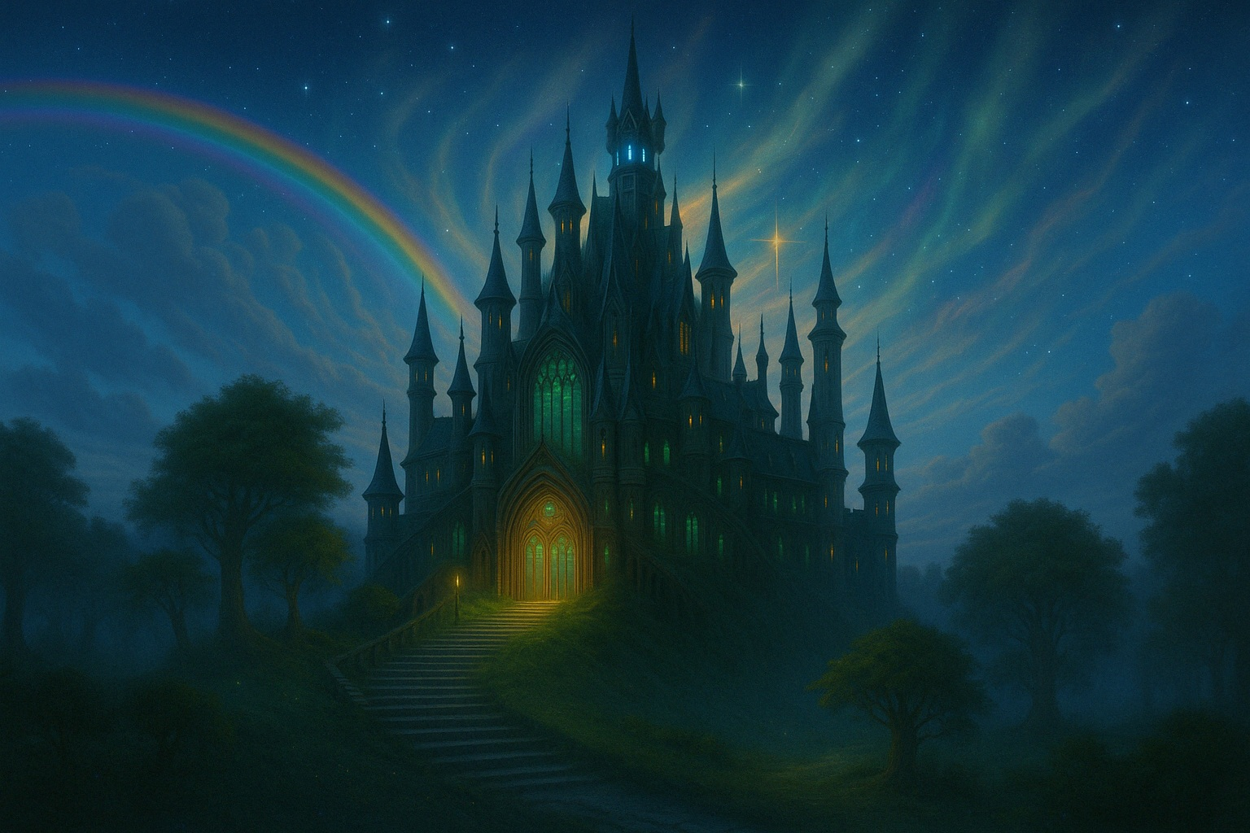
What More Funding Unlocks
A-list cast (internationally bankable actors)
Bigger VFX and action sequences
Real-location filming in Asia / Europe
Extended soundtrack / orchestral scoring
Broader global release campaign
17
Story
Film
Biz
Plan
Closing

Slide 17
PRODUCTION PLAN
Timeline
12-week principal photography schedule
6 weeks prep | 12 weeks shoot | 6 months post-production
Target shooting window: January - March 2026
Location
  Primary Choices: Winnipeg, Singapore, Hong Kong
  Secondary: AI backdrop for New Manhattan and Windleheim
Technical Pipeline
Blend of live-action, AI-assisted visuals, and VFX compositing
Mix of a human crew and AI technology
18
Story
Film
Biz
Plan
Closing

Slide 18
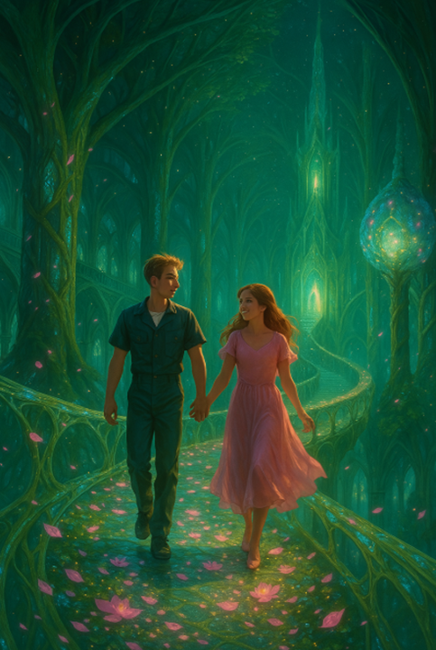
ASSETS IN PLACE
Completed 120-page screenplay
Novel published on Amazon
250-page business plan
230-page concept art book
Website (website domain secured)
Two trailers created with LTX Studio
Cast prototypes and character arcs filled
19
Story
Film
Biz
Plan
Closing

Slide 19
Why this story is personal
The Secret Treasure began as a story I wrote 12 years ago — not for studios, not for trends, but because I needed hope during one of the hardest chapters of my life.
Like Ethan, I’ve faced setbacks that left me struggling with burdens I didn’t create. I’ve carried debt, chased dreams that felt impossible, and wrestled with the question of whether the world values gold more than goodness.
This film is a love letter to anyone who's ever felt invisible, underestimated, or broken. It’s about finding the courage to rise, the strength to believe again, and the healing that comes when someone finally says, “You matter.”
I wrote this story to remind people — especially the next generation — that real power doesn’t come from wealth or titles. It comes from kindness, from purpose, and from love that doesn’t give up. I’ve spent 12 years building this world. Now, I’m ready to share it with the world.
20
Story
Film
Biz
Plan
Closing

Slide 20
CLOSING VISION STATEMENT
The Secret Treasure is more than a film — it’s a cinematic experience that blends breathtaking visuals with timeless themes of love, sacrifice, and redemption. It reminds us that true worth isn't measured in gold, but in the courage to care, the power to forgive, and the strength to believe in something bigger than ourselves.
Our vision:
  To create a modern-day myth that resonates across generations and cultures.
  To build a global franchise that blends art, emotion, and cutting-edge technology
  To deliver a story that stays with the audience after the credits roll
21
Story
Film
Biz
Plan
Closing

Slide 21
CLOSING VISION STATEMENT
Why Now: The world is hungry for hope, connection, and stories that inspire. We’re combining human storytelling with AI-enhanced filmmaking to push boundaries and set a new standard
The Secret Treasure is poised to be the next breakout hit — not just for box office success, but for emotional impact
Final Note: We’ve written the story. We’ve built the world.
All we need now — is the partner to bring it to life.
22
Story
Film
Biz
Plan
Closing

Slide 22
INVESTMENT OPPORTUNITY
We are seeking $2 - $6.3M USD for Phase I development
Expected returns (includes film sales, streaming and TV licensing, merchandise/toys, ancillary revenue, home entertainment:
  Budget of $30M USD → Expected Revenue: $70M USD
  Budget of $100M USD → Expected revenue: $1.2B USD
Contact info:
  Dr. Richard Dyrkacz
  Email: info@thesecrettreasure.com
  Phone: 1 (204) 269-2311
23
Story
Film
Biz
Plan
Closing

Slide 23
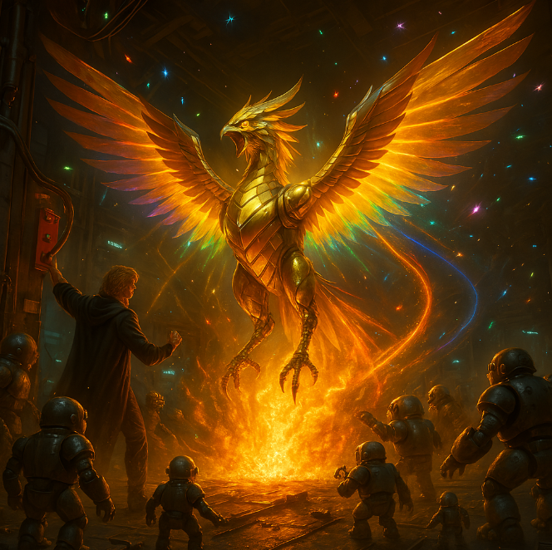
Thank you
24

