Slide 1
Cost-Effective Marine Consulting Solutions

Slide 2
Section 1
The Importance of Marine Consulting

Slide 3
Overview of Marine Consulting Services
Expertise in Maritime Operations
Marine consulting services provide specialized knowledge in vessel management, ensuring compliance with international regulations and enhancing operational efficiency through tailored solutions.

Slide 4
Benefits of Engaging Marine Consultants
01
02
03
Specialized Knowledge Access
Resource Optimization
Dynamic Support Solutions
Engaging marine consultants provides organizations with access to specialized knowledge in maritime regulations and best practices, ensuring compliance and enhancing operational performance through expert guidance.
By utilizing marine consultants, companies can optimize internal resources, allowing staff to focus on core business functions while consultants address specific maritime challenges effectively.
Marine consulting services offer dynamic support tailored to fluctuating operational needs, enabling organizations to scale their engagement without the burden of long-term staffing commitments.

Slide 5
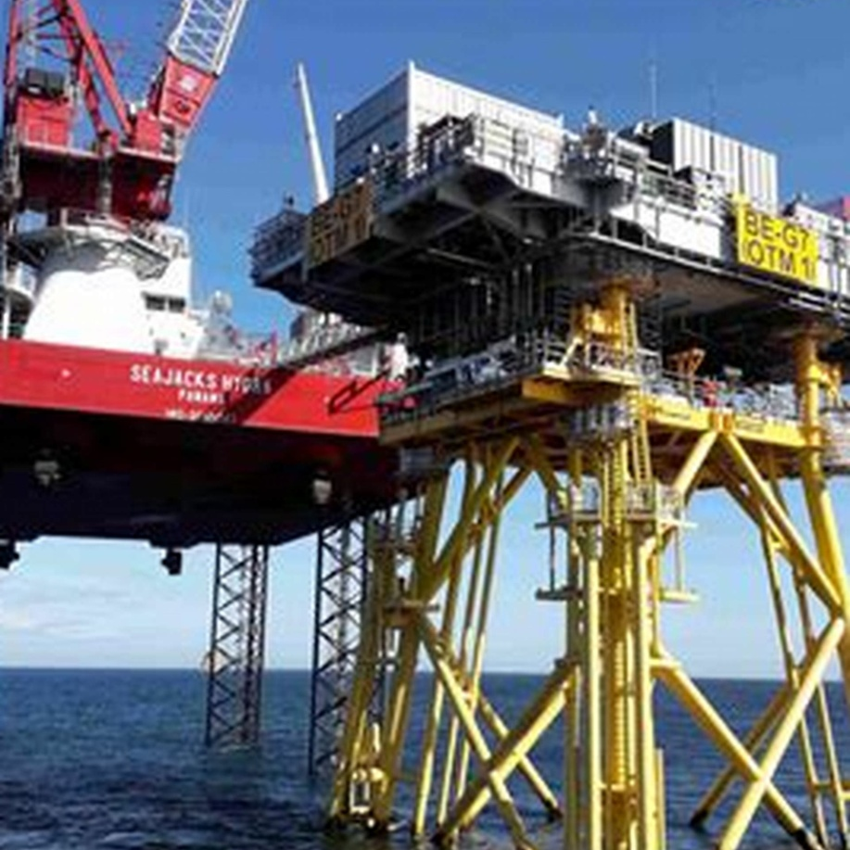
Cost Savings Through Expert Consultation
Significant Financial Benefits
Engaging expert marine consultants can lead to substantial cost reductions, with studies indicating potential savings of up to 60% compared to maintaining a large in-house team, thereby allowing organizations to allocate resources more efficiently and enhance overall operational effectiveness.

Slide 6
Section 2
Comparing In-House Teams vs. Marine Consulting

Slide 7
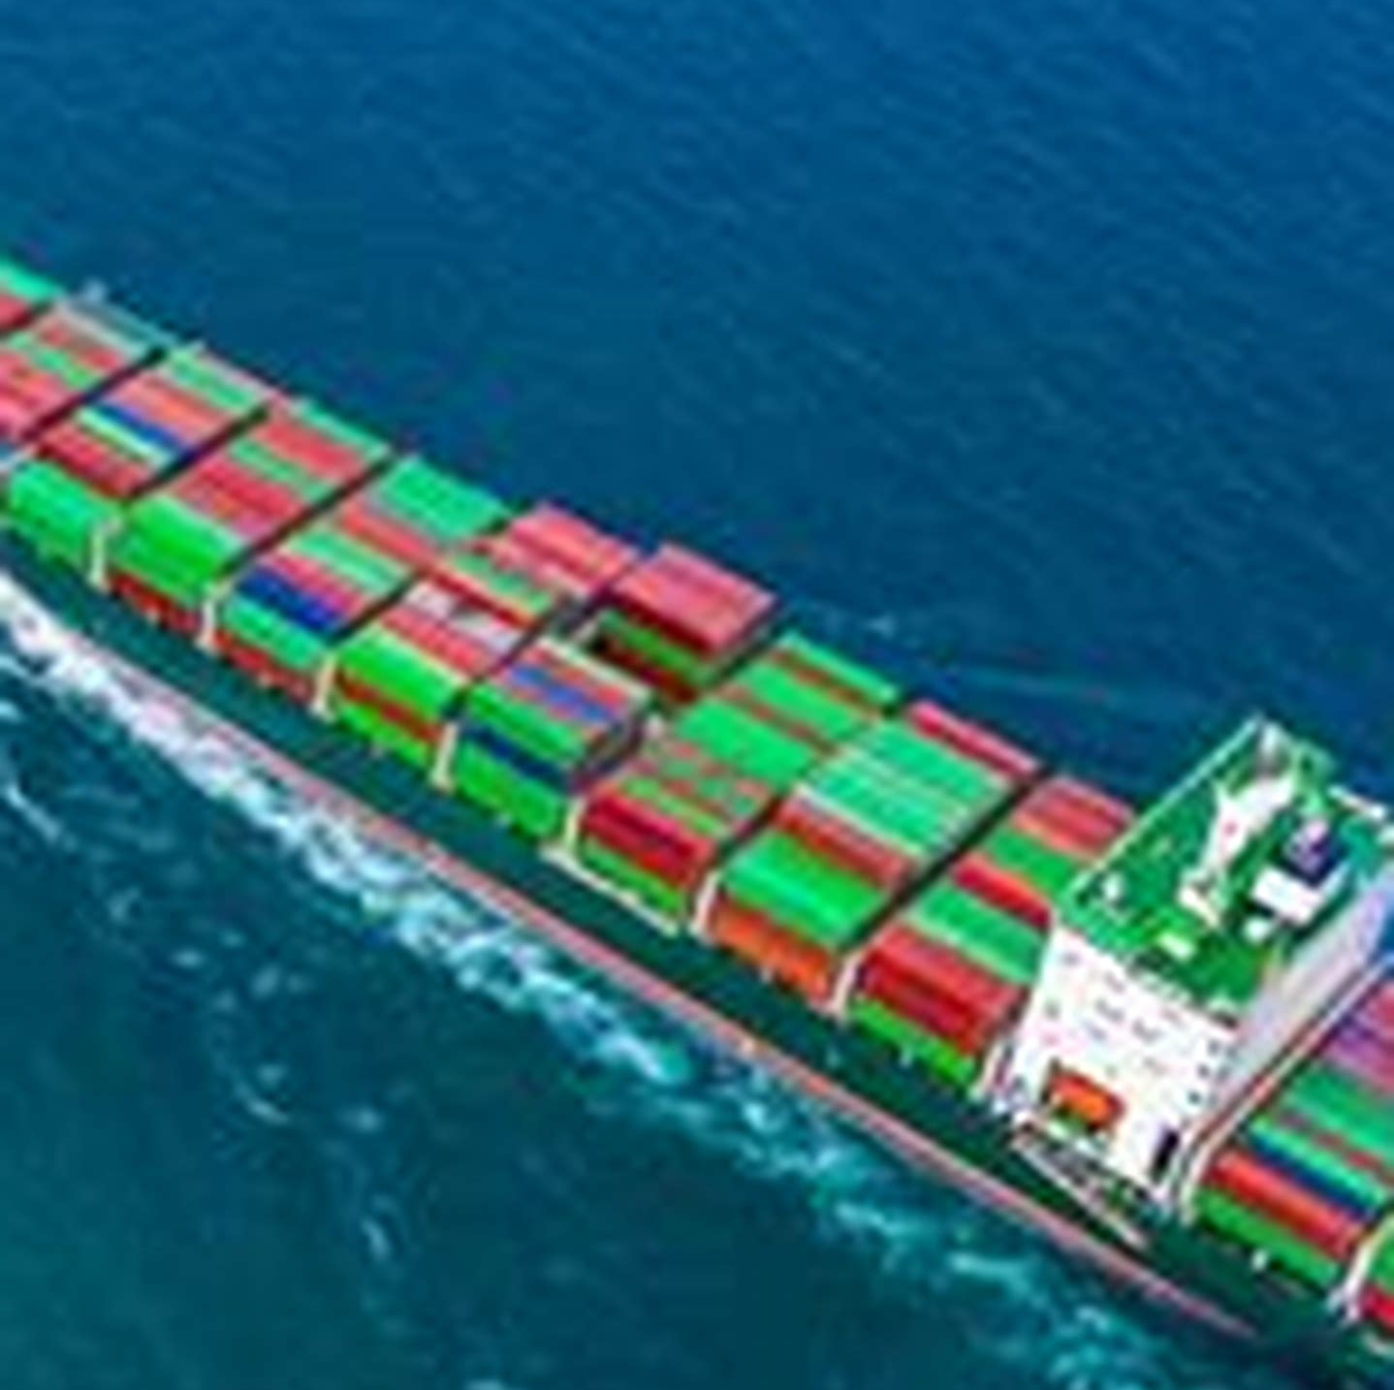
Financial Implications of Maintaining Large Teams
High Operational Costs
Maintaining large marine and technical teams incurs substantial operational costs, including salaries, benefits, and training, which can lead to financial strain, especially during periods of low activity when personnel may be underutilized.

Slide 8
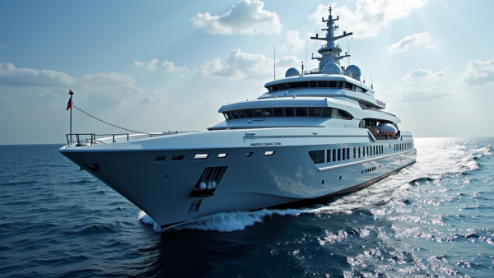
Efficiency and Expertise of Marine Consultants
Agile Resource Management
Comprehensive Industry Insights
Targeted Problem Resolution
Marine consultants provide businesses with the ability to quickly adapt to changing project requirements, ensuring that resources are efficiently allocated without the overhead of permanent staffing.
By leveraging specialized expertise, marine consultants enhance an organization's ability to identify and resolve complex maritime issues, leading to improved operational performance and reduced downtime.
With their extensive experience, marine consultants offer valuable insights into industry trends and regulatory changes, enabling organizations to stay ahead of compliance and operational challenges.

Slide 9
Success Stories in Marine Consulting
01
02
03
Operational Efficiency Gains
Regulatory Compliance Success
Cost Reduction in Dry Docking
Marine consulting has enabled companies to significantly enhance operational efficiency, as demonstrated by a shipping company achieving a 40% reduction in unscheduled maintenance through tailored fleet assessments and predictive maintenance strategies.
A drilling operator improved its compliance framework with the help of marine consultants, resulting in a 70% reduction in compliance-related incidents and increased contract opportunities, showcasing the importance of expert guidance in regulatory matters.
By adopting a performance-based procurement strategy through marine consultancy, a cruise line reduced dry dock duration by 30 days, translating to annual savings of approximately $1.5 million, highlighting the financial benefits of specialized consulting services.

Slide 10
Section 3
Conclusion

Slide 11
Thank You
Contact:
Support_team24@greenwichmarine.services
Phone: +44 7425 82 41 67

