Slide 1
Supply Operation and Cost Effectiveness in the Marine Industry

Slide 2
Section 1
Understanding the Marine Supply Chain

Slide 3
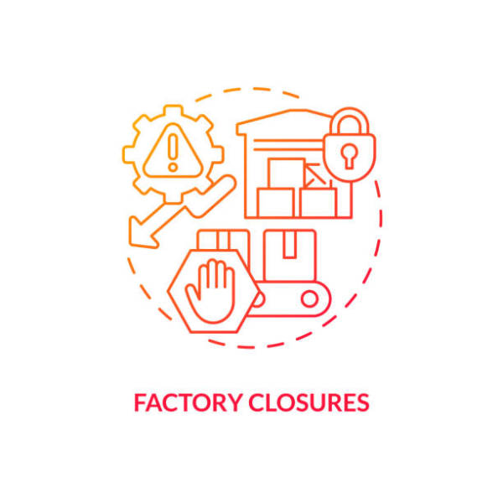
Overview of Supply Chain Dynamics in the Marine Industry
Complex Stakeholder Interactions
The marine supply chain involves intricate relationships among diverse stakeholders, necessitating effective communication and collaboration to ensure seamless operations and mitigate risks associated with maritime logistics.

Slide 4
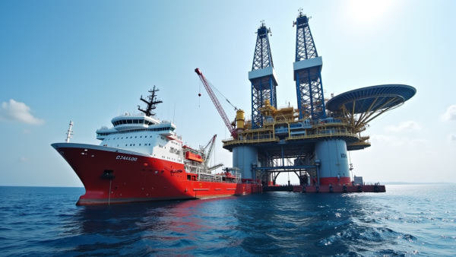
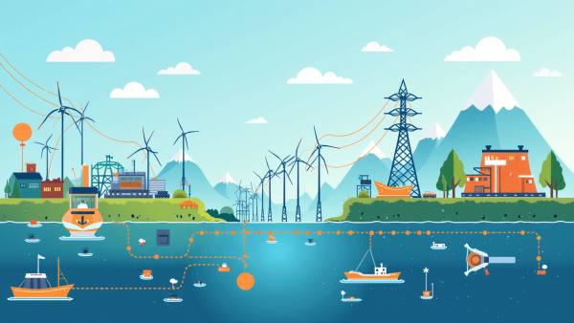
Key Challenges in Marine Supply Operations
Supply Chain Complexity
Regulatory Compliance Issues
Demand Fluctuations
The intricate nature of the marine supply chain requires effective coordination among various stakeholders, which can lead to communication breakdowns and operational inefficiencies if not managed properly.
The marine industry faces unpredictable demand shifts influenced by economic and geopolitical factors, necessitating agile supply chain strategies to avoid disruptions and maintain operational stability.
Adhering to a multitude of local and international regulations is essential, as non-compliance can result in severe financial penalties and damage to an organization's reputation in the industry.

Slide 5
Importance of Cost Management in Supply Operations
Performance Measurement and Accountability
Strategic Financial Planning
Implementing effective cost management strategies allows organizations to align their financial resources with long-term business goals. This alignment ensures that investments are made in areas that drive growth and efficiency, ultimately leading to enhanced profitability and a stronger market position in the marine industry.
Establishing clear cost management metrics enables organizations to monitor performance and hold teams accountable for financial outcomes. By regularly reviewing these metrics, companies can identify trends, make informed adjustments, and foster a culture of continuous improvement, ensuring sustained operational excellence.

Slide 6
Role of Technology in Enhancing Supply Chain Efficiency
Impact of Automation
Automation streamlines processes in the marine supply chain, reducing manual errors and increasing speed. This leads to improved inventory accuracy and faster order fulfillment, ultimately enhancing customer satisfaction and operational reliability.
Data-Driven Decision Making
Utilizing real-time data analytics empowers organizations to make informed decisions quickly. This capability allows for better demand forecasting, inventory management, and responsiveness to market changes, driving overall supply chain efficiency.
Enhanced Collaboration Tools
Advanced collaboration platforms facilitate seamless communication among supply chain partners. By sharing critical information in real-time, these tools help mitigate risks, improve coordination, and foster a unified approach to problem-solving in complex logistics scenarios.

Slide 7
Section 2
Strategies for Cost Reduction in Marine Supply Operations

Slide 8
Best Practices for Optimizing Procurement Processes
01
02
03
SMART Goal Alignment
Technology Integration
Supplier Collaboration
Utilizing procurement management software and advanced technologies like AI can automate tasks, improve data accuracy, and enable strategic decision-making, ultimately leading to significant cost savings and efficiency.
Building strong relationships with suppliers through regular communication and performance reviews fosters trust and reliability, allowing for better negotiation terms and innovative solutions to supply chain challenges.
Establishing specific, measurable, achievable, relevant, and time-bound goals ensures procurement activities are aligned with overall business objectives, enhancing focus and performance evaluation across initiatives.

Slide 9
Leveraging Strategic Partnerships for Cost Efficiency
Enhanced Operational Synergy
Strategic partnerships enable organizations to combine their strengths, leading to improved operational synergy that reduces redundancies, optimizes resource allocation, and ultimately drives down costs while enhancing service delivery across the marine supply chain.

Slide 10
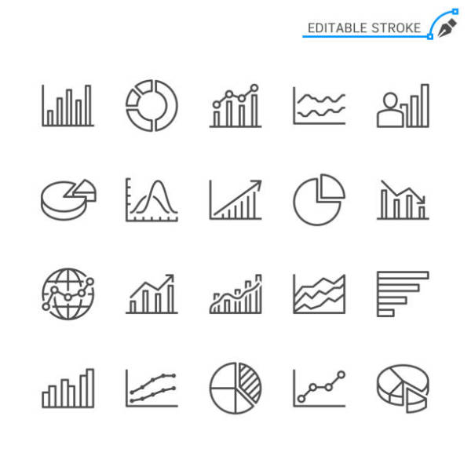
Implementing Data-Driven Decision Making
Strategic Data Utilization
Leveraging comprehensive data analytics enables marine companies to enhance operational efficiency, optimize resource allocation, and make informed decisions that align with market dynamics and customer demands.

Slide 11
Successful Cost Reduction Initiatives
01
02
03
Procurement Process Optimization
Strategic Partnerships Impact
Technology-Driven Supply Chain
V.Group's strategic review of procurement led to a 15% cost reduction by leveraging data analytics for supplier negotiations, enhancing both cost efficiency and service quality.
A shipping company's alliances with suppliers resulted in a 20% decrease in logistics costs, showcasing the benefits of collaborative resource sharing and improved negotiation power.
A maritime logistics firm achieved a 30% reduction in transportation costs through advanced tracking software, enhancing visibility and operational agility in their supply chain management.

Slide 12
Section 3
Enhancing Customer Value through Effective Supply Operations

Slide 13
Aligning Supply Chain Strategies with Customer Needs
Customer-Centric Supply Chain Design
Implementing a customer-centric supply chain design involves integrating customer feedback into every stage of the supply chain process, ensuring that operations are not only responsive to current demands but also anticipatory of future needs, thereby enhancing overall customer satisfaction and loyalty.

Slide 14
Key Performance Indicators (KPIs)
01
02
03
Importance of KPI Selection
Benchmarking for Improvement
Impact on Stakeholder Engagement
Choosing the right KPIs is crucial as they should align with strategic goals, providing relevant insights that drive performance improvements and facilitate informed decision-making within marine supply operations.
Regularly comparing KPI results against industry standards or historical data helps organizations identify performance gaps, enabling targeted strategies for enhancement and fostering a culture of continuous improvement.
Effective KPI communication to stakeholders enhances transparency and accountability, fostering trust and collaboration across departments, which is essential for achieving collective operational objectives in the marine industry.

Slide 15
Future Trends in Marine Supply Chain Manageme
01
02
03
Automation and AI Integration
Data-Driven Insights
Sustainability Initiatives
Real-time data analytics and IoT technologies will provide stakeholders with critical insights into supply chain performance, enabling proactive decision-making, optimized routing, and enhanced responsiveness to market dynamics and customer needs.
The marine supply chain will increasingly leverage automation and AI to enhance operational efficiency, reduce costs, and improve safety through autonomous vessels and smart logistics systems, necessitating workforce training for effective technology adoption.
Growing environmental regulations will drive the adoption of sustainable practices in marine supply chains, including the use of alternative fuels and eco-friendly materials, positioning companies to meet compliance standards while appealing to environmentally conscious consumers.

Slide 16
Thank You
Contact: Support_team24@greenwichmarine.services
Phone number: +44 7425 82 41 67

