Slide 1
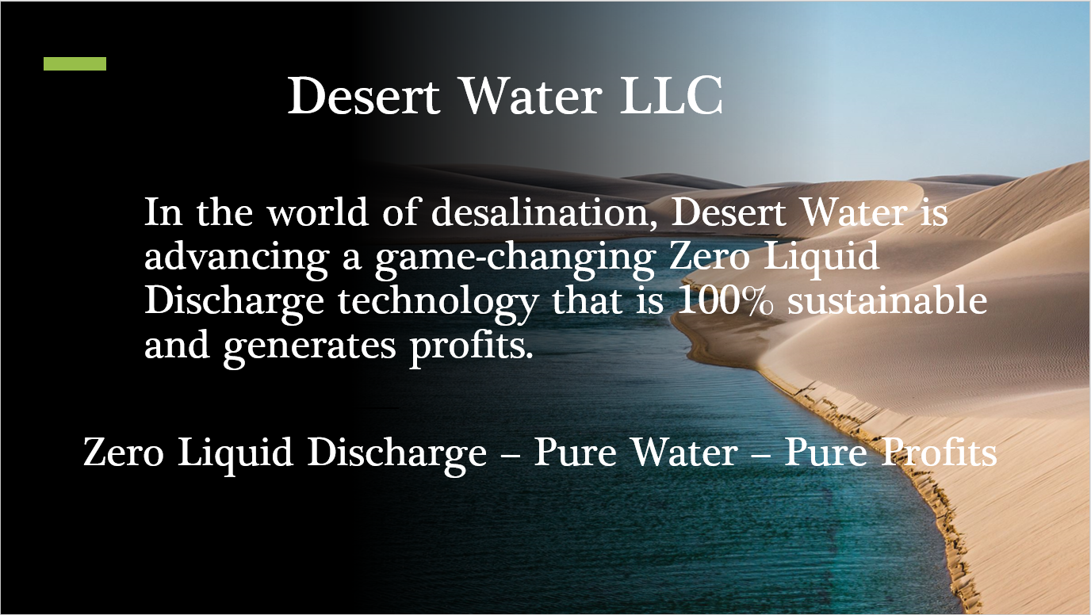

Slide 2

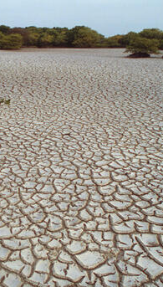
More than a billion people lack
sufficient clean water.
Problem
Desalination plants produce more
Brine waste than clean water.
40 billion gallons of toxic brine is Dumped into oceans DAILY causing
Severe environmental impacts.

Slide 3
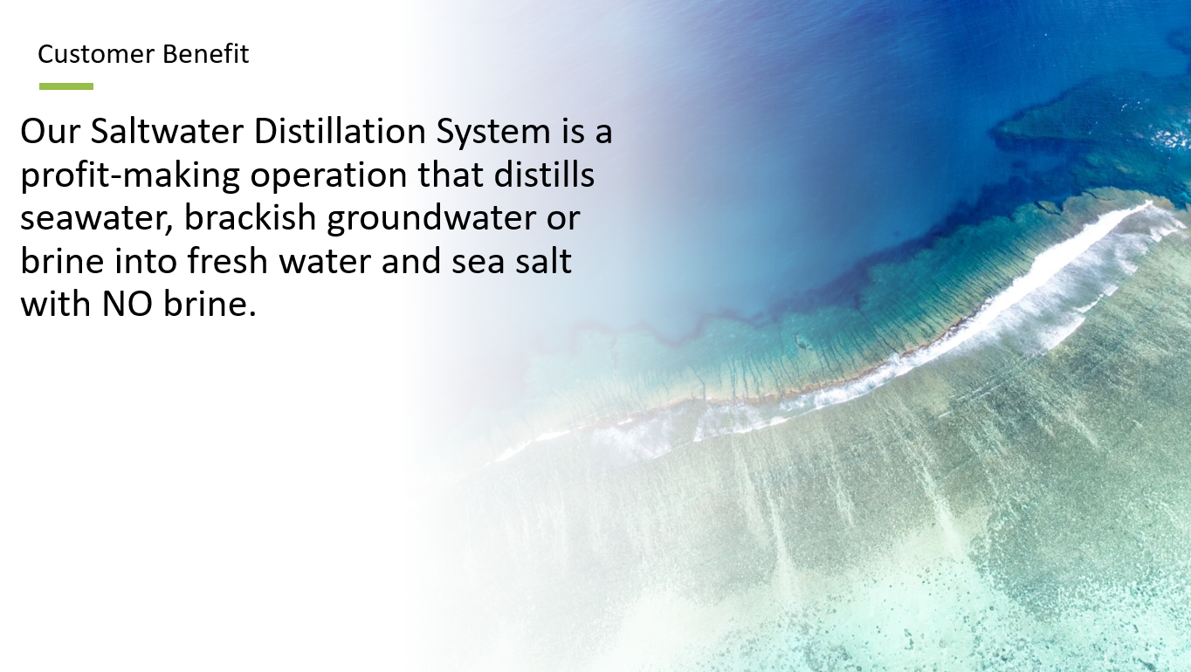

Slide 4
$10 + Billions Addressable Markets
Market Size
Primary Markets:
Zero Liquid Discharge $8 - 10B/year
Will grow exponentially with SDS capabilities
Distilled Water: $1B/year 8 – 10% CAGR
Salt, Agriculture Products, Bottled Water
Unlimited Markets
+ Immediate Opportunity: New Markets – Micro Desalination –
Homes, Schools, Farms and Businesses
TAM - $10 + Billions
SAM - $2.5 Billion
SOM - $1 Billion

Slide 5
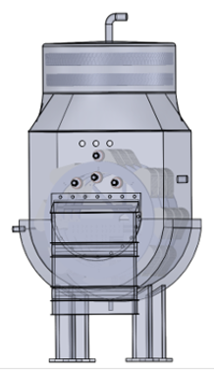
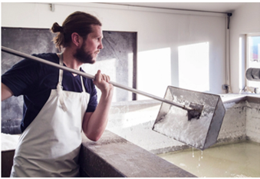
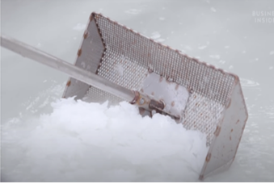
Technology
Harvesting salt from sea water is an ancient practice that is still done today.
The new, patented Desert Water vessel is the first machine that recovers
the salt by mechanical means and collects the steam at the same time.

Slide 6
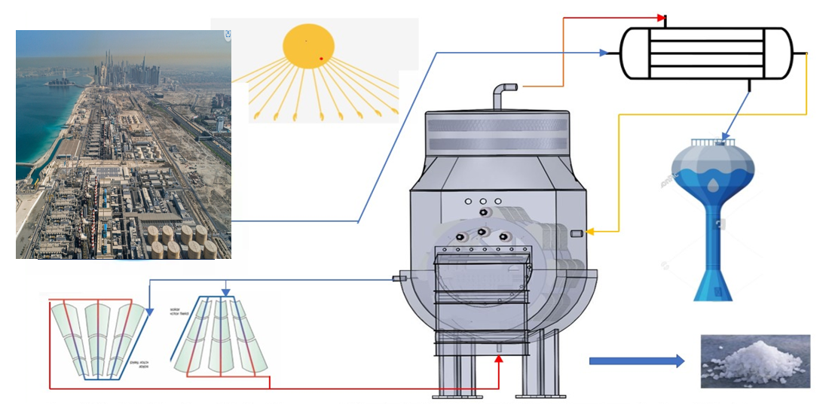
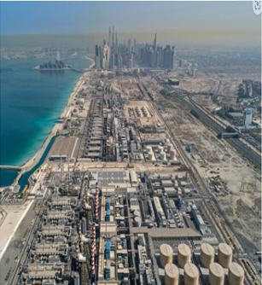

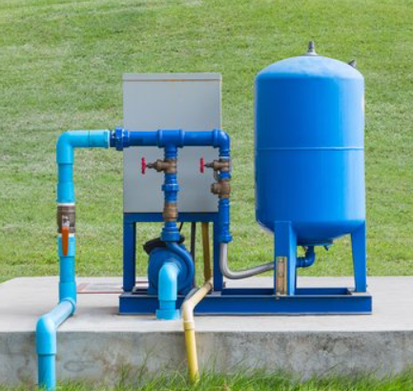
Technology
Steam
Heated Brine
Brine
Distilled
Water
Cool Heating Fluid
Salt
Hot Heating Fluid
The DW SDS ZLD system processes brine, brackish groundwater and ocean water

Slide 7
Component Lab Tested Technology
Ready for System Prototype “Proof of Concept” Lab Test
Development Status:
✅ System Research & component lab testing completed
(Youngstown State University)
✅ Equipment patent #11,780,744 with international protection
✅ Process patent pending
✅ Preliminary prototype designs complete
⏳ Prototype lab testing (current funding need)
Strategic Partnership: Stainless Specialties LLC (fabrication expertise)
Brite Energy Innovators (fully equipped and staffed wet lab)
Next Milestones: Lab prototype → Field testing → Commercial deployment

Slide 8

Desert Water LLC Saltwater Distillation System impact
Environmental Impact:
Impact KPI’s
Volume of clean water produced (gallons/day)
Salt recovery rates and quality metrics
Energy efficiency compared to traditional desalination
Carbon footprint reduction vs. conventional methods
Social Impact:
Number of people provided with clean water access
Communities served and geographic reach
Job creation in local markets
Cost savings for end users vs. alternative water sources
Economic Impact:
Revenue generated from both water and salt production
Cost per gallon of water produced
Local economic multiplier effects
Return on investment for customers
Impact Goal Statement: The revolutionary patented DW SDS is 100% environmentally sustainable with solar power integration, it eliminates brine waste, generates revenue from distilled water, salt and agrivoltaics and is a profitable operation unlike existing desalination which requires ongoing financial support.
Data Collection Methods:
Real-time monitoring systems integrated into our equipment
Customer usage reporting and feedback surveys
Third-party verification of environmental benefits
Partnership with local organizations for community impact assessment
Regular audits and impact reporting aligned with industry standards

Slide 9

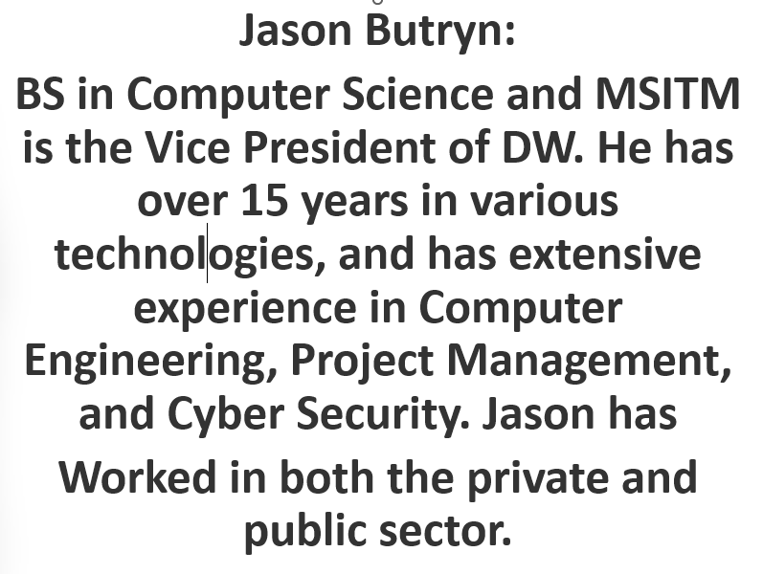
Management Team

Slide 10
Business Model
Global Engineering & Construction Company
Phase 1: New integrated desalination + SDS facilities
Phase 2: Retrofit existing desalination plants with SDS ZLD systems
Phase 3: Micro-desalination market expansion
Phase 4: International leasing, licensing and franchising
Target Customers:
Countries, communities and businesses seeking water
Existing desalination plant operators
Water utilities seeking ZLD compliance
Power plants and industrial facilities
Ocean going ships

Slide 11
Multiple Revenue Streams = Profitability
Sales Strategy
Revenue Sources:
1. Engineering and Construction - Design, install, maintain facilities
2. Equipment Operation/Sales/Lease/Licensing - SDSs globally
3. Distilled Water Sales - Premium pricing for ultra-pure water
4. Salt - Secondary Market with gourmet market potential
5. Agrivoltaic Integration - Additional agricultural revenue
Financial Advantage: Revenue-generating vs. cost-center ZLD systems
Payback Period: ≤10 years (vs. perpetual costs for traditional systems)

Slide 12
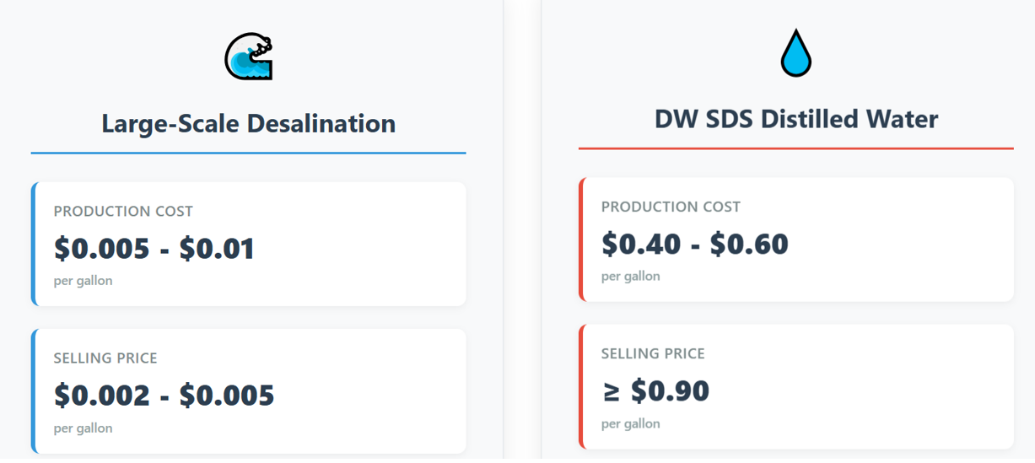

Slide 13
Competitive Analysis
Revenue Growth Through
Market Penetration and Expansion
Economic Advantage:
Profit-generating vs. cost
consuming
Year 1-2: Prototype validation + first
commercial installation
Year 3-5: Scale manufacturing +
expand to multiple markets
Year 5+: International expansion +
license/lease revenue
Multiple revenue streams
100% Sustainable and Profitable
with Solar Integration
Market Position:
Key Metrics:
First-mover in profitable ZLD
Projected profits >$0.30/gallon of
distilled water produced
Improved concept with
university validation
Payback period: ≤10 years
Multiple revenue streams reduce risk
Recurring service revenue provides stability

Slide 14
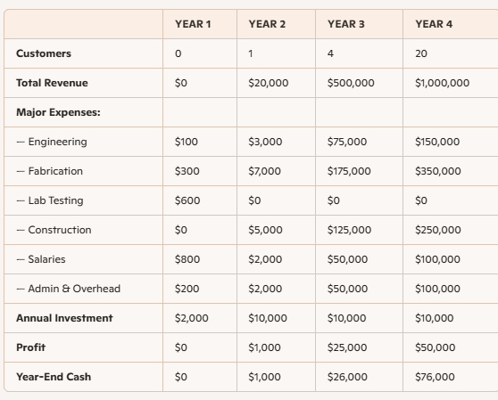
Finance Slide

Slide 15
Ask
Seeking $2 Million for Prototype Lab Test for Proof of Function
Use of Funds:
15% Engineering of prototype vessel and lab procedures
25% Procurement of vessel and lab materials
30% Laboratory test
20% - Team expansion & operations
10% - Administration, Intellectual property & regulatory
Milestones
Month 4: Engineering complete
Month 8: Fabricated vessel and all equipment at the lab
Month 12: Lab test complete

Slide 16
💡 Exit Scenarios for Investor Return - All options remain viable pending market conditions and performance milestones:
M&A – Acquisition by strategic buyer in water, cleantech, or infrastructure
IPO – Potential longer-term exit after commercial scaling
Loan Repayment / Revenue-Based Financing – Repayment from project income
Flow-Through of Profits – As an LLC, DW may distribute profits directly
Dividends – Once projects become cash-flow positive
💰 Anticipated Investment Required Pre-Exit
Current Round: $2M - Lab prototype + IP filings (equipment + process patents, incl. international)
Future Rounds (Years 2–3): Up to $20M - Commercial-scale field deployment & customer onboarding
Total Investment to Exit: < $22M
🤝 M&A as a Plausible Exit Path - Strategic Acquirers in Market:
Xylem → Acquired Evoqua for $1.7B (2023) Veolia → Multiple water tech acquisitions (e.g., Suez, Kurion) Gradiant → Raised $225M (2023) in ZLD & water reuse Dupont Water Solutions → R&D – desalination and membrane technology
Relevance: Global demand for scalable, low-energy desalination and ZLD makes DW a fit for acquisition by industry leaders seeking growth and ESG impact.

