Slide 1

CLOSE PACKED STRUCTURES
Unit 1: The Solid State
Class: XII

Slide 2
Close Packing in One Dimension
Close Packing in Two Dimensions
Close Packing in Three Dimensions
  Placing second layer over the first layer
  Placing third layer over the second layer
Formula of a Compound and Number of Voids Filled
Locating the voids
Worksheet
CONTENTS

Slide 3
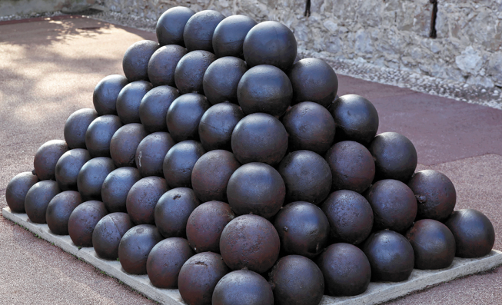

Close Packing in One Dimension
Assume that the solid constitutes of particles that are close-packed, Let us consider the constituent particles as identical hard spheres
There is only one way of arranging spheres in a one-dimensional close packed structure, that is to arrange them in a row and touching each other
coordination number = 2
Coordination number: The number of nearest neighbours of a particle

Slide 4
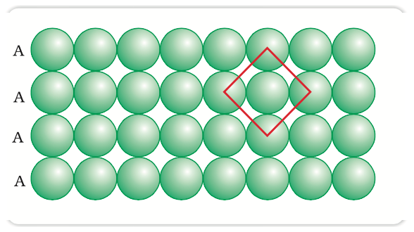
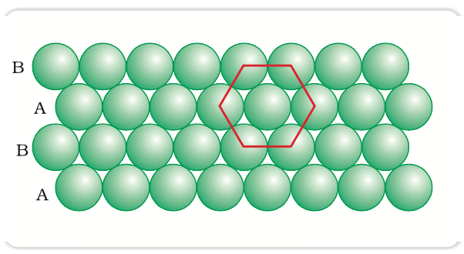
Close Packing in Two Dimensions
The second row may be placed in contact with the first one such that the spheres of the second row are exactly above those of the first row. If we call the first row as ‘A’ type row, the second row being exactly the same as the first one, is also of ‘A’ type.
The second row may be placed above the first one in a staggered manner such that its spheres fit in the depressions of the first row. this arrangement is of ABAB type
coordination number = 4
Two dimensional square close packing
coordination number = 6
Two dimensional hexagonal close packing

Slide 5
Close Packing in Three Dimensions
All real structures are three dimensional structures.
Two dimensional layer
Three dimensional structure
Two dimensional layer
Two dimensional layer
Types of two dimensional packing: square close-packing and hexagonal close-packing

Slide 6
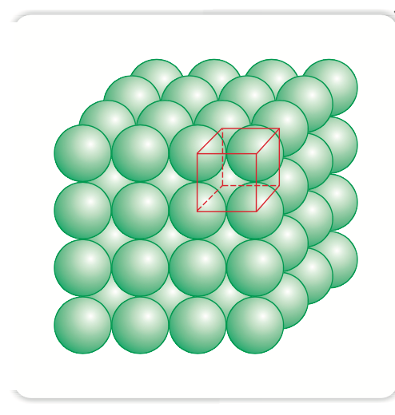
Close Packing in Three Dimension
Three-dimensional close packing forms two-dimensional square close-packed layers:
The second layer is placed over the first layer such that the spheres of the upper layer are exactly above those of the first layer.
If the arrangement of spheres in the first layer is called ‘A’ type, all the layers have the same arrangement. Thus this lattice has AAA.... type pattern.

Slide 7
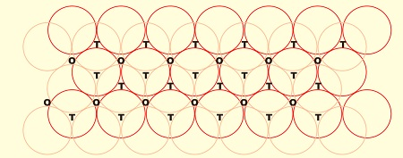

Close Packing in Three Dimension
Three dimensional close packing from two dimensional hexagonal close packed layers:
Placing second layer over the first layer
a two dimensional hexagonal close packed layer ‘A’ and place a similar layer above it such that the spheres of the second layer are placed in the depressions of the first layer.
Voids in cheese !

Slide 8
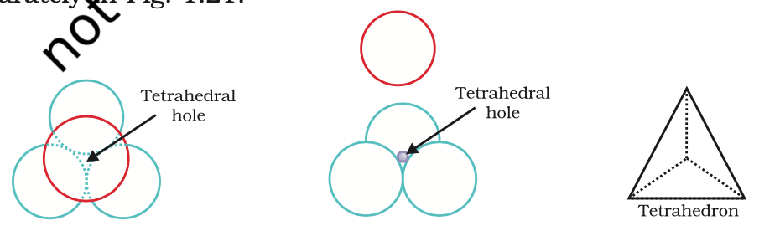
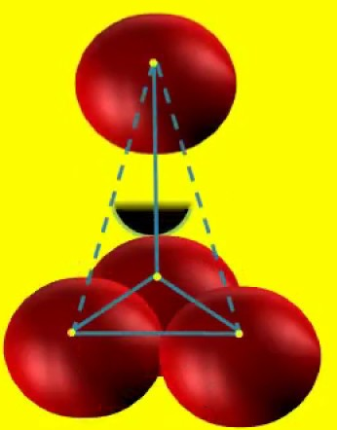
Types of Voids
Tetrahedral void is formed by placing a sphere of the second layer is above the void of the first layer (or vice versa)
a tetrahedron is formed when the centres of these four spheres are joined

Slide 9
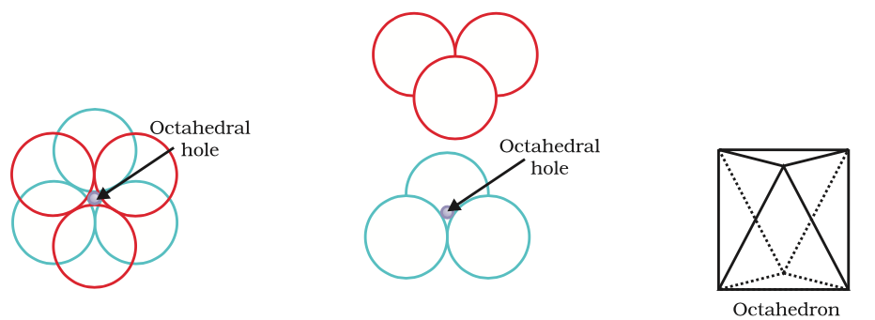
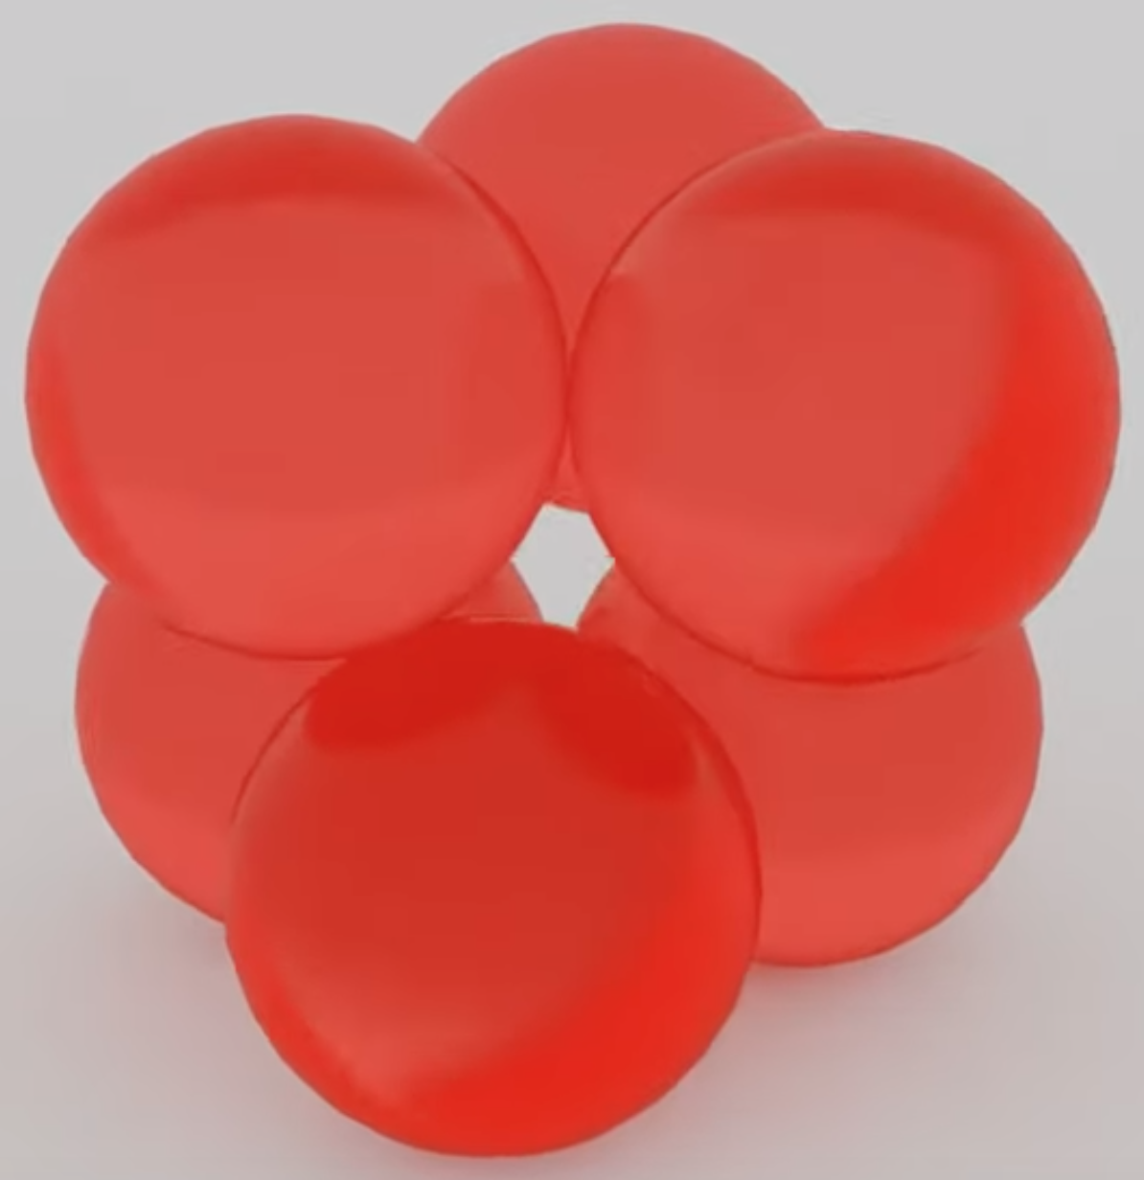
Types of Voids
Octahedral voids: octahedral voids are surrounded by six spheres. The number of these two types of voids depend upon the number of close packed spheres.
Let the number of close packed spheres be N, then:
The number of octahedral voids generated = N
The number of tetrahedral voids generated = 2N

Slide 10
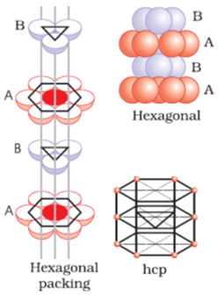
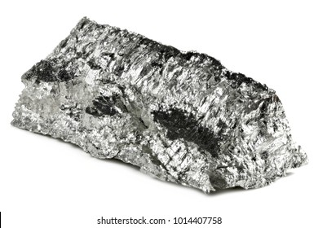
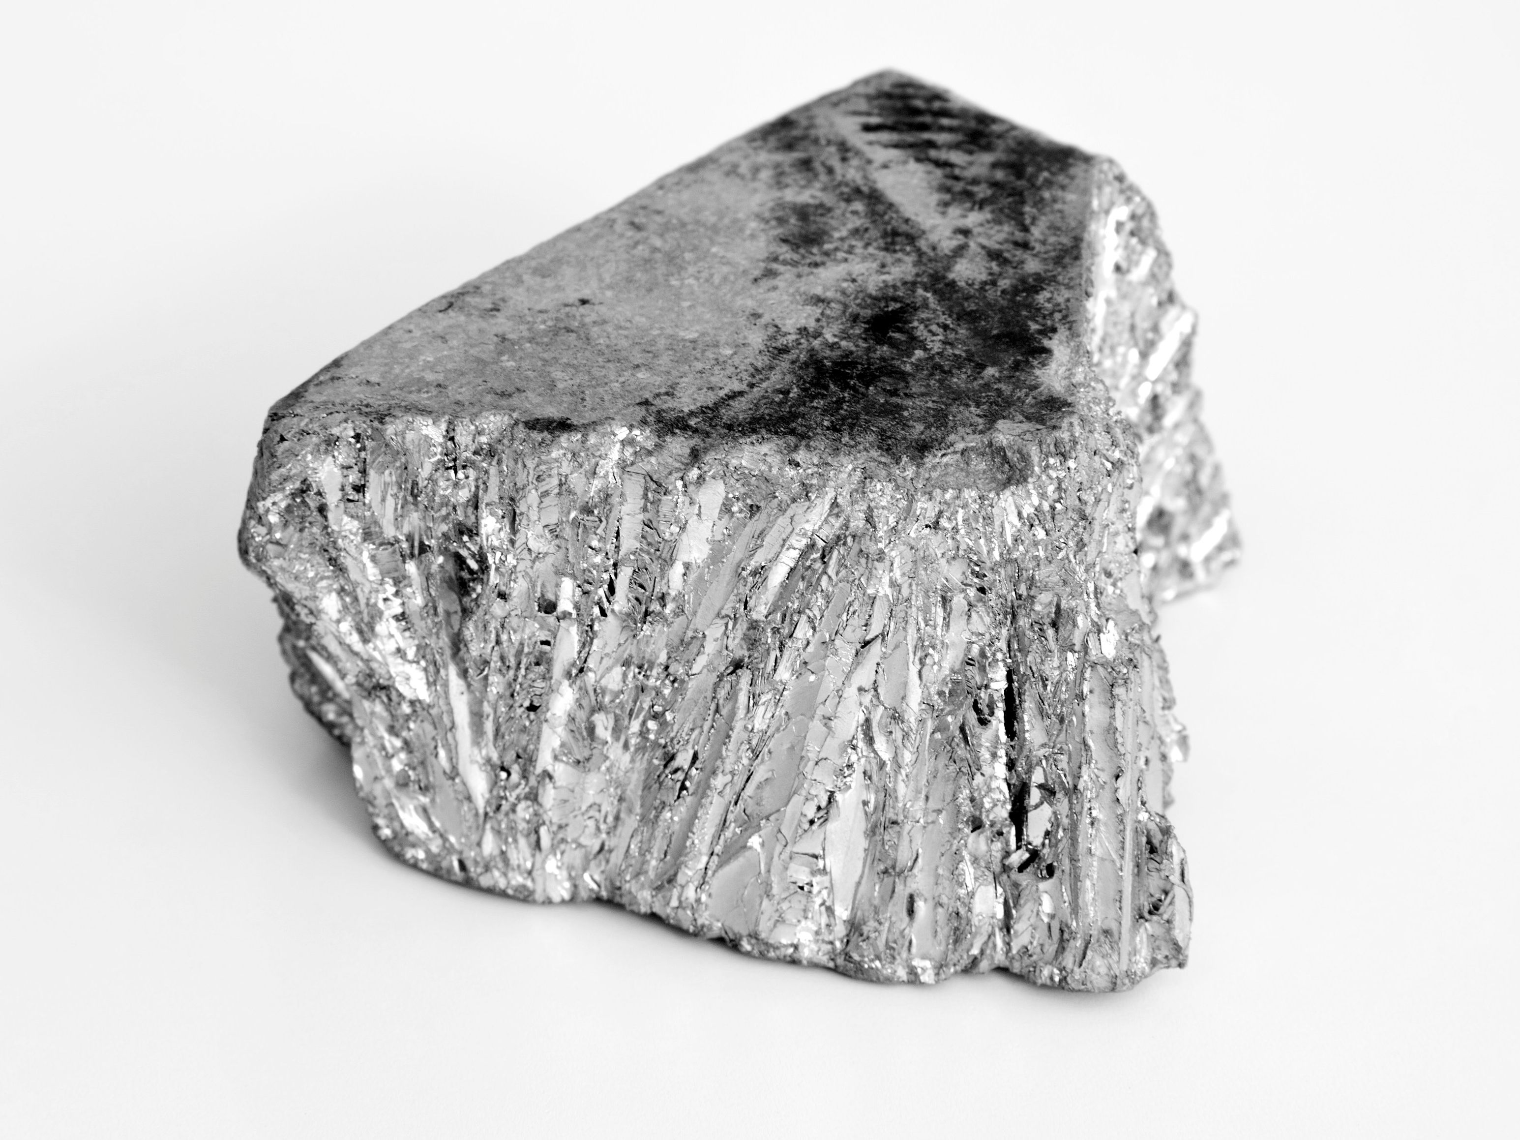
Close Packing in Three Dimension
b) Placing third layer over the second layer
Covering Tetrahedral Voids:
Tetrahedral voids of the second layer may be covered by the spheres of the third layer.
In this case, the spheres of the third layer are exactly aligned with those of the first layer. Thus, the pattern of spheres is repeated in alternate layers.
This pattern is often written as ABAB ....... pattern.
This structure is called hexagonal close packed (hcp) structure
Example:
Magnesium
zinc

Slide 11
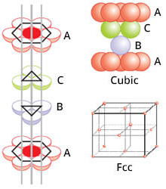
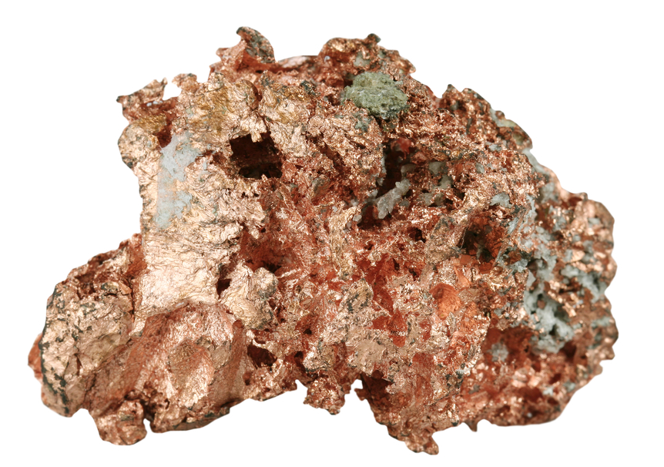
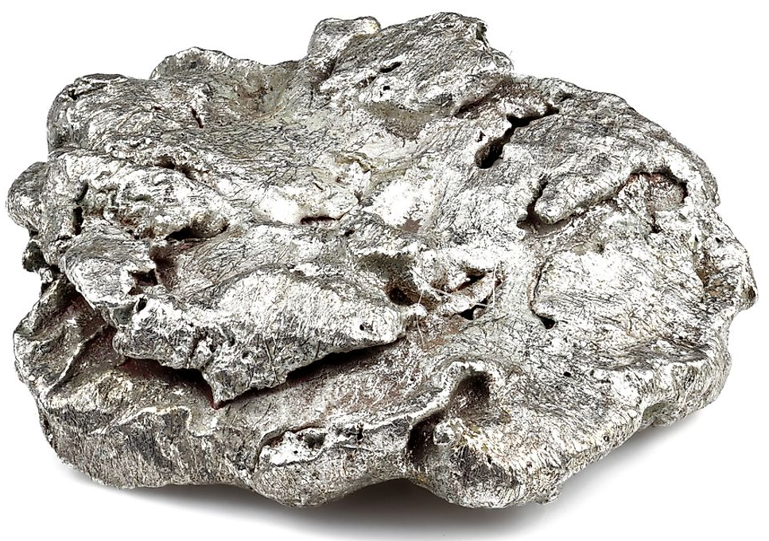
Close Packing in Three Dimension
Covering Octahedral Voids:
The third layer may be placed above the second layer in a manner such that its spheres cover the octahedral voids.
The spheres of the third layer are not aligned with those of either the first or the second layer.
This pattern of layers is often written as ABCABC ...........
This structure is called cubic close packed (ccp) or face-centred cubic (fcc) structure.
Example:
Copper
Silver

Slide 12

Formula of a Compound
and Number of Voids Filled
While the number of octahedral voids present in a lattice is equal to the number of close packed particles, the number of tetrahedral voids generated is twice this number.
In ionic solids, the bigger ions (usually anions) form the close packed structure and the smaller ions (usually cations) occupy the voids.
If the latter ion is small enough then tetrahedral voids are occupied, if bigger, then octahedral voids.
All octahedral or tetrahedral voids are not occupied.
In a given compound, the fraction of octahedral or tetrahedral voids that are occupied, depends upon the chemical formula of the compound.

Slide 13
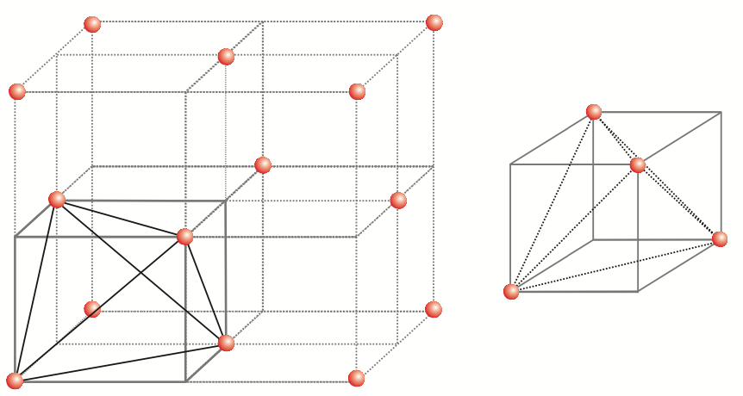
Locating Tetrahedral Voids
fcc lattice: The unit cell is divided into eight small cubes.
One tetrahedral void in each small cube and eight tetrahedral voids in total.
Each of the eight small cubes have one void
Total number of tetrahedral voids = 8
We know that ccp structure has 4 atoms per unit cell.

Slide 14
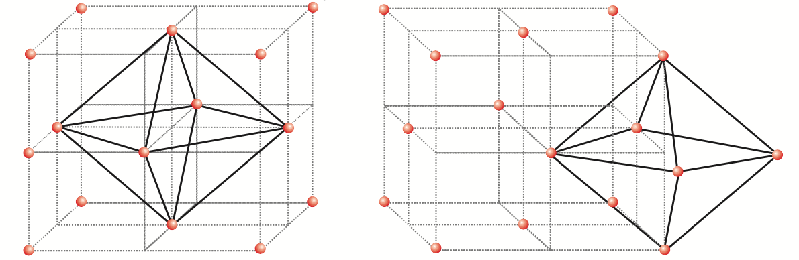
Locating Octahedral Voids
fcc lattice
This unit cell has one octahedral void at the body centre of the cube.
There is one octahedral void at the centre of each of the 12 edges
It is surrounded by six atoms, four belonging to the same unit cell (2 on the corners and 2 on face centre) and two belonging to two adjacent unit cells.

Slide 15
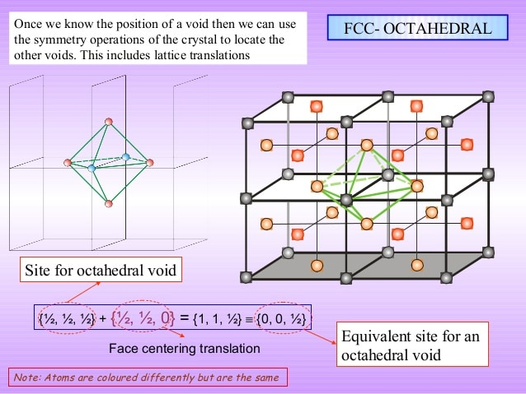
Locating Octahedral Voids
FCC
FCC
FCC
FCC
Each void belongs to 4
FCC unit cell.

Slide 16
Locating Octahedral Voids
Each Octahedral voids are equally divided to 4 equal parts

Slide 17

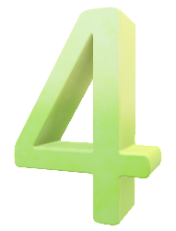
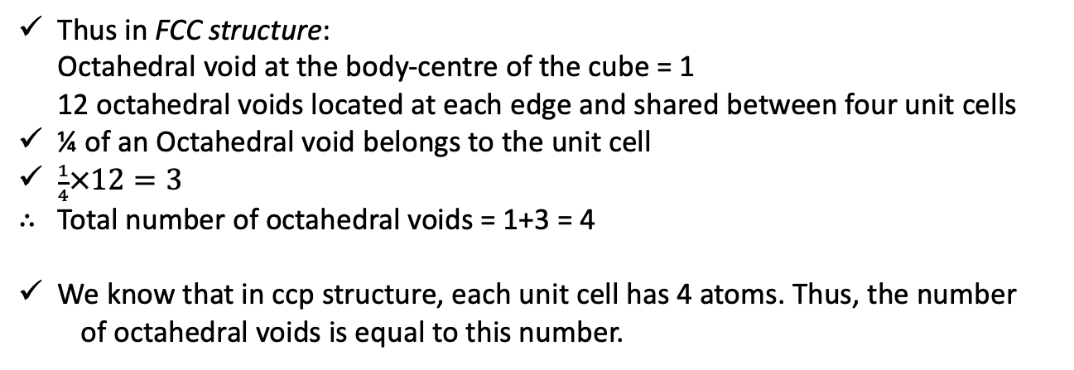


Locating Octahedral Voids
Thus in FCC structure:
Octahedral void at the body-centre of the cube = 1
12 octahedral voids located at each edge and shared between four unit cells
¼ of an Octahedral void belongs to the unit cell
$\frac{1}{4}×12=3$
Total number of octahedral voids = 1+3 = 4
We know that in ccp structure, each unit cell has 4 atoms. Thus, the number
of octahedral voids is equal to this number.
Do try to locate the octahedral voids and tetrahedral voids in bcc structure.

Slide 18
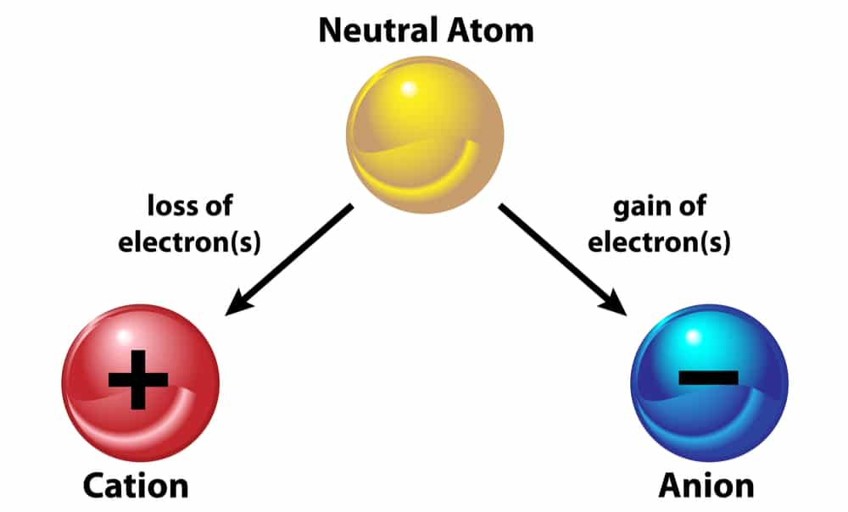
Worksheet
? A compound is formed by two elements X and Y. Atoms of the element Y (as anions) make ccp and those of the element X (as cations) occupy all the octahedral voids. What is the formula of the compound?
ccp lattice
all the octahedral voids
Number of octahedral voids generated would be equal to the number of anions
All the octahedral voids are occupied by the atoms of cations
Anions = cations
The atoms of elements X and Y are present in equal numbers or 1:1 ratio
Therefore, the formula of the compound is XY

Slide 19
Worksheet
? Atoms of element B form hcp lattice and those of the element A occupy 2/3rd of tetrahedral voids. What is the formula of the compound formed by the elements A and B?
B
A
The number of tetrahedral voids formed is equal to twice the number of atoms of element B
Only 2/3rd of these are occupied by the atoms of element A.
Hence the ratio of the number of atoms of A and B is 2 × (2/3):1 or 4:3
The formula of the compound is A₄B₃

Slide 20

THANK YOU

