Slide 1
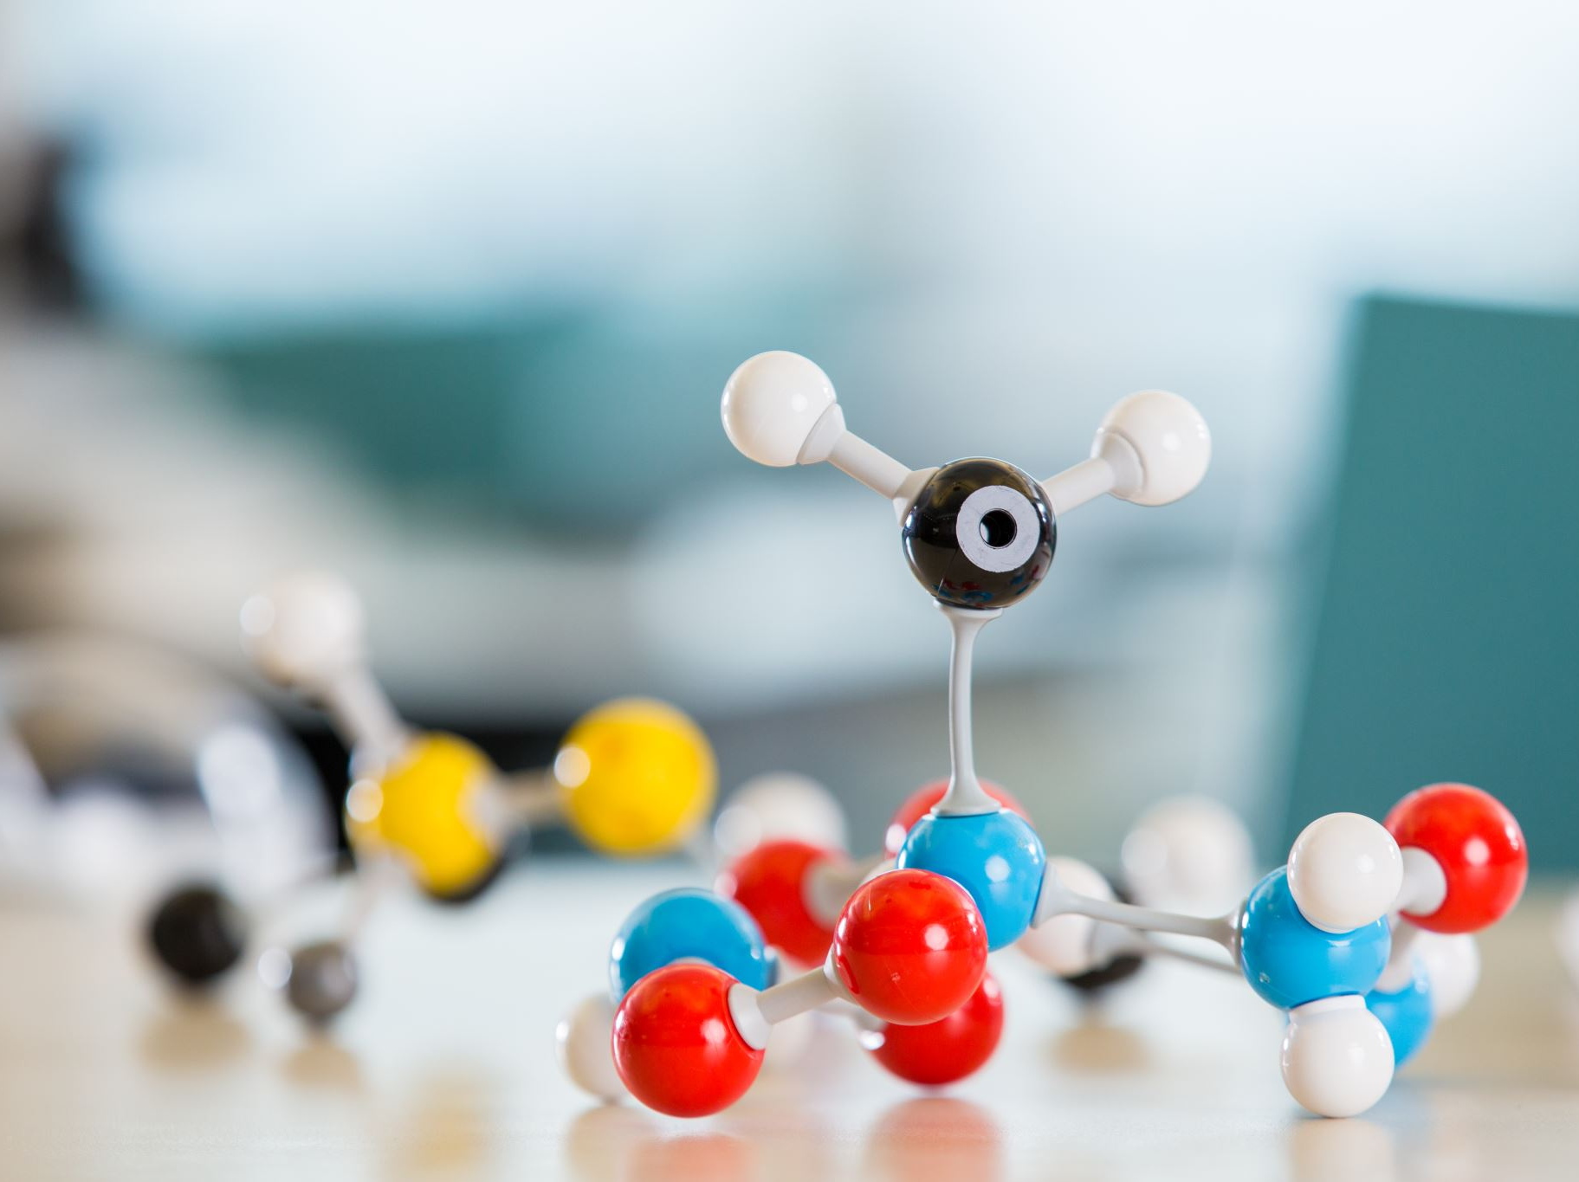
HYBRIDISATION
Unit 4: Chemical Bonding and Molecular Structure
Class: XI A

Slide 2

Contents
Introduction
Concept of hybridisation
Features of hybridisation
Conditions for hybrididsation
Types of hybridisation
Worksheet

Slide 3
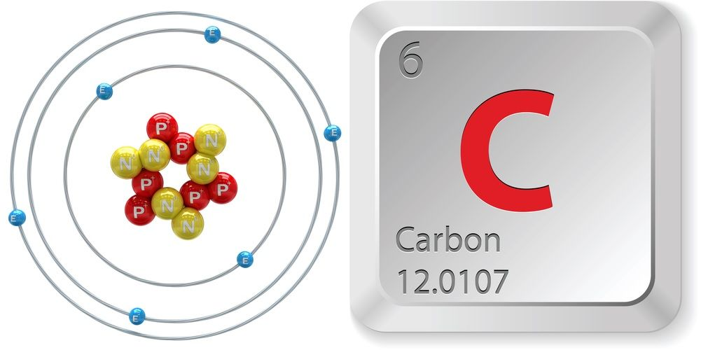
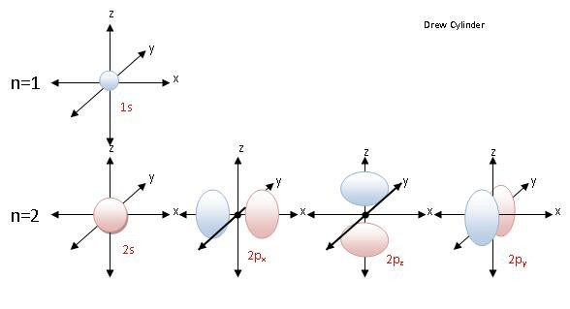
Let’s see the structure of CH₄:
What is the central atom?
Electrons are present in different orbital:
1s²
2s²
2p²
(Ground state)
Excited state configuration:
1s² 2s¹2p³
⇣⇡ | ⇡ | ⇡ | ⇡ | ⇡
H H H H

Slide 4
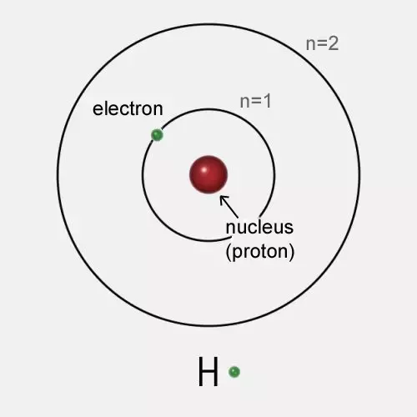
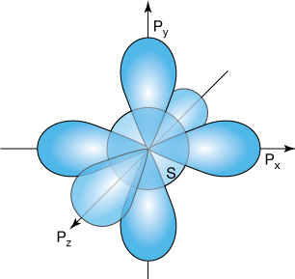
Let’s see the structure of CH₄:
Hydrogen atom has one electron in 1s orbital :
The bonding between orbitals we expect as following:-
H
Bond angle = 90°
H
H
H

Slide 5
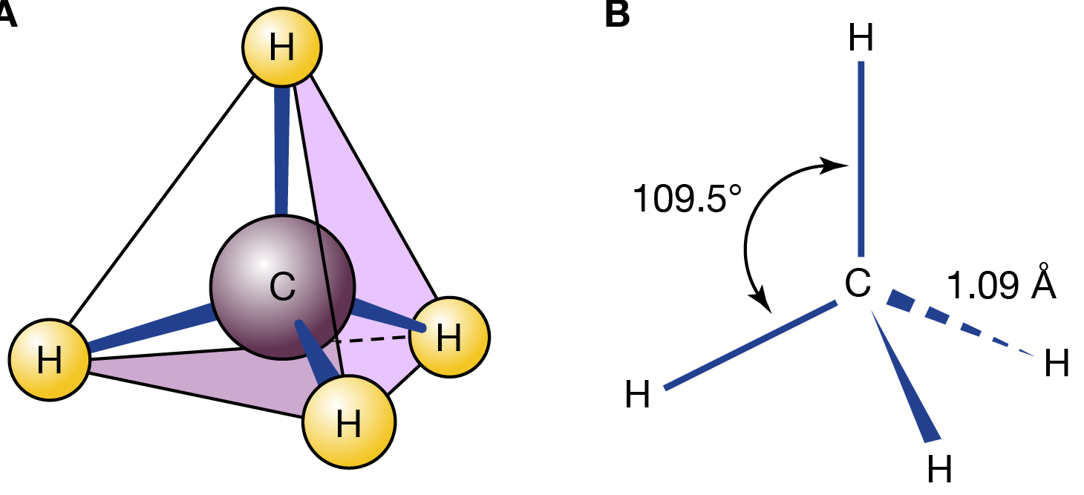

The structure of CH₄
Tetrahedral structure
HYBRIDISATION

Slide 6
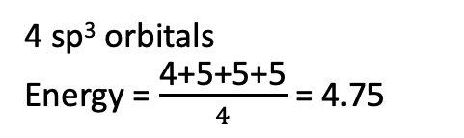
Hybridisation
The atomic orbitals combine to form new set of equivalent orbitals known as hybrid orbitals
Hybrid orbitals are used in bond formation
hybridisation is the process of intermixing of the orbitals of slightly different energies so as to redistribute their energies, resulting in the formation of new set of orbitals of equivalent energies and shape.
For example, C atom have 4 orbitals to form hybrid orbitals:
Assume energies to be:
4 5 5 5
4 sp³ orbitals
Energy = $\frac{\text{4+5+5+5}}{4}$ = 4.75

Slide 7
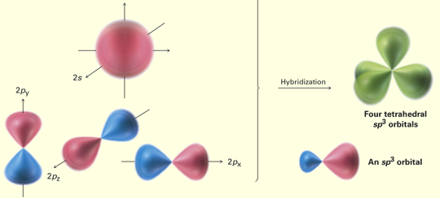
Features of hybridisation
The number of hybrid orbitals is equal to the number of the atomic orbitals that get hybridised.
2. The hybridised orbitals are always equivalent in energy and shape.
Equivalent energy and shape
CH₄ :
4 Atomic orbitals
4 Hybrid orbitals

Slide 8
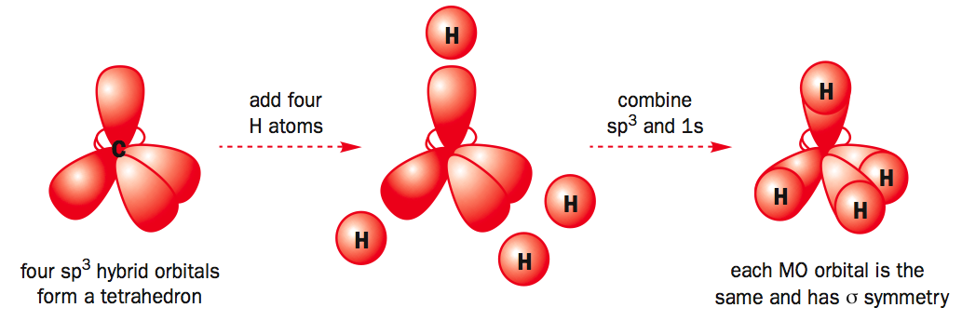
Features of hybridisation
The hybrid orbitals are more effective in forming stable bonds than the pure atomic orbitals.
These hybrid orbitals are directed in space in some preferred direction to have minimum repulsion between electron pairs and thus a stable arrangement. Therefore, the type of hybridisation indicates the geometry of the molecules.

Slide 9
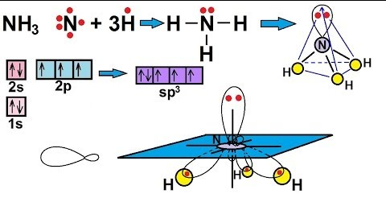
Conditions for hybridisation
The orbitals present in the valence shell of the atom are hybridised.
(ii) The orbitals undergoing hybridisation should have almost equal energy.
(iii)Promotion of electron is not essential condition prior to hybridisation.
(iv) It is not necessary that only half filled orbitals participate in hybridisation. In some cases, even filled orbitals of valence shell take part in hybridisation.

Slide 10
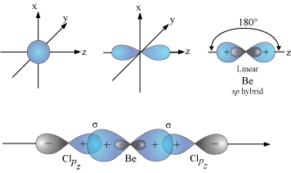
Types of Hybridisation
There are various types of hybridisation involving s, p and d orbitals
sp hybridisation:
mixing of one s and one p orbital resulting in the formation of two equivalent sp hybrid orbitals.
Each sp hybrid orbitals has 50% s-character and 50% p-character.
sp hybrids point in the opposite direction (linear geometry). This type of hybridisation is also known as diagonal hybridisation

Slide 11
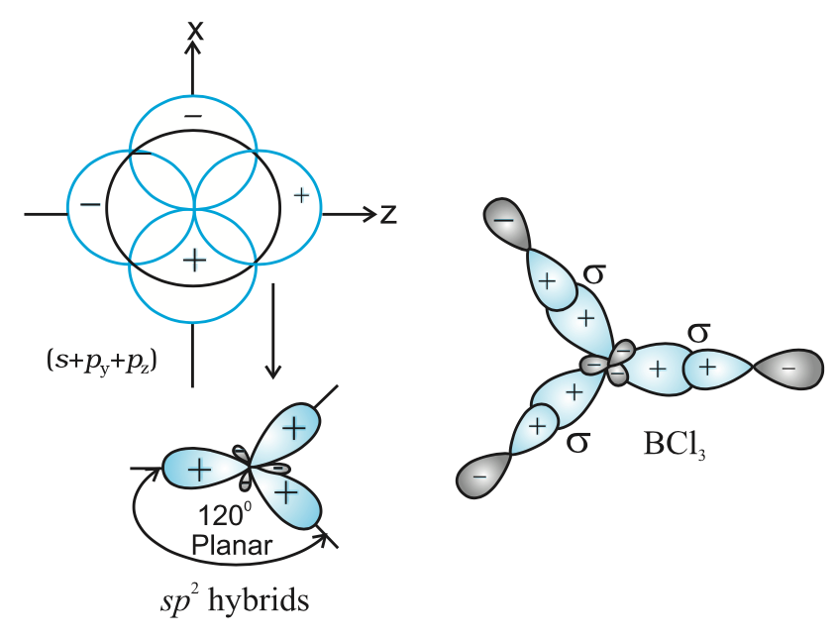
sp² hybridisation
mixing of one s and two p orbital resulting in the formation of two equivalent sp² hybrid orbitals.
Each sp² hybrid orbitals has 33% s-character and 66 % p-character.

Slide 12
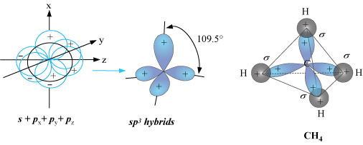
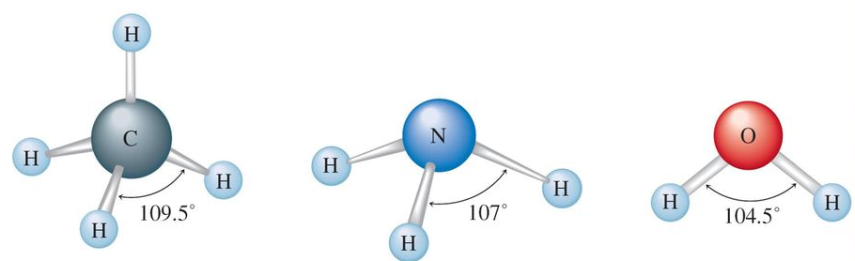
sp³ hybridisation
Mixing of one s and three p orbital resulting in the formation of two equivalent sp³ hybrid orbitals.
Each sp³ hybrid orbitals has 25 % s-character and 75 % p-character.
All sp³ hybridization:

Slide 13
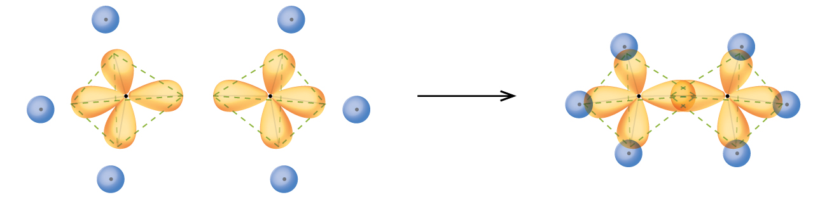
WORKSHEET
?) Following is the pictorial representation of bonding in C₂H₆, two types of σ bonds are present in it. Mark which one is sp³-sp³ σ bond and sp³–s σ bond
?) How many π bonds are present in C₂H₄ and C₂H₂ molecule? Explain with diagram. (Given the hybridisation of C₂H₄ ans C₂H₂ are sp² and sp³ respectively.

Slide 14
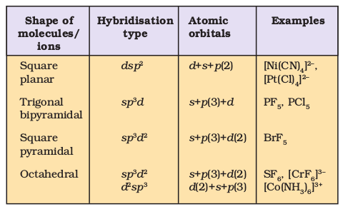
Hybridisation involving d Orbital
The elements present in the third period contain d orbitals in addition to s and p orbitals.
The energy of the 3d orbitals are comparable to the energy of the 3s and 3p orbitals.
The energy of 3d orbitals are also comparable to those of 4s and 4p orbitals.

Slide 15
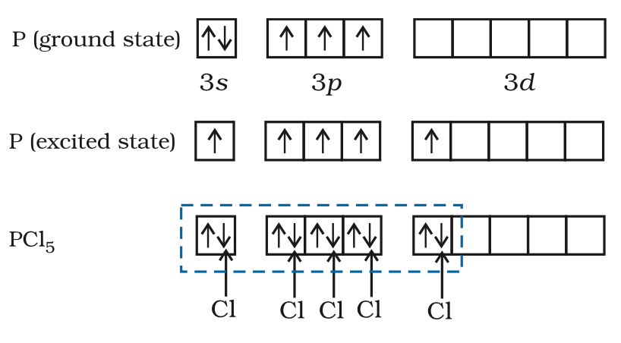
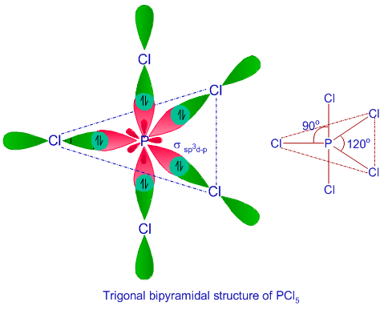
Example: PCl₅
Central atom: phosphorus (Z=15)

Slide 16
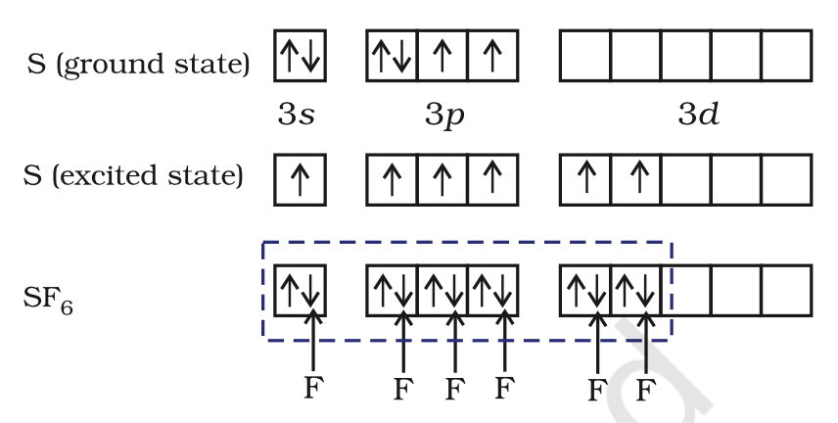
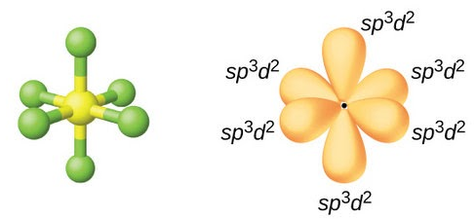
Example: SF₆

Slide 17


