Slide 1
Unit 5: THERMODYNAMICS Class: XI
THERMODYNAMIC TERMS

Slide 2
System and Surroundings
Types of the System
The State of the System
The Internal Energy
Work and heat
Worksheet
CONTENTS

Slide 3
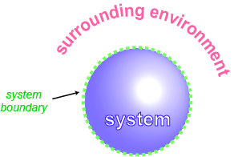
System and Surroundings
A system in thermodynamics refers to that part of universe in which observations are made and remaining universe constitutes the surroundings.
The universe = The system + The surroundings
The wall that separates the system from the surroundings is called boundary.
The surroundings are that portion of the remaining universe which can interact with the system. Usually, the region of space in the neighbourhood of the system constitutes its surroundings.

Slide 4
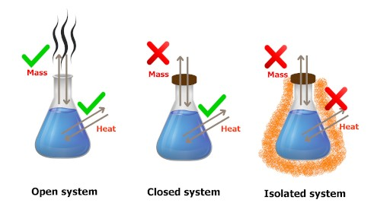
Types of the System
Open system can exchange both energy and matter between system and surroundings
Closed system can exchange energy but not matter between system and surroundings
Isolated system can exchange neither energy nor matter between system and surroundings

Slide 5
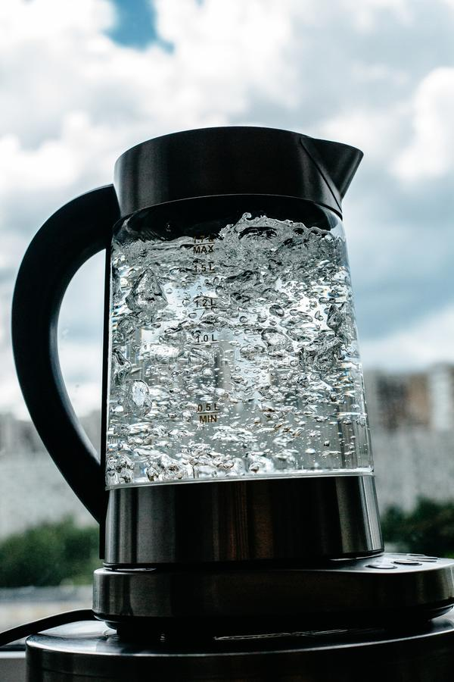
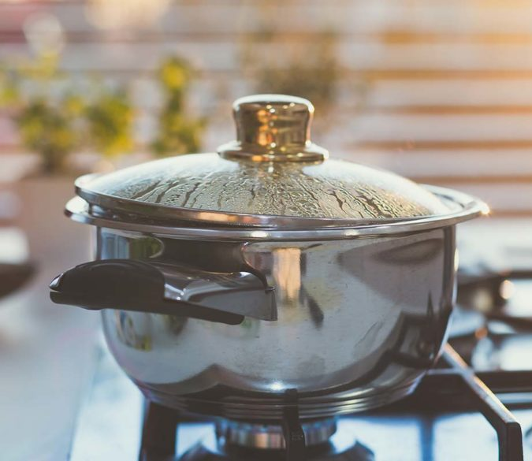
The State of the System
State of the thermodynamic system is described by its measurable or macroscopic (bulk) properties.
The state of a gas can be described by quoting its pressure (p), volume (V),temperature (T ), amount (n).etc
State functions or state variables depend only on the state of the system and not on how it is reached
Water boiled using ‘gas stove’.
Final Temperature of boiling water = 100 °C
Water boiled using ‘electric kettle’.
Final Temperature of boiling water = 100 °C
Temperature is a state function

Slide 6
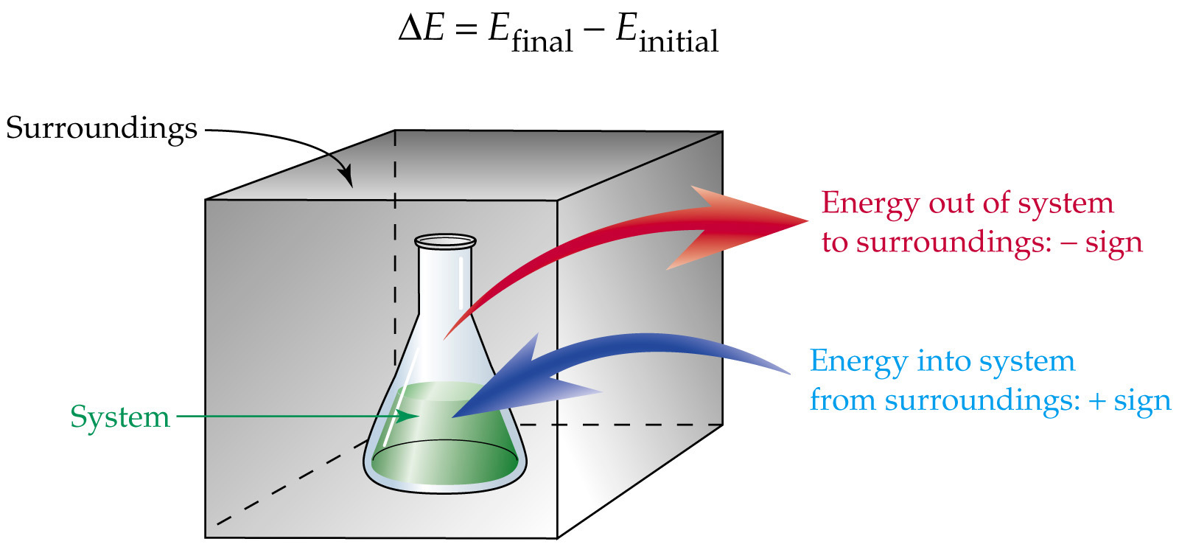

The Internal Energy
The total energy of the system is represented by the internal energy, U of the system.
It may be chemical, electrical, mechanical or any other type of energy you may think of, the sum of all these is the energy of the system.
Internal energy changes by certain processes (and vice versa).
Matter leaves the system
Work is done by the system
Heat passes into the system

Slide 7

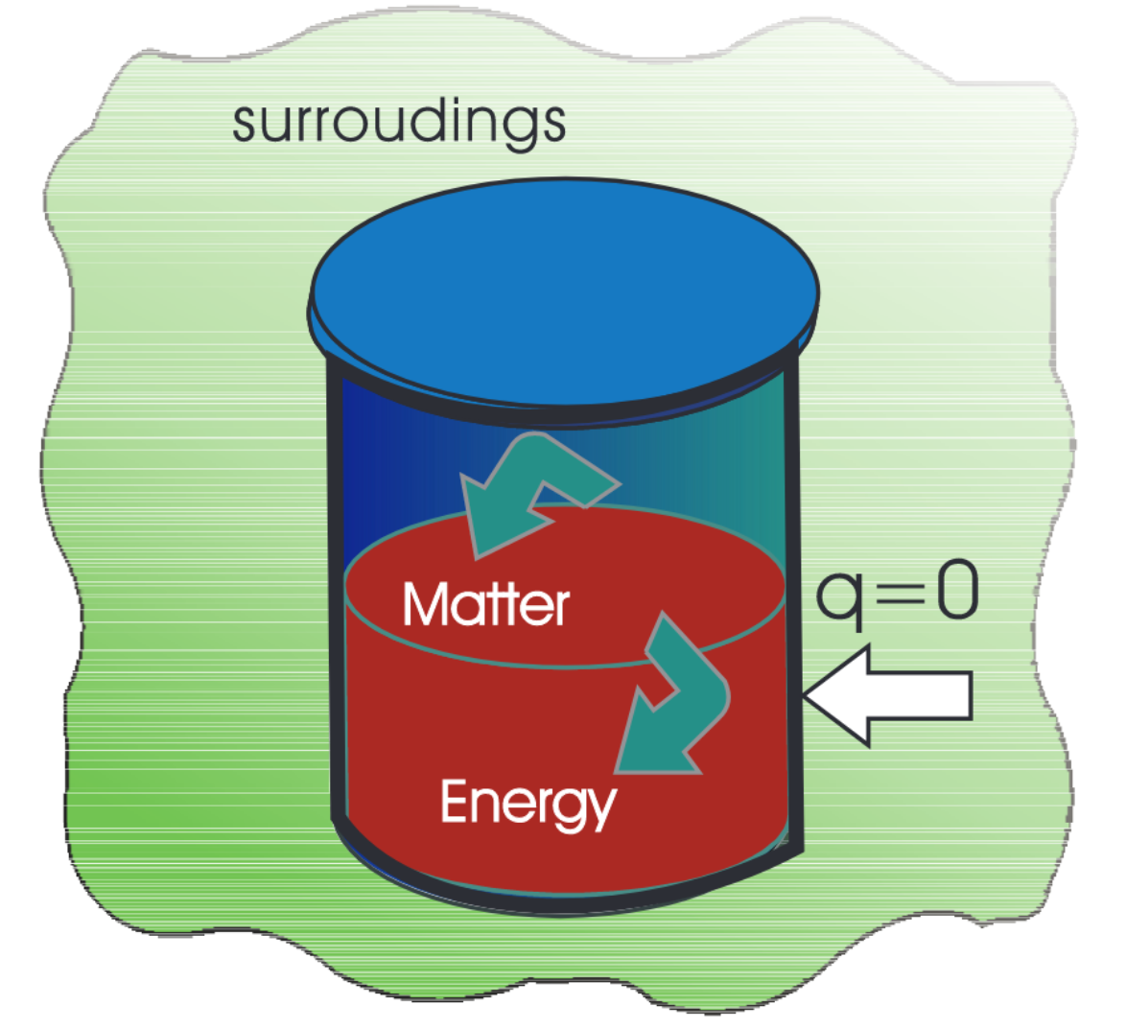
Work
A well insulated thermos flask would not allow exchange of heat between the inside and outside through its boundary, and we call this type of system as adiabatic
Adiabatic process is a process in which there is no transfer of heat between the system and surroundings.
Initial state of the system (A) Temperature =T_{A}
Internal energy =U_{A}
We need to bring the change in the internal energy of the system by doing some work

Slide 8
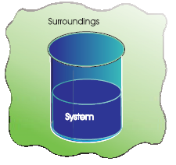


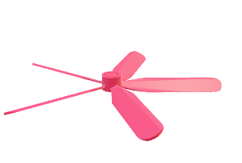

Work
One way:
Mechanical work = 1 kJ
(Rotating a set of small paddles and thereby churning water)
New state of the stystem (B)
Temperature = T_{B ,} T_{B} > T_{A}
Change in temperature, ∆T = T_{B}–T_{A}
Internal energy of the system = U_{B}
Change in internal energy, ∆U =U_{B}– U_{A}
Second way:
Electrical work = 1 kJ
(An immersion rod heated the water)
New state of the stystem (B’)
Temperature = T_{B ,} T_{B} > T_{A}
Change in temperature, ∆T = T_{B}–T_{A}
Internal energy of the system = U_{B}
Change in internal energy, ∆U =U_{B}– U_{A}
Internal energy, U, of the system is a state function.

Slide 9
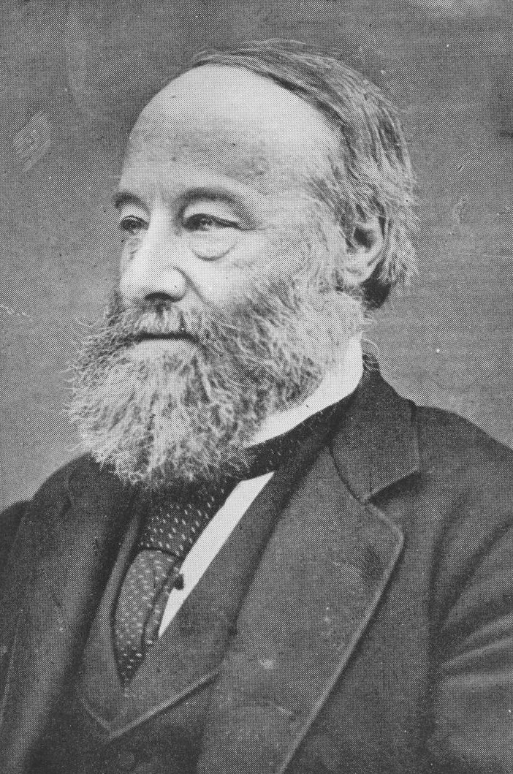
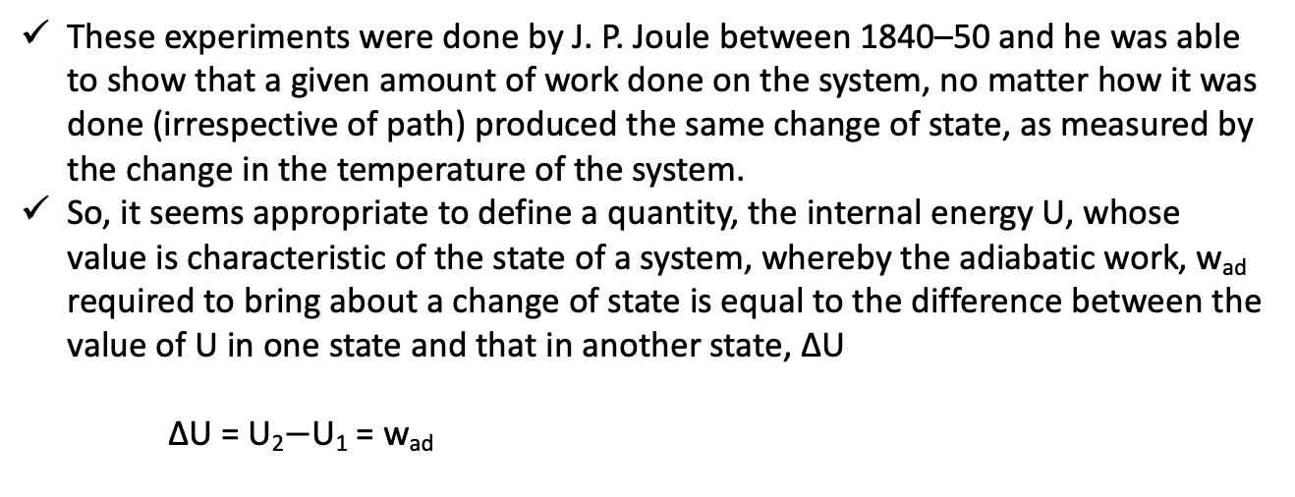
Work
These experiments were done by J. P. Joule between 1840–50 and he was able to show that a given amount of work done on the system, no matter how it was done (irrespective of path) produced the same change of state, as measured by the change in the temperature of the system.
So, it seems appropriate to define a quantity, the internal energy U, whose value is characteristic of the state of a system, whereby the adiabatic work, w_{ad} required to bring about a change of state is equal to the difference between the value of U in one state and that in another state, ∆U
∆U = U₂$−$U₁ = w_{ad}
J. P. Joule
(1818-1889)

Slide 10
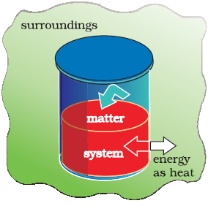
Heat
It is possible to change the internal energy of a system by transfer of heat from the surroundings to the system or vice-versa.
This exchange of energy, which is a result of temperature difference is called heat, q.
We take water at temperature, T_{A} in a container having thermally conducting walls, say made up of copper and enclose it in a huge heat reservoir at temperature, T_{B}. The heat absorbed by the system (water), q can be measured in terms of temperature difference ,T_{B} – T_{A}. In this case change in internal energy, ∆U= q, when no work is done at constant volume

Slide 11
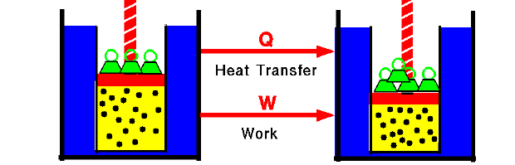
The general case
Let us consider the general case in which a change of state is brought about both by doing work and by transfer of heat. We write change in internal energy for this case as:
∆U = q + w
Is the mathematical statement of the first law of thermodynamics
Will depend only on initial and final state.
The energy of an isolated system is constant.
Difference between a thermodynamic property and Mechanical property:
Mechanical property such as volume. We can specify an unambiguous(absolute) value for volume of a system in a particular state.
For the internal energy (thermodynamic property), we can measure only the changes in the internal energy, ∆U of the system.
State 1
Volume = 10 L
Energy = U₁
State 2
Volume = 7 L
Energy = U₂
Absolute values = V₁, V₂, ∆U

Slide 12
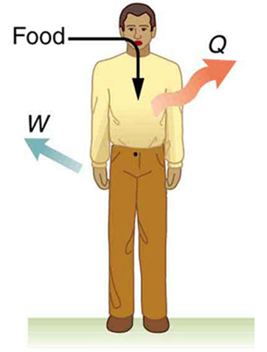
Worksheet
?) Find out whether the following property is a state function or not?
1) Volume
2)Pressure
3)Mass
4)Density
5)Temperature
6)Internal energy
?) Determine the type of the following system, Also write down the equation for the change in internal energy (Note: do follow the IUPAC convention of +/- for each quantities like food, W, Q)

Slide 13
Worksheet
?) Express the change in internal energy of a system when
(i)No heat is absorbed by the system from the surroundings, but work (w)is done on the system. What type of wall does the system have ?
(ii)No work is done on the system, but q amount of heat is taken out from the system and given to the surroundings. What type of wall does the system have?
(iii)w amount of work is done by the system and q amount of heat is supplied to the system. What type of system would it be?

Slide 14


