Slide 1







Pre-Integration
Preparing your systems prior to Integration is the key to Success.
Amber Wells,
Integration and QB Specialist

Slide 2
What we will Discuss
What Syncs and How?
Things to Know
5 main types of records that are linked and synced
How to setup both systems for optimal integration success
Using cost codes properly
QBO vs Desktop Integration (Servers)

Slide 3
What Syncs and how?
During the integration - only records themselves are linked, not historical transactions (invoices, expenses, ect.. prior to the integration, regardless of project status)
  Note: There are ways to push over for current projects transactions that you may have started by updating or adding a line item to make it appear in Contractor Foreman. This must be done with all transactions within the project that were added prior to the day of integration. Otherwise only transactions created after the integration will appear in Contractor Foreman going forward.
Records consist of Names, Addresses, Emails and Phone Contacts. Records from both systems must be linked properly for transactions to flow back and forth between systems.
Each systems records must mirror the other for the records to link properly
There are 5 main record types that are involved that we will discuss in more detail
1. Employee Records
2. Customer Records
3. Vendor Records
4. Projects
5. Cost Codes

Slide 4
Things to know
Less manual entry is better prior to syncing because the integration is designed to “fill in the blank”
Common record fields in both systems are designed for the data to be entered as it was intended.
If you choose to use fields for data other than intended, please be sure to use the corresponding field in Contractor Foreman the same way otherwise duplicate records will happen.
Once the sync is complete records from each system will reflect the same in each system, yet project transactions will remain in their respective systems as before the integration.
Take a deep breath and know that the integration process will not affect current QuickBooks financial data in a negative way or “mess up your QuickBooks”. After over 500 integrations, none have never resorted in this type of situation. Therefore, using trial data to “test” the integration is not necessary and a waste of your integration time.

Slide 5
Customer Records
Customer Records are either an individual or a company in which you're billing.
Projects from Contractor Foreman will sync over as sub-customers. Therefore, we recommend that you don’t use project names as customers in QuickBooks or you will have the same names for both customer and sub-customer.
If you use anything other than [First, Last Name or Company Name] as customers, such as addresses, or even [Last Name, First] you must maintain this structure in Contractor Foreman as well or you will constantly create duplicates. (Not recommended)
Note: If your customers are based on a three or four tier structure (Main-customer: locations: projects) than you should set up a post integration meeting to address the best way to enter these in QBDT and CF because the integration is only based on a two-tier structure
Make sure to archive any customers that you don’t want to sync to Contractor Foreman
See Illustration on the next page.

Slide 6
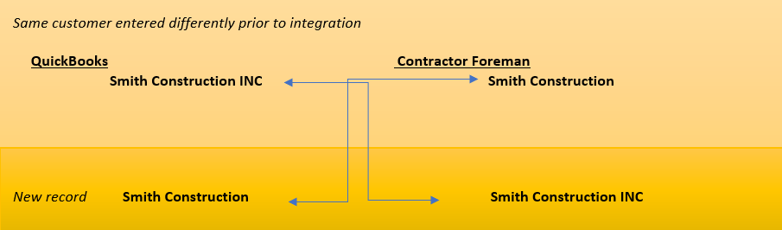
Illustration of how Duplicates happen

Slide 7
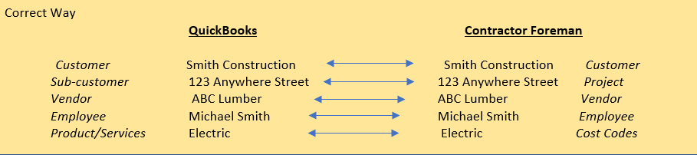
Correct way to avoid duplicates

Slide 8
Vendor Records
Same rules apply as customer records. Each record in either system must reflect the same information. If a record is only in one system let the integration create a new record. Manually entering information or even uploading information from QuickBooks to Contractor Foreman can cause syncing issues.
Make sure to archive any vendors that you don’t want to sync to Contractor Foreman

Slide 9
Employee Records
If Users in Contractor Foreman are created prior to the integration just be sure that the employee information is identical to what you have in QuickBooks.
Different variations of a name can create duplicate employee records.
Make sure to archive any employees that you don’t want to sync to Contractor Foreman

Slide 10
Projects
* Project records from Contractor Foreman with display as sub-customers in QuickBooks.
*Note: Projects will not sync into the Projects tab of QBO and this is the case with any project management software as this is QuickBooks’s competition in the Project Management Industry.

Slide 11
Final records Recap
Employee Names need to be the same variation. (ex. Not Michael in QB and Mike in Contractor Foreman), Customer Names, Vendor Names, and Project Names all apply this same rule regardless of which version of QuickBooks used.
If the time isn’t taken to make sure these records are the same, then you will spend more time cleaning up after. Again, don’t import information from one system to the other if it’s not there already. More is less to avoid syncing issues.
Just make sure any existing information is matched up between the two systems.
The best integration is when one system is completely empty and the other is cleaned up to how you want it.
*This also applies to cost codes which I’ll explain more in the next section

Slide 12
Cost Codes
What are Cost Codes and why are they important?
If you are new to cost codes these are equivalent to products and services (or items in QBD) in QB Online. Cost Codes are the essence of job costing and the main reason for using Contractor Foreman. These are different and separate from the QuickBooks chart of accounts. Cost Codes are the products or services you are performing.

Slide 13
Cost Codes (Cont.)
If you are new to Contractor Foreman, be advised that it comes preloaded with the Construction Specifications Institute (CSI) Cost Codes. These codes cover many different trades and are a good starting point if you’re just getting started. You can always archive the ones you don’t use after the integration then build on the ones that relate to your profession.
Contractor Foreman also uses a two-tier cost code system. Both QuickBooks and Contractor Foreman will need to be set up this way. If you prefer to only use your own cost codes already in QB, then I recommend contacting support@contractorforeman.com to have the preloaded cost codes deleted (not archived) to best assure that your codes in QB are the only codes to integrate.
On the other hand, if you want to implement these codes than make sure any items in your QuickBooks (Online: Products and Services) or (Desktop: Items list) are either deleted (archived) or set up as a hierarchy two-tier category/item to Product and services/sub-item as shown in the CF/QB Integration Guides (below) on pg. 4

Slide 14
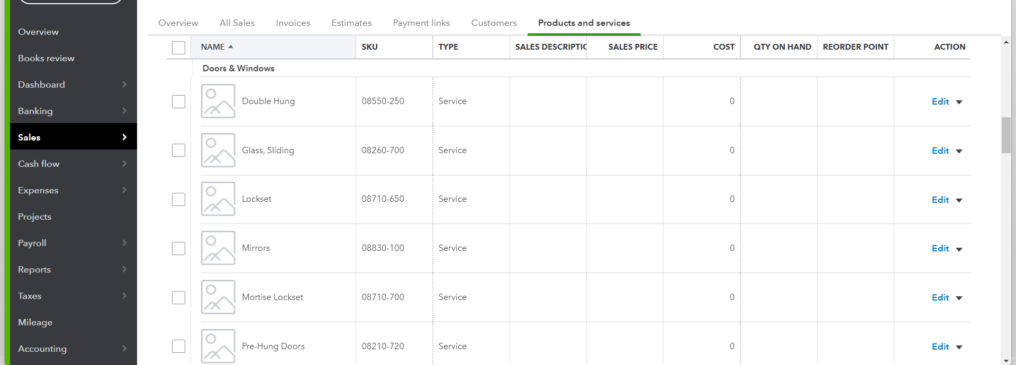
How Products and Services are to be structured in QBO.
A Parent code in Contractor Foreman (Doors & Windows as shown below) are listed as Categories in QuickBooks Online.
Child codes in Contractor Foreman (Double Hung: as shown Below) are Products/Services in QuickBooks Online.
Make sure to archive any unused cost codes prior to the integration

Slide 15
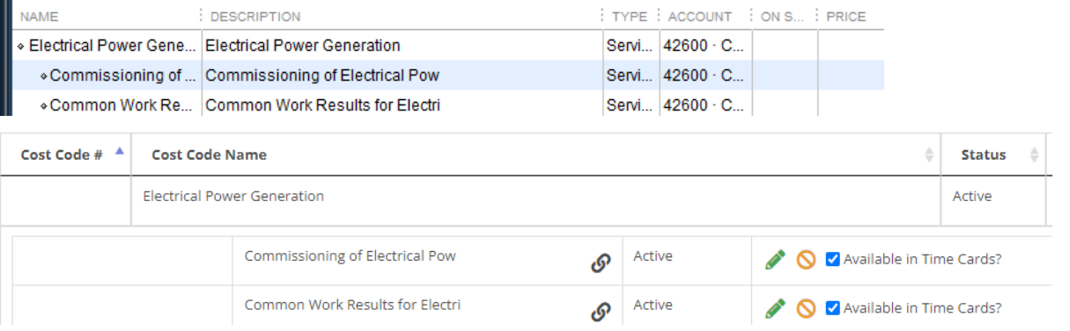
How the Items list in QBDT with look and import into Contractor Foreman
Electrical Power Generation is the Parent Code in Contractor Foreman and the equivalent of Item in QuickBooks Desktop.
Commissioning of Electrical Power is a Child Code in Contractor Foreman and the equivalent of a sub-item in QB Desktop.
Make sure to archive any unused cost codes prior to the integration.

Slide 16
The Syncing difference between QBO and QBDT with the integration tool.
Also be advised that once the integration is complete, that if you have QB Online the syncing between systems is automatic and instantaneous. However, when using QB Desktop this process must be done manually through the integration tool. You may also set it up to sync every day or night at a specified time.
* We recommend QBO for a faster and smoother syncing process but not required to have Contractor Foreman. QBO Plus or Advanced is needed for Contractor Foreman because it supports project management. All other QBO Subscriptions aren’t sufficient.

Slide 17
QuickBooks Desktop Only Clients
Contractor Foreman offers an integration tool to bridge the gap between QuickBooks Desktop and Contractor Foreman but if not setup properly, up front, can lead to syncing issues.
Servers: Let us know if you are using a server. This may cause a problem with downloading the integration tool depending on if it allows 3rd-Party Apps to be downloaded.
* Important: The integration tool must be downloaded to the server that hosts your QBDT file (.QBW)

Slide 18
You are ready to integrate.
Once you have reviewed this guide and feel your system is ready then you can continue with your Integration meeting. If you have further questions than feel free to email us at support@smartbusinesssolutionsllc.com
IF you need more time to prepare for your integration call than please reschedule your integration call to give yourself plenty of time to prepare. This step is important to ensure the most of your included 1.5 hours of Integration time. (Additional time is charged at $65/hour)
We look forward to working with you to make the integration a success.

Slide 19
Additional Trainings Available (Hourly rates apply)
Advanced Cost Code Training- How to build out cost codes and how they reflect on financial reports.
Workflow Process Training- We analyze your current data entry process to help you determine the best strategy to entering data and which system. We also help with syncing current project over during this training.
QuickBooks Training and Support – If you have recently migrated to QuickBooks Online and just need assistance with learning more about QuickBooks and/or setup.
Post Integration Support- If additional support is needed outside of the original integration or additional integration time is needed outside of system related issues.
You will receive follow-up emails with links to schedule these additional trainings. Each training is an hour long and charged at $65 per hour.

