Slide 1

ENGAGING GOD’S WORD
KNOWING GOD BY KNOWING THE BIBLE
© August 2025 C.M. Nutting

Slide 2

Studying the Bible can be intimidating. The current estimation is that there are 450 different English translations and editions of the Bible. Which version do you choose when you are first approaching the Bible? What’s the difference between versions? Is one version more holy than the others? How do you study the Bible? Do I need a group? Can I understand it on my own? Should I download the ap? I still don’t know which version to read!
The oldest translation of the original Hebrew scriptures is the Septuagint, which was written in Greek in the 3rd Century B.C. during the era when Alexander the Greek had conquered the eastern Mediterranean era. Though the Jewish nation for the most part resisted efforts to Hellenize their culture (particularly resisting the polytheism of Greek religion), the Septuagint filled a need for the Jewish people living in the Greek-speaking cultures of the Diaspora (the nations outside Israel) and for Christians who spoke Greek. With the shift from Greek to Latin in the Roman Empire during the 4th-5th centuries BCE came Saint Jerome’s Latin translation of the Bible, the Vulgate. This would be the definitive Catholic version of the Bible until 1963. John Wycliffe created the first English translation, the Wycliffe Bible, utilizing the Vulgate.
The Geneva Bible, published in 1560, was the first English version to include verse numbers and commentaries. King James 1 commissioned his King James Version in 1604 wanting a version that was accessible to a broad base of English-speaking believers. It is known for its Elizabethan English. It has proven to be a popular and enduring edition.

Slide 3
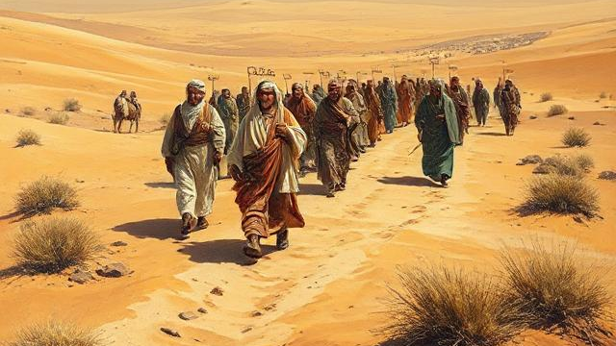
Here are some basic facts about the Christian Bible (we will address how it differs from the Catholic Bible later in this lesson). There are 66 books in the Bible. 39 Books are the Old Testament, which spans the period from Creation and the Fall of Adam and Eve and ends approximately 100 years B.C.. These books detail the creation of Adam and Eve and their temptation to rebel against God by Satan (the fall of man which corrupted all subsequent generations of mankind to be born into sin). God promises a path to redeem mankind from sin through Eve’s descendant (the future Messiah, Jesus Christ). God judges the rampant
wickedness of men by destroying all life in the Great Flood except for Noah and his family and two of every kind of creature on earth. God promises never to flood the world again, sealing the promise with a rainbow in the clouds. God chooses Abraham to be the patriarch of the future nation of Israel and makes a covenant with Abraham to make his name great, give him countless descendants, provide a promised land for those descendants, and that other nations would be blessed through his descendants. The book of Genesis details the next three generations of Abraham’s family: Isaac, who would be Abraham and Sarah’s miracle child in their old age; Jacob, son of Isaac and Rebekkah, who would be the father of twelve sons. Jacob’s name would be changed by God to “Israel” (the name of His chosen nation of people). The twelve tribes of the people of Israel would be named for eleven of Jacob’s sons and grandsons through Joseph. Jacob’s descendants would live as slaves in Egypt for several centuries until God unleashes plagues upon the land to force Pharaoh to release the His people, the nation of Israel. Moses is God’s prophet and spokesman among the Israelites. The lack of faith and trust of God among the first generation of Israelites causes them to be banned from entering the Promised Land and they are forced to wander the desert for 40 years until that generation passes away.
Their children, led by Joshua, enters the Promised Land (a land called Canaan), which God helps them to conquer and establish as the physical land of Israel. Each of the twelve tribes is given a share of the land (except for the tribe of Levites, who are a tribe of priests and has the special privilege of serving at the Lord’s tabernacles and temple). God presents the Israel the Law of Moses, which is a system of laws and sacrifices to guide daily life and righteous living in Israel. God is their king, but He appoints a succession of judges to watch over the people and speak on His behalf. Things deteriorate rather quickly. Because the Israelites disobey God’s command to destroy all people in the land, they fall under the influence of pagan cultures, which leads to more rebellion against God. The first true rebellion is the people’s demand to have a human king so that they can be like the surrounding nations. God first gives them King Saul, who eventually spirals into wickedness. God then places King David on the throne, making a covenant that there would always be a descendant of David on the throne of Israel, including the future

Slide 4

Messiah. David’s son, Solomon, has a reign of great prosperity and builds the Lord’s Temple in Jerusalem. However, Solomon was later drawn into worship of pagan gods, and his son Rehoboam rebelled against him. Israel was ultimately divided into two separate kingdoms: The two tribes of Judah and Benjamin remained faithful to the Davidic throne and became the nation of Judah. The other ten tribes were the remains of Israel under a succession of corrupt kings who permitted paganism and did evil in the Lord’s sight. They ignored the warnings of prophets sent by the Lord to call them into repentance and restoration to the Lord. Eventually, the Lord allowed the nation of Assyria to conquer Israel and take its people into captivity. God kept His promise to preserve a descendant of David (the line of the Messiah) despite turmoil in Judah.
The kings of Judah alternated between faithfulness to God and paganism and wickedness. They also ignored God’s warnings to repent and return to God. Eventually, God allowed them to be conquered and taken captive in Babylon for 70 years. The term “Diaspora” refers to Jewish people living outside of Israel among the other nations. After the time known as the Exile, God moved the heart of King Cyrus to allow the Jewish people to return to their homeland (once again simply known as Israel).
The New Testament refers to a period of time following the Old Testament where there was no new revelation from prophets or from God. The New Testament opens with the births of John the Baptist (the reincarnation of Elijah as prophesized in the Old Testament) and Jesus Christ (the Messiah prophesized in the Old Testament). The books of Matthew, Mark, Luke, and John are the Gospel narratives of Jesus’ ministry, betrayal by His own apostle Judas Iscariot, trial, crucifixion, burial, resurrection, and ascension into heaven. These Gospels are the core of Christianity. Jesus’ life, death, and resurrection fulfill the covenants that God made in the Old Testament to make a means for mankind to be redeemed from sin. The old system of animal sacrifices was no longer needed because Jesus had made Himself the ultimate sacrificial Lamb of God by living a human life without sinning. He sacrificed Himself to atone for the sins of all mankind. Jesus’ life without sin meant that He had also perfectly fulfilled the Law of Moses. So, neither animal sacrifice or obedience to the Law was required for men and women to be made right with God. Jesus has made us right with God. We only need to receive God’s grace by believing in Jesus as our Savior to be redeemed, restored to relationship with God, and justified by God. Believers receive the Holy Spirit, who works continuously to help them be sanctified by transforming their hearts to love and follow Jesus and to reflect Jesus’ love to the world. The remainder of the New Testament details the acts and letters of Jesus’ apostles as they form the early Christian church and begin to spread the Gospel of Christ to the nations of the world. The final book of the New Testament is the Book of Revelation, which details a vision given to the apostle John of the future final battle between God and Satan, the Second Coming of Jesus Christ, the judgement of mankind, and the city of New Jerusalem, which will be the eternal kingdom of Jesus Christ.

Slide 5
The Old Testament Books:
Genesis (History, first book of the Torah/Pentateuch)
Exodus (History, second book of the Torah/Pentateuch)
Leviticus (Law, third book of the Torah/Pentateuch)
Numbers (Law, third book of the Torah/Pentateuch)
Deuteronomy (Law, third book of the Torah/Pentateuch)
Joshua (History/Narrative)
Judges (History/Narrative)
Ruth (Narrative)
1 Samuel (History/Narrative)
2 Samuel (History/Narrative)
1 Kings (History/Narrative)
2 Kings (History/Narrative)
1 Chronicles (History/Narrative)
2 Chronicles (History/Narrative)
Ezra (History/Narrative)
Nehemiah (History/Narrative)
Esther (History/Narrative)
Job (Narrative)
Psalms (Wisdom/Poetry)
Proverbs (Wisdom)
Ecclesiastes (Wisdom)
Song of Solomon (Wisdom/Poetry)
Isaiah (Prophecy)
Jeremiah (Prophecy)
Lamentations (Prophecy)
Ezekiel (Prophecy)
Daniel (Prophecy)
Hosea (Prophecy)
Joel (Prophecy)
Amos (Prophecy)
Obadiah (Prophecy)
Jonah (Prophecy)
Micah (Prophecy)
Nahum (Prophecy)
Habakkuk (Prophecy)
Zephaniah (Prophecy)
Haggai (Prophecy)
Zechariah (Prophecy)
Malachi (Prophecy)
Torah or Pentateuch – The first five books of the Old Testament, authorship is attributed to Moses.
Talmud – The Jewish oral history tradition used alongside the Torah and the Old Testament
Septuagint – The Greek translation of the Hebrew Bible written by 72 Jewish scholars in the third century for the Jewish people living in Egypt. Also known as the Translation of the Seventy. Also contains the Apocrypha or deuterocanonical books.

Slide 6
THE NEW TESTAMENT BOOKS
Matthew (Gospel)
Mark (Gospel)
Luke (Gospel)
John (Gospel)
Acts (History)
Romans (Epistle of Paul)
1 Corinthians (Epistle of Paul)
2 Corinthians (Epistle of Paul)
Galatians (Epistle of Paul)
Ephesians (Epistle of Paul)
Philippians (Epistle of Paul)
Colossians (Epistle of Paul)
1 Thessalonians (Epistle of Paul)
2 Thessalonians (Epistle of Paul)
1 Timothy (Paul’s pastoral instructions)
2 Timothy (Paul’s pastoral instructions)
Titus (Paul’s leadership advice)
Philemon (Paul’s personal request)
Hebrews (authorship is debated)
1 Peter (epistle of Peter)
2 Peter (epistle of Peter)
1 John (Johannine epistle)
2 John (Johannine epistle)
3 John (Johannine epistle)
Jude (half-brother of Jesus, brother of James)
Revelation (apocalyptic genre/prophecy)
THE CATHOLIC APOCRYPHA BOOKS
Tobit
Judith
1 Maccabees
2 Maccabees
Wisdom of Solomon
Sirach or Ecclesiasticus
Baruch
These books are accepted as canon in the Catholic and Eastern Orthodox denominations but generally are not accepted as canonical or included in Western Christian versions of the Bible (with some exceptions).

Slide 7
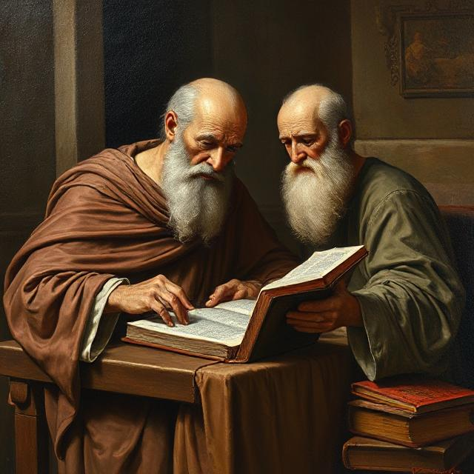
Let’s begin by saying the most important part of Bible study is the fact that you do study the Bible. The best approach will vary from person to person. As for which version, the major versions of the Bible are the King James Version, the New International Version (NIV) and the New Living Testament (NLT). There is no word-for-word translation from the original languages of the Old Testament (written in Hebrew and Aramaic) and the New Testament (primarily written in Greek), so there are nuances of the original language which do not translate well, especially when the original was written thousands of years ago in varying historical-cultural contexts for varying audiences. Most ancient languages didn’t use punctuation, which also complicates translation.
Trying as much as possible to translate the original scriptures word-for-word is called formal equivalence. If you prefer this method, check out the King James Version (KJV), the New King James Version (NKJV), or the English Standard Version (ESV). You might find that the language of these versions, particularly in the King James Version can be somewhat daunting on the first few readings. Functional equivalence means versions which translate the original scripture thought-for-thought rather than word-for-word. The New International Version (NIV) and New Living Translation (NLT) fall into this category, though the NIV is viewed as having a good balance between formal and functional translations and may be a good first Bible for those new to the faith.
For Christians truly seeking a deep and abiding relationship with God, the study of His Word is a lifelong endeavor. No matter how many time we read through the Bible, we will always discover new layers to its teachings, especially as we learn more about the biblical authors and the historical-cultural context in which they wrote their specific sections. The Holy Spirit will illuminate passages of the Bible that are informative and applicable to our circumstances at the time. In other words, with the guidance of the Spirit, each reading of the Bible is a new experience that helps us mature spiritually. It is an exciting journey

Slide 8
BIBLICAL VOCABULARY BUILDER
“Apocalyptic literature” - Apocalypse is a Greek term meaning “revelation” or “an unveiling of things not previously known”. It describes events of the end times (the Christian theological field known as “Eschatology” is the study of end times as it relates to the coming kingdom of Christ and New Jerusalem). It began as a Jewish genre of writing. Isaiah 24 is the first book of the Bible to use apocalyptic references. The Book of Revelation is another example of apocalyptic literature.
“Justification” – An act whereby God pronounces a sinner to be righteous because of his or her faith in Christ. It works in combination with repentance, which is turning away from sinful behaviors and choosing to follow Christ. Justification is a gift of God’s grace, not something that man can achieve by good works or right living. Those things are man’s gift to God to thank Him for His grace in saving us through Christ’s sacrifice.
every time we walk through scripture because every new revelation from the Word helps us know and understand God a little better, building our relationship with our Lord. The joy in the journey as we discover our “family history” in the Bible.
As for study methods, if you are a person who works better with a structured approach to learning, there are options available to help you. There are multiple Christian websites that offer a “Read the Bible in a Year” plans which assigns specific chapters for daily reading. I suggest that if you take this approach, only do it once. After you have read through the Bible for the first time, take a slower approach that allows you to linger over a passage or Book as the Spirit guides you. If you are a person who would get easily discouraged or frustrated if you missed a day of the reading plan (or two or three), this is perhaps not the ideal approach. Reading the Bible (much like prayer) is our “quality time” with God, not a “read-for-speed” challenge. If any study method is hindering you from having time to fully absorb what you’re reading, try a new method.
Devotional reading involves reading small sections of the Bible, then meditating and praying about what you have read (perhaps even journaling about it). The purpose is to consider how that passage might be applied to your life. This approach emphasizes spending thoughtful time building your relationship with God.
Thematic Bible study means focusing on a specific topic or theme and reading the related passages in the Bible. For example, if you wanted to study the concept of God’s grace or love or the concept of sanctification, you would research which passages specifically reference this theme. The value of this approach is that you visit multiple books of the Bible each time you choose a theme, which helps you notice the cohesiveness of the Bible’s teachings despite the diversity of authors, genres, and historical-contexts of its books. You could also read by genre (for example, study Christ’s parables, the books of poetry, the concept of justification, or the apocalyptic writings).
The Historical-critical method is more of an academic approach to Bible study. This approach actively examines each book of the Bible by its historical and cultural context and literary genre to seek the original meaning of the texts. This approach guards

Slide 9

against imposing modern biases and presumptions when interpreting scripture. While historical and cultural background do yield new levels of understanding for each book, unless you are studying the Bible for scholastic reasons, you might delay taking this approach until you have a working familiarity with the Bible and are ready to “dig deeper” into the historical background of its authors and the Israelite nation.
Other resources which may be useful when you are seeking to rightly understand the Bible include Bible dictionaries, Bible commentaries, and Bible concordances. Additionally, there are websites dedicated to answering questions that people may have when they are studying (Biblical Hermeneutics, BibleGateway.com, and GotQuestions.org are two examples of useful research sites).
Is it better to try individual or group Bible study? Both are necessary if you are hoping for a fully rounded knowledge of the scriptures. Individual Bible study is your “alone time” with God (and every relationship needs some alone time). Don’t be afraid to underline passages in your Bible or write in the margins if a passage is particularly relevant to your current circumstances or if something is confusing and you’d like to study it more deeply. There is also much to discover about the Bible by studying it with a group of other believers. There’s the benefit of gaining new insights about a passage through the perspectives of others. A good teacher or group leader will also bring up the historical-cultural context of the passage to help with your comprehension and application of the text.
Whatever approach suits your learning style, please be patient with yourself. Pray for the Holy Spirit’s guidance and illumination each time you sit down to study the Bible. The study of scripture is not the endgame. We go to the Bible to hear the Word so that we can discern God’s will for His people, the church of believers, and so the

Slide 10

Holy Spirit can help the Word transform our hearts so that we can apply the teachings to our daily lives. Imago Dei means being the living image of Christ, which is living all that the Word teaches so that others see our transformation and are drawn to the light of Christ in us.
There will always be the possibility of misinterpreting the Bible, so believers should take care to avoid some common errors of interpretation. Misinterpretation will distort God’s message and hinder our spiritual growth by leading us to a false theology for our daily living.
Proof-texting is the most common error. This occurs when someone takes a selected passage or quote from the Bible out-of-context to support a pre-determined conclusion. This usually means ignoring the larger lesson of the chapter and perhaps even the whole of the Bible’s teaching on the subject. One example might be taking a verse about prosperity out-of-context to “prove” a conclusion that poverty is a sign that a person is under divine judgement. Such a presupposition ignores the lessons on how Jesus, John the Baptist, and many of the prophets lived in poverty. In Luke 6:20-21, Jesus specifically blesses the poor, promising them the kingdom of Heaven. In Mark 10:21-22, Jesus specifically tells a rich young man to sell all his belongings and give them to the poor before becoming Christ’s disciple. Jesus’ parable of the rich man in Luke 12:16-21 details how a poor man is comforted in heaven while a gluttonous rich man is condemned to hell. Clearly, the message of the Bible does not state that the rich are automatically blessed nor the poor under God’s divine wrath.
Allegorizing means that the reader is imposing a meaning onto the text that isn’t inherently present and/or lacks sufficient textual proof to validate that meaning. The

Slide 11

Conclusions are subjective interpretations and far removed from the biblical author’s intention. For example, a reader might attach some kind of deeper symbolic meaning on the whale who swallows Jonah in the Book of Jonah when the fish is only God’s means of disciplining the prophet.
We noted that failing to consider the historical-cultural context of each biblical book can lead to erroneous interpretation. Some readers impose modern presuppositions onto the text without considering the original historical setting of the passage or the culture and social norms that existed during the author’s lifetime. For example, polygamy and slavery were more prevalent in biblical times, with some biblical figures having multiple wives or slaves, but that doesn’t mean that the Bible is endorsing such practices for modern believers. The believer must pay attention to the rest of the passage and the Bible’s overall teachings on marriage and freedom and not reach conclusions based on modern cultural and social norms.
Canonical context means that the Bible is a unified whole. Correct interpretation of any passage or verse requires us to examine how it relates to other passages on the same topic. Any conclusions or interpretations which contradict the Bible’s unified core message should be scrutinized to see if those conclusions are theologically consistent with the whole of the Scriptures.
Once again, the believer should begin by praying for the guidance of the Holy Spirit as the first step in avoiding misinterpretation of the Bible. Choose a version of the Bible which suits your particularly learning style. Carefully read (and re-read) each passage, noting key words, phrases, and grammar. We saw in a previous lesson that one simple word makes the difference between whether the Bible tells us to pray to the saints or for the saints (which would significantly effects one’s prayer practices). Consider the

Slide 12
core message of that specific biblical chapter, the author’s historical and cultural background, and the author’s intended audience. Paul, for example, was apostle to the Gentile nations and his epistles were often addressed to Gentile churches or Gentile believers. The passages about Mosaic Law in the Old Testament were written to an Israelite audience in a historical period predating Jesus Christ’s ministry and salvific sacrifice. The whole of the Bible’s teachings instruct that believers are no longer living under the Law of Moses (for example, the modern believer does not need to practice animal sacrifices for purification from sin as prescribed in that Law but should concentrate on how Christ is the final sacrifice for all of mankind). Consider also the literary genre of the passage while discerning its meaning. Jesus’ straightforward instructions are very easy to interpret and apply; the symbolism of John’s writings in the Book of Revelation require more intense scrutiny and very likely some consultation with extrabiblical resources such as biblical commentaries, a Bible study group at your church, or online Bible lessons about the Book of Revelation.
The point of immersing ourselves in God’s Word and discovering ways to apply His Word is not formulating a set of rules and regulations for our daily lives. Such legalism was the error of Jewish sects such as the Pharisees, Sadducees, and Essenes. There are many issues with legalism: We can end up confusing our personal morals with God’s divine decrees, it takes the focus off our relationship with God, it gives the impression of our personal piety but in truth we may be obeying laws without our hearts being truly submitted to God, and it’s a subtle way to attempt to take salvation into our own hands rather than receiving it as a gift of God’s grace. The New Testament teaches very clearly that mankind now lives under grace, not the Law of Moses, because Christ’s life and sacrifice fulfilled that Law on behalf of all mankind. We study God’s Word to better learn how to allow that grace to transform our hearts to reflect God and how to carry that grace into the world with us.
For example, if we examine the Bible’s teachings on relationships (whether marital, familial, or friendship), there is emphasis on love, forgiveness, mutual self-giving, and reconciliation. This is the relationship which God gifts to us: His love, His forgiveness, His self-sacrificial
BUILD YOUR BIBLICAL VOCABULARY
“Legalism”: The belief that a person can earn God’s favor by fulfilling the requirements of law or accomplish our own salvation through good works and adherence to the law. Legalism also attached human laws to God’s law as if the human ordinances are somehow divine. The Protestant Reformation of 1517 was sparked by the debate between Martin Luther and the Roman Catholic church over whether faith alone accomplished salvation or whether salvation came from both faith and obedience. In the case of ancient Israel, the Pharisees had expanded the Law of Moses into a system of 613 laws which placed heavy burdens on the Jewish people (a legal system Jesus explicitly denounced and rejected).

Slide 13

love, and our reconciliation with God through Christ our Savior. Relationship is about selfless, unconditional love which mirrors Christ’s love for His church body of believers and His compassion and mercy for the whole of mankind. However, we are not only in relationship with people close to us: In our daily lives, we are to regard all people with these same qualities of love, compassion, mercy, empathy, and forgiveness. Reconciliation is so important to God that the Bible teaches us to settle any disputes or misunderstandings with other people before we approach God to worship or give offerings (Matthew 5:23-26). Not only will such forgiveness help maintain a relationship (or forge new relationships), it also prevents a situation from escalating, promotes a spirit of peace, and manifests God’s love and forgiveness. If it becomes necessary to confront another person about a misdeed, the apostle Paul gives us guidance on how to approach that conversation in his epistles to the Corinthian church (1 Corinthians 5, 2 Corinthians 2).
Practicing God’s empathy and compassion helps us see the perspectives of others so we can better witness for Him as His imago dei. It deepens our relationship with God as well.
At work, the Bible teaches us to work diligently and with integrity, in fact to work as though God is our employer (Colossians 3:23-24). This means that we should work with honesty (speaking the truth with love to build others up instead of tearing them down), reliability, kindness, fairness, and strive as always to be the manifestation of God’s love and grace for co-workers and customers. While everyone needs to earn a living, the Bible teaches that believers cannot serve God and serve money. God must have priority. In his ministry, Paul usually sought some kind of employment so that he could meet his own needs rather than insist that the churches support him financially, lest he become a burden to them (1 Thessalonians 4:11-12). We should likewise not become a burden to our employers or co-workers but rather reject laziness, dependence, and short-cuts or dishonest practices.

Slide 14

Humility in this context means not seeing ourselves as better than our co-workers, employers, or subordinates but in humility to think of them as better than ourselves (Philippians 2:3-4). Our motives are not selfish ambition but serving others with diligence, reliability, productivity, and a dedication to fostering a positive environment for everyone. Our vocations are opportunities to serve God and to love people.
Being industrious and self-sufficient requires that we keep our focus on God. Proverbs 22:7 reminds us to be financially responsible by budgeting, making informed financial decisions, and avoiding excessive debt This is a challenge when the cost of living is high and there are many options for purchasing on credit. Where borrowing or lending is concerned, the Bible advises us to give without expecting anything in return and not to lend money in order to profit from others (especially the poor). Paul advises us not to borrow at all (Romans 13:8). 1 Timothy 6:10 teaches that money is the root of all evil because man can prioritize the pursuit of money above the pursuit of relationship with God and love of others.
Giving without expecting anything in return is also a foundational principle for Christian charity. 2 Corinthians 9:7 tells Christians to be generous to those in need. The Bible urges us to give because we are images of God’s love and compassion and never to give grudgingly or reluctantly (and never for our own glory, for if we give to charity to gain acclaim, the acclaim will be our only reward). Jesus teaches this in Matthew 6:2-5. advising that it’s better to make charity donations anonymously if possible because God will see our acts of charity and reward us according to His judgement.
Christians may have conflicted feelings on the issue of tithing. There are some believers who tithe down to the penny, and some churches that mandate tithing 10% of your income to the church. Let’s spend a moment examining what the Bible has to say on the subject.

Slide 15
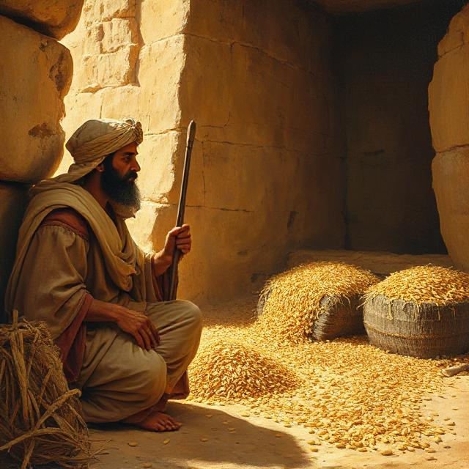
Tithing comes from the Old English word teogotha, which means “tenth”. It refers to the practice of believers giving 10% of their income or resources (such as crops) to support a church or religious community. Tithing originate in the Mosaic Law of ancient Israel (see Leviticus 27:30, Deuteronomy 14:24, and 2 Chronicles 31:5). As we have seen, the sacrifice of Christ on the cross fulfilled the Law and released believers from living under the Law. We live under the grace and love of God because of Christ’s sacrifice. The Bible shows how the practice of giving a portion of resources was used for greater good. In the Book of Genesis 41, Joseph interpreted Pharaoh’s dream as God’s warning of an imminent worldwide famine. Joseph took a portion of all grain produced in Egypt for the next several years to prepare for the famine. This obedience to God’s purpose saved countless people in Egypt and from other nations.
Technically, Christians are not obliged by law to offer tithes as we have been freed from the Law. We are, however, stewards of the resources God gives us and expected to use the resources He gives us to accomplish His good purposes and will in this world. We no longer need to tithe to support the temple in Jerusalem, but as the church body of Christ, we are mandated to further Christ’s work and spread the Gospel message to the world. Two resources are indispensable for this work to succeed: The dedication of believers’ time and talent and the finances to support our outreach. Churches are non-profit entities, as such each congregation relies heavily on the financial support and volunteer work of its membership to keep the church doors open and facilitate outreach ministries.
The bottom line is that believers who are submissive to God in relationship with Him should give to support His work as they are able, whether it be financial support or volunteering their time for church service and ministry. .God promises blessings to those who are generous and give cheerfully (remember that the condition of our heart is of paramount importance for a God whose essence is love). He does not want us to give grudgingly or reluctantly. We should consider how

Slide 16

much God has already given us: The gift of life, the beauty of creation, salvation through Christ’s sacrifice. Giving to His people has been a demonstration of God’s provision and love since the beginning of creation. Giving to Him in return is an act of worship and gratitude and a demonstration of our love for God. It’s another way that we dedicate ourselves to aligning our lives with God’s will.
Let’s look at two biblical instances of giving to God. Mark 12:41-44 tells the story of a widow who gave her last two coins as an offering to God. Jesus praised her act of devotion as giving more than the wealthy who had donated from their surplus. Contrast sold a piece of land and claimed to have given the whole sale price to the early Christian church. Christians of the early times of the church gave to one another out of love, meeting in one another’s home and sharing all that they possessed. This is likely what prompted Ananias and Sapphira’s promises. Had they only promised what they were willing to give, it would have been received as a gift. God was not fooled by their deception. He enacted judgment on them not because of the amount of the donation but for being dishonest in dealing with the church.
God makes no demand of believers other than to have faith in Him, trust Him, to act with love towards Him and towards other people. This means practicing integrity with our gifts. If money is too tight, you can still “tithe” by giving of your time and your talents for God’s purposes. Whether you promise God to give 10% or 1% or 50% of our income, whether you cannot make monetary donations but promise to donate time, prayerfully follow the prompting of the Holy Spirit and do whatever it is that you promise to do for God. Give only what you can give with a joyful heart, eager to come alongside God’s work in this world.

Slide 17
Some clarification might be required at this point: Believers will hear the word “canon” used to describe the books of the Bible. What does that mean? The term originated in the 3rd century with Origen, who used it to mean “the rule of faith” as the standard by which we evaluate. “Canon” as applied to the Bible simply means “an officially accepted list of books”. The church councils did not create the canon, they examined many scriptures to determine which ones were the divinely inspired Word of God. This obviously leads us to the question about what criteria was used to determine which writings were the true divine Word.
The early Christian church was an assortment of decentralized groups of believers. What these groups considered as “canon” varied by region. Many factors influenced canon. Local traditions influenced worship and which writings were taught in a community group. The availability or rarity of a specific text would influence whether it was included in canon (not every community had access to all the Christian writings of the era). Gradually, through internal debate and responses to heresies which threatened to destabilize some of the community groups of believers, an accepted Christian doctrine began to develop. Still, the criteria for which texts should be included in canon was not clear. Liturgical context was a big factor in canon, which means that the more frequently books (liturgy) were used in worship, the more these books gained acceptance as canon.
As the Christian faith spread among nations, a more centralized church structure with a centralized ecclesiastical authority emerged and fostered attempts at unifying this scattered community groups, especially with regards to doctrine and canonical texts. The church Council of Carthage in 397 CE formally listed texts which were to be regarded as canon for the Old Testament and New Testament. While this helped standardize which texts would be used by the various community churches, this list did not receive uniform acceptance among all Christian groups.
The Protestant Revolution further complicated the debate over church canon. At the center of the controversy were the “apocrypha” or “deuterocanonical” texts. There was debate over whether these writings (over 100 texts in all) qualified as Christian canon. Seven of these books are included in the Catholic Bible but not the Christian versions of the Bible. The Catholic Bible also contains additional sections of the books of Daniel and Esther. Why are they called “deuterocanonical” by the Catholic church? Because their status as canon was accepted later in history by the Catholic church that the first books (what Christians call canon) accepts these deuterocanonical books as canon just the same as the proto-canonical (first) books. The reasons why the Roman Catholic and Eastern Orthodox churches accepted 7 books of the apocrypha as biblical canon are complex, as are the reasons why other Christian faiths reject all apocrypha books.

Slide 18
THE BASIC TEACHINGS OF MARTIN LUTHER IN THE PROTESTANT REFORMATION
The core beliefs that fueled the Protestant divergence from Catholic beliefs are summarized by the “Five Solas”. Those are:
SOLA SCRIPTURA: The Bible is the sole authority for Christian doctrine and faith.
SOLA FIDE: Salvation is found only through faith in Jesus Christ.
SOLUS CHRISTUS: Jesus is the only source of our salvation.
SOLA GRATIA: Salvation is a gift from God and cannot be obtained by any human works or human merit (other than faith in Jesus).
SOLI DEO GLORIA: Salvation is a work of God for His glory.
Basically, there were multiple factors involved in establishing a Christian doctrine. Beyond establishing a theological and textual criteria, there were political and ecclesiastical realities involved in the debate. The Council of Carthage affirmed the 27 books of the New Testament as we know them today, a step towards establishing the standard canon of the Western Christian church. Apostolic authorship was an important factor in accepting texts as canon (this is the belief that a text was authored by or closely associated with an apostle). The Pauline epistles, for example, met the criteria as these were letters directly attributable to the apostle Paul. Theological consistency among the texts was also a factor (remember that God does not contradict Himself, therefore any texts that are divinely inspired by the Holy Spirit would not have contradictory teachings or messages).
Carthage didn’t resolve all debates over canonicity because there were still regional variations in worship and liturgical contexts, and the church was still very decentralized.
The Council of Trent was convened during the Protestant Reformation (1545-1563 CE) and particularly focused on the debate over the Apocrypha. The council affirmed the 7 deuterocanonical books of Tobit, Judith, Wisdom, Sirach, Baruch, 1 Maccabees, and 2 Maccabees. The 7 deuterocanonicals were included. Their decision was reaffirmed by subsequent councils in Hippo (393 A.D.), Carthage (397 A.D.), Nicea (787 A.D.), Florence (1442 A.D.) and Trent (1546 A.D.).
The Protestant Reformers rejected these books, questioning their authority and divine inspiration. The canonical status of the Apocrypha because a distinguishing feature between Catholic and Protestant traditions and their respective understandings of scripture and ecclesiastical authority. The Reformers had challenged the Catholic church’s authority to interpret scripture and define orthodoxy. When the Council of Trent affirmed the Apocrypha, it affirmed this authority of the Catholic church. Martin Luther had challenged papal authority. In doing so, he irrevocably altered Western Christianity, which led to a reassessment of many of its traditional practices (including acceptance and interpretation of scripture). Reformers believed that the church’s authority was derived from the Bible, whereas the Catholic belief was that the church had the authority to define what was accepted and authoritative in the Bible.

Slide 19
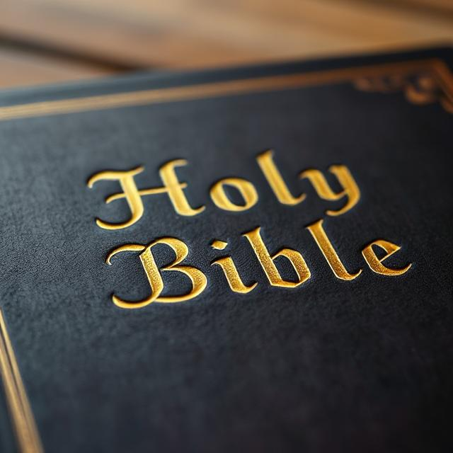
There were multiple factors at the heart of the Protestant reformers’ rejection of the apocrypha. The primary question was the books’ authorship and historical reliability. They felt the apocrypha lacked any clear apostolic lineage. Proponents of the apocrypha argued that the books connected to respected figures of biblical history, but reformers found these connections to be tenuous and indirect, therefore unreliable.
The reformers also cited theological inconsistencies between the apocrypha and the universally accepted canonical books. For example, apocrypha taught the concept of Purgatory (though many of us have heard of the concept of Purgatory, the Bible does not speak of it. The Hebrew Bible uses the term “sheol” and the Greek equivalent is “hades”, both terms meaning “the place/land of the dead”. Sheol is divided into two realms: Heaven, the place where departed souls go to be with God, and a second place of torment where souls who did not go to God are kept until the final resurrection (see Luke 16 and Luke 23:43). The New Testament uses the word Gehenna (meaning “hell”). But Purgatory is an apocryphal concept rather than a biblical truth. The apocrypha contradicted established church doctrines and presented an alternate narrative from the canonical texts. This undermined the claims that the apocrypha could be divinely inspired and authoritative scripture. The reformers also wanted to purify the church from beliefs and practices that they deemed to be corrupt or suspicious. They viewed the apocrypha as an accumulation of later additions to canon rather than part of the original, divinely-inspired Hebrew scriptures (the Jewish canon).
Some reformers (including Martin Luther) did not immediately remove the apocrypha from their bibles but instead placed those books in a separate section of the Bible. They deemed the books as useful for edification while not possessing weight or authority of canonical scripture. Other reformers removed the apocrypha completely from their bibles.

Slide 20

The fact that Protestant canon lacked the apocrypha became a distinguishing feature between Protestantism and Western Christianity and Catholicism and Eastern Orthodox tradition. Why did Catholicism argue for the inclusion of the apocrypha in church canon? First, they rejected the idea of a universal Hebrew canon. For example, unlike the prevalent Jewish tradition, the Sadducees only recognized the Torah as canon (this is the first five books of the Bible, the books attributed to Moses). Those who recognized the apocrypha believed that there was a larger Jewish biblical canon (translated into Greek during the times of Alexander the Great) among the Jewish Diaspora than the Palestine Jewish canon upon which the Protestant Christian Bibles are based. This canon existed before the time of Christ. These writings, which included the apocrypha books are known as the Alexandrian canon and should all be accepted as divinely inspired scripture. They point out that the more conservative Jewish leaders in Palestine along rejected Jesus (making their ability to discern biblical truth suspect) and that leaders such as the Sadducees had a smaller biblical cannon than either the Alexandrian or the Palestine canons---therefore the matter of what should be considered Old Testament canon was certainly not universal or “closed” by the age of Christ, which was an assertion of those who rejected the apocrypha. Another argument of those who say the Jewish canon was “closed” is that prophetic gifts had ceased after the period of the Old Testament. The Roman Catholic arguments points to New Testament references to people of that era who were described as “prophets”, including John the Baptist, Simeon, Barnabas, and Christ Himself.
They point to the fact that there are many allusions to the apocryphal books in the accepted New Testament canon, which is seen by Roman Catholics as approval of the apocryphal books as divinely inspired. The fact that Jesus Himself is recorded in the New Testament as celebrating Hanukkah (a holiday originating in the Maccabean revolution) and quoting Maccabean leader, Judas Maccabee, as Jesus approving the rebellion and the apocryphal books written about the rebellion. The Roman Catholic arguments also assert that even if the apocryphal books are not quoted in the New Testament, this is not evidence that the apocrypha are not divinely inspired. There are other Old Testament books that are accepted as canon but are not quoted anywhere in the New Testament.

Slide 21

The liturgical practices of the early Christian communities also factored into arguments favoring the apocrypha because these texts were included in early church teachings and worship. This demonstrated that the apocrypha had practical authority and theological significance, which made them suitable for devotional use and theological reflection. They felt that the apocrypha offered a tapestry of theological themes and perspectives that enriched and complimented the narratives and doctrines of universal church canon. The apocrypha gave a more nuanced understanding of God’s revelation, human nature, and salvation history. Examples would include the apocrypha’s expansion on concepts like wisdom, on living virtuous lives, and deeper understanding of the attributes of God.
Those who favored the apocrypha also felts that these texts contributed to a fuller understanding of the historical context of the Jewish nation and the formation of the early Christian church. One example would be the books of the Maccabees, which give insights to the political and religious struggles of the Jewish people during the spread of Greek influence among nations and the attempts to Hellenize the Jewish people. They felt that the introduction of figures like Judas Maccabee, Tobit, and Judith and their narratives enriched the biblical tapestry by giving examples of faith from diverse backgrounds and circumstances.
While he was translating the Bible from Greek to Latin (the Vulgate), St. Jerome in the fourth century A.D. made the distinction: The apocrypha were not books of canon and should not be considered as Scripture. They were, however, books of the church. They did not have divine origin, but they were useful for educational purpose (for example, teaching about the rebellion of the Maccabees in understanding the history of the Jewish people being under the oppression of outside nations. His opinion was discounted, and the apocrypha were included as canon until the time of the Protestant Reformation/ The Geneva Bible of 1599 did not accept apocrypha as canon. The King James Version removed the apocrypha in 1885.

Slide 22
The bottom line is this: Are the apocrypha divinely inspired? Only the Lord can say for certain. The takeaway here is that believers need to be aware that establishing canonicity in the church has always been a fluid process rather than a static entity. Canon is a historical artifact that is shaped by ongoing dialogue, conflict, and an evolving understanding of faith and authority within the church. This Is why it’s so important for believers to remain plugged into God through prayer. As a believer guided by the Holy Spirit, it is up to you to decide whether to read the apocrypha and what to make of them. I can only tell you to keep in mind two things: One: The Christian church as a whole cannon come to a consensus on these books, a fact which you need to bear in mind. Two: There does seem to be some consensus that they can teach us something about Jewish history, and it is good for us to know about redemption history.
The time we spend discovering God through the study of the Bible is a gift. We owe a debt to the people of ancient Israel and the meticulous ways in which they copied and preserved the scriptures which became the Hebrew Bible so that not a single letter of God’s Word was lost, for they preserved what would become the Old Testament. We owe a debt those early Christian believers who endured persecution even as they copied, circulated, and preserved authoritative texts such as the letters from the apostles so that those writing could one day become the New Testament. We owe a debt to the early church for carefully evaluating early scriptures to verify authenticity and authority of the writings our of desire to separate false theologies from the true Word of God.. We owe a debt to the church forefathers who translated the Bible and made it accessible to the common population, including Martin Luther (who translated the New Testament into German in 1522 and his complete Bible in 1534) and William Tyndale, who translated the Bible for the English-speaking public, laying the groundwork for future versions of the Bible such as the King James Version.
When we consider how many believers before us risked their lives out of great love for God and desire to fulfill His purposes in sharing the Gospel message with the world, we appreciate how very privileged we are simply to be able to sit and read the Word. Even today, there are many places in the modern world where Christians read the Bible at risk of their own lives. Truly, our chance to sit and immerse ourselves in God’s Word is a genuine miracle and gift of God’s continued direction of history. Please do not waste this gift, whether you study for an hour or can only manage a few minutes each day. If you can, make a dedicated, quiet place where you can be alone with God to attune yourself to the illumination of the Spirit as you read. Choose whichever version of the Bible suits your learning style, including Bible study groups, audio Bibles, and online classes. Pray and meditate on any passage that the Spirit highlights for you. And don’t forget to always discuss what you have learned with God through prayer.

Slide 23
REFERENCES:
“Noah’s Sons and Their Descendants”. Biblehub.com;
biblehub.com/topical/n/noah's_sons_and_their_descendants.htm
“Hebrew Names: Abraham”, Jeff A. Benner; Ancient Hebrew Research Center;
“What Does the Name Sarah/Sarai Really Mean?”, Bible Hermeneutics; hermeneutics.stackexchange.com; 2025
“Why Did Isaac Still Bless Jacob After He Lied?”, BibleAskTeam, March 2015;
bibleask.org/why-did-isaac-still-bless-jacob-after-he-lied/
“What is the meaning of Jacob wrestling with God?”, GotQuestions.org; www.gotquestions.org/Jacob-wrestling-with-God.html
“Why did the Israelites make a golden calf?”, Josh Drummond; Biblicalarcheology.org; April 9, 2025
“Why Didn’t the Israelites Destroy the Canaanites?”, BibleAskTeam, March 18, 2012; bibleask.org/why-didnt-the-israelites-destroy-the-canaanites/
“Why Did the Israelites Want an Earthly King When They Had God?”, Vivian Bricker; Christianity.com; 1/5/22

