Slide 1


Understanding NIL deals and student athletes
BY: Adam Santiago
Cameron Jones-Brown
Dejuan Buford
Ezekiel
Luay Shahbain

Slide 2
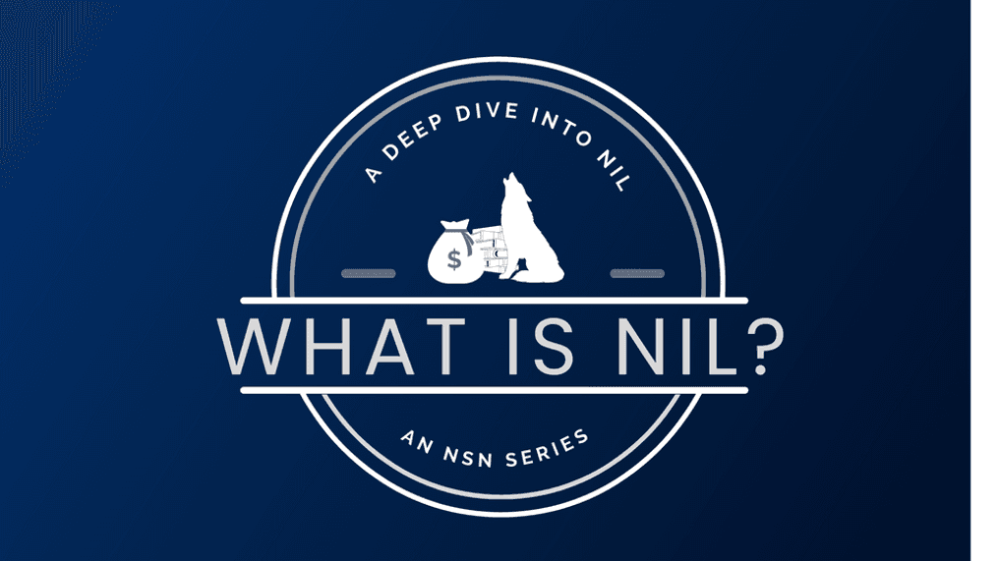
01
What is an NIL deal?

Slide 3
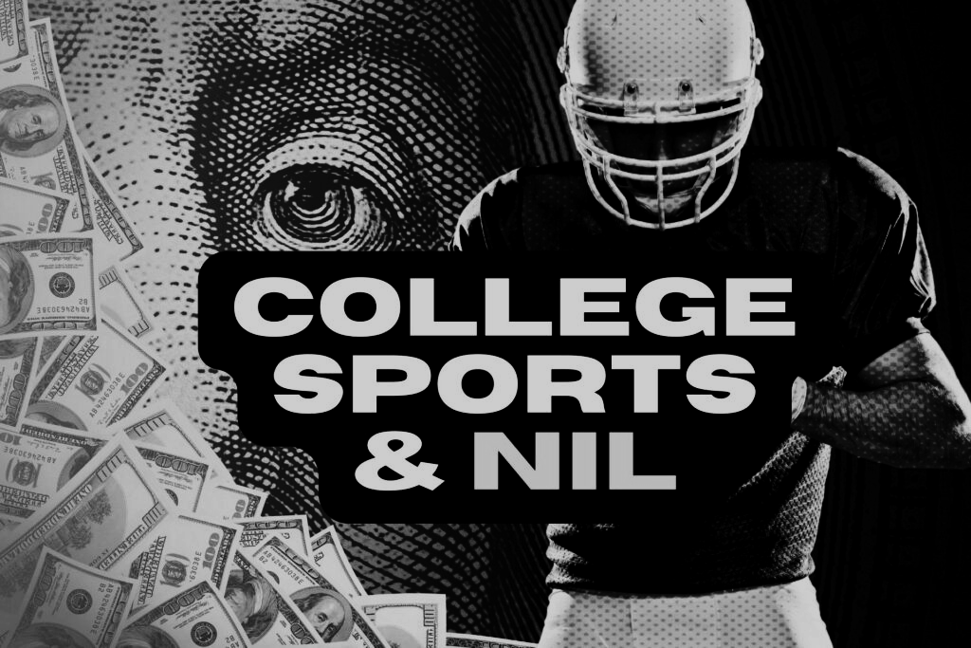
NIL deals
A "NIL deal" for student-athletes refers to an agreement where student-athletes can earn money from their name, image, and likeness. Since 2021, the NCAA allows athletes to profit through endorsements, social media partnerships, autograph signings, and other opportunities without affecting their eligibility to play college sports. These deals enable athletes to monetize their personal brand based on their popularity and social media presence.

Slide 4

How can you get an NIL Deal
You can start by building a strong personal brand, leveraging social media, exploring local opportunities, and utilizing NIL marketplaces to connect with brands. You need to have a positive reputation as a dedicated hardworking with a strong online presence. You need to use social media to share content that describes your talents greatly it may interest brands to make a partnership with you.

Slide 5
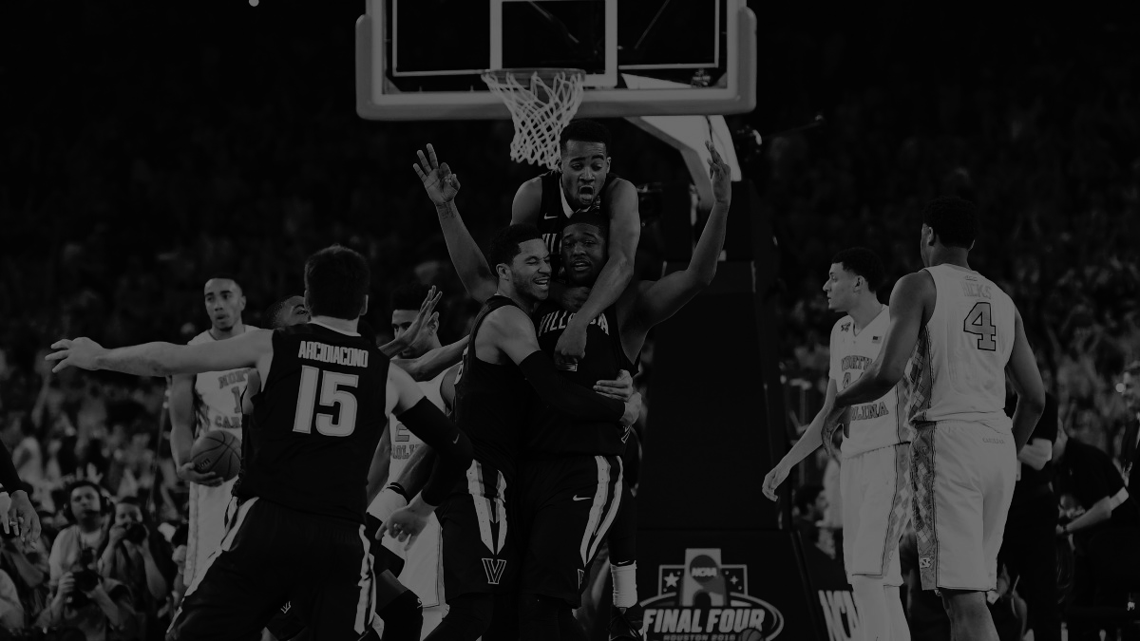
02
What are the pros of NIL deals?

Slide 6
Pros
The pros of NIL deals for student-athletes include the ability to earn income while still in college, increased exposure and brand-building opportunities, and the chance to capitalize on their popularity or unique talents. NIL deals can help athletes gain financial independence, provide valuable networking opportunities, and prepare them for potential professional careers. Additionally, it allows athletes to benefit from their hard work and dedication in ways that were previously restricted, while also helping to level the playing field with other students who can already benefit from similar opportunities.

Slide 7

03
What are the cons of NIL deals?

Slide 8



Cons
The cons of NIL deals for student-athletes include the potential for distractions, as managing deals and maintaining a public image can take time and focus away from academics and athletics. There's also the risk of exploitation, with some athletes, especially those less experienced in business, being taken advantage of by unscrupulous agents or companies. NIL deals can also create inequities, as high-profile athletes with large social media followings may secure much larger deals, leading to disparities between athletes within the same sport or team. Additionally, the pressure to maintain a personal brand can add stress, affecting mental health and overall well-being.

Slide 9
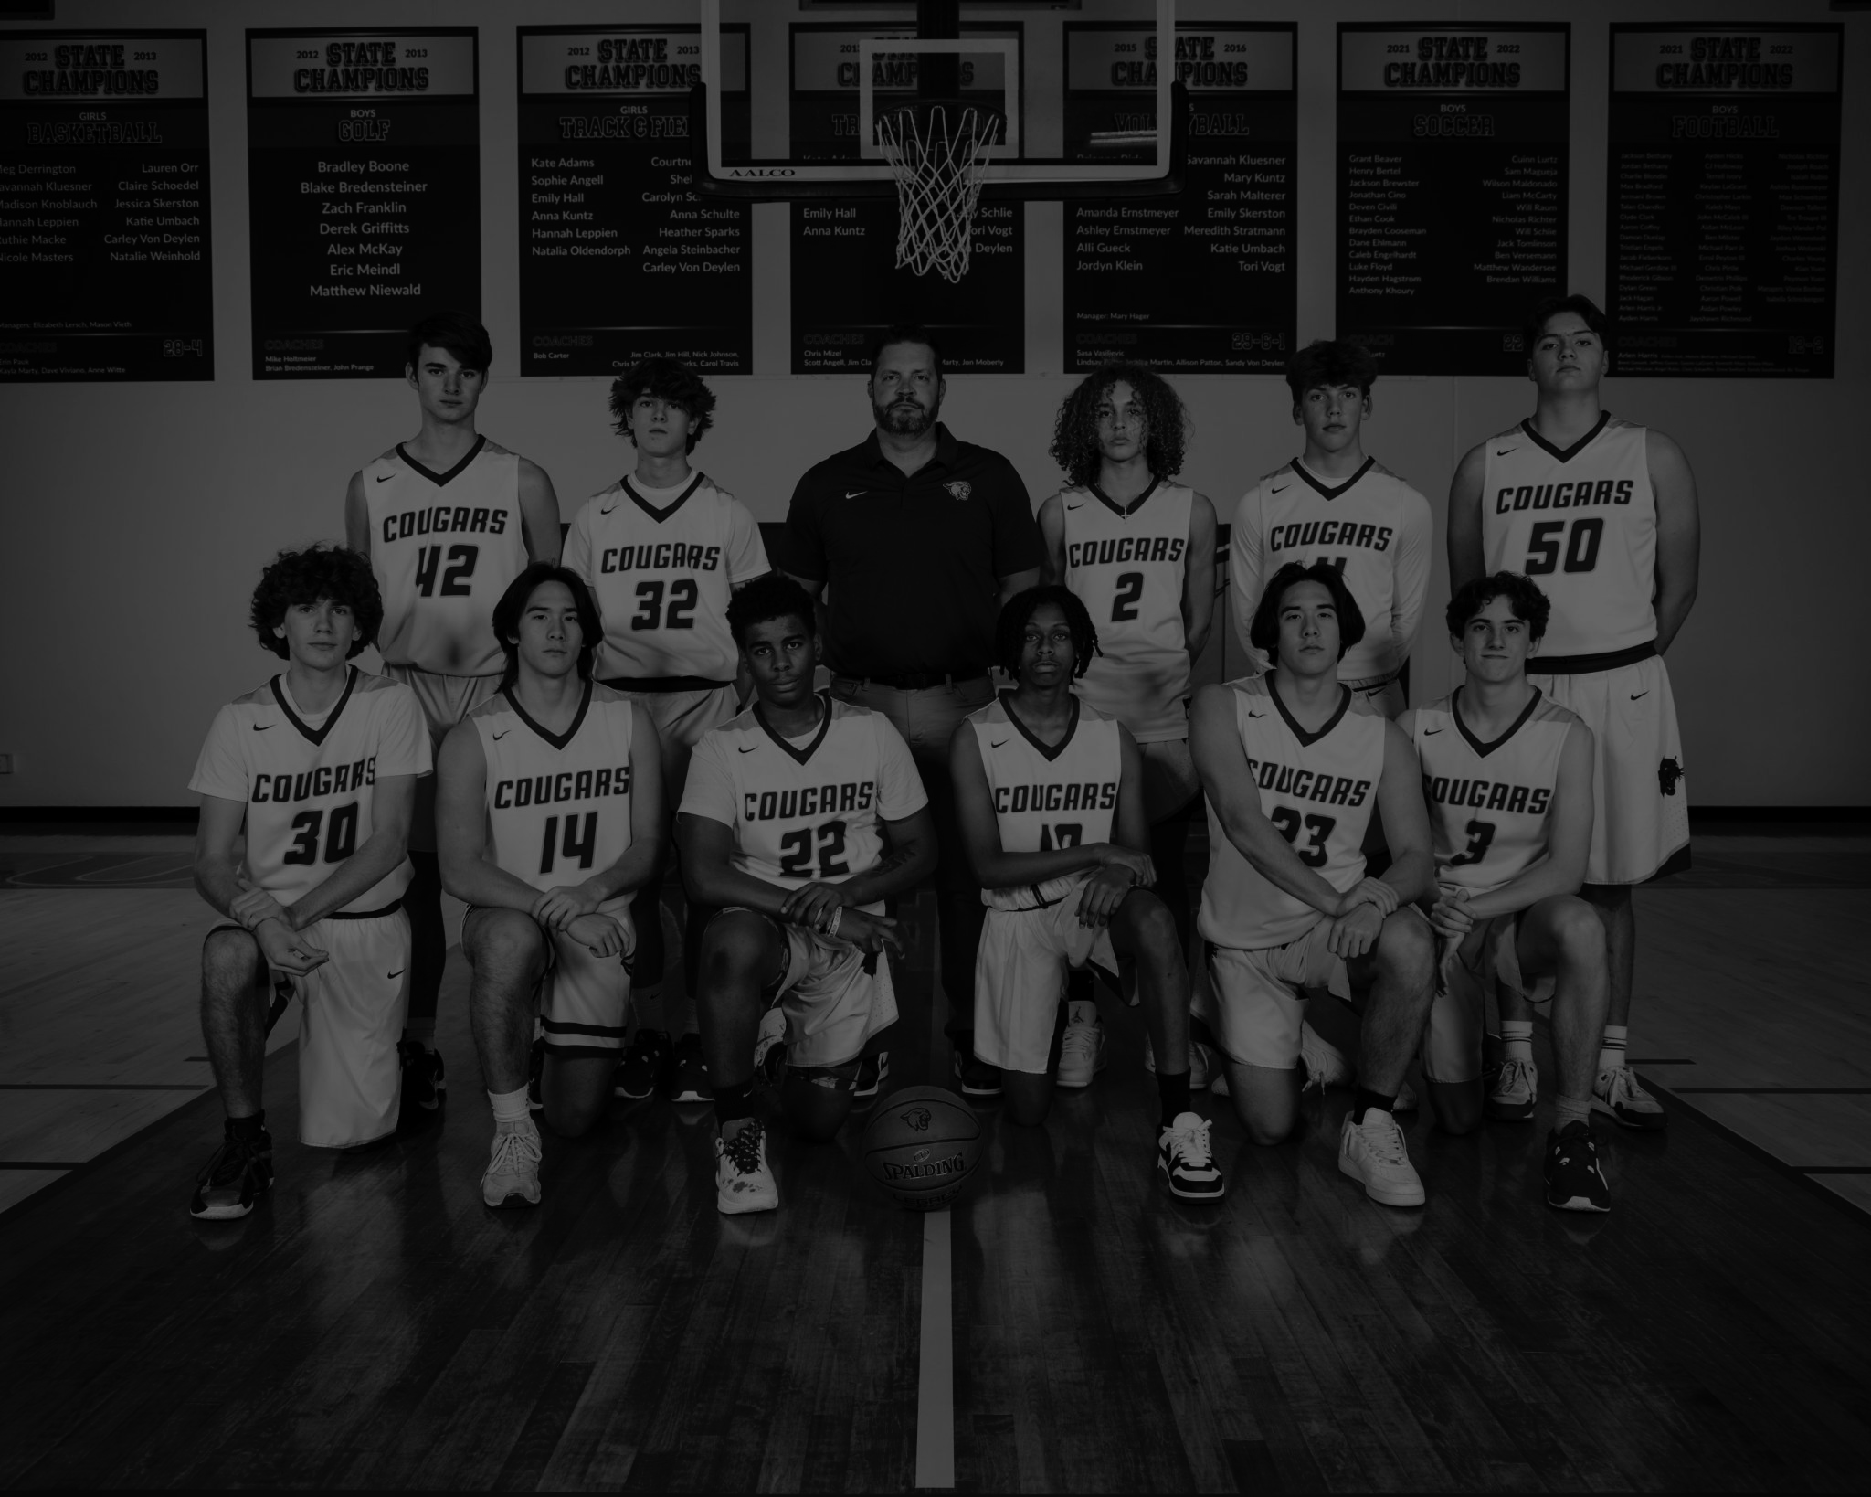
04
How do you think NIL deals will have an impact on your generation?

Slide 10

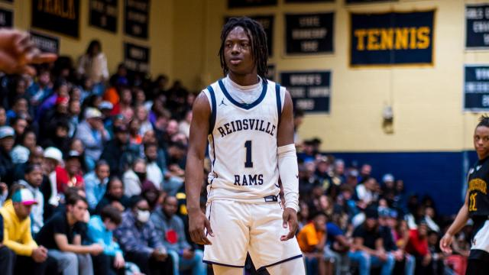
Impact on our generation
For middle school students, NIL deals could influence how they view sports and success, inspiring them to build personal brands and potentially profit from their talents early on, especially with social media being a major factor. While this could encourage entrepreneurial thinking, it may also add pressure and distractions, as managing a brand at such a young age could be overwhelming. There's a risk that kids might focus more on money than enjoying the sport, and they could be vulnerable to exploitation. Overall, NIL deals could shape how young athletes approach competition and fame, but it's important for them to prioritize their growth, education, and well-being.

Slide 11

05
How can you make healthy choices when faced with risky situations?

Slide 12
How to make healthy choices in risky situations
When it comes to NIL deals and student-athletes, making healthy choices involves staying focused on long-term goals while navigating the potential risks. It's important to understand your worth, set clear boundaries, and avoid letting the pressure of money or fame distract from your academics and athletics. Educating yourself about the NIL landscape and seeking guidance from trusted mentors or professionals can help you make informed decisions. Additionally, it's essential to be cautious of deals that might exploit you, ensuring that you're protected by working with reliable agents or legal experts. By staying true to your values and priorities, you can make balanced decisions that benefit both your personal growth and athletic career.

Slide 13
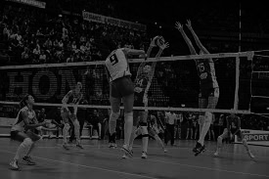
06
How does different cultures feel about NIL Deals?

Slide 14
How does different Cultures feel about NIL Deals?
Coaches have mixed feelings about about nil deals with some thinking it will corrupt their players’ ability to perform at their highest while others believe their players should be rewarded for their hard work.
Companies feel positive about nil deals since they can use the players they sign to expand their business.
Player generally feel positive about nil deals since they can expand their name, image, and brand by doing what they love and they can even make money from it

Slide 15

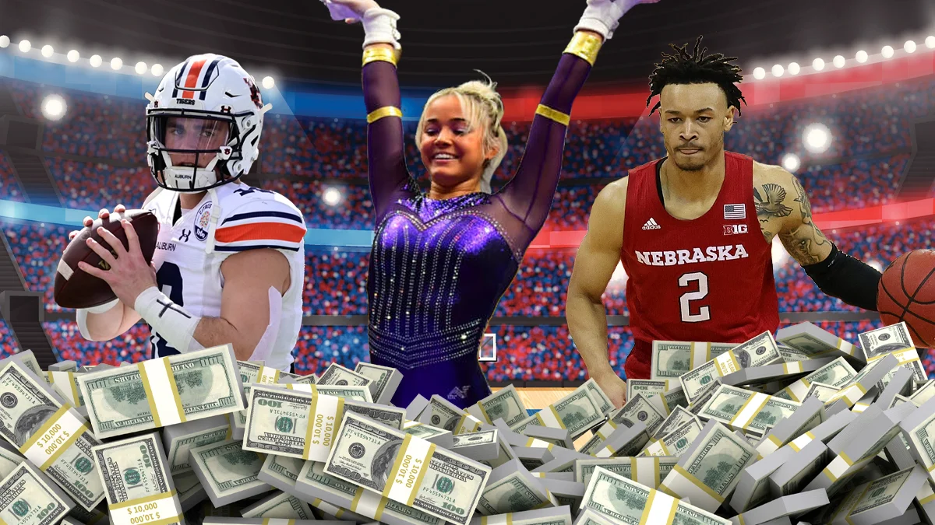
07
What are the success rates of athletes after NIL deals?

Slide 16
What are the success rates of athletes after NIL deals?
The success rate of an athlete after securing an NIL (Name, Image, and Likeness) deal can vary significantly from person to person, depending on a variety of factors. Athletes may experience different levels of success based on their personal brand, marketability, and engagement with fans. On average, NIL athletes can expect to earn a steady income ranging from $1,000 to $10,000, though this can fluctuate based on the athlete's popularity and the scope of the deals they sign. As they build their brand and expand their network, NIL athletes often have the potential to access even more opportunities and larger income streams.

Slide 17
Financial Management
Nil deals refer to agreements where no direct financial exchange takes place between the parties involved, often seen in sports contracts, sponsorships, and business transactions. Players might sign a contract with no immediate salary, often as a part of a trial period or in exchange for future compensation.
Financial management of Nil deals involves valuing non-cash compensation, getting rid of potential future gains, managing any tax implications. While no immediate money is exchanged, these deals can still have value, especially in long-term strategic planning.

Slide 18
Summary
So in conclusion, NIL (Name, Image, and Likeness) deals allow student-athletes to profit from their personal brand by monetizing their name, image, and likeness while still maintaining their eligibility to participate in college sports. Introduced in 2021, these deals provide athletes the opportunity to sign sponsorships, promote products, and even earn revenue from social media platforms, without the restrictions that previously limited their financial opportunities. NIL has created a significant shift in college athletics, enabling athletes to secure compensation while balancing their academic and athletic commitments. However, it has also raised questions about fairness, recruitment advantages, and the overall impact on the integrity of college sports.

