Slide 1



The State of Florida & The Concealed Weapon license
Frank L. Piper - Instructor
(904) 410 – 2123

Slide 2
Gun Owner’s Responsibilities
Americans enjoy a right that citizens of many other countries do not—the right to own firearms.
But with this right come responsibilities.
It is the gun owner’s responsibility to store, operate and maintain his or her firearms safely.
It is the owner’s responsibility to ensure that unauthorized or untrained individuals cannot gain access to his or her firearms.
And it is the gun owner’s responsibility to learn and obey all applicable laws that pertain to the purchase, possession and use of firearms in his or her locale.
Guns are neither safe nor unsafe by themselves. When gun owners learn and practice responsible gun ownership, guns are safe.

Slide 3
Introduction to Concealed Carry Safety and The Defensive Mindset
Learning Objectives: Upon completion of this lesson, you will be able to explain:
  The importance of carrying and using a handgun responsibly and ethically for personal protection outside the home.
  How the three fundamental NRA rules for safe gun handling apply when carrying or using a concealed handgun outside the home.
  How the NRA rules for using or storing a gun apply when carrying or using a concealed handgun outside the home.

Slide 4
Ethical Responsibility
Tool of last resort
Imminent danger
Are you capable of using deadly force?
Are you capable of exercising mature judgment?

Slide 5
NRA Rules for Safe Gun Handling
ALWAYS keep the gun pointed in a safe direction.
ALWAYS keep your finger off the trigger until ready to shoot.
ALWAYS keep the gun unloaded until ready to use.

Slide 6
NRA Rules for Using and Storing Guns
Know your target and what is beyond.
Know how to use the gun safely.
Be sure the gun is safe to operate.
Use only the correct ammunition for your gun.
Wear eye and ear protection as appropriate.

Slide 7
NRA Rules for Using and Storing Guns (Continued)
Never use alcohol or drugs before or while shooting.
Store guns so they are inaccessible to unauthorized persons.
Be aware that certain types of guns and many shooting activities require additional safety precautions.

Slide 8
Special Safety Considerations
Think ahead
Make sure your holster or holster purse allows proper gun retention.
Make sure you have the proper carry mode for your gun.

Slide 9
Mental Awareness
Levels of Awareness
  Unaware
  Aware
  Alert
  Alarm
Maintaining Awareness

Slide 10
Defensive Mindset
Never give up!
  Why do you go home ????
Training
  Develop a plan
  Practice visualization
  Practice the plan
  Continue training
  Train for real life
  Train to control the encounter
  Train for stress

Slide 11
Avoiding Confrontations Outside the Home
Be aware of potential threats in the environment.
Plan ahead to maximize your safety and minimize the risk of having a violent encounter.
Avoid dangerous people who may constitute a threat, or who may get you into trouble.

Slide 12
Avoiding Confrontations (Continued)
Avoid dangerous situations, such as darkness, being alone, hitchhiking, etc.
Avoid dangerous places, such as high-crime neighborhoods, unfamiliar areas, etc.
Avoid making yourself a target by not dressing or behaving in a manner that causes you to stand out or which may tempt or antagonize others.
Avoid antagonizing others through provocative T-shirts or bumper stickers, confrontational behavior, or unusual dress.

Slide 13
Avoiding Confrontations (Continued)
Avoid having a pattern or predictable routine that a criminal may take advantage of.
Don’t respond to antagonistic behavior by arguing aggressively, losing your temper, or otherwise responding to verbal attacks; don’t do anything to escalate a confrontation.
Look for escape routes when you are walking on the street or driving in your car; these may allow you to escape a threat that confronts you.

Slide 14
Responding to an Attack Outside the Home
Psychological Reactions To A Threat
  Five possible responses
    Freeze
    Submit
    Posture
    Flight
    Fight
  Cannot predict response
  Responses may escalate assailant responses

Slide 15
Responding to an Attack Outside the Home “Continued”
Physiological Reactions To A Life-Threatening Encounter
  General bodily responses to imminent danger
  Adrenaline rush
  Diminished use of fine motor skills

Slide 16
Responding to an Attack Outside the Home (Continued)
Perceptual Changes During A Threatening Encounter
  Tunnel vision
  Auditory exclusion
  Time dilation
  Temporary loss of memory

Slide 17
Responding to an Attack Outside the Home (Continued)
Controlling an Encounter Outside the Home
  Keep your distance
  Be wary of strangers
  Yell your commands
    Verbal commands
      Loud and confident voice
      Heard by:
        Attacker
        Witnesses
  If he flees, let him go

Slide 18
Controlling an Encounter Outside the Home (Continued)
Holding An Attacker At Gunpoint
  Do not approach him for any reason.
  Have him put any weapon he may have on the ground at some distance away.
  Have him keep his hands high in the air.
  Have him lie face-down, away from his weapon, legs apart, arms outstretched and palms up.
  Back against cover to protect yourself from attacks from the rear.
  Call the police.
  Keep aware of other potential threats.

Slide 19
Differences between Armed Self-Defense in the Home and Outside the Home.
The defensive firearm must always be concealed outside the home.
Potential threats are more ambiguous outside the home.
You generally will be on unfamiliar ground when you are confronted by a threat outside your home.
You will have no safe room to retreat to if you are confronted outside your home.

Slide 20
If You Must Shoot
Number of shots
No immediate effect or apparent injury
Spotting hits
Possibility of injury
If you are injured
Maintain will to prevail

Slide 21
If You Must Shoot (Continued)
Once Your Attacker is Down
  Do not approach the assailant
  Scan for threats
  Move to cover
  Contact the police

Slide 22
If You Must Shoot (Continued)
Once your attacker is down
  Wait for the police
  Guard against a resumption of the attack
  Maintain the integrity of the shooting scene
  Greeting the police
  Leaving the shooting scene

Slide 23
The Aftermath of a Defensive Shooting
Emotional Aftermath
  Elation
  Revulsion
  Remorse
  Self-doubt
  Acceptance
  Post-traumatic stress disorder

Slide 24
The Aftermath of a Defensive Shooting (Continued)
Reducing the emotional aftermath
  Counseling
  Self-reinforcement
Legal aftermath
Social aftermath

Slide 25
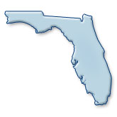

Slide 26

How many civilians in the U.S. have been issued a Florida concealed carry license?
About 75,000.
Between 175,000 and 200,000.
Almost 500,000.
More than 1.7 million.
With 1,755,580 licenses issued as of April, 2017, Florida enjoys one of the most popular, and most widely recognized licenses in the United States.

Slide 27
Popularity of Florida Permit
As of April 2017, Florida has nearly double the number of permit holders compared to the next most popular permit, from the state of Texas.

Slide 28
The Florida Concealed Carry Law
Subject to certain exceptions which we’ll review, a license to carry a concealed firearm issued by the Florida Department of Agriculture authorizes the licensee to carry a concealed firearm on or about their person.
Unlike many states which also allow “open carry,” Florida has no such provision, and it is “unlawful for any person to openly carry on or about his or her person any firearm or electric weapon or device.” However, it is not a violation of this section for concealed carry licensees, to “briefly and openly display the firearm to the ordinary sight of another person, unless the firearm is intentionally displayed in an angry or threatening manner, not in necessary self-defense.”
Our advice is that you should plan for a carry method that completely conceals your firearm, rather than depending upon the argument that any exposure of your firearm was unintentional.

Slide 29
Who is Eligible?
The Florida Concealed Carry law requires the Department of Agriculture to issue a permit to carry a firearm, to any applicant that meets the following criteria:
Is a resident and citizen of the United States or a permanent resident alien.
Is 21 years of age or older (18 if serving active duty in the military).
Does not suffer from a physical disability which prevents the safe handling of a weapon or firearm.
Has not been convicted of a felony.
Has not been committed for the abuse of a controlled substance or been found guilty of a crime under the provisions of chapter 893 or similar laws of any other state relating to controlled substances within a 3-year period immediately preceding the date on which the application is submitted.
Does not chronically and habitually use alcoholic beverages or other substances to the extent that his or her normal faculties are impaired.
Has not been adjudicated an incapacitated person under s. 744.331, or similar laws of any other state, unless 5 years have elapsed since the applicant’s restoration to capacity by court order.

Slide 30
Who is Eligible (Continued)
Has not been committed to a mental institution under chapter 394, or similar laws of any other state, unless the applicant produces a certificate from a licensed psychiatrist that he or she has not suffered from disability for at least 5 years prior to the date of submission of the application.
Has not had adjudication of guilt withheld or imposition of sentence suspended on any felony or misdemeanor crime of domestic violence unless 3 years have elapsed since probation or any other conditions set by the court have been fulfilled, or the record has been sealed or expunged.
Has not been issued an injunction that is currently in force and effect and that restrains the applicant from committing acts of domestic violence or acts of repeat violence.
Is not prohibited from purchasing or possessing a firearm by any other provision of Florida or federal law.
Demonstrates competence with a firearm with an approved training program (which we’ll explain next).

Slide 31
Training Required
Prior to applying for your permit, you must demonstrate competence with a firearm with any one of the following (and you must have documentation to prove it):
Completion of any hunter education or hunter safety course approved by the Fish and Wildlife Conservation Commission or a similar agency of another state;
Completion of any National Rifle Association firearms safety or training course;
Completion of any firearms safety or training course or class available to the general public offered by a law enforcement, junior college, college, or private or public institution or organization or firearms training school, utilizing instructors certified by the National Rifle Association, Criminal Justice Standards and Training Commission, or the Department of Agriculture and Consumer Services;
Completion of any law enforcement firearms safety or training course or class offered for security guards, investigators, special deputies, or any division or subdivision of law enforcement or security enforcement; division or subdivision of law enforcement or security enforcement;

Slide 32
Training Required (Continued)
Presents evidence of equivalent experience with a firearm through participation in organized shooting competition or military service;
Is licensed or has been licensed to carry a firearm in this state or a county or municipality of this state, unless such license has been revoked for cause; or
Completion of any firearms training or safety course or class conducted by a state-certified or National Rifle Association certified firearms instructor.

Slide 33
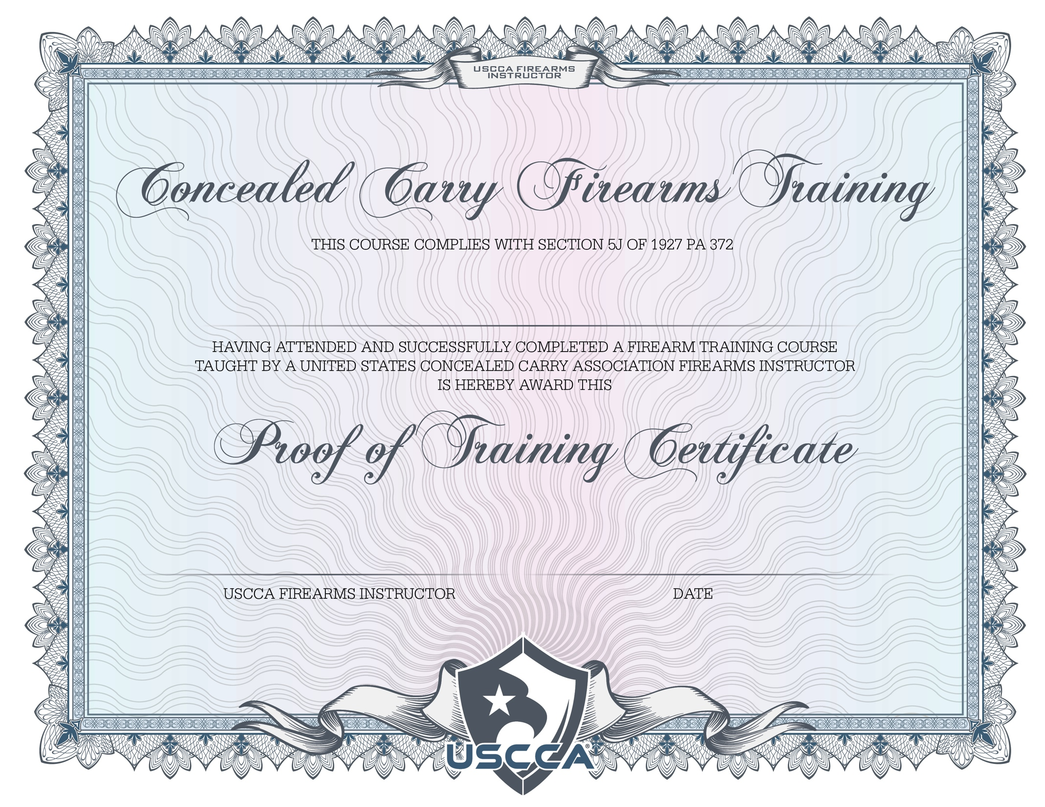
Training Documentation
As part of your application packet, you must include documentation confirming that you have fulfilled the training requirement.
Documentation may include: A photocopy of a certificate of completion of any of the courses or classes; an affidavit from your instructor, school, club, organization, or group that conducted or taught your course; a copy of any document which shows completion of the course; or evidence of participation in firearms competition.

Slide 34
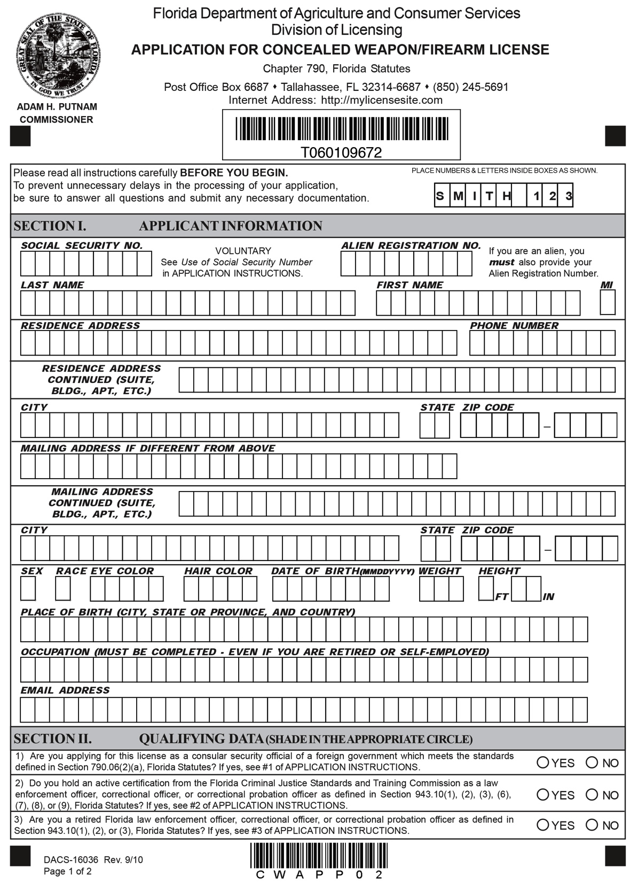
Application and Approval Process
There are two ways to submit an application:
The Fast Track Process allows you to complete and submit your application in person at one of eight Regional Department of Agriculture offices located throughout Florida. Simply call the office nearest you to schedule an appointment. At the time of your appointment, you will be directed to a computer station where you will complete an electronic version of the application form. Staff will preview your application, scan your fingerprints, take your photograph and process your payment.

Slide 35
Application and Approval Process
Alternatively, you can submit your application by mail to the Department of Agriculture. Applications and instructions may be downloaded from https://licensing.freshfromflorida.com/forms/FormsRequest790.aspx
  If submitting an application by mail, you must also contact your local law enforcement agency to submit fingerprints electronically or using the traditional hard-card method.

Slide 36
Application and Approval Process
If downloading an application, a unique, personal tracking number will be generated.
You will use this tracking number to check the status of your application while it is being reviewed and evaluated by Division personnel. Because the tracking number is unique for each individual application, it is very important that you do not make copies of your application and provide them to others for their use.
If another person submits a copy of your application to the Division, the tracking number can no longer be used to check the status of your application.

Slide 37

Items to Submit with Application
A completed application.
The fee of $97, which includes the initial license fee of $55, and a fingerprint processing fee of $42.
A full set of fingerprints of the applicant administered by a law enforcement agency or the Division of Licensing of the Department of Agriculture.
A photocopy of your proof of training.
A full frontal view color photograph of the applicant taken within the preceding 30 days, in which the head, including hair, measures 7/8 of an inch wide and 11/8 inches high.
The Department of Agriculture and Consumer Services, upon receipt of the items listed above, will forward the full set of fingerprints to the Department of Law Enforcement to be processed for any criminal justice information.

Slide 38
Application and Approval Process
The Department of Agriculture and Consumer Services must, within 90 days after the date of receipt of the items listed in subsection (5):
Issue the license; or
Deny the application based solely on the ground that the applicant fails to qualify under the criteria listed in subsection (2) or subsection (3). If the Department of Agriculture and Consumer Services denies the application, it must notify the applicant in writing, stating the ground for denial and informing the applicant of any right to a hearing pursuant to chapter 120.
In the event the department receives criminal history information with no final disposition on a crime which may disqualify the applicant, the time limitation prescribed by this paragraph may be suspended until receipt of the final disposition or proof of restoration of civil and firearm rights.

Slide 39
Application Fees
The total fee for the concealed weapon license is $97.
This total consists of two separate fees: an application fee ($55) and a fingerprint-processing fee ($42).
Renewal fees are $45 for Florida Resident and $87for out of state residents.

Slide 40
Moving or Loss of Card
Within 30 days after the changing of a permanent address, or within 30 days after having a license lost or destroyed, you must notify the Department of Agriculture and Consumer Services of such change. Failure to do so constitutes a noncriminal violation with a penalty of $25.
In the event that your license is lost or destroyed, your license will automatically become invalid, and you must request a duplicate. Duplicate licenses will be provided upon payment of $15 to the Department of Agriculture and Consumer Services, and furnishing a notarized statement stating that your license has been lost or destroyed.

Slide 41
Renewals
Licenses are valid for seven years from the date of issue.
No less than 90 days before the expiration date of the license, the Department of Agriculture and Consumer Services will send a written notice of the expiration and a renewal form to each licensee.
The licensee must renew his or her license on or before the expiration date by filing with the Department of Agriculture and Consumer Services the renewal form containing:
  A notarized affidavit stating that the licensee remains qualified pursuant to the criteria specified in subsections (2) and (3).
  A color photograph as specified in paragraph (5)(e), and
  The required renewal fee.
  Out-of-state residents must also submit a complete set of fingerprints and fingerprint processing fee.
The license shall be renewed upon receipt of the completed renewal form, color photograph, appropriate payment of fees, and, if applicable, fingerprints. Additionally, a licensee who fails to file a renewal application on or before its expiration date must renew his or her license by paying a late fee of $15. A license may not be renewed 180 days or more after its expiration date, and such a license is deemed to be permanently expired, and a “new” license packet must be submitted.

Slide 42
Lawful Requests for Permit and ID
The licensee must carry the license, together with valid identification, at all times in which the licensee is in actual possession of a concealed weapon or firearm and must display both the license and proper identification upon demand by a law enforcement officer.
Violations of the provisions of this subsection shall constitute a noncriminal violation with a penalty of $25, payable to the clerk of the court.
If you are asked whether you are carrying (or if you volunteer the information), keep your hands where the officer can see them, and provide the officer with clear, direct language, such as:
  “I do have a concealed carry permit, which is in my wallet in my back left pocket, and I am carrying today, in a holster on my right hip. What should I do?”
Follow the officer’s instruction to the letter, and be prepared to be temporarily disarmed.

Slide 43
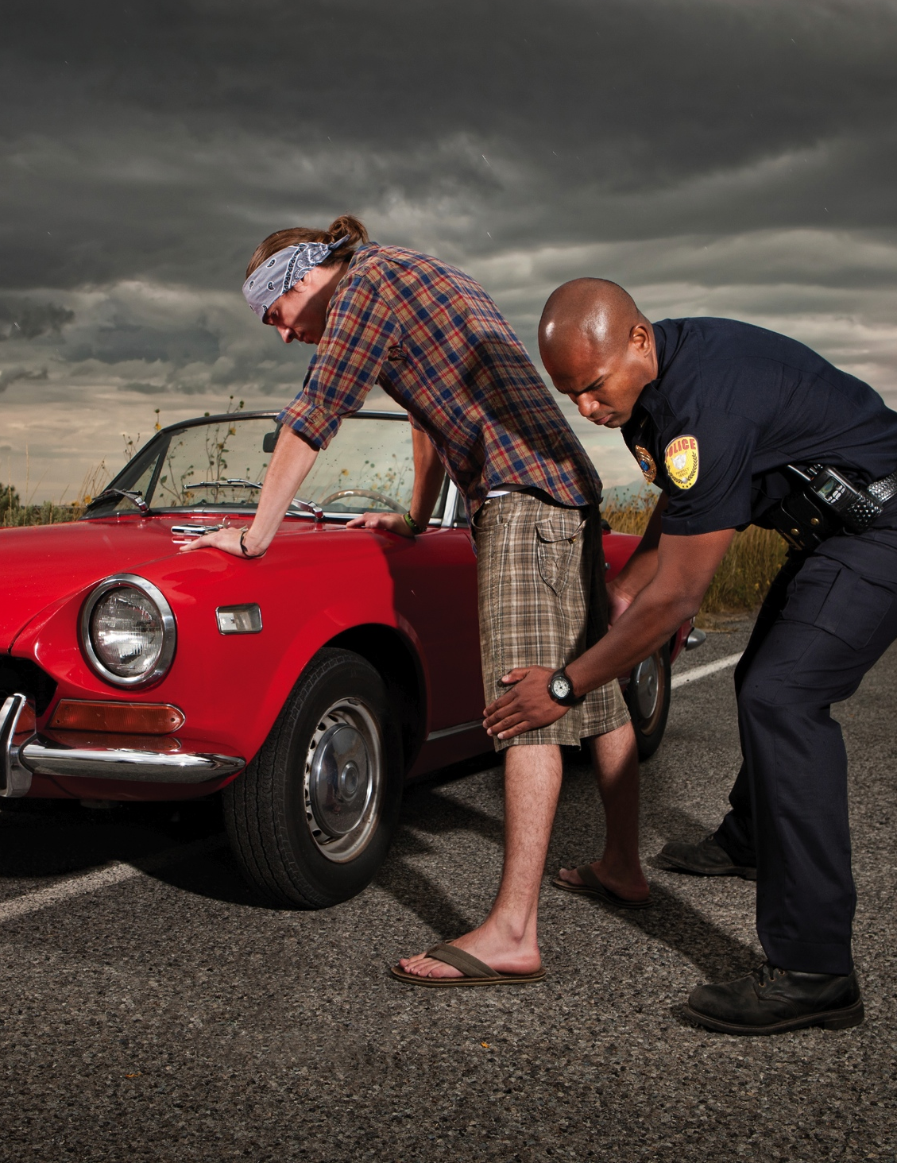
Volunteering the Fact that you are Carrying
If you come into contact with a law enforcement officer and the officer doesn’t ask, you aren’t required to volunteer the fact that you are carrying, although many instructors suggest that you volunteer this information at the earliest time possible. However, there is one time when you should alert the officer that you are carrying a firearm under a permit, and that’s when you suspect the officer is going to find out anyway, such as if they’re about to perform a pat down, or if they ask you to step out of your vehicle. In that case, it’s much better to inform the officer(s) before they discover it on their own. When alerting the officer that you are carrying, use the language discussed on the previous page.

Slide 44
Prohibited Areas
While the possession of an Florida carry permit allows you to carry in many locations, there are also a large number of locations where you may not carry, permit or no permit.
In most cases no sign will be posted on these locations informing you of that fact, so it is up to YOU to know the law, both state, and federal.
Any person who knowingly and willfully violates any provision of this subsection commits a misdemeanor of the second degree.
We’ll review these locations one at a time.

Slide 45
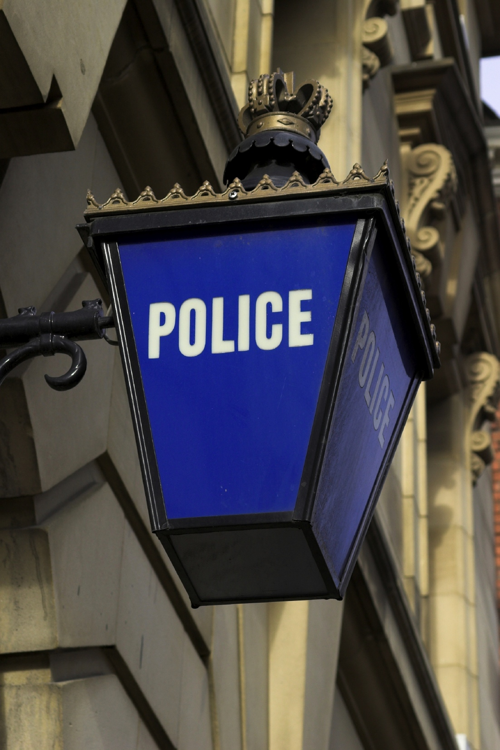
Law Enforcement Offices
You may not carry in any police, sheriff, or highway patrol station.

Slide 46
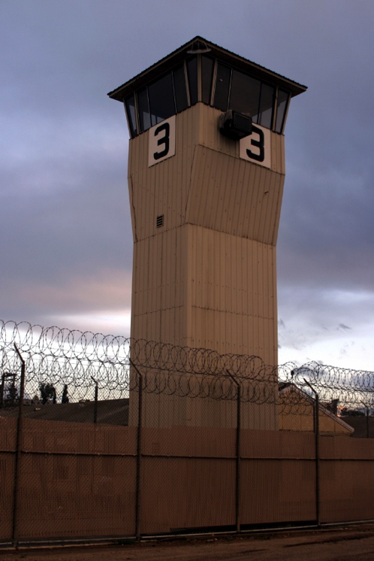
Jail and Other Detention Facilities
It is unlawful to carry a firearm into any detention facility, prison, or jail.

Slide 47

Courthouses
It is unlawful to carry a firearm into any courthouse or courtroom in Florida.

Slide 48
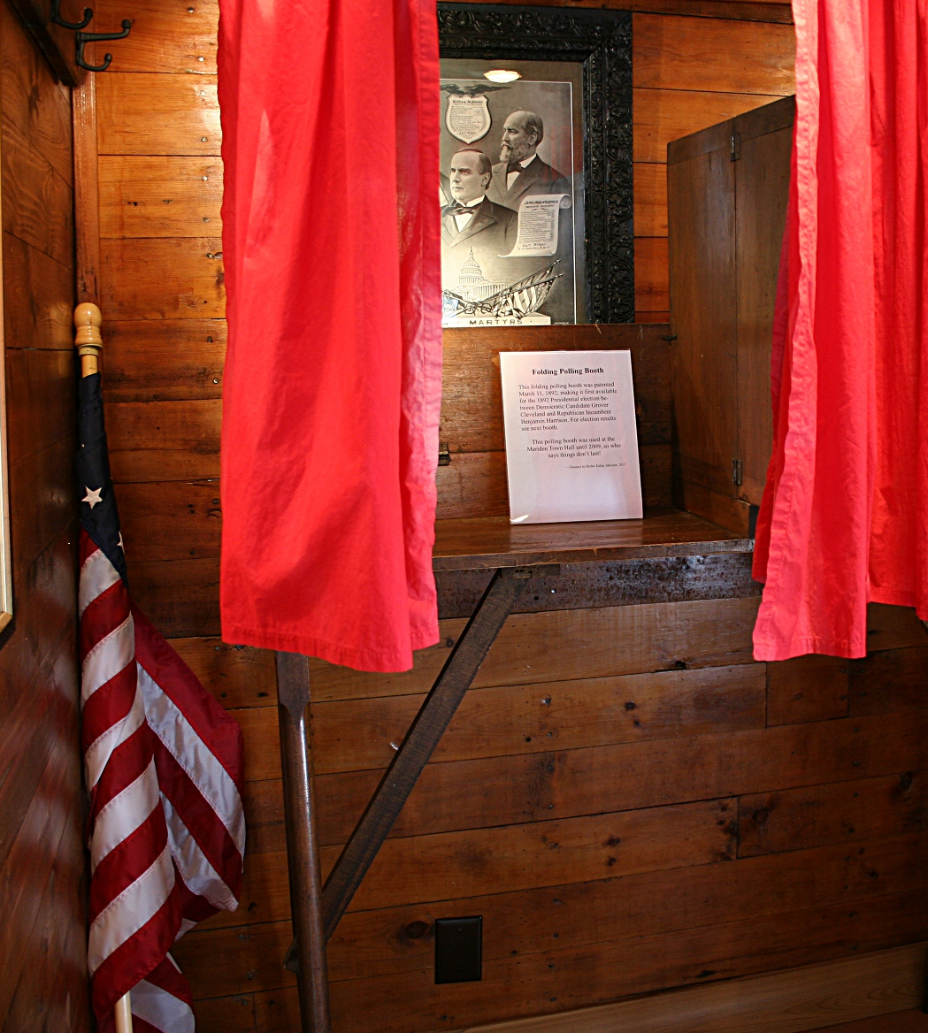
Polling Places
It is unlawful to carry a firearm into any polling place in Florida.

Slide 49

Certain Meeting Locations
It is unlawful to carry a firearm into any meeting of the governing body of a county, public school district, municipality, or special district; or any meeting of the legislature or of a legislative committee.

Slide 50

Athletic Events
It is unlawful to carry a firearm into any school, college, or professional athletic event not related to firearms.

Slide 51

School Buildings
It is unlawful to carry a firearm into any elementary or secondary school facility or administration building.

Slide 52
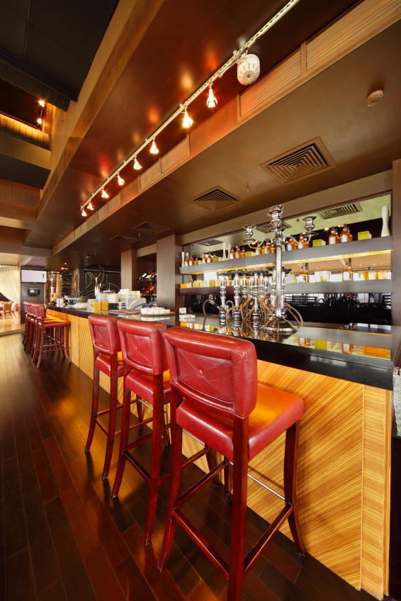
Carrying Firearms were Liquor is Consumed
It is unlawful to carry or possess a firearm in an establishment licensed to dispense alcoholic beverages for consumption on the premises, while in the portion of the establishment which is primarily devoted to such purpose.
Exactly what part of a bar is “primarily devoted” to serving alcohol, will probably be up to the prosecutor. Don’t try to outsmart the prosecutor by claiming that you were in a bar, but you weren’t in the part that was “primarily devoted” to serving and consuming alcohol. That’s most likely an argument that you would lose.

Slide 53
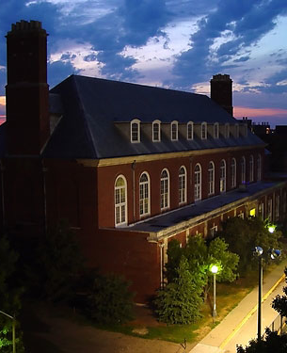
Colleges and Universities
It is unlawful to carry a firearm into any college or university facility.

Slide 54

Airports
It is unlawful to carry a firearm into the inside of the passenger terminal and sterile area of any airport.
This prohibition does not limit you from carrying a legal firearm into the terminal which is cased for purposes of checking the firearm as baggage.

Slide 55

Post Offices
The federal government prohibits firearms in federal facilities (which includes post offices, IRS offices, etc.).
Violating this prohibition may result in federal charges, and imprisonment up to a year.
As of July 2015, this prohibition once again includes post office parking lots. In a 2 – 1 vote, the 10th U.S. Circuit Court of Appeals said that a U.S. Postal Service regulation banning firearms on postal property is constitutional, which reversed a lower court ruling from July of 2013 that would have let people keep weapons inside their vehicles in post office parking lots.

Slide 56
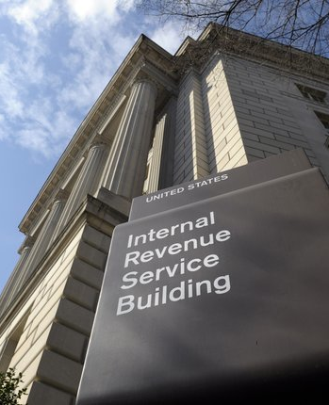
Other Federal Facilities
The term “Federal Facility” means a building or part thereof owned or leased by the Federal Government, where Federal employees are regularly present for the purpose of performing their official duties.
This would include federal court houses, IRS offices, Post Offices, Ranger Stations and other buildings in Federal Parks, etc.

Slide 57

Carrying Under the Influence
Although the state of Florida doesn’t explicitly bar you from drinking when carrying a firearm, you will be charged with a misdemeanor of the second degree if you are found holding a loaded firearm, or if you discharge a firearm while under the influence of alcohol or any chemical substance.

Slide 58
Carrying Under the Influence
Just One Drink Can’t Hurt, Can It?
In a word, yes. Conventional wisdom is that the average drinker can remain below the legal limit if they ingest no more than a drink an hour. While that may be true, if an incident occurs where you use any level of force, even a trace of alcohol in your blood can taint your “reasonable person” argument with the prosecutor and a potential jury.

Slide 59
Carrying Under the Influence
Just One Drink Can’t Hurt, Can It?
In other words, you may have been the innocent victim, and you may have done everything right, yet you may have lost your case before it even began, because you had alcohol in your blood.

Slide 60
“Places of Nuisance”
Florida law also bans the carrying of firearms in “places of nuisance” which are defined as places which “annoy the community or injure the health of the community, or become manifestly injurious to the morals or manners of the people…, or any house or place of prostitution, assignation, lewdness or place or building where games of chance are engaged in violation of law or any place where any law of the state is violated.”
Since this is a VERY broad definition, count on the prosecutor to decide when this definition applies.

Slide 61
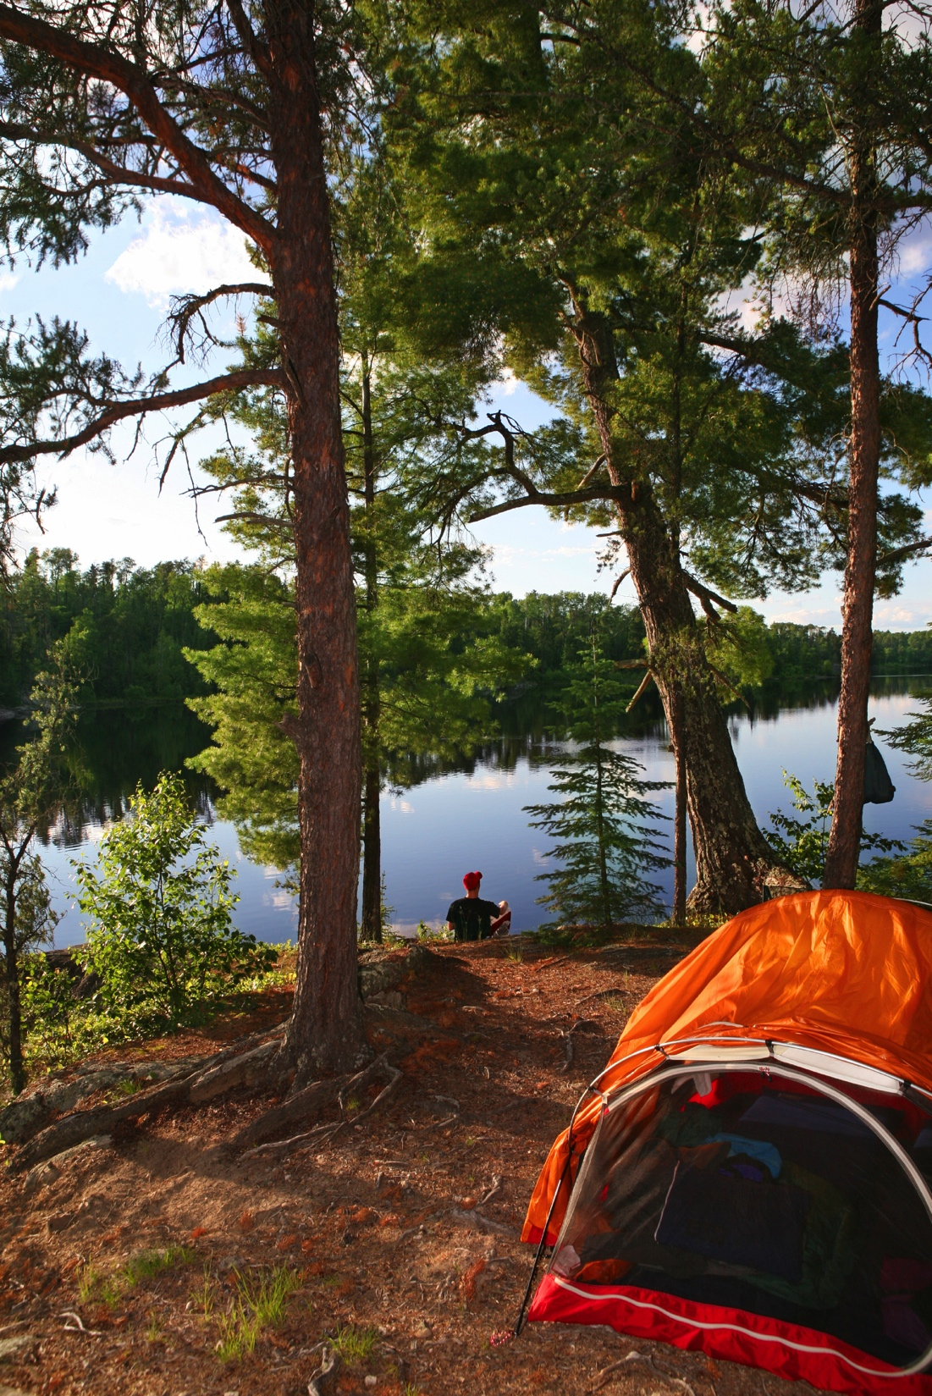
Non-Prohibited Areas: National Parks
In a change in law which took effect in February of 2010, the regulations governing the possession of firearms in National Parks and Wildlife Refuges were updated to allow individuals who possess a permit to carry a firearm recognized by the state in which the National Park or Wildlife Refuge is located, to carry in those locations.
However (and this is a big however), that right does not extend to carrying in federal buildings, which as mentioned earlier, are off limits. So while you may legally carry in national parks and wildlife refuges, you may not carry in ranger stations or other federal buildings within those parks.

Slide 62
What kinds of weapons are included in the concealed weapons law?
The Jack Hagler Self-defense Act defines concealed weapons or firearms as follows: handguns, electronic weapons or devices, tear gas guns, knives and billies. The information provided emphasizes handguns, because they are one of the most commonly used weapons for self-defense.

Slide 63
What if I am in my vehicle?
A person has no duty to retreat in his lawfully occupied vehicle against a person who was in the process of unlawfully and forcefully entering or had unlawfully and forcefully entered an occupied vehicle or had unlawfully and forcefully removed or was attempting to remove another against that person's will from the occupied vehicle.

Slide 64
When is a Handgun "Concealed?"
The Florida Legislature defines a concealed firearm as any firearm “carried on or about a person in such a manner as to conceal it from the ordinary sight of another person.” A person carrying a concealed firearm without a license is guilty of a felony of the third degree. The penalty for this offense is a prison term of up to five years.

Slide 65
When can I use my handgun to protect myself?
Trying to protect yourself or another person from death or serious bodily harm;
Trying to prevent a forcible felony, such as rape, robbery, burglary or kidnapping.
Using or displaying a handgun in any other circumstances could result in your conviction for crimes such as improper exhibition of a firearm, manslaughter, or worse.

Slide 66
EXAMPLE
Two neighbors got into a fight, and one of them tried to hit the other by swinging a garden hose. The neighbor who was being attacked with the hose shot the other in the chest. The court upheld his conviction for aggravated battery with a firearm, because an attack with a garden hose is not the kind of violent assault that justifies responding with deadly force.

Slide 67
Verbal threats are not enough to justify the use of deadly force. There must be an overt act by the person which indicates that he immediately intends to carry out the threat. The person threatened must reasonably believe that he will be killed or suffer serious bodily harm if he does not immediately take the life of his adversary.

Slide 68
What if someone is attacking me in my own home?
The courts have created an exception to the duty to retreat called the “castle doctrine.” Under the castle doctrine, you need not retreat from your own home to avoid using deadly force against an assailant. The castle doctrine applies if you are attacked in your own home by an intruder.

Slide 69
What if I point my handgun at someone but don't use it?
Never display a handgun to gain "leverage" in an argument. Threatening someone verbally while possessing a handgun, even licensed, will land you in jail for three years. Even if the gun is broken or you don't have bullets, you will receive the mandatory three-year sentence if convicted. The law does not allow any possibility of getting out of jail early.

Slide 70
Example
In a 1987 case, a woman refused to pay an automobile mechanic who she thought did a poor job repairing her car. They argued about it, and the mechanic removed the radiator hose from the car so she couldn't drive it away. She reached into her purse, pulled out an unloaded gun, and threatened to kill the mechanic if he touched her car again. The mechanic grabbed the gun and called the police.

Slide 71
EXAMPLE cont.
The woman was convicted of aggravated assault with a firearm and sentenced to serve a mandatory three-year prison term. The fact that the gun was not loaded was irrelevant. Even though she was the mother of three dependent children and had no prior criminal record, the statute does not allow for parole. Her only recourse was to seek clemency from the Governor.

Slide 72
When can I use deadly force in the defense of another person?
If you see someone who is being attacked, you can use deadly force to defend him/her if the circumstances would justify that person's use of deadly force in his/her own defense. In other words, you "stand in the shoes" of the person being attacked.

Slide 73
What if I see a crime being committed?
A license to carry a concealed weapon does not make you a free-lance policeman. But, as stated earlier, deadly force is justified if you are trying to prevent the imminent commission of a forcible felony. The use of deadly force must be absolutely necessary to prevent the crime. Also, if the criminal runs away, you cannot use deadly force to stop him, because you would no longer be "preventing" a crime. If use of deadly force is not necessary, or you use deadly force after the crime has stopped, you could be convicted of manslaughter.

Slide 74
Summary
Never display a handgun to gain "leverage" in an argument, even if it isn't loaded or you never intend to use it.
The law permits you to carry a concealed weapon for self-defense. Carrying a concealed weapon does not make you a free-lance policeman or a “Good Samaritan.”
Never carry your concealed weapon into any place where the statute prohibits carrying it.

Slide 75
The amount of force that you use to defend yourself must not be excessive under the circumstances.
Never use deadly force in self-defense unless you are afraid that if you don't, you will be killed or seriously injured;
Verbal threats never justify your use of deadly force;
If you think someone has a weapon and will use it unless you kill him, be sure you are right and are not overreacting to the situation.

Slide 76
Concealed Carry Requirements
What factors should be considered when choosing a handgun carry device?
  Concealment
  Access
  Retention
  Comfort

Slide 77
Concealed Carry Devices
What materials are handgun carry devices usually constructed from?
  Leather
  Nylon fabric
  Plastic or polymer

Slide 78
Holsters Types
Shoulder holsters
Strong-side hip holsters
Crossdraw holsters
Ankle holsters
Small-of the–back holsters

Slide 79
Shoulder Holsters
Strengths
  Concealment
  Access
  Comfort
Limitations
  Safe direction
  Retention

Slide 80
Strong-Side Hip Holsters
What are the types of strong-side hip holsters?
Strengths
  Safe direction when presenting the gun
  Fastest draw
  Retention
Limitations
  Must wear something to conceal the gun
  Access when seated

Slide 81
Cross-draw Holsters
Strengths
  Access to the gun
  Comfort
Limitations
  Safe direction
  Retention

Slide 82
Ankle Holsters
Strengths
  Concealment
Limitations
  Accessing the gun
  Safe direction
  Uncomfortable

Slide 83
Small-of–the-Back Holsters
Strengths
  Concealment from front view
Limitations
  Safe direction when presenting the gun
  Retention
  Comfort

Slide 84
Pocket Carry
Strengths
  Concealment
  Convenience
  Inexpensive
Limitations
  Small gun
  Tight cloth will “print”

Slide 85
Other Devices
Holster vests/jackets
Pager holsters
Briefcases and day planners
Underwear holsters
Belly bands

Slide 86
Holster Accessories
Gun belt
Magazines
Speedloaders
Magazine and speedloader pouches

Slide 87
Holster Purses
Strengths
  Concealment
  Access
  Comfort
Limitations
  Safe direction when presenting the gun
  Retention

Slide 88
Fanny Packs
Strengths
  Concealment
  Access
  Comfort
  Retention
Limitations
  Safe direction when presenting the gun
  Incompatible with some attire

Slide 89
?

