Slide 1


Slide 2


Brought to you by…….
Frank L. Piper, President
Critical Awareness & Protection Education, LLC
• NRA Law Enforcement Firearm Instructor
• Protective Service Expert, (35 years)
• Teaching Security & Firearms Since 1987
• Teaching RTBAV since 1995
• True “SHEEPDOG”

Slide 3

Getting Started
• Seminar will be interrupted periodically for breaks
• Feel free to ask questions or express comments
• Defer complicated questions to breaks
• Please raise your hand and wait to be recognized
• Be respectful of others speaking
• Visit the display and information tables

Slide 4
What is Refuse To Be A Victim®?
A nationally recognized crime prevention and personal safety program designed to provide men and women with information that assists in the development of their own personal safety strategies

Slide 5
Program History
• Developed by the National Rifle Association in 1993 for women
• In 1997, the program became co-ed
• One of the NRA’s many General Operations programs designed to educate, inform and foster safety

Slide 6

National Crime Statistics
• Estimated 1,163,146 violent crimes in 2013
- 1 violent crime occurs every 27.1 seconds
- Violent crime includes murder, rape, robbery, aggravated assault
• Estimated 8,632,512 property crimes in 2013
- 1 property crime occurs every 3.7 seconds
- Property crime includes burglary, larceny-theft, motor vehicle theft, arson
*According to 2013 FBI Crime Statistics

Slide 7

Psychology of Criminal Predators
Let’s examine our day:
- Mentally review your daily activities
- Identify areas and activities where you are most vulnerable
What does the word “criminal” mean to you?
What are the physical characteristics of a criminal?
Can’t control the criminal; can make yourself a harder target.

Slide 8


Psychology of Criminal Predators
• Common characteristics of criminals:
- Extremely selfish attitudes
- Lack of conscience and sense of mercy
- View niceness as weakness
- Blend in well to appear non-threatening and innocent
- Constantly seeking criminal opportunity

Slide 9



Mental Preparedness
• Different awareness levels for different situations
Low level - In the comfort of your home
Moderate level - In a familiar area, but surrounded by strangers
High level - In an unknown area that may be associated with crime

Slide 10

Mental Preparedness
• Mental conditioning: - Developing a “mental” plan of action to use in the event you are confronted with certain situations
- No “one size fits all” approach
• Ramifications and outcomes: - Consequences of your reactions could result in criminal prosecution or a civil lawsuit against you

Slide 11


Slide 12


Physical Security
A.I.M. & Boundaries
• Awareness
• Intuition
• Mindset
• Boundaries

Slide 13
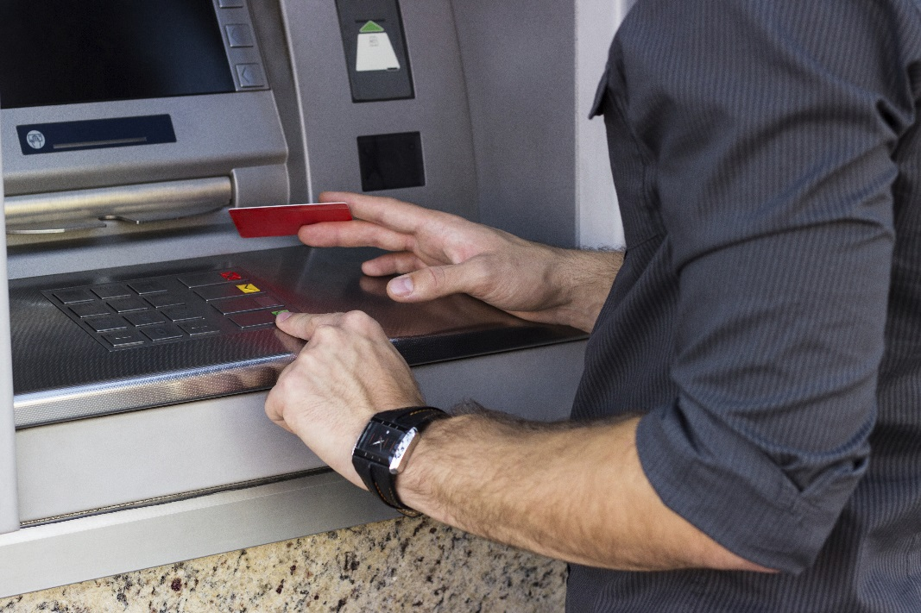
Physical Security
Automated Teller Machines
Stay alert
Don’t go into vestibules
Plan ahead

Slide 14

Physical Security
Walking
• Oncoming traffic
• Wide curves for corners
• Ask friends to wait for you

Slide 15

Physical Security
Elevators
Stand back while waiting
Don’t get on if you feel uncomfortable
Stand near control panel

Slide 16
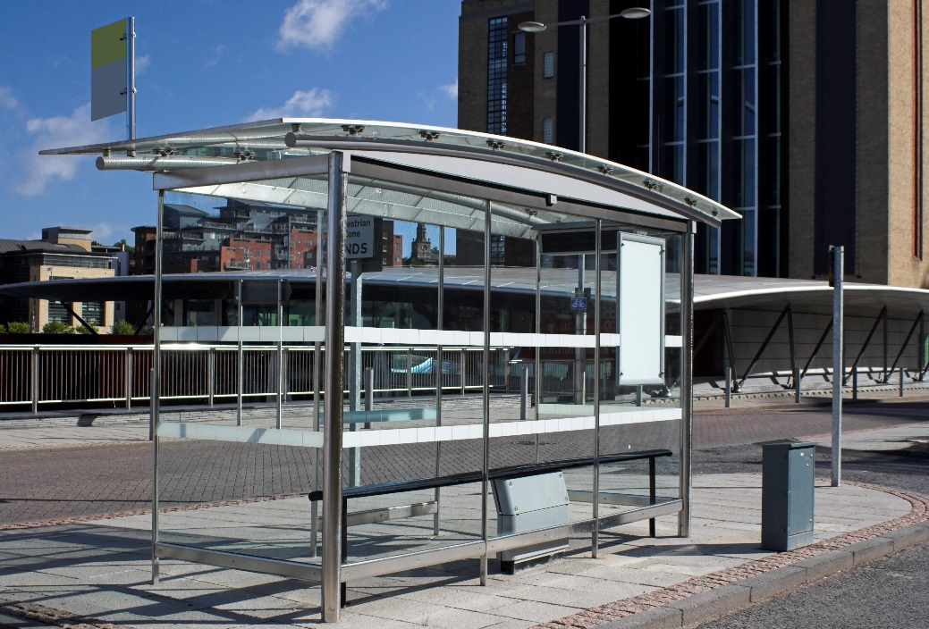
Physical Security
Buses & Subways
• Wait in well-lit areas
• Watch your belongings

Slide 17

Physical Security
Briefcases, Purses & Wallets
• Carry only necessary items
• Fanny pack or money belt
• Mugger money or chump change
• Decoy wallet
• Dump it!

Slide 18
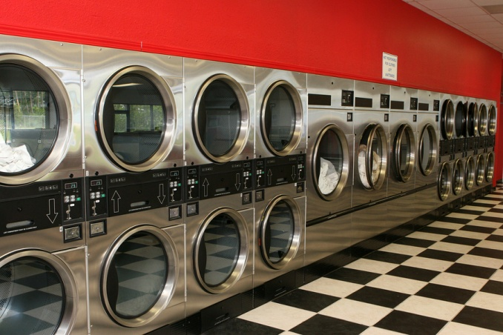
Physical Security
Public Safety
Laundry rooms/laundromats
Don’t go alone
Don’t go early/late
Always bring cell phone
Public restrooms

Slide 19

Physical Security
Personal Alarms
• Pros
- Battery powered
- Loud noise
- Activated by button or pin
• Cons
Must be in close contact
May not draw attention

Slide 20

Personal Security
Self-Defense Physical Training
• Locate
• Investigate
• Commit

Slide 21


Slide 22

Home Security
• Is your home a safe place?
• FACTS: - Majority of sexual assaults take place in victims’ homes
- According to a U.S. Department of Justice study, if you are home when a criminal gains entry, there is a one in three chance of becoming a victim of violence.

Slide 23



Home Security
Doors
• Garage doors
• Front, side, rear entry doors
• Door frames
• Sliding glass doors
• Pet doors
• Door viewers

Slide 24

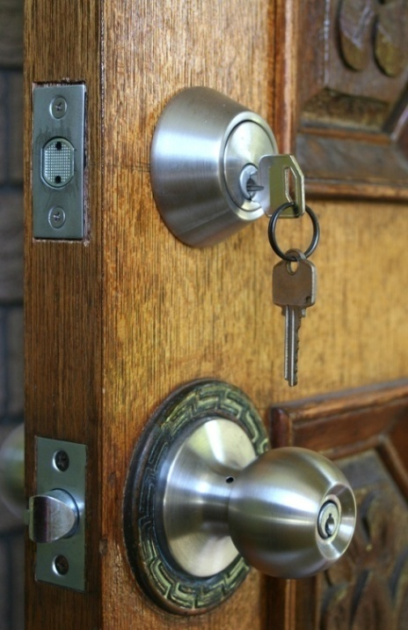
Home Security
Locks
• Types of locks: - Chain locks vs. “bar” type locks
- Single-cylinder deadbolt locks
- Double-cylinder deadbolt locks
- Keyless locks
• Re-key new house/apartment
• Key storage

Slide 25


Home Security
Windows
• Types of windows: - Double sash - Casement
• Window coverings: - Examine your home from outside
• Window locks: - Install good quality, metal locks

Slide 26

Home Security
Lighting
• Interior lighting: - Create the illusion of being home - Types of timers: • Photoelectric cells • Motion sensors • Night lights
• Exterior lighting: - 360° lighting - Pathway lighting

Slide 27
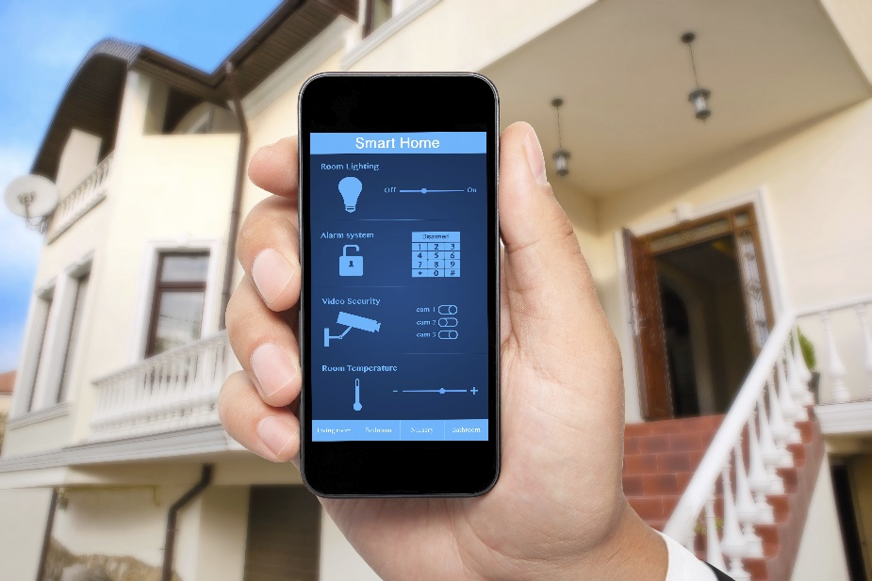
Home Security
Alarms
• Alarms: - Silent - Perimeter - Motion detection - Alarm signs
• Alarm monitoring: - Evaluate companies - Reset codes periodically

Slide 28
Home Security
Security Cameras
Simple vs. complex system?
Maintenance
Fake camera

Slide 29

Home Security
Dogs
• Alternative to alarm system
• Positives: - Acute hearing and smell
• Negatives: - Care and training - Liability and insurance
• What size is best?
• Fool the criminal techniques

Slide 30

Home Security
Keys
• Separate your keys
• Two-piece key rings
• What to do with spare keys: - Don’t hide in car - Don’t label
• Children and keys

Slide 31

Home Security
Defense Plan & Safe Room
• Determine the best location
• Safe room necessities: - Cell phone - Flashlight/extra batteries - Home/car keys - Protective devices - Ladder
• Discuss plan with all occupants and practice!

Slide 32
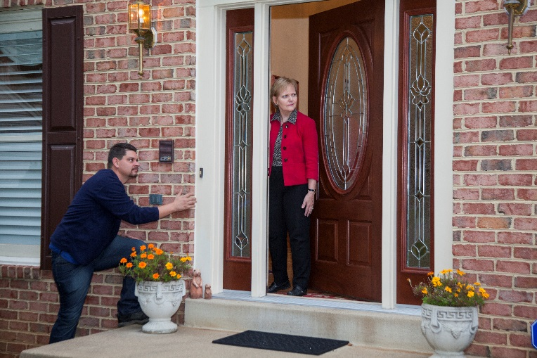
Home Security
Visitors
• Wide angle door viewers
• Confirm identification
• Packages
• Never tell visitors you are alone
• Offer to make call while visitor waits outside
• Don’t broadcast your plans in public

Slide 33

Home Security
Mailbox Services
• Personal mailbox service
• Post office box

Slide 34


Slide 35
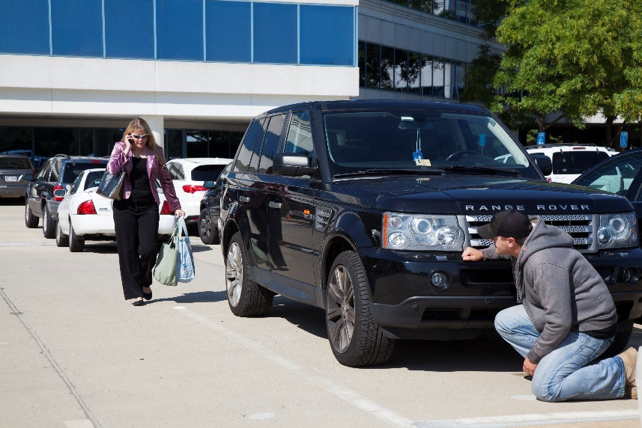
Automobile Security
Approaching, Entering & Exiting Your Car
• Be alert!
• Park in well-lit areas
• Keep one hand free
• Keys in hand
• Look inside
• Lock your doors first
• Passenger side window

Slide 36

Automobile Security
Dealing with Breakdowns
• Keep gas tank half full
• Map/navigation system
• Cell phone

Slide 37
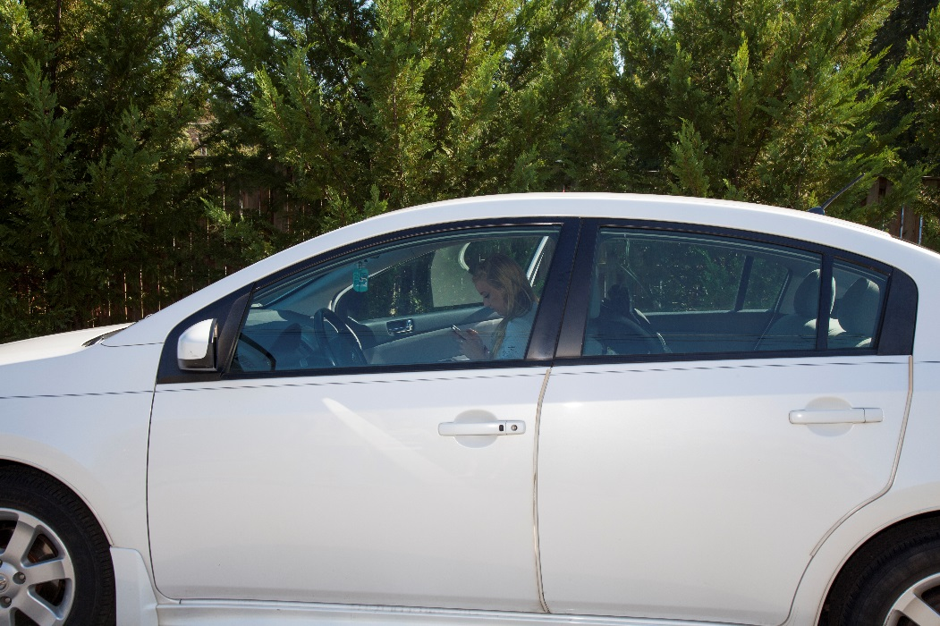
Automobile Security
Getting Help
• Doors locked
• Windows rolled up
• Tell someone where you are

Slide 38
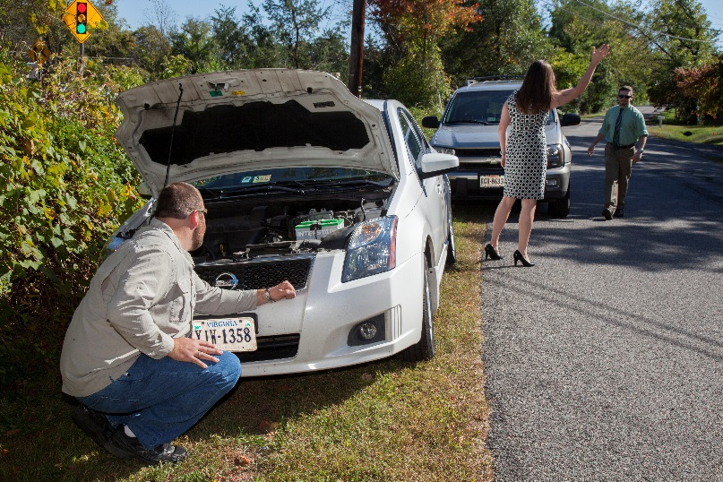
Automobile Security
Breakdown Ploys
• Something is wrong with your car
• Someone needs help
• Stealing gas: - Use a locking gas cap or lockable hinges gas tank cover
•Staged accident

Slide 39
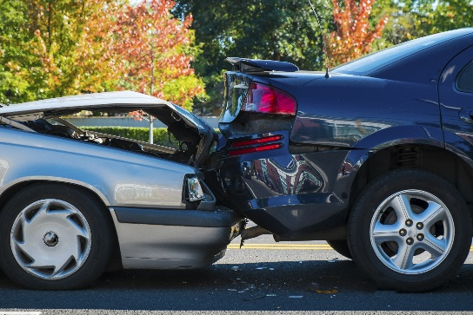

Automobile Security
Accidents & Police Cars
• Stay in your car
• Partially lower your window
• Request another officer

Slide 40

Automobile Security
Hitchhikers & Road Rage
• Hitchhikers: - Never pick up!
- Casual acquaintances
• Road rage: - Give the right of way
- Don't react

Slide 41

Automobile Security
Vehicle Theft Prevention Devices
• Steering wheel locks
• Car alarms
• Kill switches
• Vehicle tracking devices

Slide 42
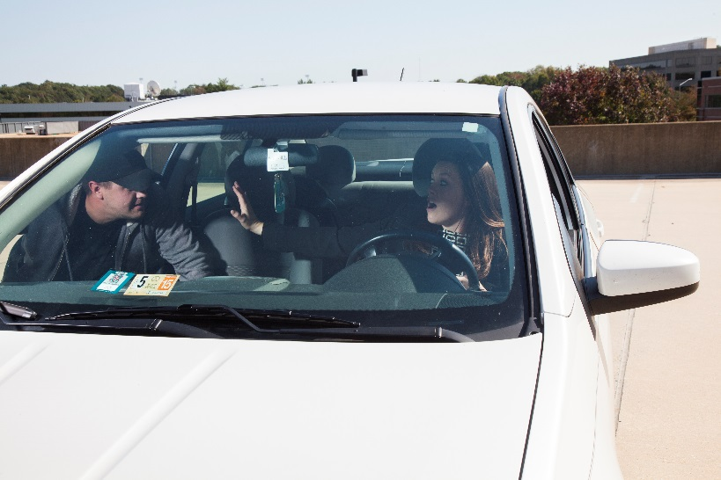
Automobile Security
Carjacking
• Self-service gas pumps
• Stop lights - Drive away

Slide 43


Slide 44

Travel Security
Airport Security
• Luggage tags
• Packing your luggage
• Ticket counters & security checkpoints
• Checking luggage
• Waiting areas

Slide 45

Travel Security
Car Rentals
Don’t look like a tourist
Have directions ahead of time
Don’t leave travel documents in car when returning it

Slide 46

Travel Security
Taxis, Private Hire Vehicles, and
Public Transportation
Check for displayed credentials
Take picture of license plate
Don’t sacrifice safety for convenience
Public transportation
Avoid isolated stops
Sit near driver

Slide 47
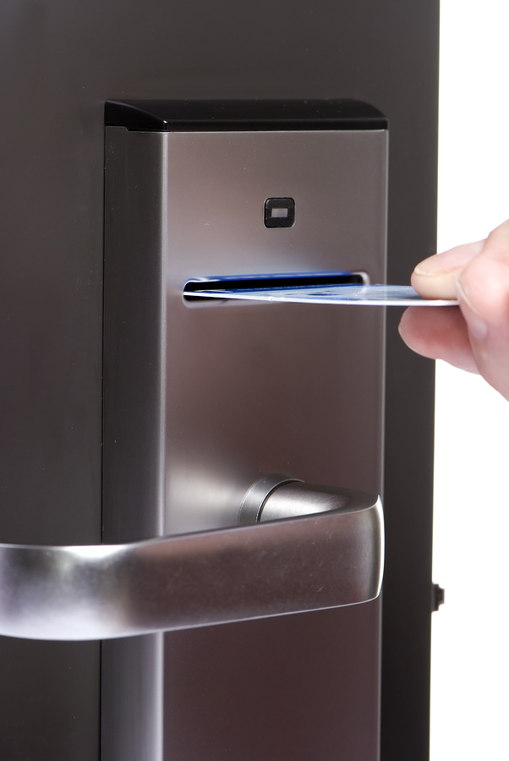

Travel Security
Accommodations
• Security
- Locks
- Door Viewers
- Keys
• Not above the tenth floor
• Safe area
• Security staff
• Room entry ploys

Slide 48

Travel Security
Traveling to a Foreign Country
• Don’t take excessive cash
• Take a translation dictionary and map
• Do your research:
- Culture
- Laws
- Crime statistics
- Emergency numbers
- Phone system

Slide 49

Travel Security
Don't Forget Back Home
• Mail pick up
• Periodic inspection
• Remove circulars
• Parked car

Slide 50


Slide 51

Technological Security
Telephone Security – Phone Scams
Phone scams
Free product
You won!
Outstanding ticket/warrant
Needs money wired
Don’t give out payment info
Call back using number found on official website/in phone book

Slide 52

Technological Security
Telephone Security - Telemarketers
• Telemarketers: - www.donotcall.gov
• Assistance services:
- Direct Marketing Association
• www.the-dma.org
- Federal Trade Commission Consumer Information
• P.O. Box 45600 District of Columbia 20026
• www.consumer.ftc.gov
• 877-987-3728

Slide 53
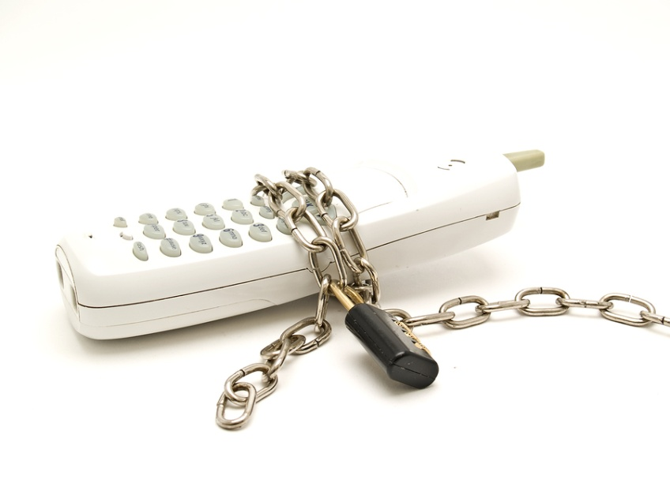
Technological Security
Telephone Security
Abusive Phone Calls
Optional Phone Services
Caller ID
Anonymous Call Rejection
Call Block
Call Trace
Using 911

Slide 54
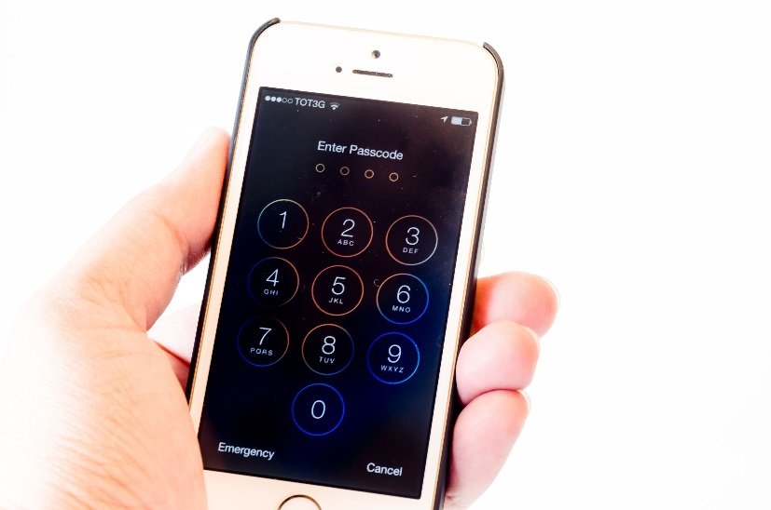
Technological Security
Telephone Security – Cell Phones
Any charged cell phone can call 911
Keep phone charged
Know coverage limits
Conversations may not be private
Keep locked
Deactivate GPS when taking pictures

Slide 55
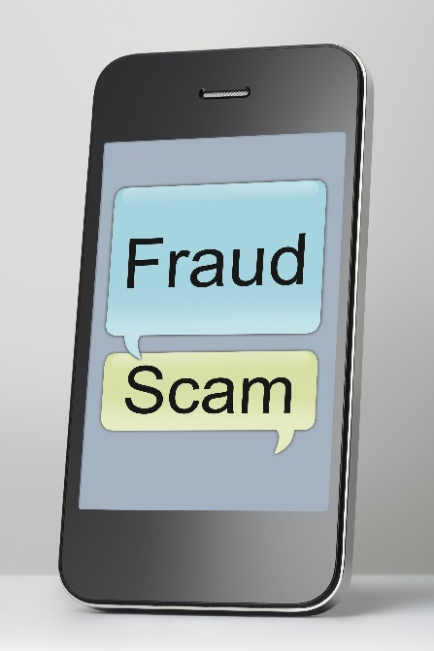
Technological Security
Telephone Security – Text Scams
Similar to email scams
Don’t click on links from people you don’t know
Don’t give out payment info
Don’t respond to numbers you aren’t familiar with

Slide 56
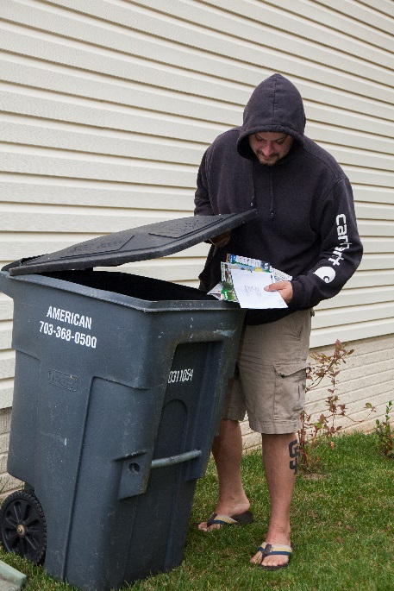
Technological Security
Identity Theft
• Mail
• Receipts
• Check identification
• Debit/Check card
• PIN Number/Password
• Shredder

Slide 57

Technological Security
Internet Cyber Fraud/Electronic Theft
• Use virtual credit card
• Use strong passwords
• Update security software
• Clear browser
• Use secure sites

Slide 58

Technological Security
Internet Cyber Fraud/Electronic Theft
• Attachments and hyperlinks
• Antivirus software
• Secure connection indicator
• Uniform Resource Locator (URL)

Slide 59
Technological Security
Social Media
Don’t connect with people you don’t know
Don’t post pictures in real time
Disable GPS
Don’t click on links
Adjust security settings
Discuss safety with children!!

Slide 60


Technological Security
Internet Cyber Fraud/Electronic Theft
• Resources:
- Federal Trade Commission
• www.ftc.gov
- Federal Bureau of Investigation
• www.fbi.gov
- Consumer Action Handbook
• www.publications.usa.gov

Slide 61

Technological Security
Cyberstalking/Cyberbullying
Types of Harassment:
- Postings on social media
- Email
- Instant messaging
- Text messaging
- Blogs
- Cell phone calls/texts

Slide 62

PERSONAL PROTECTION DEVICES

Slide 63
Personal Protection Devices
The devices we are about to discuss are not legal everywhere. Be sure you know the laws of your local jurisdiction. Always follow these laws and do not attempt to get a personal protection device that is illegal in your jurisdiction.

Slide 64
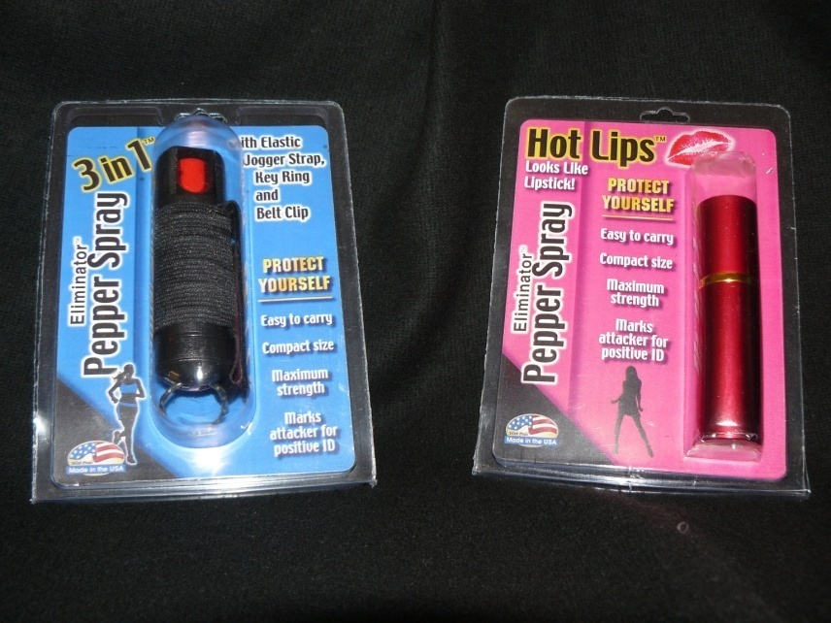
Personal Protection Devices
Pepper Sprays & Foams
• Various forms: - Sprays, foams & streams
• Instant effect:
- More effective than mace
• Strengths vary
• Affects breathing and sight for 20-40 minutes

Slide 65

Personal Security
Pepper Sprays & Foams
• Safety and expiration date
• Familiarity course and practice
• Laws
• Liability

Slide 66

Personal Security
Batons
• Batons:
- Sizes
- Training
- Practice

Slide 67

Personal Security
Tasers/Stun Guns
• Taser:
Shoots up to 15 feet
Doesn’t work on thick clothing
Stun Gun:
Requires close contact
Doesn’t work on thick clothing

Slide 68

Personal Security
Other Devices
• Whistles
• Keys
• What else could you use?
Firearms:
Seek certified instruction
1-800-NRA-3888
Know the firearm laws for your state
Seek legal advice

Slide 69
Closing Remarks
• Safety is not always convenient
• Practice good safety habits
• Stay alert and aware of your surroundings
• Alertness-Awareness-Avoidance-Action
• You can REFUSE TO BE A VICTIM®

Slide 70
Thank you for coming!
Please fill out an evaluation so we know how you liked the seminar.
Questions or concerns? Contact the Refuse To Be A Victim Program at 800-861-1166 or refuse@nrahq.org

Slide 71


Slide 72

In the Workplace
Basic Measures & Working Alone
• Building security
• Emergency evacuation procedures
• Emergency exits
• Valuables
• Before and after business hours
• Security

Slide 73

In the Workplace
Interacting With Co-workers
• Report harassment
• Personal information
• Over 1 million assaults and threats annually
• Strangers

Slide 74

In the Workplace
Workplace Violence
• Possible warning signs:
- Threats
- Irrational behavior
- Displays of unwarranted anger
- Inability to take criticism
- Lack of concern for the
safety of others

Slide 75

In the Workplace
Miscellaneous
• Stalking or harassment, on or off the job
• Doors and lights

Slide 76


Slide 77

Parents & Children
Pre-School Through Elementary School
Discuss safety often
Approach a family if lost
Lock doors when home
Don’t tell others your schedule
Safety in numbers

Slide 78

Parents & Children
Pre-School Through Elementary School
Don’t leave children unattended in public
Don’t put names on clothes, belongings
Discuss internet safety and use parental controls
Listen to your children!
Know what’s going on at school

Slide 79

Parents & Children
Middle School Through High School
• Personal possessions
• Gangs
• Drugs and alcohol
• Social gatherings
• Transportation
• Listen
• Social media

Slide 80


Parents & Children
College Students
Be observant!
Don’t fall prey to crimes of opportunity
Don’t leave dorm room unlocked
Don’t leave valuables in sight
Don’t leave backpack/purse unattended
Don’t broadcast schedule

Slide 81

Parents & Children
College Students
Safety in numbers
Don’t do laundry early in the morning/late at night
Always tell someone where you are going

Slide 82

Parents & Children
College Students
Don’t trust someone just because they’re an acquaintance
Know where call boxes are
Report all crimes
Know your limits

Slide 83


Slide 84

Seniors & Physical Disabilities
Background & Scope
Often considered easy targets
Often isolated, hesitant to report crimes
May be victimized by family or caregivers

Slide 85
Seniors & Physical Disabilities
Personal Protection Devices
• Electronic devices:
- Small
- Summon help - Name and address not required
- Investigate the company
• Items on hand:
- Cane
- Crutches - Wheelchair
- Whistle
- Broom

Slide 86
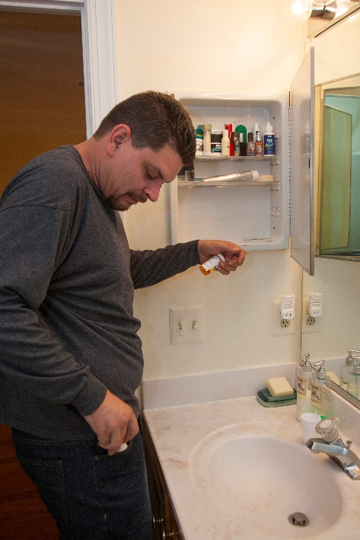
Seniors & Physical Disabilities
Inside Your Home
Keep valuables locked up
Install wide angle door viewer
Keep meds locked up, shred medical info
Make home accessible to avoid accidents
Lock doors/windows not frequently used

Slide 87

Seniors & Physical Disabilities
Outside Your Home
Safety in numbers
Stay alert
Apply for parking permit
Don’t accept help from strangers

Slide 88
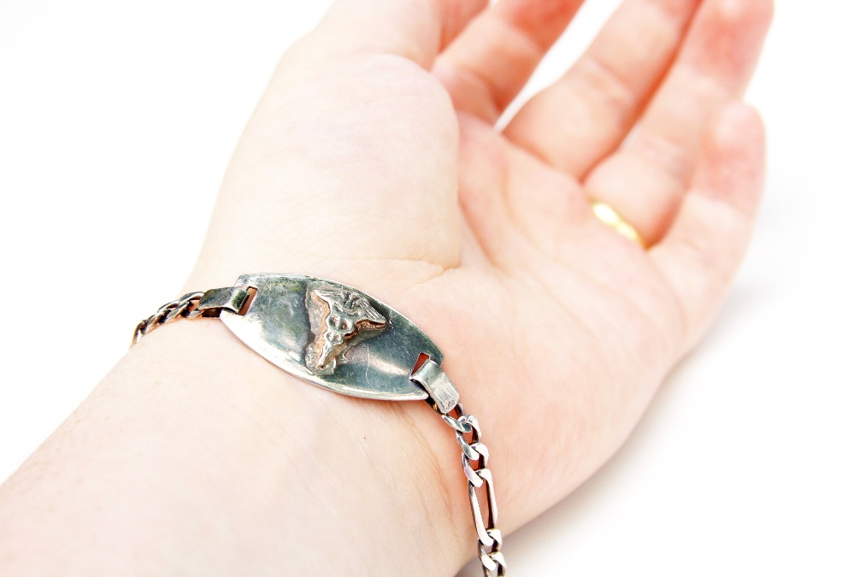
Seniors & Physical Disabilities
Travel Tips
Travel with a companion
Bring extra medication
Bring valuables/meds in carry on luggage
Inquire about special accommodations on plane, in hotel, etc.

Slide 89
Seniors & Physical Disabilities
Abuse
• Domestic elder abuse:
- Known to victim
• Institutional elder abuse: - Residential facilities
• Self-inflicted abuse
• Choose carefully
• Investigate
• Interview
• Talk to staff and residents
• Report

Slide 90

Seniors & Physical Disabilities
Scams, Direct Deposit & Wills
Scams
Sweepstakes
Pretending to be a family member in trouble
Pay only for shipping
Never give payment info over the phone
Use direct deposit
Be careful of people asking about wills

Slide 91

Seniors & Physical Disabilities
Government Agencies/Services
• Police department:
- Daily calling service
• Department of Aging:
- Transportation and escorts
• Health departments
• Medical appointments

Slide 92
Domestic Violence and Stalking
• National Domestic Violence Hotline
www.ndvh.com; 800-799-SAFE
National Organization for Victim Assistance
www.trynova.org; 800-TRY-NOVA
The Stalking Sanctuary
www.stalkingvictims.com
Office for Victims of Crime
www.ojp.gov/ocv
National Center for Victims of Crime
www.ncvc.org; 800-FYI-CALL

Slide 93
Header
• Body Copy Header
- First bullet point

Slide 94
Header
Sub Header
• Body Copy Header
- First bullet point

Slide 95


Slide 96

INSTRUCTOR DEVELOPMENT WORKSHOP
PHASE 2
INSTRUCTOR TRAINING

Slide 97
INSTRUCTOR TRAINING
DESIGNED TO PREPARE AND TRAIN QUALIFIED INSTRUCTORS TO TEACH REFUSE TO BE A VICTIM® SEMINARS

Slide 98
INSTRUCTOR TRAINING
ORIGIN OF REGIONAL COUNSELORS
RC program started in 1997
RCs are recruited from ranks of basic instructors
RCs are not assigned specific regions or states
RTBAV strives to maintain adequate number of RCs to conduct IDWs

Slide 99
INSTRUCTOR TRAINING ROLE OF THE REGIONAL COUNSELOR
Conduct IDWs
Train qualified RTBAV basic instructors
Mentor RTBAV basic instructors
Provide program recommendations to NRA

Slide 100
INSTRUCTOR TRAINING
REQUIRED IDW MATERIALS
RTBAV Seminar Student Packet
IDW Kit

Slide 101
INSTRUCTOR TRAINING
SEMINAR STUDENT PACKET
RTBAV Student Handbook
RTBAV Firearm Supplement
RTBAV Brochure
RTBAV Instructor Brochure
RTBAV Participation Certificate

Slide 102
INSTRUCTOR TRAINING
IDW KIT
RTBAV Instructor’s Manual
RTBAV Instructor Promotion Kit
RTBAV Promotional DVD
RTBAV Directional Signs
RTBAV Lapel Pin

Slide 103
INSTRUCTOR TRAINING
PURPOSE OF PRESENTATION ASSIGNMENTS
Chance to speak in front of a group
Reinforces seminar information
Receive feedback from others
Presentations are not pass/fail projects

Slide 104
INSTRUCTOR TRAINING
ASSIGN PRESENTATION TOPICS
Time allowed
Visual aids encouraged
Supporting facts encouraged
Creativity encouraged

Slide 105
INSTRUCTOR TRAINING PLANNING AND CONDUCTING YOUR SEMINAR
Identify team instructors
Apply for grant funding
Establish seminar details
Register with NRA
Advertise and promote
Order student packets
Compile instructor display kit
Prepare seminar room
Conduct seminar
Close seminar with NRA

Slide 106

INSTRUCTOR TRAINING
IDENTIFY TEAM INSTRUCTORS
Less strenuous
Provides audience with personality variety and diversification
May require additional rehearsal time
Recommended but not required

Slide 107
INSTRUCTOR TRAINING
APPLY FOR GRANT FUNDING
State Friends of NRA
Apply every year
Instructors have received over ½ million in funding
Obtain application by calling (877) 487-3006 or visit www. nrafoundation.org/grants/statefund.asp
Submit applications to your state NRA Field Representative

Slide 108
INSTRUCTOR TRAINING
ESTABLISH SEMINAR DETAILS – PLAN EARLY!
Date/time/location
Maximum number of attendees
Contact information
Type of seminar (public or private)
Seminar fee

Slide 109
INSTRUCTOR TRAINING
A WORD ABOUT SEMINAR FEES…
Seminar fees are determined by the instructor
Seminar fees should cover all expenses
Seminars should always be (at minimum) break-even events

Slide 110
INSTRUCTOR TRAINING
REGISTER YOUR SEMINAR WITH NRA
All seminars must be registered with NRA
Register early via the NRA website, fax or mail
If seminar is cancelled, notify NRA immediately

Slide 111
INSTRUCTOR TRAINING
ADVERTISE AND PROMOTE YOUR SEMINAR
Advertising and promotion are the key elements to a successful seminar (If no one knows about the seminar, no one will come)
Utilize the Instructor Promotion Kit
Utilize fraternal items
Be creative
How would YOU promote a seminar?

Slide 112
INSTRUCTOR TRAINING
ORDER SEMINAR STUDENT PACKETS
Can only be ordered by certified instructors
Every seminar attendee must receive a Student Packet
Order from the NRA Program Materials Center
Allow 3-4 weeks for delivery
Save packing slip (needed for returns & discrepancies)
Verify orders upon receipt

Slide 113
INSTRUCTOR TRAINING COMPILE INSTRUCTOR DISPLAY KIT
RTBAV Directional signs
Wide-angle door viewer
Defensive spray (inert)
Appliance timer
Photoelectric cell
Personal alarm

Slide 114
INSTRUCTOR TRAINING CONSIDER OPTIONAL DISPLAY KIT ITEMS
Detachable key ring
Kubaton® key chain
Double deadbolt locks
Door Club™
Stun Gun
Hide away key devices
Large dog dish & bone
Signage
Caller ID display unit
Cell phone
Flashlight
Bag/purse/briefcase

Slide 115

INSTRUCTOR TRAINING CAUTIONS…
Never display illegal units – use photographs
Never demonstrate alarms without warning participants
Never pass around or display “live” units

Slide 116
INSTRUCTOR TRAINING PREPARE SEMINAR ROOM
Use Seminar Room Preparation Checklist
Display Seminar/IDW Sign-In Sheet
Display Photographic Model Release (optional)

Slide 117
INSTRUCTOR TRAINING CONDUCT THE SEMINAR
Follow Instructor’s Manual
Provide information table(s)
Policy on guest speakers
Take pictures and videos
Distribute seminar Student Packets (required)
Have participants complete seminar evaluation form

Slide 118
INSTRUCTOR TRAINING THE VALUE OF EVALUATIONS…
Gives participants an opportunity for input
Provides instructors with feedback on their presentation skills (strengths/weaknesses)
Provides NRA with feedback for next generation program materials

Slide 119
INSTRUCTOR TRAINING CLOSE THE SEMINAR WITH NRA
Closing documents must be submitted to NRA within 3 days of seminar completion
• Instructor’s Seminar Attendance Report
• Photographic Model Release (optional)
• Seminar/IDW Sign-In Sheet
• Seminar Participant Evaluations

Slide 120
INSTRUCTOR TRAINING OFFICIAL DOCUMENTS
• Certified Instructor Guidelines
• Instructor Application
• Certified Instructor Agreement

Slide 121
INSTRUCTOR TRAINING CERTIFIED INSTRUCTOR GUIDELINES
Introduction
Program Goals & Philosophy
Instructor Certification
Seminar Specifics
Instructor Responsibilities
Use of NRA Names & Trademarks

Slide 122
INSTRUCTOR TRAINING INSTRUCTOR APPLICATION
Contains instructor’s contact information
Contains instructor’s experience history
Contains the information instructor’s want NRA to use for referrals

Slide 123
INSTRUCTOR TRAINING HOMEWORK ASSIGNMENTS
Complete Instructor Application
Complete Instructor Agreement
Prepare for oral presentation
Bring Application to next session

Slide 124
INSTRUCTOR TRAINING
ORAL PRESENTATIONS

Slide 125
INSTRUCTOR TRAINING INSTRUCTOR CANDIDATE QUIZ
Is not a pass/fail test
Is a learning/reinforcement exercise

Slide 126
INSTRUCTOR TRAINING IDW EVALUATION
Provides the instructor candidate with an opportunity for input
Provides the RC and the NRA with an indication of how the IDW was received
Provides the NRA with recommendations that may influence program changes and enhancements

Slide 127
INSTRUCTOR TRAINING HAND IN…
Seminar Participant Evaluation Form
Instructor Application
Instructor Candidate Quiz
Instructor Fee
IDW Participant Evaluation

Slide 128
INSTRUCTOR TRAINING CONCLUSION OF IDW
Do you have your RC’s contact information?
Thank you for your dedication and interest in the Refuse To Be A Victim® Program. We hope you are excited about planning and conducting your first seminar!

