Slide 1
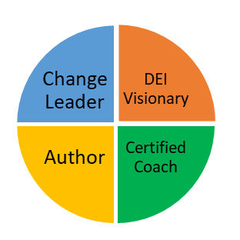
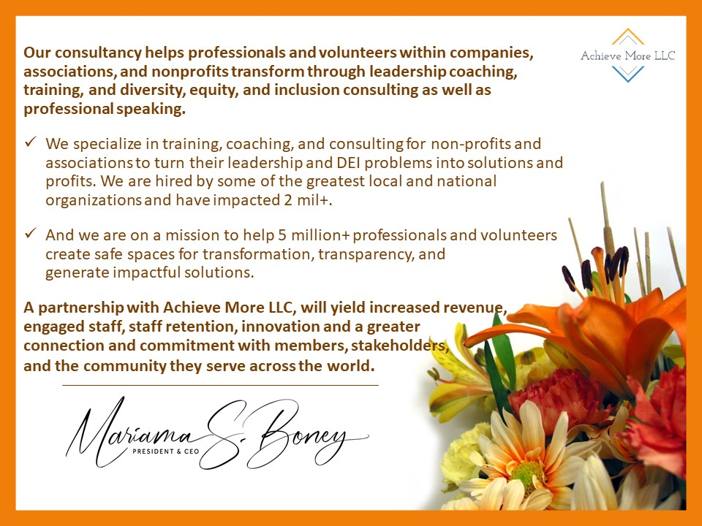
Operational
Personal
Strategic
You

Slide 3
Transform DEI
Through Leadership
Learning
Outcomes
Post-Learning Resources
Core Concepts
Interactive groups and dialogue
Pre-work
Scenarios
Reflection Questions

