Slide 1
CLEAN POWER SOLUTIONS, LLC
CLEAN POWER SOLUTIONS, LLC
Sparkling Waters Ct.
South Lyon, MI 48178
E: frank.cleanpower@gmail.com
C: 616-633-1805
WWW.CLEANPOWERSOLUTIONSGROUP.COM
50 Years In The Electrical Industry
WWW..CLEANPOWERSOLUTIONSGROUP.COM

Slide 2
WHAT ARE THE PROBLEMS & THE SOLUTIONS: (Automatic Voltage Equalizer System) PATENTED….AVE
CLEAN POWER SOLUTIONS, LLC
ARC FLASH…..................WHAT IS IT ?
WWW..CLEANPOWERSOLUTIONSGROUP.COM

Slide 3
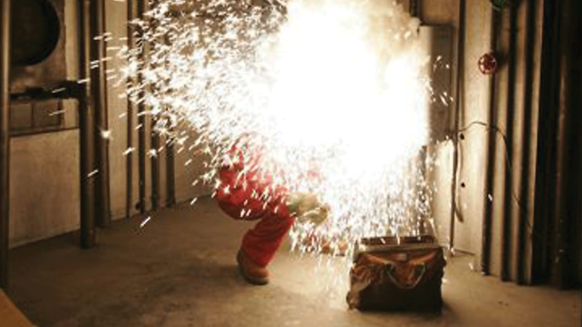
CLEAN POWER SOLUTIONS, LLC
WWW.PHASEBACK.COM

Slide 4
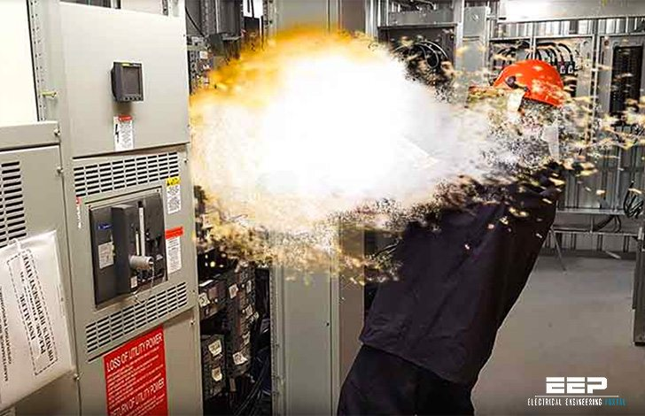
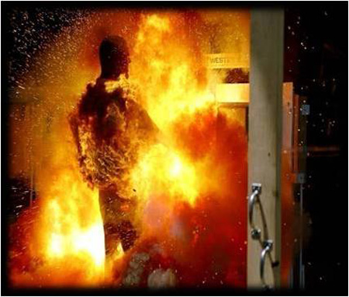
CLEAN POWER SOLUTIONS, LLC
WWW.PHASEBACK.COM

Slide 5
STATISTICS:
DEPT. LABOR 7 YEAR STUDY:
EVERY YEAR: 400 DEATHS
4,686 WORK LOSS INJURYS
7,000 BURN INJURYS
2,000 HOSPITALIZATIONS
30,000 EVENTS EVERY YEAR
HOW MANY ARE UNREPORTED?
HOW MANY ARE IN MICHIGAN?
ROGER REASON ITE SIEMENS

Slide 6
Transient overvoltage causes a phase angle shift so they are not longer 120 degrees apart. It only takes 6 degrees off to cause drives and motors to fail. When the problem increases, other more catastrophic problems can occur. These problems can be eliminated by stabilizing the voltage potential between phase and ground. Without the AVE, transient overvoltage causes insultation breakdown and premature failures. AVE makes an instantaneous correction to all phase voltages out of balance. The AVE keeps the voltage differential to a minimum of 5% making an ARC FLASH IMPOSSIBLE
CLEAN POWER SOLUTIONS, LLC
ARC FLASH ….............. WHAT IS IT ?
WWW..CLEANPOWERSOLUTIONSGROUP.COM

Slide 7
CLEAN POWER SOLUTIONS, LLC
The Problems
A Decaying, Unreliable National Grid
Proliferation Of High Frequency Electronics Installed In Past 35 Years
Primarily Internally Generated Transient Voltages 90%
Poor Grounding Methods
4,000 People Have Died In Last 10 Years: Department of Labor Study.
Potential Arc Flash Temperature Can Reach 35,000 Degrees in 1/1000 Of A Second
Consulting Engineers Need To Take Lead With Arc Flash Specifications
WWW. CLEANPOWERSOLUTIONSGROUP.COM

Slide 8
CLEAN POWER SOLUTIONS, LLC
2020 National Electric Code & AVE
Arc Flash Prevention Will Be Addressed……….Required ?
Patented EM Energy AVE Is The Only Product Tested and Approved
Detailed Testing at PNDC Laboratory Strathclyde University In Scotland
Arch Flash Article In March Issue of EC&M
Industry Providing Safety Training Instead of Solving The Problem
WWW. CLEANPOWERSOLUTIONSGROUP.COM

Slide 9
CLEAN POWER SOLUTIONS, LLC
AVE: The Solution With Benefits:
Prevents Voltage Surges Up To 230,000 Volts
Prevents Arc Flash Events 100% of The Time !!!
Improves Power Factor Which Increases Available Power
Reduces Harmonics By A Minimum Of 85% At Same Time
Reduces End User Energy Consumption
Prevents Phase Loss
WWW. CLEANPOWERSOLUTIONSGROUP.COM

Slide 10
CLEAN POWER SOLUTIONS, LLC
AVE: Additional Benefits
Reduces Nuisance Tripping Of Critical Equipment
Improves Operational Efficiencies & Saves End User Money
Prevents All External And Internal Voltage Spikes
Eliminates Costs/Need For All Downstream TVSS Products
Eliminates Ground Noise
ROI In Months, Not Years
Eliminates Downstream
WWW.CLEANPOWERSOLUTIONSGROUP.COM

Slide 11
CLEAN POWER SOLUTIONS, LLC
AVE: More Benefits
Prevents Voltage Sags
Prevents Phase Voltage Imbalances
Prevents Ground Faults
Restores Phase Angle Differentials
Extends Capacitors, Motors, Drives & Control Systems Life
Electromagnetic Solution, No Electronics to Fail
Eliminates Downstream
WWW.CLEANPOWERSOLUTIONSGROUP.COM

Slide 12
CLEAN POWER SOLUTIONS, LLC
AVE: How Our Patented Technology Works
Voltage Spikes Cause Phase Angle To Shift From Intended 120◦
A 6◦ Change Can Cause Wire Insulation Breakdowns, Failures, Ground Faults
3 Single Phase Bi Directional Transformers In Series With SS Grid Resister
Wire Wound Resistor In Circuit Causes Lowering Of Capacitive Energy Potential
Energy From Higher Voltage Phase Is Redirected To Phase With Lowest Voltage
Utilizes Electromagnetic Interaction Of Mutual Induction To Control Voltages
WWW. CLEANPOWERSOLUTIONSGROUP.COM

Slide 13
CLEAN POWER SOLUTIONS, LLC
AVE: How Is It Installed ?
Install As Close To The Main Distribution Panel As Possible
Install At Xfmr & Main Panel Anytime Ground Reference Changes
Connect The Prewired Harness To A 30 Amp Breaker
The Straighter And Shorter The Wire Connection The Better
Selection Of Unit Is Based On KVA & Voltage Of The Main Transformer
Only One AVE Unit Is Required Per Ground Referenc
WWW. CLEANPOWERSOLUTIONSGROUP.COM

Slide 14
CLEAN POWER SOLUTIONS, LLC
AVE: The Operational Savings
We Can Calculate End User Annual Projected Savings
Based On Customers Utility KW & Demand Rates And Operational Hours
ROI Determined By Our Software Program
Developed The Algorithm Program & Validated With Square D.
Average ROI Is In Months, Not Years.
WWW. CLEANPOWERSOLUTIONSGROUP.COM

Slide 15
CLEAN POWER SOLUTIONS, LLC
Estimated 3000 KVA Savings Calculation
Horsepower
1,678
Cost Per Kilowatt Hour
$0.114
Kilowatts
1,250
Hours Per Year
4,500
Kilowatts/ Horsepower
0.746
Energy Savings Per Year
$21,602
Load
0.8
Demand Savings Per Year
$7,201
Effective Improvement
0.042049
Total Savings Per Year
$28,803
WWW. CLEANPOWERSOLUTIONSGROUP.COM

Slide 16
CLEAN POWER SOLUTIONS, LLC
Important Notes:
If Power Factor Improvement is important:
Voltage Fluctuations Will Cause Capacitors To Fail
Motor Loads Are What Affects The Power Factor The Most
AVE Will Extend The Life of Capacitors and Motors
AVE APF Unit Properly Sized And Installed Can Help Obtain PF Unity
LED Lighting Systems Need Voltage Stabilization To Survive
WWW. CLEANPOWERSOLUTIONSGROUP.COM

Slide 17
CLEAN POWER SOLUTIONS, LLC
250KVA TO 6,000 KVA UNITS
5Kv and 15kv units available
$$$$$$
$ 12 ,500 Plus Average Cost Of 600v Units
Average Weight is 250 lbs.
WWW. CLEANPOWERSOLUTIONSGROUP.COM

Slide 18
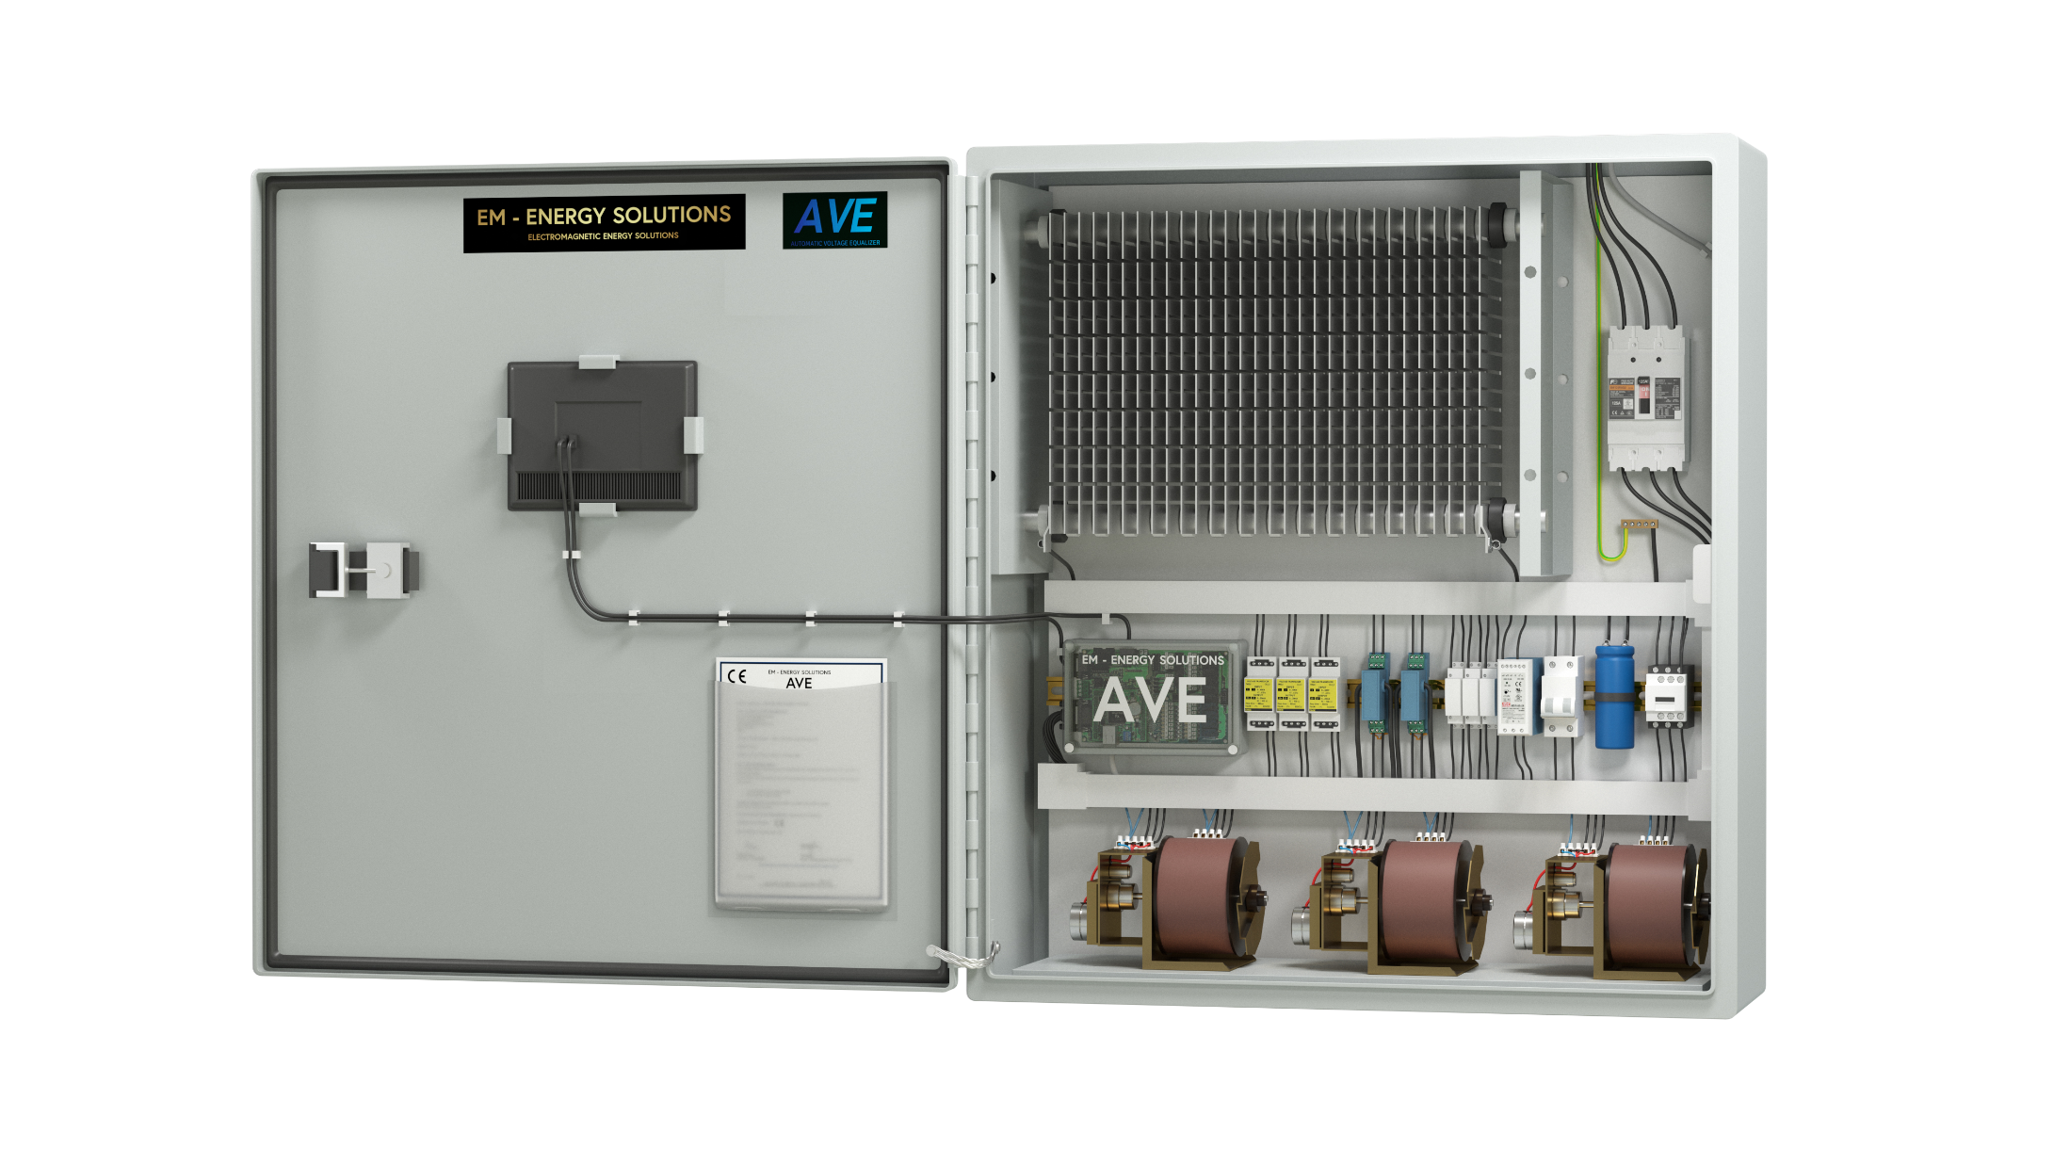
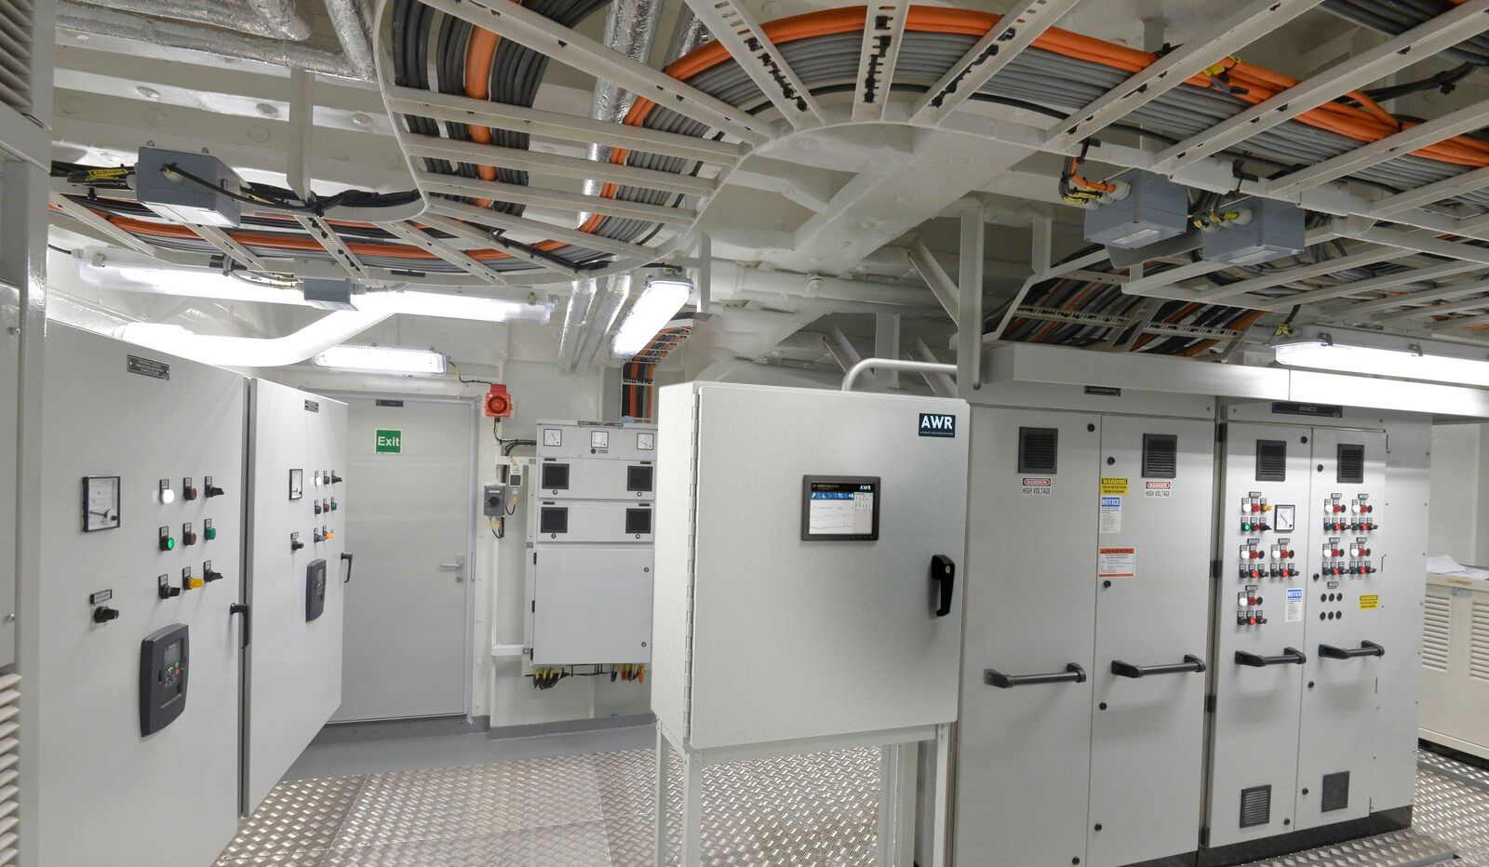
Product Design: Installation:
CONNECT TO ANY 30 AMP CIRCUIT BREAKER IN MDP

Slide 19
CLEAN POWER SOLUTIONS, LLC
THIS ???
WWW.PHASEBACK.COM

Slide 20
CLEAN POWER SOLUTIONS, LLC
AND THIS ???
WWW.PHASEBACK.COM

Slide 21
CLEAN POWER SOLUTIONS, LLC
OR THIS ?
WWW. CLEANPOWERSOLUTIONSGROUP.COM

Slide 22
CLEAN POWER SOLUTIONS, LLC
CLEAN POWER SOLUTIONS RESOURCES:
AVE BROCHURE
AVE PROJECT SPECIFICATION
AVE INSTALLATION MANUALS
AVE LAB TEST REPORT
AVE CAPABILITIES SUMMARY
AVE ROI CALCULATOR PROGRAM
AVE PROJECT BUDGETS
WWW. CLEANPOWERSOLUTIONSGROUPCOM

Slide 23
CLEAN POWER SOLUTIONS, LLC
CLEAN POWER SOLUTIONS, LLC
Sparkling Waters Ct.
South Lyon, MI 48178
E: frank.cleanpower@gmail.com
C: 616-633-1805
WWW.CLEANPOWERSOLUTIONSGROUP.COM
WWW.CLEANPOWERSOLUTIONSGROUP.COM

