Slide 1
Carl Weeks, MRC, Neurotherapist
NON-MEDICINAL OPTIONS
EVOLVE NEUROFEEDBACK

Slide 2
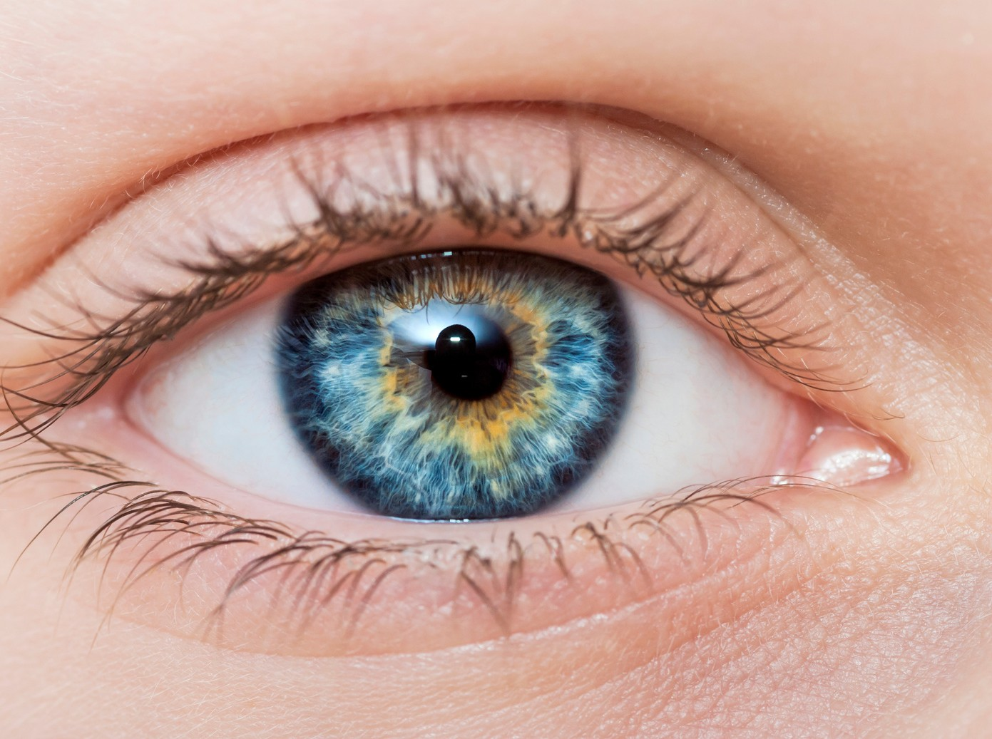
EMDR
Eye Movement Desensitization and Reprocessing ( EMDR) It is widely assumed that severe emotional pain requires a long t ime to heal.
EMDR and Neurofeedback therapy shows that the mind can in fact heal from psychological trauma much as the body recovers from physical trauma.
Once the block is removed, healing resumes. EMDR
therapy demonstrates that a similar sequence of events occurs with mental processes. The brain’ s information
processing system naturally moves toward mental health.

Slide 3
Improved communication and interpersonal skills
COUNSELING
Counseling offers you the chance to talk about social, emotional, or behavioral problems that are causing you concern or interfering with your daily activities.
Students and family attending the twin falls school district I believe have access to counseling services.
Improved self-acceptance and self-esteem
Capability to change self- defeating behaviors and habits More suitable expression and management of emotions Relief from depression, anxiety, or other mental health conditions
Greater confidence and decision-making skills
Ability to manage stress more effectively
Improved abilities for problem-solving and conflict
resolution

Slide 4
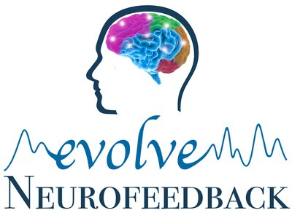
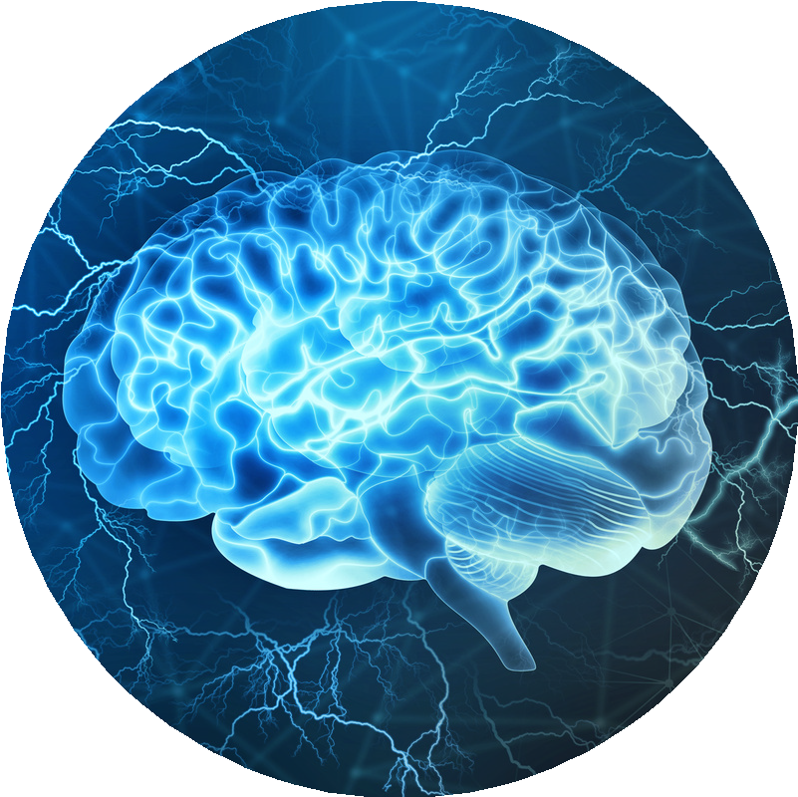
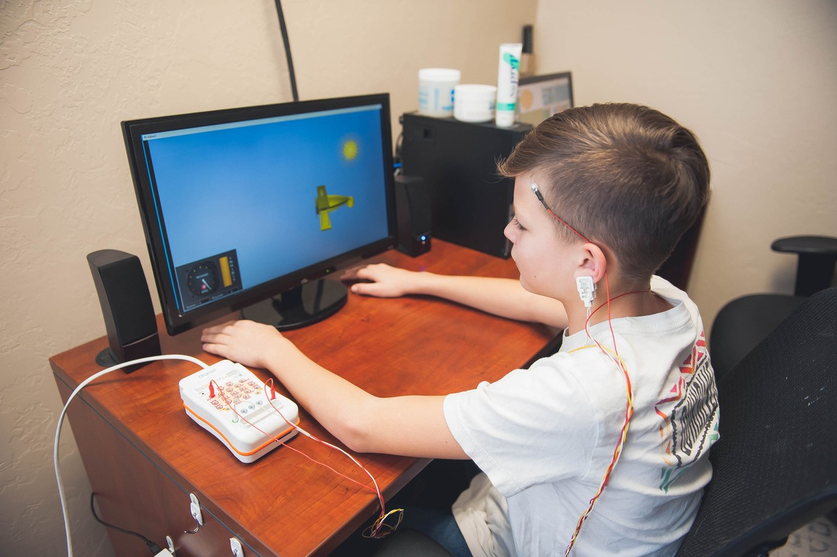
NEUROFEEDBACK
Neurofeedback is a non-invasive treatment that encourages the brain to develop healthier patterns of activity through reinforcement.
The brain is not stimulated with electro cranial stimulation and drugs are not administered.
We measure and study your brain wave activity to understand its specific problematic patterns so we know where and why you are feeling the way you feel the way you do.
Neurofeedback, a type of Bio-Feedback, teaches self- regulation of brain function by measuring brain wave activity, while providing real-time feedback. Neurofeedback can be a stand alone or adjunctive treatment used for psychiatric/ MH conditions such as: ADHD, Generalized Anxiety Disorder, Depression, Post Traumatic Stress Disorder, Obsessive- Compulsive Disorder, processing disorders and Insomnia.

Slide 5
BEHAVIORAL
Natural at home options
1. Value yourself:
Treat yourself with kindness and respect. Healthy self-talk in the mirror every morning is incredibly mentally fortifying
Make time for your hobbies doing thing you love tend to improve moods

Slide 6
BEHAVIORAL
Natural at home options
2. Take care of your body:
Taking care of yourself physically, Emotional and nutritionally can improve your mental health. Be sure to:
Eat nutritious meals Drink plenty of water Exercise
Exercise which helps decrease depression and anxiety and improve moods. Reduces stress
Ward off anxiety and feelings of depression Boost self-esteem
Improve sleep
It strengthens your heart. It increases energy levels. It lowers blood pressure.
It improves muscle tone and strength. It strengthens and builds bones.
Sleep is the natural way the body gets is recharge 8 hours of quality sleep is crucial for adults, 8-10 for children during peak development
LESS SCREEN TIME- Blue light emitted, with the stimulation we naturally get from games, shows and movies. Both of these components increased cerebral stimulation

Slide 7
BEHAVIORAL
Natural at home options
3. Surround yourself with good people:
People with strong family or social connections are generally healthier than those who lack a support network. When we are social your brain's release of the chemicals oxytocin, dopamine, serotonin, and endorphins. This increases over all health and well being.
Join a support group
People in school join a club with likeminded individuals

Slide 8
BEHAVIORAL
Natural at home options
4. Give of yourself:
Volunteer your time and energy to help someone else. Human altruism releases Dopamine, serotonin, and oxytocin which I refer to as the Happiness Trifecta.
Dopamine is connected to motivation and arousal.
Serotonin is connected to sleep, digestion, memory, learning, and appetite
Oxytocin blood pressure decreases, Bonding increases, social fears are reduced and trust and empathy are enhanced.
Oxytocin is an anti-inflammatory, reduces pain and enhances healing.

Slide 9
BEHAVIORAL
Natural at home options
5. Learn how to deal with stress:
Like it or not, stress is a part of life. Practice good coping skills: take a nature walk to get fresh air, play with your pet or try journal writing as a stress reducer. Breathing techniques

Slide 10
BEHAVIORAL
Natural at home options
6. Quiet your mind:
Try meditating, Mindfulness and if you’re a religious person pray. Relaxation exercises and prayer can improve your state of mind and outlook on life. In fact, research shows that meditation may help you feel calm and enhance quality of life

Slide 11
BEHAVIORAL
Natural at home options
7. Get help when you need it:
Seeking help is a sign of strength — not a weakness. People who get appropriate care can recover from mental illness and addiction and lead full, rewarding lives.

