Slide 1
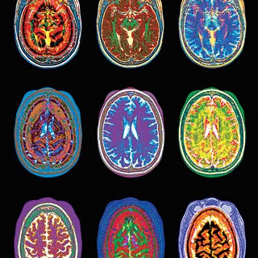
Pediatric
Mental Health treatment
Paula Griffith, MD
Human2Human Community Collab
March 2, 2023

Slide 2
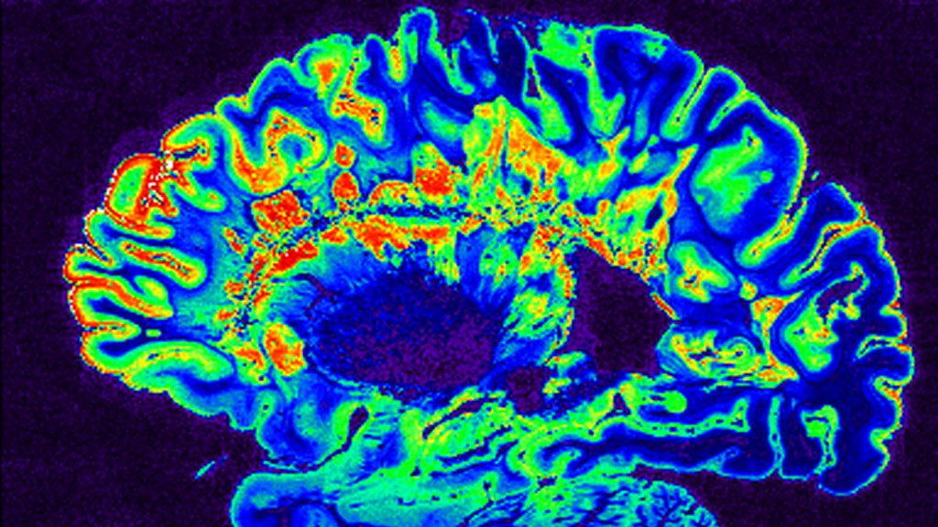
Common MH conditions in kids
ADHD = 9.8% (approximately 6.0 million children)
Anxiety = 9.4% (approximately 5.8 million children)
Depression = 4.4% (approximately 2.7 million children)
www.cdc.gov/childrensmentalhealth/data.html

Slide 3

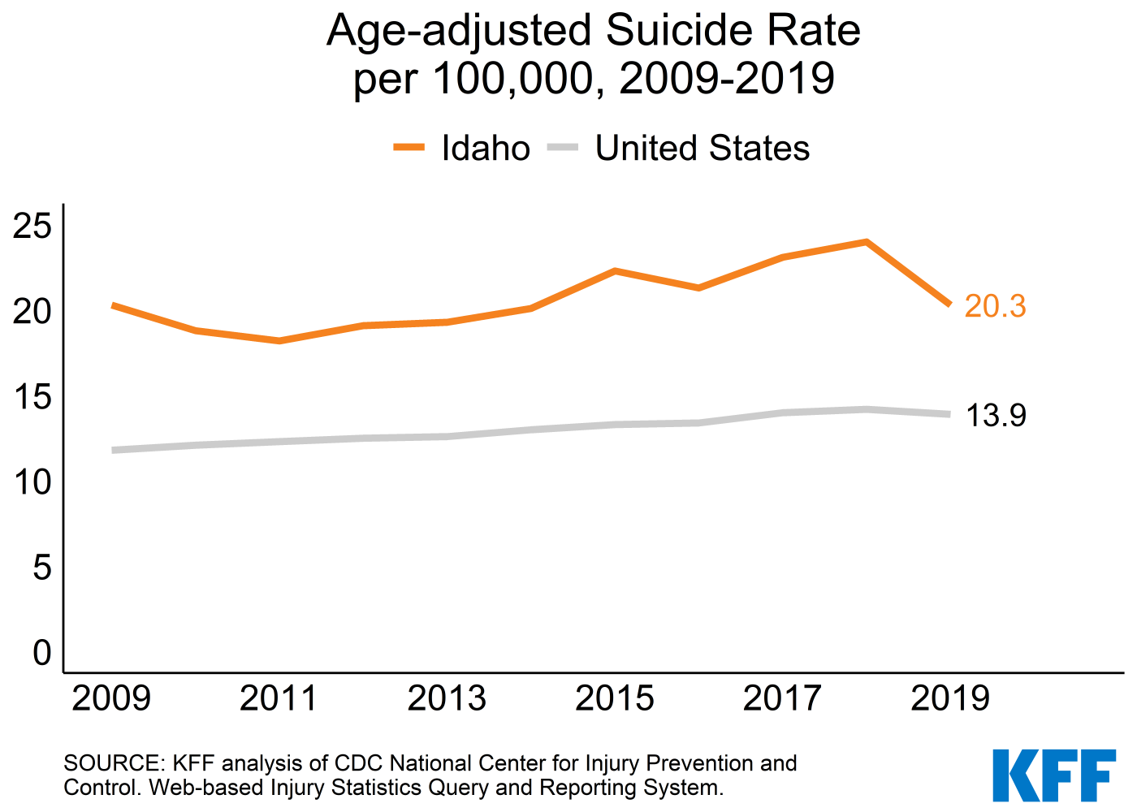
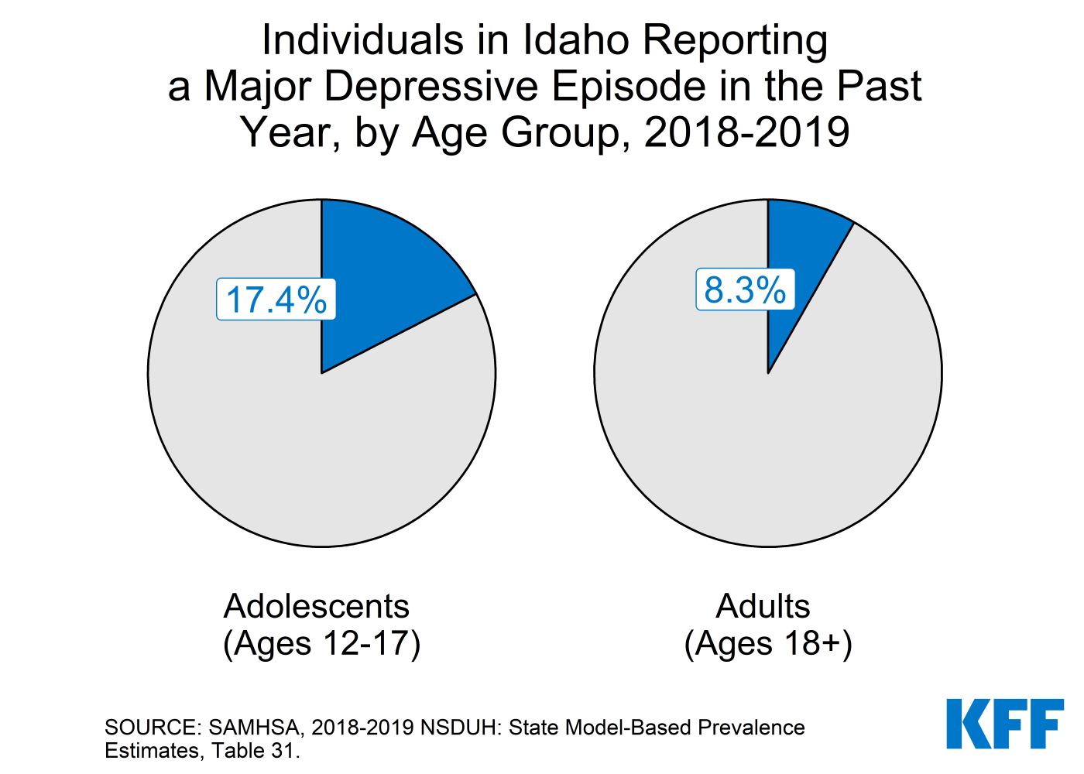
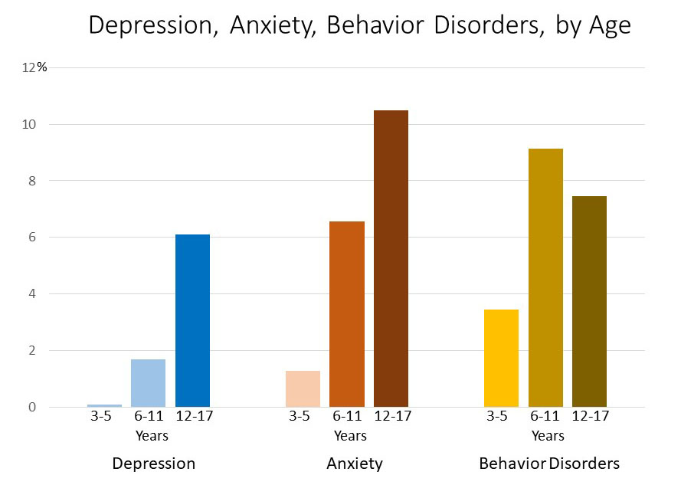

Idaho has Elevated rates of depression and suicide

Slide 4
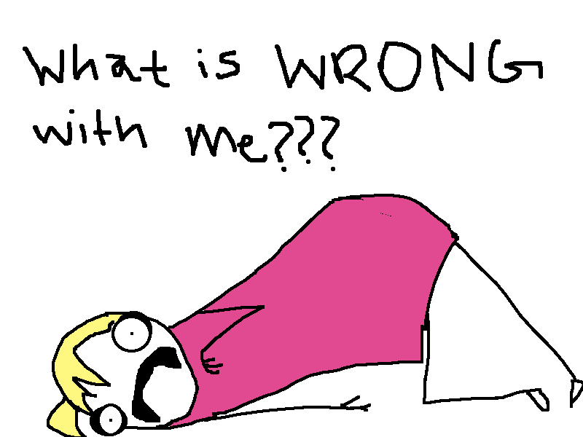

What does depression/anxiety/ADHD look like in kids and teens?
Notes:
Can look quite different. Irritability can be a primary sx of many disorders like depression, anxiety, or ADHD. Fatigue, impulsivity, sensitivity, social isolation, can all be symptoms.

Slide 5
Treatments for depression
6-9 months = average length of a depressive episode WITHOUT treatment
Therapies: CBT, DBT, IPT, family-based interventions
FDA Approved Medications
Fluoxetine (Prozac) Ages 8 and up
Escitalopram (Lexapro) Ages 12 and up
Second line:
  other SSRI: sertraline, citalopram, fluvoxamine
  SNRI: venlafaxine (Effexor), duloxetine (Cymbalta)
  bupropion (wellbutrin)
aacap.org Resource Center: Depression Parents Medication Guide
Therapy + Meds improves response to treatment
Notes:
https://www.apa.org/depression-guideline/children-and-adolescents#:~:text=For%20the%20treatment%20of%20depression%20in%20adolescents%2C%20the%20selective%20serotonin,safety%20concerns%20with%20other%20medications.

Slide 6
Treatments for anxiety
Many types of anxiety can present in children: generalized anxiety, obsessive compulsive disorder, panic disorder, separation anxiety, selective mutism, and others.
Therapies: CBT (cognitive behavioral therapy)
FDA Approved Medications
GAD: Duloxetine (Cymbalta) age 7+
OCD: fluvoxamine (luvox) age 8+, fluoxetine (Prozac) age 8+, sertraline (Zoloft) age 6+, clomipramine (Anafranil) age10+.
Other options:
  SSRIs: citalopram (Celexa), escitalopram (Lexapro), etc.
  SNRI: venlafaxine (Effexor)
  Buspirone (Buspar)
aacap.org Resource Center: Anxiety Disorders Parents Medication Guide
Therapy + Meds improves response to treatment
(pills can’t teach healthier coping skills)

Slide 7
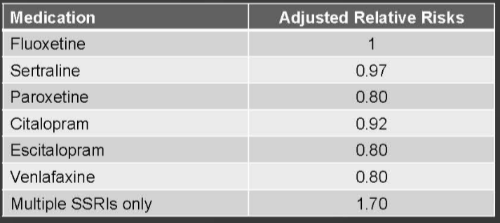
About the black box…
Issued in 2004: “Increased risk of suicidal thoughts and behavior (“Suicidality”) in children and adolescents being treated with antidepressant medications.”
REVISED in 2007: “increased risks of suicidal thinking and behavior, known as suicidality, in young adults ages 18 to 24 during initial treatment (generally the first 1-2 months).”
Emphasized that depression is associated with increased risk of suicide
FDA News. 2004. 2007
Meta-analysis of 27 studies of pediatric MDD: Antidepressants = 3% rate of SI/attempts Placebo = 2% rate of SI/attempts
Comparison of SA’s in Youth: 36,842 youth on Medicaid, new to SSRI’s. 419 medically treated attempts.
Comparison of Antidepressants and suicide attempts: COOPER WO et al Pediatrics. Bridge JA et al, JAMA 2007; 297: 1683-1696
Notes:
2004: “Increased risk of suicidal thoughts and behavior (“Suicidality”) in children and adolescents being treated with antidepressant medications.”
At that time prozac was the only approved medication but warning applied to ALL antidepressants
REVISED in 2007: “warnings about increased risks of suicidal thinking and behavior, known as suicidality, in young adults ages 18 to 24 during initial treatment (generally the first one to two months).”
Emphasized that depression is associated with increased risk of suicide.
FDA News 2004, 2007.
Tennessee Medicaid Study = 419 medically treated SA’s.

Slide 8
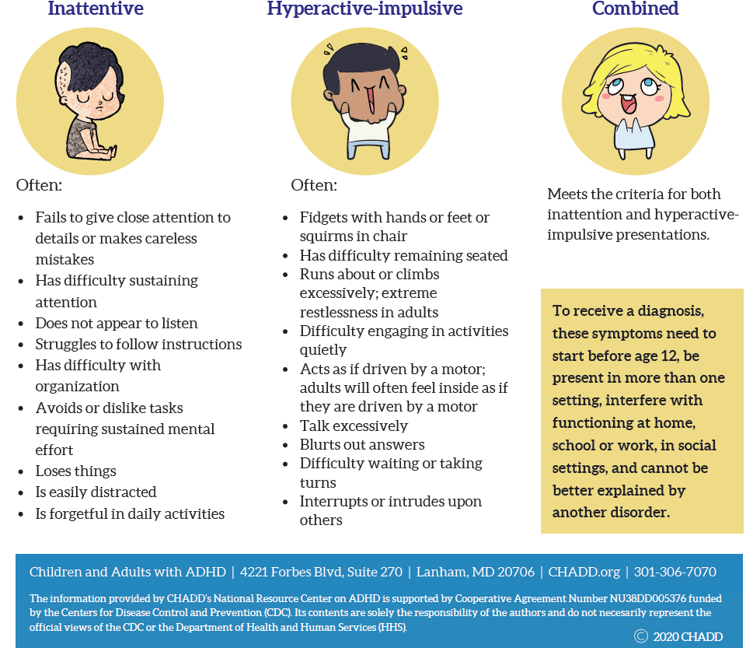
ADHD facts
ADHD diagnosis
ADHD prevalence among 8- to 15-year-olds: 8.7%
ADHD prevalence among 18- to 44-year-olds: 4.4%
Associated with chronic course
  ~ 75% persistence from childhood into adolescence
  ~ 50% persistence from childhood into adulthood
Associated with high degrees of psychiatric comorbidity
Associated with impairment in multiple domains
Froehlich TE, et al. Arch Pediatr Adolesc Med. 2007;161(9):857-864. Kessler RC, et al. Am J Psychiatry. 2006;163(4):716-723. Wilens TE, et al. Postgrad Med. 2010;122(5):97-109; Faraone et al, Nature Neuroscience, 2015

Slide 9
MEDICATIONS for adhd
Pharmacological Treatment
Stimulants
Methylphenidate (Ritalin)
Amphetamine/Dextroamphetamine
(Adderall)
Noradrenergic agents
Atomoxetine
Viloxazine XR
Alpha Agonists
Guanfacine (XR)
Clonidine (XR)
Guan XR or Clon XR + stimulants
Antidepressants
Bupropion
Tricyclics
Combination/others
Modafinil
Memantine
FDA Approved
FDA Approved
FDA Approved
FDA Approved
Update on ADHD Pharmacotherapy, Newcorn and Wilens (eds), Child Adoles Psych Clin N America 2022

Slide 10
Developmental Impact of Untreated ADHD
Academic difficulties
Self-esteem issues
Legal issues
Smoking
Injuries
Occupational failure
Self-esteem
Relationship problems
Injuries/accidents
Behavioral
disturbance
Preschool
Adolescent
Adult
School-age
College-age
Behavioral disturbance
Academic difficulties
Peer relationships
Self-esteem issues
Academic failure
Occupational difficulties
Self-esteem
Substance abuse
Injuries/accidents
Pliszka S; AACAP Work Group on Quality Issues. J Am Acad Child Adolesc Psychiatry. 2007;46(7):894-921. Brown TE, et al. Postgrad Med. 2010;122(5):42-51. Adler, Spencer, Wilens ADHD in Children and Adults, 2015, Cambridge Press
Notes:
Core symptoms of this syndrome always have been defined on the basis of behavioral characteristics.
Early descriptions were found as the sequelae of an insult to the brain (head injury, CNS infection). When these behavioral characteristics were found in children with no history of such insult, the damage to the CNS was considered to be so minimal that the only manifestations were behavioral. Thus the term Minimal Brain Damage.
In the early 1960s the term Minimal Brain Dysfunction was used to describe a cluster of symptoms including specific learning disabilities, hyperkinesis, impulsivity, and short attention span. MBD was vague, overinclusive, and lacked predictive validity.
In 1968, DSM-II described the behavioral manifestations (overactivity, restlessness, distractibility, short attention span) as a specific syndrome—Hyperkinetic Reaction of Childhood—stressing the motoric symptoms.
More modern classifications (DSM-III, DSM-III-R, and DSM-IV) have described the signs and symptoms of the disorder without implying specific etiology (as Minimal Brain Damage did). Current criteria emphasize three main behavioral areas—inattention, impulsivity, and hyperactivity.
Untreated ADHD is associated with substance use, accidents (TBI, MVA), and suicide attempts.

Slide 11
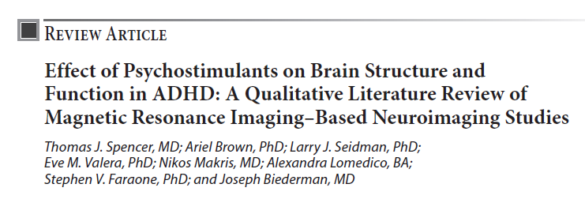
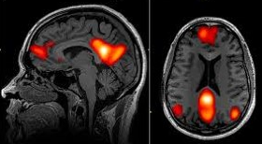
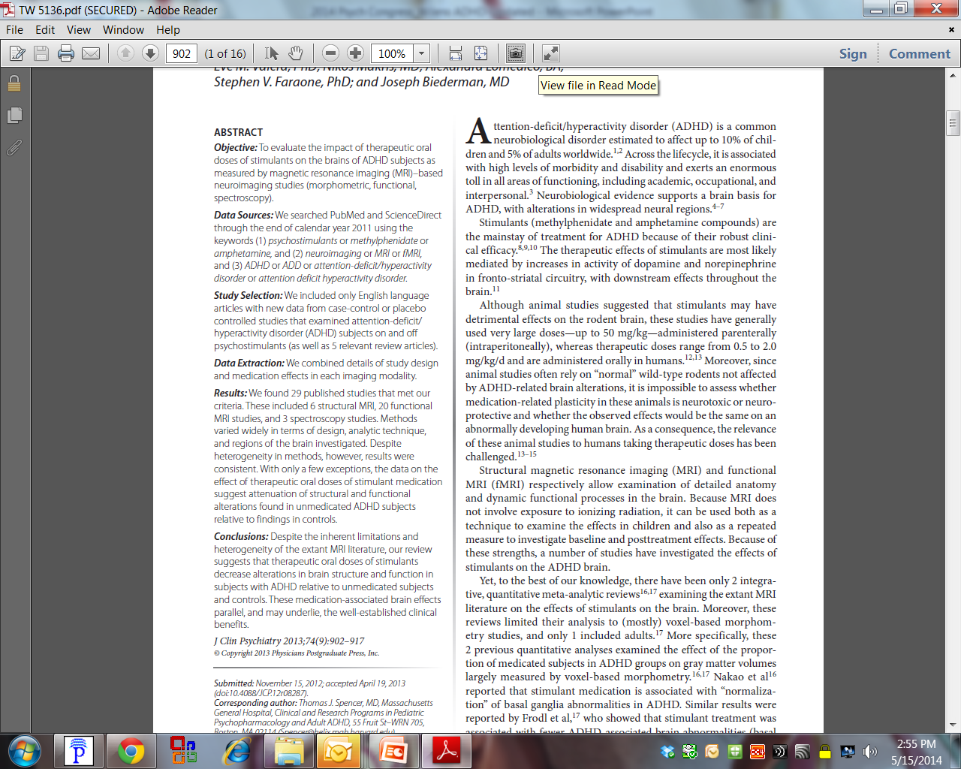
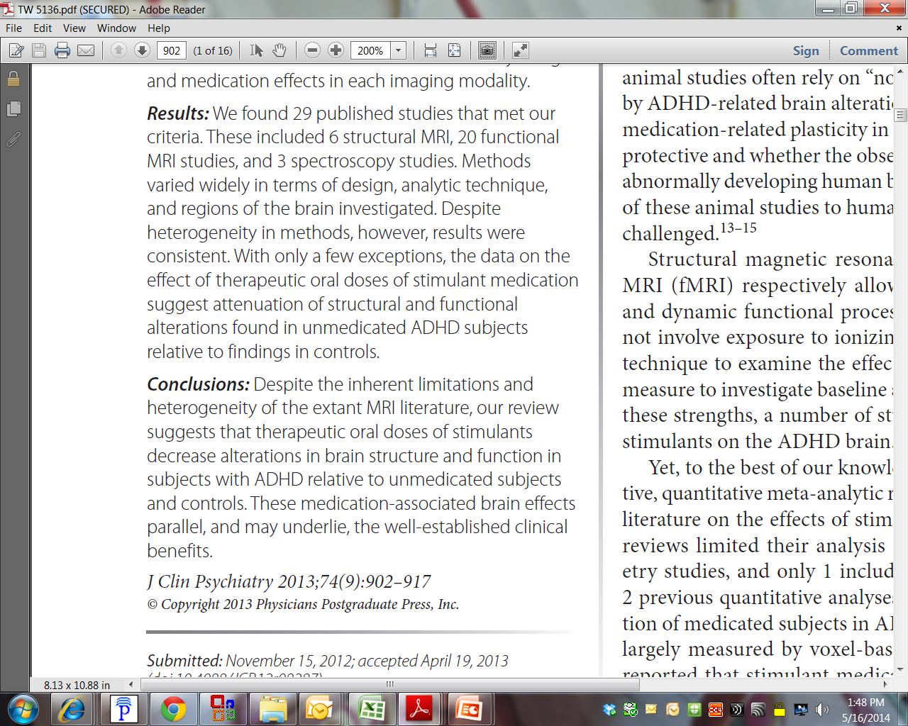
Notes:
Stimulant use is associated with reduced risk of TBI, reduced risk of mood disorders and suicidal behavior, and reduced criminal behavior.

Slide 12
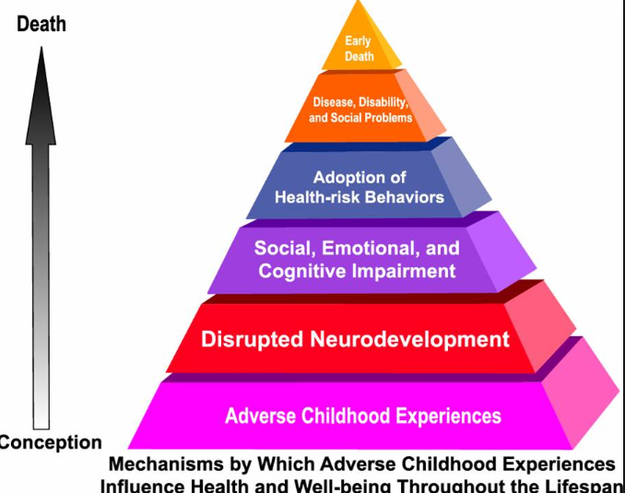
Childhood TRAUMA
Adverse childhood experiences (ACEs) are potentially traumatic events that occur in childhood (0-17 years)
experiencing violence, abuse, or neglect
witnessing violence in the home or community
having a family member attempt or die by suicide
Other ACEs can undermine their sense of safety, stability, and bonding, such as growing up in a household with:
substance use problems
mental health problems
instability due to parental separation or household members being in jail or prison
61% of adults surveyed across 25 states reported they had experienced at least one type of ACE before age 18, and nearly 1 in 6 reported they had experienced 4+ ACEs

Slide 13
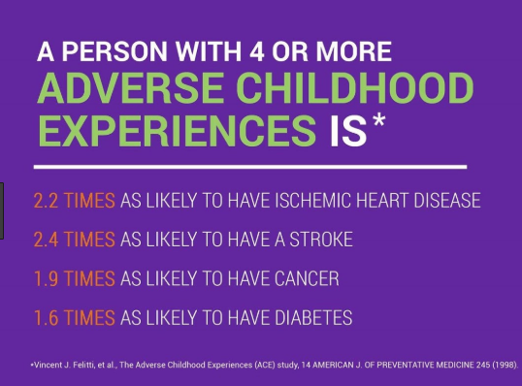
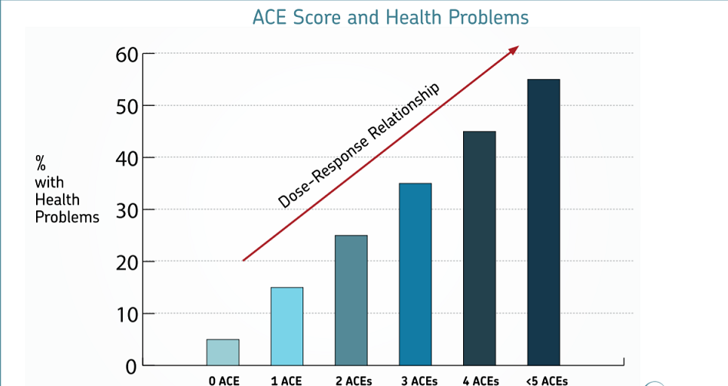
6+ ACEs can lower an individual’s life expectancy by
nearly 20 years

Slide 14
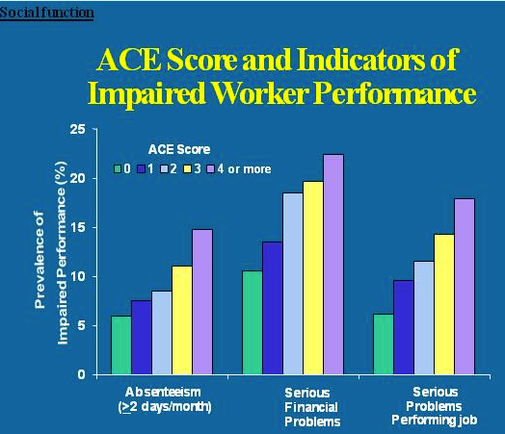
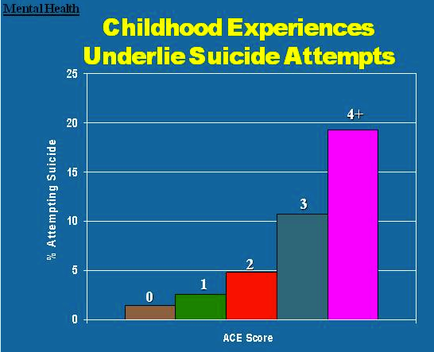
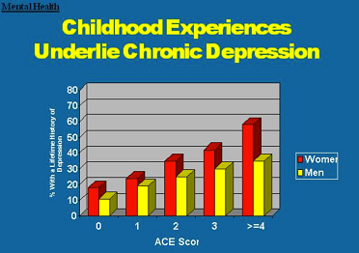

Slide 15
Trauma treatment
Medications (prazosin, alpha agonists, SSRIs, SGAs) can help with trauma symptoms but the gold-standard of trauma treatment for children and adolescents is trauma therapy
Evidence based trauma therapies:
  TF-CBT
  EMDR
The focus of treatment is to:
  Assist the child or adolescent to develop coping strategies for traumatic stress reactions
  Reduce symptoms of depression, anxiety, or acting out behavior which are common in children exposed to trauma
  www.tfcbt.org

Slide 16



Please reach out to your pCP with questions
Thank you to Dr. Nikki Halverson & Jennie Fulmer for the invitation to speak
Special thanks to Dr. Timothy Wilens for his ADHD slides which I adapted for this presentation.

Slide 17
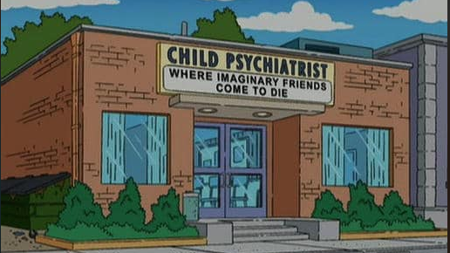
Supplemental info

Slide 18
Increasing Rates…
Depression and anxiety have increased over time
  “Ever having been diagnosed with either anxiety or depression” among children aged 6–17 years increased from 5.4% in 2003 to 8% in 2007 and to 8.4% in 2011–2012.⁴
  “Ever having been diagnosed with anxiety” increased from 5.5% in 2007 to 6.4% in 2011–2012.⁴
  “Ever having been diagnosed with depression” did not change between 2007 (4.7%) and 2011-2012 (4.9%).⁴
www.cdc.gov/childrensmentalhealth/data.html

Slide 19
concerns for our youth
For adolescents, depression, substance use and suicide are important concerns.
Among adolescents aged 12-17 years in 2018-2019 reporting on the past year:
  15.1% had a major depressive episode.²
  36.7% had persistent feelings of sadness or hopelessness.²
  4.1% had a substance use disorder.²
  1.6% had an alcohol use disorder.²
  3.2% had an illicit drug use disorder.²
  18.8% seriously considered attempting suicide.²
  15.7% made a suicide plan.²
  8.9% attempted suicide.²
  2.5% made a suicide attempt requiring medical treatment.²

Slide 20
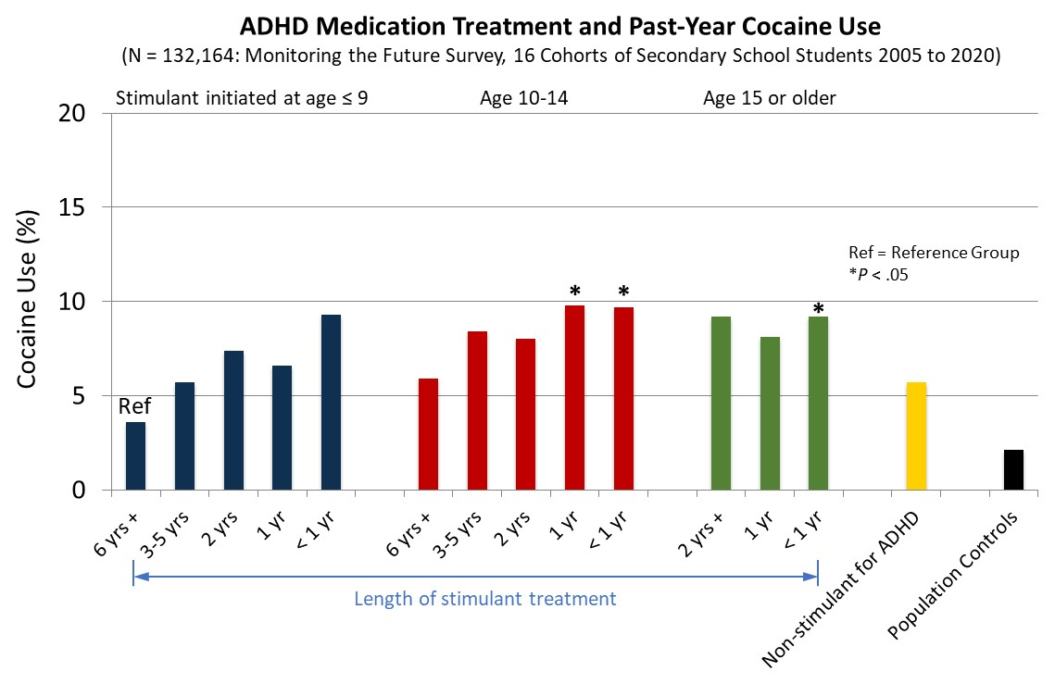
Early-onset and Longer Duration Stimulant Use for ADHD is NOT associated with later Cocaine (or Methamphetamine) Use
McCabe et al., Annual Scientific Meetings of CPDD, Minneapolis MN, 2022

Slide 21
Early ADHD Treatment Reduces
Marijuana Use
10 Cohorts of Senior Years 2005 to 2014
(N=40,358; ca. 10% with ADHD)
Population risk
Stimulant use started prior to
9 years of age*
Stimulant use started between
10-14 years*
Stimulant use started after
15 years of age**
P<0.001 vs. controls
P<0.001 vs. controls
Past Year Use
* > 6 years of treatment
** > 3 years of treatment
McCabe, West, Dickinson, Wilens. J Am Acad Child Adoles Psych 2016: 55:479-486

Slide 22
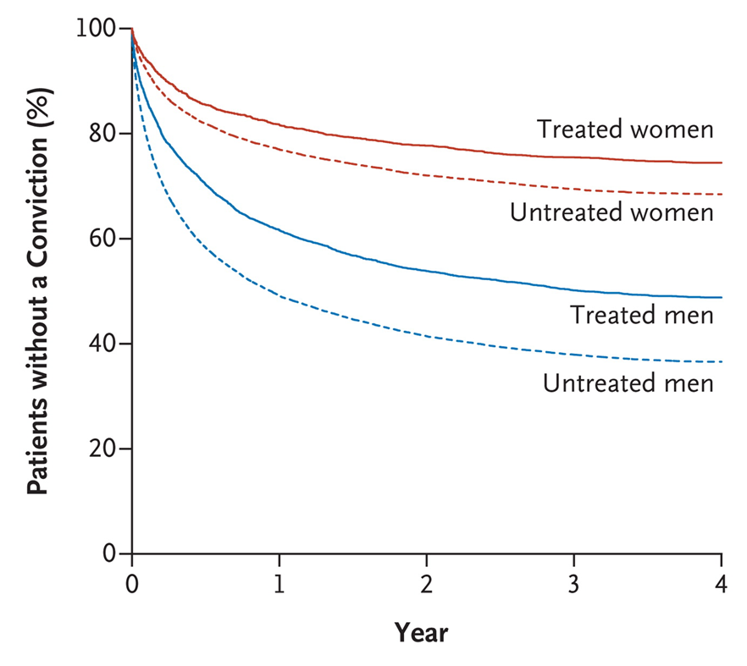
Medication for ADHD Reduces Criminality
Swedish national registers
N=25,656 with ADHD, about 50% on medications
40% of convictions related to drug offenses (Tx OR=0.6).
No difference in type of ADHD medication (stimulants, nonstimulants) or level of crime.
Lichtenstein P et al. N Engl J Med. 2012;367(21):2006-2014.

