Slide 1
Is this normal?

Slide 2
Fine Line between Stress and Anxiety

Slide 3
Fine Line between Stress and Anxiety
Stress
Anxiety
Typically external trigger
Short term or long term
Irritability
Anger
Fatigue
Muscle pain
Digestive troubles
Difficulty sleeping
Persistent, excessive worries that don’t go away even in the absence of a stessor.
Insomnia
Difficulty concentrating
Fatigue
Muscle tension
irritability

Slide 4
Symptoms of GAD
Excessive anxiety and worry occurring more days than not for at least 6 months, about a number of things
The individual finds it difficult to control the worry.
At least 3 of the following symptoms:
Restlessness or feeling keyed up or on edge.
Being easily fatigued.
Difficulty concentrating
Irritability
Muscle tension
Sleep disturbances
Cause distress or impairment in functioning

Slide 5
Am I Sad or Depressed?
Sadness
Depression
Feel sad about everything
Can occur in absence of trigger
Saps energy, motivation, and ability to experience joy, pleasure, excitement, anticipation, satisfaction, connection, and meaning.
Impatient
Quicker to get angry or frustrated
Quicker to break down,
Longer to bounce back from everything
Normal human emotion
Everyone will experience it
Usually triggered by a difficult, hurtful, challenging, or disappointing event, experience, or situation.
Sadness remits
Something changes
Emotional hurt fades
Period of adjustment

Slide 6
Symptoms of Depression
5 or more of the following in same 2-week period:
A depressed mood most of the day, nearly every day, *In children and adolescents can be irritable mood.
Diminished interest or pleasure in almost all activities
Significant weight change when not dieting or trying to gain weight
Insomnia or hypersomnia nearly every day
Psychomotor agitation or retardation (restlessness or being slowed down).
Fatigue or loss of energy
Feelings of worthlessness or excessive guilt
Diminished ability to think or concentrate
Recurrent thoughts of death or suicidal ideation

Slide 7
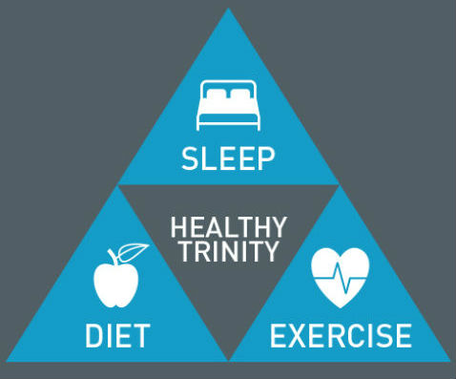
Similar Coping Mechanisms
Good sleep hygiene
Consistent sleep routine
Control blue lights
Move your body during the day
Physical activity
Cancel impact of stress on immune system
50% less perceived stress
Nutritious and varied diet
Rainbow of fruits and vegetables
No alcohol

Slide 8
More Coping Mechanisms
Eliminate or minimize stressors
Cultivate social support
Relax muscles
Meditate
Take a moment in nature
Nature videos v. Urban scenes
Keep your pleasurable activities
Reframe your thinking

Slide 9
When to Seek Help
Mood does not respond to management techniques
Mood affecting day-to-day functioning.
Symptoms have lasted more than two weeks
Unable to perform usual daily functions

Slide 10
Conclusion
Don’t stress if you can’t tell the difference
Try healthy coping Mechanisms
Impaired functioning/two weeks

