Slide 1
Magic Valley Human2Human
February 13, 2023
Community Collab

Slide 2
An upward trend
46 percent of Americans will meet the criteria for a diagnosable mental health condition sometime in their life, and half of those people will develop conditions by the age of 14.
16% of youth report suffering from at least one major depressive episode in the past year.
More than 2.7 million youth are experiencing severe major depression (feeling symptoms daily
59.8% of youth with major depression do not receive any mental health treatment.
Nationally, only 28% of youth with severe depression receive some consistent treatment

Slide 3
Notes:
Total Suicide Deaths in Idaho

Slide 4
Notes:
5th District includes: Cammas, Gooding, Blaine, Lincoln, Jerome, Minidoka, Cassia, Twin Falls
Attempts: A non-fatal, self-directed, potentially injurious behavior with intent to die as a result of said behavior. A suicide attempt might not result in injury.
Ideation: Thinking about, considering or planning suicide

Slide 6
Myths versus Facts
Talking to someone about suicide may increase the likelihood they will die by suicide.
You can’t stop a person, once they’ve decided to die by suicide.
Only depressed people die by suicide.
Suicidal people don’t usually share their intentions
Suicidal people are just looking for attention.
Youth will usually tell a friend that they are suicidal, but usually an adult too.

Slide 7
Call to Action
.
In the U.S., there are an estimated 350 individuals for every one mental health provider
However, these figures may be an overestimate of active mental health professionals, as it may include providers who are no longer practicing or accepting new patients.
As Humans: We all have a role to play in preventing suicide.

Slide 8
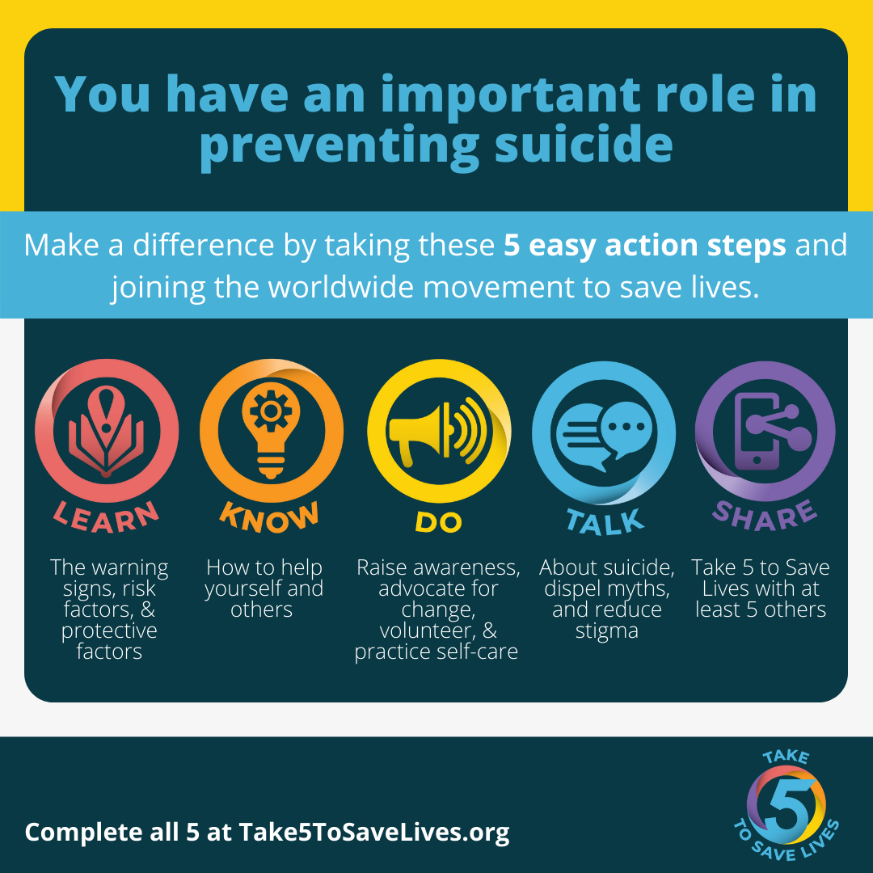

Slide 9
Notes:
Are you thinking about suicide—communicates that you are open to speaking about suicide in a non-judgemental and supportive way.
Can open the door for effective dialogue.
Do not ever agree to keep their thoughts a secret.

Slide 10
Notes:
Help them to focus on THEIR reasons for living and avoid imposing YOUR reasons for them to stay alive.
Be there physically (on the phone or when you can in person). Follow through. Be there in ways you say you will; don’t commit to “being there” in ways you can note.
Find out who and what they believe may be the most effective sources of help.
Why:n Being there for someone with thoughts of suicide is life-saving. Increasing connectedness to others and limiting isolation has show to be a protective factor against suicide.
Connectedness also is show to reduce the escalation of thoughts of suicide to action and acts as a buffer against hopelessness and psychological pain.

Slide 11
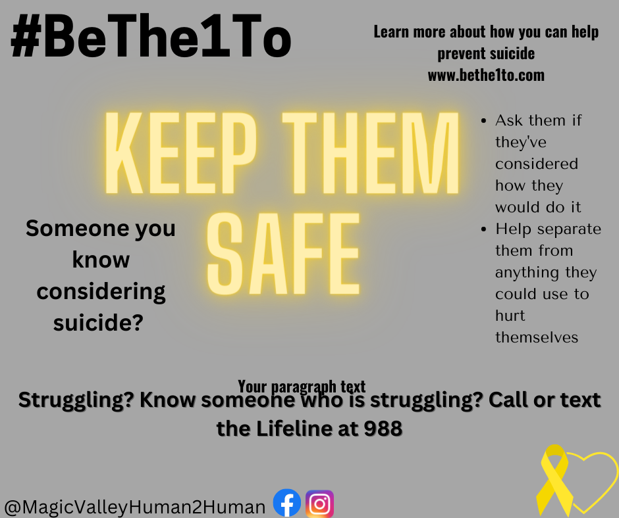
Notes:
The Help Keep Them Safe step is really about showing support for someone during the times when they have thoughts of suicide by putting time and distance between the person and their chosen method, especially methods that have shown higher lethality (like firearms and medications).

Slide 12
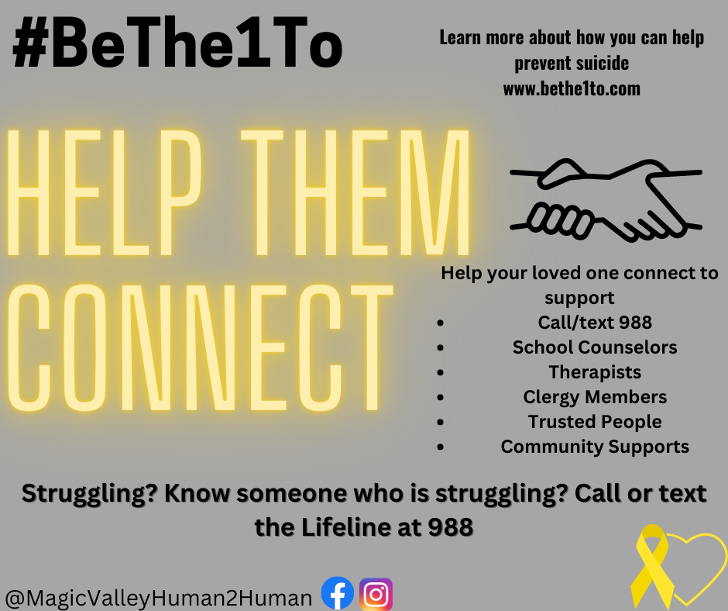
Notes:
found that individuals that called the National Suicide Prevention Lifeline were significantly more likely to feel less depressed, less suicidal, less overwhelmed,

Slide 13
Notes:
this type of contact can continue to increase their feelings of connectedness and share your ongoing support. There is evidence that even a simple form of reaching out, like sending a caring postcard, can potentially reduce their risk for suicide.

