Slide 2
If you have any covid symptoms, family and friends have treated it with the following.
Please do your own research, this protocol is what worked best for them. Each individual's experience may differ. I am not a medical professional

Slide 3
Supplement | Dosage / Duration
Liposomal Vitamin C 1000mg | 5ml Twice Per Day for 14 Days
Vitamin D3 | One 5000 iu capsule daily for 14 Days

Slide 4
Supplement | Dosage / Duration
Zinc | 100mg per day after food for 14 days
Curcumin | 500mg Twice Daily Take with Zinc for 14 Days

Slide 5
Supplement | Dosage / Duration
Zinc | 100mg per day after food for 14 days
Curcumin | 500mg Twice Daily Take with Zinc for 14 Days

Slide 6
These 2 products are the most important ones you need to take
Supplement | Dosage / Duration
Quercetin | Take one 800mg tablet daily for 14 Days
Black Cumin Seed Oil | 7.5ml daily for 14 days

Slide 7
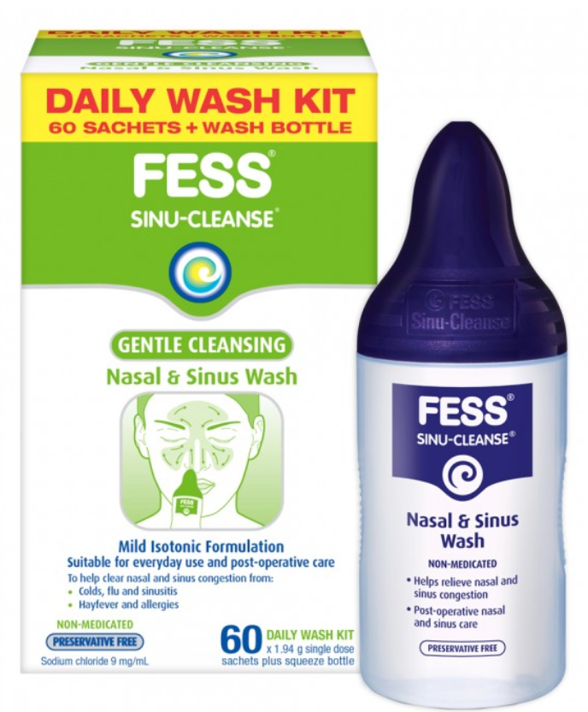
Dr Peter A McCullough MD, MPH
Discussing Betadine Ready to use sore throat Gargle

