Slide 1



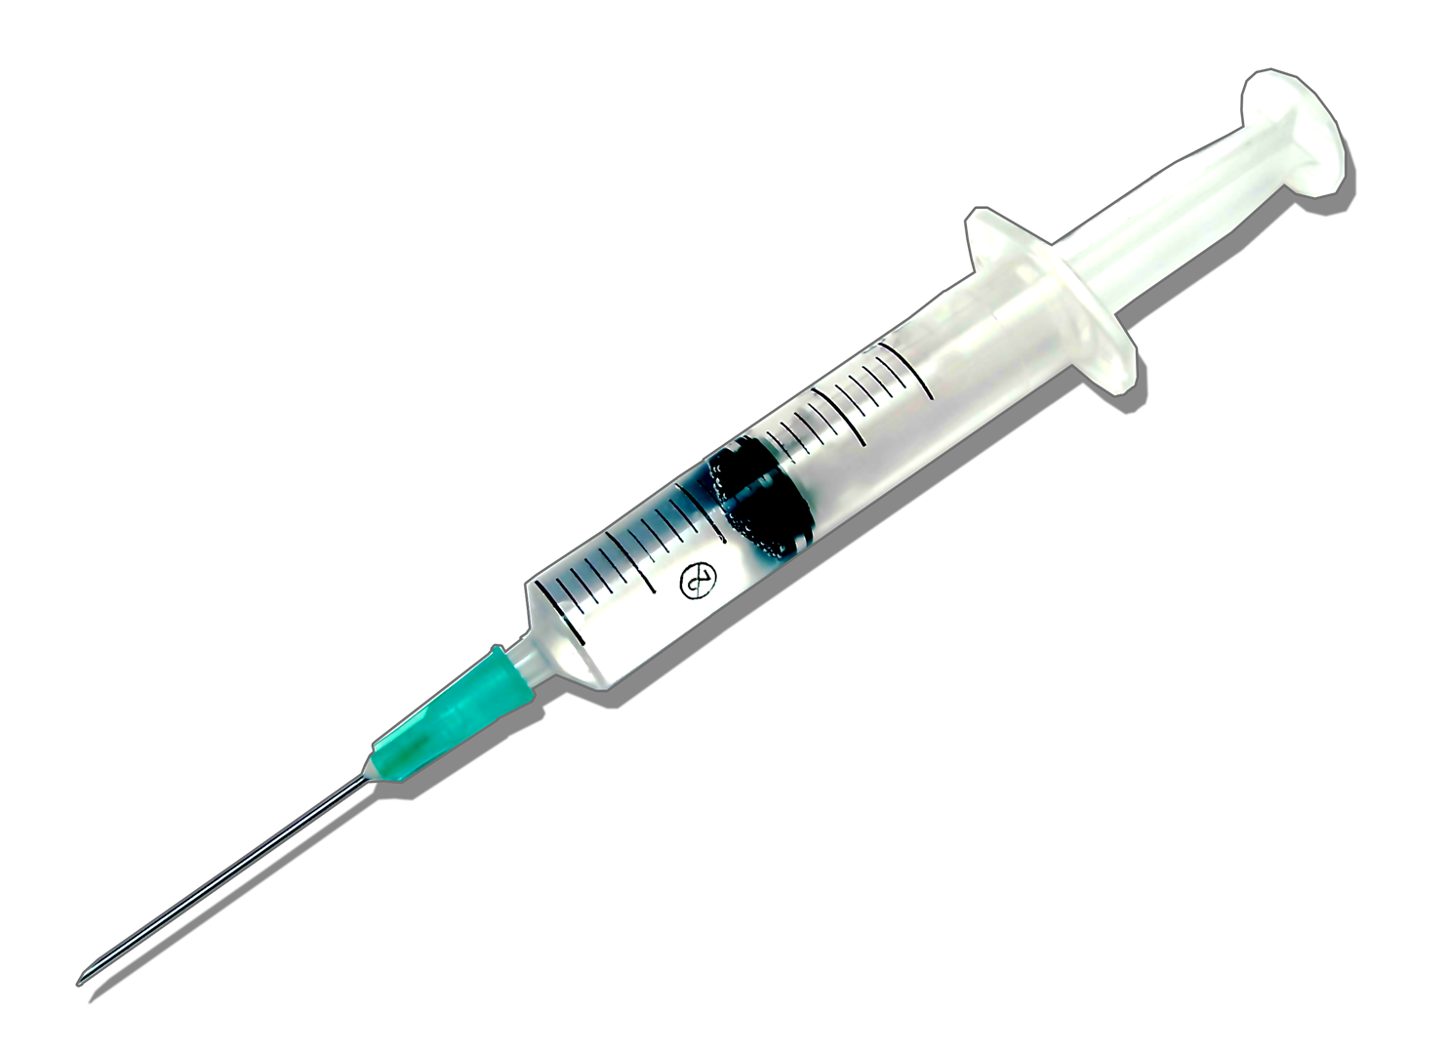


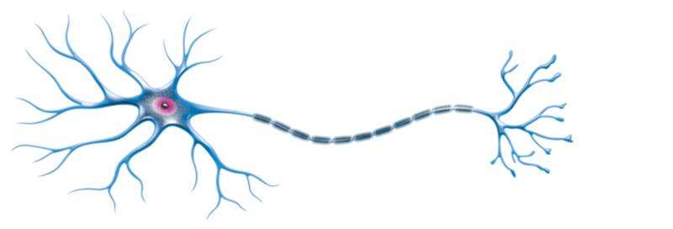





5G EMF ACTIVATED
FTWPROJECT.COM
HOPE AND
TIVON

Slide 2
SUMMARY
-Why most people don’t want to talk about the technology used in the COVID agenda.
-Blue tooth technology basics
-Evidence and Tests showing MAC addresses and EMF Emitted from Humans
-How to scan for Bluetooth codes
-Ingredients found in Vaccine are just like computer components
-Microscope Army, Tests Done on Injection Components with EMF
-Evidence they are already scanning human bodies for proof of injection
-How they track and trace humans using biological technologies
-White fibrous structures found by embalmers growing in vaccinated deceased
-Fractal Antennae
-Efforts underway to find a solution: Equipment needed
-How to fight back against the technology
ALL REFERENCE LINKS AVAILABLE IN BLOG POST
HOPEGIRLBLOG.COM
FTWPROJECT.COM

Slide 3
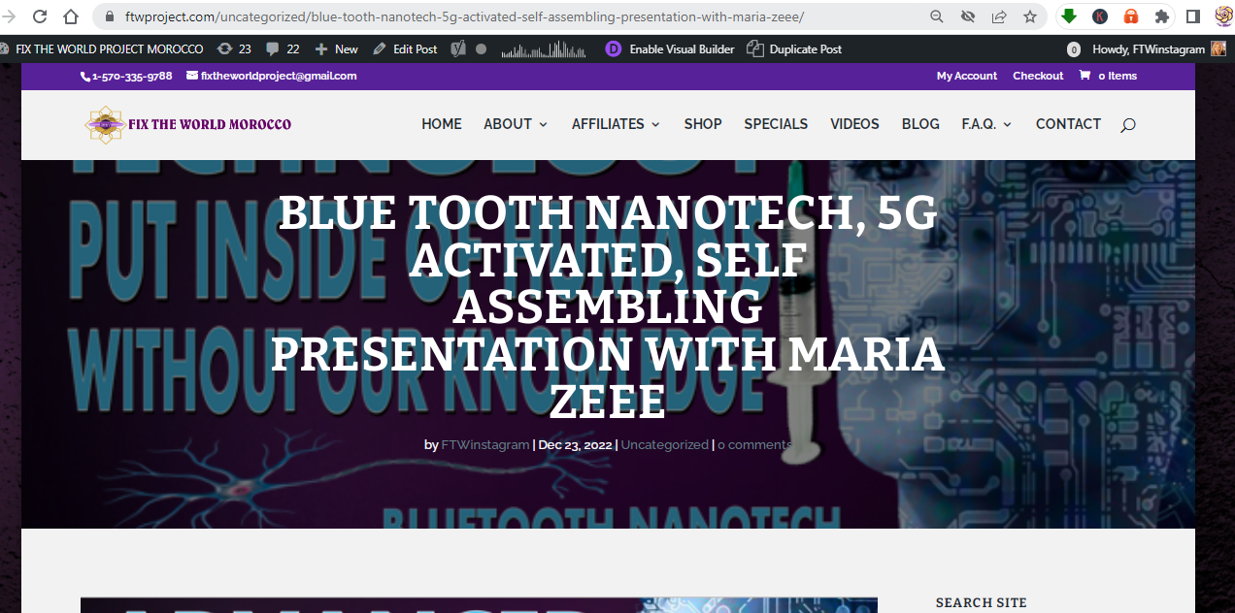
ALL REFERENCE LINKS AVAILABLE IN BLOG POST
https://www.ftwproject.com/uncategorized/blue-tooth-nanotech-5g-activated-self-assembling-presentation-with-maria-zeee/ref/468
HOPEGIRLBLOG.COM
FTWPROJECT.COM

Slide 4
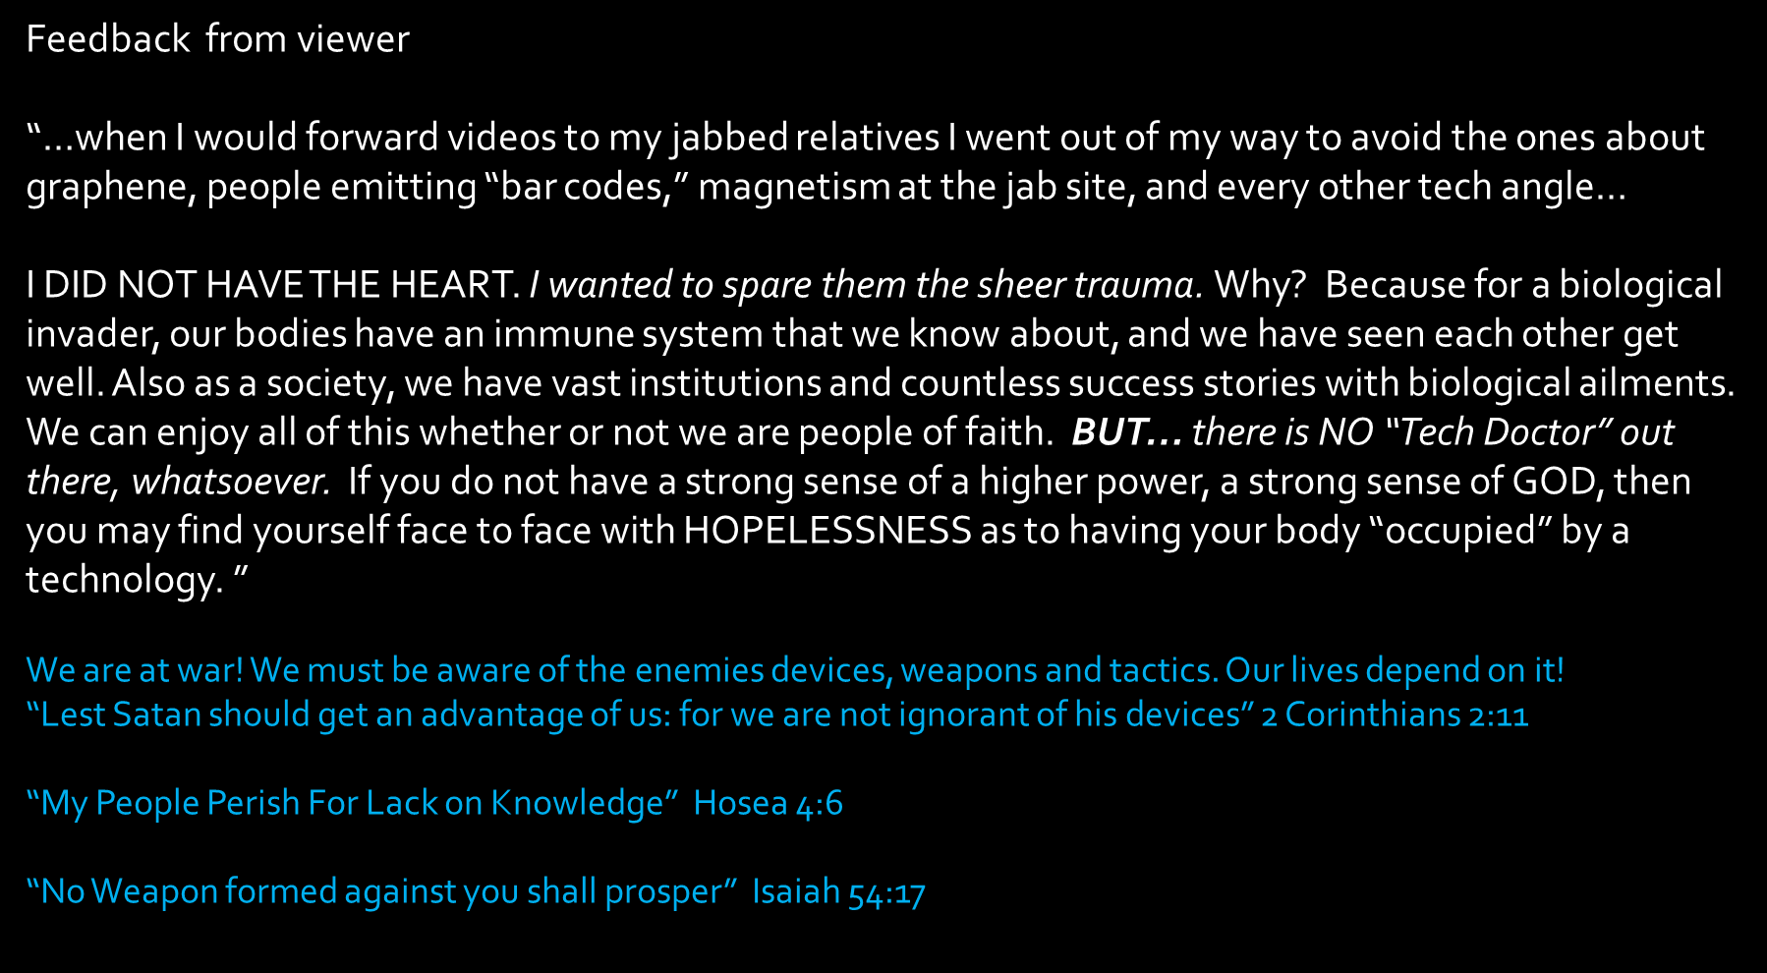

Why Most People Don’t Want to Talk About the Technology Used in the COVID Agenda
HOPEGIRLBLOG.COM
FTWPROJECT.COM

Slide 5

BLUE TOOTH TECHNOLOGY BASICS
Tivon Rivers Network Technician
How the technology works where does the signal come from?
How the network is set up and how it functions on different levels of access for technicians.
How to read a Bluetooth Code MAC Address
How you know it’s a MAC Address coming from a Human Body and NOT coming from a device.
The Bluetooth codes don’t always show, they need to be activated by EMF in order to show up or “ping back”
This is what an “anonymous MAC address” looks like:
69:2B:E8:A2:11:54
HOPEGIRLBLOG.COM
FTWPROJECT.COM

Slide 6

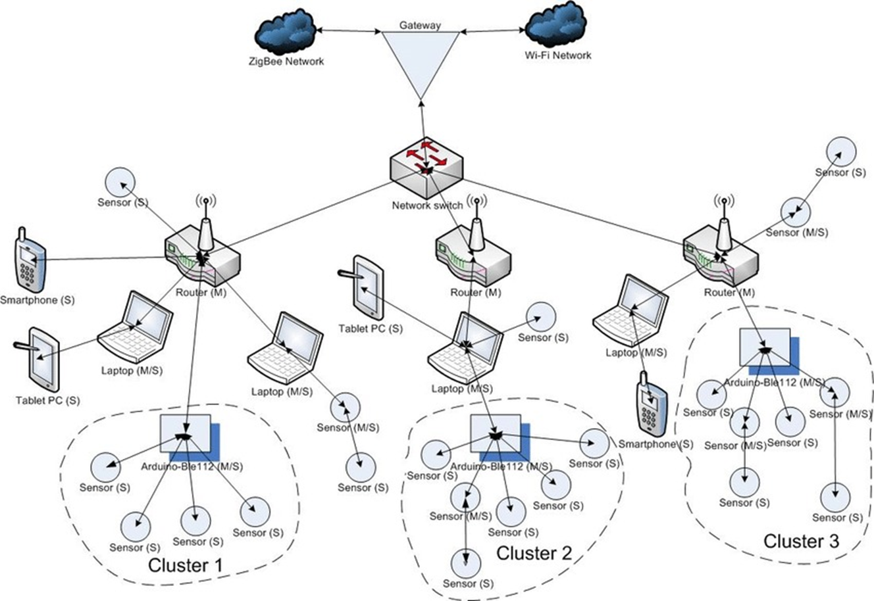
EMF WIFI
HOPEGIRLBLOG.COM
FTWPROJECT.COM

Slide 7
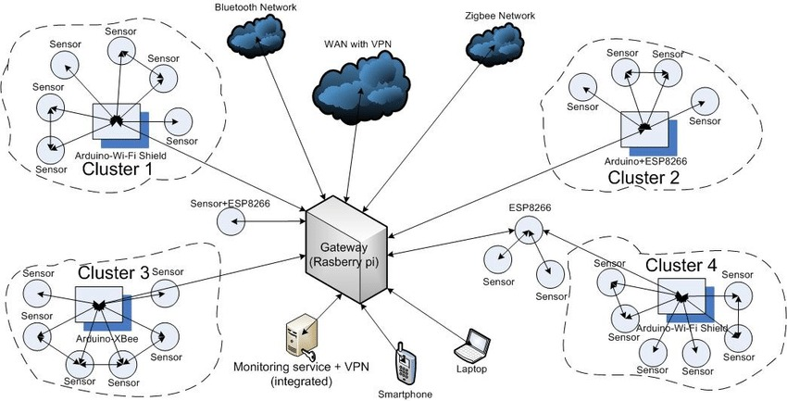
EMF WIFI
HOPEGIRLBLOG.COM
FTWPROJECT.COM

Slide 8

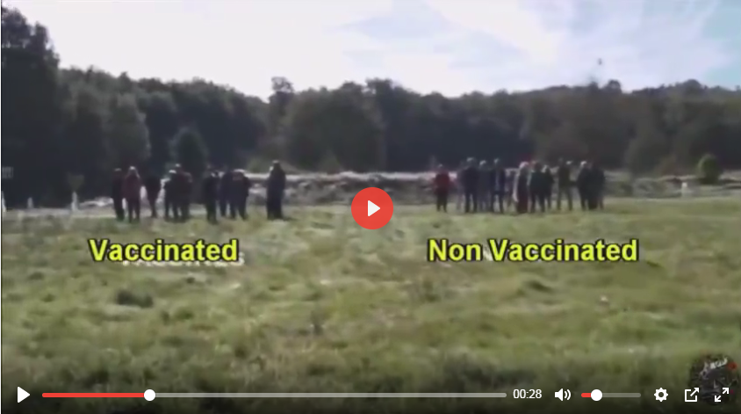
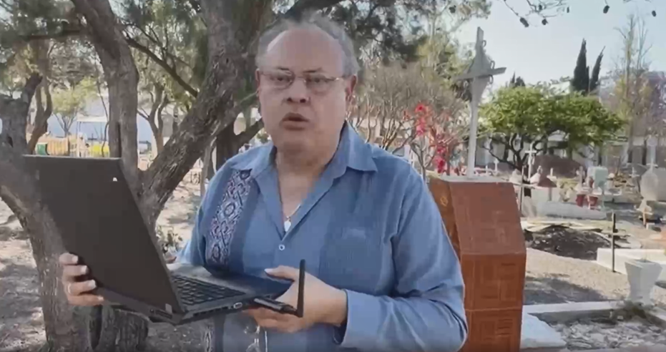
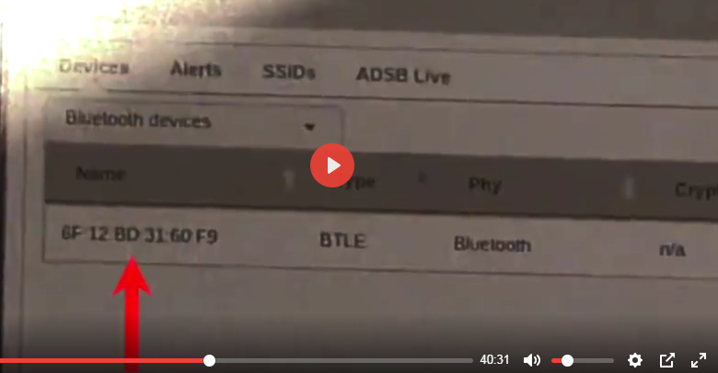
VACCINATED HUMANS ARE NOW EMITTING BLUETOOTH CODES
A research team in Mexico headed by Dr. Pedro Chavez Zavala has been conducting studies on the Bluetooth codes emitted from people who received the Covid vaccine. They made a documentary (in Spanish) called “BlueTruth”. In the documentary Dr. Pedro brings his equipment and reveals that Bluetooth codes are being emitted from the graves of the vaccinated deceased.
https://www.comusav.com/2022-05-14-bluetruth/
A French research team stopped random volunteers in a park. Separated them into groups of vaccinated and non vaccinated. They were then tested with their laptops Bluetooth and the vaccinated were registering an unnamed mac address as each were called near from the field.
HOPEGIRLBLOG.COM
WWW.FTWPROJECT.COM

Slide 9
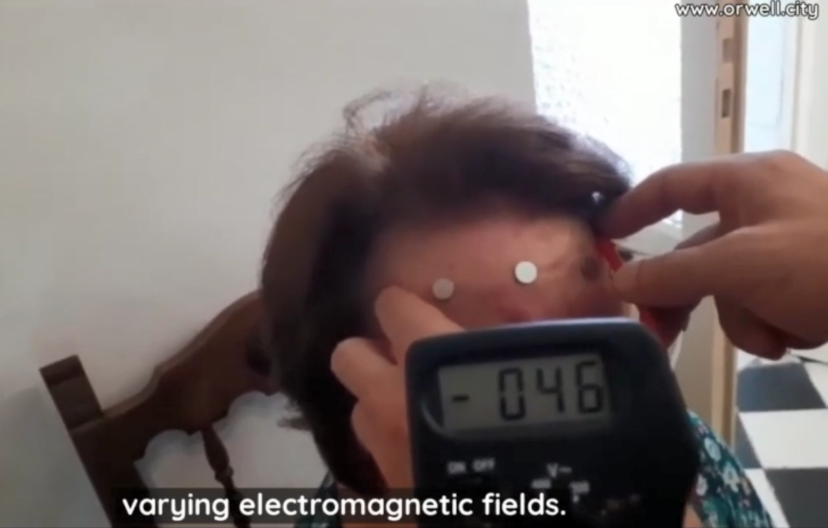
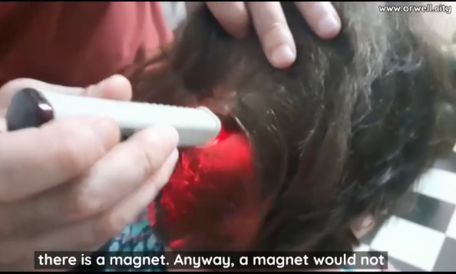
HUMANS EMITTING EMF FROM THE INJECTIONS
Video: Ricardo Delgado from La Quinta Columna in Spain
shows result of magnetism and EMF on a person who had 2 Pfizer shots.
First is shown that 5 neodymium magnets are sticking to the forehead.
A multimeter measures fluctuating voltage coming from the subjects head. the difference in voltage coming from the subjects head. This shows that something outside of the body is inducing these voltage fluctuations. EMF is generating varying electromagnetic fields. Which is why there is repulsion and sometimes extraction of magnets.
An electromagnetic radiation detector pencil placed directly on the head of the twice jabbed Pfizer subject and it starts going off in specific areas of the head, showing that the Pfizer Jabs make you EMIT EMF!
This is precisely what we covered in our last presentation in regards to “shedding” one theory being that the shots were turning humans body into EMF emitters and that’s how they were transmitting illness to non vaxxed people.
HOPEGIRLBLOG.COM
WWW.FTWPROJECT.COM

Slide 10
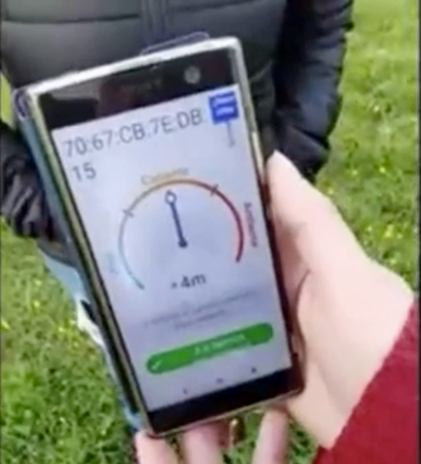
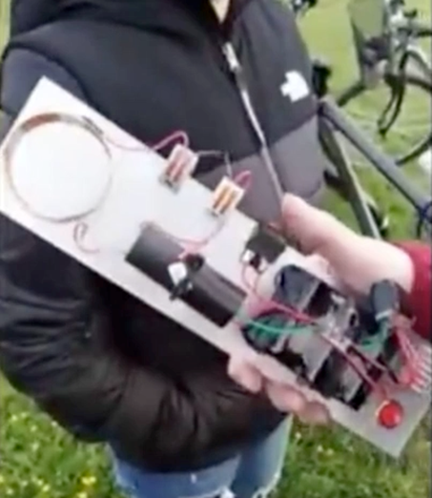
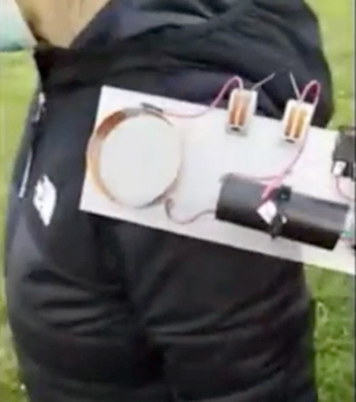
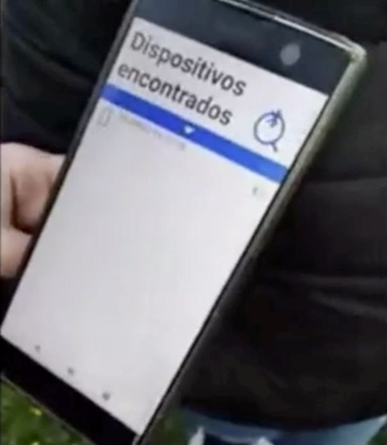
TESTS DONE TO DEACTIVATE THE BLUETOOTH CODES
In the video shared by La Quinta Columna a person who has taken the injection is in a field and is emitting a Bluetooth code that can be seen on the mobile phone. The two operators then use the pulse emp circuit over the injection site in both arms of the person emitting the signal. After a minute of use, the operators were not able to get a Bluetooth signal from the injected person. The chip was disabled. This was a painless procedure. They just simply waved the coil over the vaccination site and it deactivated the chip.
WWW.FTWPROJECT.COM

Slide 11
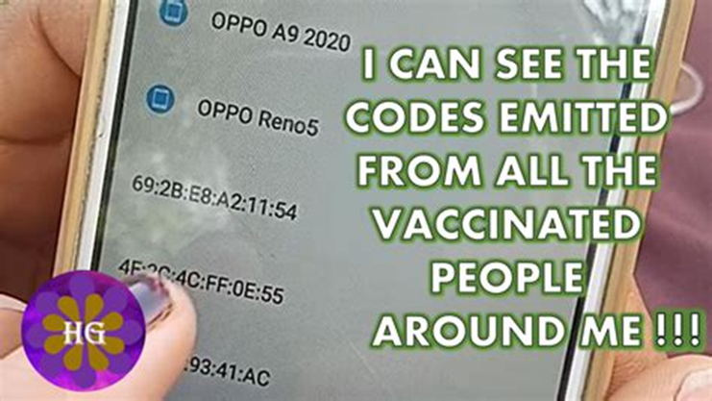
HOW TO SCAN FOR BLUETOOTH CODES
Using your phone in developer mode this is how we do it. Why we do it in developer mode and not in consumer mode.
You can go to google play and download any Bluetooth app for android from the google store.
FOR ALL PHONES
Search for how to put your phone in developer mode to do a Bluetooth scan
Search for any app for your phone that can do this type of a Bluetooth scan
HOPEGIRLBLOG.COM
FTWPROJECT.COM

Slide 12
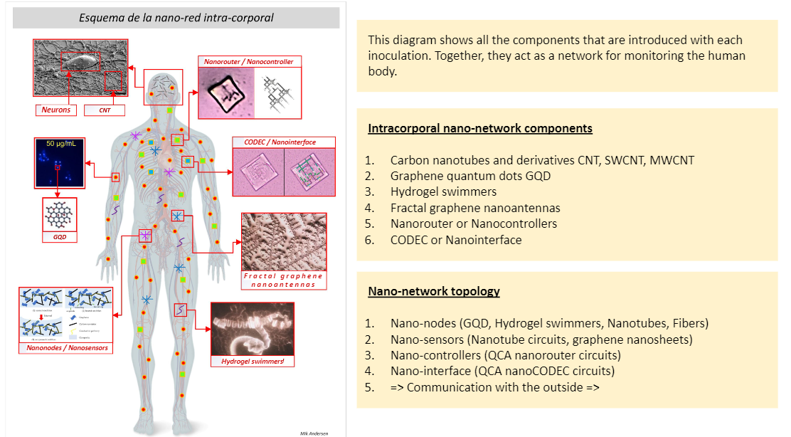
Found in Covid Injections: (compared to scientific papers)
Nano Routers that emit MAC addresses via Bluetooth
Nano antennas and plasmonic antennas to amplify signal
Nano rectennas as rectifier bridge of alternating and direct current
Codecs- devices that perform transformations on a data stream or signal
Logic gates- small digital electronic devices that compute binary functions like “and”, “or” ,“not” ,“true”, “false” ,“less than” ,“greater than” , etc. Used for the encryption of these network communications from vaccinated individuals to a remote network server.
PATENTS THAT DESCRIBE HOW THEY WILL HOOK UP HUMAN BEINGS TO THE “INTERNET OF THINGS” VIA 5G. (Now we know that they need the nanotech in the Covid shots in order to accomplish this)
Routing policies for biological hosts (AT&T) US10163055B2
Devices and Methods for Transferring Data through a Human Body (AT&T) No. 20130142363
Cryptocurrency system Using Body Activity Data (Microsoft) W02020060606
Text
EXCELLENT REPORT! MUST READ! LINK IN BLOG POST TO REPORT IN ENGLISH
“INTRABODY NANO NETWORK BRIEF SUMMARY” –MIK ANDERSON THROUGH LA QUINTA COLUMNA
WWW.FTWPROJECT.COM

Slide 13

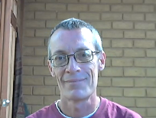
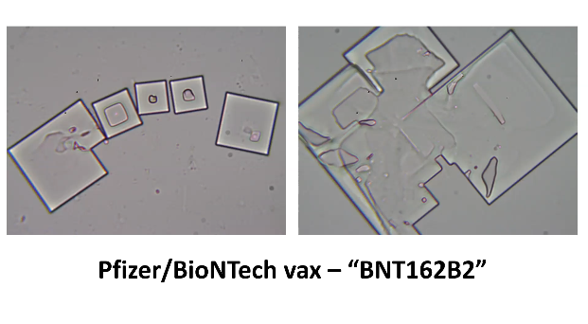
“MICROSCOPE ARMY” TESTS DONE ON COMPONENTS IN VACCINES WITH EMF
MATT TAYLOR
ELECTRICAL ENGINEER
HOLDS TWO MASTERS DEGREES
AMERICAN EXPAT LIVING IN ECUADOR
HAS EVALUATED COVID VACCINES, TEST SWABS, MASKS UNDER A MICROSCOPE WHILE STIMULATING WITH EMF
HOPEGIRLBLOG.COM
SEE FULL REPORT IN SHOW NOTES
FTWPROJECT.COM

Slide 14
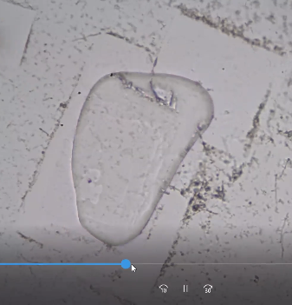
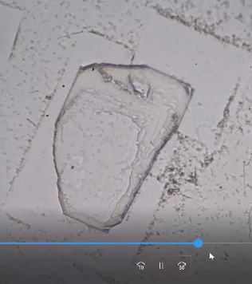
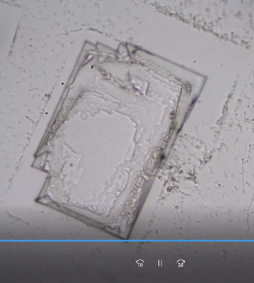
COMPONENTS IN COVID SHOTS TRANSFORM
FROM THIS
TO THIS
WHEN STIMULATED WITH EMF FROM WIFI
HOPEGIRLBLOG.COM
FTWPROJECT.COM

Slide 15
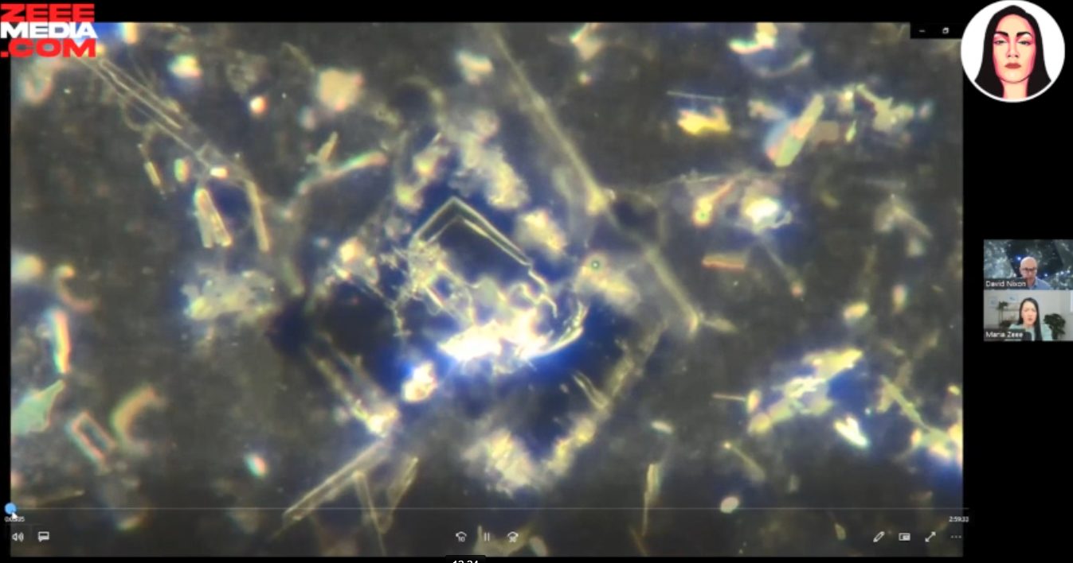
AGAIN.. SELF ASSEMBLY OF NANOTECH WHEN STIMULATED BY EMF
David Nixon showing Covid injections self assembling with robotic arms when stimulated by EMF.
These same experiments are being replicated by several “Microscope Army soldiers”
around the world.
When put in an EMF blocking Faraday Cage, the components disassembled and virtually disappeared and would not reassemble.
HOPEGIRLBLOG.COM
FTWPROJECT.COM

Slide 16
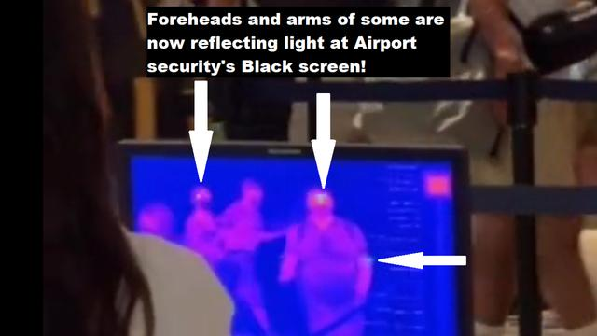
Bodies being scanned at an airport by a camera looking for luciferase glowing areas on people from the COVID injections.
SEE FULL REPORT IN SHOW NOTES
HOPEGIRLBLOG.COM
FTWPROJECT.COM

Slide 17
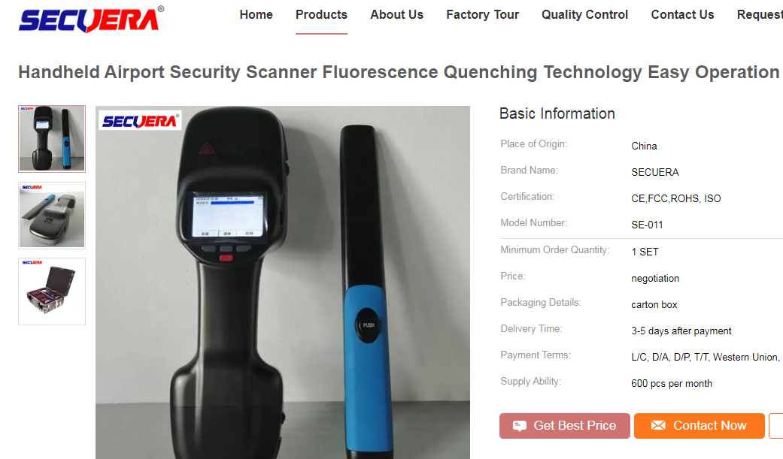
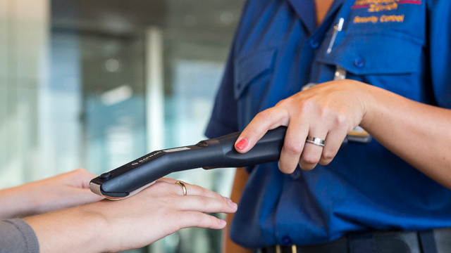
Airport Security Fluorescence Hand Held Scanner
HOPEGIRLBLOG.COM
FTWPROJECT.COM

Slide 18
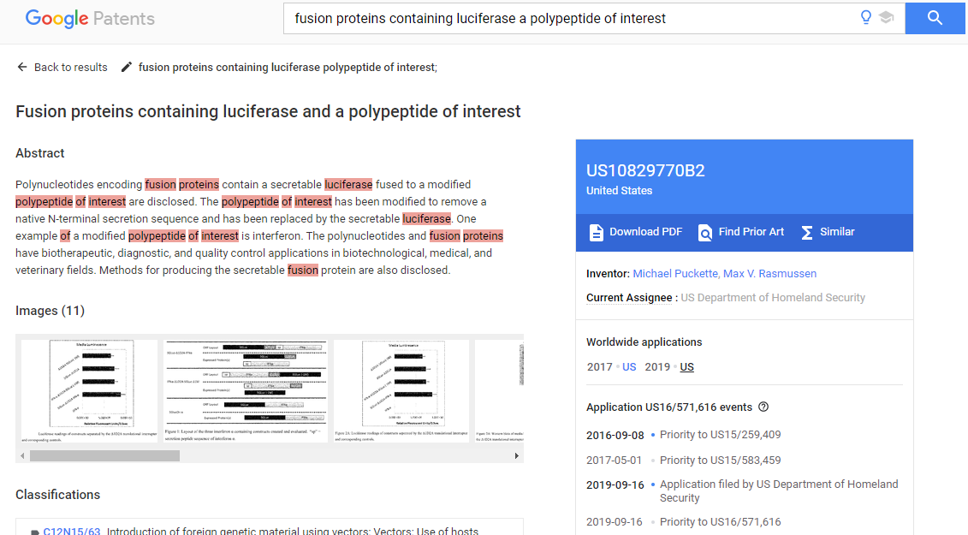
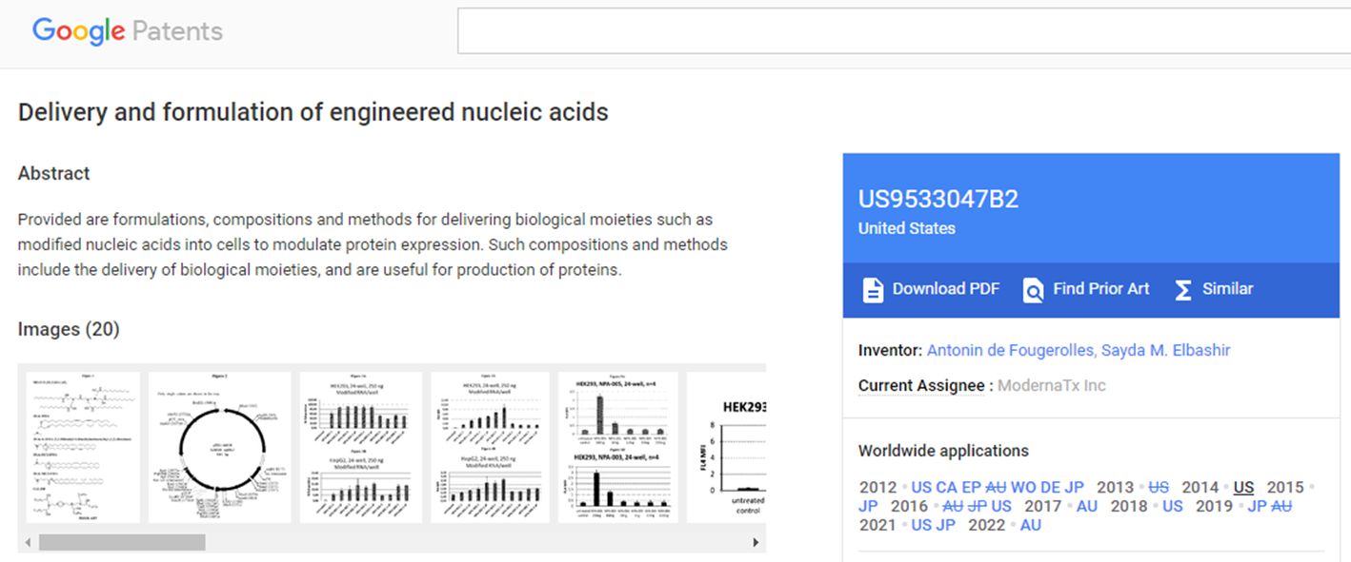
Patents showing Luciferase used in COVID Injections
HOPEGIRLBLOG.COM
FTWPROJECT.COM

Slide 19
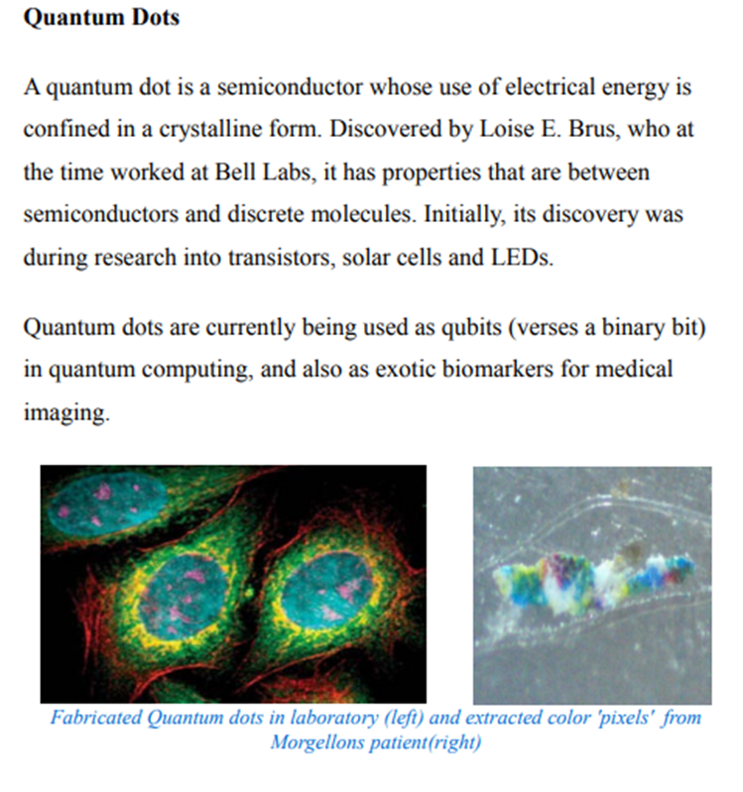
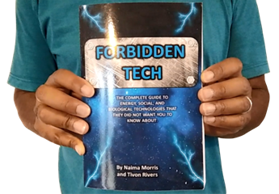
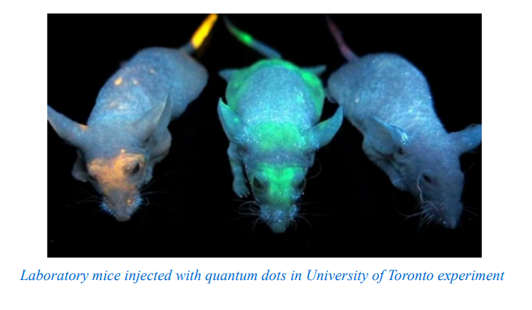
We wrote about Quantum Dots in 2017. Now quantum dot technology is found to be in the COVID vaccines.
FROM OUR BOOK “FORBIDDEN TECH” 2017
WWW.FTWPROJECT.COM

Slide 20
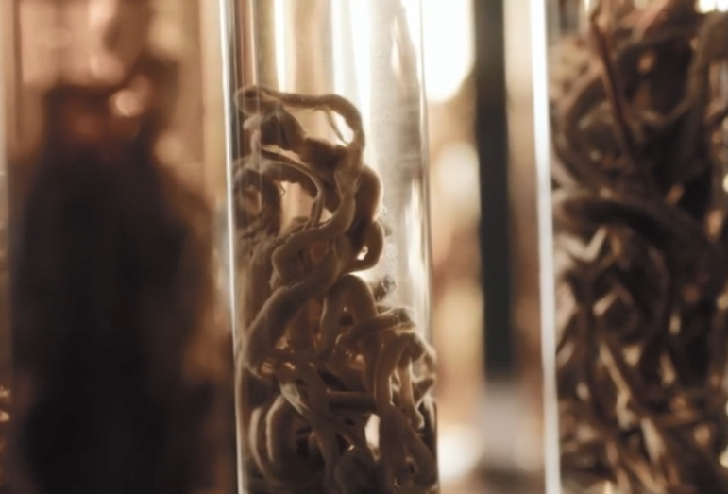
ANALYSIS OF WHITE FIBROUS STRUCTURES FOUND BY EMBALMERS
Question arises. What connection do these constructs have with the clotting structures extracted from the embalmers?
Are the white fibrous structures made by and from the technology in the shots?
-Dr. Jane Ruby and Mike Adams (‘The Health Ranger’) Reveal Post-Covid Clot Mysteries
“These rubber structures are NOT blood clots”
Summary of Laboratory Analysis Findings that were published from the elemental analysis:
- self assembling biostructures that get bigger over time inside peoples’ blood vessels
- unlike blood, contains only trace amounts of iron (5%), potassium, magnesium and chlorine, but more potassium
- Sodium, Tin (588%), and Aluminum were in much higher amounts in the structures than human blood
- This structure is ‘harvesting’ conductive elements from the blood to increase its size (grow). The structure take the shape of the artery (or vein) it resides in.
- These elements make these structures electromagnetically conductive in the RF range . For what purpose?
- It is unknown the exact mechanism by which these things are forming, although there are ideas. Lookup Dr. Charles Lieber Patents (arrested and convicted for selling ‘bio-circuitry’ secrets to China)
HOPEGIRLBLOG.COM
SEE FULL REPORT IN SHOW NOTES
WWW.FTWPROJECT.COM

Slide 21
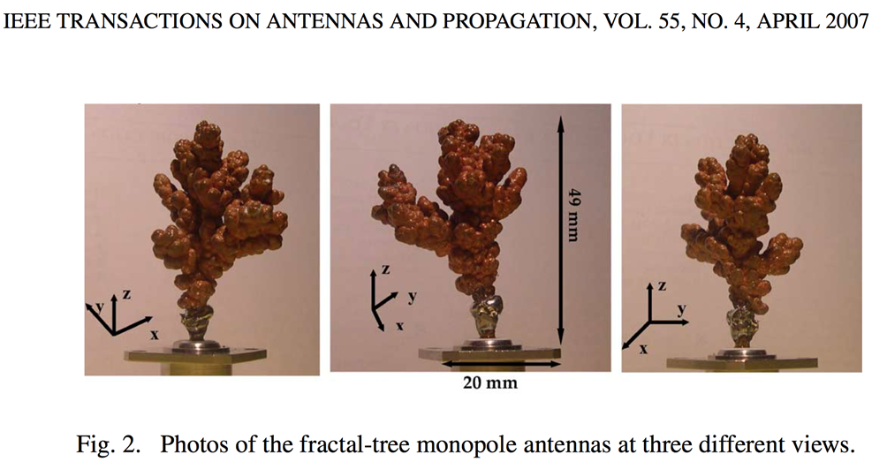
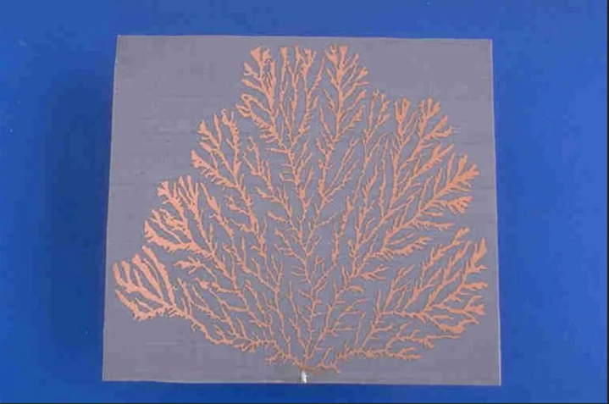
FRACTAL ANTENNAS
Can the fibrous structures behave like fractal antennas?
Suggested Tests on Rubbery Fibrous ‘Clots’
- Do these fibrous clots change dimension when stimulated by EMF pulse(s)?
- Is there instantaneous thermal heating associated with these ‘clots/structures’ when stimulated by EMFs?
- Do these structures have resonant frequencies in the mega (and gigahertz) range (with low loss)?
HOPEGIRLBLOG.COM
WWW.FTWPROJECT.COM

Slide 22
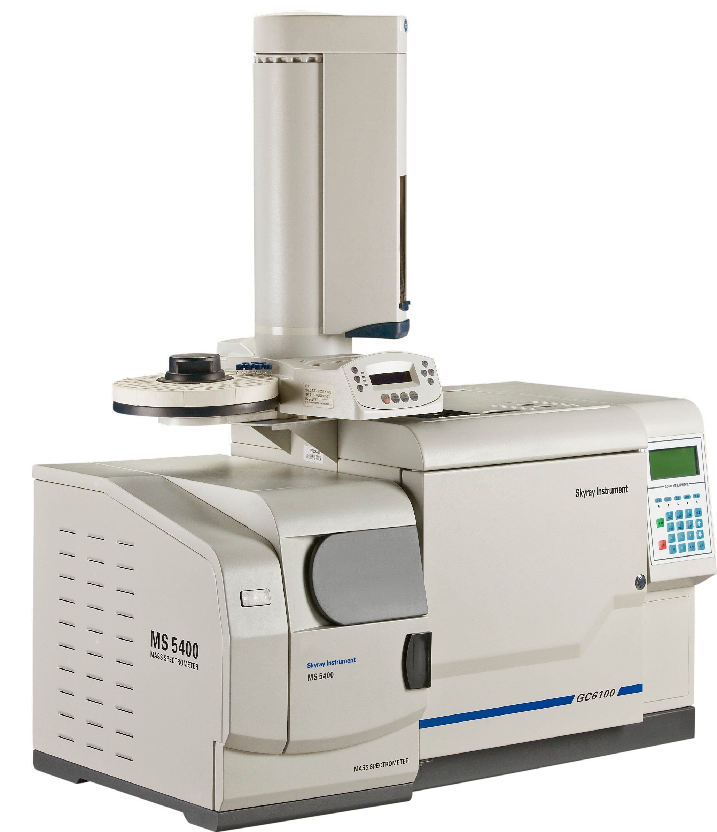
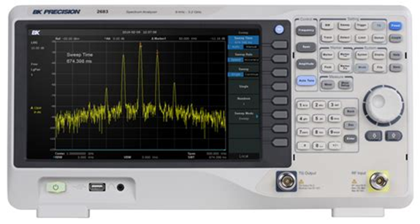
EFFORTS ARE UNDERWAY TO FIND A SOLUTION: THE MICROSCOPE ARMY
UPDATE! Matt Taylor and Dave Nixon are both currently working on testing blue tooth code activations with the right equipment. Their findings so far: they can grow the chips outside of the body and get them to emit. They are also able to “harvest” chips at will. This means that we can start testing tools to eliminate these from the body without running human risk. More COMING soon.
Equipment requires training to operate and a budget:
- 12,000 USD for a good dark/light field microscope w/ digital display output
- 2K-3K USD for laptop, video display and HD editing
- 7K USD for lab hardware, supplies, accessories, etc.
(Note: this is only to do microscopic study.)
- Mass Spectrometer (2k – 200k)
- Electromagnetic Detection Hardware (spectrum analyzer, etc.)
- Faraday Cage
- Oscilloscope / Signal Generator
Equipment to run experiments (Faraday Cage, hardware R&D, etc.)
Conclusion: You need time, money and technical competency
HOPEGIRLBLOG.COM
FTWPROJECT.COM

Slide 23


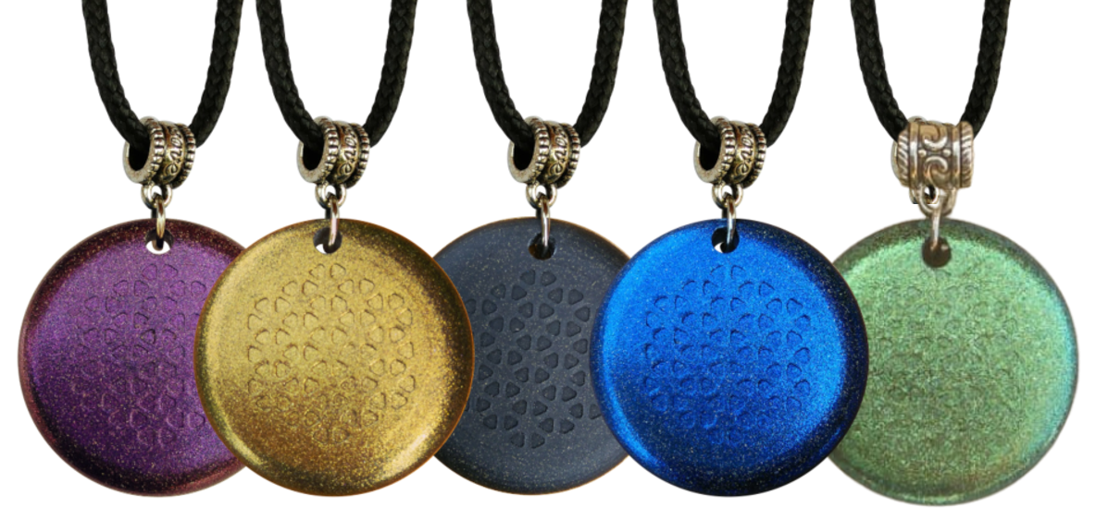
HOW DO WE FIGHT BACK AGAINST THIS TECHNOLOGY?
Three Basic Vectors of Defense:
FRY THE CIRCUIT
-Experiments with EMF pulse therapies are underway
DETOX THE BODY
-Heavy Metal Detox Protocols
-Graphene Oxide Detox Protocols
-Immune System Boosting Supplements
MITIGATE EMF IN ENVIRONMENT
-Turn off Wi-Fi at night
-Metal Screens in windows
-EMF blocking Paint on walls
-EMI filters on sockets
-Move away from cities
-Use orgone EMF protection products
HOPEGIRLBLOG.COM
LINKS TO ALL IN SHOW NOTES
FTWPROJECT.COM

Slide 24
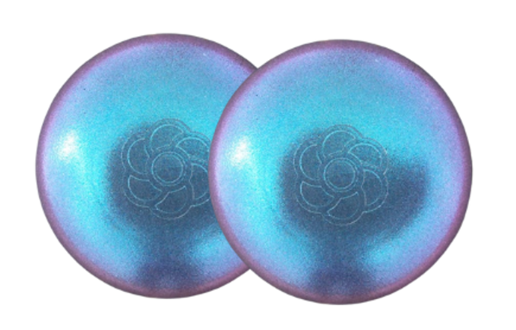

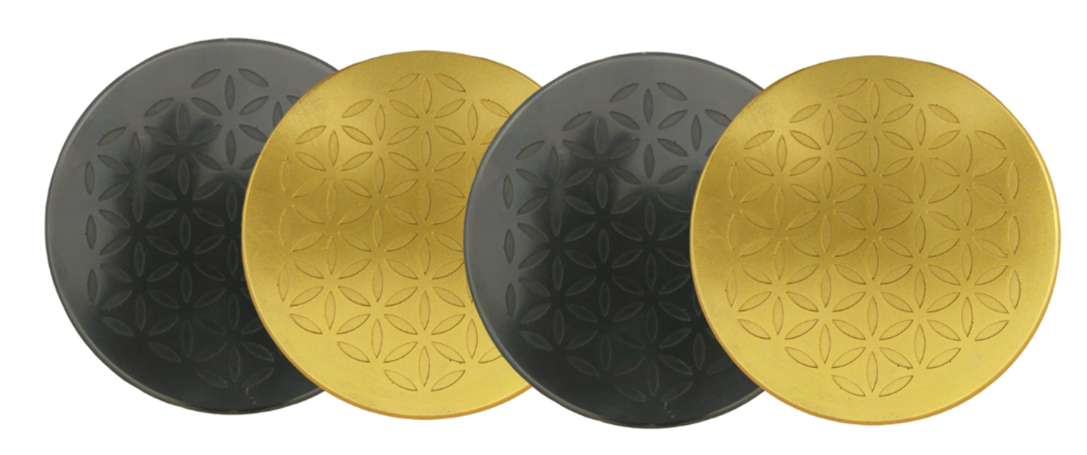
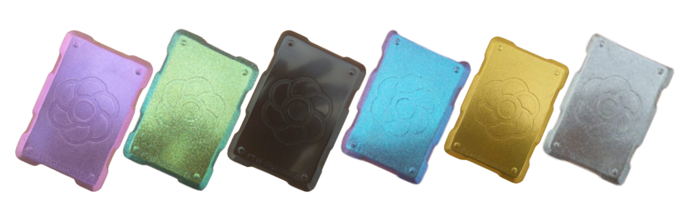
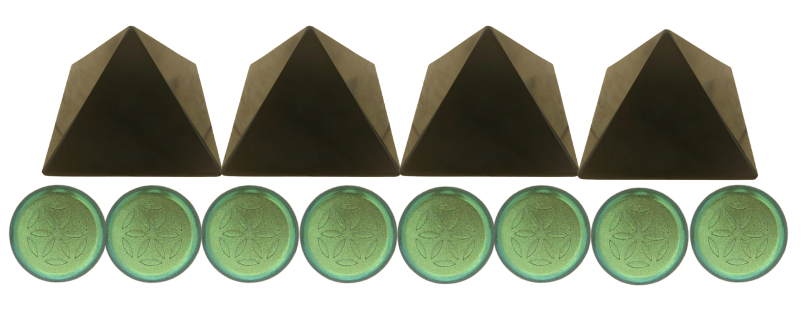
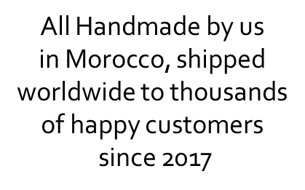
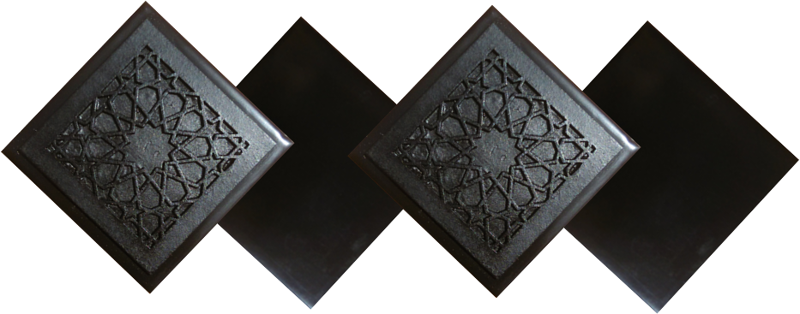
ABOUT OUR EMF PROTECTION PRODUCTS
SLEEPING PODS For a good nights sleep
HELP SUPPORT MARIA ZEEE BY SHOPPING FROM THIS LINK: https://www.ftwproject.com/ref/468/
CHARGE PLATES for use around the home, to preserve food and more
“We just can't believe our eyes! We have placed the garden pucks from our first order around our property, and the plants/trees with the pucks are BLOOMING within days! This is happening with every single place the pucks have been rested. Just incredible.” -Australia
PHONE SHIELDS to put on your cell phone, laptop and routers
PENDANTS for personal emf protection on your body
PYRAMIDS and garden sets for gridding your home / property / garden for emf protection on a large scale
SCIENTIFIC STUDIES AND DOCUMENTATION DESCRIBING HOW OUR PRODUCTS WORK AVAILABLE ON OUR WEBSITE.
TILES for incorporating emf protection into construction projects
WWW.FTWPROJECT.COM

Slide 25

Our Book “Forbidden Tech”
The complete guide to energy, social, and biological technologies that they did not want you to know about.
www.forbiddentech.website

