Slide 1

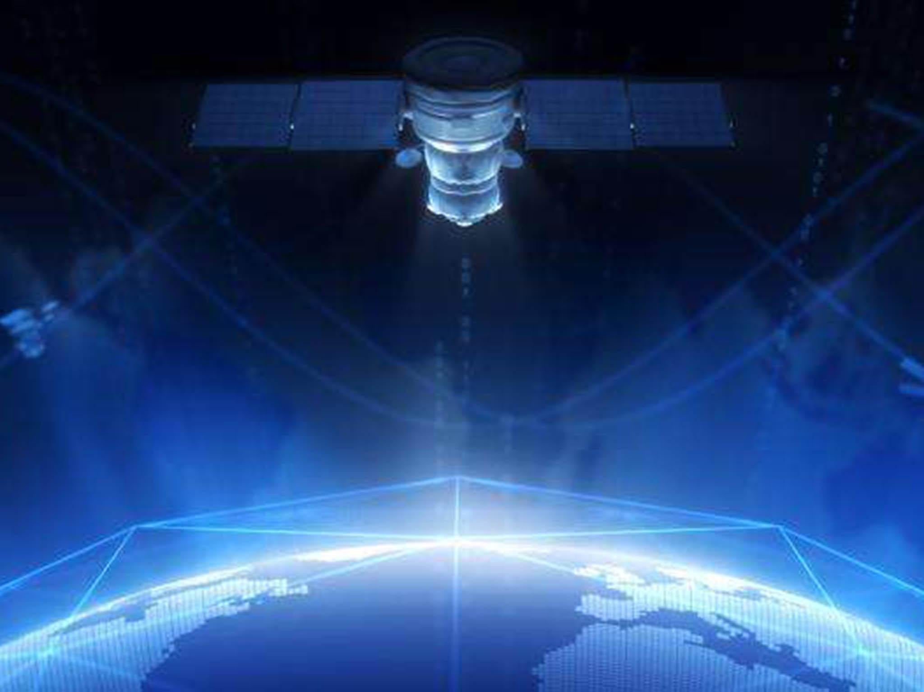




Slide 2
Our Presentation Goal
In this presentation we are attempting to explain the mechanics of the Beast System, and how through recent COVID agenda tactics and now chemical warfare, their plans of implementing a 4th industrial revolution with mass migration, transhumanism and depopulation are underway.
To understand what makes the “internet of things” operate, we must first understand its quantum underpinnings. The technology being used today is much more advanced than they disclose.
The goal of this presentation (and all of our others) is to equip you with knowledge and understanding of how the weapons that are being used against you work. Hopefully this will help you to better protect yourself and your families for the days that are ahead.
WWW.FTWPROJECT.COM

Slide 3
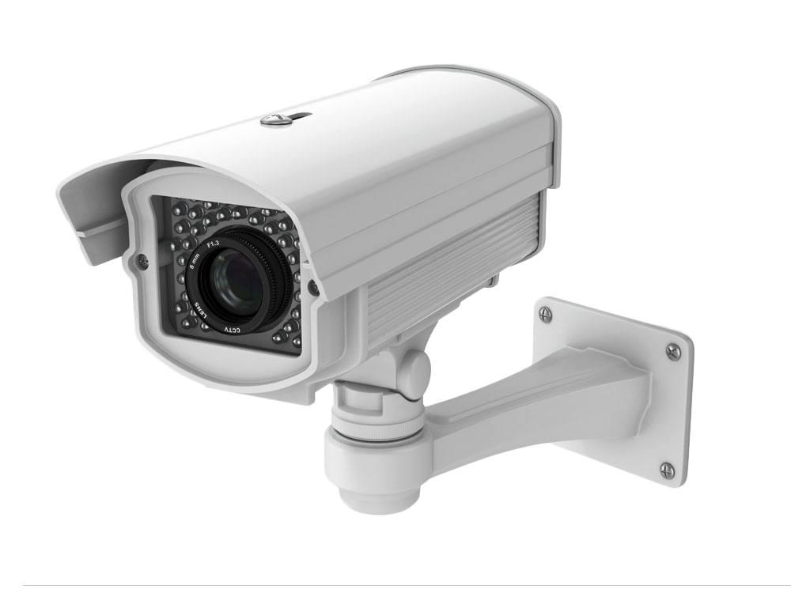
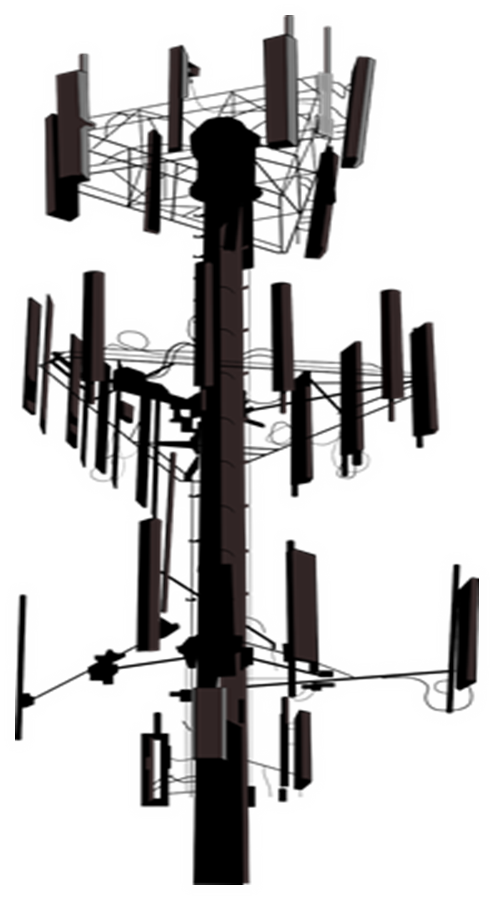
SUMMARY
-Defining Quantum Entanglement
-Explaining Quantum Communication
-Quantum Communication tests done by Chinese University-Bombshell, most governments could be using this network right now
-Defining Supercomputers- what data is being aggregated?
-Cesium Atomic Clocks
-Graphene Oxide in the shots works quantumly to control 5G
-Update on White Fibrous Clots investigation
-surveillance updates facial recognition and more
-Chemical Warfare List of Chemical Crisis since the beginning of the year in the US
-Description of the chemicals used in WWI -East Palestine Ohio
-The dangers of Dioxin Articles
-The 3 narratives: Fukushima replay and how you know this is a coverup
-FTW Cattle Farmer Project
Blog Post with Links to everything referenced in the description.
WWW.FTWPROJECT.COM

Slide 4
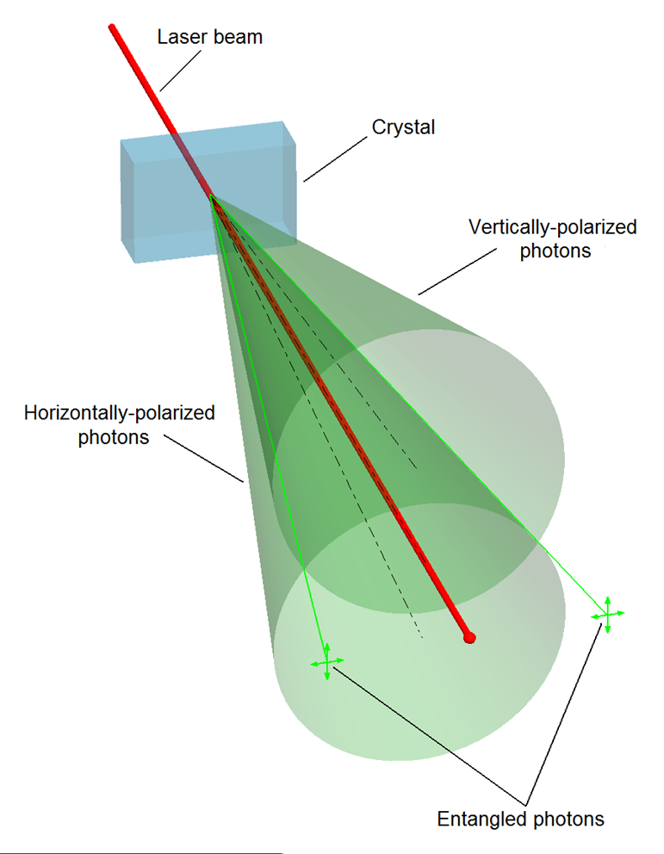
What is Quantum Entanglement?
Quantum entanglement is the phenomenon that occurs when a group of particles are generated, interact, or share spatial proximity in a way such that the quantum state of each particle of the group cannot be described independently of the state of the others, including when the particles are separated by a large distance. The topic of quantum entanglement is at the heart of the disparity between classical and quantum physics: entanglement is a primary feature of quantum mechanics not present in classical mechanics. - wikipedia
WWW.FTWPROJECT.COM

Slide 5

Quantum Communication
The quantum internet uses single photons to carry information. There are various methods that take advantage of the subatomic properties of light to create secure near-instant communication
Quantum networks use the quantum properties of photons to encode information. For example photons (light) polarized in one orientation may pass through an optical filter oriented in the same direction, verses light polarized in an inverted direction will not pass. This property can used to pass a 1 or a 0, the foundation of logic.
These protocols of quantum communication also have a property called superposition, where the information the photon carries is portrayed in several states simultaneously. If a hacker tries to intercept the photon, the information state collapses to only a single value, thus destroying the information and indication the communication line (fiber optic cable) has been breached. A properly designed and operated quantum network derives inherent security from this behavior.
Quantum network repeaters are being developed that are able to use entanglement of photons in the network to amplify and reach the distant recipient.
(‘DOE Explains...Quantum Networks’ – energy.gov)
https://www.energy.gov/science/doe-explainsquantum-networks
WWW.FTWPROJECT.COM

Slide 6
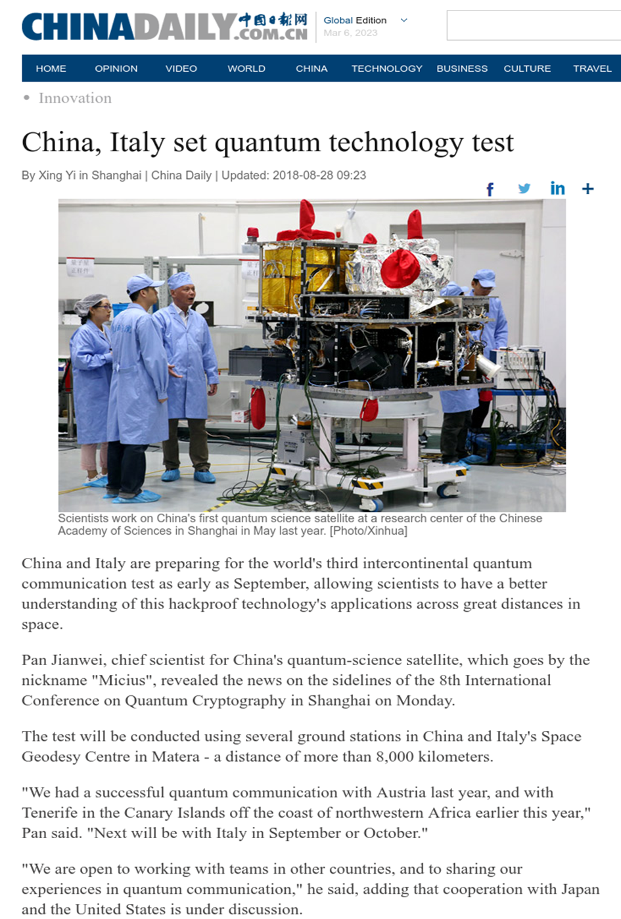
Quantum Communication Test Done By China

Slide 7
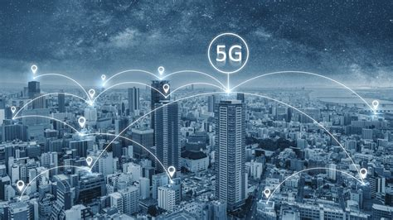
5G is “All in the Timing”
Network Synchronization problems for 5G
Carrier in North America rely on GPS to tell their cell sites what time it is. This method worked for 4G LTE, but not for 5G due to tighter requirements.
Getting out of sync with the larger network could cause the site to go down (offline)
Traditionally, cell sites needed to be on synchronized clocks to avoid interference among signals on the same frequency (4G). This would be too expensive to deploy on a 5G network in an urban environment.
One solution is to have redundancy built into current infrastructure by installing GPS distributed timing modules at the edge (the cell site), new built distributed 5G central offices that are closely tied to the core network, and border/boundary clocks within the network.
(‘5G Potential Is All in the Timing’ – LightReading.com)
https://www.lightreading.com/mobile/5g/5g-potential-is-all-in-the-timing/d/d-id/751383

Slide 8
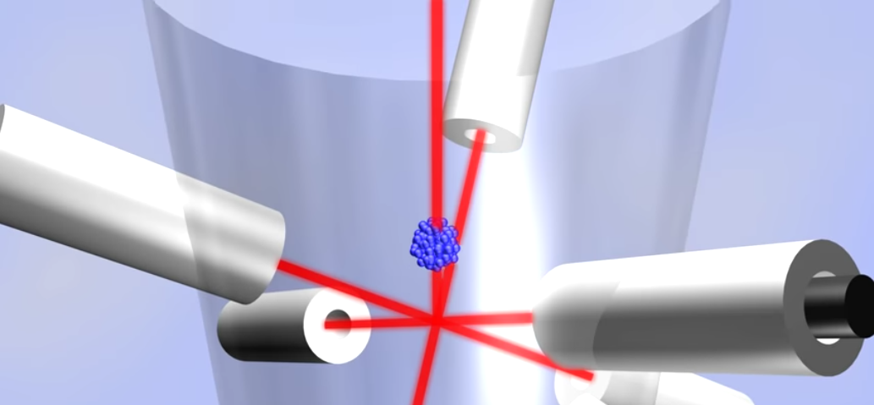
Network Timing and Atomic Clocks- Essential for any loT Network
– Atomic clocks are the most accurate timekeeping device available, and measures time by the oscillation frequency of energized atoms either by RF or optical pumping (i.e. lasers).
–The first atomic clock that used Cesium atoms was designed by Louis Essen in 1955, and built at the National Physics Laboratory in the UK.
–Evolutions of the Cesium-based atomic clock with improved accuracy has made it the universal global standard for timekeeping. ex. NIST-F1
–Coordinated Universal Time, (UTC), is the primary standard adopted throughout the world to regulate time reference by highly accurate atomic clocks.
–NTP, is the abbreviation for Network Time Protocol, which is a standard used for synchronizing the computer network equipment (IoT) to an accurate time source (remote GPS, NIST, or UTC Time Server). Note: GPS is favored option
–Global Positioning System - GPS, consists of 24 satellites which orbit the Earth. It was originally developed by the US military to provide accurate global positioning information for navigational purposes. Each satellite has on-board a highly accurate atomic clock & ground-based GPS receivers can obtain the precise time information GPS offers for synchronization of devices’ internal time. The GPS signal is available anywhere in the world and is universal. NTP time servers reference the GPS system! Are the new satellites using Cesium Atomic Clocks or something else?

Slide 9
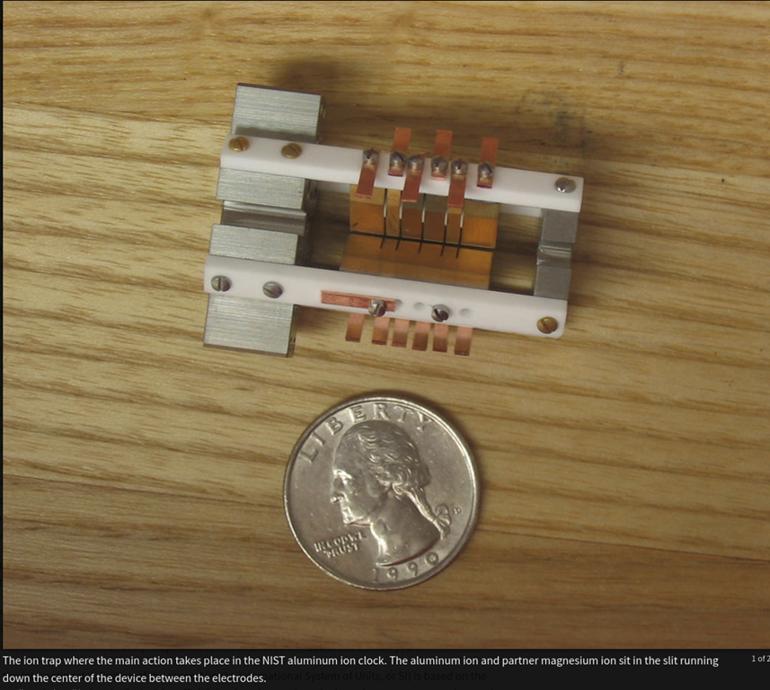
A Revolution in GPS Infrastructure- the new Quantum Logic Clock
“NIST's Second 'Quantum Logic Clock' Based on Aluminum Ion is Now World's Most Precise Clock” - https://www.nist.gov/news-events/news/2010/02/nists-second-quantum-logic-clock-based-aluminum-ion-now-worlds-most-precise
2010 NIST scientist built an experimental atomic clock based on a single aluminum atom that is now the world’s most precise clock, more than twice as precise as the atomic Mercury clock. It neither gain nor lose one second in about 3.7 billion years!
By comparison the Cesium F1 clock neither gain nor lose one second in about 100 million years!
“Other possible applications may include ultra-precise autonomous navigation, such as landing planes by GPS.”
Summary: More accurate, higher frequency atomic clocks allow for higher bandwidths across the global network to be achieved. When combined with quantum logic, it is possible to affect one device (or many) simultaneously through remote platforms that rely on high precision communication. We are witnessing a revolution in the GPS infrastructure.

Slide 10
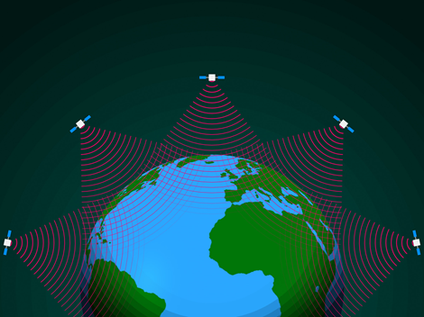
New Satellite Clusters Resolve Timing Issues
Timing is also getting resolved by having new satellite clusters deliver wireless internet directly to the your current mobile phone
(‘Satellite Cell Towers Will Beam 4G to Your Phone’ – successdigestonline.com), 2020
https://successdigestonline.com/satellite-cell-towers-will-beam-4g-to-your-phone/
“The hard part is the uplink from the phone,” says Charles Miller, cofounder and CEO of Lynk, a satellite communications company based in Virginia. “You can’t change the phone to add more power. It needs to work out of pocket.”
The signal from ground device to satellite used to be too weak until Lynk started testing core technology on 2G network from ISS to mobile devices on the ground in 2019 in remote locations. The solution involves the used of a special antenna configuration that company will not publicly disclose.
April 1st 2022, Lynk launched ‘world’s first commercial cell-tower-in-space’ www.lynk.world
Lynk has plans for 5,000 micro-satellites in very low Earth orbit (LEO)
What about the non-commercial cell-towers-in-space?
If such infrastructure can locate and communicate with your phone anytime, anywhere then potentially it can target you for death and destruction anytime, anywhere.

Slide 11
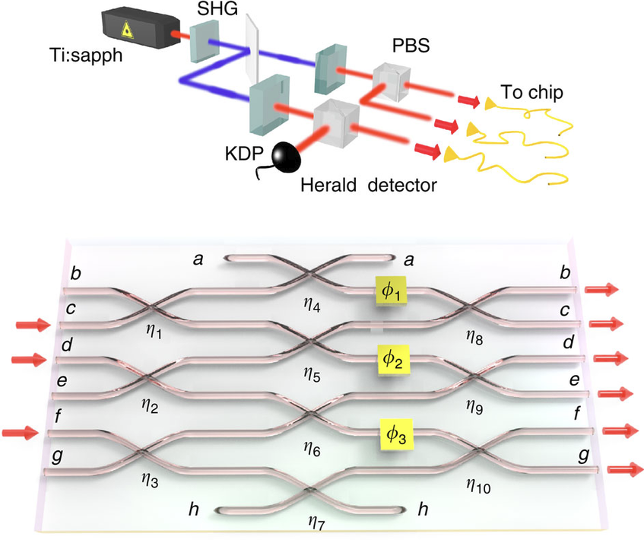
Modern Supercomputers
A super computer is a computer that has been constructed to do an insane amount of calculations much faster than the consumer desktop. The supercomputers of today would basically be a form of quantum computer, only operated by governments and contractors and banks. There are several types of quantum computers currently in operation: One are cryogenic super-cooled quantum computers (D-Wave). There are ion confinement atomic clocks that take the charged ions (i.e. Aluminum and Manganese) and use this atoms as a means of calculating time and qubit logic. This is attractive design as similar versions of ion confinement can be done at room temperature room temperature. The science has been around for a long time.
There is another type of quantum computer that is light based. The circuit boards themselves use light diffraction. To do this they need to create optical photon circuit-boards.
https://www.researchgate.net/publication/234142226_Multiphoton_quantum_interference_in_a_multiport_integrated_photonic_device

Slide 12
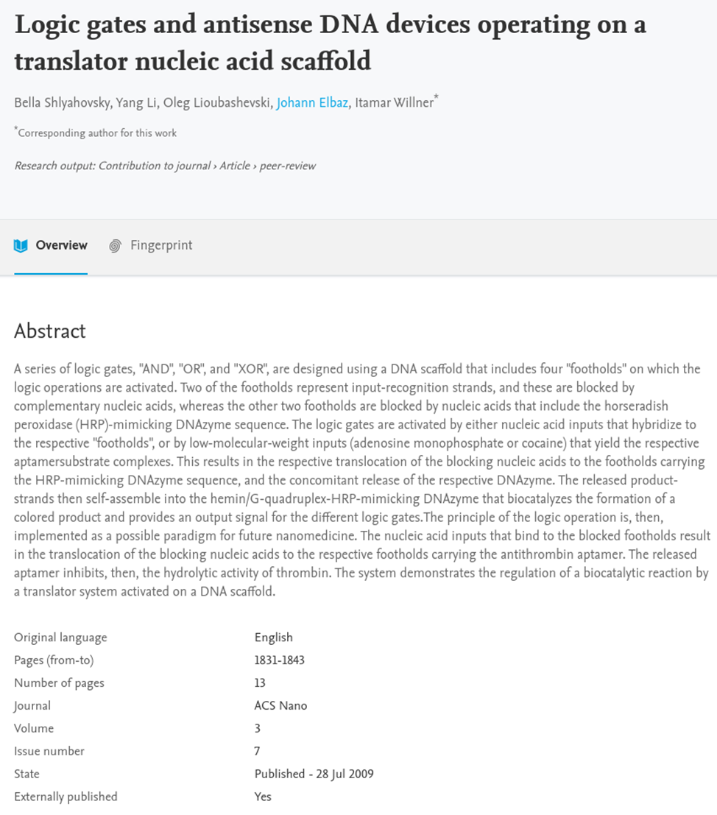
DNA Based Computers
A third kind of computer is DNA based computing, where they use the DNA strand itself to perform computer logic operations, 2009!
This is the kind of hardware that you need to run this kind of infrastructure. This technology is around right now and is being used. The question is to what degree is it being used? We know from human history that work on these things can take decades before the general public becomes aware.
Our physical bodies require DNA instructions to survive. DNA computing can turn it into electric analog signals. Once you get to this point you have your infrastructure that can take this biological information, and turning the analog signal into a digital signal to be displayed as a series of intelligent waveforms that can be interpreted as: voice, sound, thoughts, images, etc.

Slide 13
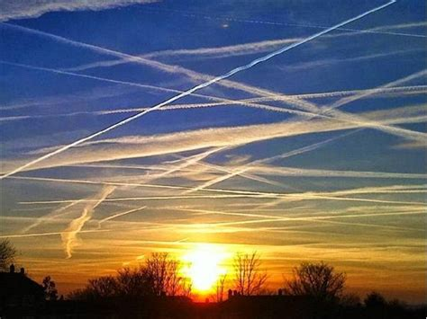
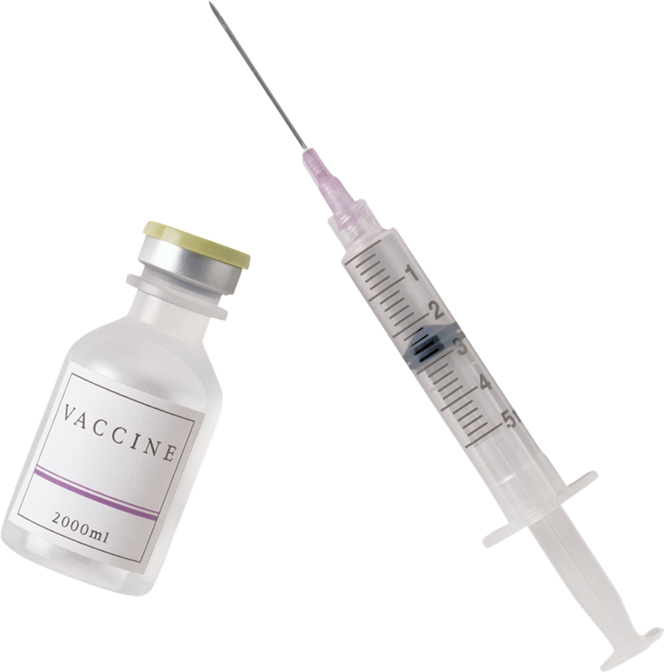
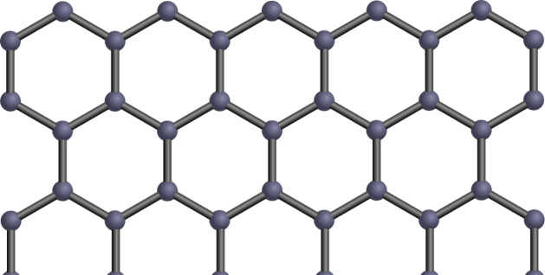
Replicates and self assembles nanotech inside of the body
Used to track and trace humans
DNA targeting
Used for mind control and other forms of control of humans
Used for depopulation
(references in our past presentations)

Slide 14
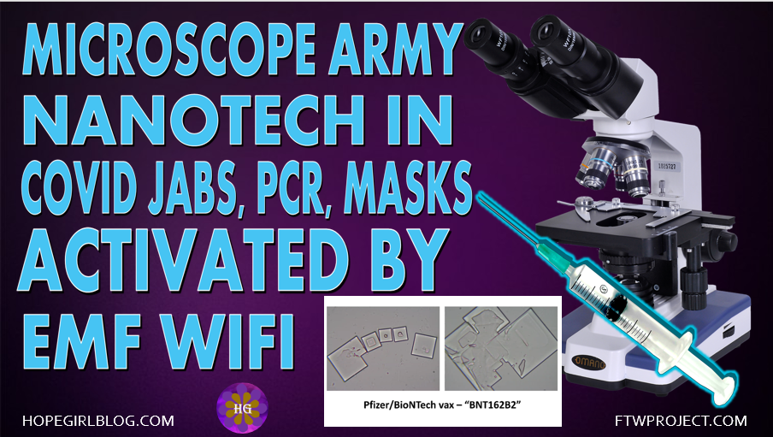
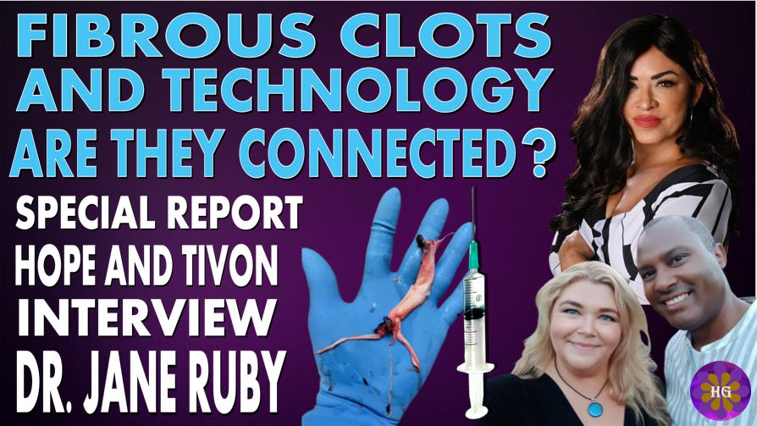
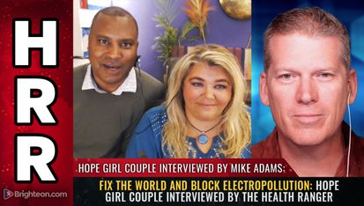
ARE THEY TURNING HUMANS IN TO TRANSHUMAN ANTENNAES?
UPDATE ON WHITE FIBROUS CLOTS INVESTIGATION
Are the white fibrous clots found the vaccinated deceased by embalmers the evidence that the Covid Vaccines are turning people into walking antennae's to be controlled by an outside source such as 5G?
We have been conducting an ongoing investigation over the last several months regarding the white fibrous clots that embalmers have been finding in the vaccinated deceased all over the world.
November 2022
Spoke with Engineer
Matt Taylor
December 2022
Spoke with Dr. Jane Ruby
February 2023
Spoke with Mike Adams
WWW.FTWPROJECT.COM

Slide 15
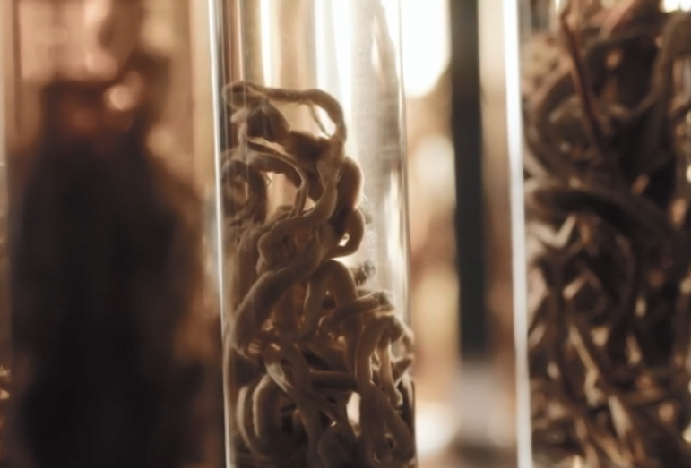
WHITE FIBROUS CLOTS FOUND IN VACCINATED DECEASED
Are the white fibrous structures made by and from the technology in the shots?
-Dr. Jane Ruby and Mike Adams (‘The Health Ranger’) Reveal Post-Covid Clot Mysteries
“These rubber structures are NOT blood clots”
Summary of Laboratory Analysis Findings that were published from the elemental analysis:
- self assembling biostructures that get bigger over time inside peoples’ blood vessels
- unlike blood, contains only trace amounts of iron (5%), potassium, magnesium and chlorine, but more potassium
- Sodium, Tin (588%), and Aluminum were in much higher amounts in the structures than human blood (these are electrical conductive elements)
- This structure is ‘harvesting’ conductive elements from the blood to increase its size (grow). The structure take the shape of the artery (or vein) it resides in.
Our Notes and observations:
It is unknown the exact mechanism by which these things are forming, although there are ideas. Lookup Dr. Charles Lieber Patents (arrested and convicted for selling ‘bio-circuitry’ secrets to China)
- These elements make these structures electromagnetically conductive in the RF range . For what purpose?
WWW.FTWPROJECT.COM

Slide 16
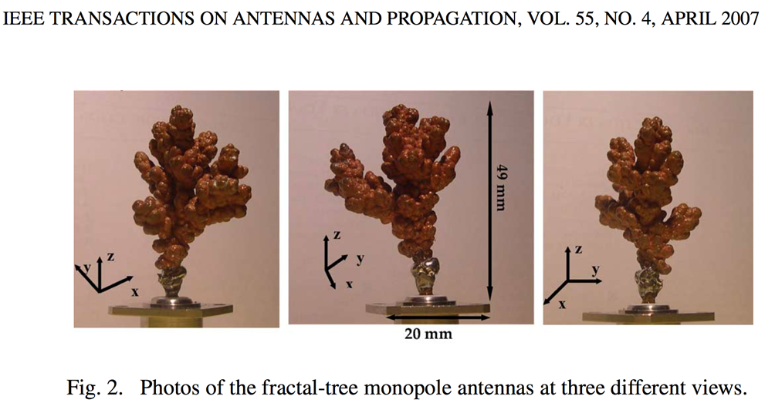
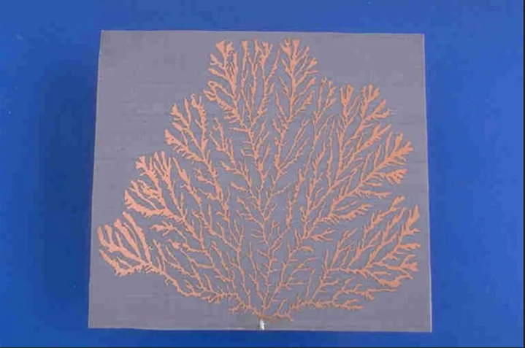
WHITE FIBROUS CLOTS FOUND IN VACCINATED DECEASED
Can they behave like fractal antennas?
Suggested Tests on Rubbery Fibrous ‘Clots’
- Do these fibrous clots change dimension when stimulated by EMF pulse(s)?
- Is there instantaneous thermal heating associated with these ‘clots/structures’ when stimulated by EMFs?
- Do these structures have resonant frequencies in the mega (and gigahertz) range (with low loss)?
WWW.FTWPROJECT.COM

Slide 17

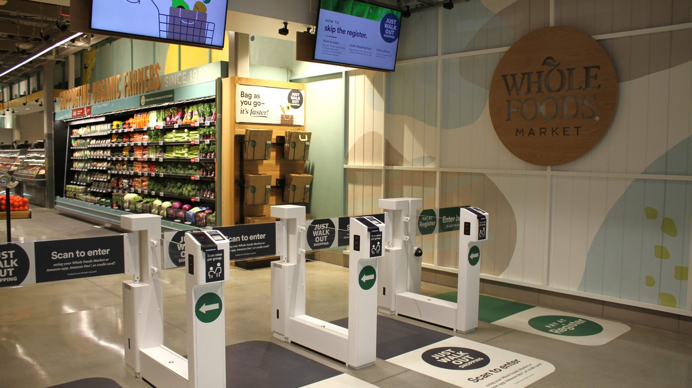
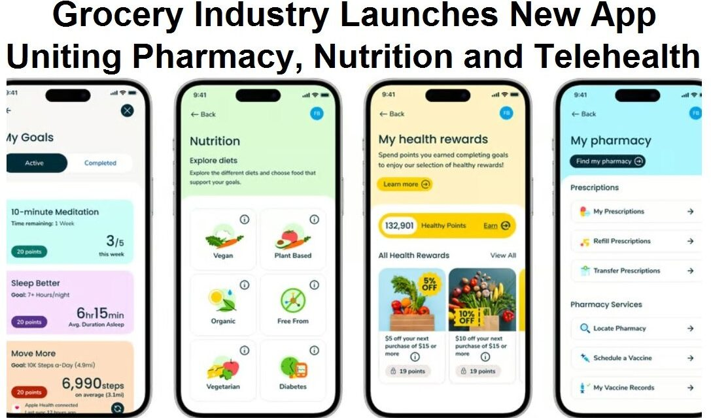
SURVEILLANCE STATE UPDATES
Facial recognition now used in the US in order to board international flights. No prior notice is given, they spring it on you just when you are about to board the plane. Your face is scanned to match up with your photo ID. Special Report on Hopegirl Rumble channel coming soon!
Whole foods has implemented Amazons walk out technology that scans your palms and your face when you walk in and deducts the money from items you purchased from your bank account.
The grocery industry has just launched a new app that tracks drug and vaccine purchases along with Food.
WWW.FTWPROJECT.COM

Slide 18
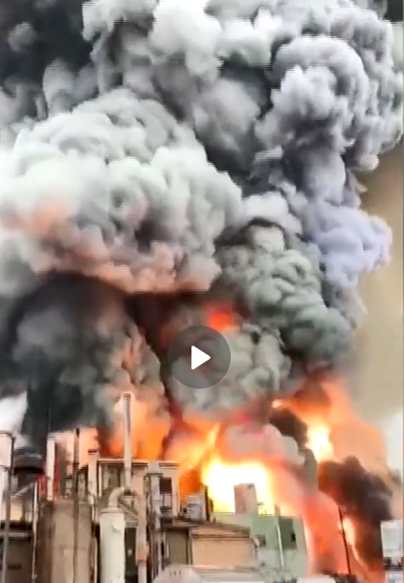
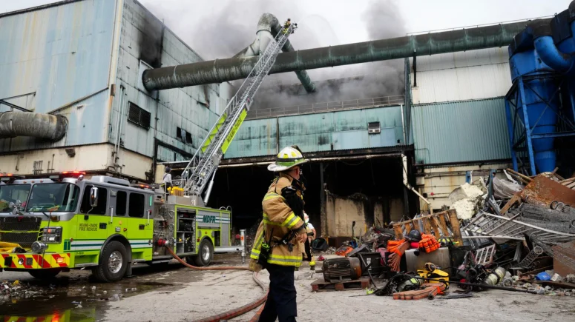
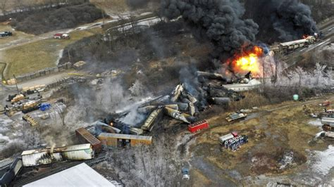
CHEMICAL WARFARE
LIST OF HAZARDOUS CHEMICAL SPILLS / EXPLOSIONS/ FIRES ON US SOIL SINCE THE BEGINNING OF 2023
Chemical Fire Illinois Jan 12
Louisiana Train Derail Acid Spill Jan 28
Ohio Train Derail Chernobyl Level Chemical Spill February 2
Ohio Building Fire Acid Leak February 3
California Fuel Pipeline Leak February 11
Florida Waste Plant Fire February 11
Texas Hazmat Train Crash February 13
South Carolina Hazmat Train Crash February 13
Arizona Nitric Acid Spill February 14
Oklahoma Chemical Tank Fire February 15
Raging Plastics Warehouse Fire in Florida February 16
Hazardous Materials Train Derailment in Michigan February 16th
Hazardous Materials Chemical Fire in Massachusetts February 16th
Nebraska Coal Train Derailment February 21
Uranium Fire in Tennessee February 22
(reference links in notes)
WWW.FTWPROJECT.COM

Slide 19
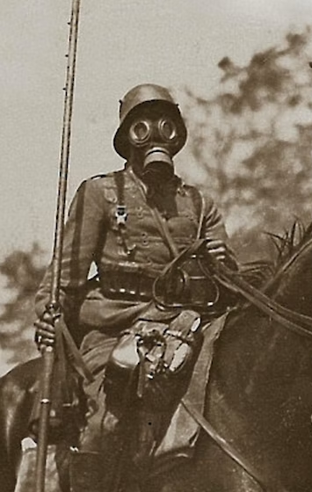
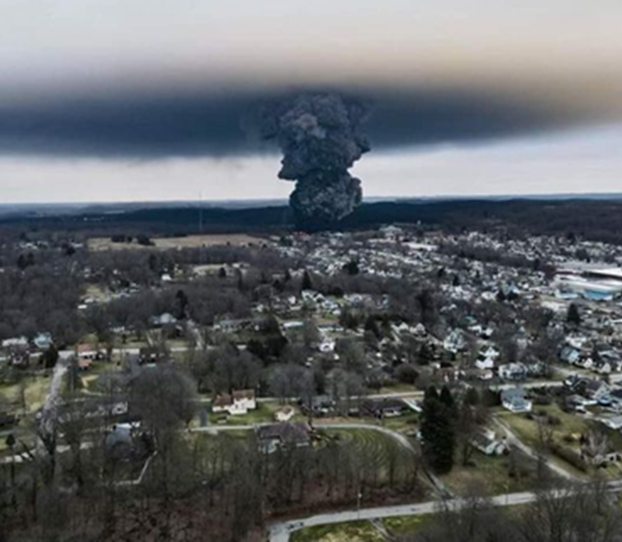
WWI Level Chemical Warfare Though East Palestine Ohio Train Derailment
Chemical Emitted In Ohio Train Crash Breaks Down Into World War I Chemical Weapon When Burned
Vinyl chloride, the chemical released from the site of the Norfolk Southern train derailment in East Palestine, Ohio, breaks down during combustion into phosgene, a substance used as a chemical weapon in World War I, according to multiple fact sheets from federal agencies.
Dioxins, a chemical byproduct of the burning of vinyl chloride and other chemicals were also released after the Ohio train derailment. They persist in the environment and will contaminate the food supply.
WWW.FTWPROJECT.COM

Slide 20


The Dangers of Dioxins
Agent Orange and Dioxin
https://agentorangerecord.com/agent-orange-and-dioxin/
Dioxins and their effects on human health
https://www.who.int/news-room/fact-sheets/detail/dioxins-and-their-effects-on-human-health
Dioxins –National Institute of Environmental Health Sciences https://www.niehs.nih.gov/health/topics/agents/dioxins/index.cfm
Learn About Dioxin EPA
https://www.epa.gov/dioxin/learn-about-dioxin
WWW.FTWPROJECT.COM

Slide 21
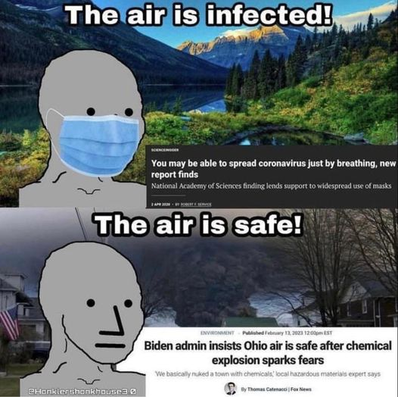
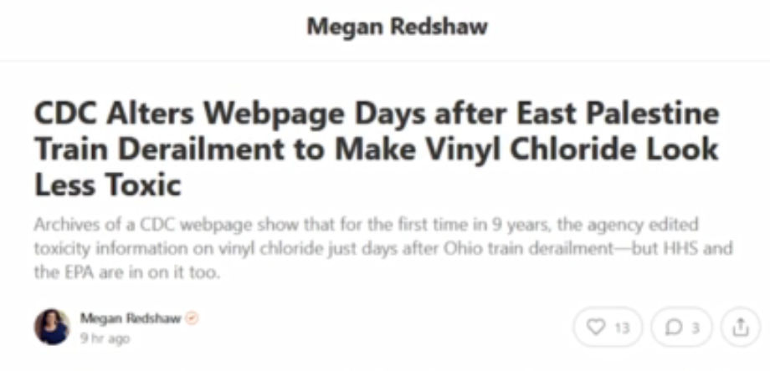
The 2 Narratives: Is this a Fukushima Replay?
Currently there are two narratives running for the chemical spills.
Narrative 1: “its not that bad”
Narrative 2: “its much worse than they are reporting”
Narrative 3: “its not that bad, they are trying to force us off the land”
Also: The CDC changed the regulation policy to make the chemicals appear to be less toxic
This is the same protocol that was implemented after Fukushima
THESE ARE SIGNS OF A COVERUP
WWW.FTWPROJECT.COM

Slide 22
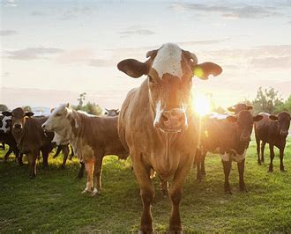
Our FTW Cattle Farmer Project
The attack on our food supply is worse than ever, especially in the meat and dairy industry.
We have been contacted by dairy farmers who have cattle that are suffering from a decreased milk supply due to 5G EMF and powerlines around their ranch.
We are running an experiment with several cattle farmers to see if our EMF protection products, along with other methods could help protect the cattle and increase a healthy meat and dairy supply.
A similar experiment was done with bees and it resulted in quadrupling the beehive. If it worked for bees, maybe it can work for cattle!
If you are a cattle farmer and you are interested in participating with us in this experiment, please contact us on the form on our website.
WWW.FTWPROJECT.COM

Slide 23
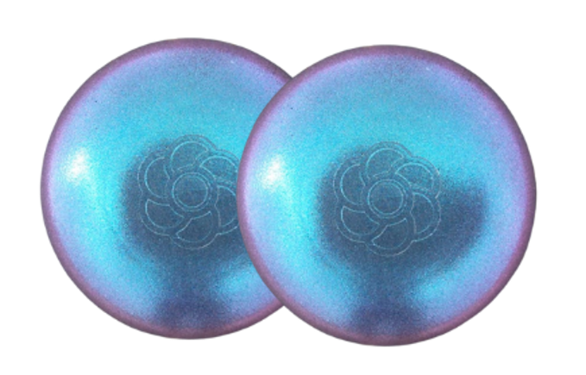

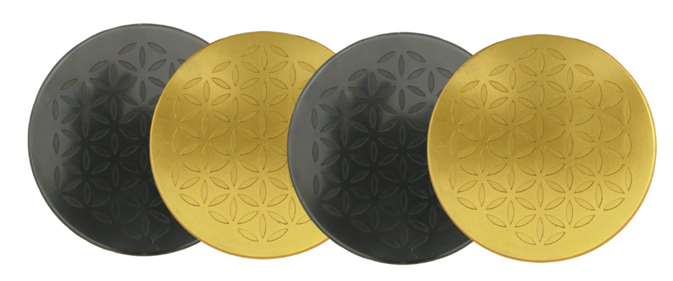
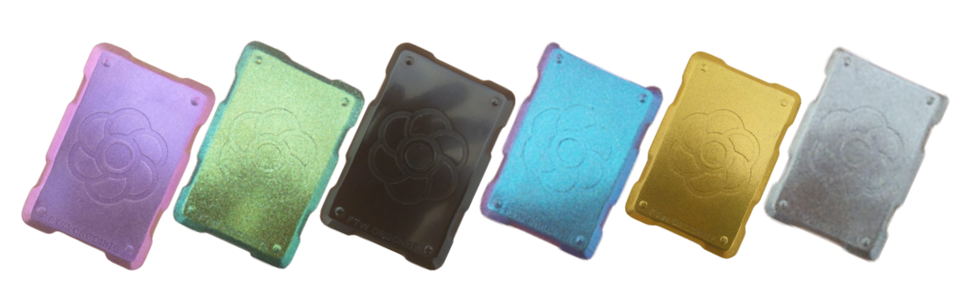
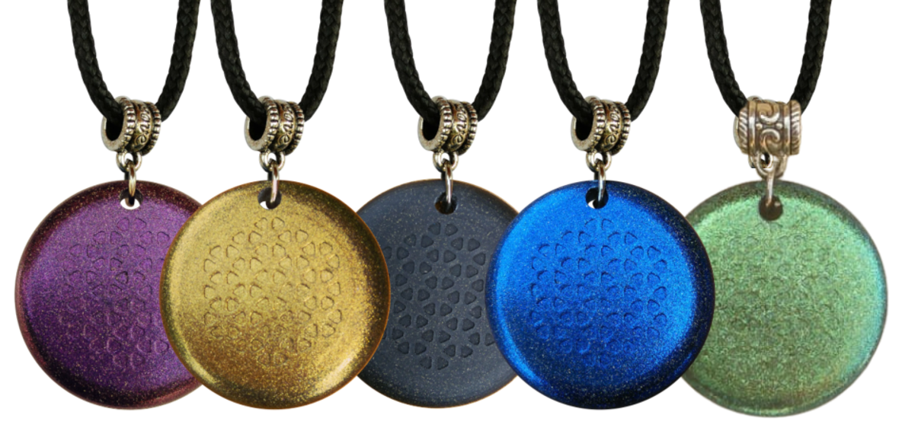
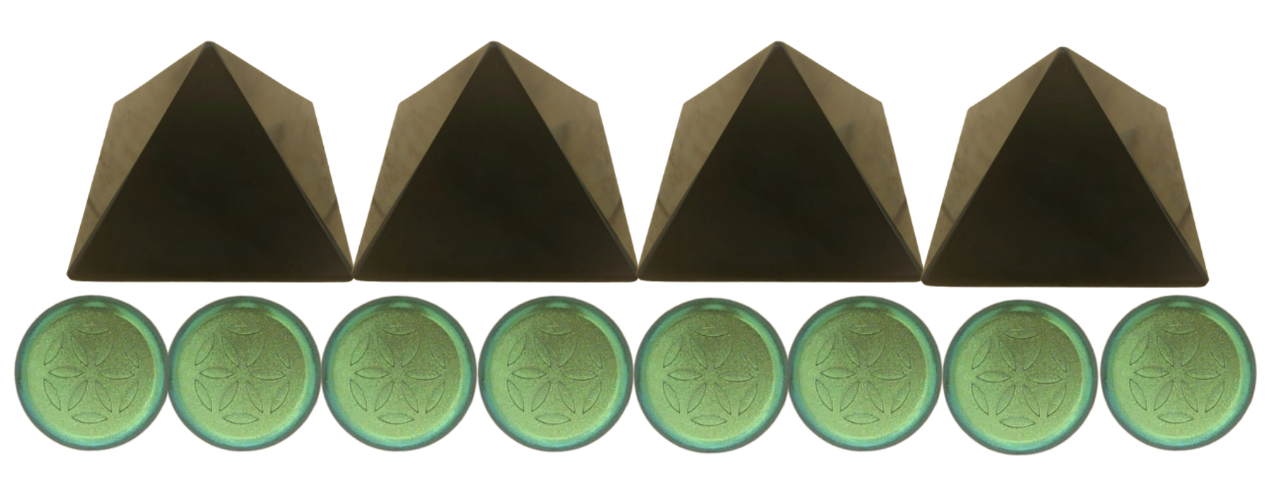
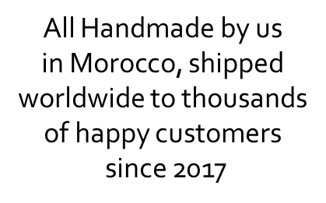
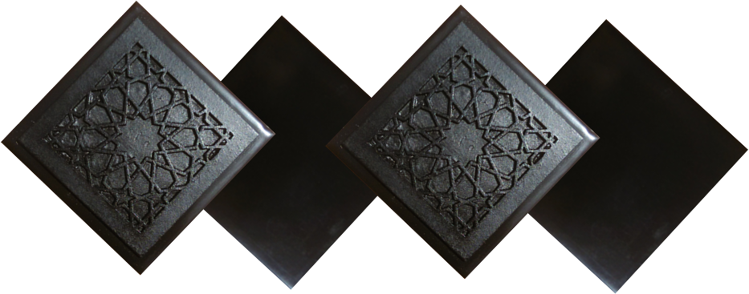
ABOUT OUR EMF PROTECTION PRODUCTS
HELP SUPPORT SGT REPORT BY SHOPPING FROM THIS LINK: https://www.ftwproject.com/ref/6/
SLEEPING PODS For a good nights sleep
CHARGE PLATES for use around the home, to preserve food and more
“We just can't believe our eyes! We have placed the garden pucks from our first order around our property, and the plants/trees with the pucks are BLOOMING within days! This is happening with every single place the pucks have been rested. Just incredible.” -Australia
PHONE SHIELDS to put on your cell phone, laptop and routers
PENDANTS for personal emf protection on your body
PYRAMIDS and garden sets for gridding your home / property / garden for emf protection on a large scale
SCIENTIFIC STUDIES AND DOCUMENTATION DESCRIBING HOW OUR PRODUCTS WORK AVAILABLE ON OUR WEBSITE.
TILES for incorporating emf protection into construction projects
WWW.FTWPROJECT.COM

