Slide 1
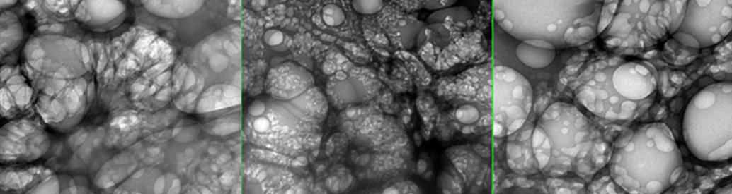
GRAPHENE OXIDE, 5G AND COVID
A PRESENTATION BY FTWPROJECT.COM

Slide 2


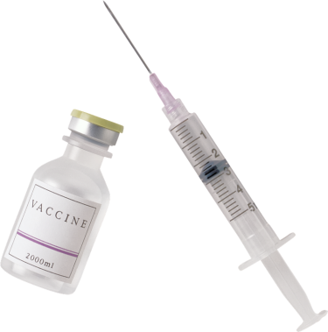
GRAPHENE OXIDE, 5G AND COVID
SUMMARY
PART 1
-Graphene Oxide Explained. They are trying to kill you with a 160 year old poison.
Graphene vs. Graphene Oxide- why its important to know the difference
How is Graphene Oxide made?
What can Graphene Oxide Do? Its unique properties is why they put it in everything.
-Graphene Oxide is the main ingredient in DARPA Hydrogels
-What’s in the Covid shots? GO, Steel, Parasites and more: New Photos
-Graphene Flagship. The money and power behind the agenda.
-Before Covid, a study was done: How much GO can they put in a human before fatal?
-Graphene Oxide in the PCR tests, in the masks, in the water supply and in chemtrails.
-How Graphene Oxide works with 5G
WWW.FTWPROJECT.COM

Slide 3


GRAPHENE OXIDE, 5G AND COVID
SUMMARY
PART 2
-Spike Proteins, Graphene Oxide, Covid Shots Explained
-Health concerns of Graphene Oxide
-Its the same symptoms! GO poisoning, EMF Radiation Sickness, Covid
-Magnetism in those who got the shots explained. It’s the graphene oxide and other nanotech.
-Connection between 5G rollouts and the Covid Variants
-How to get graphene oxide out of your body
-Orgone Energy, EMF protection and Graphene Oxide
WE CAN BACK UP EVERYTHING WE SAY WITH SCIENTIFIC EVIDENCE
EXTENSIVE NOTES, ARTICLES, REFERENCE LINKS, STUDIES, VIDEOS AS WELL AS FREE TO USE GRAPHICS AND COPIES OF THIS SLIDESHOW ARE AVAILABLE AT OUR WEBSITE WWW.FTWPROJECT.COM
WWW.FTWPROJECT.COM

Slide 4
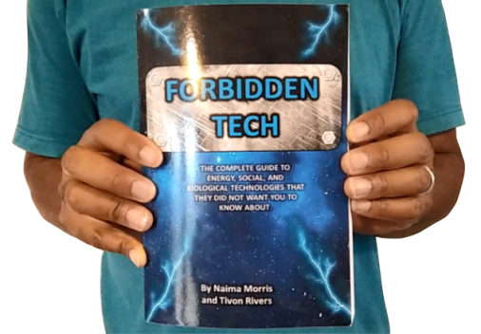
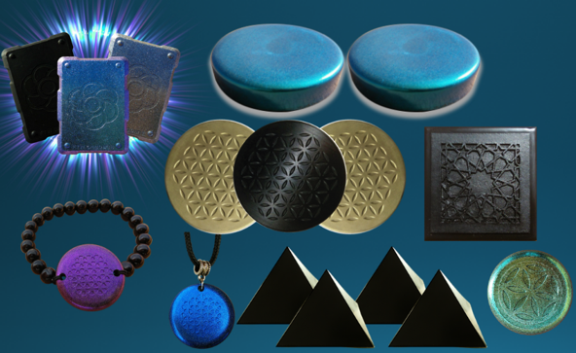

WHY WE DO WHAT WE DO
We are Christians, Engineers and Scientists. We feel it is our calling to help inform people about the technology that is being used against Gods creation. We have been monitoring the news on 5G, Covid Vaccine related issues so that we can present them in a condensed summary to inform the public.
“I will give thee the treasures of darkness, the hidden riches of the secret places…” Isaiah 45:3
FORBIDDEN TECH: The complete guide to energy, social, and biological technologies that they did not want you to know about. (2017)
www.FORBIDDENTECH.WEBSITE
Handmade products orgone and shungite for EMF protection. Made by us in our workshop in Morocco. WWW.FTWPROJECT.COM
Online engineering academy for the co-development of researching and building DIY off grid energy devices. WWW.CLEANENERGYACADEMY.COM
WWW.FTWPROJECT.COM
Notes:
If time permits we’d like to play this 4 minute clip https://www.youtube.com/watch?v=aVj7_0A5-Ew

Slide 5
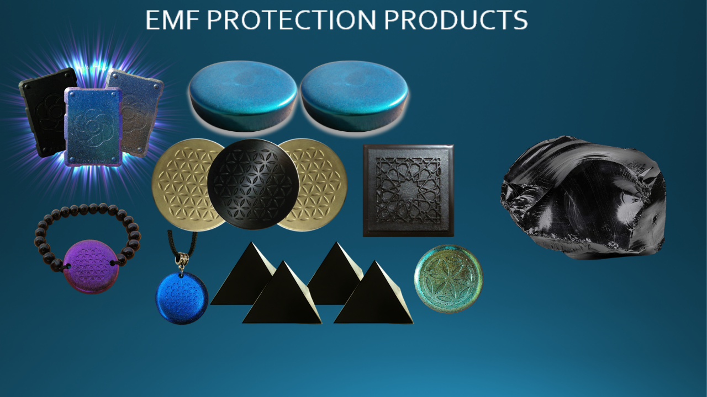
EMF PROTECTION PRODUCTS
MADE WITH SHUNGITE
HELP SUPPORT SGT REPORT BY SHOPPING FROM THIS LINK: https://www.ftwproject.com/ref/6/
WWW.FTWPROJECT.COM
Notes:
While we are describing the products we’d like to play this three minute video showing how we make the products: https://www.youtube.com/watch?v=k0ti-R0dEfQ

Slide 6
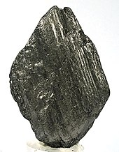
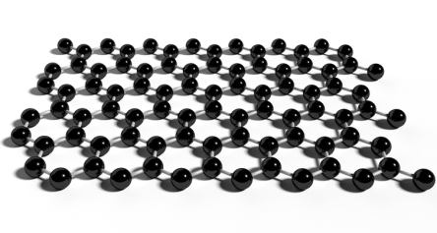
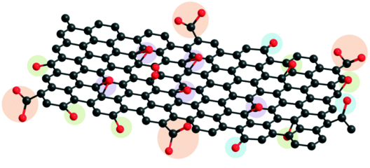
Graphite
STEP 1
STEP 2
Graphene Oxide
Exfoliate to get
Graphene
Oxidize
to get
A natural form of carbon
“DISCOVERED”
IN 2004?!?!
DISCOVERED IN 1859
( a known poison according to its Wikipedia page)
THE GRAPHENE INDUSTRY TROJAN HORSE
FOR A 160 YEAR OLD KNOWN POISON?
WWW.FTWPROJECT.COM

Slide 7
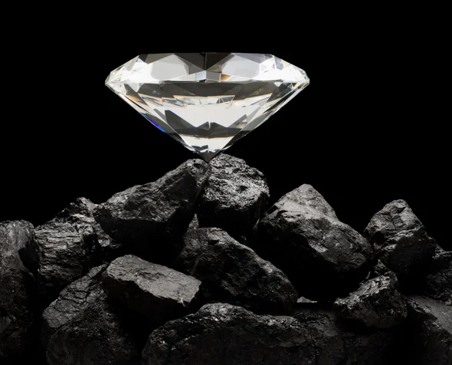
GRAPHITE BASICS: UNDERSTANDING CARBON
-Has the elemental symbol of 3 and an atomic number of 6
-Carbon-12 (one of two stable isotopes) is composed of 6 protons, 6 neutrons and 6 electrons in all diverse organic compounds and has the unusual ability to form polymers at commonly encountered temperatures on earth
-4th most abundant element in the observable universe & 15th most abundant in the Earth’s crust
-It is the second most abundant element in the human body by mass (about 18.5%) after oxygen.
-It is readily able to bond with other carbon atoms to form allotropes with unique properties, a form of the element that has a distinctly different molecular structure to another form of the same element. Physical and electrical properties are determined by different structural modifications of the same element alone! (example diamond vs. graphite)
-Carbon forms vast amount of compounds, more than any other element ( about 10 million compounds to date, both organic; limestones, dolomites & CO₂ and inorganic; coal, peat, oil, etc.) Thus, carbon has been referred to as the “King of Elements”
Note: Carbon nanotubes may or may not contain graphene
WWW.FTWPROJECT.COM

Slide 8
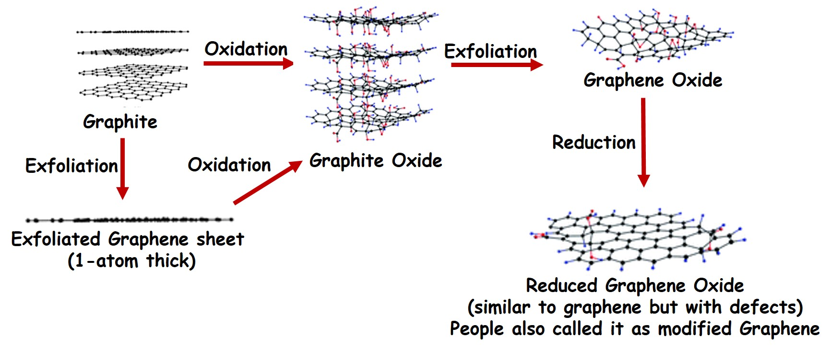
How is Graphene and Graphene Oxide Made?
WWW.FTWPROJECT.COM

Slide 9
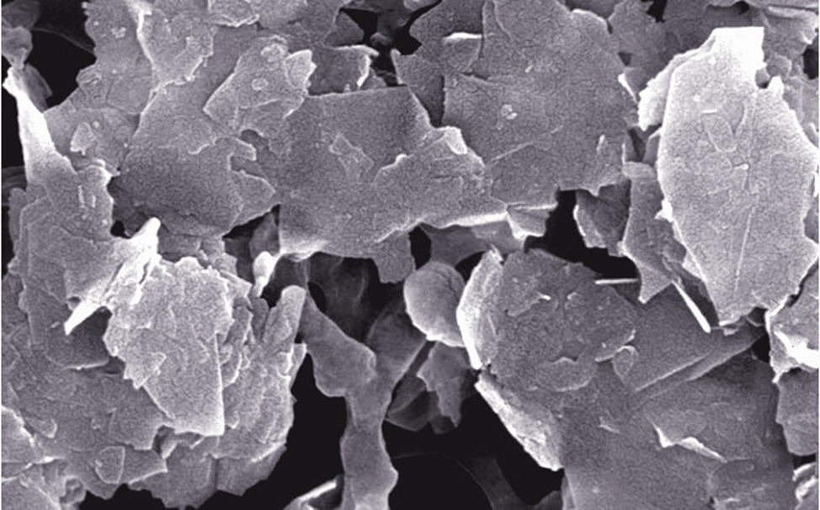
What is Graphene?
Graphene is a single layer of carbon atoms, tightly bound in a honeycomb lattice. It is an allotrope of carbon.
According to the official narrative:
“Discovered” in 2004 when researchers at University of Manchester isolated a single plane of graphite (graphene) using a kind of scotch tape.
This 2D material revealed properties that lend to a number of applications in electronics, remote sensing, medicine (in graphene oxide form), quantum computing:
It is stronger than diamond yet flexible and transparent
Graphene conducts heat and electricity and superconductor efficiencies!
Its electronic properties make it highly sensitive to the absorption of molecules such as CO, NO, NO2, and NH3. Research has indicated that this sensitivity can be increased by 100 fold with addition of Boron.
Graphene has made possible the development of electron-spin based quantum computing. Many types of graphene components are in development to test various quantum computing qubit models.
Water filtration and purification (highly absorbent used in oil spill cleanups at only a fraction of the weight)
WWW.FTWPROJECT.COM

Slide 10
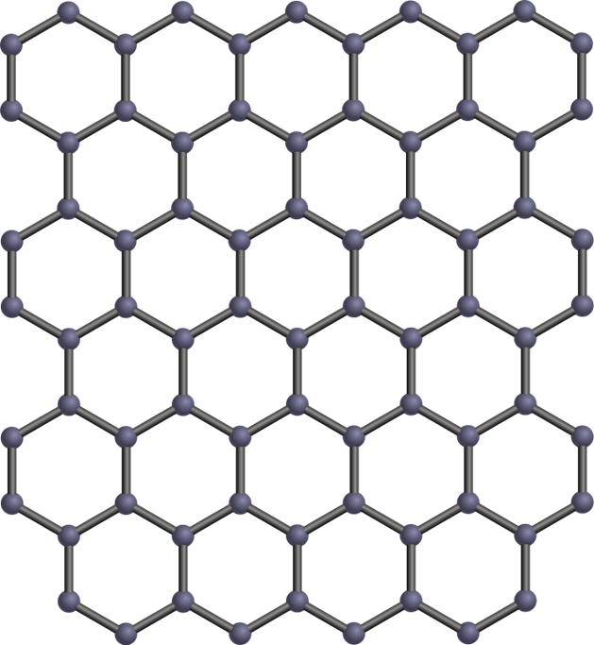
Properties and Uses for Graphene
Revolutionary supercapacitor technology and antimicrobial devices using laser etching fabrication
Strengthen different composites including human bone implants
Magnetically-driven nano-scale human bio-sensor and graphene micro-motor drug delivery research – “Graphene micromotors spin forward” –(video in blog post)
Strongly electrically and mechanically reactive to external electrostatic and RF radiation (Teslaphoresis) - “Nanotubes assemble rice introduces Teslaphoresis” (video in blog post)
Graphene synthesis in bulk is still challenging even though it can be made by the garage researcher using Laser-Induced Method or Flash method. Quality of Graphene fabrication is proportional to the cost, but is an unregulated market and open to lack of quality control and fraud
WWW.FTWPROJECT.COM

Slide 11
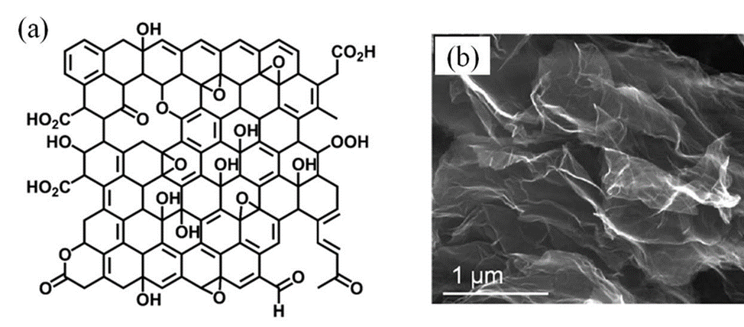
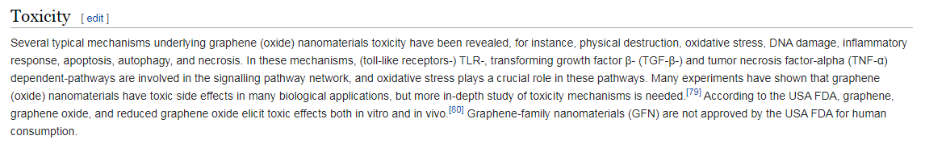
What is Graphene Oxide?
Graphene oxide (GO) is and oxidized form of graphene with oxygen molecules (ie. OH, CO, COOH, HO, etc.) attached on the surface (called functional groups).
Discovered in 1859
GRAPHENE OXIDE 160 YEAR KNOWN POISON !!!
“Oops” they forgot to scrub the Wikipedia page
This is why they don’t want to disclose what’s in the shots.
WWW.FTWPROJECT.COM

Slide 12
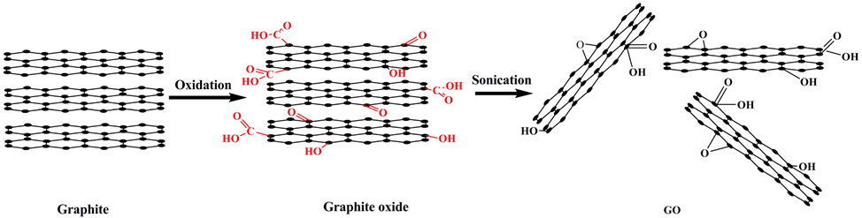
Why Graphene Oxide is Used in the Bio-Medical Industry
(even though it shouldn’t be):
The type of oxygen-based molecules attached to graphene oxide determines its unique properties and function to the graphene lattice, and why it has been researched in the biotech industry.
Graphene oxide production is relatively easier to produce on large scales compared to graphene. It contains semi-conducting properties proportional to the level of oxidation of the graphene oxide. It’s hydrophilic (attracted to water) and has good dispersibility in an aqueous environment.
Applications for Graphene and Graphene Oxide include:
Water filtration
Covalent functionalization (drugs, polymers, fluorescent tags)
Bio-devices, biosensors, human tissue scaffolds, drug delivery and gene therapy vectors
Energy Storage for ultracapacitors and batteries cathode/dielectric interface
Enhanced fluid separation for passive porous membrane filters
Claimed GO shows excellent DNA absorption properties and ‘biocompatiblity’. DNA binding to GO is found to be very stable and reversible. 6 - (conflicting studies)
WWW.FTWPROJECT.COM

Slide 13


Properties of Graphene Oxide
(or why they are REALLY using it in Bio-Medical Industry)
-Stimulated / controlled by EMF frequencies, specifically those found in 5G
-multiplies when electronically stimulated
-transparent
-LUCIFEROUS-bioluminescence
-magnetism
-passes through the blood brain barrier
- extremely strong
-can be used to manipulate neural pathways in the brain.
THIS IS WHAT THEY ARE PUTTING IN YOUR BODY!!
(VIEW IN SLIDESHOW MODE FOR ANIMATION)
WWW.FTWPROJECT.COM

Slide 14

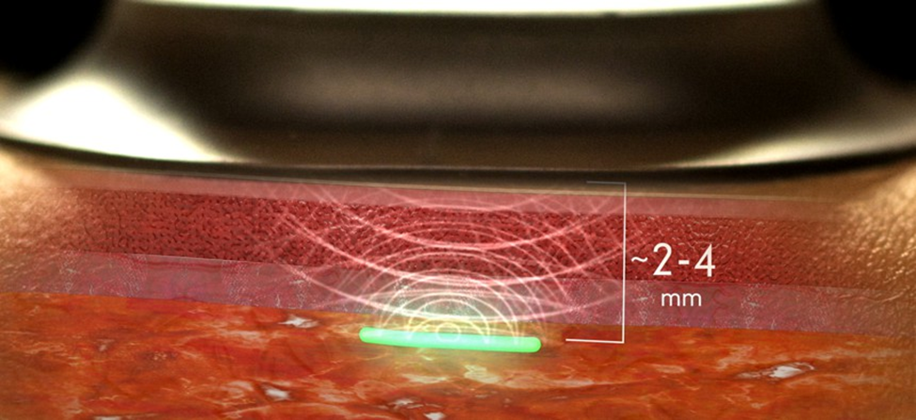
From: A Military-Funded Biosensor Could Be the Future of Pandemic Detection
There are THOUSANDS of peer reviewed scientific studies and articles discussing conductive hydrogels. We’ve put together a short list of some relative studies as backup documentation.
Summary of Hydrogel & Quantum Dot Nanotechnology Characteristics-Click to Download
WWW.FTWPROJECT.COM

Slide 15

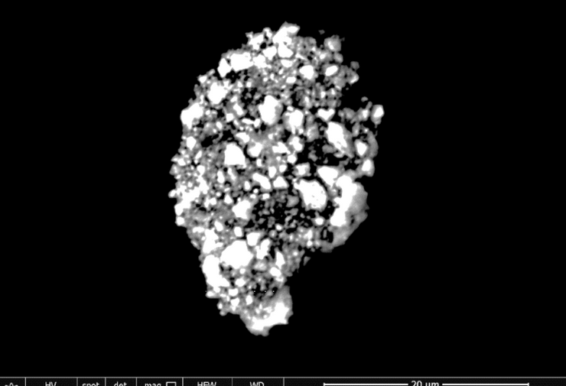
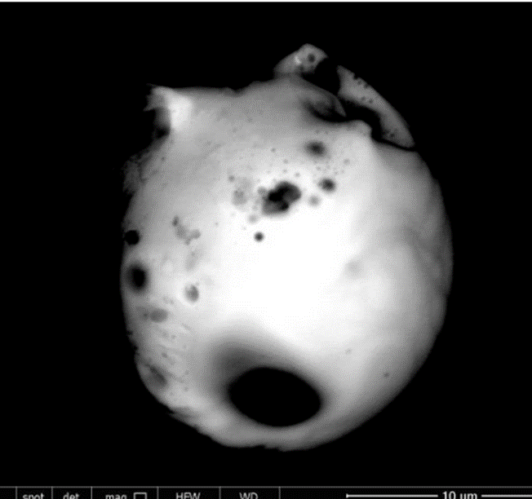
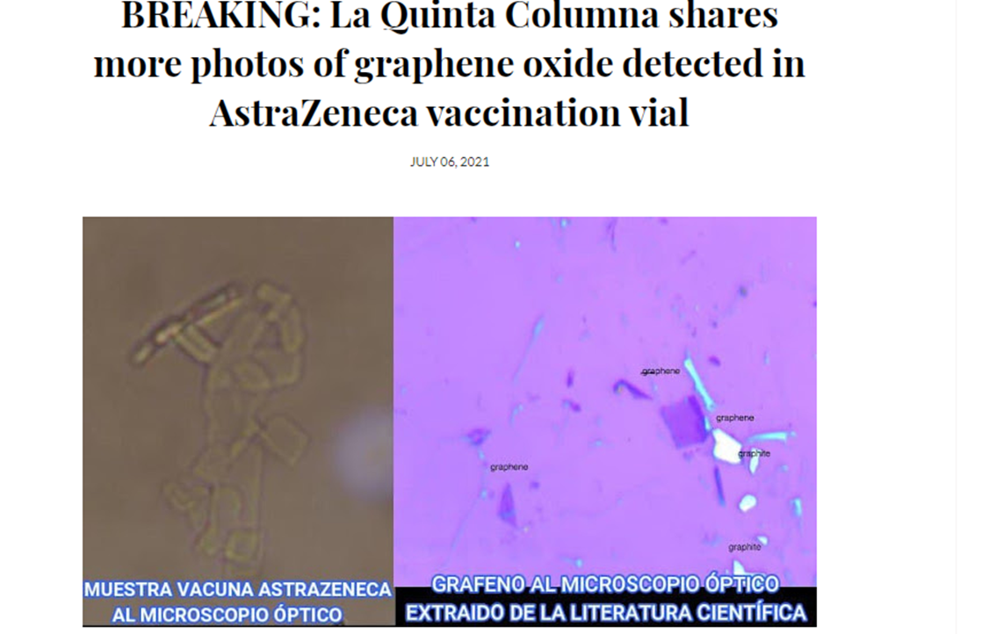
WHATS IN THE COVID SHOTS? GRAPHENE OXIDE, STEEL, PARASITES AND MORE
GRAPHENE OXIDE FOUND IN ALL THE COVID SHOTS
J&J
MODERNA
ASTRA ZENECA
PFIZER
Photo’s from lab work done on Covid Vaccine Vials from Dr. Robert Young and La Quinta Columna
Many other independent lab teams are replicating this work, in the true scientific method.
WWW.FTWPROJECT.COM

Slide 16
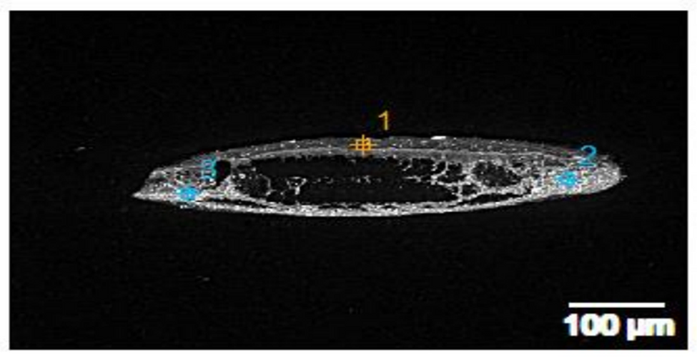
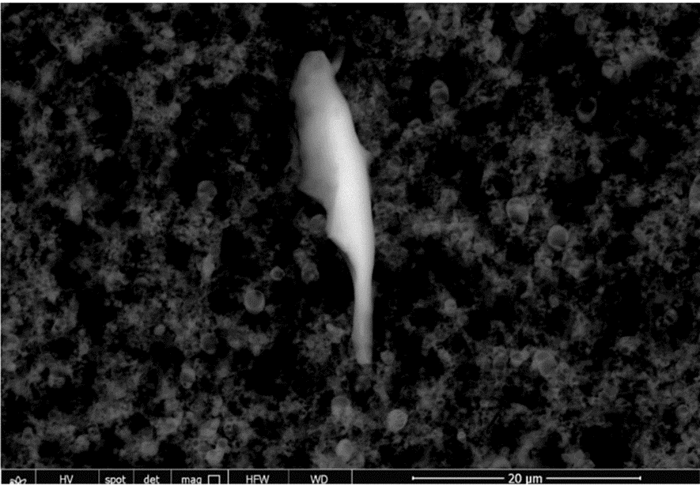

WHATS IN THE COVID SHOTS? GRAPHENE OXIDE, STEEL, PARASITES AND MORE
Stainless Steel found in Astra Zeneca
WWW.FTWPROJECT.COM

Slide 17
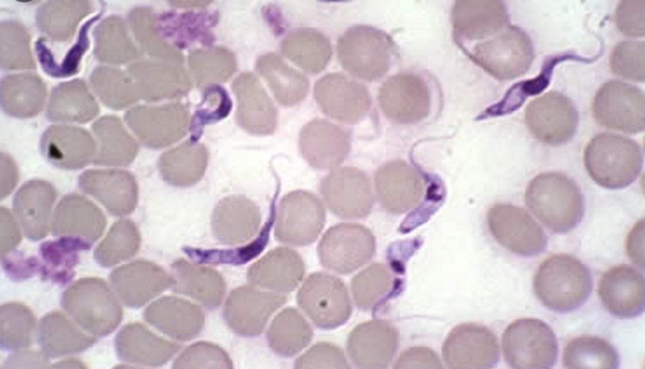
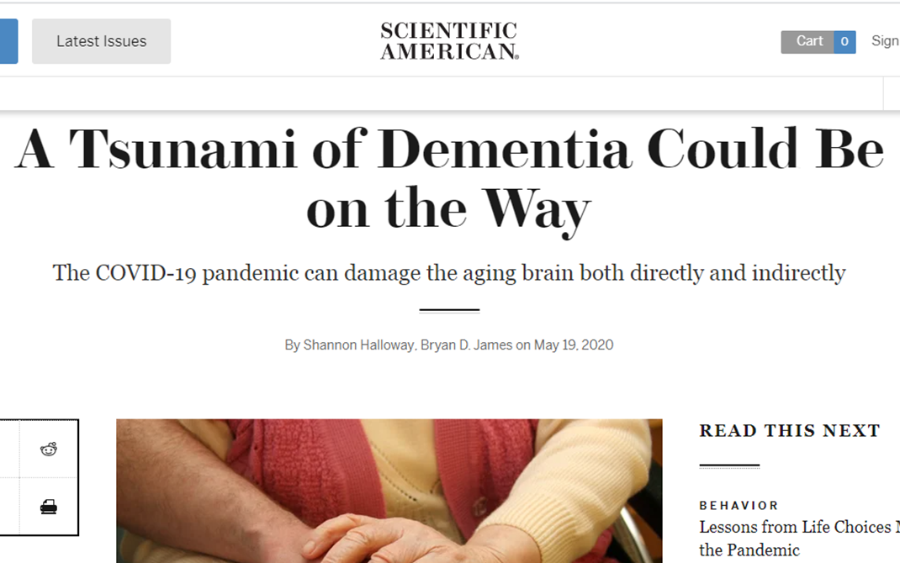
WHATS IN THE COVID SHOTS? GRAPHENE OXIDE, STEEL, PARASITES AND MORE
Trypanosoma Parasite in human blood.
This parasite is known as
“Sleeping Sickness”
According to the CDC website, symptoms are: Fever, severe headaches, irritability, extreme fatigue, swollen lymph nodes, and aching muscles and joints are common symptoms of sleeping sickness. Some people develop a skin rash. Progressive confusion, personality changes, and other neurologic problems occur after infection has invaded the central nervous system.
THEY WERE EXPECTING THIS
BECAUSE THEY PUT IT IN THE SHOTS!
WWW.FTWPROJECT.COM

Slide 18
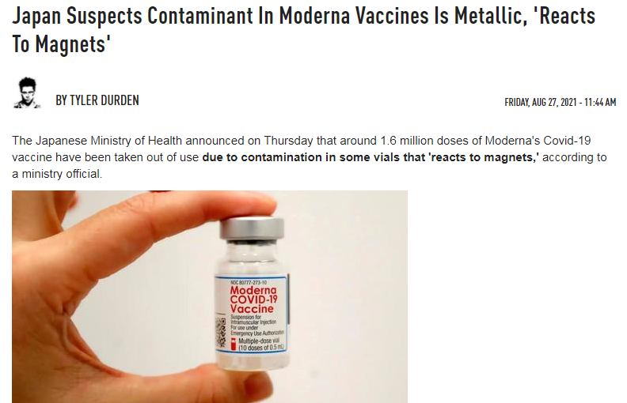
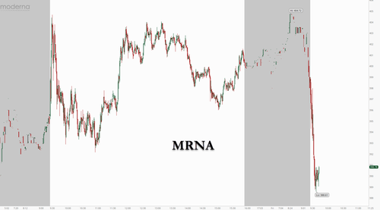
What’s in the Covid Shots?
Japanese government recalls Moderna vaccines because of a “metallic substance” that is magnetic and is killing people.
This is what happened to Moderna Stock afterwards:
WWW.FTWPROJECT.COM

Slide 19
Re-branded with a
different name
TROJAN HORSE
Poison Injected into billions of people without their informed consent
Funded by Globalists
Multi-Billion
$$
160+ Years of experimentation
with invisible known poison
2013
Graphene Flagship Founded
1859
2004
Graphene
“Discovered”
(patentable
Trade secret)
2021
Covid “Vaccine” Rollout
Graphene Oxide Discovered
(unpatentable)
2010
Nobel Prize Awarded
WWW.FTWPROJECT.COM

Slide 20

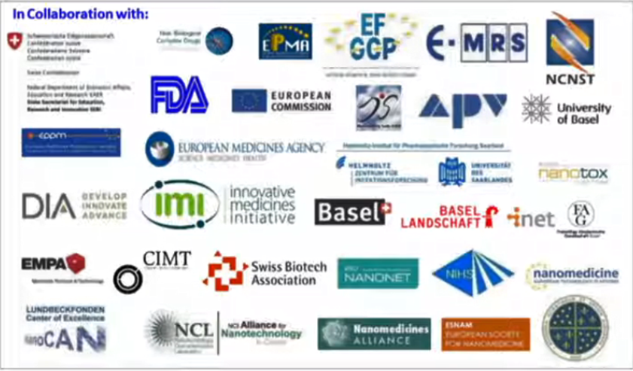
SUMMARY
-text
These are only some of the many organizations and governments that are a part of the “Graphene Flagship” Multibillion $ Project.
“GRAPHENE WILL CHANGE THE WORLD!
GRAPHENE WILL BE IN EVERYTHING!!”
WWW.FTWPROJECT.COM

Slide 21
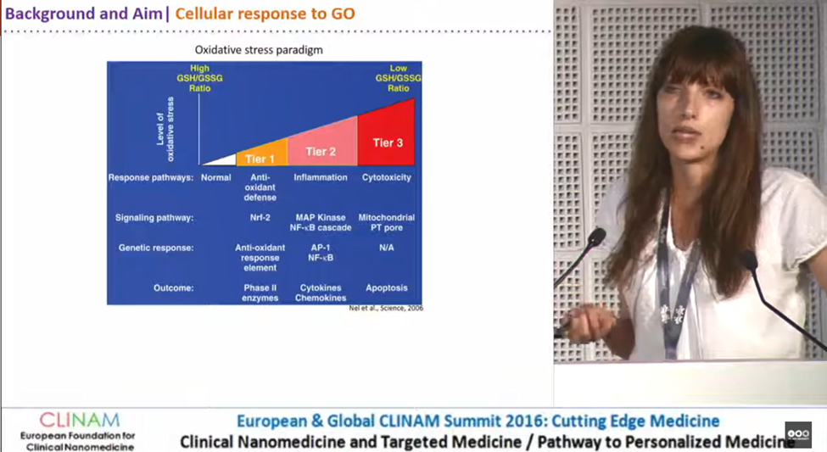
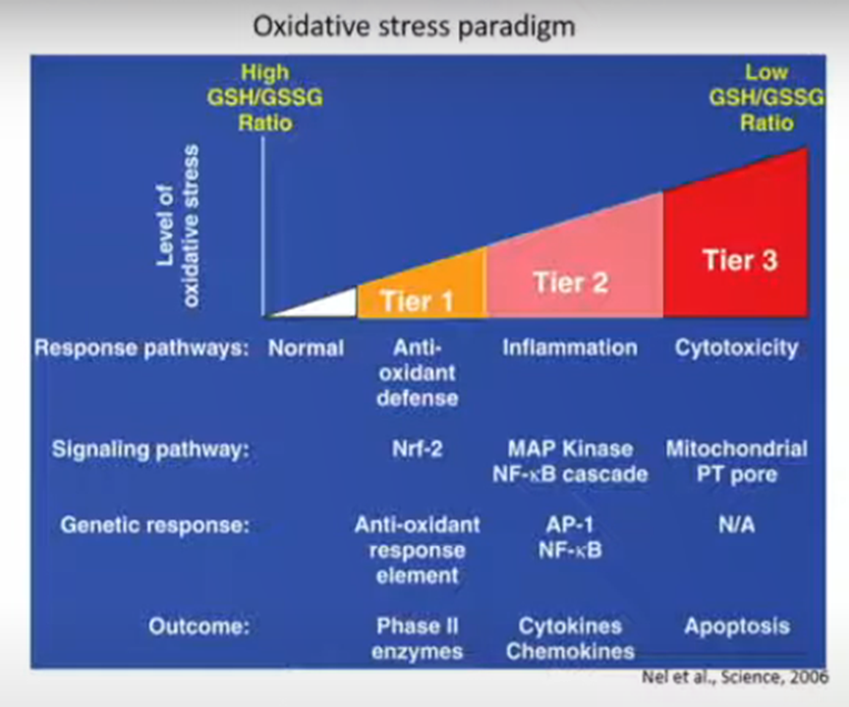
2016 “Cellular Responses to Graphene Oxide Sheets” Dr. Sandra Vranic
PROOF THEY KNEW THIS WOULD KILL PEOPLE BEFORE THEY INJECTED BILLIONS WITH THIS TOXIC SUBSTANCE IN COVID SHOTS.
Special thanks given to the “Graphene Flagship” in the presentation
AFTER GO was discovered in the Covid Vaccines, people found this presentation and the comments section exploded. It will probably be removed from Youtube soon, we saved the video file and screen shots of the comments.
WWW.FTWPROJECT.COM

Slide 22
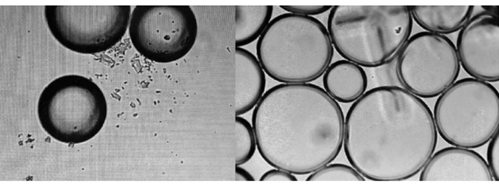

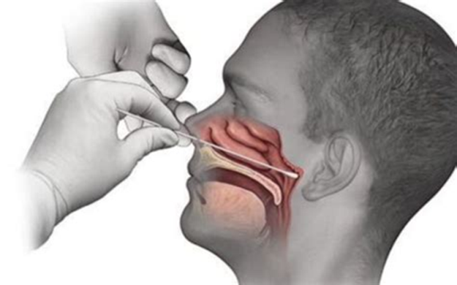
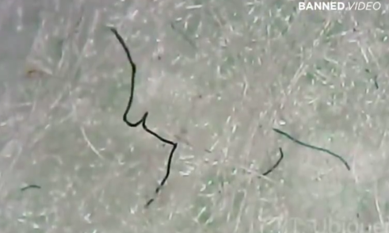
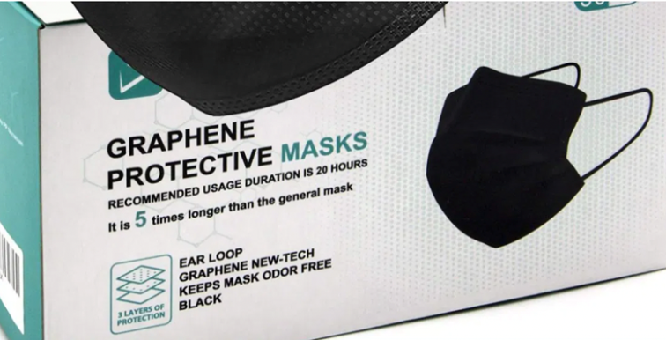
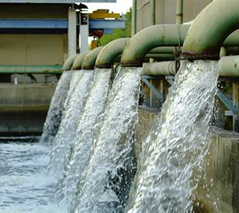

Graphene Oxide used in chemtrails (studies and patents)
Graphene Oxide found in PCR Tests
(lab studies)
Graphene Oxide used in water supply
(major contract in UK)
Graphene Oxide found in masks
(Canada and Spain Gov recall and independent findings)
WWW.FTWPROJECT.COM

Slide 23
How Graphene Oxide Works with 5G
Graphene oxide is activated by electromagnetic frequencies (EMF), specifically the frequencies that are part of the 5G spectrum.
All materials have what is known as an electronic absorption band. An absorption band is a range of wavelengths, frequencies or energies in the electromagnetic spectrum which are characteristic of a particular transition from initial to final state in a substance. This is a specific frequency above which a substance is excited and oxidizes very quickly.
Frequencies beamed at human beings that have a build up of graphene oxide in their body can cause the graphene oxide to multiply very rapidly, breaking the balance of glutathione and causing a cytokine storm in a matter of hours.
THIS IS WHAT THEY ARE PUTTING IN YOUR BODY!!
(VIEW IN SLIDESHOW MODE FOR ANIMATION)
This is why EMF protection and graphene oxide removal are an essential way for you and your family to fight back.
MUCH MORE ABOUT THIS IN PART TWO!
WWW.FTWPROJECT.COM

