Slide 1
Careers in the
Nuclear Power Industry
Nuclear Power: Clean, Safe, and Effective

Slide 2
Gross Profit =
Money (before taxes) that is expected to be deposited to your bank account for personal spending
US Navy Sailor - Nuclear Enlisted (College Degree After) – 6 Year Commitment
  Net Value - $618,000 / Gross Profit: $340,000 after 6 years
  Resume Bullets After 9 years –
    College Bachelors Degree (of your choice)
    4 Years of Operational Experience of a Nuclear Reactor and Related Systems
    Multiple Certifications with Hands-On/Logged Experience Based on Rating Specialty
      Electronics Technician – Reactor Operation, Electronic Component Troubleshooting, Fiber Optics
      Machinist Mate – Quality Assurance, Refrigeration, Gage Calibration, Emergency Welding, Water Treatment Operator, Machinery Mechanic, Industrial Maintenance
      Electrician’s Mate – Electrical Journeyman’s License, Power Plant Operator, Electric-Motor Repair
      Machinist Mate (Engineering Laboratory Technician) – Radiation Detection, Engineering Plant Chemistry Control
    Salary Negotiation: “If I continue with the Navy, I would have made excess of 6 figures by the 10 year mark with full benefits”
US Navy Officer (College Degree Before) – 9 Year Commitment
  Net Value - $618,000 / Gross Profit: $398,000 after 9 years
  Resume Bullets After 9 years –
    College Bachelors Degree (Based on ROTC Application Acceptance)
    5 Years of Service Upon a Navy Vessel with Direct Management of Supporting Personnel
    Salary Negotiation: “If I continue with the Navy, I would have made excess of 6 figures by the 10 year mark with full benefits”
US Navy Sailor (College Degree After) – 4 Year Commitment
  Net Value – (E-1 Start) $347,000 / Gross Profit: $112,000 after 8 years
  Net Value - (E-3 Start) $365,000 / Gross Profit: $130,000 after 8 years
  Resume Bullets After 8 years:
    College Bachelors Degree (of your choice)
    4 Years of Work Experience in the United States Navy
    Multiple Certifications with Hands-On/Logged Experience Based on Rating Specialty
      (Over 90+ Ratings, 70+ Trade Skill Certification Programs)
Net Value Assumptions:
G/I Bill / ROTC Scholarship: $180k
Full Coverage Healthcare/Dental: $5k/year
Worldwide Travel: $5k/year
Certification Training Programs: $15k
Gross Profit Added for Final Total
Full Benefits:
Free Full Coverage Healthcare/Dental
401K (TSP)
20 Year Pension/Retirement
Life Insurance
Guaranteed 4 Week/Year Vacation Time
Free Family Support Programs

Slide 3
United States Navy (Nuclear Propulsion Program)
Pros
  High employability in electrical power generation careers following the completion of your contract
  Your G/I Bill can be used on ANY degree plan after your contract, with the housing allowance delivered directly to your bank account (apartment, dorms, or mortgage)
  Special pay and bonuses exclusive to the NF
  Fast-Track promotion programs (immediate E-3, E-4 within 3-6 months, high advancement rate compared to all branches)
  Officer Programs are encouraged
    Prior to Enlistment (ROTC/Naval Academy Dual Enrollment)
    During Enlistment (STA-21)
    After Enlistment (OCS)
Cons
  You must use college credits from your JST to finish your degree, you are not awarded a degree automatically
  Extended - 6 year contract (normally 4 for enlisted contracts)
  Withdrawal from the program will still maintain your contract obligation to 6 years and in another Navy rating
  You are only allowed to serve on a Submarine or an Aircraft Carrier
  You cannot specify your rating prior to enlistment (ET/EM/MM (ELT in prototype))
  You are not given a DOE reactor operator license for completion of qualifications during your time in the USN
$180,000 - G/I Bill (Tuition/Room/Board)
$20,000 – Worldwide Travel Expenses
$20,000 – Full Coverage Healthcare/Dental
$38,000 - Enlistment Bonus
$42,000 - 60 College Credits (77 obtainable) awarded from JST from the first 2 years of education, “Room and Board” during school is paid for
$303,000 – Start at E-3, Accelerated to E-4, 6 Year Career, Average Submarine Career
$15,000 Optional Trade Skill Certification
TOTAL VALUE
$618,000 over 6 Years
Overall Profit over 6 Years = $340,000
$27.24/hour averaged over 6 years if you remove all other value

Slide 4
United States Naval Officer (ROTC/Academy)
Pros
  You MUST have a college degree prior to commissioning
  Allowed to serve on any class of ship if you are chosen for it
    (exceptions for specialty programs like NUPOC, WC, Medical, Pilot)
  1st year is free, regardless of withdrawal status
Cons
  College choice is limited, you must attend a specified college for the NROTC program or the Naval Academy (Annapolis)
  Room/Board fund is NOT provided to your bank account, but given directly to the college instead by the USN
  Your specialty/assignment and location is based upon the needs of the Navy, your college performance, and degree plan
  Tier 1/2/3 degrees may influence the job you choose and where you are stationed
    Not allowed to have a degree outside of these tiers
  Required classes in college (1 year of calculus, 1 year of calculus-based physics, Naval Science, etc.) on top of your normal required credit hours necessary for graduation
  Withdrawal after the first year will incur charges upon the student for tuition/room/board
  Any degree plan over 4 years will be paid for out of pocket by the student (scholarships/grants acceptable)
$180,000 – College ROTC Scholarship
$7,800 – (Total NROTC stipend amount during college given to midshipmen)
$20,000 - Full Coverage Healthcare/Dental
$20,000 - Worldwide Travel
$390,000 - Average 5-Year Officer Career
TOTAL VALUE
$618,000 over 9 Years
Overall Profit over 9 years = $398,000
$21.26/hour averaged over 9 years if you remove all other value

Slide 5
Does the Math Add Up? (Gross Profit)
Check it yourself! All information concerning the average career for these choices are readily available online.
Surface Warfare Officer
Electronics Technician Nuclear
Navy Officer | Time | Annual Salary
 |  |  | $/hour
ROTC ($250/month) | Year 1 | 1500
ROTC ($300/month) | Year 2 | 1800
ROTC ($350/month) | Year 3 | 2100
ROTC ($400/month) | Year 4 | 2400
O-1 | Year 5 | 62760 | 30.17
O-1 | Year 6 | 62760 | 30.17
O-2 | Year 7 | 76944 | 36.99
O-2 | Year 8 | 87204 | 36.99
O-3 | Year 9 | 100416 | 48.28
 | Total | 397884
Sub Nuke ET | Time | Annual Salary
 |  |  | $/hour
E-3/E-4 $38k Bonus | Year 1 | 64860 | 31.18
E-4 BAH (Prototype) | Year 2 | 39556 | 19.02
E-4 | Year 3 | 35052 | 16.85
E-5 (BAH Start) | Year 4 | 61812 | 29.72
E-5 | Year 5 | 68196 | 32.79
E-6 | Year 6 | 71316 | 34.29
 | Total | 340792
O-1/O-2/O-3 BAH Zip Code 23701 (Norfolk, VA)
<2% of all Navy officers are on submarines (NUPOC)
Assume officer career is at sea
6 months of BAH Zip Code 29445 while training at prototype (Charleston SC)
E-5/E-6 BAH Zip Code 23701 (Norfolk, VA)
30% of nuclear field applicants volunteer for submarine service

Slide 6
What is your Career Goal? (In Nuclear Power)
Listed below are the jobs that are in demand in the Nuclear Power Generation Field
Operations
  Reactor Operation
  Electrical Power Distribution
  Machinery Operation and Monitoring
  Engineering Plant Chemistry
Maintenance and Repair
  Electronic Component / Circuit Card
  Computer Program System Monitoring
  Valves/Pipe/Pump/Turbine
  Switchboard Operation / Wiring
System Engineer
  Determine problems based on your system specialty for maintenance and repair teams
    (“The Valve Guy”)
  Manage existing hardware and resources to recommend fixes and replacement options
Supply / Receipt
  Provide the necessary materials and equipment to maintenance and repair teams
Research and Development / Design
Radiation Detection / Waste Management
  Monitor radioactive systems to limit the spread of radiation to personnel/environment
  Internal monitoring and dosimetry
  Radioactive worksite management and oversite
  Radioactive Waste Disposal
Management
  Senior Reactor Operator
  Maintenance Supervisor
  Plant Scheduling
    Personnel
    Maintenance Availabilities
Auditing
  Internal Auditing
    Maintenance
    Operations
  External Auditing
    Suppliers
    Interplant Exchange (Audit other plant programs)

Slide 7
Nuclear Power Industry
Careers in the US Nuclear Navy
(ENLISTED) – System experts concerning the equipment they are responsible for. The only ones allowed to operate/maintain/repair equipment on a Navy vessel are enlisted personnel. They are also directly responsible for the training and development of junior enlisted personnel.
The principal goal of a Navy career as an Enlisted is to become a system expert in your field, train future system experts, manage/lead other system experts to solve problems expediently, and become a representative for your field to recommend fixes for future problems.
Electronics Technician (ET)
  Reactor Operation, Electronic Component Troubleshooting, Fiber Optics, Reactor Safety Computer Program Information Technology
Machinist’s Mate (MM)
  Quality Assurance, Refrigeration, Gage Calibration, Emergency Welding, Water Treatment Operation, Machinery Mechanic, Industrial Maintenance
Electrician’s Mate (EM)
  Electrical Equipment Repair, Power Plant Operator, Electric-Motor Repair, Hydro-Electric Machinery Mechanic
Engineering Laboratory Technician (ELT)
  Radiation Detection, Engineering Plant Chemistry Control, Nuclear Waste Management
(OFFICER) – Responsible for the administration, oversight, and supervision of enlisted operation and maintenance. Held directly accountable for all mishaps under their supervision.
The principal goal of a Navy career as an Officer is to ensure procedural compliance, maintain good order and discipline, and (for Navy Line Officers) become an expert at conducting warfare through supplementary or direct command of a Navy vessel, or in the future, a fleet.

Slide 8
Nuclear Power Industry
Career Opportunities
How Will You Gain Experience?
Operations
  Reactor Operation (ET)
  Electrical Power Distribution (EM)
  Machinery Operation and Monitoring (MM)
  Engineering Plant Chemistry (ELT)
Maintenance and Repair
  Electronic Component / Circuit Card (ET)
  Computer Program System Monitoring (ET)
  Valves/Pipe/Pump/Turbine (MM)
  Switchboard Operation / Wiring (EM)
System Engineer
  Determine problems based on your system specialty for maintenance and repair teams (ENLISTED)
    (“The Valve Guy”)
  Manage existing hardware and resources to recommend fixes and replacement options (ENLISTED)
Supply / Receipt
  Provide the necessary materials and equipment to maintenance and repair teams (ENLISTED) (OFFICER)
Research and Development / Design
Radiation Detection / Waste Management
  Monitor radioactive systems to limit the spread of radiation to personnel/environment (ELT)
  Internal monitoring and dosimetry (ELT)
  Radioactive worksite management and oversight
  (ELT) (ENLISTED) (OFFICER)
  Radioactive Waste Disposal (ELT)
Management
  Senior Reactor Operator (ENLISTED) (OFFICER)
  Maintenance Supervisor (ENLISTED) (OFFICER)
  Plant Scheduling (ENLISTED) (OFFICER)
    Personnel
    Maintenance Availabilities
Auditing
  Internal Auditing (ENLISTED) (OFFICER)
    Maintenance
    Operations
  External Auditing (OFFICER)
    Suppliers
    Interplant Exchange (Audit other plant programs)

Slide 9
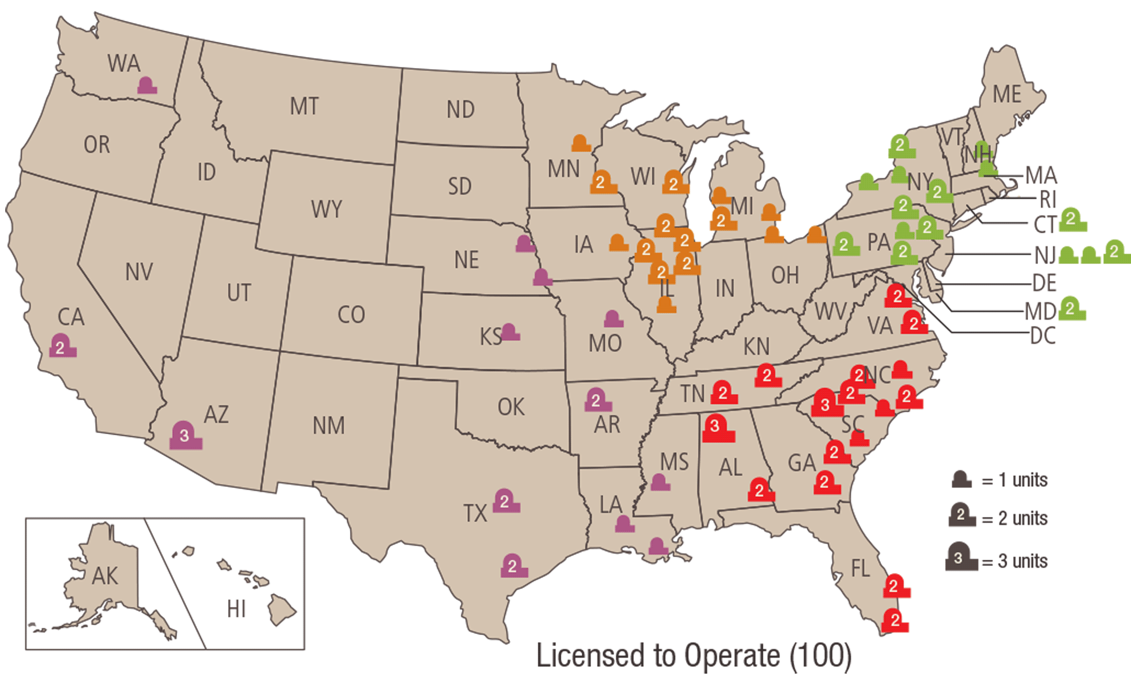
Nuclear Power Plants in America
Nuclear Power: Clean, Safe, and Effective

Slide 10
Nuclear Power Industry
What is the Mission?
Commercial
Military
Generate power for commercial electrical power grid demand
  Preference to maintain stable power output to maximize lifetime fuel
  Extra energy produced is dissipated as heat
    (Normally within +/- 5% of nominal production)
Generate power for:
  Propulsion
  Electricity
  Ship Operations (Steam Catapults)
Power generation is variable dependent on the mission:
  Reconnaissance
  Immediate Escape
  Collision Avoidance
  Long Distance Travel
  Ship Equipment Usage

Slide 11
Nuclear Power Industry
Operational Experience Hiring Preference
From the DTE Energy Hiring Department: Ask Them Yourself!
Careers@dteenergy.com
  Reactor Operators are hired:
    98% from the military (Navy Nuclear Enlisted Background Experience)
    2% from “Internal NO” (Nuclear Operator Non-Licensed Population)
    “Depending on the job classification, military are pretty much the only ones that can qualify”
  Senior Reactor Operator Positions (Operational Management)
    Preferred Employment Consideration
      Navy Nuclear Officer
      4-Year Degree with operational experience (Prior Enlisted)
  Engineering
    “The leadership team is very adamant on everyone having a 4-year degree.”
      Engineers with operational experience are preferred over those with only 4-year degrees

Slide 12
Nuclear Power Industry
Operational Experience Hiring Preference
From the DTE Energy Hiring Department: Ask Them Yourself!
Careers@dteenergy.com
  Maintenance, Operational, and Management Positions:
    50% from “Internal NO” (Nuclear Operator Non-Licensed Population)
    50% from the military (Navy Nuclear Operational Background Experience)
  Percentage of the US population in the Military: Less than 1%
  About 1,195,000 of 329 Million US Citizens
  Percentage of the military population in the US Navy: Less than 19%
  About 336,000 of 3.29 Million Military Personnel
  Percentage of the US Navy in the Nuclear Power Field: Less than 3%
  About 10,000 of 336,000 US Navy Personnel
  The top %0.003 of the Nation has first-pick priority to
  +50% of all commercial Nuclear Power positions.

Slide 13
Nuclear Power Industry
Sea Tour Key Differences
Nuclear Enlisted
Nuclear Officer
Maintenance
  Build / Follow a Maintenance Schedule
  Prepare Paperwork
  Set-Up the Job Site
  Perform Work
  Perform Re-Tests
Operation
  Operate the engineering plant
    Reactor Operation
    Water System / Mechanical Operation
    Electrical Load Distribution
    Chemistry / Radiation Control
Extra Responsibilities
  Perform/practice ship-wide casualty response
  Train / supervise junior enlisted personnel
  Obtain additional certifications to assist maintenance and repair efforts
Maintenance
  Approve Maintenance Schedules
  Review Paperwork
  Inspect Job Sites
  Supervise Work
  Supervise Re-Tests
Operation
  Supervise the engineering plant
    Grant Permission for Non-Emergent Evolutions
      Ensure procedural compliance
    Manage and Supervise Plant Stabilization for Emergent Evolutions
    Supervise required plant evolutions
Extra Responsibilities
  Qualify as “Officer of the Deck”
    Command and maneuver the ship
  Support Ship-Wide Divisions and Department Heads
    Navigation, Weapons, Engineering

Slide 14
What does the First “Military Tour” Look Like?
Nuclear Enlisted
Nuclear Officer
6 Year Contract
20 Month (+/-2 Month) Training Period
  2 months of Navy Basic Training
  6 months to learn your engineering specialty
    (electronics, electricity, machinery)
  6 months to understand the theory of how a Navy Nuclear Reactor operates
  6 months of hands on-experience on a Nuclear Reactor with trained instructors
46 (+/- 2 Month) Sea Tour
  1 year to qualify as a supporting Nuclear Operator onboard a Navy Vessel
    Maintenance Qualifications
    Supporting Watch Stations
  The remaining time will be spent operating the reactor.
  Supervisor qualifications are optional
5-6 Year Obligation
18 Month (+/-2 Month) Training Period
  3 months to become a Navy Officer (OCS)
  6 months to understand the theory of how a Navy Nuclear Reactor operates
  6 months of hands on-experience to supervise Nuclear Reactor operation
  (Optional) 3 months to learn the basic principles of submarines and system management
36 Month (+/-4 Month) Sea Tour
  6 months to qualify as a Nuclear Plant “Watch Officer”
  1 year to qualify as a Submarine Deck Officer
  1 year of submarine experience
24 Month (+0/-12) Month Shore Tour
  Admiral’s Aid
  NROTC
  Recruiting

Slide 15
Salary, Benefits, and Experience
Nuclear Enlisted
Nuclear Officer
Gross Profit (Initial 6 Year Tour)
  ~$340,000
    Start as an E-3, end as an E-6
Benefits (Exclusive)
  4+ Years of Nuclear Reactor Plant Operational and Maintenance Experience
  $180,000 Forever G/I Bill
    Covers Tuition/Books/Room and Board
    Room and Board fund given DIRECTLY to bank account of the applicant
  60-90 College Credit Recommendations
    Dependent on rank and job specialty
  Trade Skill Certification Programs
Gross Profit (Initial 5 Year Tour)
  ~$390,000 (Potentially ~$500,000)
    Start as an O-1, end as an O-3
    +$15k-$100k dependent on NUPOC program acceptance and enrollment period
Benefits (Exclusive)
  3+ Years of Nuclear Reactor Plant Supervision
  Officer of the Deck Qualification
    (Command and Maneuver a Submarine or Aircraft Carrier)
  Start the required path to becoming a Navy Captain
    Submarine or Aircraft Carrier
  Benefits (Universal)
  Tax Free Money for Housing
  Free Medical/Dental Coverage
  Expense Free World-Wide Travel
  Student Loan Repayment Programs (Up to $65,000)
  Access to VA Home Loans, Discounts, and Small Business Loans
  30 Day/Year Vacation Time (Unused Days Carry Over)

Slide 16
Enlisted NF Contract
ET/EM/MM
(ELT Training Optional for MM)
Navy
Basic Training
Submarine
-Or-
Aircraft Carrier
College + Forever G/I Bill ($180k)
(Tuition/Room/Board/Books)
Obtain Debt Free Bachelor’s Degree
(Or Master’s)
Navy OCS
Continue Navy Enlisted Career
Retirement Pension in 20 Years
Employment
(Civilian Nuclear Power)
Navy NUPOC Program
Start Career as a Naval Officer
(General, Aviation, Medical, Nursing, Support)
Start Career as a Nuclear System Engineer
-or -
SRO (Senior Reactor Operator)
Start Career as a Nuclear Naval Officer
(Line Officer, Instructor, Naval Reactors Engineer)
Employment (Civilian Nuclear Power)
40+ Year Career in the Civilian Nuclear Field
Civilian Career
40+ Year Civilian Career
20+ Year Career in the Civilian Nuclear Field
As a Nuclear Enlisted Sailor,
The Choice is Yours…
O-1E to O-3E Earnings (5 years)
= ~$455k
Or apply to become a
Naval Officer while in the Navy
STA-21
ROTC
Academy
NUPOC Benefits = Up to $205,000 paid to you in college including sign on bonus
O-1E to O-3E Earnings (5 years)
= +$455k (Not including Sub Bonus Pay or Nuke Bonus Pay)
START
60-90 College Credits Obtained from the Navy Nuclear Program
SRO Salary =
~$150k-$200k/year including overtime and bonus pay
2 mo.
22 mo.
48 mo.
SRO Salary =
~$150k-$200k/year including overtime and bonus pay
E-9 Pension = $30-$50k/year
Earn Up to $340k total
(E-6 by year 5, no STAR reenlistment)
(Up to $607k by the 8th year if STAR reenlisted)
RO Salary =
~$100-$140k/year including overtime and bonus pay

Slide 17
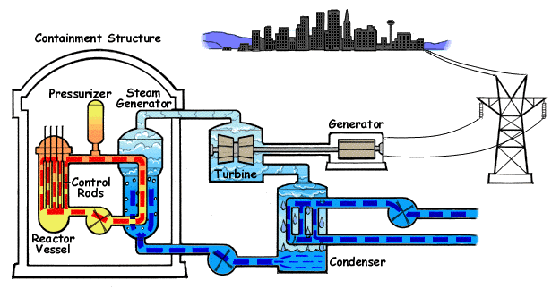
Nuclear Power: Clean, Safe, and Effective

