Slide 1
ELT
Engineering Laboratory Technician
Chemistry Control
Radiation Control
Nuclear Waste Management
Nuclear Plant Mechanical Equipment Operation

Slide 2
Definitions – What is an ELT?
ELT is an acronym for Engineering Laboratory Technician.
MMN is an acronym for Machinist’s Mate (Nuclear)
An MMN has the following responsibilities
  operate and maintain Naval Nuclear propulsion plants and associated equipment
  supervise and administer Naval nuclear propulsion plant operations
  operate and repair systems associated with reactor plants, propulsion plants, and auxiliary support systems
  perform tests, transfers, and inventories of lubricating oils, fuels, and water
  maintain records and reports on both submarine and surface ships.
An ELT is an MMN with additional training in boiler water chemistry control and analysis and reactor plant water chemistry control and analysis. In addition, an ELT is a specialist concerning Nuclear Waste Management and Radiation Detection/Control
An ELT will qualify to perform operations on mechanical equipment, but does not maintain records and reports or perform in depth maintenance on those systems

Slide 3
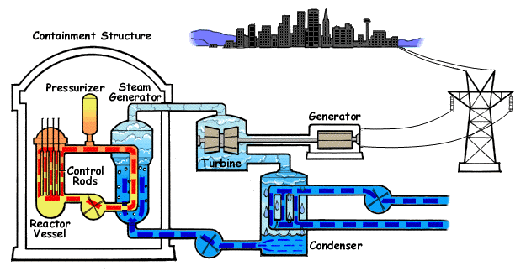
Why Have Separate Jobs? (MMN+ELT)
A pressurized water reactor plant (the only type currently in use in the Navy) has two independent loops.
  One loop circulates water through the nuclear reactor to transfer the heat generated by the nuclear reaction to a heat exchanger.
  The other loop runs through the heat exchanger, turns to steam, and runs the steam turbines.
  The loops are independent because the loop running through the nuclear reactor becomes radioactive.

Slide 4
Chemistry Control
Things in contact with water tend to corrode (rust). (This is a VERY simplified view)
To minimize corrosion, we add chemicals to the water. ELT’s control the water in the reactor loop (called the primary loop) differently than the water in the steam plant loop (called the secondary loop).
One of the jobs of the ELT is to know what chemicals to add and to periodically monitor the water to determine whether or not to add more water or more chemicals to the plant.

Slide 5
Radioactivity
The water in the primary loop becomes radioactive.
Ideally, the water in the secondary loop is not radioactive.
Another job of an ELT is to perform radiochemical analyses to determine the level of radioactivity and what isotopes are causing the radioactivity in the primary loop, and also to test the secondary loop to ensure none of the radioactive water has leaked from the primary side to the secondary side.

Slide 6
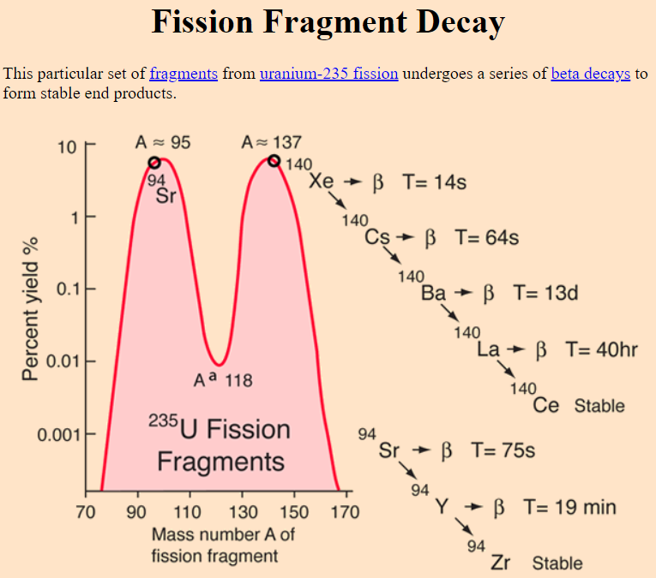
Radiation vs. Contamination
The third job of the ELT is to monitor the radioactivity released by the nuclear reactor plant.
First is to monitor the radiation produced by the reactor plant. This is by using instruments such as a Geiger-Mueller counter (among several other instruments)
The second is to monitor the contamination that might have escaped from the primary plant.
(Radiation is like the heat given off, contamination is like dirt or dust which is left when water evaporates.)

Slide 7

Can Mechanics Do The Same Job?
Typically, these tasks are performed exclusively by ELTs. (Chemistry Control, Radiation Control, Nuclear Waste Management)
In the fleet, non-ELT MMNs can by trained by ELTs to perform boiler water analyses, however the ELT must add the chemicals.
The MMNs do this because it is part of their watchstanding duties.
MMNs can also perform radiation and contamination surveys, but usually do not because, with a few exceptions, the surveys are not part of their watchstanding duties.
Primary plant analyses are only performed by ELTs (with some exceptions, such as supervisory watchstation qualifications).

Slide 8
In the Navy Nuclear Field,
Everyone Learns Everyone’s Job
An important part of nuclear qualifications is cross rate training.
Everyone will learn the theory behind what an ELT does (what chemicals are used, what the water specifications are, what the radiation and contamination levels mean), but generally, only the ELT will perform those tasks.
Radiation Control effects every Nuclear Rating
  Electronics Technicians
    Higher level of nuclear power operation => more fission => more neutrons, gammas, and fission product decay => more radiation
    If radiation is too high, that could be indicative of a larger problem in the plant that might not be detectable by electronic instruments
  Electrician’s Mate
    Electronic/Electrical equipment in the Reactor Compartment may be contaminated or radioactive.
    Lack of understanding could lead to higher than appropriate radiation exposure or risk the spread of contamination and generating a large amount of Nuclear Waste when repairing/maintaining electrical equipment
  Machinist’s Mate
    Operation of Primary (radioactive system) equipment could lead to the spread of contamination if operated incorrectly
    Repair and replacement of Primary systems could lead to the spread of contamination if operated incorrectly
Chemistry Control if unmonitored could cause corrosion or other problems, leading to the failure of high pressure steam systems or radioactive water systems.

Slide 9
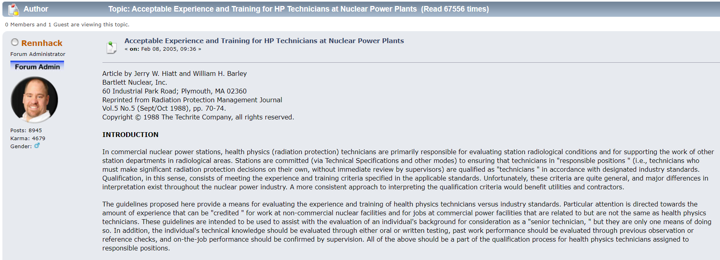
Careers after the USN?
Experience Matters
https://www.nukeworker.com/forum/index.php/topic,4395.0.html

Slide 10
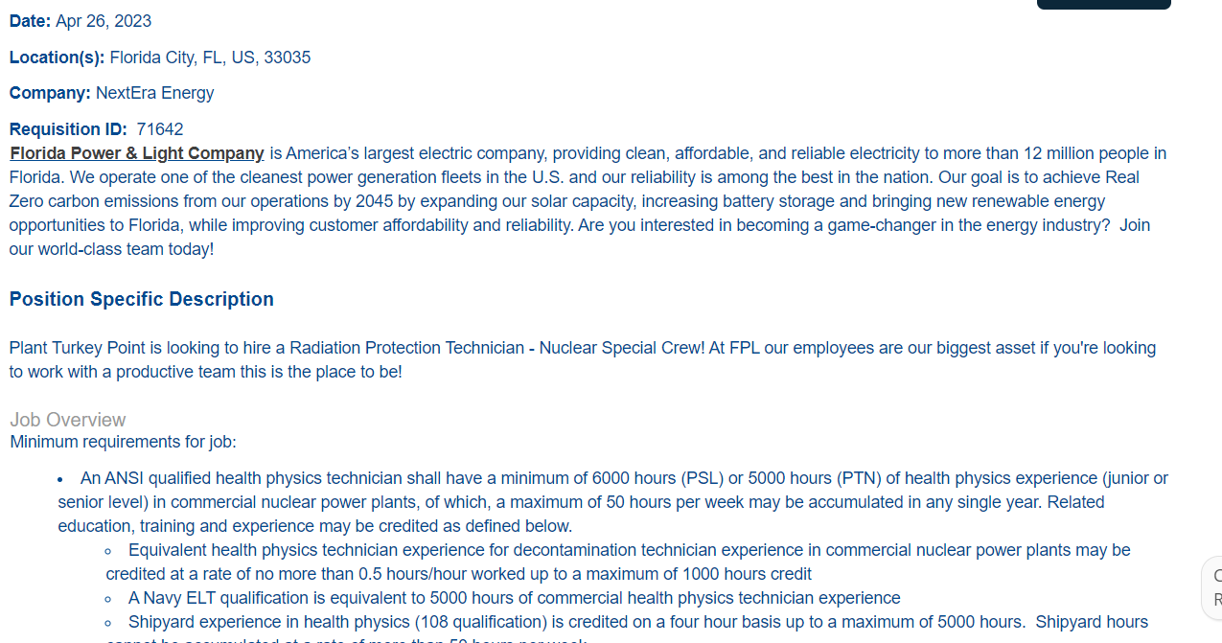
Employers Know Who You Are
https://jobs.nexteraenergy.com/job/Florida-City-Radiation-Protection-Technician-Nuclear-Special-Crew-FL-33035/1009447800/

Slide 11
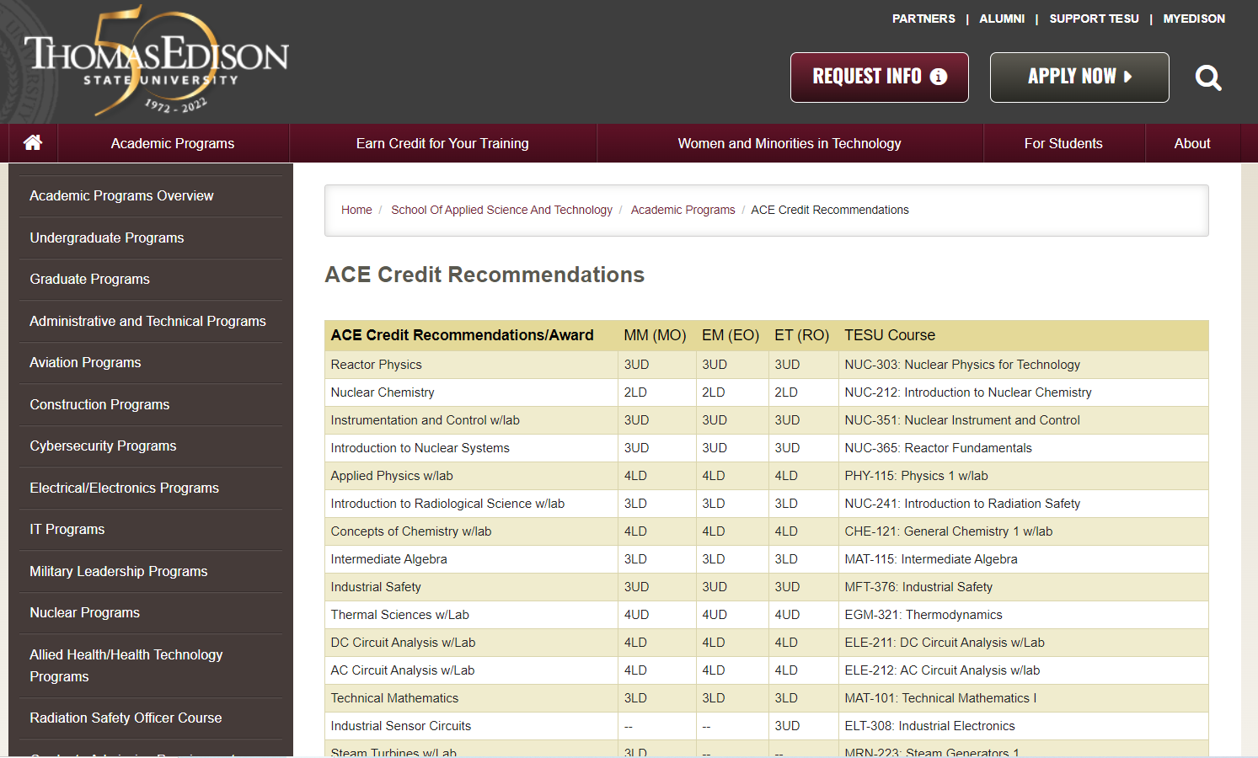
Colleges Understand What Credentials To Certify
https://www.tesu.edu/ast/programs/ace-credit-recommendations

Slide 12
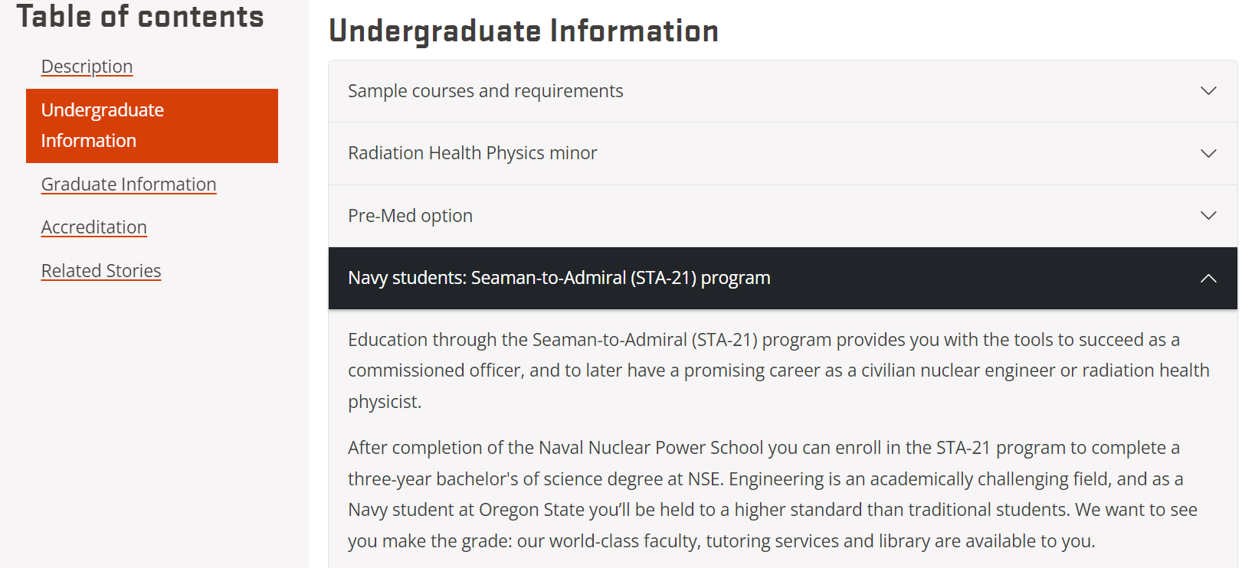

Do you want to become an officer instead? Colleges are waiting for you.
https://engineering.oregonstate.edu/Academics/Degrees/Radiation-Health-Physics
Current STA-21 pickup rate from FY2022 in Nuclear Power School: ~50%
(STA-21 = Seaman to Admiral)
(Get paid to attend College)

Slide 13
How Do I Become an ELT?
NOTE: IT IS NOT GUARANTEED
Become an MMN (rating specialties are chosen in basic training)
  ETN and EMN are not eligible to become ELTs
Successfully pass A-School and Power School
  Get great grades in Chemistry/Radiation/Materials (CMR) classes
In Prototype, put in for an ELT package, get accepted
  They look at your CMR practical skills and your past grades
Complete Prototype
Complete ELT School (After Prototype)

Slide 14
Personal Opinion (ETN1 Ortiz)
I view the job of ELT as the most challenging position in the US Navy Nuclear Engineering Program. I believe that it has the most career/commercial viability after US Navy Completion.
ETN (Nuclear Reactor Operator) is a great job, but the outcomes show that ELT is just better overall.
Daily Hands On Work in the Job You Signed Up For
Major Nuclear Plant Responsibilities (Chemistry and Radiation is Everyone’s Problem)
Extremely Viable Resume after Service
The ONE drawback I see with ELT is that it is not guaranteed at the beginning of your contract. You have to “risk” becoming an MMN to try out for the job.
However in my website: whatisyourplan101.org you can see that even Navy Mechanics get preferential hiring at commercial Nuclear Power Plants for jobs they aren’t even “qualified” for.

