Slide 1
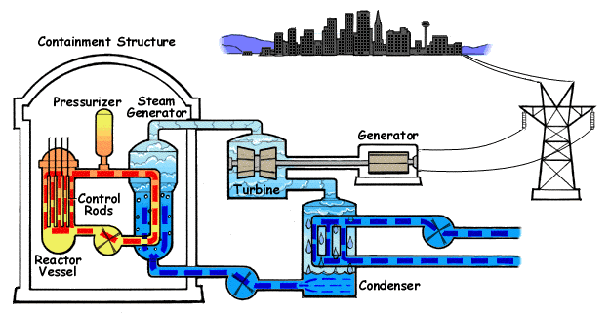

Slide 2
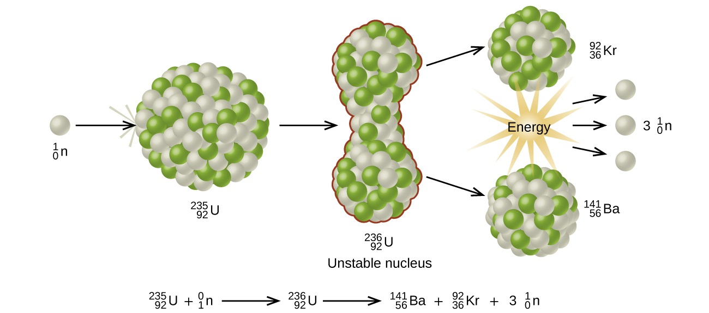
Fission (Liquid Drop Model)

Slide 3
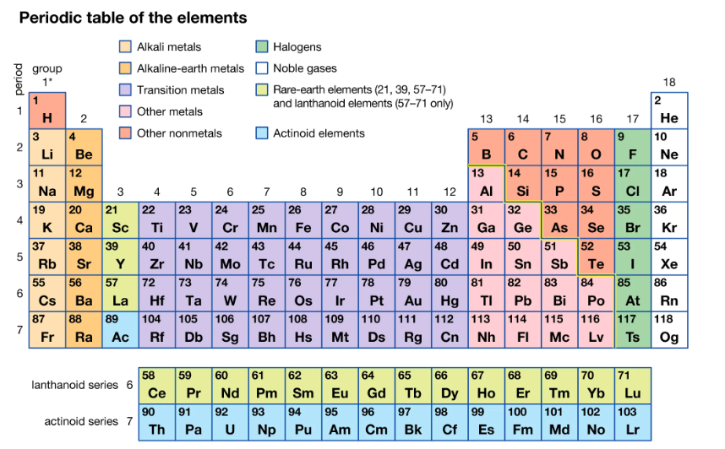

Slide 4
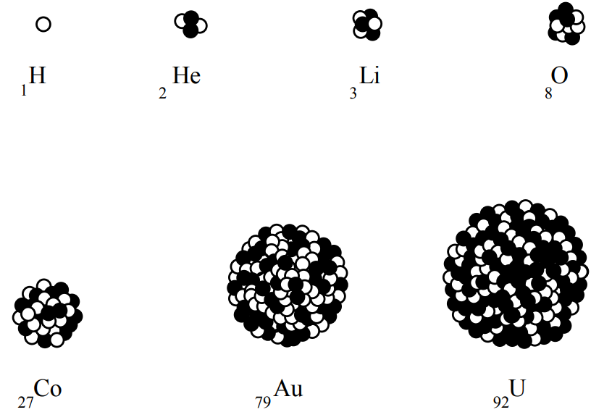
Atomic Number = Protons

Slide 5
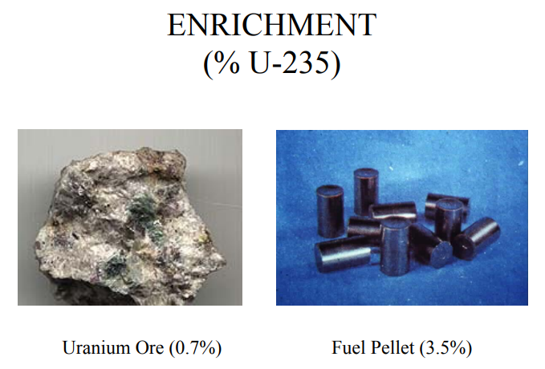
Not just any rock will do…
We need more isotopes that produce controllable fission.

Slide 6
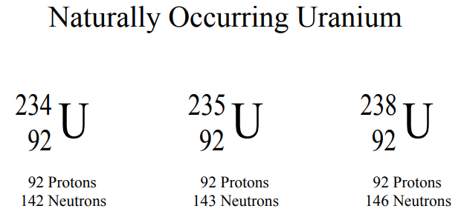
Isotope = Protons + Neutrons

Slide 7
Fission (Liquid Drop Model)

Slide 8
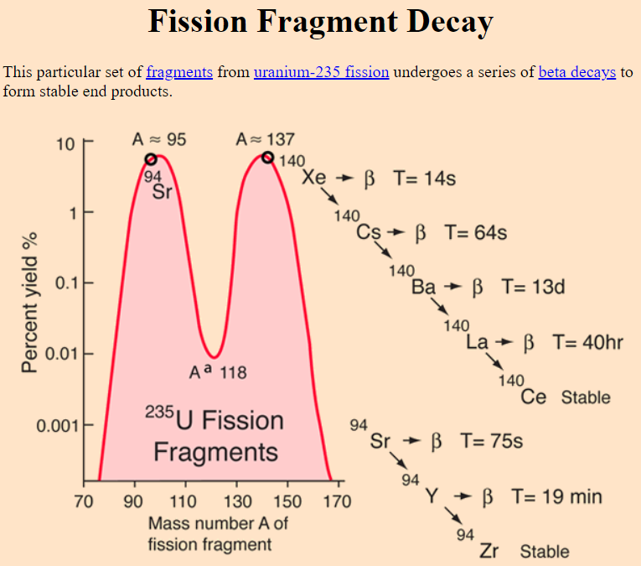

Slide 9
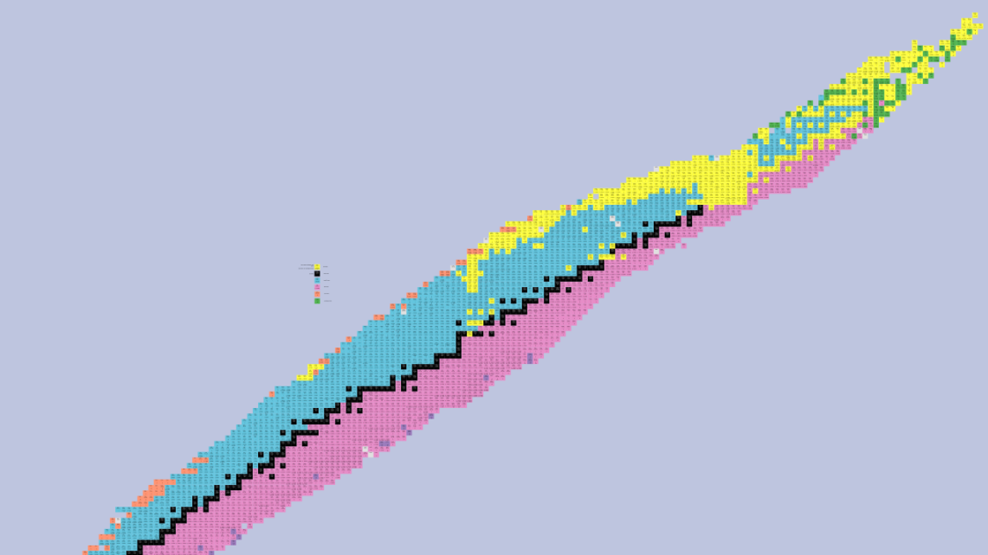
The Chart of Nuclides

Slide 10
What is “Radiation”
Radiation- energy moving in the form of particles or waves. Familiar radiations are heat, light, radio waves, and microwaves. Ionizing radiation is a very high-energy form of electromagnetic radiation.
Radioactive Material - material that contains unstable (radioactive) atoms that give off radiation as they decay.
Roentgen (R): a unit of exposure to x-rays or gamma rays.
Rad (radiation absorbed dose): a basic unit of absorbed radiation dose. It is a measure of the amount of energy absorbed by the body. The rad is the traditional unit of absorbed dose.
Rem (roentgen equivalent, man): a unit of equivalent dose. Not all radiation has the same biological effect, even for the same amount of absorbed dose. Rem relates the absorbed dose in human tissue to the effective biological damage of the radiation. It is determined by multiplying the number of rads by the quality factor, a number reflecting the potential damage caused by the particular type of radiation.

Slide 11
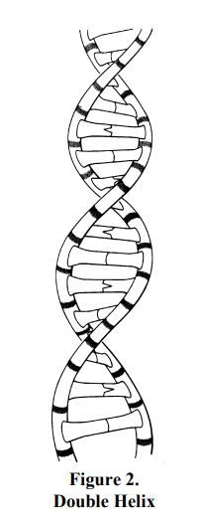
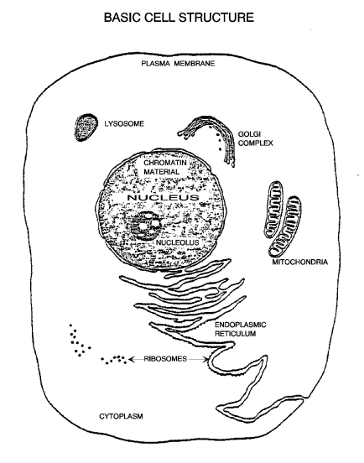
How Does Radiation Cause Damage?
Radiosensitive Cells
  High Division Rate
  High Metabolic Rate
  Non-Specialized
  Well Nourished
Reproductive
Bloodforming
Skin
Gastrointestinal

Slide 12
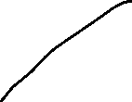

Good No Change
Daughter No Effect
Bad Cell is Altered
Daughter
Dead New Cell Dies
Daughter
No Cell Dies
Daughter

Slide 13



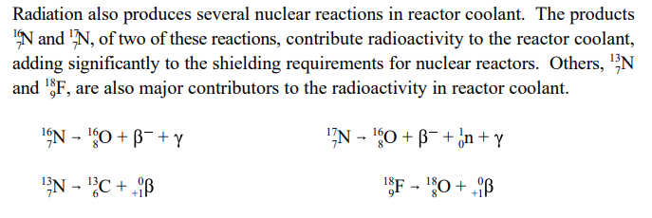
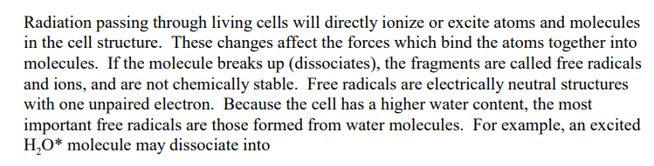
Radiation and Chemistry Go Hand-In-Hand

Slide 14
What is “Radiation”
Radiation- energy moving in the form of particles or waves. Familiar radiations are heat, light, radio waves, and microwaves. Ionizing radiation is a very high-energy form of electromagnetic radiation.
Radioactive Material - material that contains unstable (radioactive) atoms that give off radiation as they decay.
Roentgen (R): a unit of exposure to x-rays or gamma rays.
Rad (radiation absorbed dose): a basic unit of absorbed radiation dose. It is a measure of the amount of energy absorbed by the body. The rad is the traditional unit of absorbed dose.
Rem (roentgen equivalent, man): a unit of equivalent dose. Not all radiation has the same biological effect, even for the same amount of absorbed dose. Rem relates the absorbed dose in human tissue to the effective biological damage of the radiation. It is determined by multiplying the number of rads by the quality factor, a number reflecting the potential damage caused by the particular type of radiation.

Slide 15
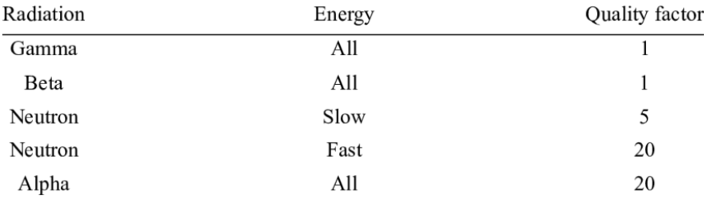

Slide 16
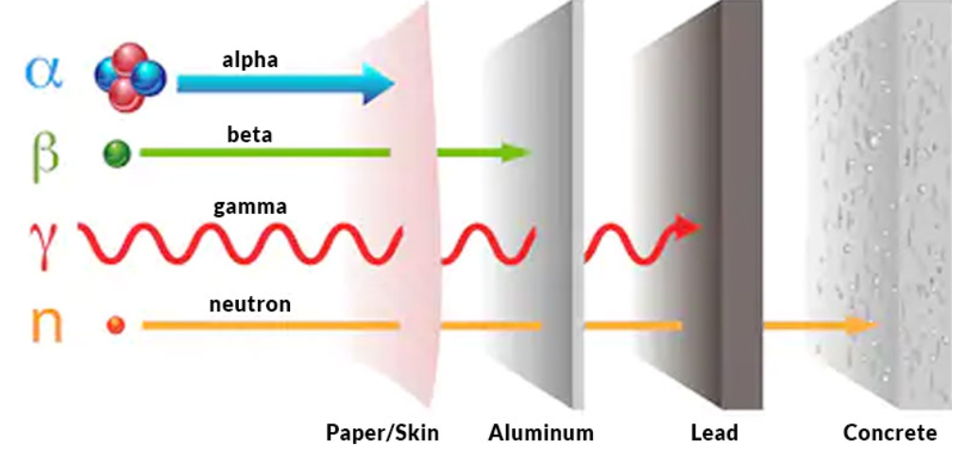

Slide 17
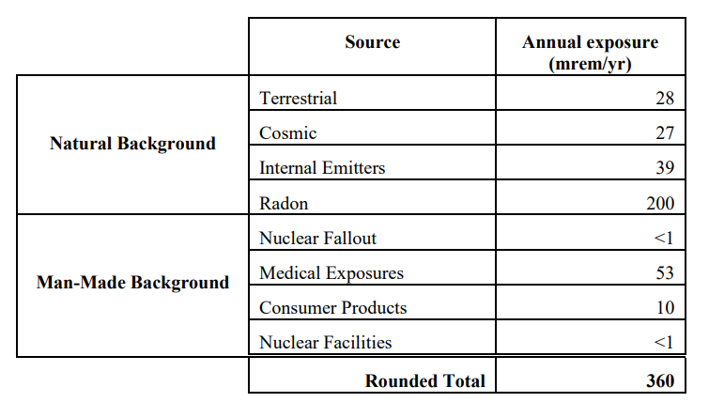
Sources of Radiation

Slide 18
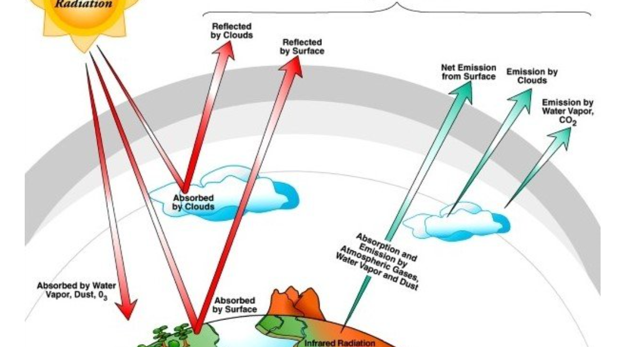

Slide 19
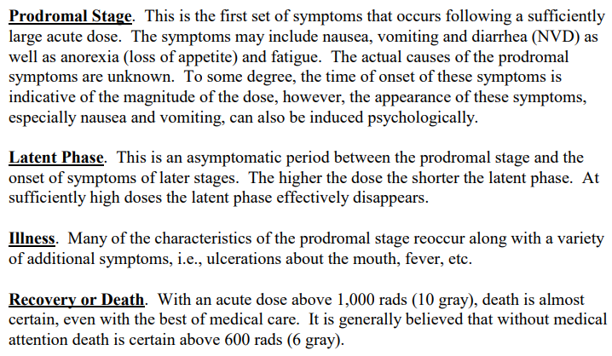

Slide 20
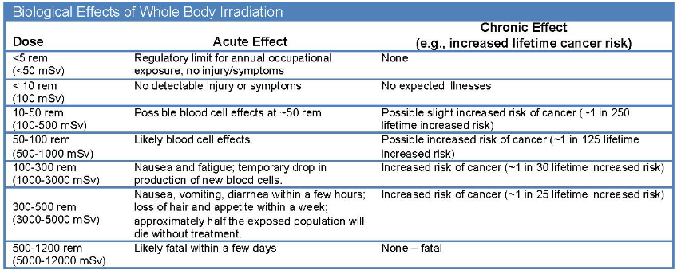
We generally measure in mRem

Slide 21
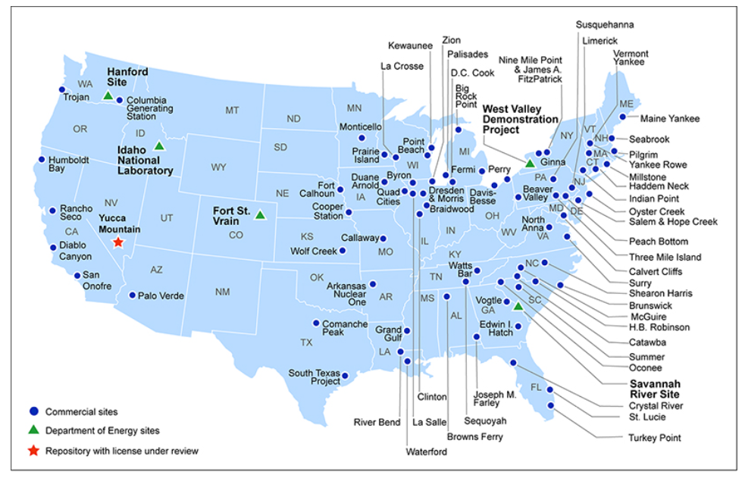

Slide 22
THE U.S. GENERATES ABOUT 2,000 METRIC TONS OF SPENT FUEL EACH YEAR
The clean energy generated from this fuel would be enough to power more than 70 million homes—avoiding more than 400 million metrics tons of carbon dioxide emissions.
U.S. commercial reactors have generated about 90,000 metric tons of spent fuel since the 1950s. If all of it were able to be stacked together, it could fit on a single football field at a depth of less than 10 yards.
Spent nuclear fuel can be recycled to make new fuel and byproducts.
  More than 90% of its potential energy still remains in the fuel, even after five years of operation in a reactor.

