Slide 1

Health Professions Scholarship Program
HPSP

Slide 2

Why Does This Program Exist?
The Navy needs health service professionals, but not everyone is fit to serve
  Less than 25% of the USA is qualified to enter the United States Military
  These specialists must be able to physically and mentally endure life at sea, while maintaining the same standard of healthcare that is provided by normal dentists, physicians, and surgeons

Slide 3
The “Normal Way” to Become a Dentist
1. Apply and become accepted into an Undergraduate School
  While a 4-Year degree it is not required to enter Dental School with a Bachelor’s Degree, most dental schools prefer it
  The majority of dental students possess a 4-year degree or 90 College Credits
2. Take the Dental Admission Test (DAT)
  Recommended taken at least one year before dental school (3rd Year of College)
  Natural Sciences (Biology, Chemistry, Organic Chemistry)
3. Apply to Dental School
  Letters of Recommendation
  Competitive applications (High GPA, high DAT score, etc.)
4. Finish Dental School
  Traditionally 4 Years Long

Slide 4
The “Normal Way”
Average Tuition $12,000/year
Average Boarding $10,000/year
National Average: $88,000
Your Age: 26 Years Old
Expected Debt:
$292,000
1. Apply and become accepted into an Undergraduate School
  While a 4-Year degree it is not required to enter Dental School with a Bachelor’s Degree, most dental schools prefer it
  The majority of dental students possess a 4-year degree or 90 College Credits
2. Take the Dental Admission Test (DAT)
  Recommended taken at least one year before dental school (3rd Year of College)
  Natural Sciences (Biology, Chemistry, Organic Chemistry)
3. Apply to Dental School
  Letters of Recommendation
  Competitive applications (High GPA, high DAT score, etc.)
4. Finish Dental School
  Traditionally 4 Years Long
Average Tuition $41,000/year
Average Boarding $10,000/year
National Average: $204,000

Slide 5
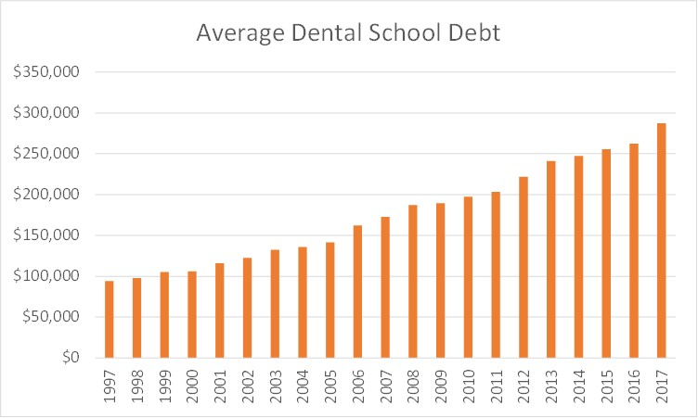
Don’t Believe Us, Believe Google
https://www.dentalpower.com/blog/life-after-dental-school

Slide 6

Are you guaranteed a job?
You spent 8 years and $300,000, what is guaranteed?
In the USA, you are guaranteed an opportunity, but you are not guaranteed an outcome.

Slide 7

Is there a better way?
What if your undergraduate degree was free?
What if your dental/medical school was free?
What if you were guaranteed a job?
  No job hunting, no applications, no interviews

Slide 8
United States Navy: HPSP
https://www.youtube.com/watch?v=DvN3w5-1ddQ
Click this link to see what the job is like!

Slide 9
The “Fine Print” of HPSP
(What is the Catch?)
We cover 100% of your medical/dental school tuition
We give you a monthly stipend of $2,088 to cover living expenses
  What is the cost of a 2 bedroom apartment?
We give you a sign-on bonus of up to $20,000 and a high salary
  We start you off as a O-3 or O-4 depending on your qualifications
  This starts off around $80,000 at first, guaranteed mid-6 Figures as you progress
Will I be in the Navy forever? (Active Duty Obligation) (5 Years average)
  One Year for Each Year in the program
  If you accept the bonus, one more year will be added
  If you go through NROTC then Dental School => (9 Years)

Slide 10
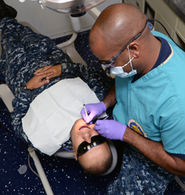

“I don’t care about this, I just want to be a Dental Hygienist” - You

Slide 11
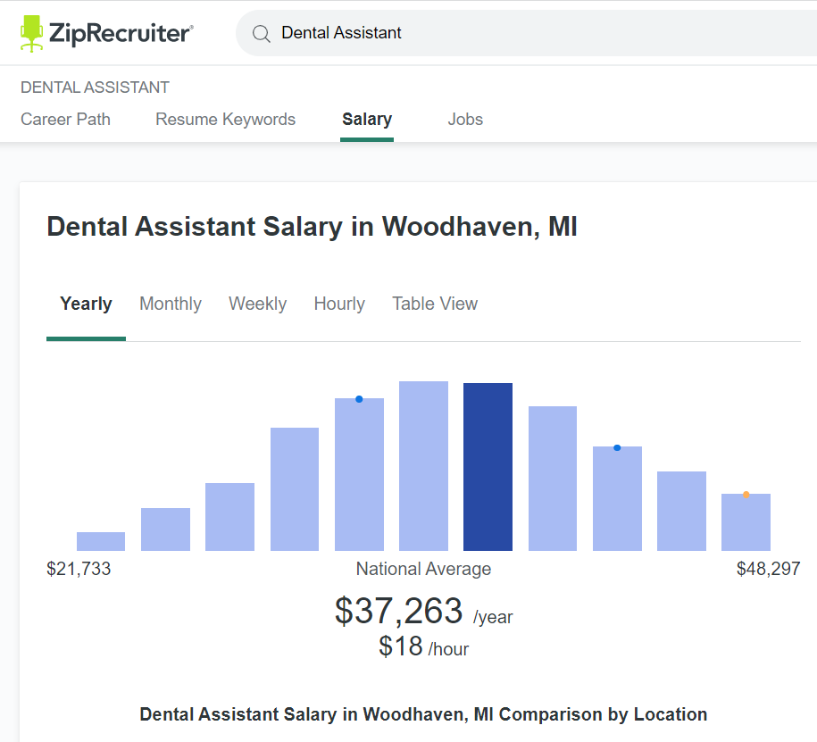
The United States Navy wants to double that salary
Also, we don’t want you to pay taxes
(MI State Tax)
(Tax-Free Cost of Living (BAH)
Also, we want to give you a full-ride scholarship
to the university/college of your choice
Also, we want make sure you don’t pay any
medical/dental bills
Also, we want you to travel the world

Slide 12
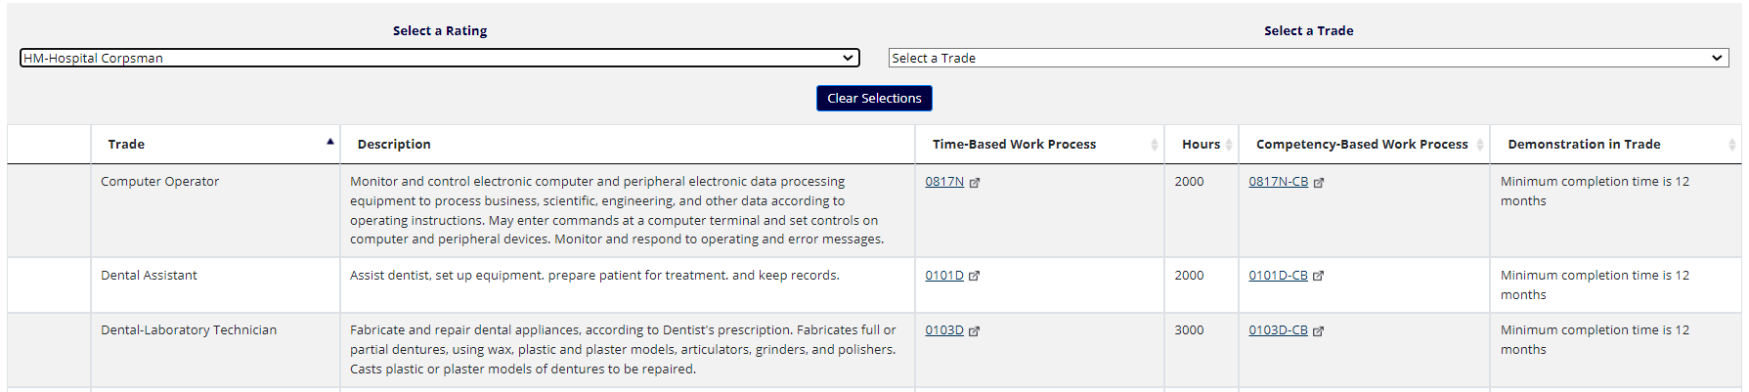
How do we certify you? USMAPS
Normal cost of Dental Assistant School: $15,000 for certification, $30,000 for a degree
The US NAVY wants to give you the same certification for free,
and pay you to get it!

Slide 13
How do I qualify for this?
1. Schedule an appointment with your local recruiter
  Bring your friends and family!
  We promise full-transparency!
2. Pass a math test (15 minutes long)
3. Tell us your medical/legal history
4. Stay off drugs (including marijuana)

Slide 14

Try a Different Path, Get the Same Outcome
Eliminate the Risk of Failure
Start as an Hospital Corpsman-Dental Specialty
4 Years Experience (Get Experience, Supplement your Resume)
Find out if you want to be in the Dentist Profession for the rest of your life
4 Free Years of College (Forever G/I Bill)
Apply to HPSP your 2nd Year of College
Free Dental School (Tuition/Room/Board)
Earn a 6-Figure Salary DAY ONE AFTER COLLEGE
(Prior Enlisted Salary O-3E + BAH = +$100,000 (20% Tax Free))

Slide 15


Career Choice
Career Choice is 100% Voluntary
Choose Your Career Before you Enter the United States Navy
Your Contract Choice Will Not Change Without Your Consent
3 Considerations
Availability (First Come / First Serve on Available Careers)
Ship Date (When do you want to leave?)
ASVAB Scores (What do you qualify for?)
US Navy Specific
Active/Reserve Duty

